Slide 1
Week 2:
U.S. States and Regions
Studies Weekly Newspaper

Slide 2
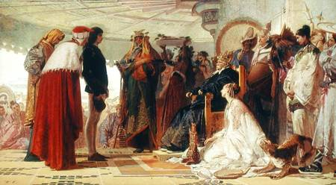
U.S Natural Regions
The study of the natural regions of the United States is done from east to west. This is based on the exploration patterns that were developed by the early explorers, settlers and pioneers.

Slide 3
Atlantic Coastal Plains
Large area of flat or gently sloping land.
Called “coastal plain” because it lies next to a body of water, the Atlantic Ocean
Divided north to south in to the plain and the piedmont. “Piedmont” means “the foot of the mountains” and is a hilly area between the plains and mountains.
The area between the piedmont and the plain is called the fall line.

Slide 4
Appalachian Mountains
Stretch north and south
Start in Alabama
Great Smokies in the south, the Blue Ridge, the Catskills, and Green Mountains in the north (older mountains because of rounded tops and low elevation)

Slide 5
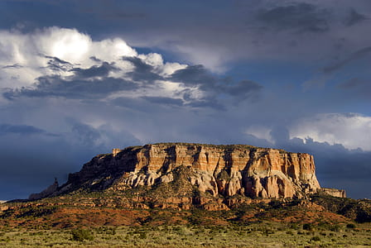
Interior Plains
Stretch between the Appalachian and the Rocky Mountains
Divided into two giant plains: east of the Mississippi and the wet Mississippi River System
Rivers that flow into this area are called tributaries
Ohio River (helped settlers get to Illinois, Indiana, and Ohio and Missouri River (used by Lewis and Clark) are the two largest tributaries that played major roles in history.
The Ozark Highlands,(Ozark Plateau), lie where the Mississippi and Missouri River meet.
A plateau is an area of flat land that is higher than the surrounding land

Slide 6
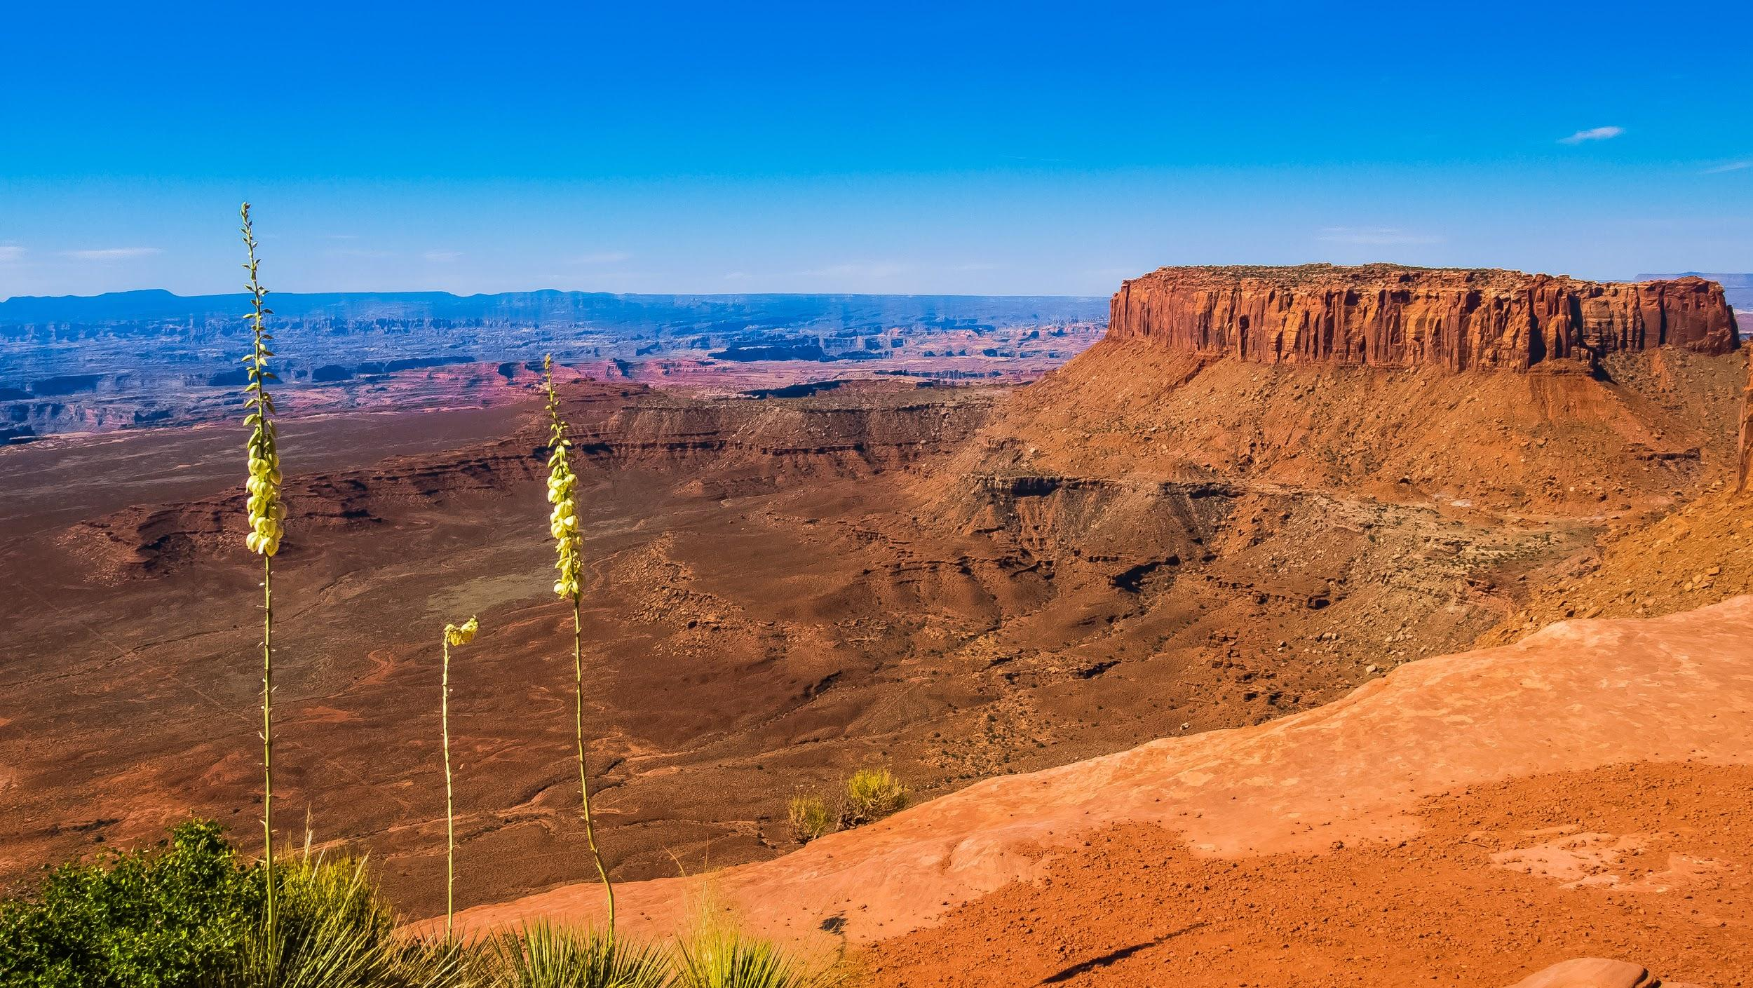
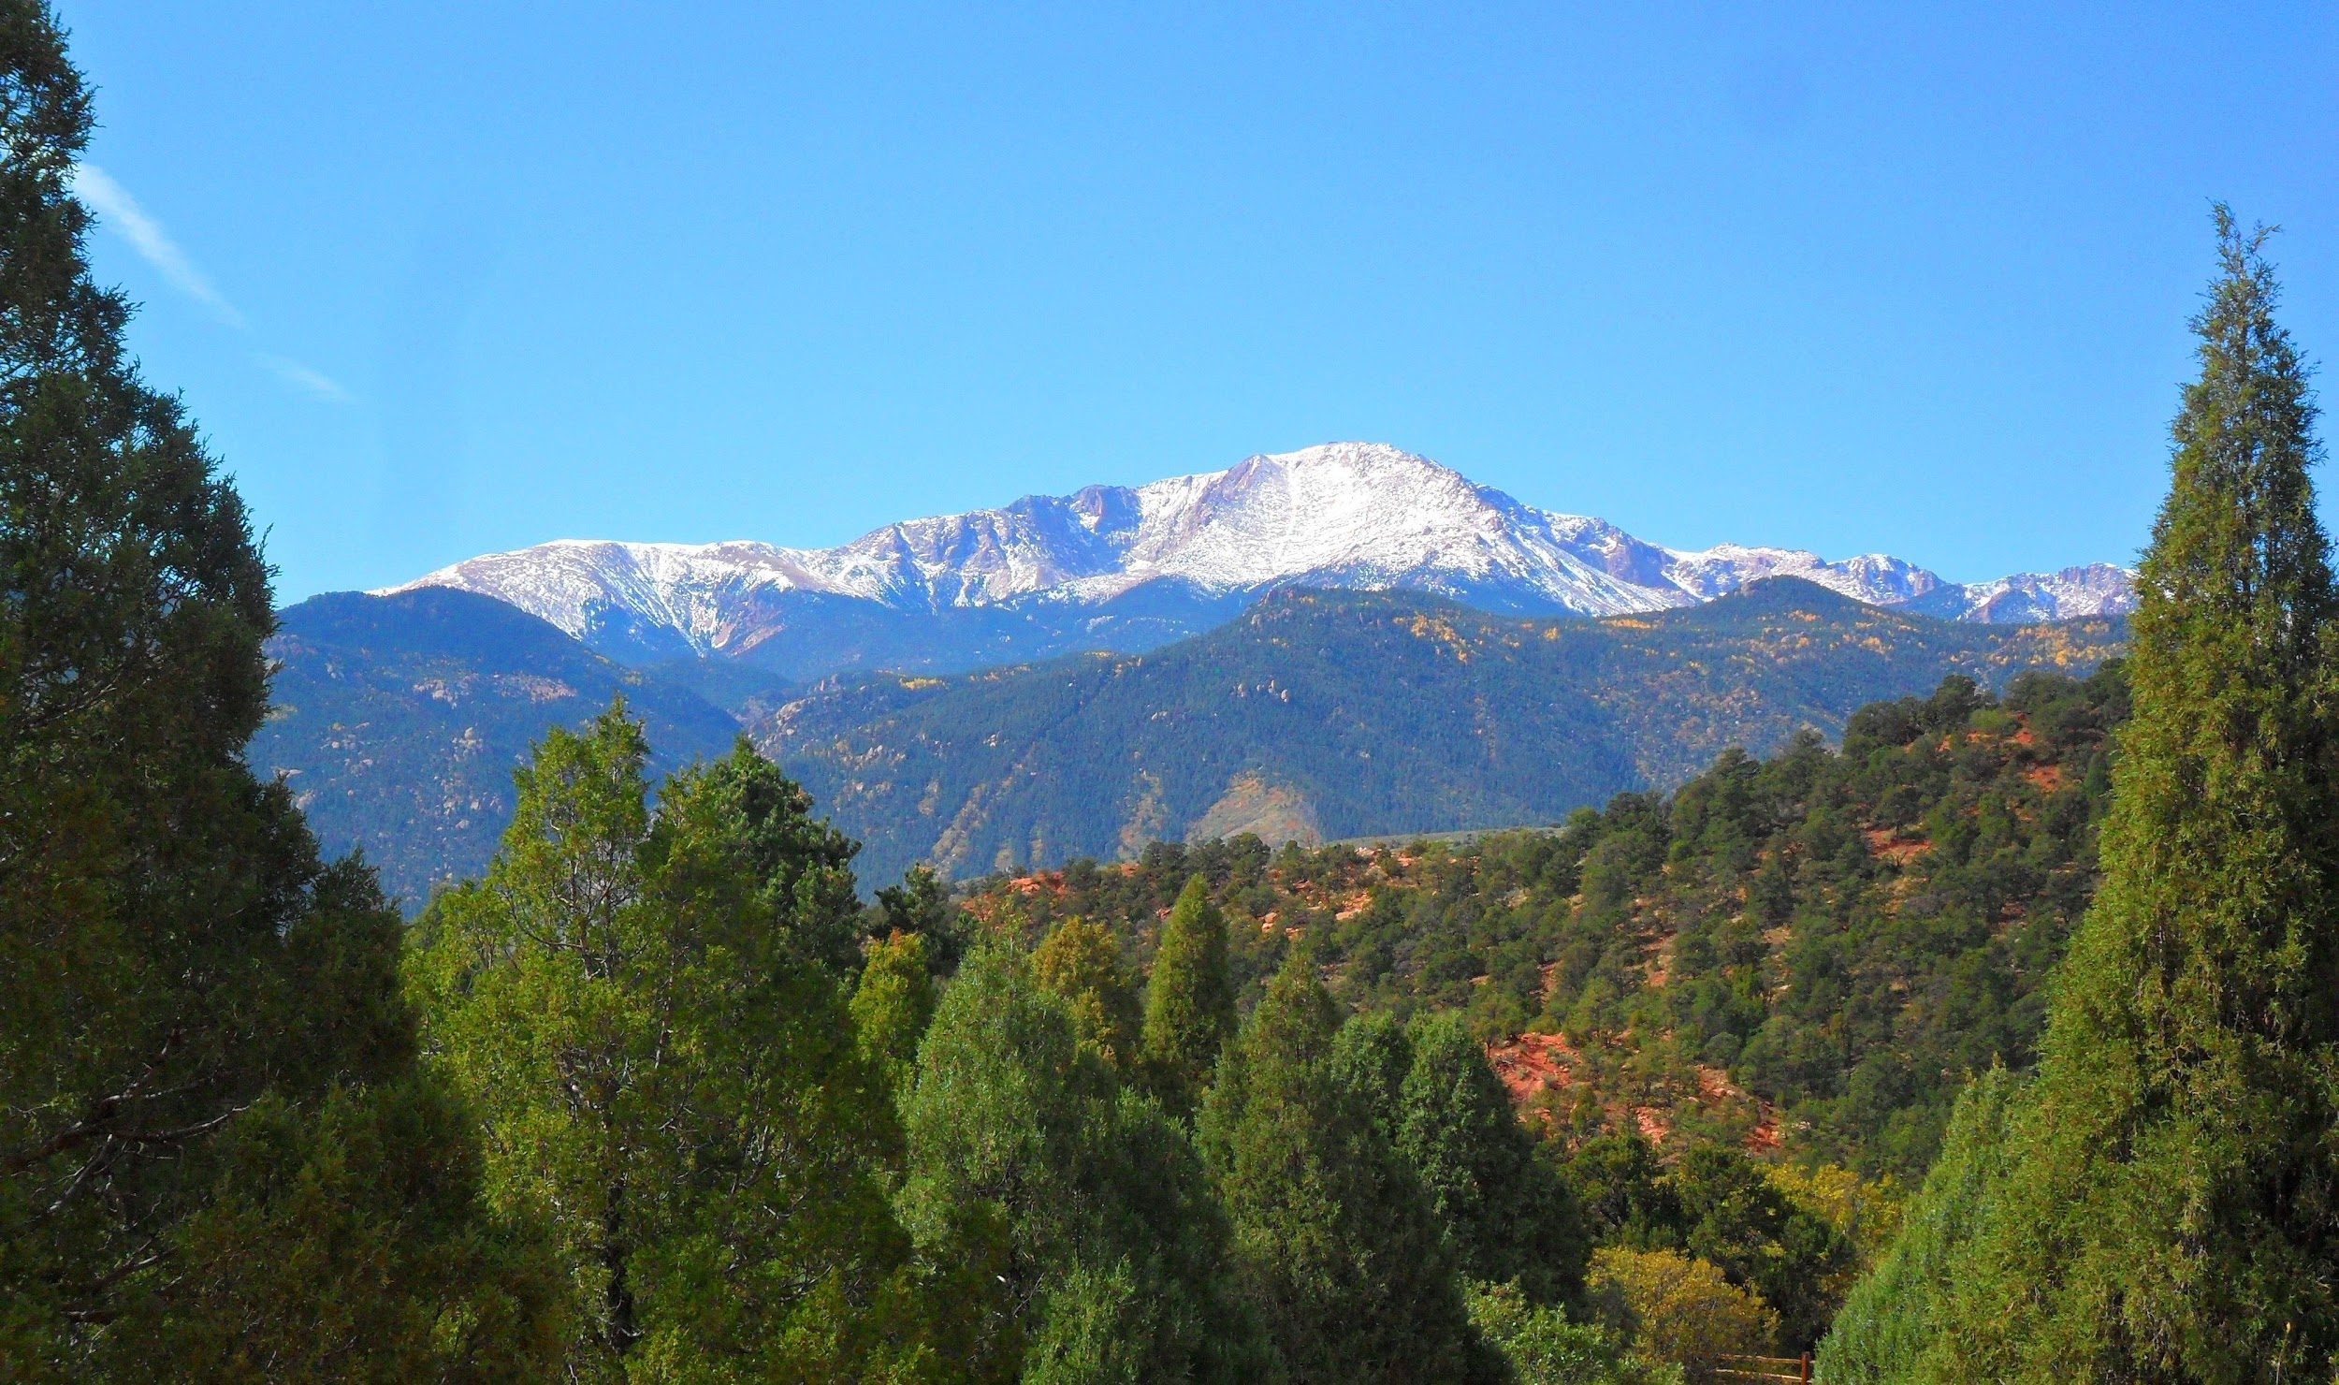
Rocky Mountains
Mountain peaks rise to 14,000 feet
Covered in pine and fir trees
Snow doesn’t melt on the highest peaks during the year
Formidable barrier to settlers
Western Plateau-extremely dry.Looks like a crumpled, brown paper bag. Settlers pushed very hard to get past this area before running out of water.

Slide 7
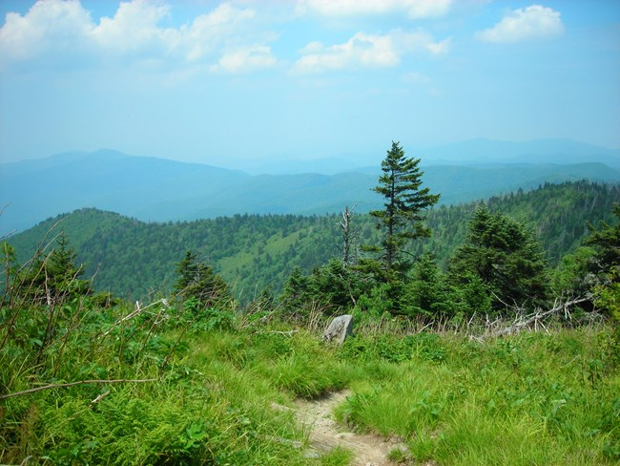
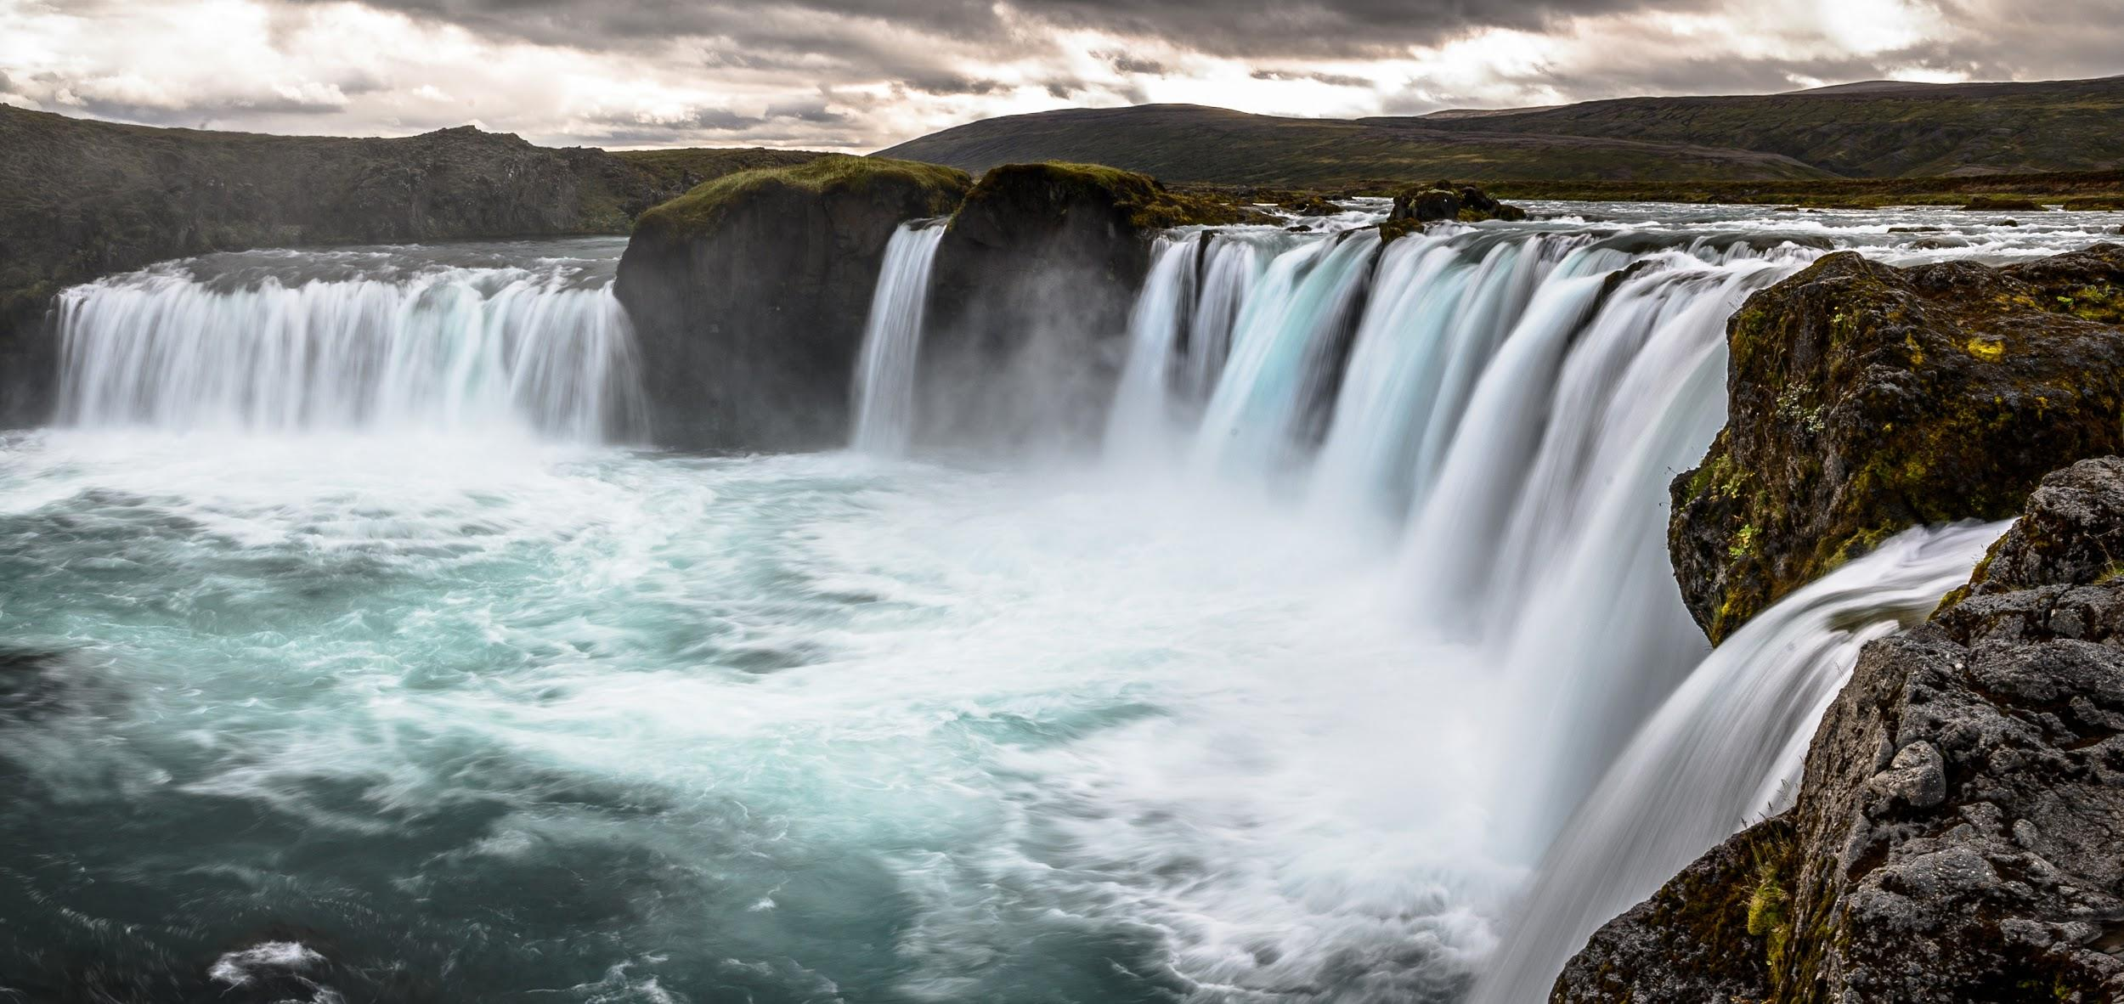
The North East Region
Includes areas where the Pilgrims settled
Land is flat and rocky-soil is not good for farming
Winters are long and cold, summers are hot and humid
Large cities: New York City
Famous place to visit: Niagara Falls and Appalachian Trail (2,200 mile trail from Maine to Georgia)

Slide 8
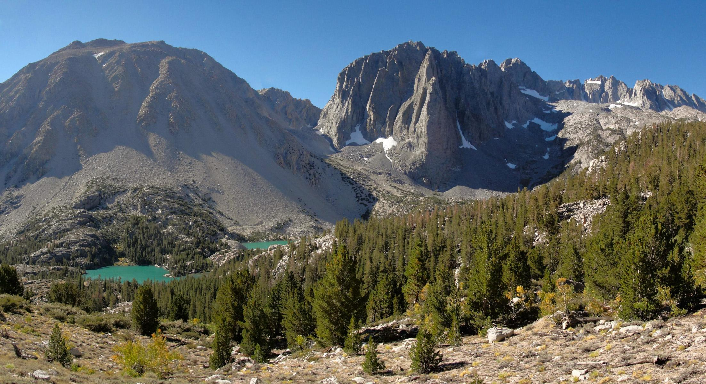
Pacific Coast Region
The Sierra Nevada Mountains- deep blue lakes and dark green tops
Luscious valleys- the Central Valley of California and the Willamette Valley of Oregon
Pacific Ocean- cold, low coast ranges
Hawaii-2,400 miles west of California
Alaska-2,314 miles north of California

Slide 9
EXPLORING THE
UNITED STATES

Slide 10
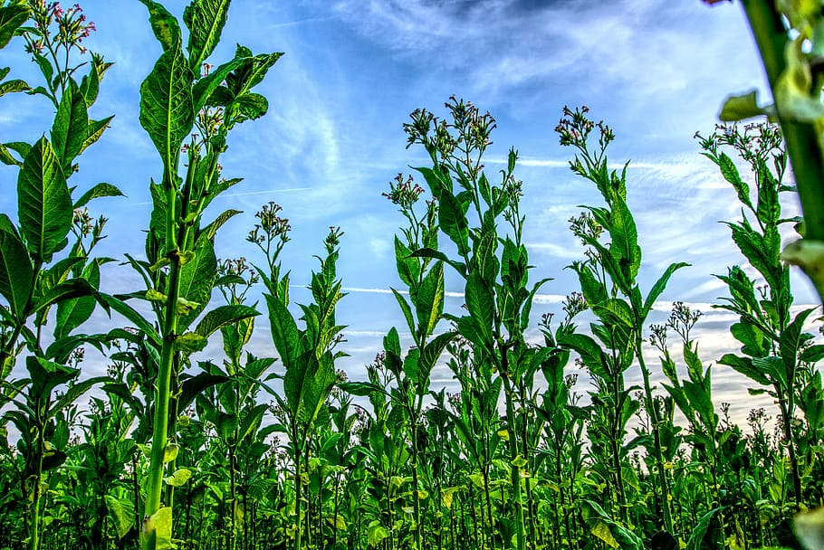
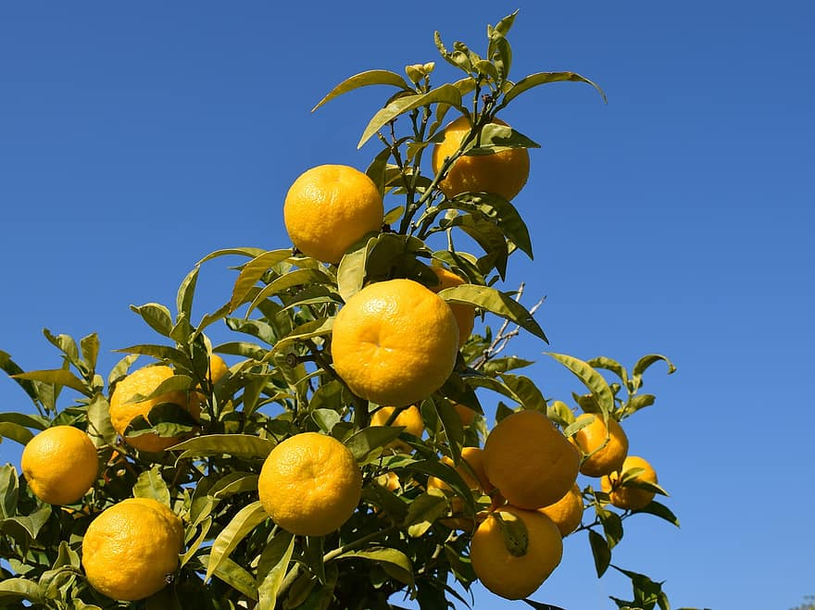
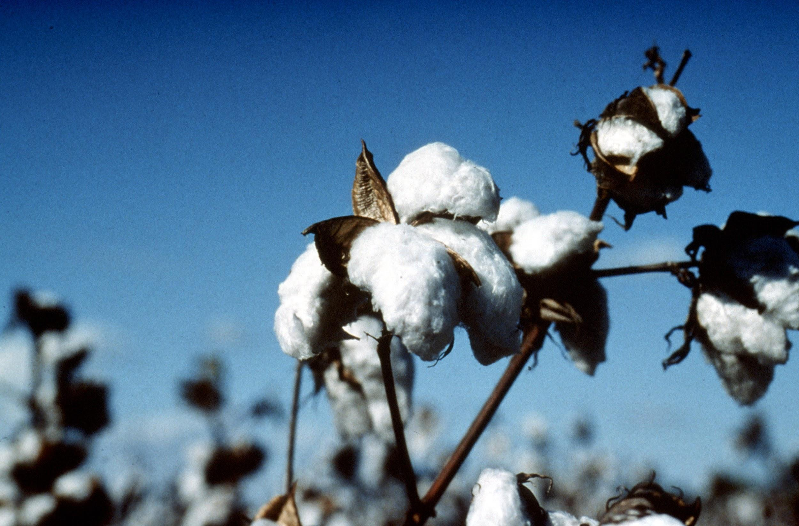
Southeast Region
Climate is cool and mild in the winter, hot and humid in the summer
Soil is good for growing peanuts, tobacco, cotton, and citrus fruits
Everglades National Park: 2,300 square miles and alligators and crocodiles live together side by side.

Slide 11
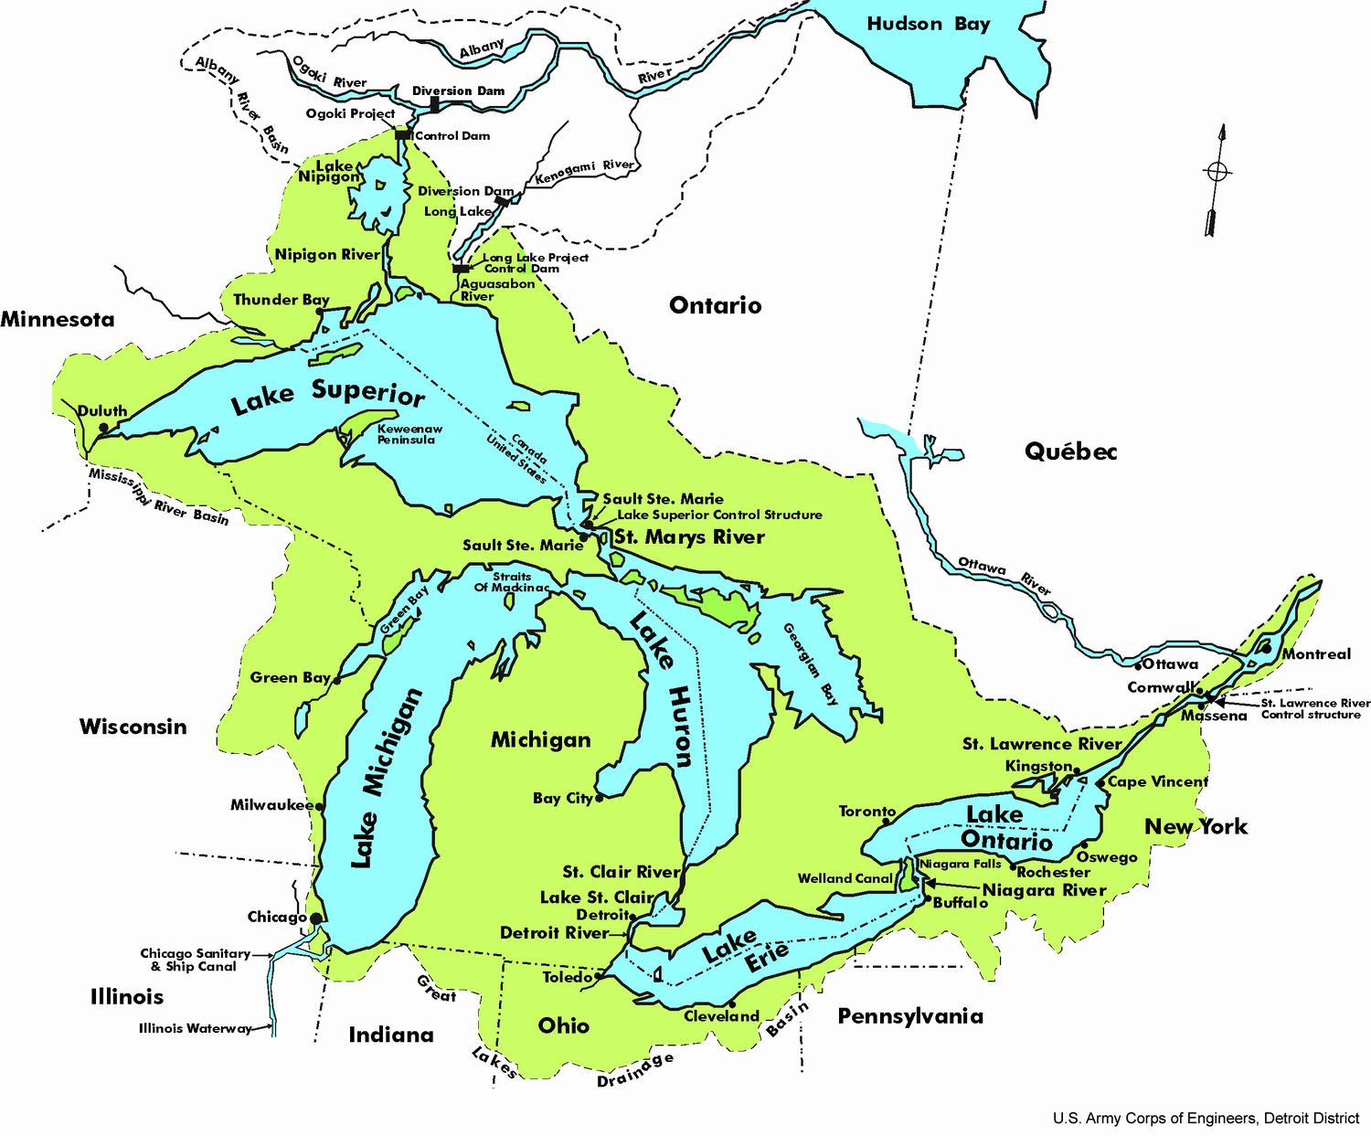
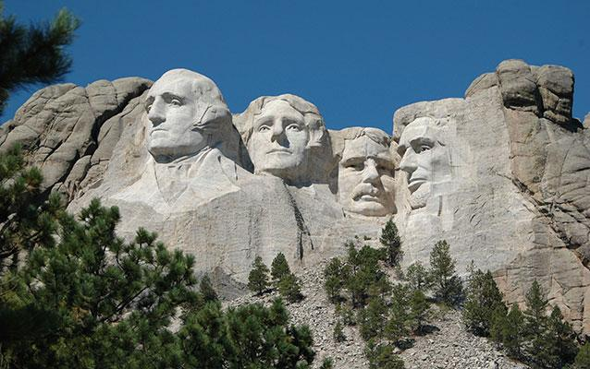
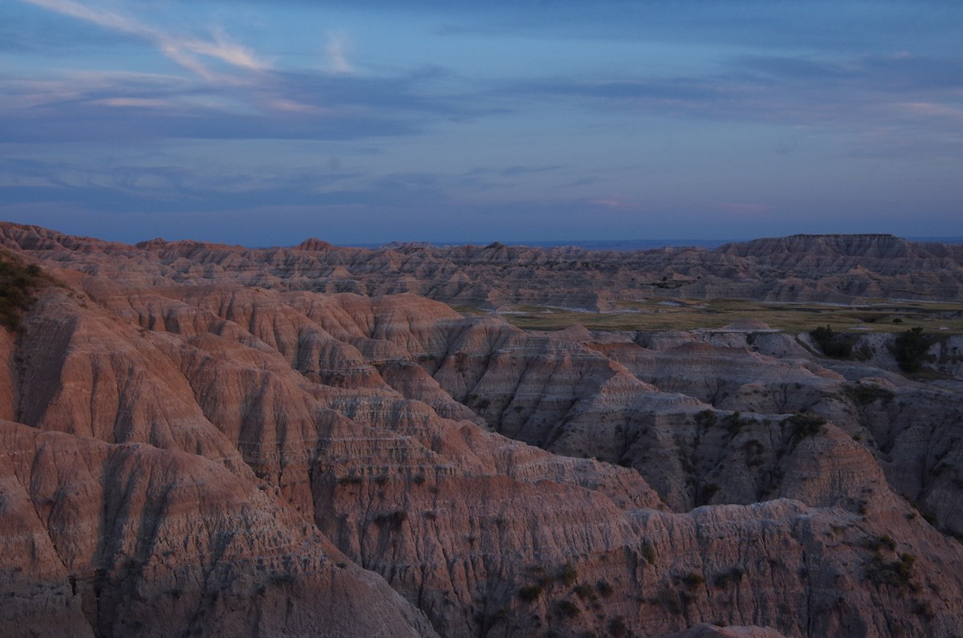
Midwest Region
Flat with great farming soil
Called “America's Breadbasket”
Mount Rushmore
Mississippi River, Great Lakes(three largest in this region, Badlands (in the Dakotas)

Slide 12
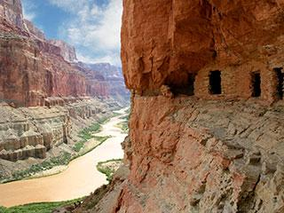
Southwest Region
Home to the Grand Canyon and Colorado River
Arid deserts, red rocked landscapes, rugged mountains
Diverse culture

Slide 13
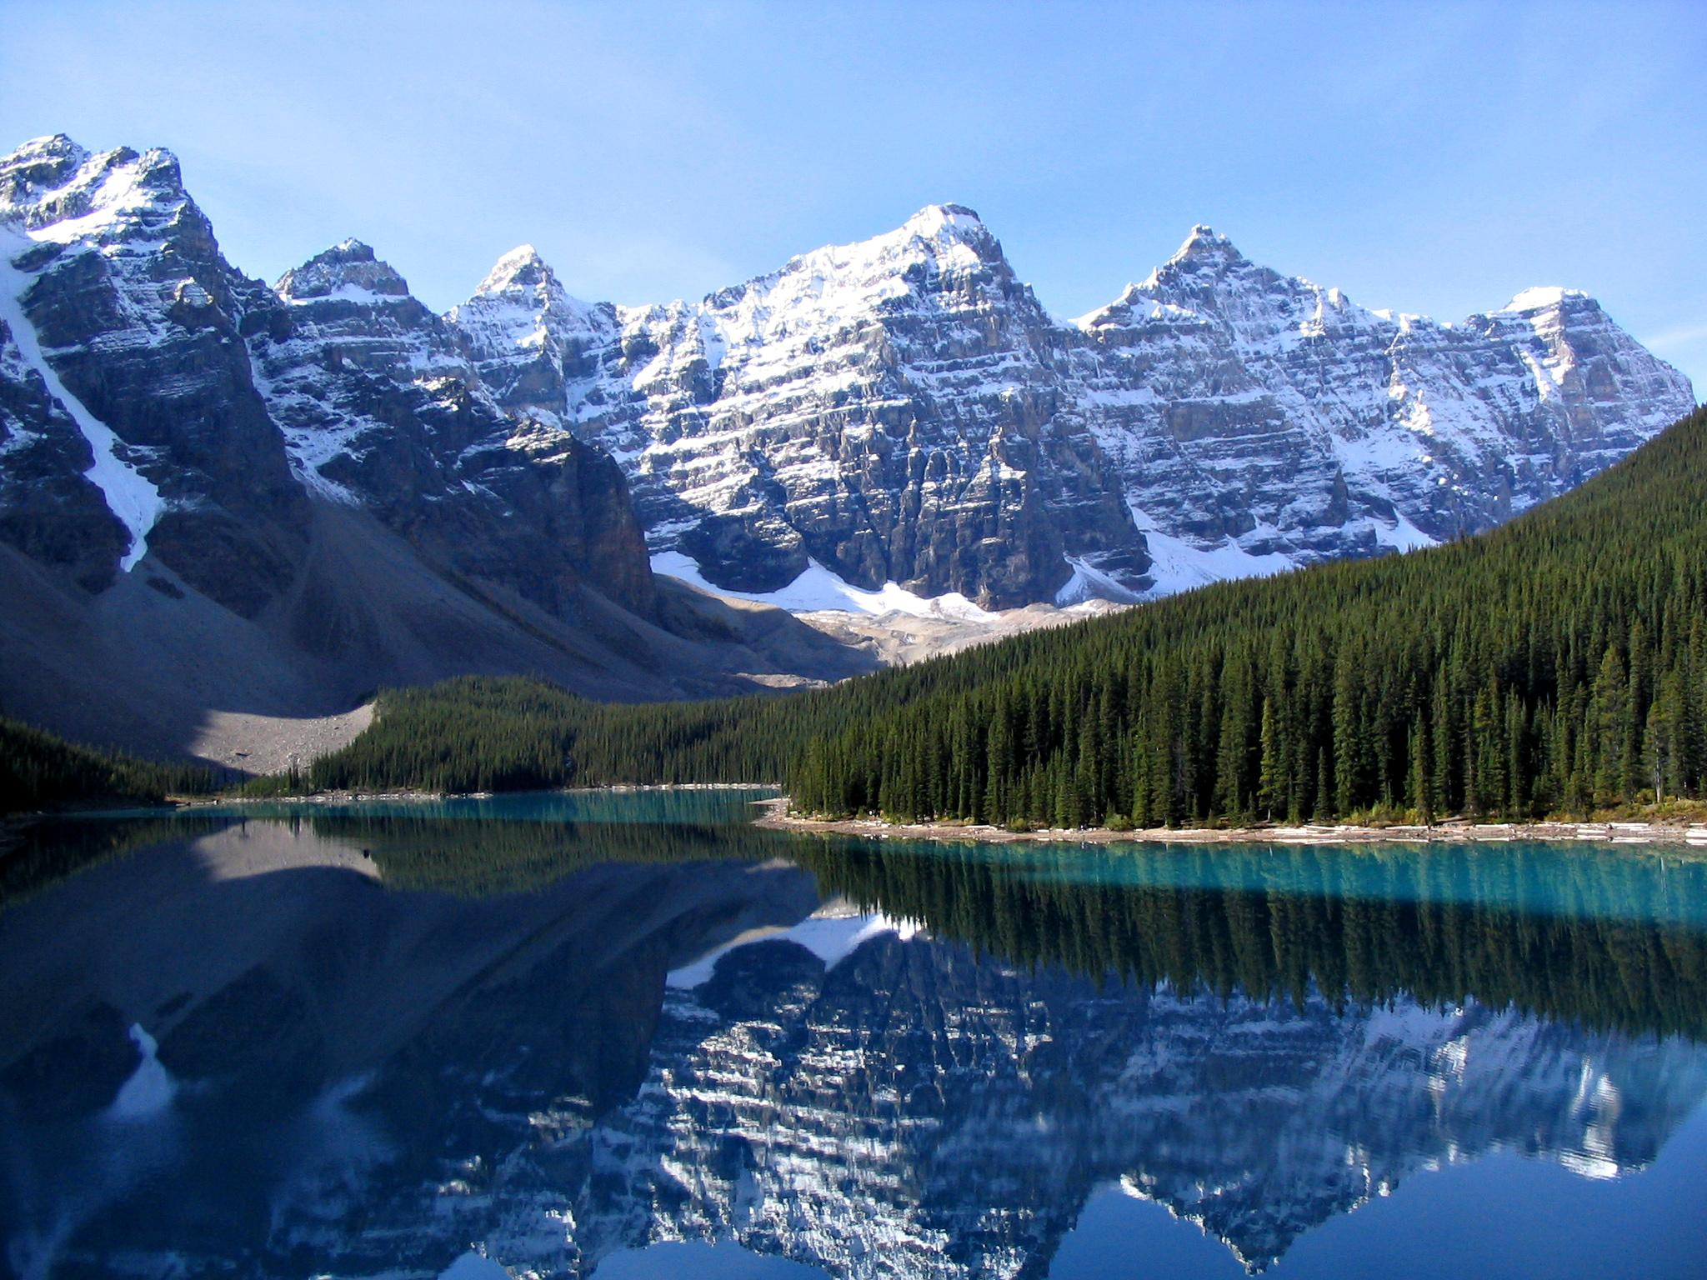
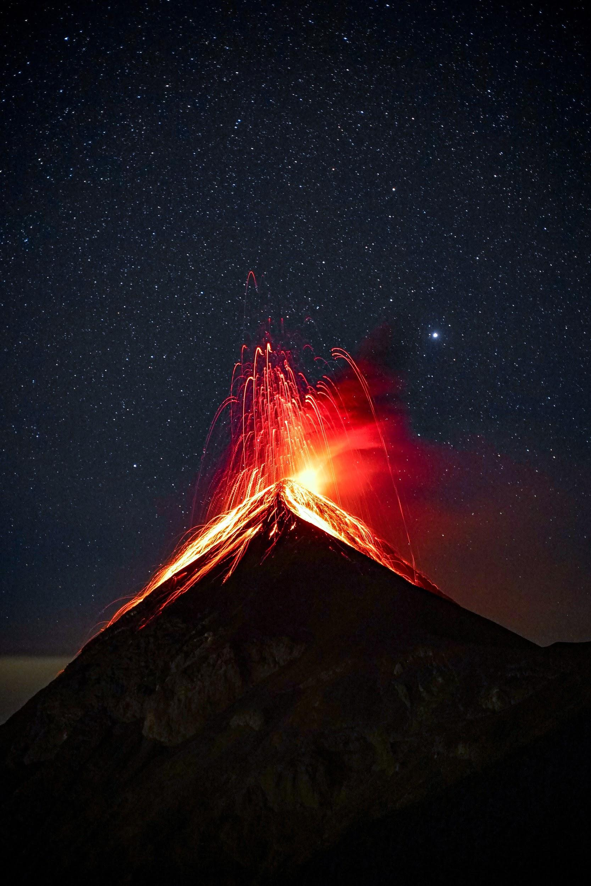
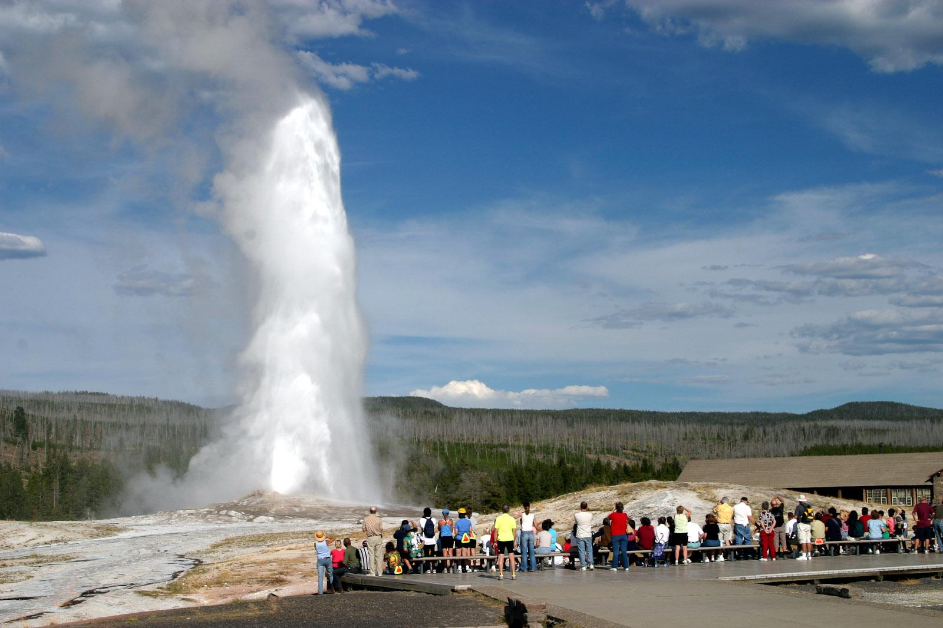
West Region
Filled with great mountains, volcanoes and rolling plains
Rocky Mountains range
Yellowstone National Park- Old Faithful
California, Oregon and Washington- earthquakes
Hawaii- many active volcanoes
National Parks and Monuments

Slide 14
Diversity
Just as there are many diverse regions, there are many diverse kinds of people living here. Why?
Sometimes America can be described as a large salad bowl
The goal in America is to value the difference we have with others and learn from them
Diversity makes this place a special place to live. :)

Slide 15
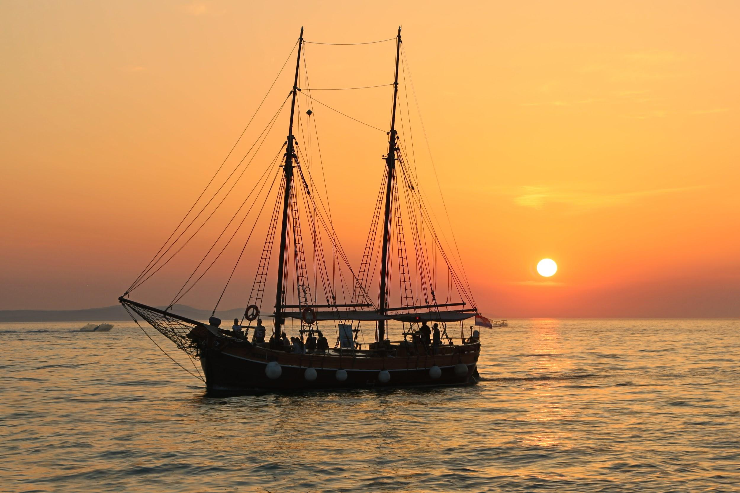
Caravel
Built in the 1400s
Could sail very fast and into the wind and could float in shallow water
Sails were shaped like triangles
Used by Columbus when he sailed for the New World (Nina and Pinta)
Caravel Video

