Slide 1
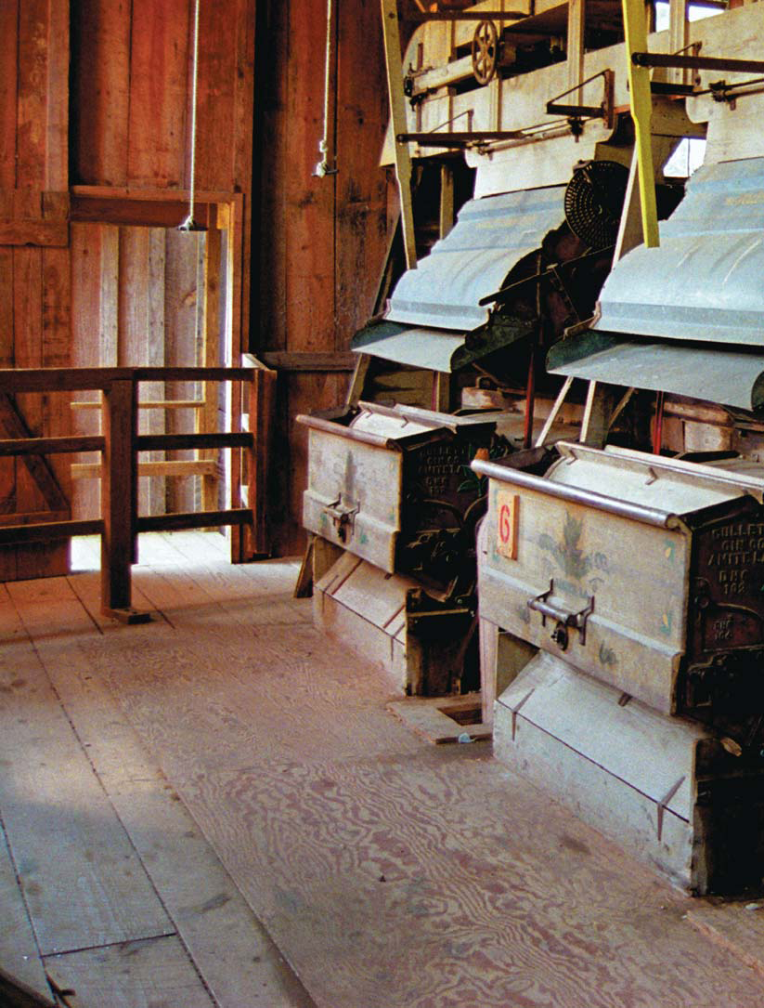
Page 154

Slide 2
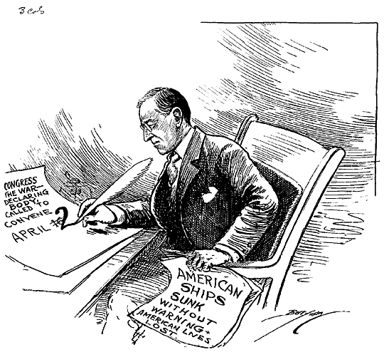
What is the cartoon about?

Slide 3
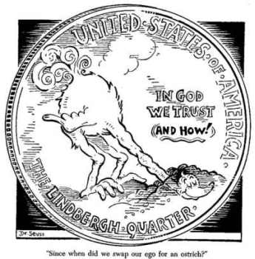
Since when did we swap our ego for an ostrich?

Slide 4
Objectives
MS1 Explain how geography, economics, history, and politics have influenced the development of Mississippi.
MS1d Analyze advanced personal economic choices (e.g., timber industry, shipping industry, gaming industry).

Slide 5
Objectives
MS1e Analyze the historical and political significance of key events in our state's development .
MS2a Identify the influence of the industrial and agricultural revolution in our state.
MS3d Analyze the significance of key events in our state's history.

Slide 6
Overview
Segregation
Lynching
Blacks reaction to segregation
Education

Slide 7
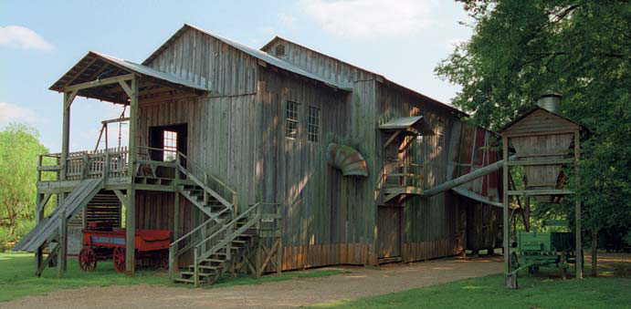
What is this a picture of?
Page 155
Turn-of-the-century cotton gin.

Slide 8
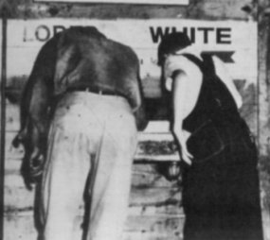
What is Segregation?
Separation of the races.

Slide 9
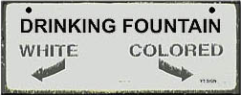
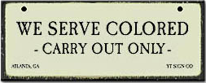
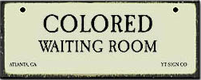
What are the laws called that separated the races?
Jim Crow Laws

Slide 10
What court case legalized Jim Crow laws in the United States?
Plessy v. Ferguson

Slide 11
Homer Plessy
Germain Plessy married Catherine Mathieu (Haitian), a free woman of color, and they had eight children, including Homer Plessy's father, Joseph Adolphe Plessy.
Homer Plessy was born less than three months after the issuance of Abraham Lincoln's Emancipation Proclamation.
One-eighth black

Slide 12
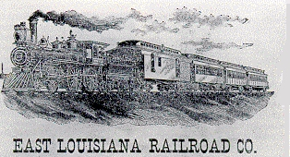
Homer Plessy
Plessy to agree to violate Louisiana's Separate Car law that required the segregation of passenger trains by race.
He bought a first-class ticket on the East Louisiana Railroad running between
New Orleans
and Covington.

Slide 13
Homer Plessy
Plessy refused to leave the white car and move to the colored car, he was arrested and jailed.
Homer Adolph Plessy v. The State of Louisiana
The judge presiding over his case, , ruled that Louisiana had the right to regulate railroad companies as long as they operated within state boundaries.
John Howard Ferguson

Slide 14
Plessy v. Ferguson
Oral arguments were held before the U.S. Supreme Court on April 13, 1896.
The case helped cement the legal foundation for the doctrine of separate but equal.

Slide 15
Did Mississippi have a lot of Jim Crow laws?
No.
Why?
Customs were so strong.

Slide 16
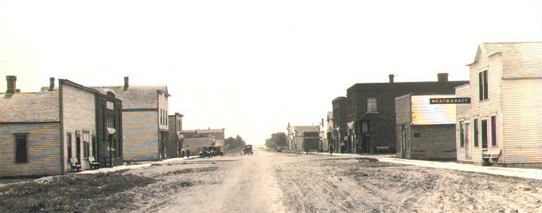
If a black man is walking on the sidewalk and a white couple is walking towards them, will the black man need to do anything?

Slide 17
When you entered a restaurant?

Slide 18
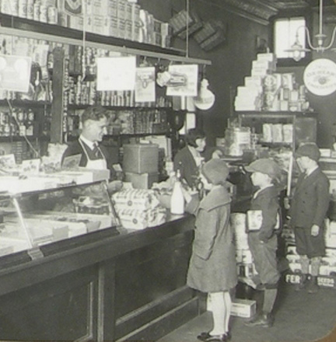
When you entered a store?

Slide 19
What happens if you violate this rigid caste system?
Violent punishment.
People disappeared.
Lynching.

Slide 20
How many lynching in Mississippi between 1889 to 1945 (56 years)
476 people (averaged 8.5 per year)
24 white
14 black females
438 black males

Slide 21
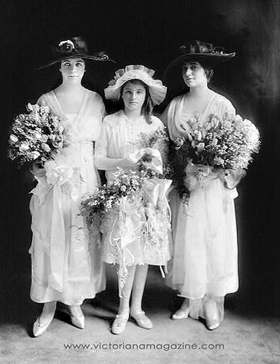
What was the number 1 reason for lynching a black man?
Messing with a white woman.

Slide 22
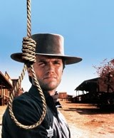
Where did lynching start in the United States?
The Wild West.

Slide 23
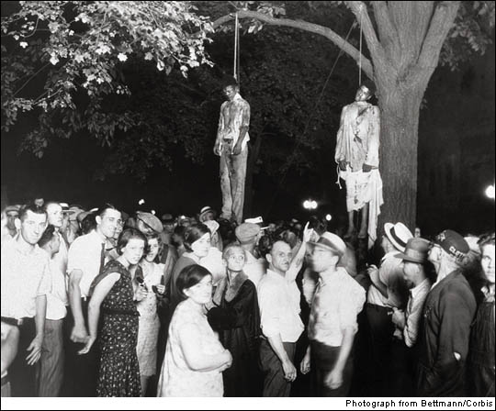
How were lynching done in the South?

Slide 24
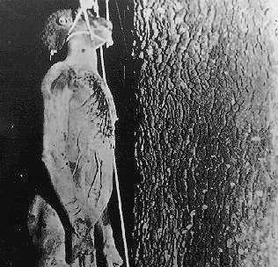
It starts with a mob.
Then a beating.
Then cutting.
Then start the hanging.
Then finally, burn him.
Why?

Slide 25
To send a message to the black community.
Was this kind of message sending done before?
Yes!

Slide 26
Give an Example?
Crucifixion
Crucifixion was in use particularly among the Persians, Seleucids, Carthaginians, and Romans from about the 6th century BC to the 4th century AD.

Slide 27
How did you die?
Death could result from any combination of causes, including blood loss, hypovolemic shock, or sepsis following infection, caused by the scourging that preceded the crucifixion, or by the process of being nailed itself, or eventual dehydration.
blood loss
hypovolemic
shock
sepsis
dehydration

Slide 28
How did the Romans do it?
Crucifixion was often performed to terrorize onlookers into submission.
Victims were left on display after death as warnings.

Slide 29
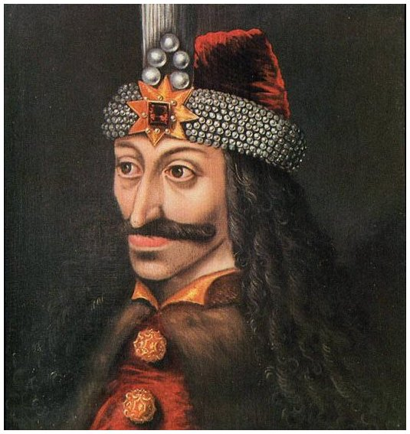
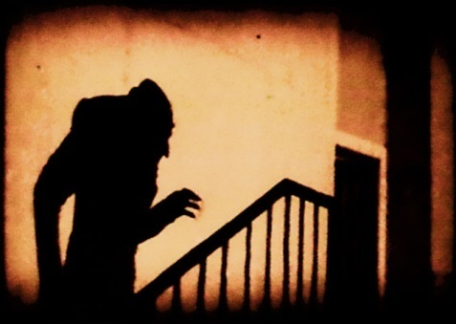
Any other types?
Vlad III Dracula
Bran Castle
Vampires

Slide 30
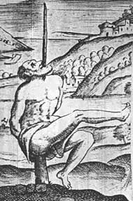
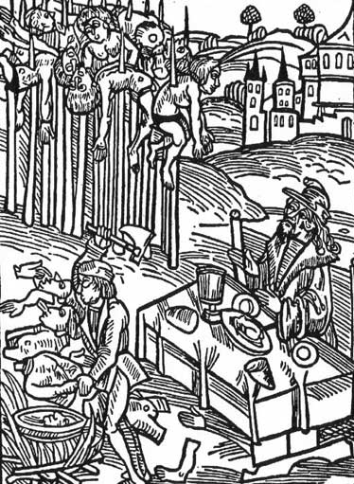
Vlad III the Impaler

Slide 31
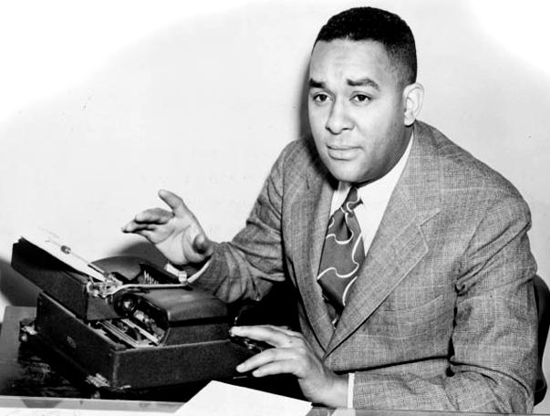
How did black people react?
Richard Wright

Slide 32
Any demonstrations in Mississippi?
One. Blacks refused to ride streetcars.
What happened?
Nothing, it collapsed after only a few weeks.

Slide 33
Did segregation have any upside for black people?
Black upper class
Doctors
Lawyers
Black middle class
Restaurants
Bars
Barbershops/Beauty shops
Funeral parlors

Slide 34
Education
After 1885, white Democrats reduced education funding. Why?
The majority of children were black.
Any difference in teacher pay levels?
White teachers - $130 a year.
Black teachers - $90 a year.
How did they fund schools?
The Poll Tax.

Slide 35
Education
Was school funding equal?
No.
How did white Democrats divide up the money from the Poll tax?
By the number of students in each county.
Where were most of the students?
The Delta.

Slide 36
Review
Segregation
Lynching
Black reaction to segregation
Education

Slide 37
Homework
Read pages 159 to 164.

