Slide 1
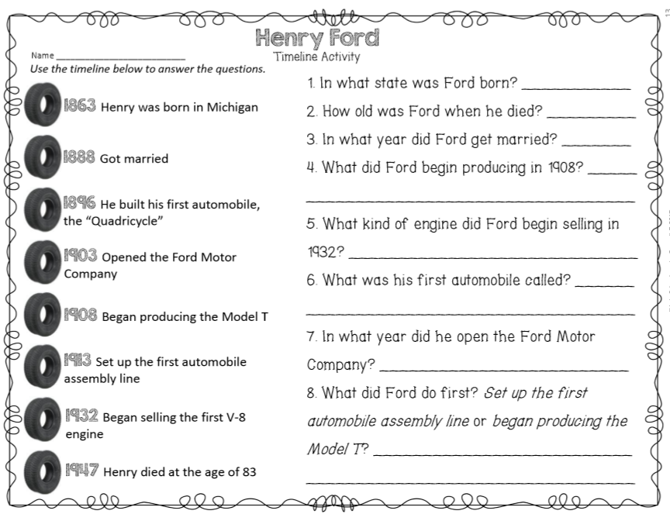
Wednesday, February 5, 2020
GREEN BUTTONS FIRST –
Superkids | Classworks – Math | Mrs. Thompson - LLI
3 – Amiyah 4 - Cohen | 1 - Jearon 2 – Kaylee 5 - Caydance 6 - Kaylah 7 – Erin 9 - Jaylie | Landon Macon Paisleigh Jaiden
7:55 – 8:30

Slide 2

CHOMP TIME
F.A.S.T. Groups
Focused Academic Support Time

Slide 3
F.A.S.T. Designations
Superkids: 7 - Paisleigh | Imagine Math: 8 – Carleen 9 – Brena | Classworks: 1 – Erin – Math 2 - Lexi – Math 3 - Emma - Math 4 - Jearon - Math 5 - Addisen - Reading 6 – Adalyn - Reading | Mrs. R: Check in: Aiden Katelynn McKenzie Khamani Elin Cayli | Mrs. T: LLI Jaylie Caydance Amiyah Cohen Kaylee | Peer Tutoring: Jaiden & Noah
Landon – Phonics 1st with Mrs. Page
Macon – SIPPS with Mrs. Bess
8:40 – 9:10

Slide 4

Reading Time
9:10 – 9:45
RI.3.2 I can determine the main idea of a text; recount the key details and explain how they support the main idea.
SL.3.2 I can determine main ideas and supporting details of a text read aloud or information presented in diverse media and formats, including visually, quantitatively, and orally.

Slide 5
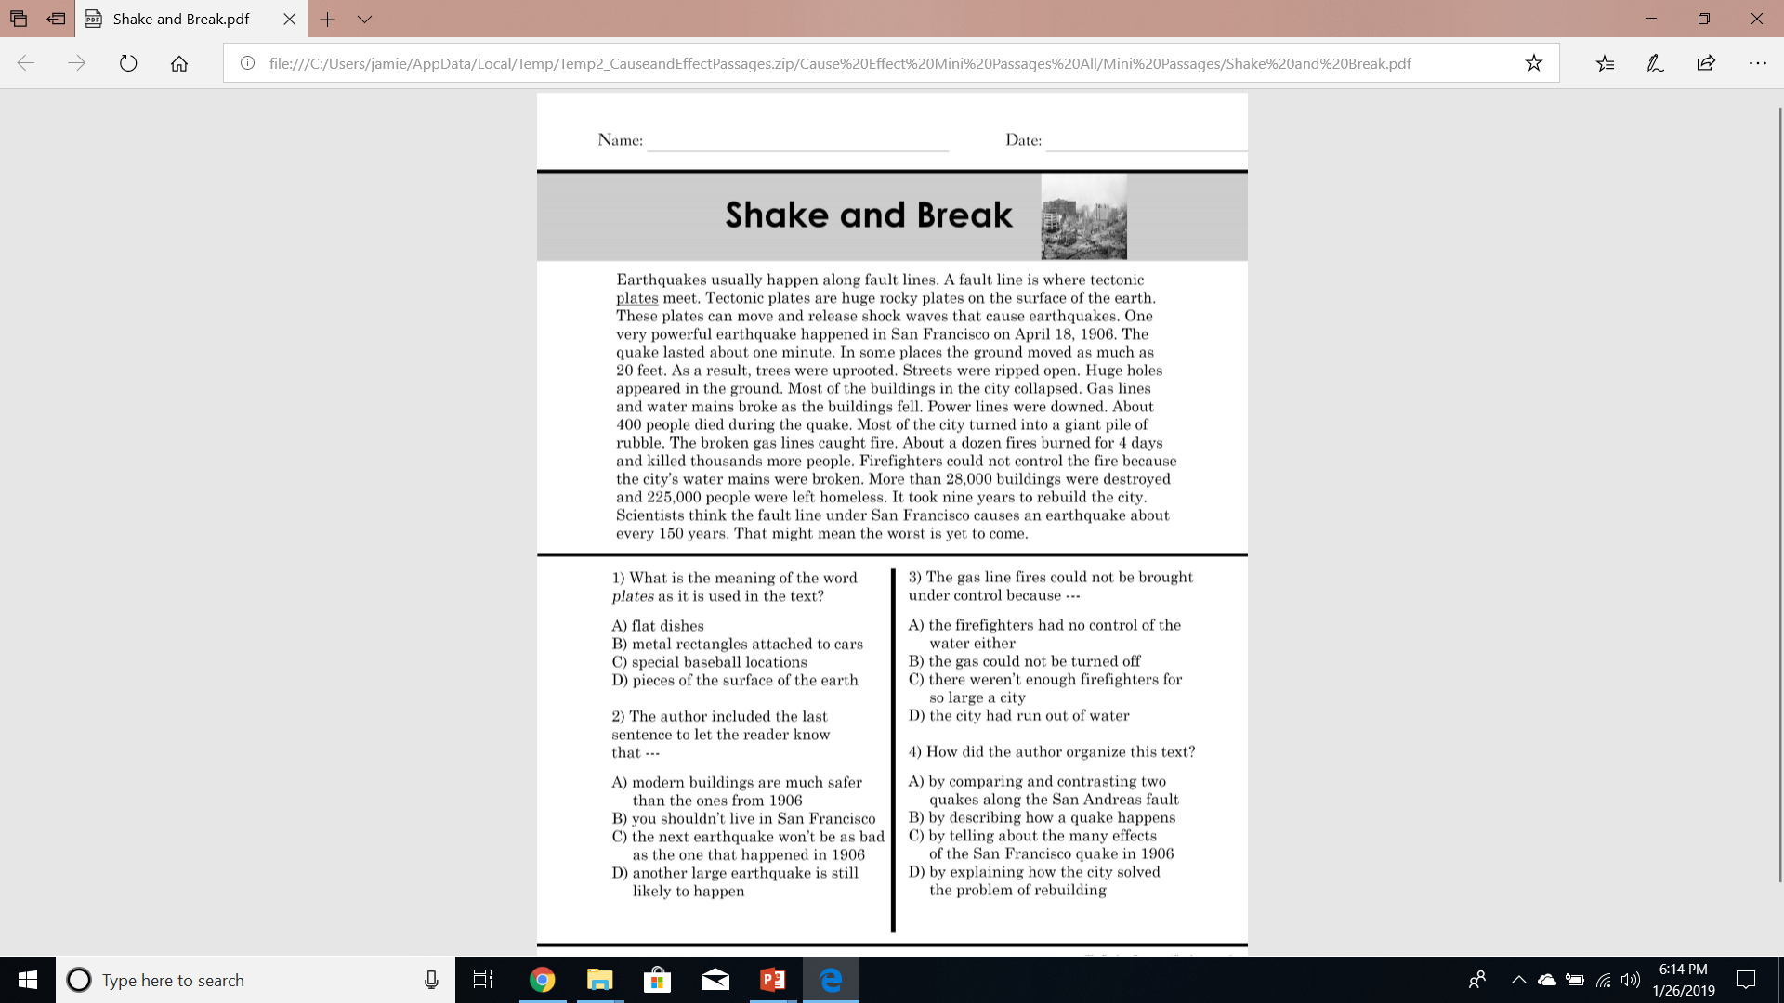

Slide 6
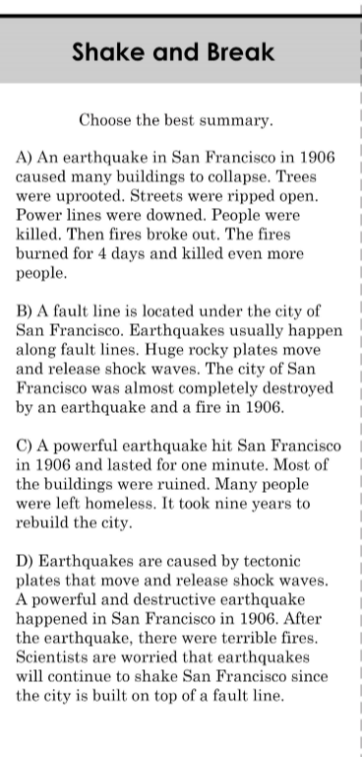

Slide 7
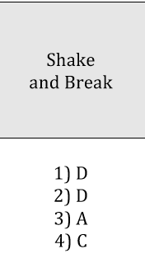

Slide 8
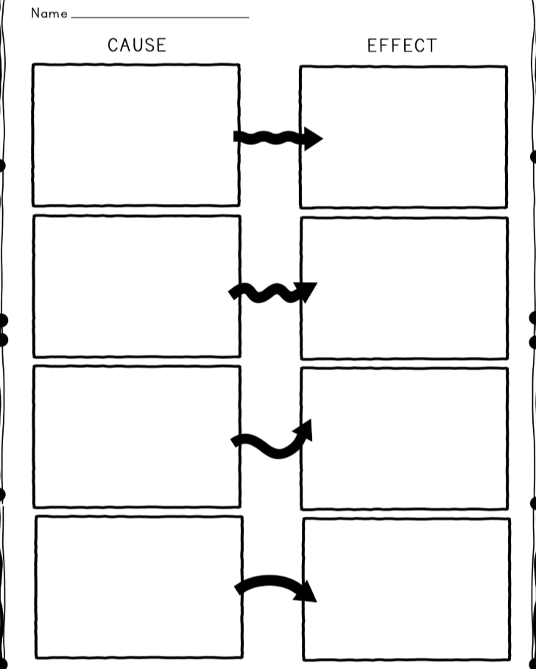

Slide 9
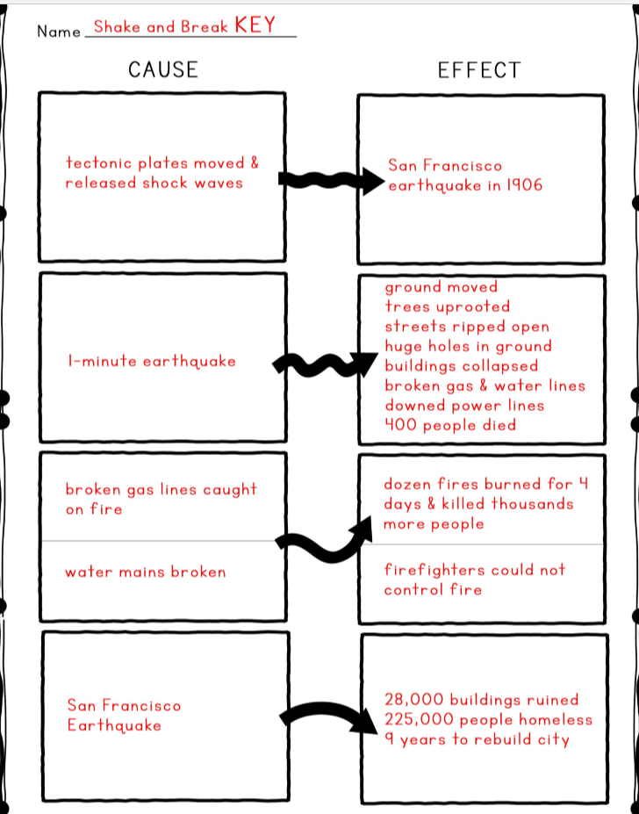

Slide 10

Restroom Break
9:45 – 9:55

Slide 11

Independent Daily Reading & Teacher Conferences
Hearbuilder: 3 – Macon | Epic: 1 – Cayli 2 – McKenzie 8 – Noah | Classworks: 4 - Jearon – R 5 – Kaylah – R 6 – Aiden – R 7 - Brena – R 9 – Addisen - M | Mrs. R Check In: Emma Adalyn Lexi Jaiden Carleen | Mrs. T SIPPS: Amiyah Jaylie Caydance Landon Kaylee Cohen Paisleigh
  All others – “Living Wax Event” Biography Book
9:55 – 10:25

Slide 12



Morning Work Review & Snack Time
10:25 – 10:40

Slide 14
Out of Classroom!
Recess 10:40 – 11:05

Slide 15
Reading Time
11:05 – 12:00

Slide 16
Math Fluency & Focus Lesson!
11:55 – 12:15
Math 3.NF.1 I can understand that a fraction 1/b as the quantity formed by one part when a whole is partitioned into b equal parts. I can understand that a fraction a/b as the quantity formed by a parts of size 1/b.
Math 3.NF.2 I can represent a fraction 1/b on a number line diagram by defining the interval from 0 to 1 as the whole and partitioning it into b equal parts.
.

Slide 17
Application Problem
Harriya and Brooklynn buy matching scrapbooks. Harriya decorates 5/9 of the pages in her book. Brooklynn decorates 5/6 of the pages in her book. Who has more decorated pages of her scrapbook? Draw a picture to support your answer.

Slide 18
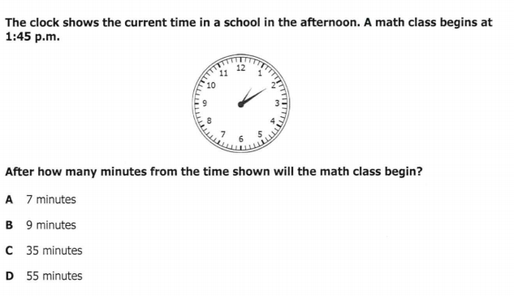

Slide 19
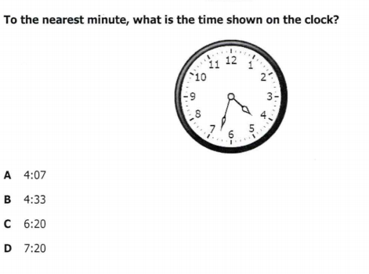

Slide 20
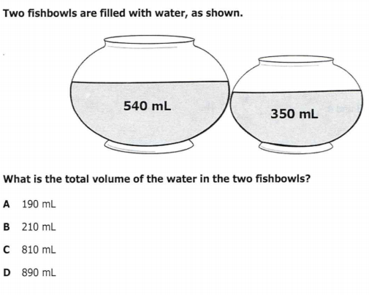

Slide 21
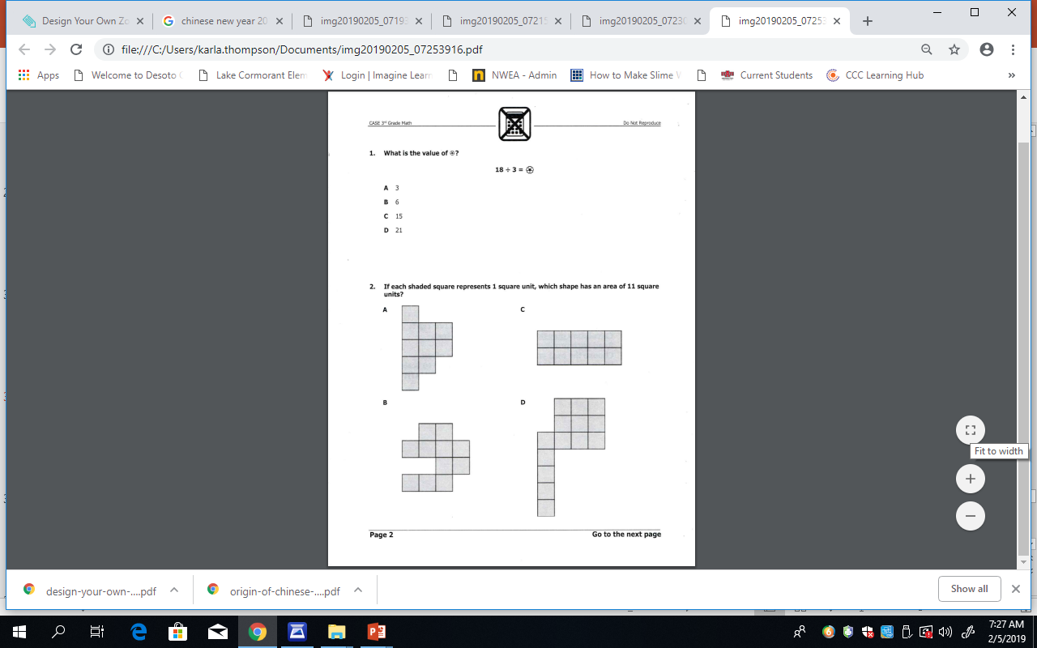

Slide 23
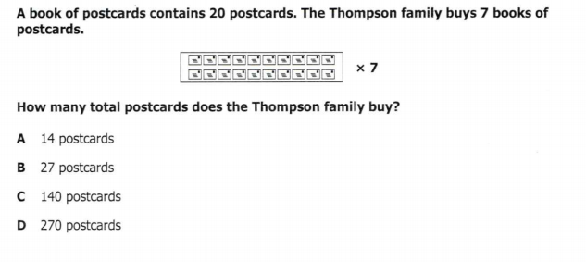

Slide 24
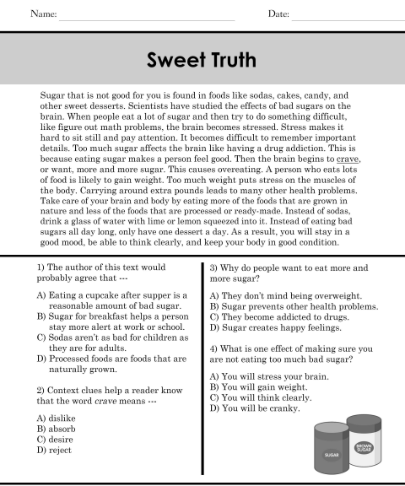
Rotating Subjects Assignment

Slide 25
Rotation 1
12:15 – 12:35
Group 1 – Computers 1-5: Classworks Reading
Group 2 – Mrs. Roby – Problem Set #28
Group 3 – Computers 6-TC: Classworks Math
Group 4 – Mrs. Thompson – Problem Set #29
Group 5 – Rotating Subjects
  (Monday: Math, Tuesday: Science,
  Wednesday: Reading, Thursday: Writing,
  Friday: Social Studies)

Slide 26

Out of Classroom!
Lunch 12:35 – 1:05

Slide 27
Restroom Break
1:05 – 1:10

Slide 28

Out of Classroom!
Activity 1:10 – 1:55

Slide 29
Rotation 2
1:55 – 2:15
Group 5 – Computers 1-5: Classworks Reading
Group 1 – Mrs. Roby – Problem Set #28
Group 2 – Computers 6-TC: Classworks Math
Group 3 – Mrs. Thompson – Problem Set #29
Group 4 – Rotating Subjects
  (Monday: Math, Tuesday: Science,
  Wednesday: Reading, Thursday: Writing,
  Friday: Social Studies)

Slide 30
Rotation 3
2:15 – 2:30
Group 4 – Computers 1-5: Classworks Reading
Group 5 – Mrs. Roby – Problem Set #28
Group 1 – Computers 6-TC: Classworks Math
Group 2 – Mrs. Thompson – Problem Set #29
Group 3 – Rotating Subjects
  (Monday: Math, Tuesday: Science,
  Wednesday: Reading, Thursday: Writing,
  Friday: Social Studies)

Slide 31
Rotation 4
2:30 – 2:45
Group 3 – Computers 1-5: Classworks Reading
Group 4 – Mrs. Roby – Problem Set #28
Group 5 – Computers 6-TC: Classworks Math
Group 1 – Mrs. Thompson – Problem Set #29
Group 2 – Rotating Subjects
  (Monday: Math, Tuesday: Science,
  Wednesday: Reading, Thursday: Writing,
  Friday: Social Studies)

Slide 32
Rotation 5
2:45 – 3:00
Group 2 – Computers 1-5: Classworks Reading
Group 3 – Mrs. Roby – Problem Set #28
Group 4 – Computers 6-TC: Classworks Math
Group 5 – Mrs. Thompson – Problem Set #29
Group 1 – Rotating Subjects
  (Monday: Math, Tuesday: Science,
  Wednesday: Reading, Thursday: Writing,
  Friday: Social Studies)

Slide 33
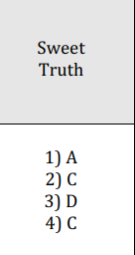

Slide 34
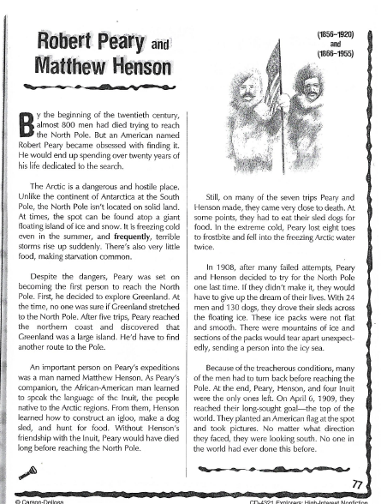
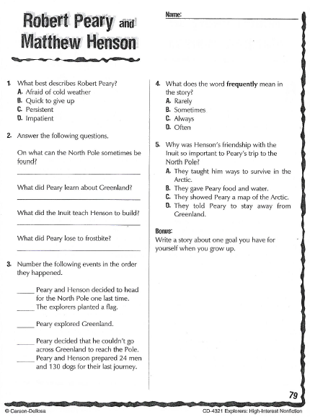
2:55 – 3:15

Slide 35
Restroom Break
3:10 – 3:15

Slide 36




3:20 – 3:25 Wrap Up!
Pair-Up back to back and share one thing you learned in class today with your partner
Pack-Up
Office will announce:
Car Riders – Leave around 3:25
Bus Riders – (listen to intercom for dismissal)
2:30 – 3:20
How much time has elapsed?

