Slide 1
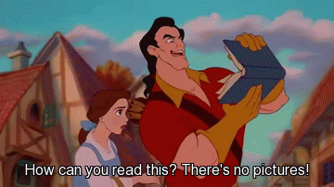
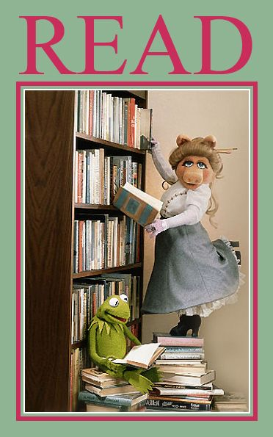
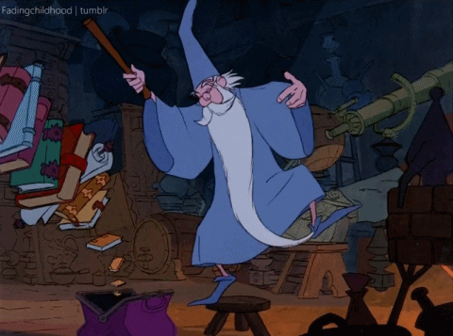
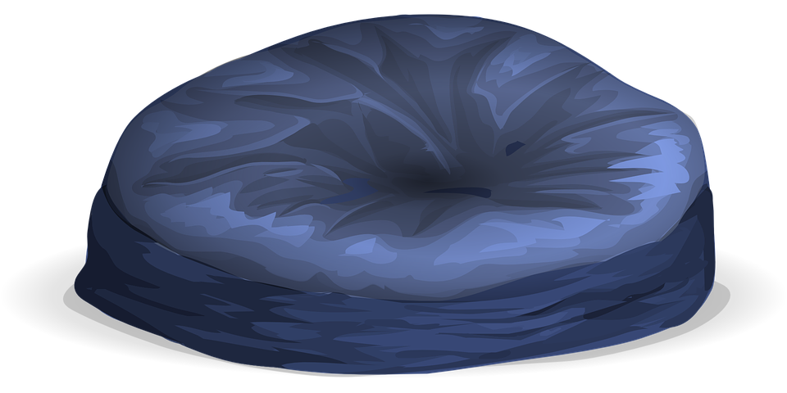
2.0
2.0
2.1
2.2
2.3
2.4
2.5
2.6
2.7
2.8
2.9
3.0
3.1
3.2
3.3
3.4
3.5
3.6
3.7
3.8
3.9
4.0
4.1
4.2
4.3
4.4
4.5
4.6
4.7
4.8
4.9
5.0
2.0
5.1
5.2
5.3
5.4
5.5
5.6
5.7
5.8
5.9
6.0
6.1
6.2
6.3
6.4
6.5
6.6
6.7
6.8
6.9
Click here for Fiction!
7.0+
Notes:
Please do not share to TPT...Sharing this with the Bitmoji Craze for Educators community so that other students may benefit!

Slide 2
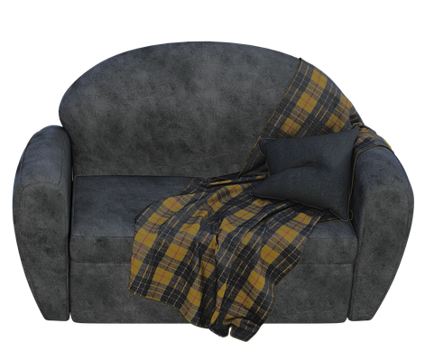
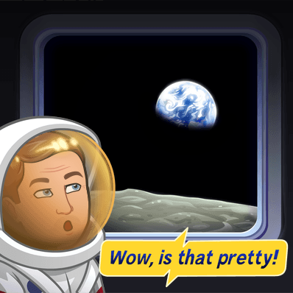
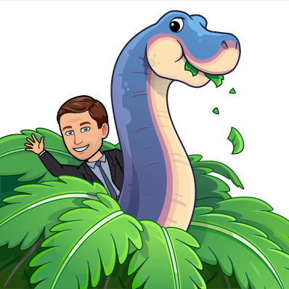
2.0
2.0
2.1
2.2
2.3
2.4
2.5
2.6
2.7
2.8
2.9
3.0
3.1
3.2
3.3
3.4
3.5
3.6
3.7
3.8
3.9
4.0
4.1
4.2
4.3
4.4
4.5
4.6
4.7
4.8
4.9
5.0
2.0
5.1
5.2
5.3
5.4
5.5
5.6
5.7
5.8
5.9
6.2
6.3
6.5
6.6
6.7
7.0
7.2
7.3
Click here for Nonfiction!
Notes:
Please do not share to TPT...Sharing this with the Bitmoji Craze for Educators community so that other students may benefit!

