Slide 1
Cell Growth and Division
This Week’s Unit
(Mitosis & Meiosis)
Cell Replication

Slide 2
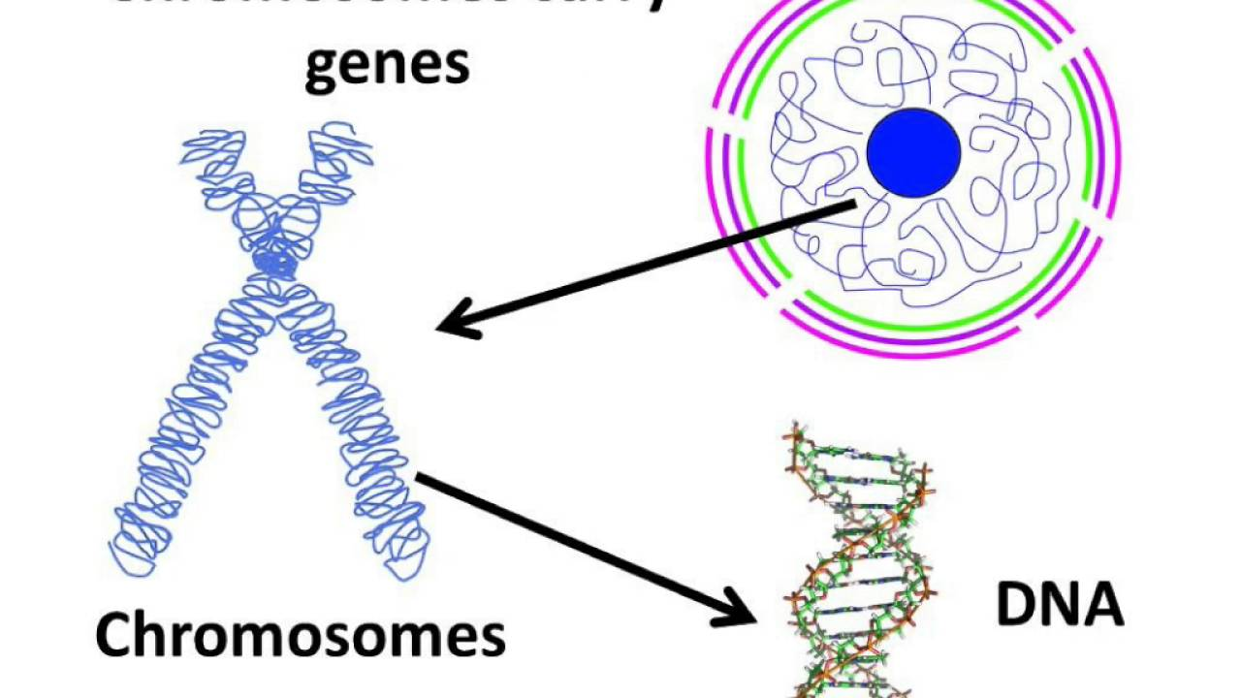
Cell, nucleus, chromosome, chromatid, DNA
Flashcard #1

Slide 3
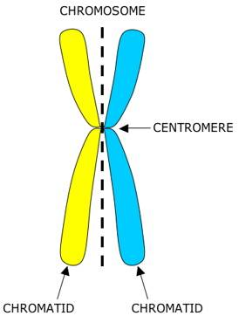
Chromosome Centromere Chromatid
#2

Slide 4
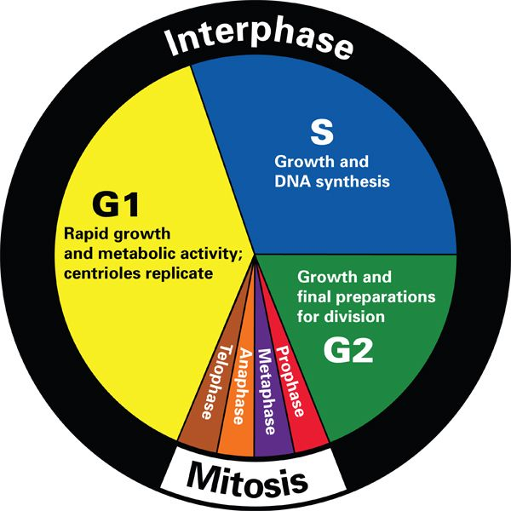
Cell Cycle
#3
Cancer cells do not know when to STOP going through the cell cycle!

Slide 5
G1 S G2 M
#4

Slide 6
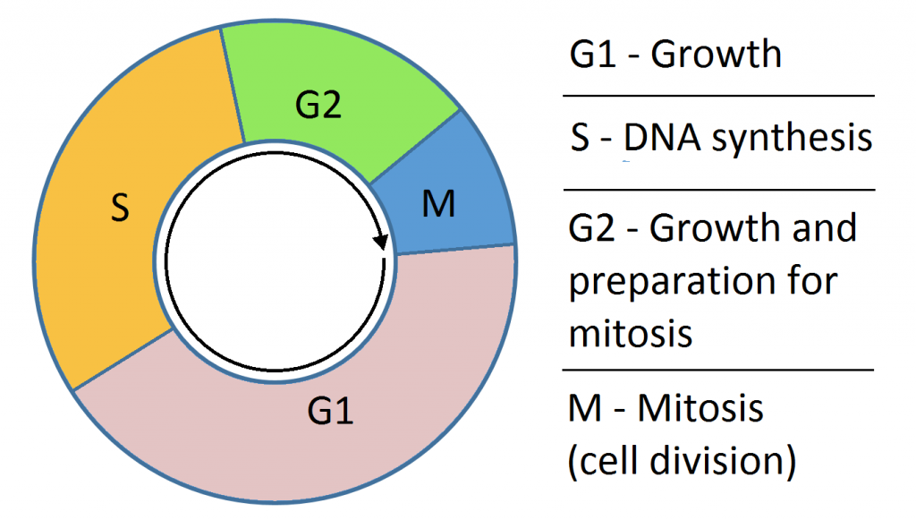
The cell grows larger and makes more organelles
#5
G1 stands for Gap1. But I like to think of it as Growth 1.

Slide 7
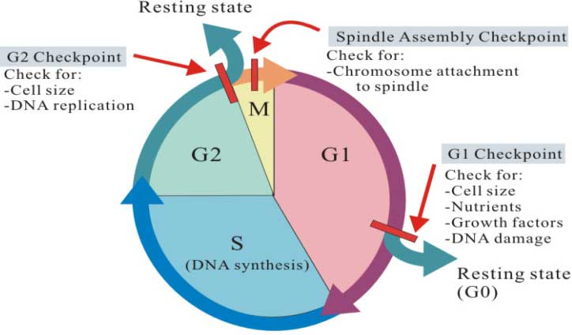
The cell makes a copy of its DNA
#6
The S stands for synthesis

Slide 8
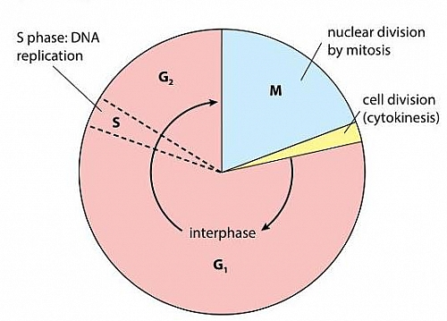
The cell grows even more
#7
G2 stands for
Gap 2

Slide 9
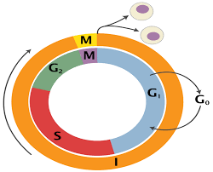
Mitosis
#8
Mitosis is the shortest phase. Can you tell what’s the longest?

Slide 10
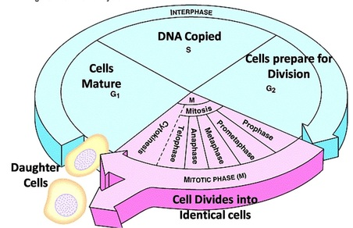
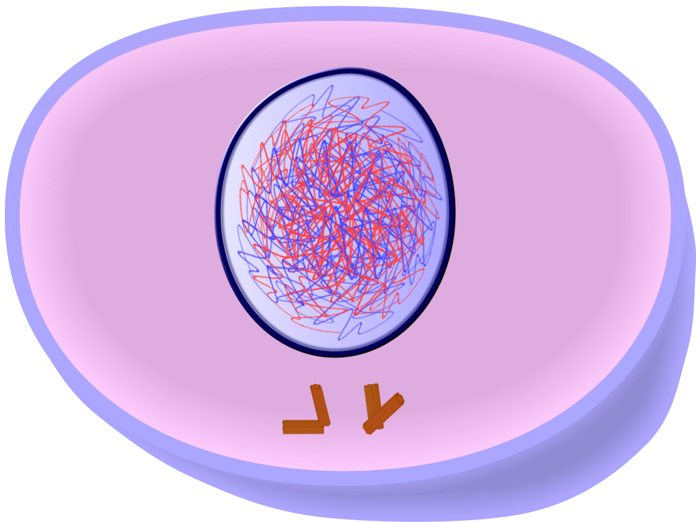
Interphase
#9
Interphase looks like a plate of spaghetti with noodles

Slide 11
P.M.A.T. prophase metaphase anaphase telophase
#10
“prometaphase”

Slide 12
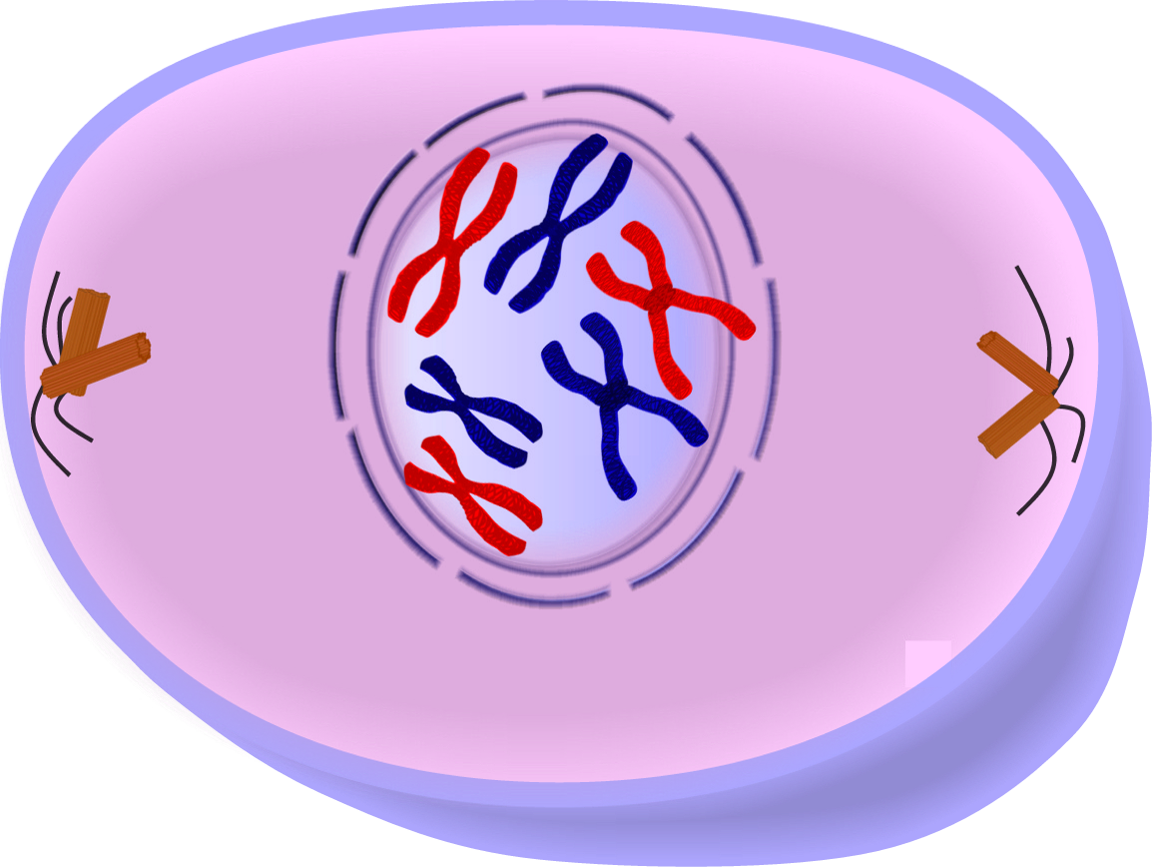
Prophase
#11

Slide 13
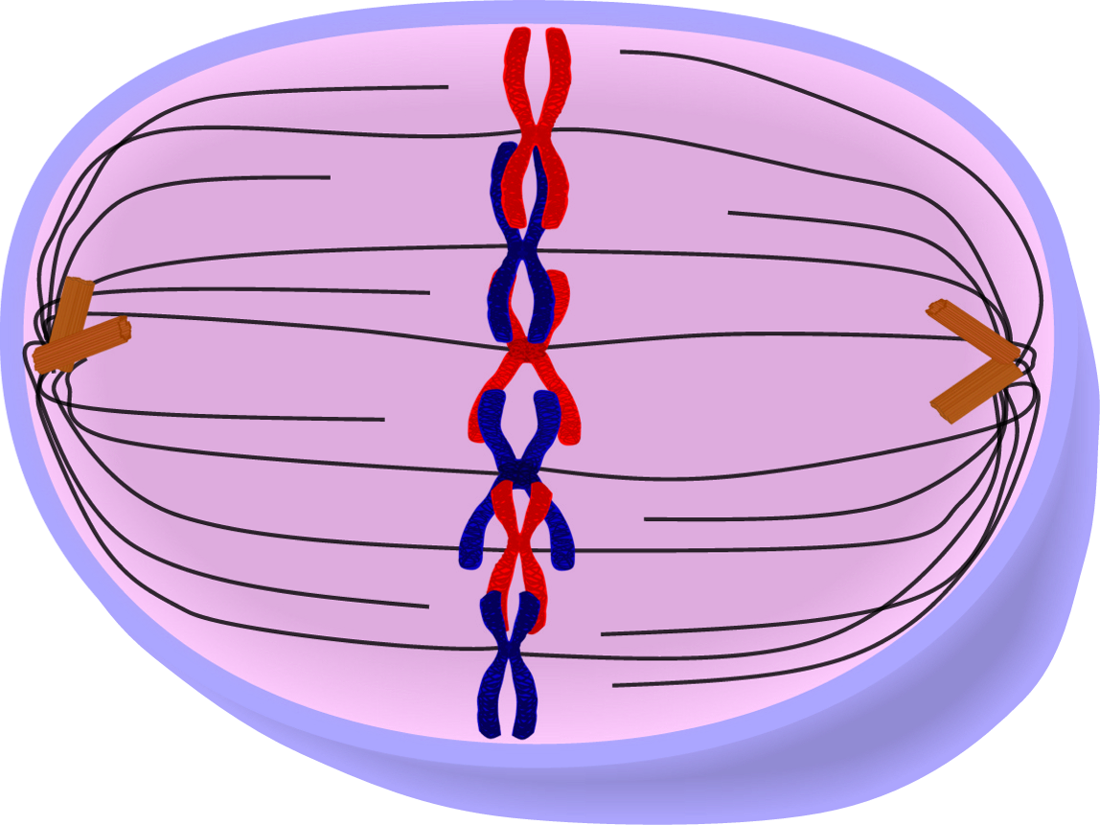
Metaphase
#12

Slide 14
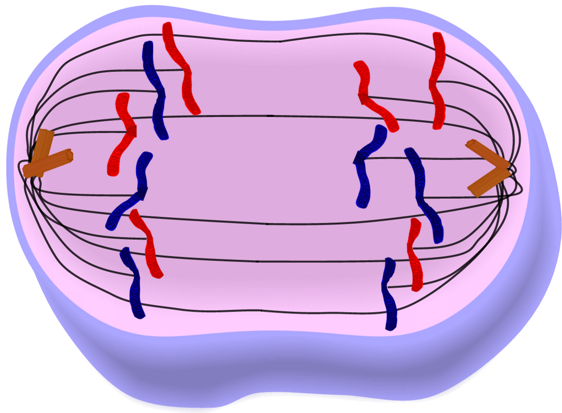
Anaphase
#13

Slide 15
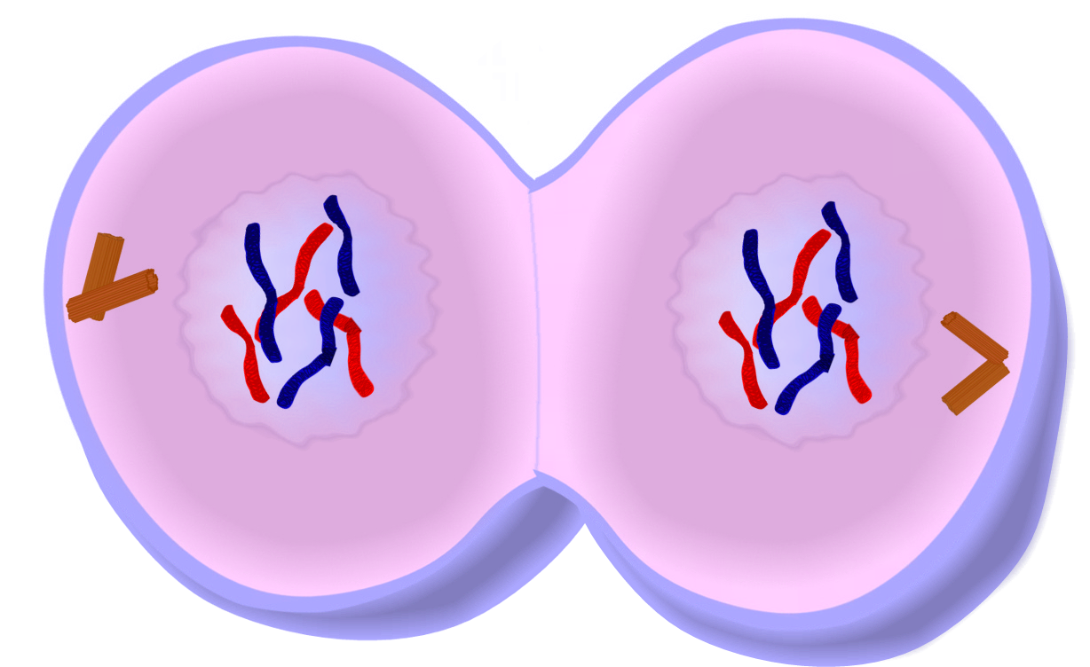
Telophase
#14
Discuss “cleavage”

Slide 16
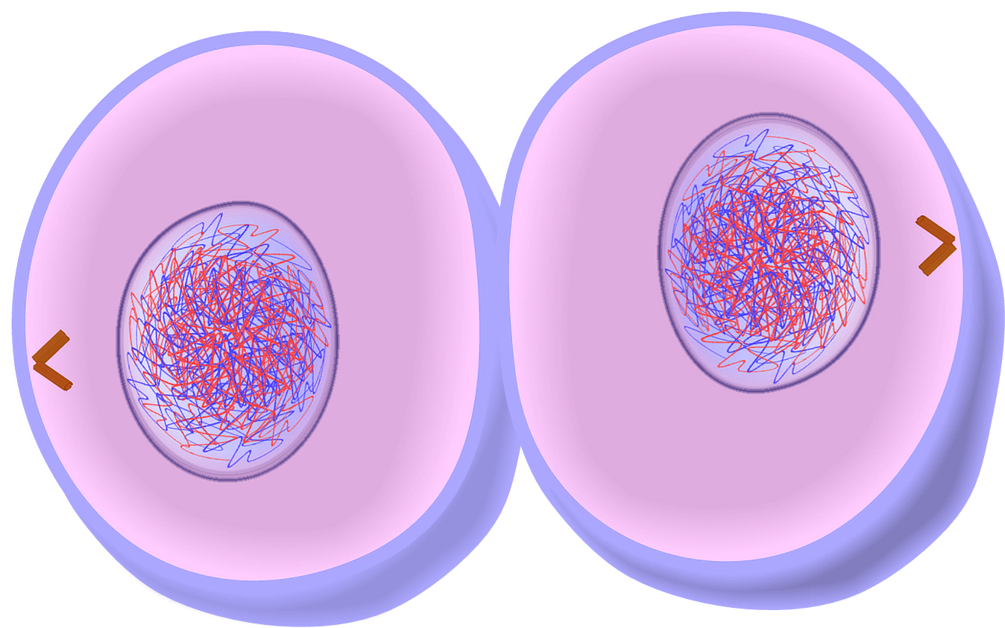
Cytokinsesis
#15

Slide 17
Somatic cells Blood cells Bone cells Muscle cells Skin cells Nerve cells
#16
Tip~ all the cells in MY TOES
(NOT sex cells)

Slide 18
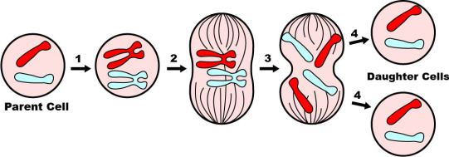
2 daughter cells Identical
#17
Tip~ MiTosis has a T in it to remind you of the number Two

Slide 19
Diploids
#18
The prefix “di” means 2

Slide 20
Growth Repair Replace
#19
Tip ~ think of
MY TOES

Slide 21
ONLY sex cells
#20
Remember the phrase “MEiosis is all about ME!”

Slide 22
Reproduction
#21

Slide 23
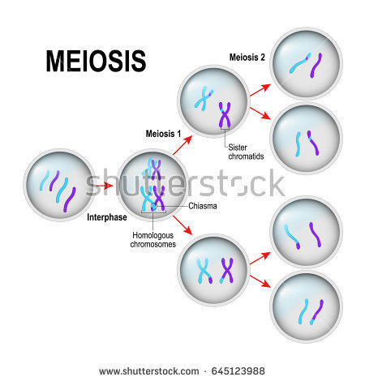
4 daughter cells NOT identical
#22
Sex cells only contain ½ the chromosomes

Slide 24
Gametes haploids
#23
Mitosis splits into 2 diploids. Meiosis splits into 4 haploids.

Slide 25
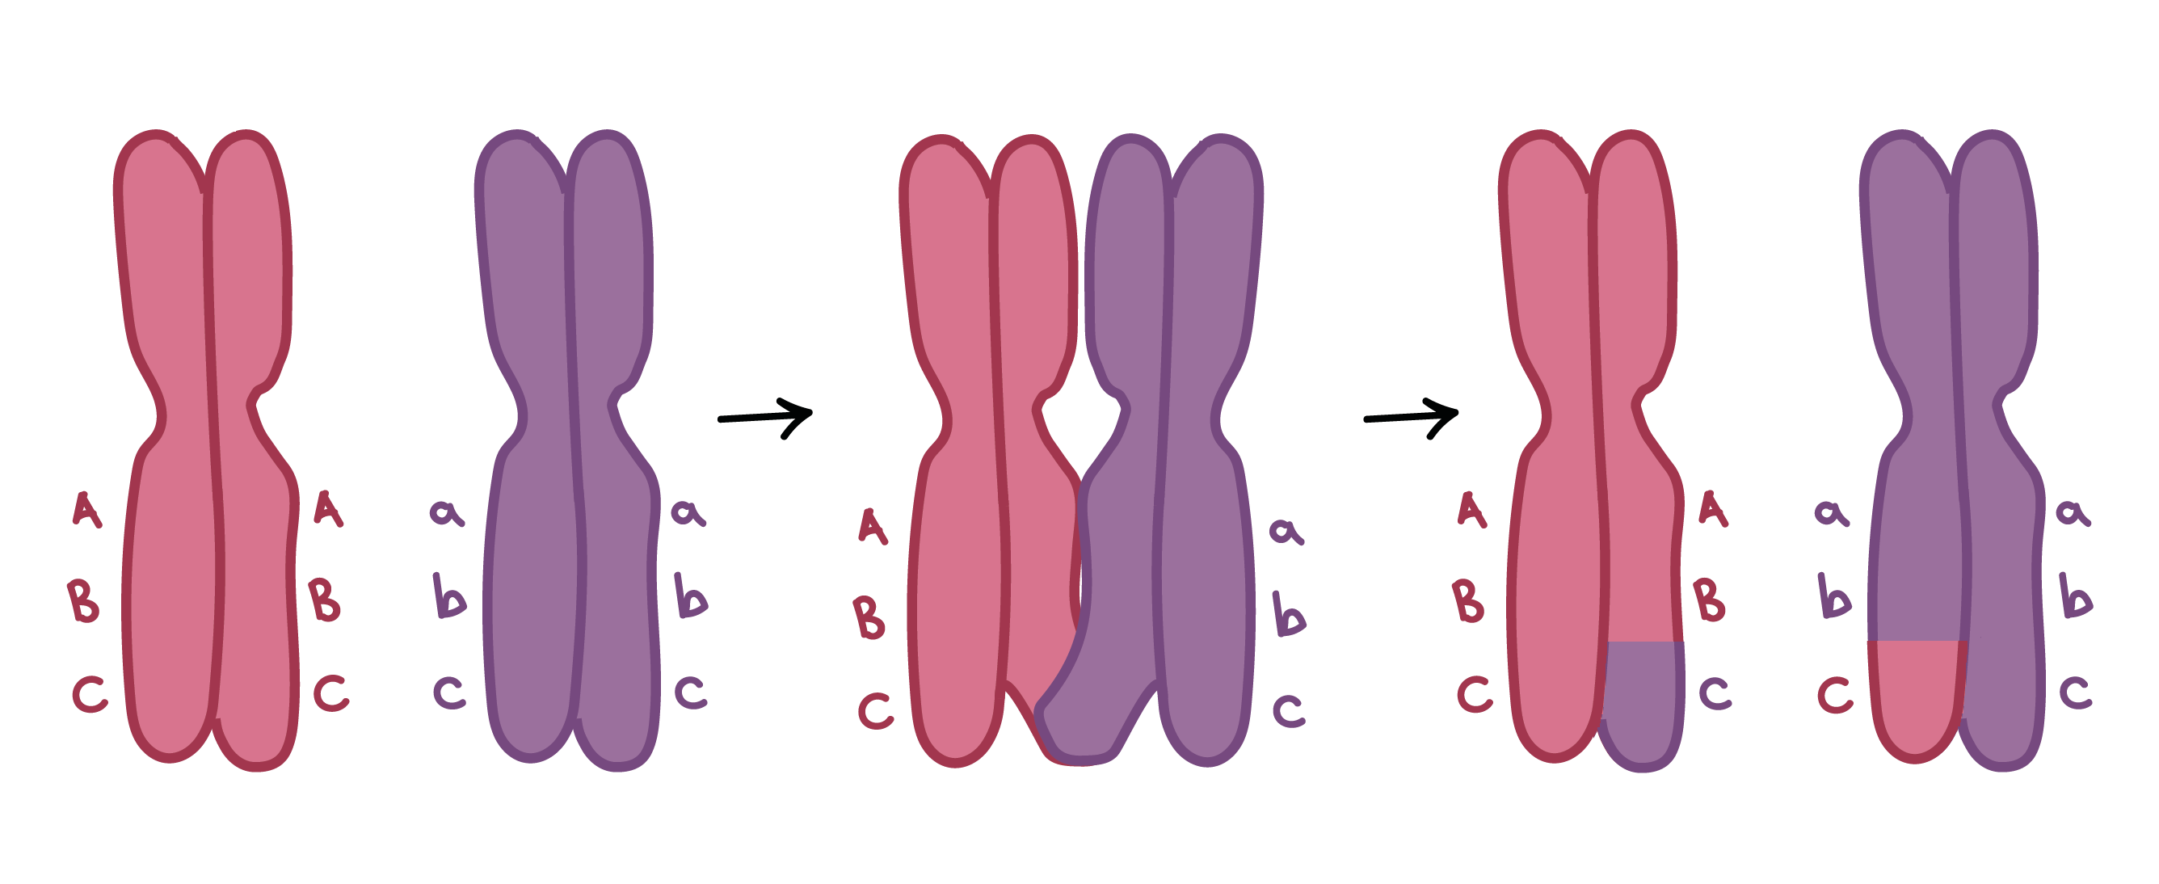
Crossing over & creates genetic variations
#24
Homologous
pairs

Slide 26
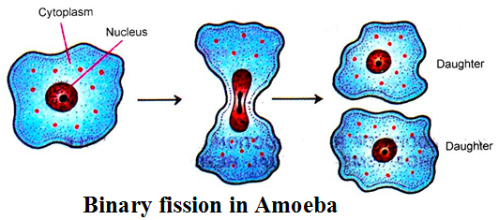
Mitosis Identical to the parent
#25

Slide 27
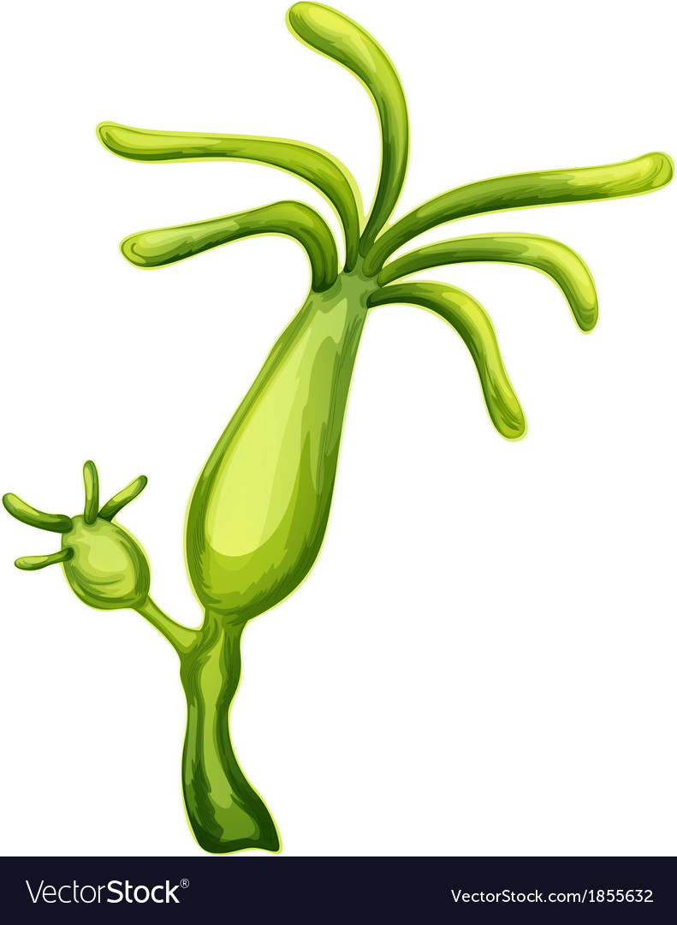
Binary fission – bacteria Regeneration – starfish Spores - fern Runners – strawberries Budding – hydra
#26
Vegetative propagation

Slide 28
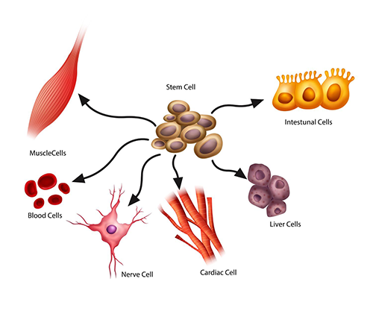
Stem cells
#27

Slide 29
Chromosomal disorders are found on a Karyotype
“nondisjunction”
Downs
Turners
Klinefelters

