Slide 1
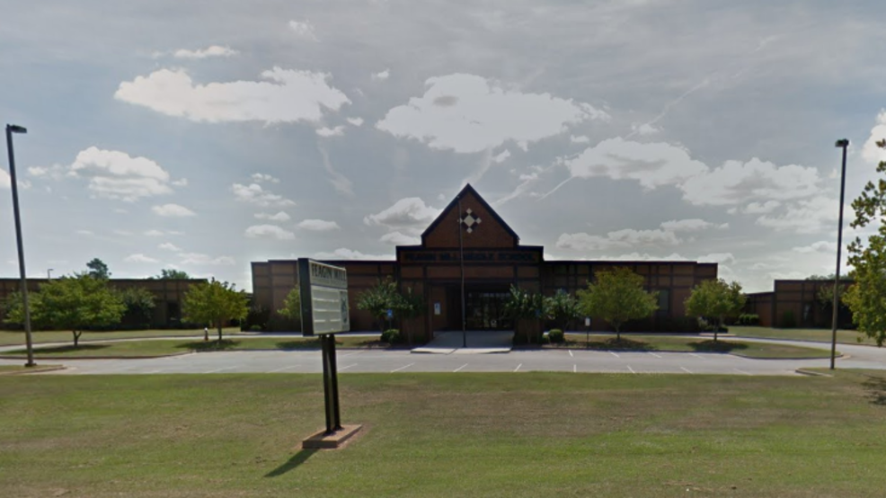
Welcome to Feagin Mill Middle School!

Slide 2
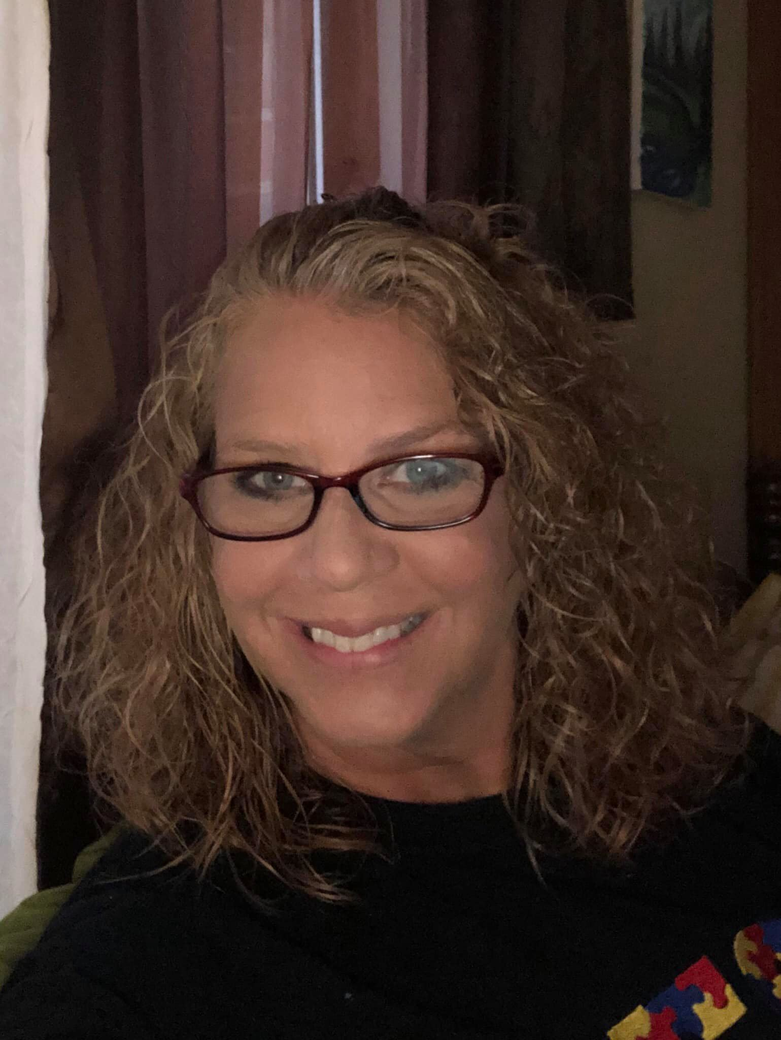
Who is your teacher?
Hi! My name is Mrs. Gina Suckow and I will be your teacher this year! I am so excited to meet you or see you again if you are returning! This year will look different from what you’re used to, but that is okay because it will still be so much fun! We will be learning lots of cool material and working on our personal goals. We are going to practice being safe by wearing our masks in the halls and when we are on the bus. We will wash our hands frequently. We will also stay in our own personal space so no one gets sick! School is made to be safe and fun, so we will be doing both! See you on August 6th!

Slide 3
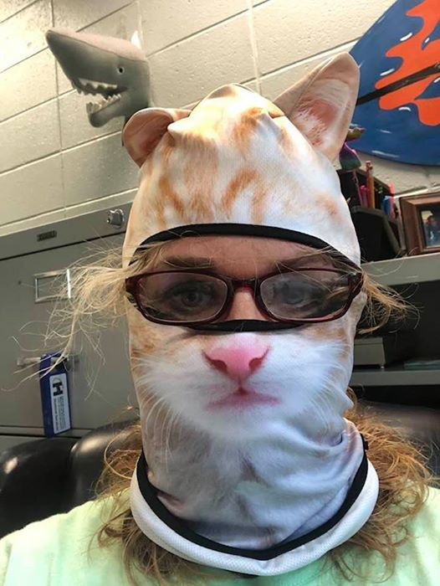
Mrs. Gina with her mask on

Slide 4
Let’s take a tour…

Slide 5
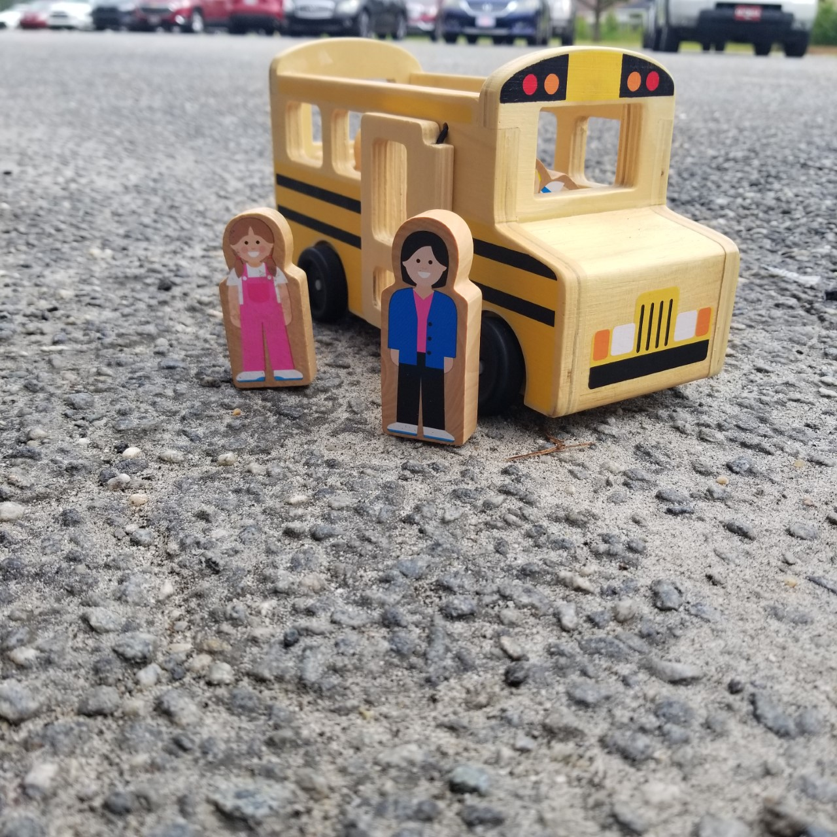
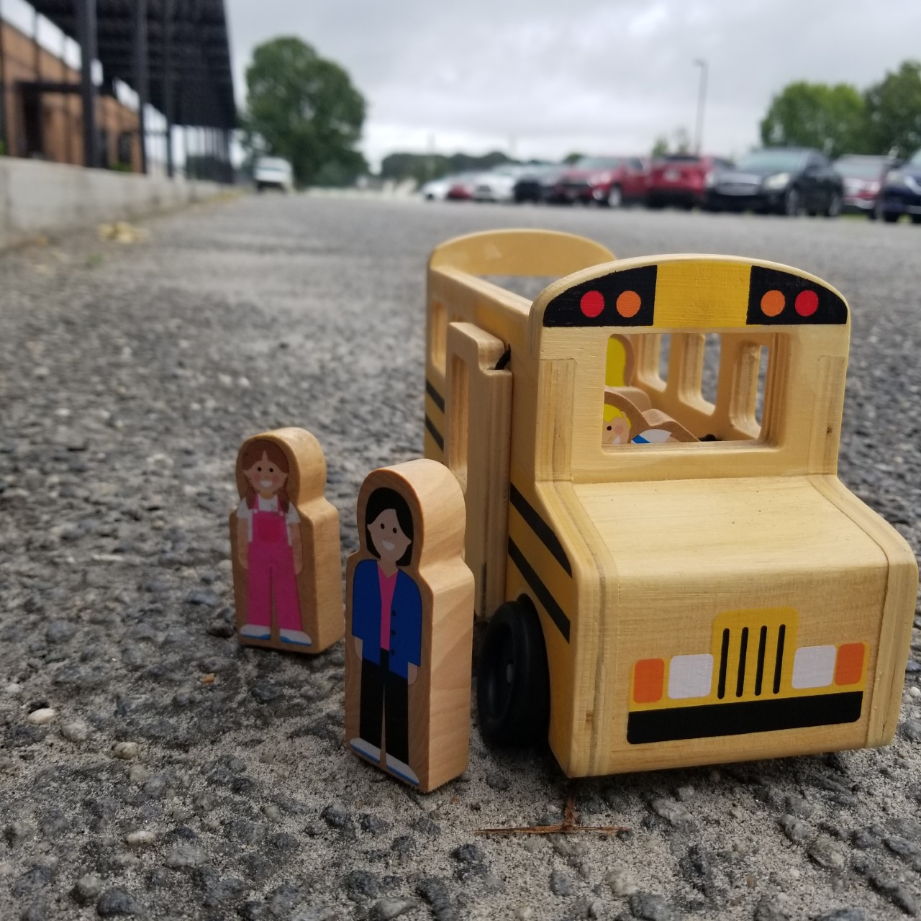
When you arrive…
Whether you’re a bus rider or car rider, you will be dropped off on the bus ramp!
When you exit the bus or car, you will be greeted by some awesome teachers!

Slide 6
Next…
You will get breakfast and head to our classroom.
On the way you will pass a few important spots to remember…
.
Across from the cafeteria, you will find the bathroom.
The cafeteria, where you get your breakfast and lunch.

Slide 7
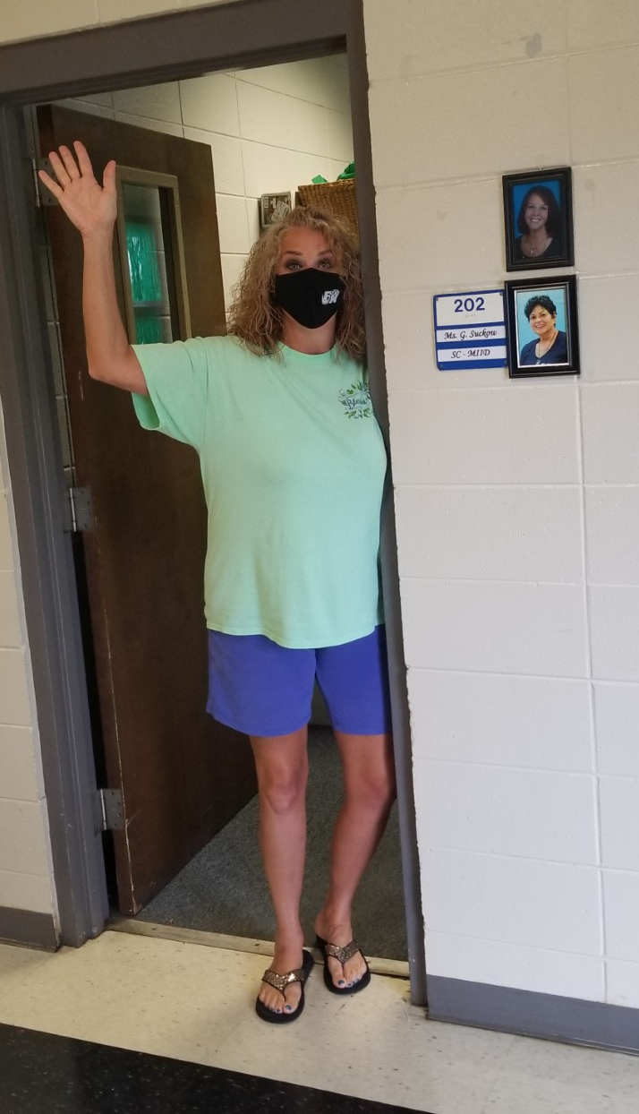
After you arrive and get breakfast…
You will head to my classroom. This is room 202! I am right across the hall from the lunchroom. Pretty easy… right?
If you forget where to go, you can look for my picture or ask someone for help!

Slide 8
Now, let’s check out some other spots around the school…

Slide 9
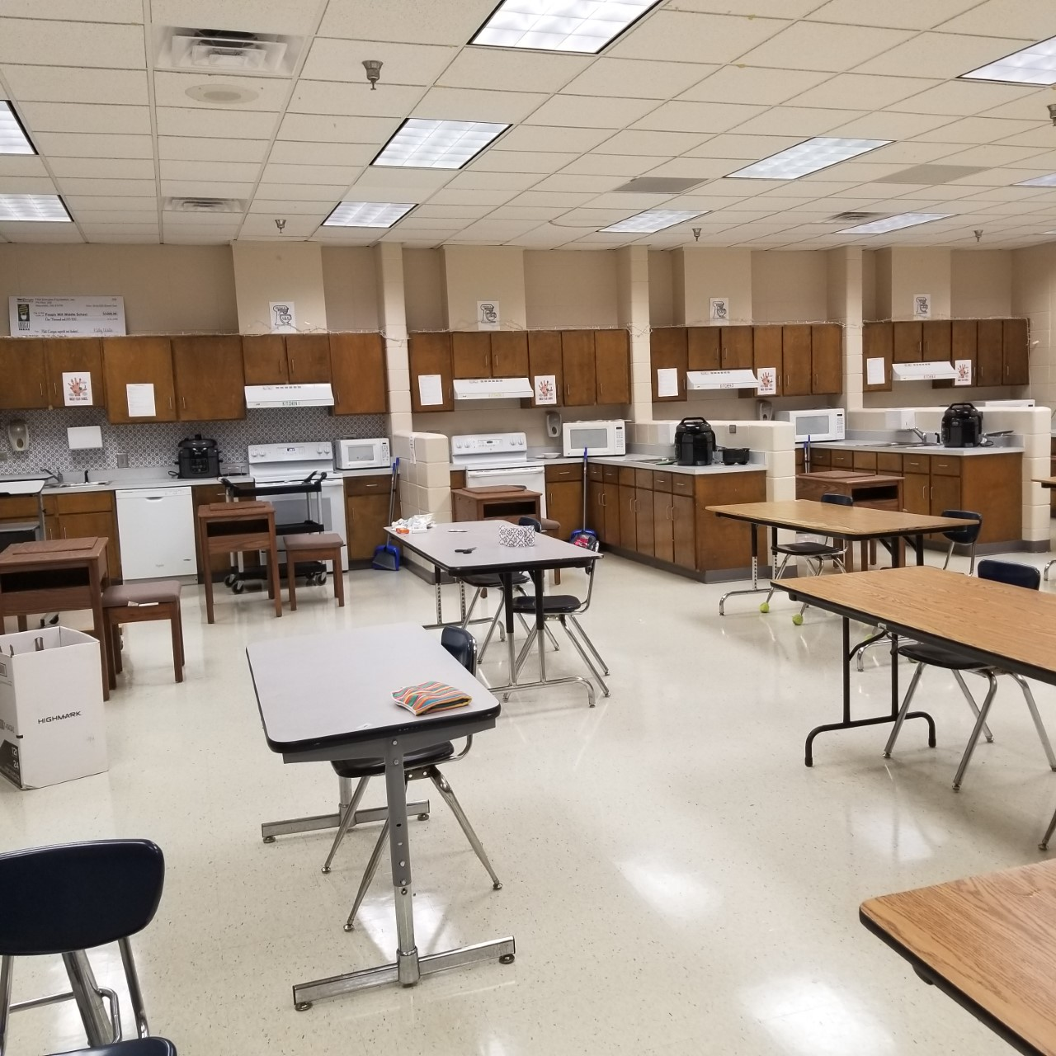
Family and Consumer Science (FACS) with Mrs. Duke
Mrs. Duke and Mrs. Gina
Mrs. Duke’s Room

Slide 10
Agriculture (AG)/FFA with Mr. Judson

Slide 11
Computers with Mrs. Folse

Slide 12
Art with Mrs. Kilmer
This is the room right across the hall from our classroom!

Slide 13
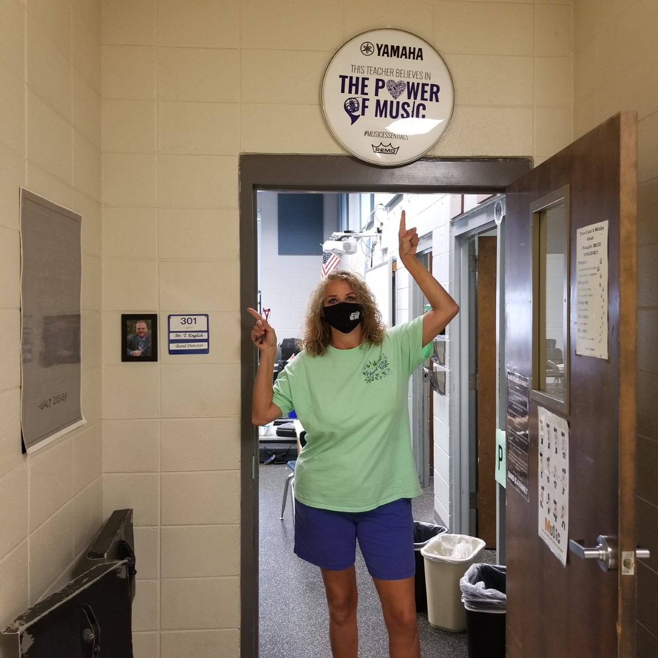
Band with Mr. English and Chorus with Mrs. Brown
Mrs. Gina showing the band room sign
Mrs. Brown (Chorus) and Mr. English (Band)

Slide 14
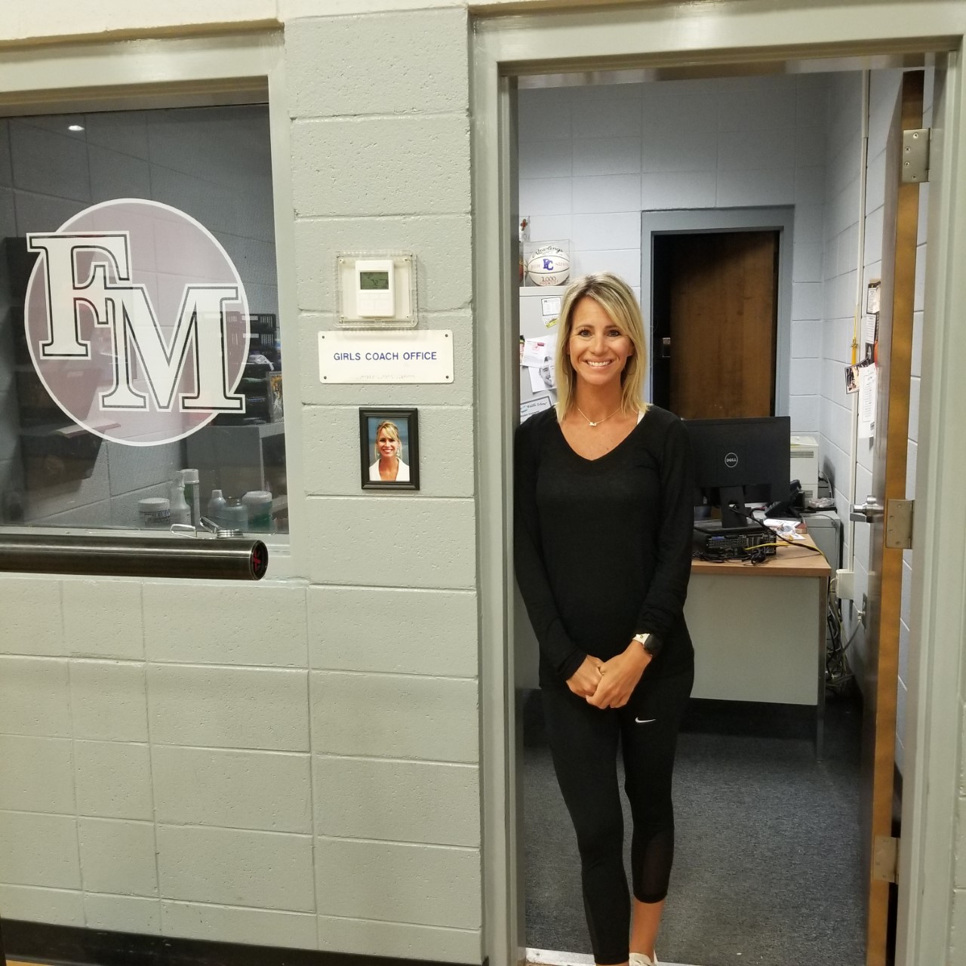
Gym/PE with Coach Pearce, Coach McDuffie, and Coach Fleming
Coach Fleming

Slide 15
Now, let’s explore the office area and who we might find there…

Slide 16
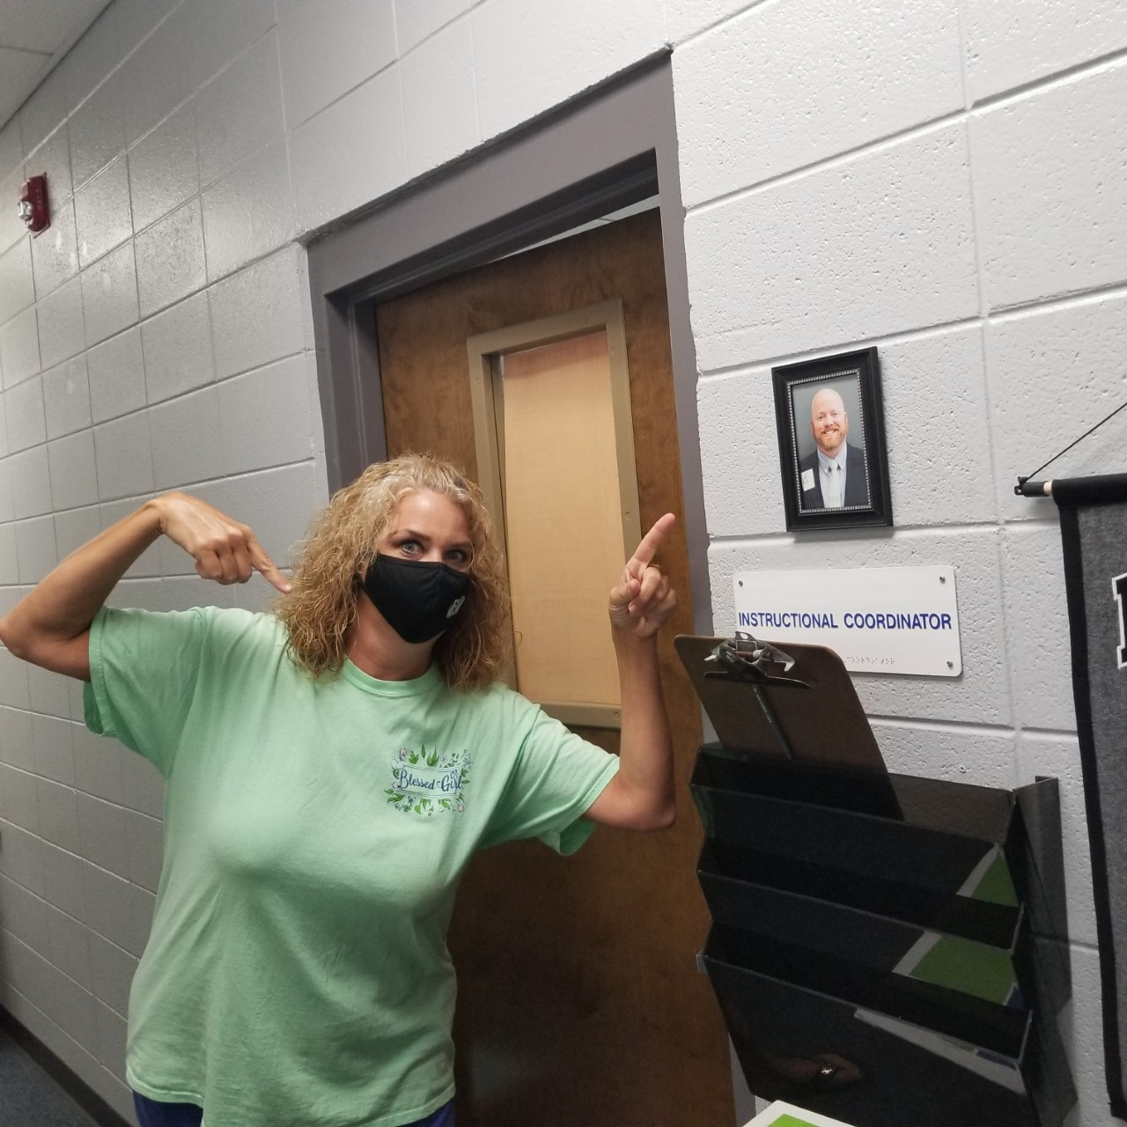
Assistant Principle: Mr. Hinson
Mr. Hinson
Mrs. Gina showing where his office is

Slide 17
Assistant Principle: Mrs. Thomas
Mrs. Gina and Mrs. Thomas doing a “cool” pose

Slide 18
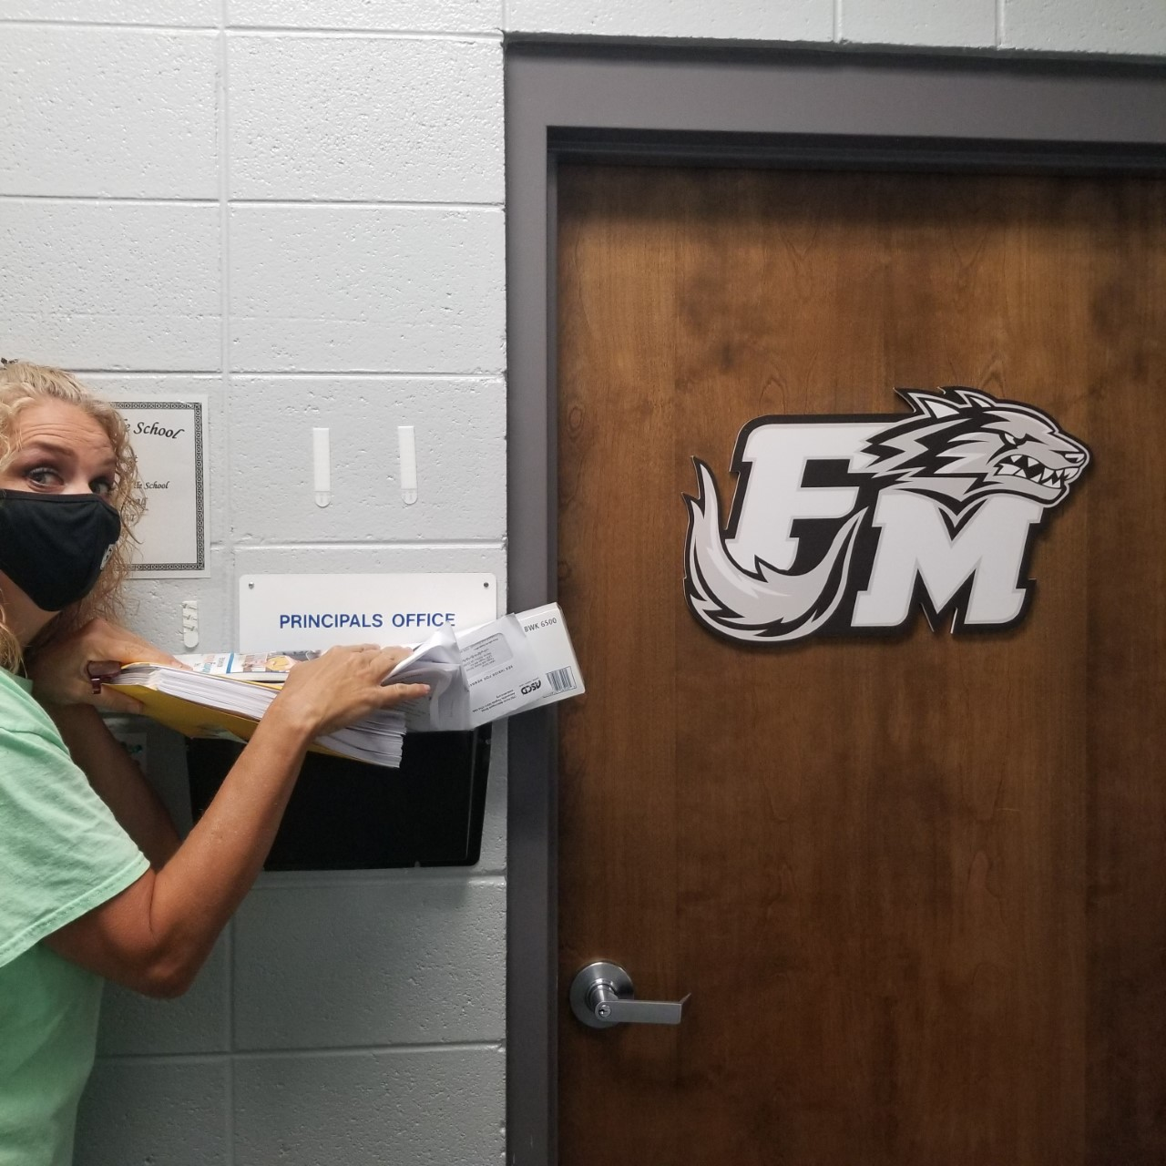
Principle: Mr. Sams
Mr. Sams
Mrs. Gina showing where Mr. Sams office is

Slide 19
Nurse: Mrs. Mobley
This is where you would take your medicine, go if you do not feel well, or if you are hurt

Slide 20
Front Desk: Mrs. Austin
If you are late or leaving early, you will see Mrs. Austin

Slide 21
School Resource Officer: Officer Ondike
Officer Ondike keeps our school safe!

Slide 22
Counselors: Mrs. Smith and Mrs. Burke
Mrs. Smith
Mrs. Burke

Slide 23
Across from the office is the Library…

Slide 24
Librarian: Mrs. Bloser

Slide 25
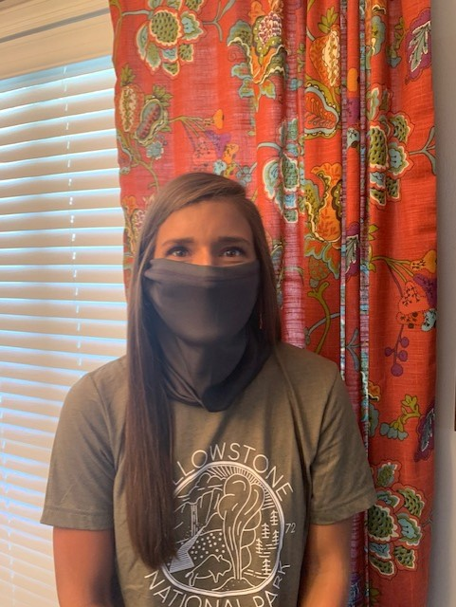
Two other people you will see are the speech teachers Mrs. Abby and Mrs. Dee
Mrs. Abby without and with her mask
Mrs. Dee with her mask on

Slide 26
That completes our school tour. Remember, if you are lost you can always ask someone for help…

Slide 27
A few things to remember:
Remember to bring your mask and water bottle to school everyday.
Wash your hands often.
Have fun.
Stay safe.
School starts August 6th.
Check out my teacher page on the Feagin Mill website.
Go to “Faculty and Staff Directory”.
Look in the “B” section for “Brueck, Gabrielle”.
Click and learn more about me!
7. Be great and back the pack!

Slide 28
I cannot wait to see you soon!

