Slide 1
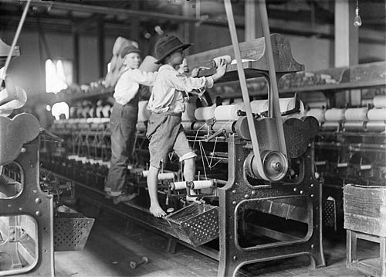
Page 172

Slide 2
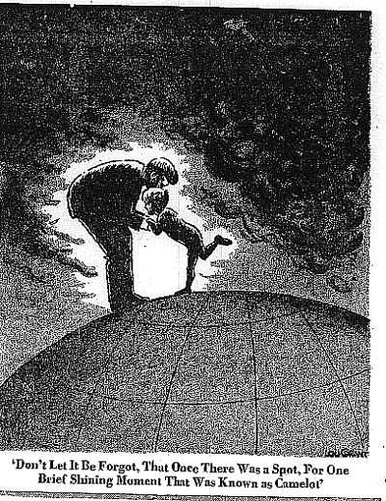
What is this cartoon about?
“Don’t Let It Be Forgot, That Once There Was a Spot, For One Brief Shining Moment That Was Known as Camelot”

Slide 3
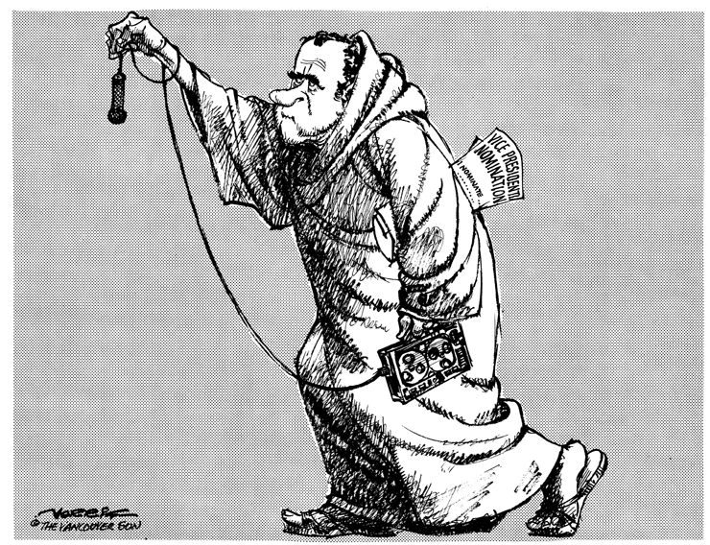

Slide 4
Objectives
MS1 Explain how geography, economics, history, and politics have influenced the development of Mississippi.
MS1d Analyze advanced personal economic choices (e.g., timber industry, shipping industry, gaming industry).

Slide 5
Objectives
MS1e Analyze the historical and political significance of key events in our state's development .
MS2a Identify the influence of the industrial and agricultural revolution in our state.
MS3d Analyze the significance of key events in our state's history.

Slide 6
Review
Problems suffered by the United States farmer.
Populists Party or the People’s Party
Political Boss System
Governor Longino
James K. Vardaman

Slide 7
Overview
Governor James K. Vardaman
The Secret Caucus
Election of 1911
Governor Theodore Bilbo
World War I

Slide 8
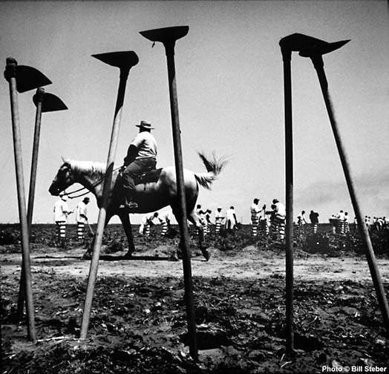
Governor James K. Vardaman
He ask the state legislature to end funding for black schools. They ignored him.
He stopped the convict lease system and improved the conditions for prisoners.
Parchman Farms

Slide 9
What is the progressive movement?
Members believed that government – local, state, and national – was best equipped to correct the ill of society.

Slide 10
James K. Vardaman
Is Vardaman a progressive governor?
No.
Why not?
His views on race.

Slide 11
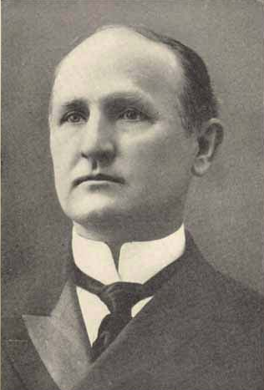
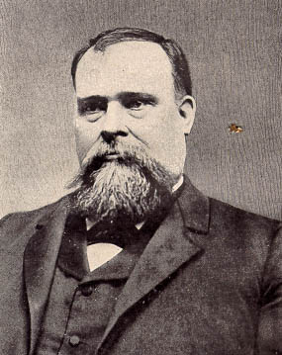
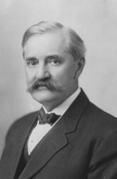
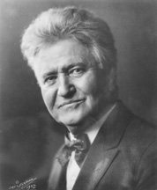
Progressive Governors
James Stephen Hogg
Charles B. Aycock
Governor of North Carolina 1901-1905
Governor of Texas 1891-1895
Albert B. Cummins
Joseph W. Folk
Robert M. La Follette, Sr.
Governor of Iowa 1902-1908
Governor of Missouri 1905-1909
Governor of Wisconsin 1901-1906

Slide 12
Vardaman’s Progressive Programs
He proposed laws to:
Restrict child labor.
Assist the deaf.
Care for the mentally ill.
The state legislature did not pass them.

Slide 13
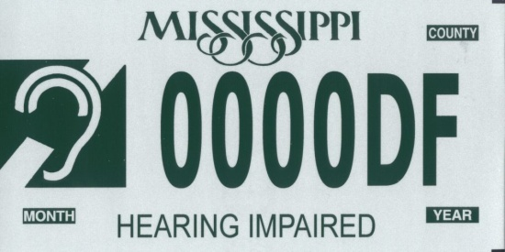
How do you assist the deaf?
Open schools for the deaf.
By the way, can a deaf person drive a car or motorcycle?

Slide 14
How did child labor start?
The father’s wage fell to a point the father could not pay to put food on the table or rent for the home.
Mother started working. The wage fell for both.
So, the children started working.

Slide 15
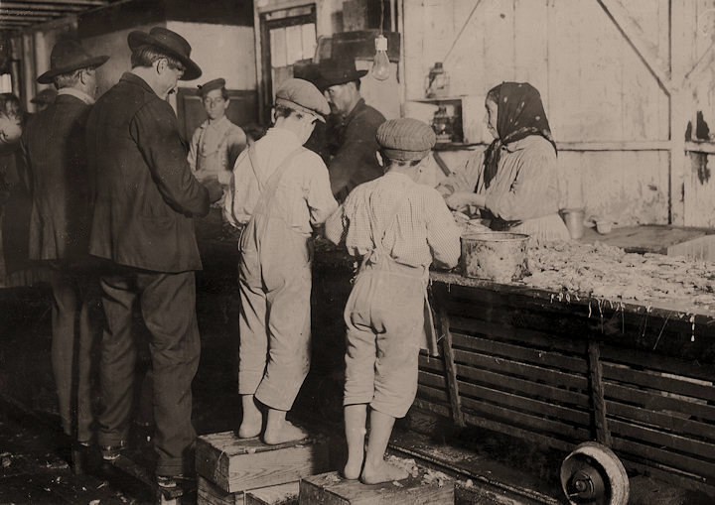
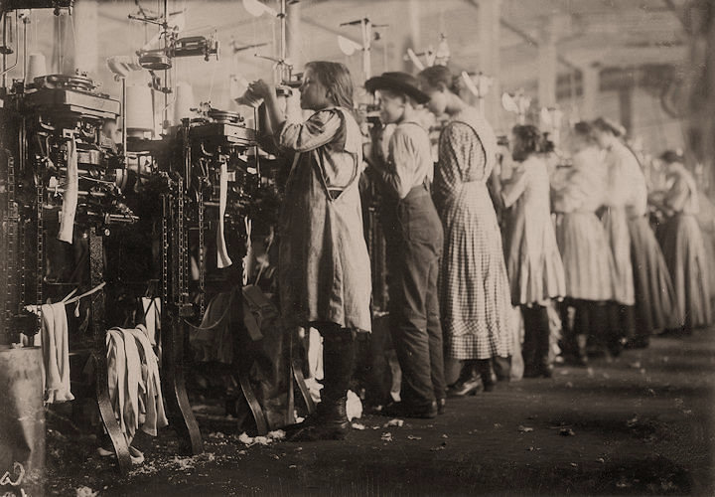
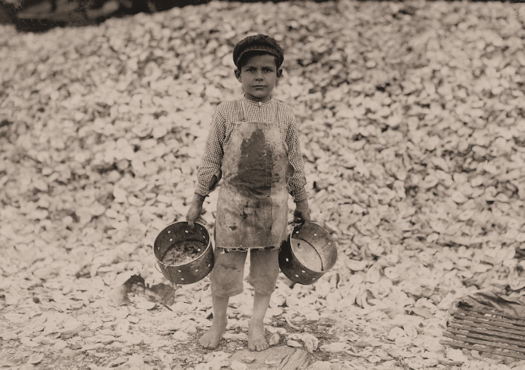
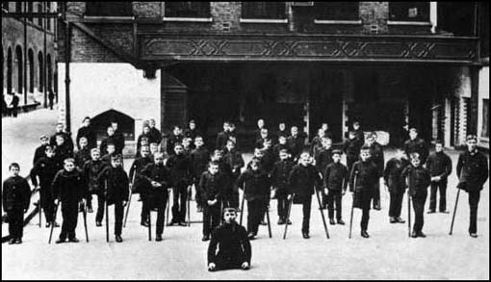
Why is child labor a problem?
The Factory: Some of the young knitters in London Hosiery Mills. London, Tennessee.
Seafood Workers: Shrimp pickers, including little 8-year-old Max on the right. Biloxi, Mississippi.

Slide 16
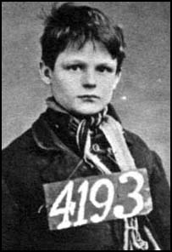
Children who worked long hours in the textile mills became very tired and found it difficult to maintain the speed required by the over lookers. Children were usually hit with a strap to make them work faster. In some factories children were dipped head first into the water cistern if they became drowsy. Children were also punished for arriving late for work and for talking to the other children. Parish apprentices who ran away from the factory was in danger of being sent to prison. Children who were considered potential runaways were placed in irons.

Slide 17
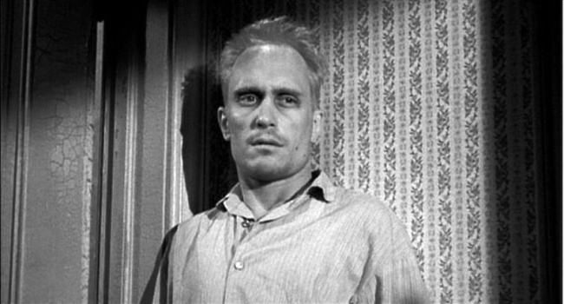
Mental Illness
What do you do with a mentally ill child?
To Kill a Mockingbird.
Insane Asylums
Boo" Radley

Slide 18
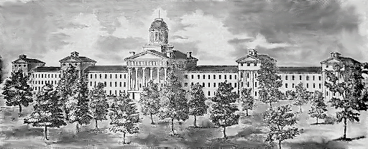
Insane Asylums
Mississippi State Lunatic Asylum (est. 1855)
Governor AG Brown made the first public proposition to establish a hospital for the insane in 1846. In 1848, the Mississippi Legislature appropriated funds for the original facility, which opened in 1855 at the present site of the University of Mississippi Medical Center in Jackson. In 1900, the name of the hospital was changed from "Mississippi State Lunatic Asylum" to "Mississippi State Insane Hospital."

Slide 19
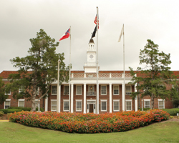
Mississippi State Hospital in Whitfield
In 1935, the psychiatric hospital was moved to the community of Howell which was then the site of the state penal colony, located near the current town of Brandon, the area was renamed "Whitfield" in honor of Gov. Henry L Whitfield.

Slide 20
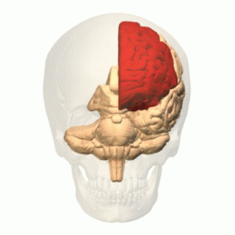
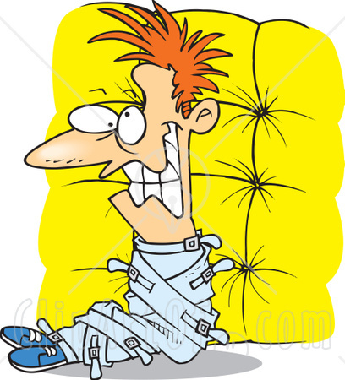
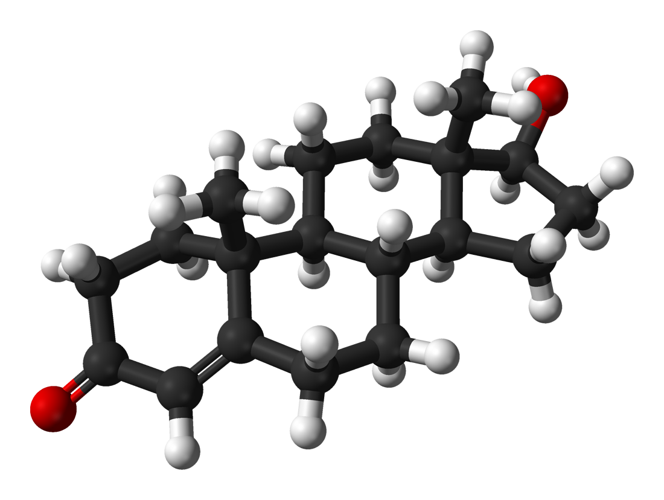
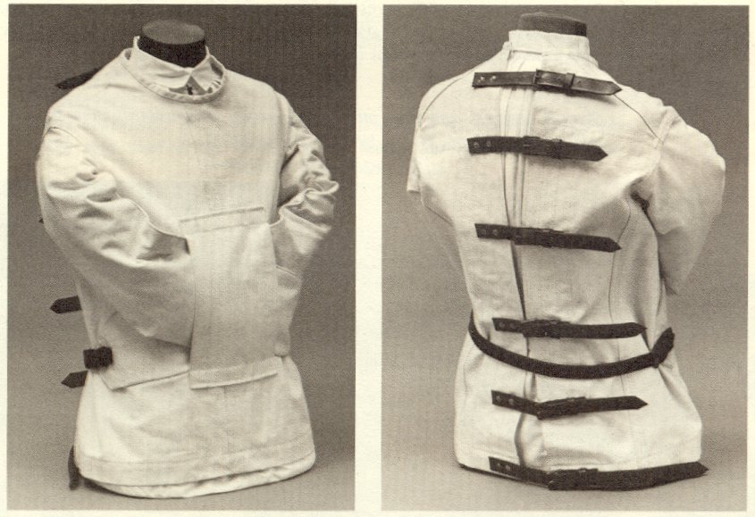
What do you do with the man you can not control?
Remove the organ that creates testosterone.
Frontal lobotomy (sometimes called frontal leucotomy)
Strait Jacket
It consists of cutting the connections to and from the prefrontal cortex, the anterior part of the frontal lobes of the brain.

Slide 21
Vardaman was successful.
Increased funding for schools and teachers.
State textbook commission. Ending a corrupt monopoly.
Regulated railroads, insurance, and utility companies.
His administration proved remarkably free of corruption.

Slide 22
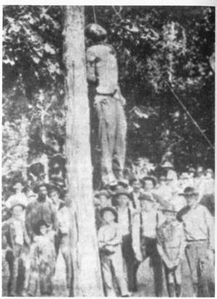
The Black Majority
Improving life for poor whites, he also helped poor blacks.
What did Vardaman do that helped only blacks?
Stop the lynching of black prisoners.

Slide 23
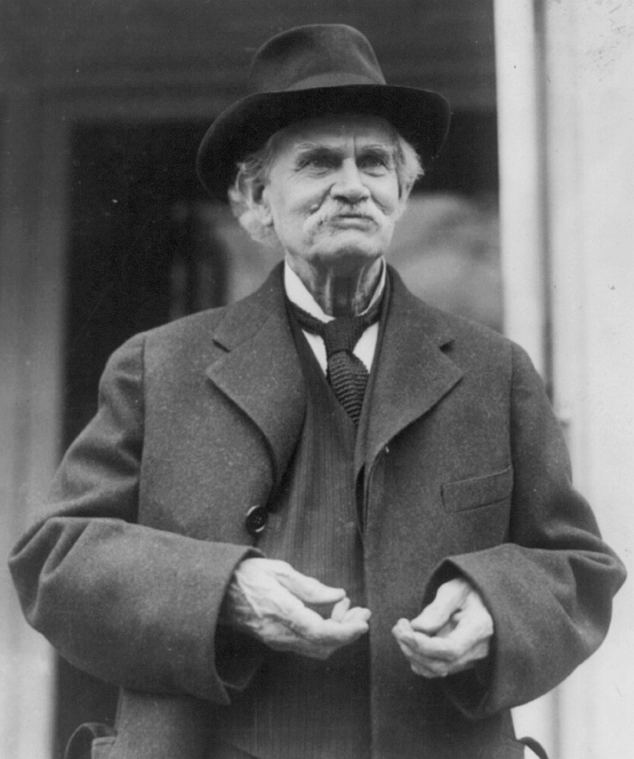
Vardaman runs for the United States Senate.
He runs against John Sharp Williams.
Williams and Vardaman are friends.
Williams wins the primary.
Why didn’t Vardaman protest the results?
Fraud on both sides and they are friends.

Slide 25
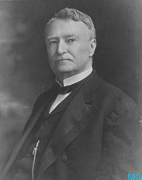
United State Senator Anselm J. McLaurin
Died in office on December 22, 1909.
Political boss in Mississippi.

Slide 26
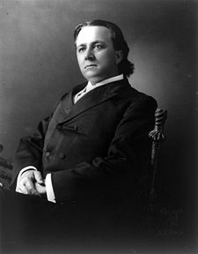
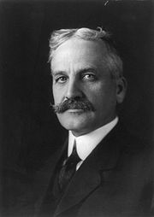
James K. Vardaman vs. LeRoy Percy
LeRoy Percy is a large planter from Greenville.

Slide 27
Secret Caucus
Do you have a right to see what the state legislature is doing?
Yes.
Can they close the door to you?
Yes.

Slide 28
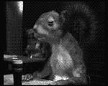
Behind closed doors.
Percy’s people would talk to the senator and say what?
What would it take for you to vote for Percy? Jobs, money, liquor or maybe women?

Slide 29
Who wins?
LeRoy Percy wins by 5 votes.
James K. Vardaman charged that the election had been stolen.
A grand jury is called to investigate.

Slide 30
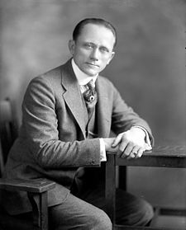
The Grand Jury
State Senator Theodore G. Bilbo is called to testify.
Which side is Bilbo for?
What is Bilbo like?
Bilbo’s speech was crude, master of insults and mistrusted educated, sophisticated or refined people.

Slide 31
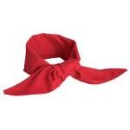
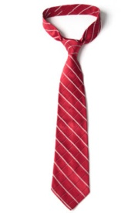
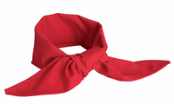
What is a Redneck?
By 1910, the political supporters of the Mississippi politician James K. Vardaman, chiefly poor white farmers, began to describe themselves proudly as "rednecks,” even to the point of wearing red neckerchiefs to political rallies and picnics.

Slide 32
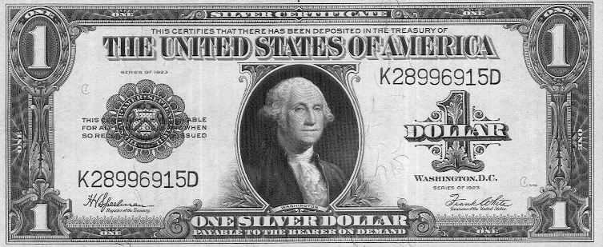
Bilbo
Bilbo said he had been bribed by Percy’s agents.
If your Percy’s attorney what do you do?
Ask for proof.
Bilbo turns over the money.
If your Percy’s attorney what do you do?
Inspect the money.
Some of it had been issued after the date of the bribe.

Slide 33
So what happened to Bilbo?
The man Bilbo tried to accuse of bribing him was acquitted.
The Senate tried to expel Bilbo but missed by a few votes.
So they passed a resolution.
It stated that Bilbo was not fit to sit in the chamber with “honest men.”

Slide 34
Election of 1911
Bilbo runs for the office of Lieutenant Governor and Vardaman for the United States Senate.
Percy out spent Bilbo and Vardaman by ten times as much money.
It was an unusually clean election.
Vardaman and Bilbo won overwhelmingly.

Slide 35
Lieutenant Governor Bilbo
Clouded by scandal.
One of his first acts as lieutenant governor was to remove the resolution calling him "unfit to sit with honest men" from the records.
Tried for taking bribes.
On charges of bribery in connection with a plan to create a new county in the Mississippi Delta. The plan would have divided Washington County, Percy's home county. It was even proposed that the new county be named after Vardaman, a further insult to Percy.

Slide 36
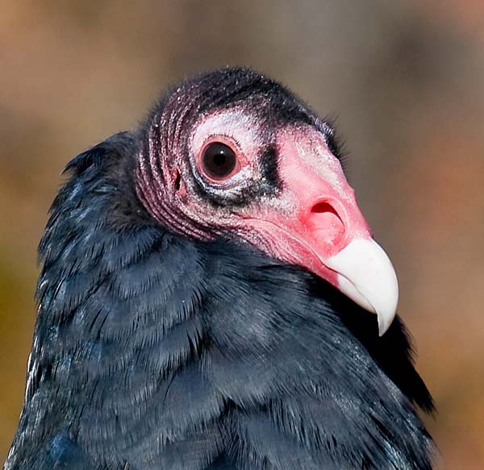
Election of 1915
Bilbo runs for Governor.
His four opponents campaigned primarily on Bilbo as an issue.
Bilbo won.
Fred Sullens, the editor of the Jackson Daily News suggested in print that with Bilbo as governor the eagle on the dome of the state capitol should be replaced with a "puking buzzard."

Slide 37
Governor Theodore G. Bilbo
Was Bilbo any good as governor?
Last sentence on the page. “Even Bilbo’s enemies were impressed.”
Bilbo did his best to make government work better.

Slide 38
Bilbo’s Programs
State Tax Commission.
Board of Bank Examiners.
Highway Commission.
Pardon Board.
Tuberculosis Hospital.
Clarity Hospital.
Training School for Delinquents.
Compulsory School Attendance.
Anti-Lobby law.
Adult Night Classes begun.

Slide 39
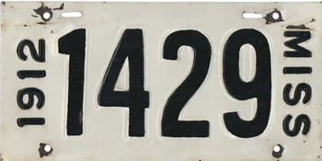
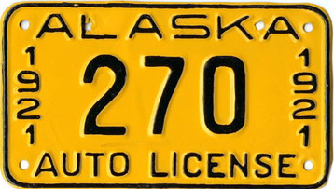
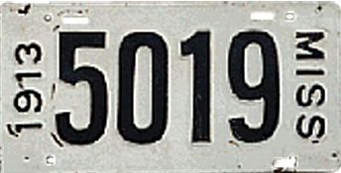
Do you need a Highway Commission, do we have any cars?
When was the first state wide car tag issued in Mississippi?
America's Most Expensive License Plates
#2 and #3
#1 plate 1921 Alaska ($60,000)
1912 Mississippi ($35,000)
1913 Mississippi ($50,000)

Slide 40
World War I
How did World War I start?
Nationalism.
Imperialism.
Militarism.

Slide 41
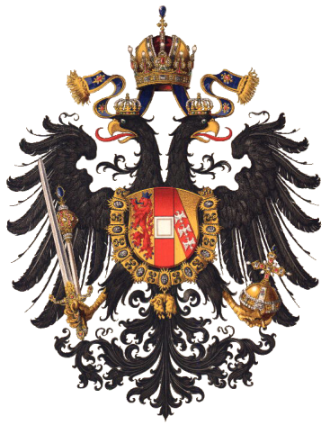
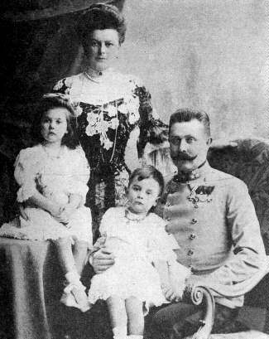
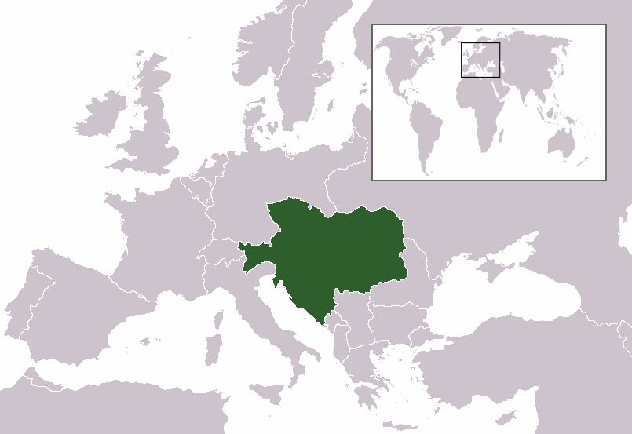
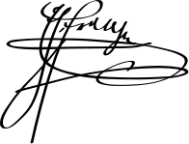
Archduke Franz Ferdinand
Heir presumptive to the Austro-Hungarian throne.
Austria-Este

Slide 42
Black Hand
Black Hand, officially Unity or Death, was a military secret society founded in the Kingdom of Serbia on May 9, 1911.
Governor of the Austrian provinces of Bosnia and Herzegovina had invited Franz Ferdinand and Countess Sophie to the opening of a hospital.
Seven conspirators lined the route.

Slide 43
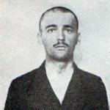
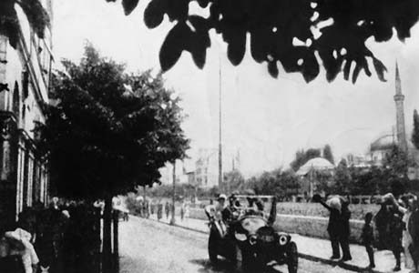
June 28, 1914
At 10:15 a.m., when the six car procession passed the central police station, nineteen-year-old student Nedeljko Čabrinović hurled a hand grenade at the Archduke's car.
“So you welcome your guests with bombs.”

Slide 44
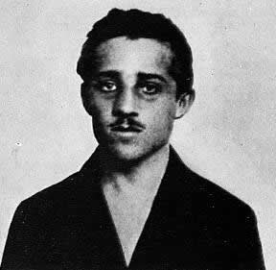
Gavrilo Princip
The royal couple insisted on seeing all those injured at the hospital. After travelling there, Franz and Sophie decided to go to the palace, but their driver took a wrong turn onto a side street, where Princip spotted them.

Slide 45
World War I Starts July 28,1914
The war is also known as the First World War, the Great War, the World War, and the War to End All Wars.
The German invasion of Belgium, Luxembourg and France.
Allied Powers Central Powers
Russian Empire
German Empire
Austria-Hungary
British Empire
Ottoman Empire
Kingdom of Bulgaria
France

Slide 46
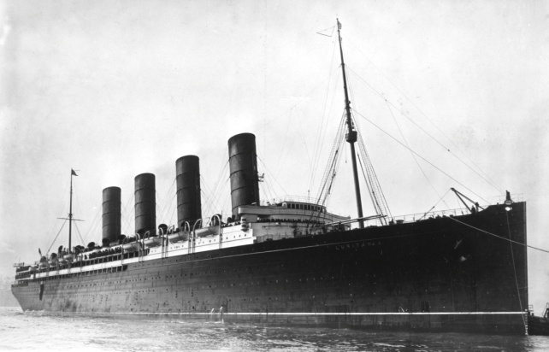
What was the United States position on the war?
The United States originally pursued a policy of isolationism, avoiding conflict while trying to broker a peace.
What will get the United States in the war?
When a German U-boat sank the British liner Lusitania in 1915, with 128 Americans aboard?
No.

Slide 47
So what gets us in the war?
The British intercepted a proposal from Berlin (the Zimmermann Telegram) to Mexico to join the war as Germany's ally against the United States, should the U.S. join the war.
The Germans would promise Mexico support in reclaiming the territories of Texas, New Mexico, and Arizona that Mexico lost during the Mexican-American War 70 years earlier.

Slide 48
James K. Vardaman
Believing big business to be the cause of the war, Vardaman voted against America’s entry into it.
For that vote, he was branded unpatriotic.
Pat Harrison defeated Vardaman in the 1918 senate race.
Vardaman never recovered; he moved to Alabama and died in obscurity.

Slide 49
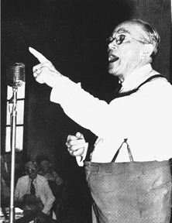
Bilbo
By 1920, Bilbo also seemed finished.
He decided to try for Harrison’s seat in Congress.
Bilbo lost that election.
Bilbo retired to Pearl River County.
His enemies pronounced his career dead.

Slide 50
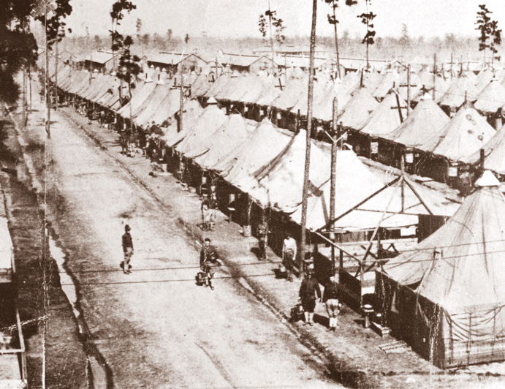
New Bases in Mississippi
Largest is Camp Shelby.
Near
Hattiesburg
Trained 30,000 recruits.

Slide 51
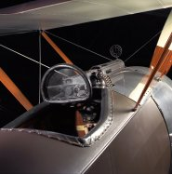
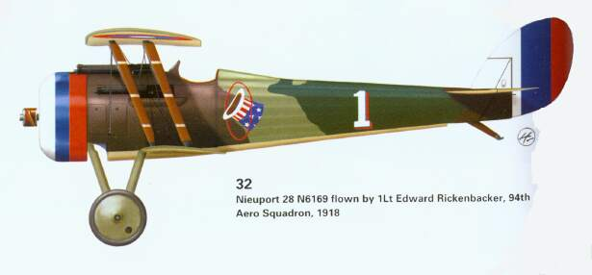
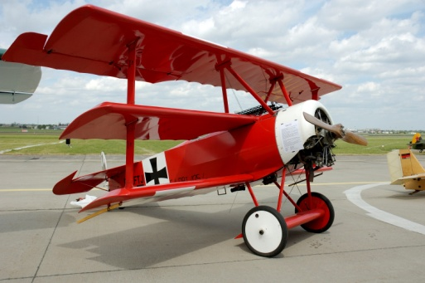
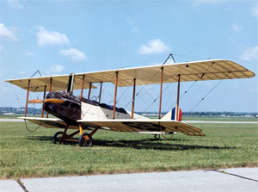
New Bases in Mississippi
Smaller base at West Point served the nation’s young air force.

Slide 52
New Weapons
British Mark V tank
5 MPH Max.
Paris Gun
210 lb shell 81 miles range
Vickers machine gun

Slide 53
Review
Governor James K. Vardaman
The Secret Caucus
Election of 1911
Governor Theodore Bilbo
World War I

Slide 54
Study for Test.

