Slide 1
Excellence In Extended Day and Year Programs
SDE Training Workshop
Sylacauga, Alabama
March 11, 2008

Slide 2
The Elmore County Board of Education serves 4 communities within the county with extended day programs:
Eclectic
Deatsville (Holtville)
Millbrook
Wetumpka

Slide 3
Child Development Program
21st Century Community Learning Centers
Excellence in Extended Day Award
Full day pre-school - After school elementary students

Slide 4
Child Development Program
21st Century Community Learning Centers
Excellence in Extended Day Award
$50,000 award for enrichment at our elementary schools

Slide 5
Child Development Program
21st Century Community Learning Centers
Excellence in Extended Day Award
$125,000 grant for each of four middle school centers

Slide 6
Our Commitment to Community Education
Family dynamics improve when the schools and community agencies help.
Community, schools and families educate the “total” child.
Classrooms and campuses can no longer be our boundaries.
School bells can no longer limit our efforts.
The resources in our schools should be shared.
Our SIPs support the importance of families and community.
Our Parental Involvement Committee implements programs for our district.

Slide 7
Our Commitment to the Extended Day
We serve all elementary and middle school students.
Resources are available before and after school.
Family involvement is required for participation.
Three and four year olds are prepared for the school experience.
Students have a greater chance to succeed.
Families have opportunities to learn and play together.
All policies in force during the day are part of the extended day.

Slide 8
Child Development Program
Excellence in Extended Day Award
21st Century Community Learning Centers

Slide 9
Child Development Program
Preschool program operates 12 months.
High Reach Learning curriculum.
Hands-on activities for colors, shapes, numbers, letters.
Enrichment activities in the arts.
Nutritious lunches.
Field trips and guest speakers (community based).
Afterschool program operates during holidays, summer.
Nutritious snacks.
Homework time/help available.
Arts, crafts, games, free play.
Health Rocks curriculum.
Cooperate with 4-H Club.
Summer field trips.
Both are tuition-based in all 4 communities.

Slide 10
Child Development Program
Excellence in Extended Day Award
21st Century Community Learning Centers

Slide 11
Available to all extended day students.
Eclectic ES outdoor learning center.
Learn through play and hands-on exploration.
Pavilion, pond, and butterfly, flower, vegetable gardens.
Cooperation of EES PTO.
Almost completed.
Holtville outdoor physical activity center – completed.
Stations to build upper and lower body strength.
Fitness course, walking track always available.
PE staff instrumental in design.
Wetumpka art and dance program – in place.
Contracted art and dance teachers.
Offerings to extended day students at no charge.
Will also provide martial arts classes
Excellence in Extended Day Award

Slide 12
Child Development Program
Excellence in Extended Day Award
21st Century Community Learning Centers

Slide 13
Our three targets are:
21st Century Community Learning Centers
COMMUNITY
HOME
SCHOOL

Slide 14
In order to be effective in each area, the learning center will strive to reach six goals.
Our success is judged by national standards from the PTA,
the NAESP and
the 21st CCLC program.

Slide 15
ACADEMICS
ADULT ED
ENRICHMENT
6
ATTENDANCE
BEHAVIOR
COMMUNITY

Slide 16
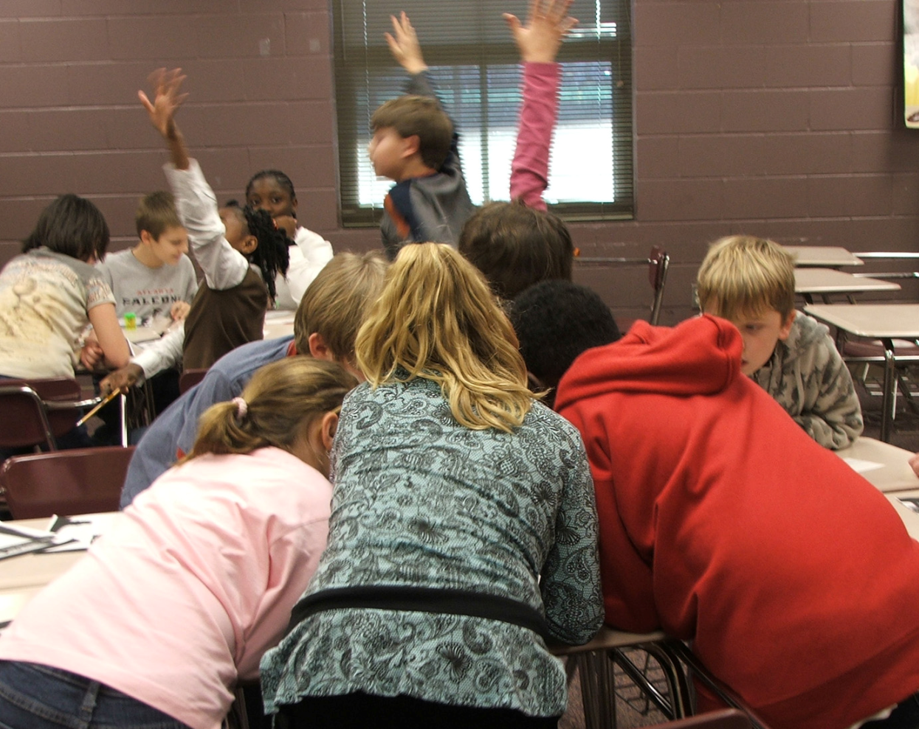
Daily Academic Topics
Reading
Language
Social Studies
Mathematics

Slide 17
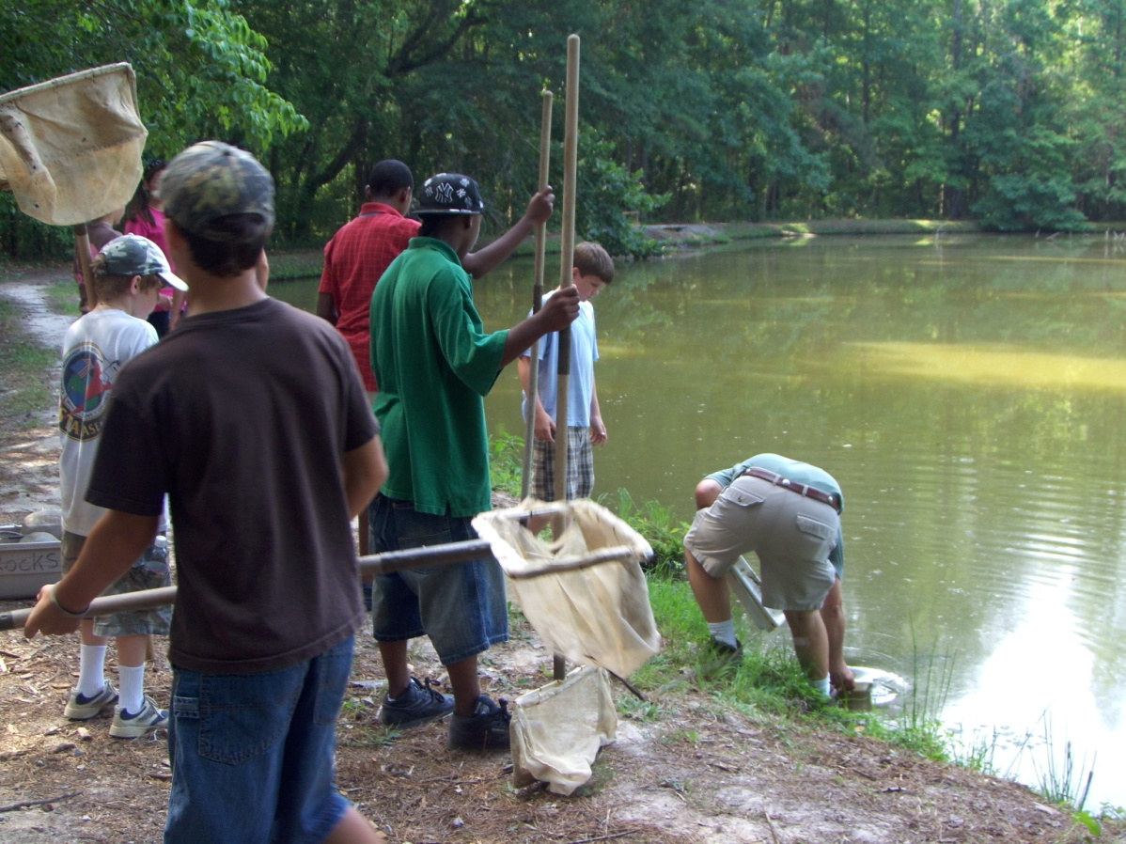
Weekly Enrichment Topics
Computer Skills
The Arts: Visual and Performing
Science and Nature
Critical thinking

Slide 18
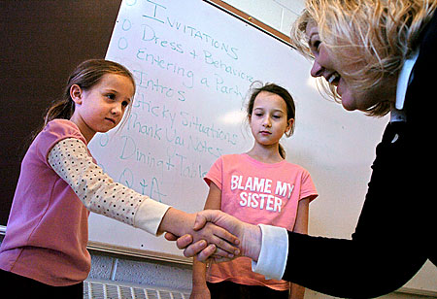
Offerings for Better Behavior
Substance Abuse Education
Anger and Stress Management
Character Education

Slide 19
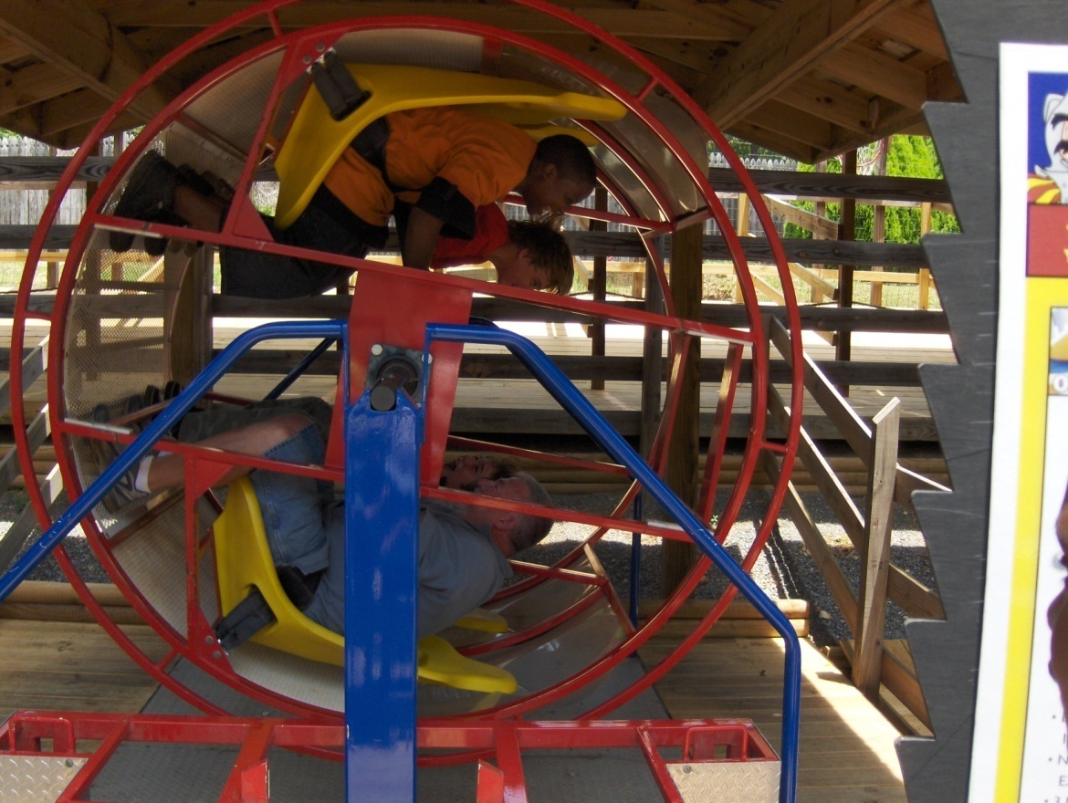
Offerings for Better Attendance
Hands-on activities
Chances to be creative
Fun and fellowship
Interaction with interesting volunteers
Field trips

Slide 20
Other Daily Offerings
Help with Homework
One-on-one Tutoring
Coordination with regular classroom
Physical Activity
Nutritious snack

Slide 21
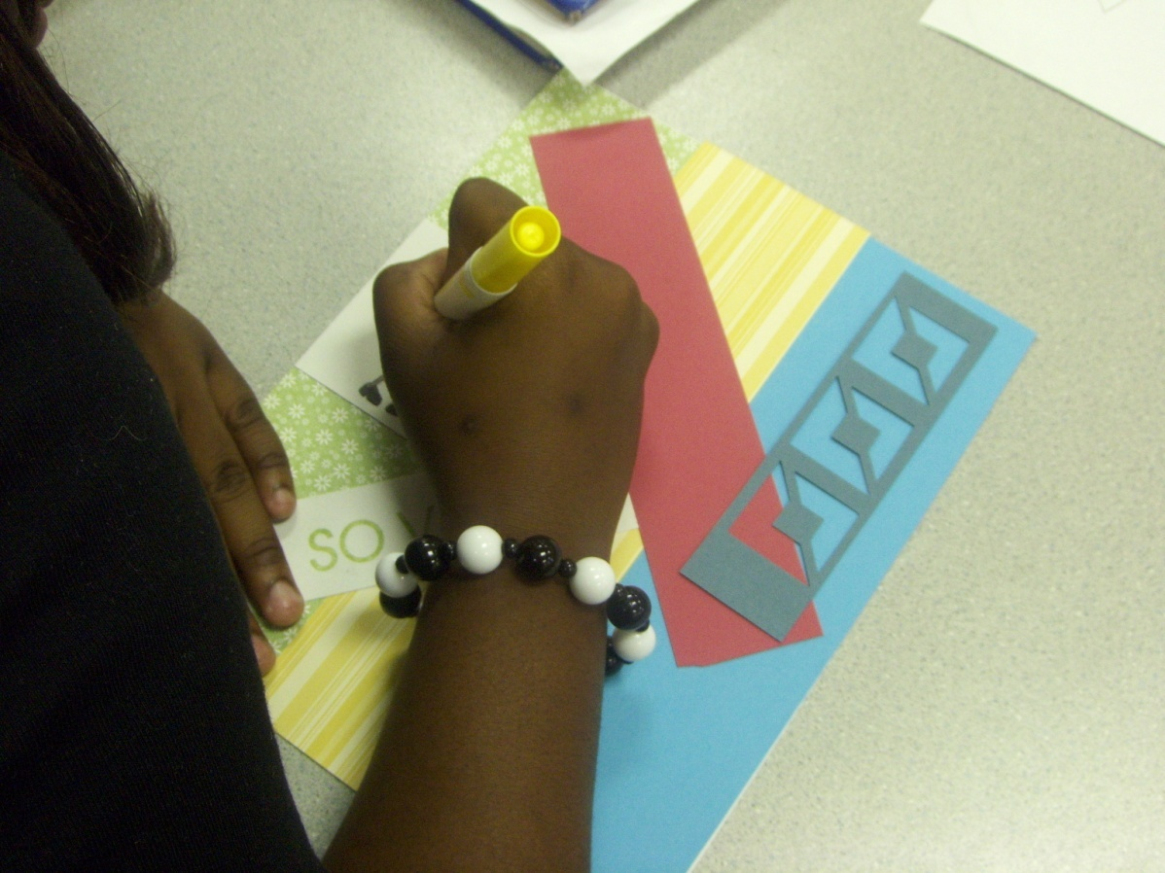
Other Periodic Offerings
Real-Life Situations
Hands-On Experience
Career Education

Slide 22
Adult Ed Opportunities
Tips and Advice on Parenting
Academic Classes
Enrichment Classes
Family Nights

Slide 23
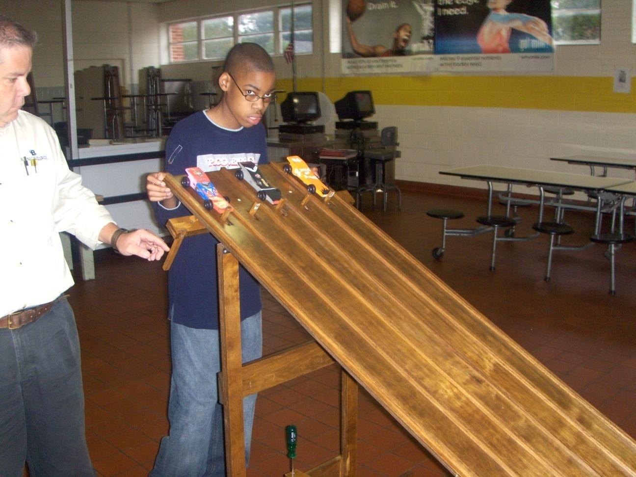
Community Awareness
Trips to local attractions
Visits from community groups
Listings of local opportunities for family enrichment

Slide 24
Expected Outcomes
Academics
Better understanding
Improved grades
Improved standardized test scores
Behavior and Attendance
Better self concept
Increased respect for rules, others
Fewer incidences of poor behavior at home and at school
Better attitude
Eagerness to learn
Fewer tardies and absences
Family
Improved family life
Improved communications
Better understanding of the school
Better awareness of the local community
More involvement of community groups
Community
Better citizens
Financial support/donations
Sponsorships
Volunteers

Slide 25
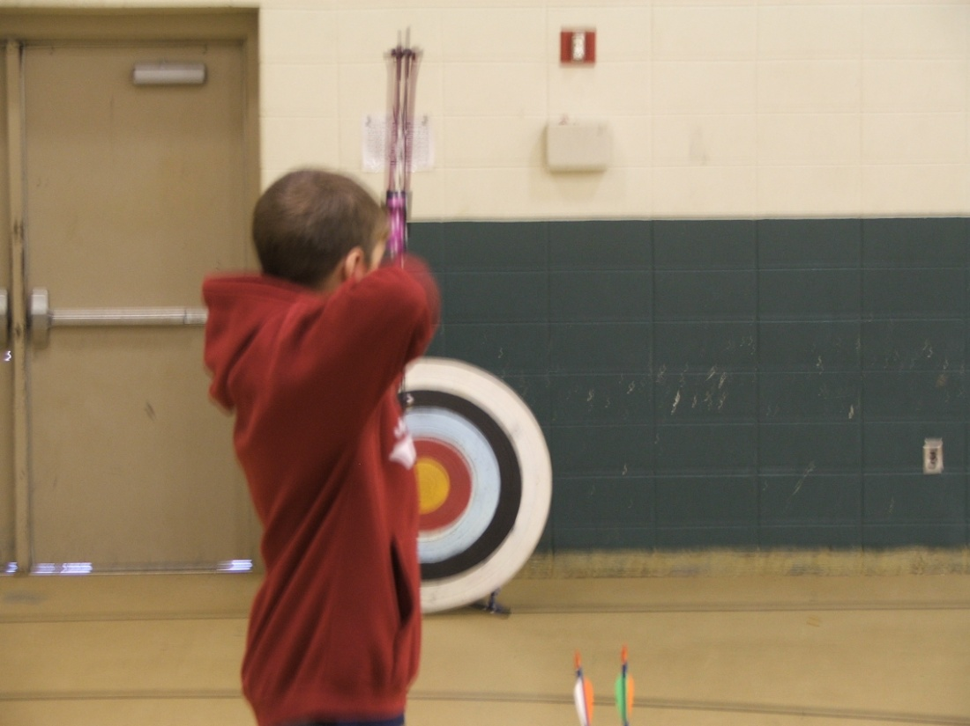
Other Aspects
Meager tuition
Move towards sustainability
Constant, constructive communications
Safe, secure environment
Operates only on school days
Periodic state evaluation
Advisory Committee support

Slide 26
Major Concerns
Meeting Time/Schedules
Thinking Outside the Box
Budgets and Spending Money

Slide 27
Questions?
Thank you for your kind attention!
Carol Kelly
carol.kelly@elmore.k12.al.us
www.elmoreco.com Select Other Programs

