Slide 1
Honor's Day
Randolph Clay High School

Slide 3
Literature and Languages Awards

Slide 4
Best in 9th Grade Lit/Com
Carlissa Baldwin

Slide 5
Best in 10th Grade Lit/Com
Markel Rainey

Slide 6
Best in American Literature
Quentasia Young

Slide 7
Best in British Literature
Mario Starling

Slide 8
Best in Spanish I
Carlissa Baldwin

Slide 9
Best in Spanish II
Aziyah Cannon

Slide 10
Best in Mathemetics Awards

Slide 11
Best in AMDM
Tyasia Daffin & Shynetrius Buster

Slide 12
Best in Algebra I
Gary Johnson

Slide 13
Best in Advanced Algebra
Quentasia Young & Aziyah Cannon

Slide 14
Best in Geometry
MyKel Rainey

Slide 15
Best in Foundations of Algebra
Tatianna Smith

Slide 16
Best in Pre-Calculus
Keri Davis

Slide 17
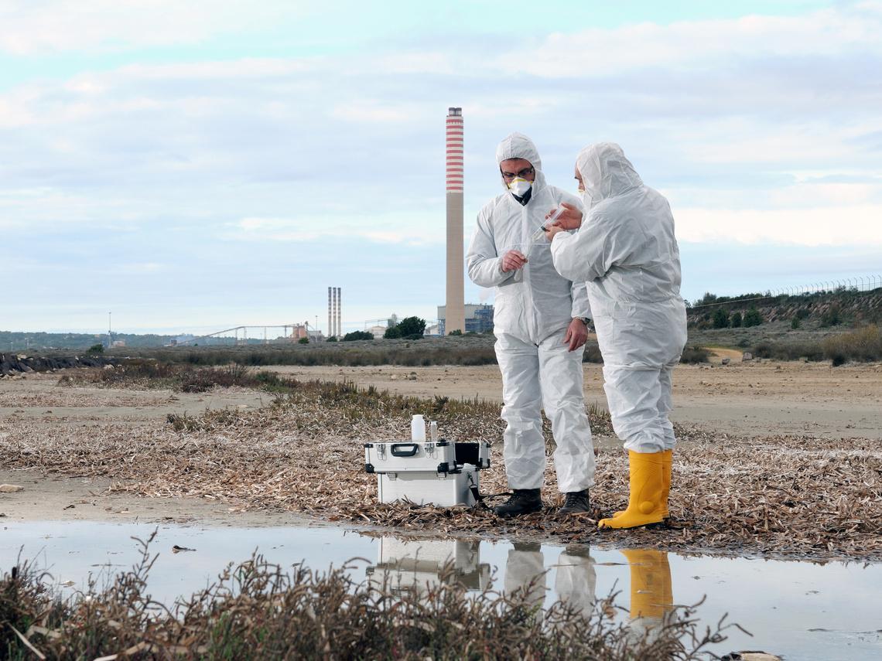
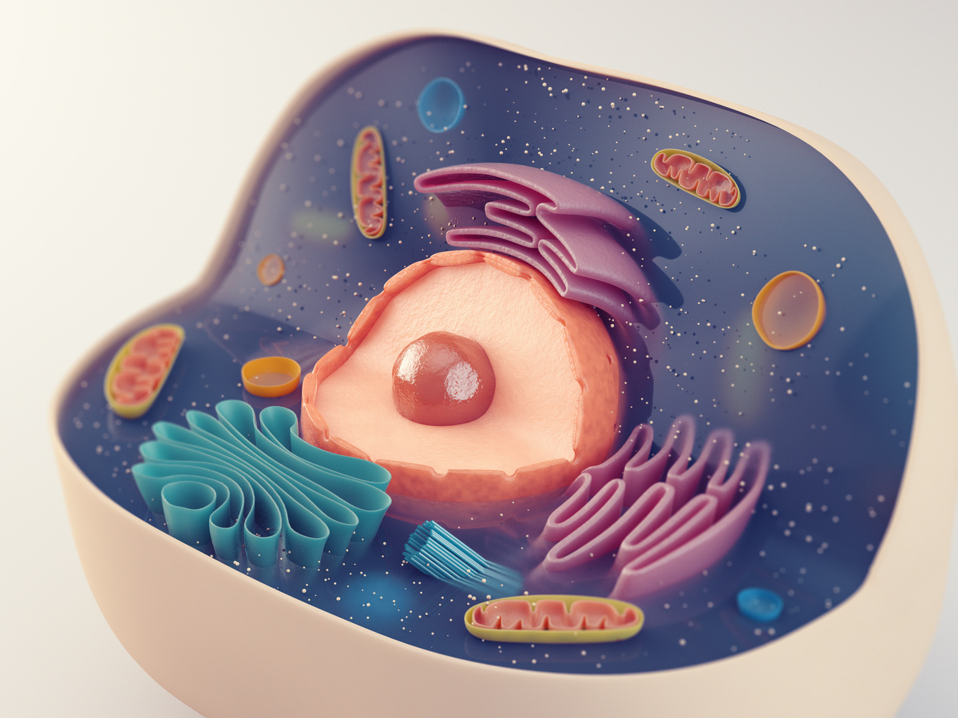
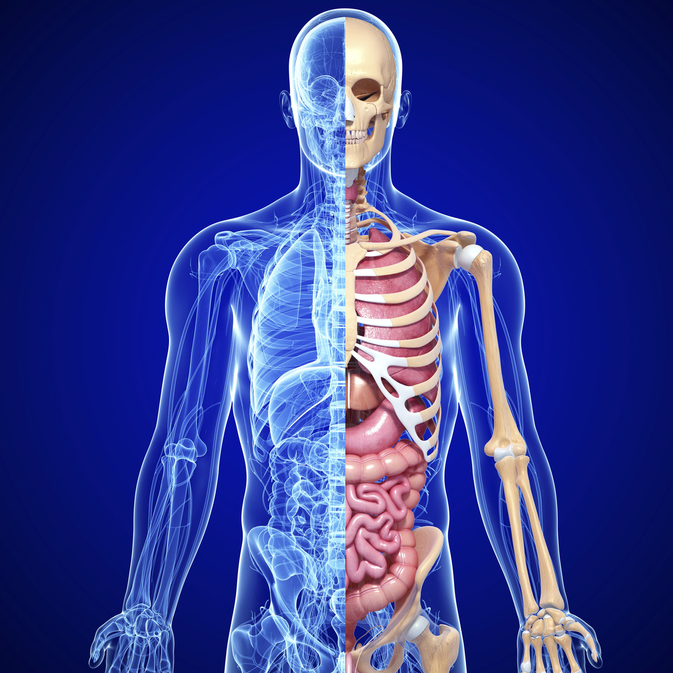
Best in Sciences Awards

Slide 18
Best in Environmental Science
Quentasia Young & Makeyah Graham

Slide 19
Best in Physical Science
Ajane Smart

Slide 20
Best in Biology
Tyroniesha Smith &
Jy'Quan Smith

Slide 21
Best in Human Anatomy and Physiology
Natasha Jones &
Tramaine Lewis

Slide 22
Best in
Social Studies
Awards

Slide 23
Best in American Government
Aziyah Cannon & Makeyah Graham

Slide 24
Best in Personal Finance
Aziyah Cannon

Slide 25
Best in Economics
Keri Davis

Slide 26
Best in World History
Janiyah McIntyre

Slide 27
Best in World History
Janiyah McIntyre

Slide 28
Best in Career
Technical and
Agricultural
Education
Awards

Slide 29
Best in Examining the Teaching Profession
Taniasya Pitts, Tanijiya Pitts, Ja'Niya Flowers, Kenya Grooms, Key'Voisie Johnson, Natia Kemp, Tykera Parkman, Zariya Gudes

Slide 30
Best in Marketing Principles
Sereniti Taylor
Quentasia Young Makayla Williams

Slide 31
Best in Introduction to Business and Technology
Tyasia Daffin

Slide 32
Best in Business and Technology
Denayshia Morgan

Slide 33
Best in Business Communications
Cielo Sanchez

Slide 34
Best in Basic Agriculture
Makayla Williams

Slide 35
Best in General Horticulture and Plant Science
Makayla Williams

Slide 36
Best in Nursery and Landscape
Tyasia Daffin

Slide 37
Best in Introduction to Graphic Design
Aziyah Cannon, Tony Nunnally, and Jalen Howard

Slide 38
Best in Music

Slide 39
Best in Music Appreciation 1A
Jayden Farrington

Slide 40
Best in Music Appreciation 3A
Aziyah Cannon
&
Quentasia Young

Slide 41
Best in Band I
Ciera Goins

Slide 42
Best in Band II
Adriana Walton

Slide 43
Best in Band III
Ellis Green

Slide 44
Band
Outstanding Performance
Adriana Walton

Slide 45
Best in Physical Education

Slide 46
Best in Health
Natasha Jones

Slide 47
Best in Personal Fitness
Tramaine Jones

Slide 48
Best in Team Sports
Bryannah Porter

Slide 49
Best in Advanced Team Sports
Noah Jackson

Slide 50
Best in Weight Training
Seron Jones

Slide 51
High Growth Award
Jalen Jackson

Slide 52
School wide Highest Growth Award
Day'vionna Nunnally

Slide 53
Participation
9th Grade
Markel Womack
&
De'Camron Williams

Slide 54
Participation
11th Grade
Ramel Thomas
&
Fredeaja Johnson

Slide 55
Good Citizenship
9th Grade
Key'Voisia Johnson

Slide 56
Good Citizenship
10th Grade
Tamia Hardy

Slide 57
Good Citizenship
11th Grade
India Hart

Slide 58
Good Citizenship
12th Grade
Tony Nunnally

Slide 59
American History Award
Aziyah Cannon
& Makeyah Graham

Slide 60
Benjamin Hawkins Chapter
Good Citizenship
Natasha Jones

Slide 61
Golden Apple Awards

Slide 62
Golden Apple Award
Natasha Jones
Mrs. Rosaland Snelling

Slide 63
Golden Apple Award
Tramaine Lewis
Ms. Shakeythia Cooper

Slide 64
Golden Apple Award
Keri Davis
Ms. Sommier Thomas

Slide 65
Golden Apple Award
Ajanae Smart
Mrs. Teresa Teal

Slide 66
Golden Apple Award
Mario Starling
Mrs. Teresa Teal

Slide 67
Golden Apple Award
Sereniti Taylor
Ms. Temeisha Moore

Slide 68
Golden Apple Award
Cielo Sanchez
Mrs. Teresa Teal

Slide 69
Golden Apple Award
Seron Jones
Ms. Temeisha Moore

Slide 70
Class of 2021

Slide 71
Salutatiorian

Slide 72
Tramaine Lewis

Slide 73
Valedictorian

Slide 74
Natasha Jones

Slide 75
!!!!!!Important Reminders!!!!!
Summer School
June 1 – 30, 2021
Open House
July 29, 2021
1st Day of School
August 2, 2021

Slide 76
Thank you for joining us and for your support

