Slide 1
Fry Noun Words
With Pictures

Slide 2
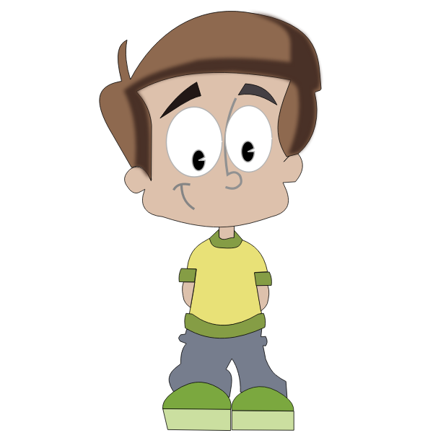
boy

Slide 3
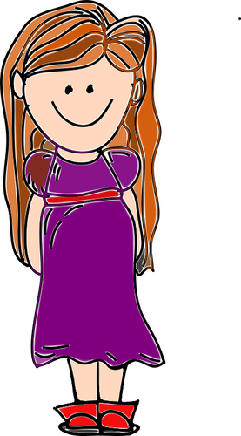
girl

Slide 4
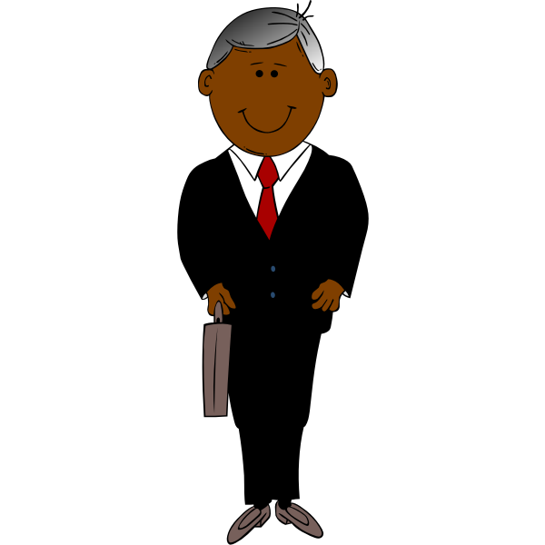
man

Slide 5
woman

Slide 6
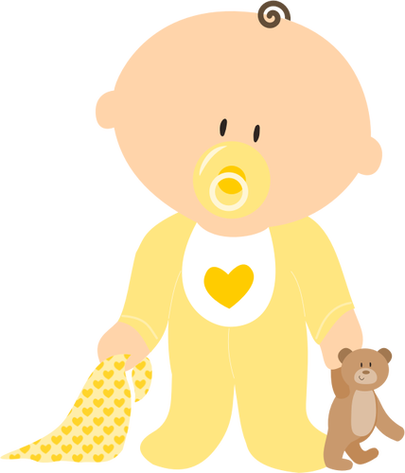
baby

Slide 7
ball

Slide 8
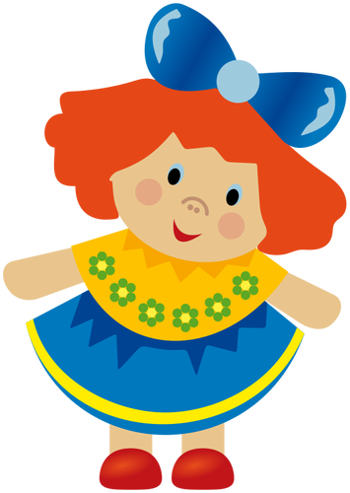
doll

Slide 9
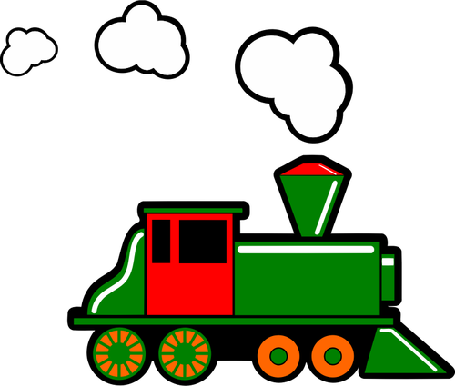
train

Slide 10
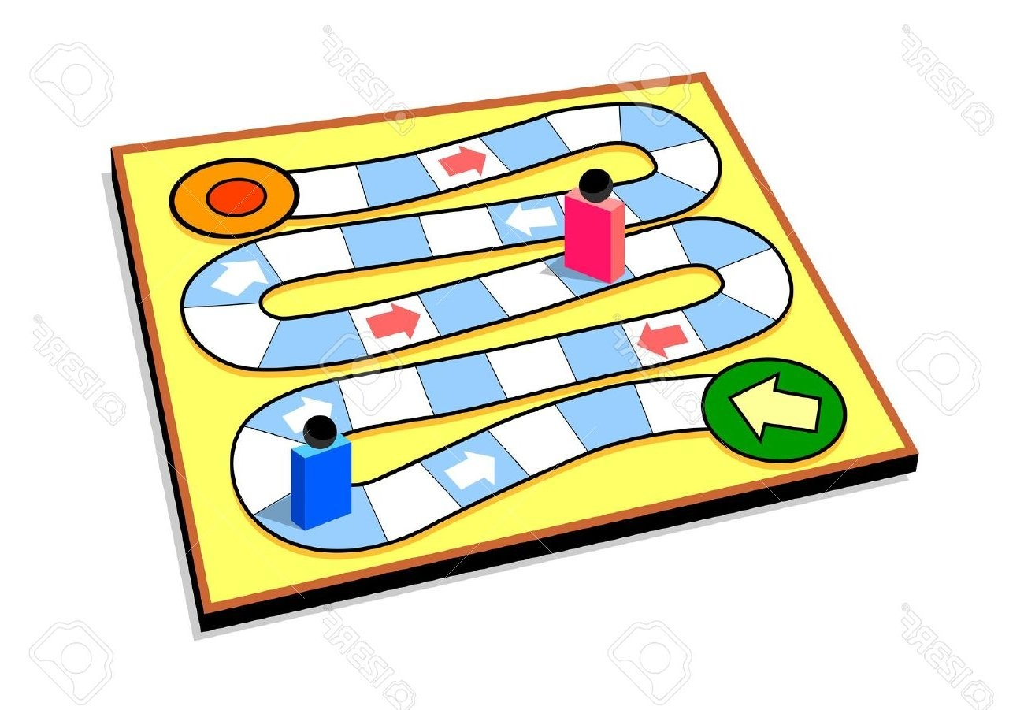
game

Slide 11
toy

Slide 12
one

Slide 13
two

Slide 14
three

Slide 15
four

Slide 16
five

Slide 17
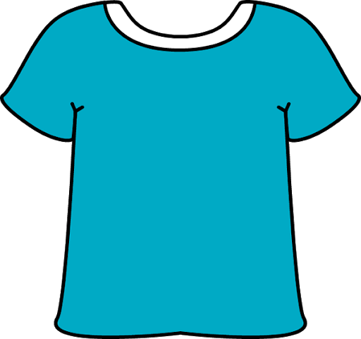
shirt

Slide 18
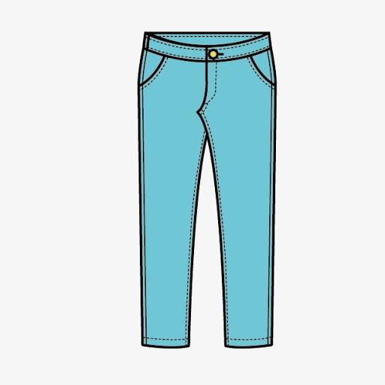
pants

Slide 19
dress

Slide 20
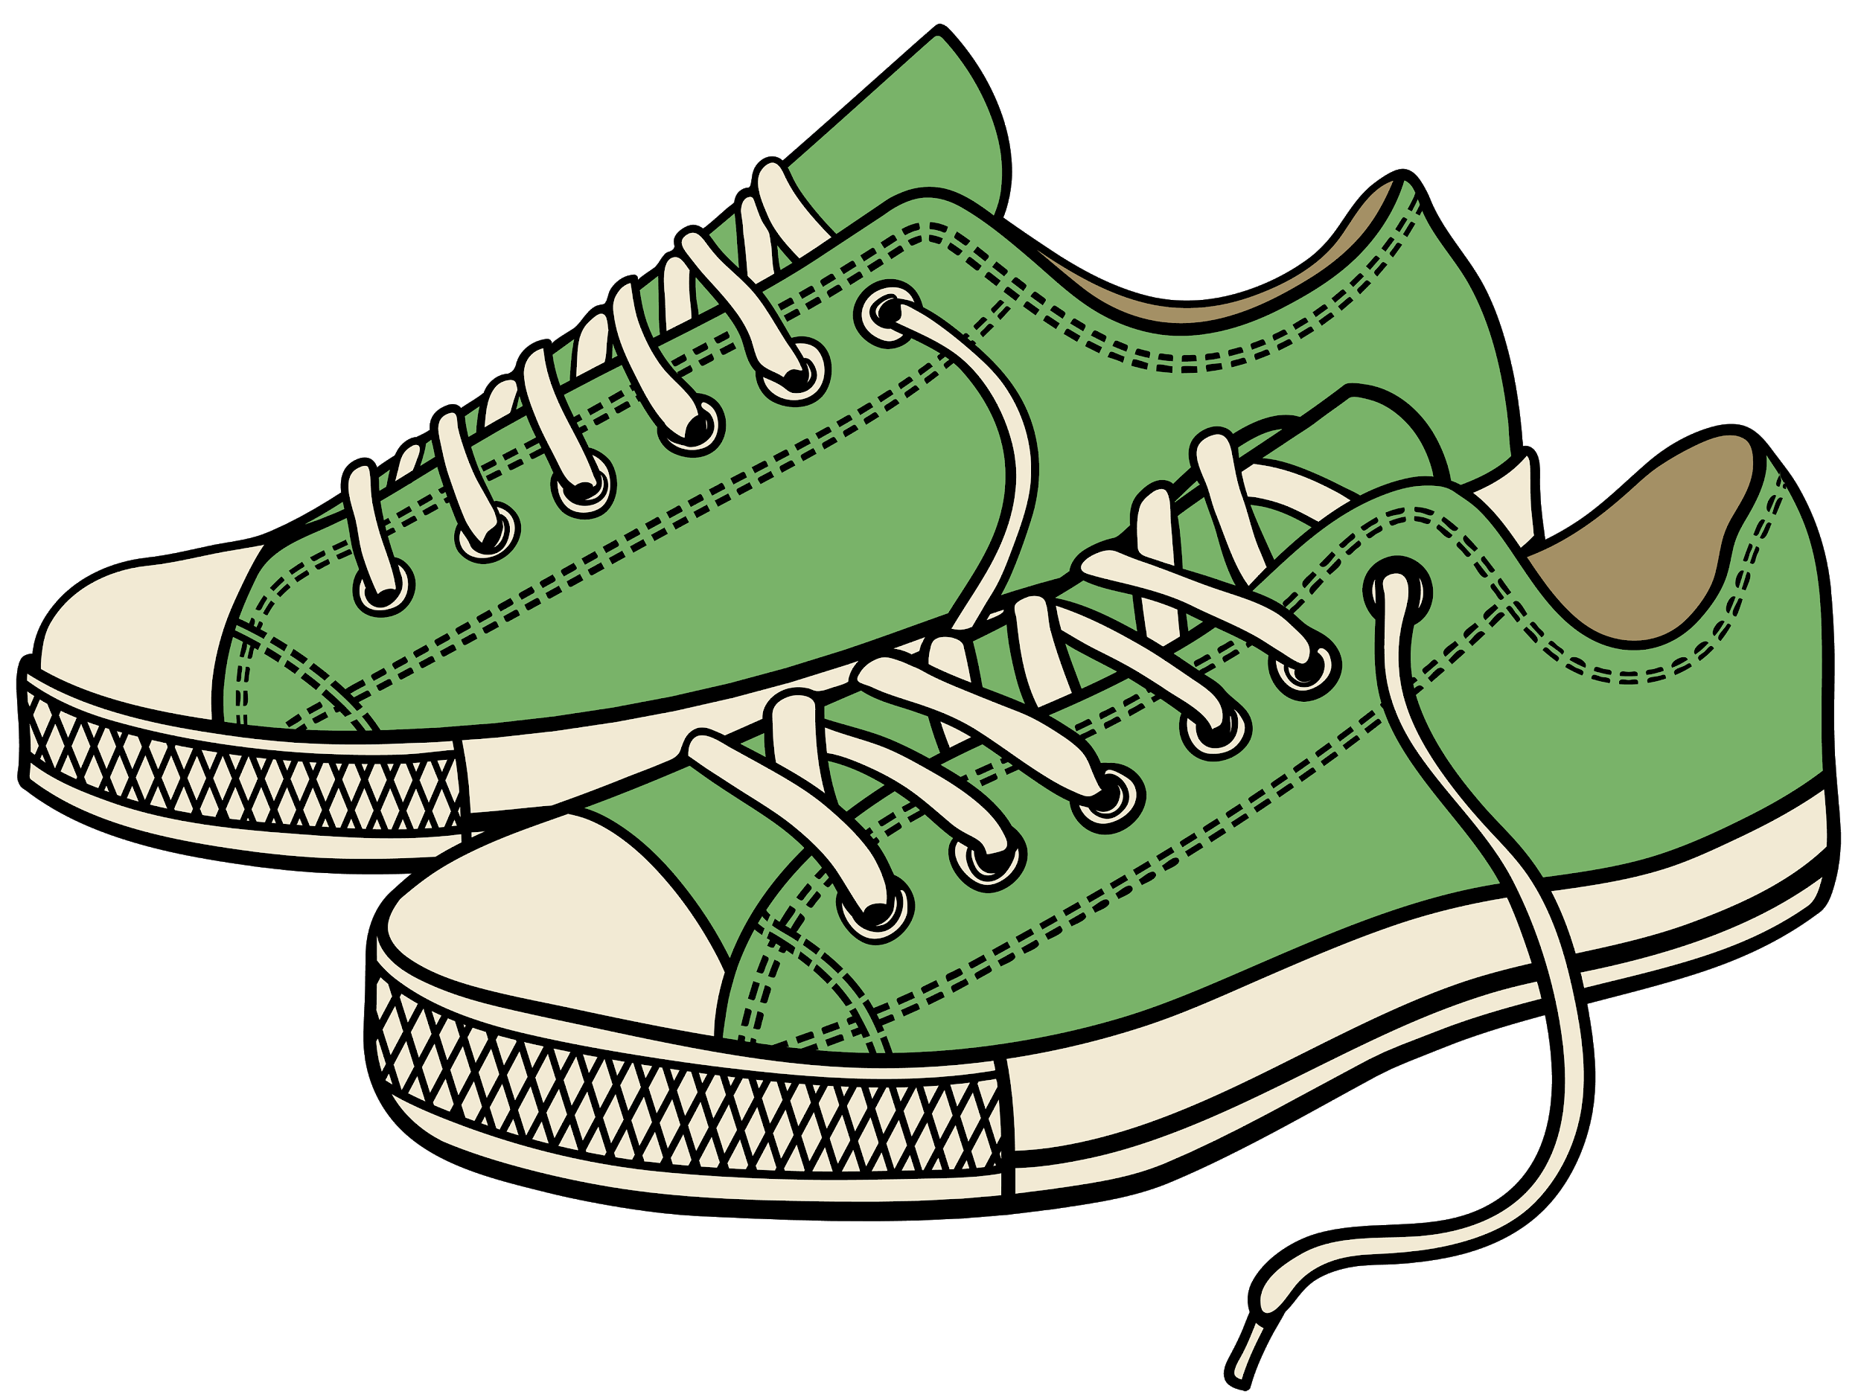
shoes

Slide 21
hat

Slide 22
cat

Slide 23
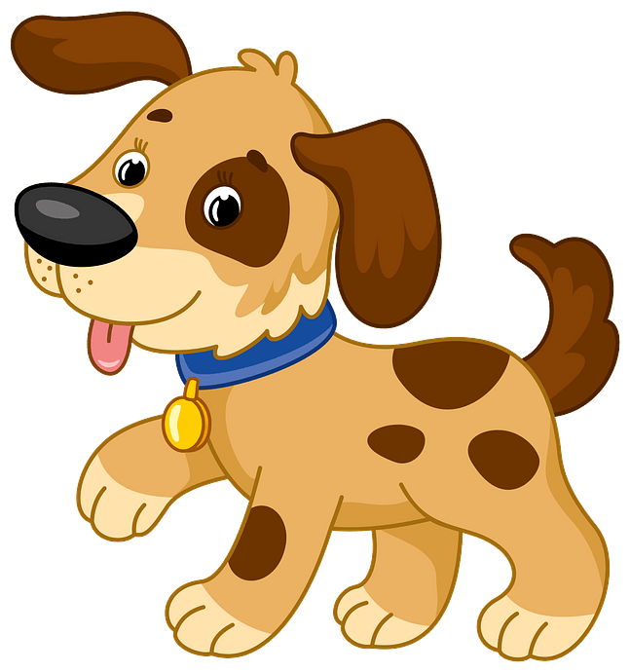
dog

Slide 24
bird

Slide 25
fish

Slide 26
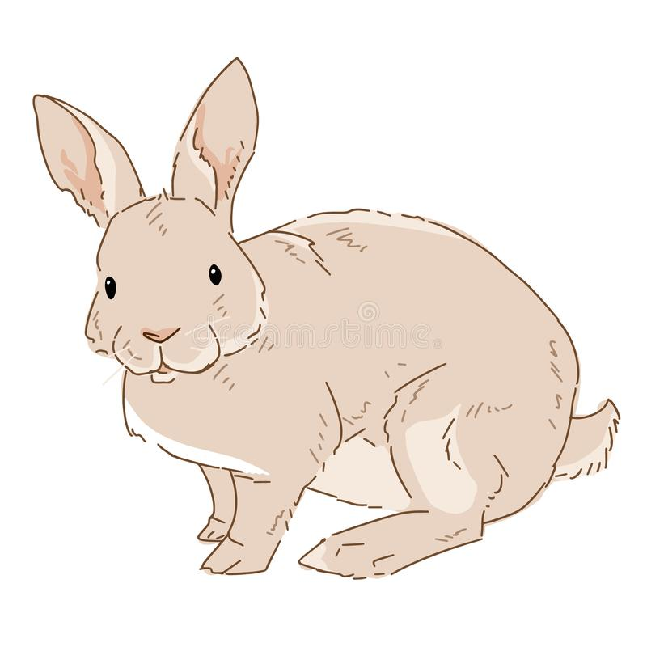
rabbit

Slide 27
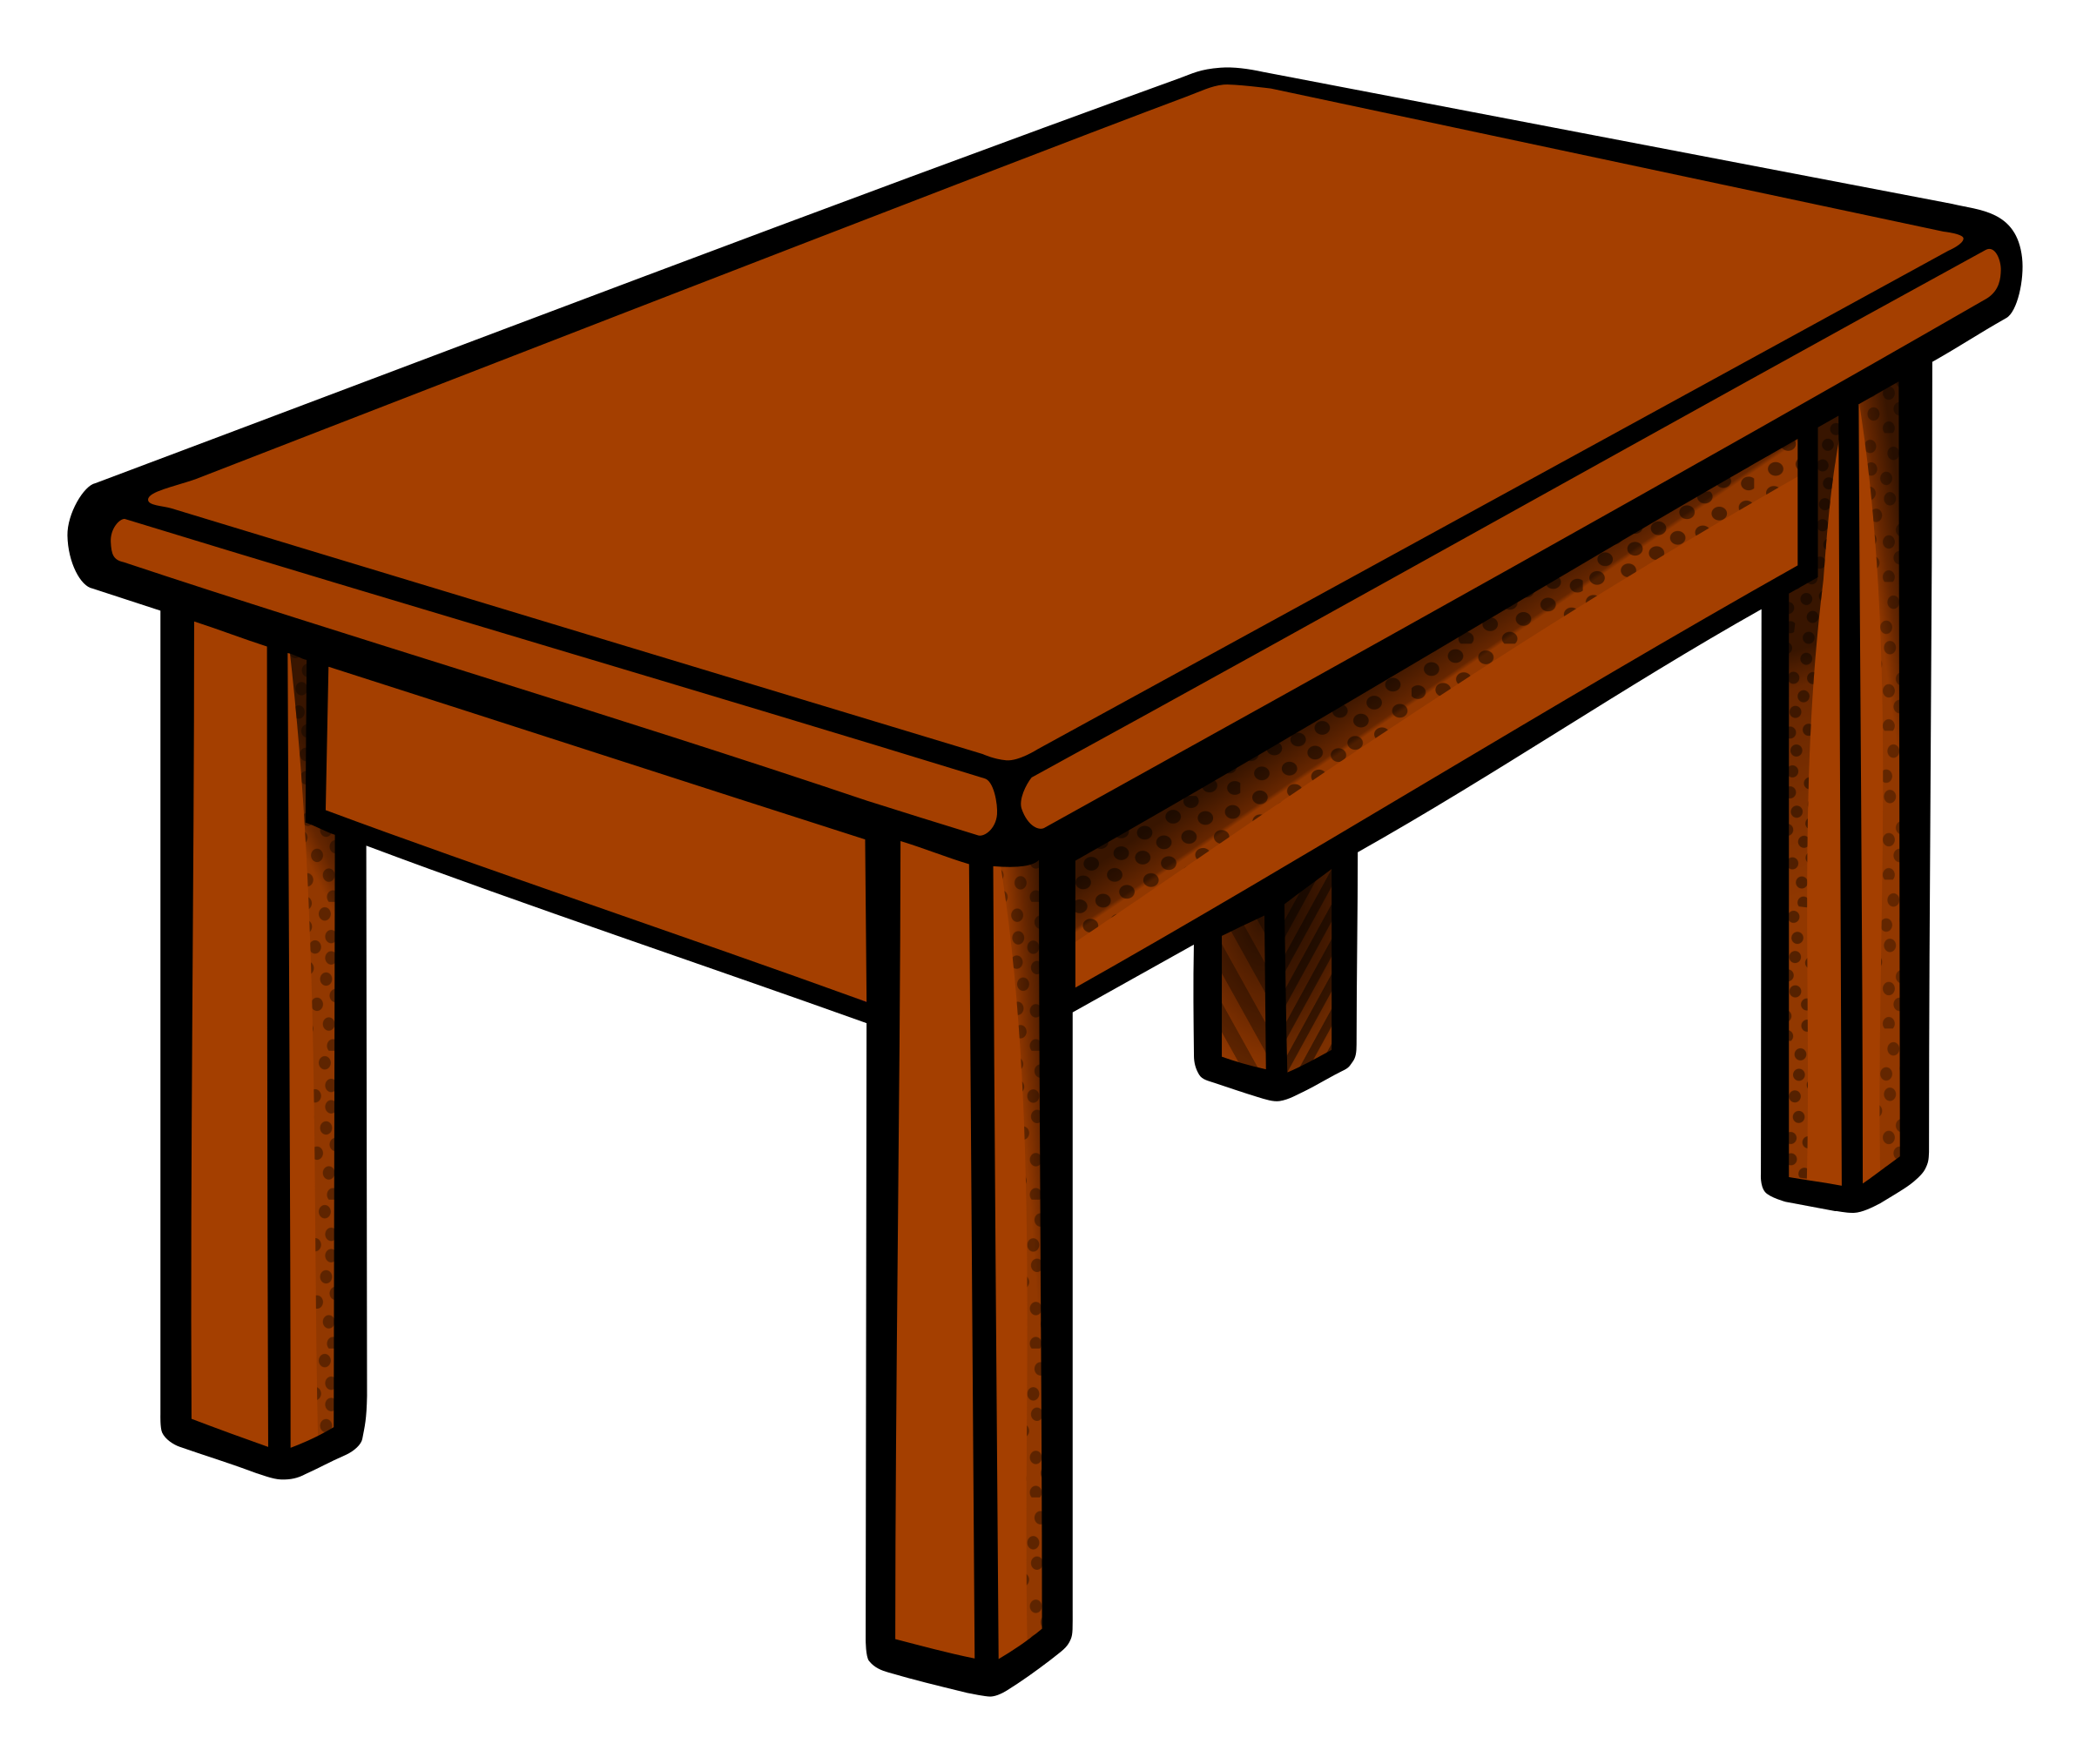
table

Slide 28
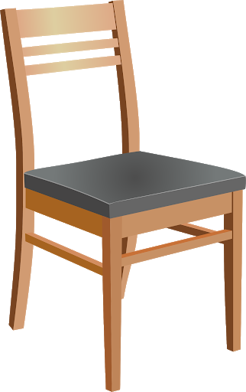
chair

Slide 29
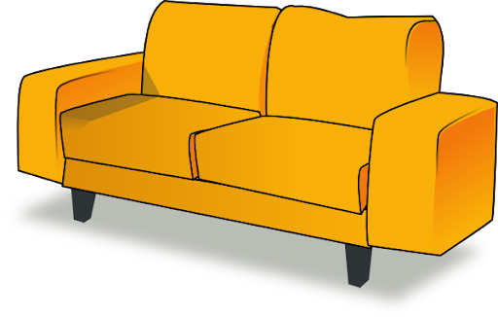
sofa

Slide 30
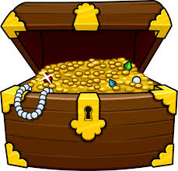
chest

Slide 31
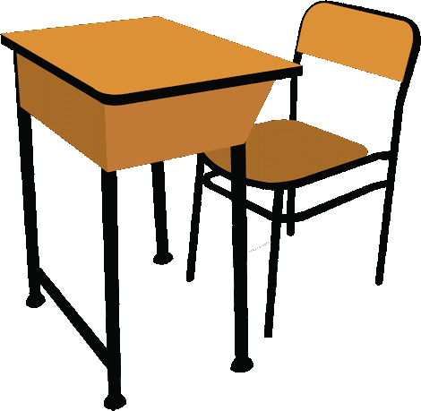
desk

Slide 32
cup

Slide 33
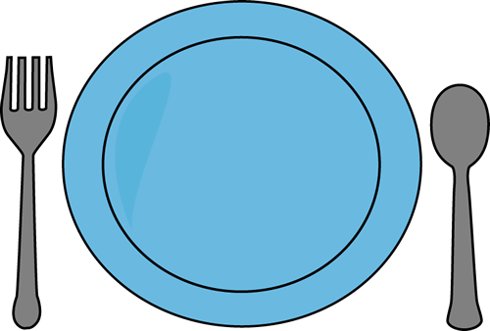
plate

Slide 34
bowl

Slide 35
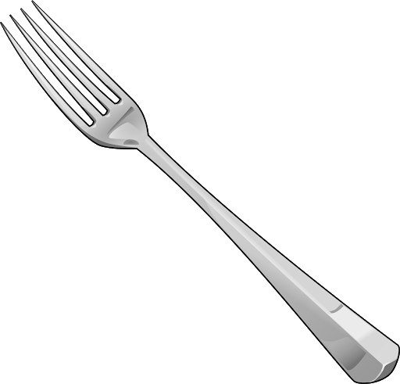
fork

Slide 36
spoon

Slide 37
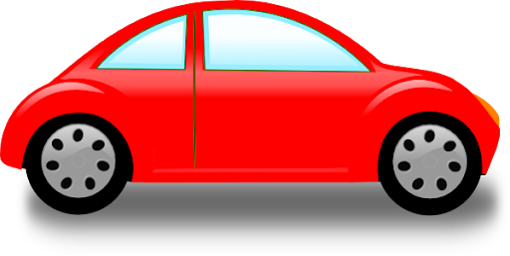
car

Slide 38
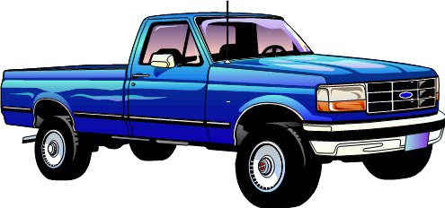
truck

Slide 39
bus

Slide 40
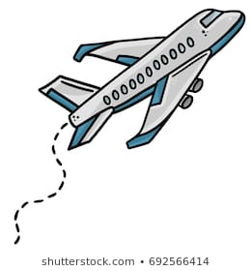
plane

Slide 41
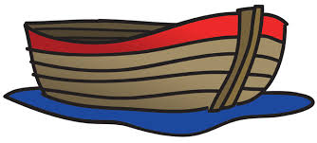
boat

Slide 42
bread

Slide 43
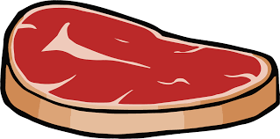
meat

Slide 44
soup

Slide 45
apple

Slide 46
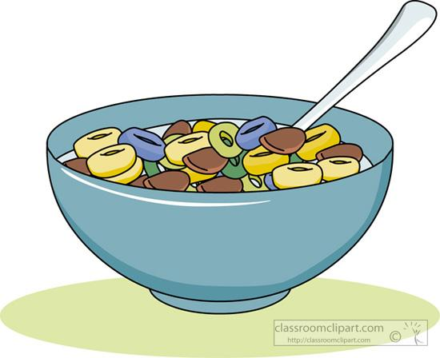
cereal

Slide 47
water

Slide 48
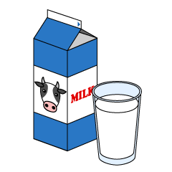
milk

Slide 49
juice

Slide 50
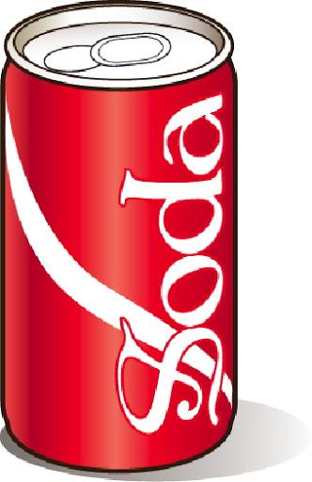
soda

Slide 51
tea

Slide 52
six

Slide 53
seven

Slide 54
eight

Slide 55
nine

Slide 56
ten

Slide 57
fruit

Slide 58
orange

Slide 59
grape

Slide 60
pear

Slide 61
banana

Slide 62
bush

Slide 63
flower

Slide 64
grass

Slide 65
plant

Slide 66
tree

Slide 67
sun

Slide 68
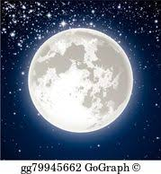
moon

Slide 69
star

Slide 70
cloud

Slide 71
rain

Slide 72
lake

Slide 73
rock

Slide 74
dirt

Slide 75
field

Slide 76
hill

Slide 77
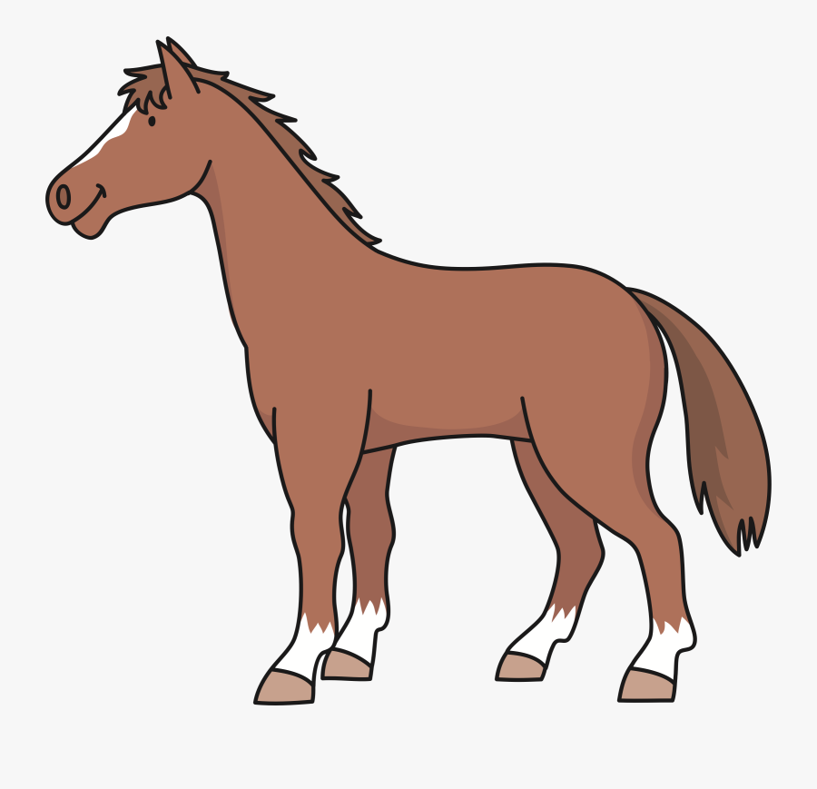
horse

Slide 78
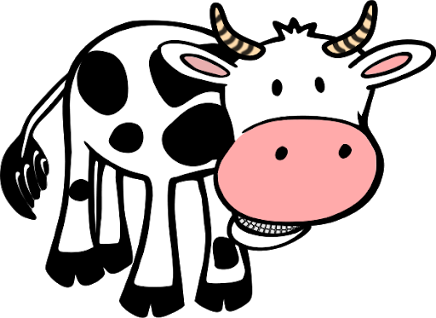
cow

Slide 79
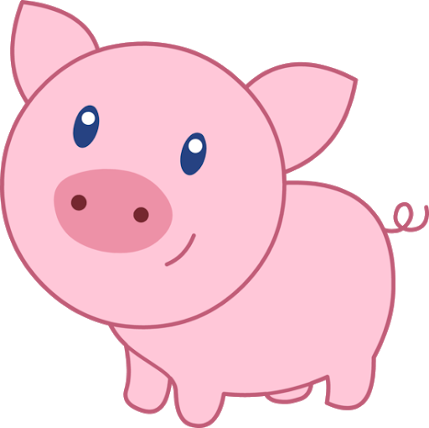
pig

Slide 80
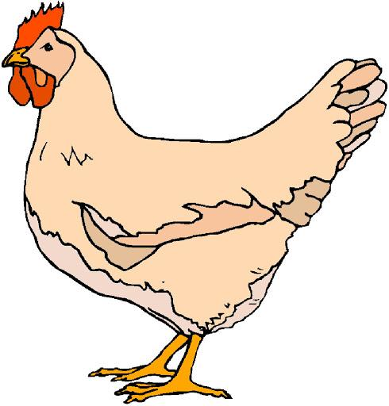
chicken

Slide 81
duck

Slide 82
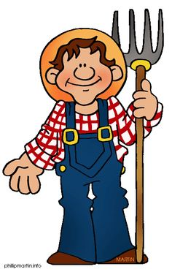
farmer

Slide 83
policeman

Slide 84
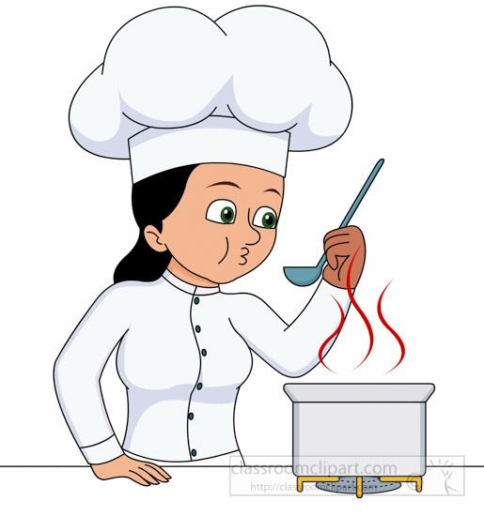
cook

Slide 85
doctor

Slide 86
nurse

Slide 87
television

Slide 88
radio

Slide 89
movie

Slide 90
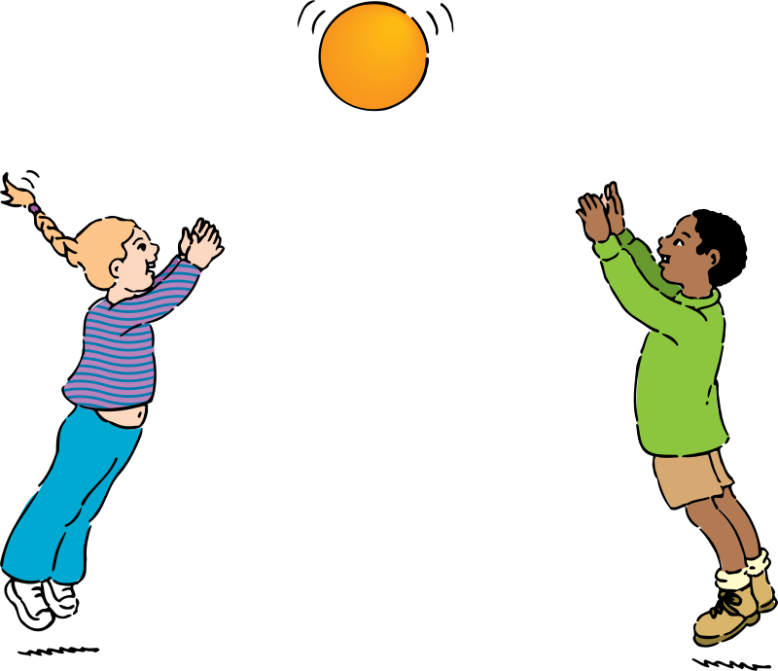
ball game

Slide 91
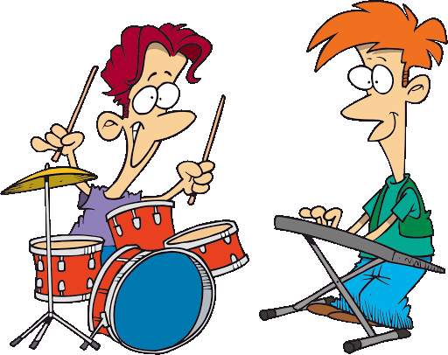
band

Slide 92
pen

Slide 93
pencil

Slide 94
crayon

Slide 95
chalk

Slide 96
computer

Slide 97
book

Slide 98
newspaper

Slide 99
magazine

Slide 100
sign

Slide 101
letter

