Slide 1
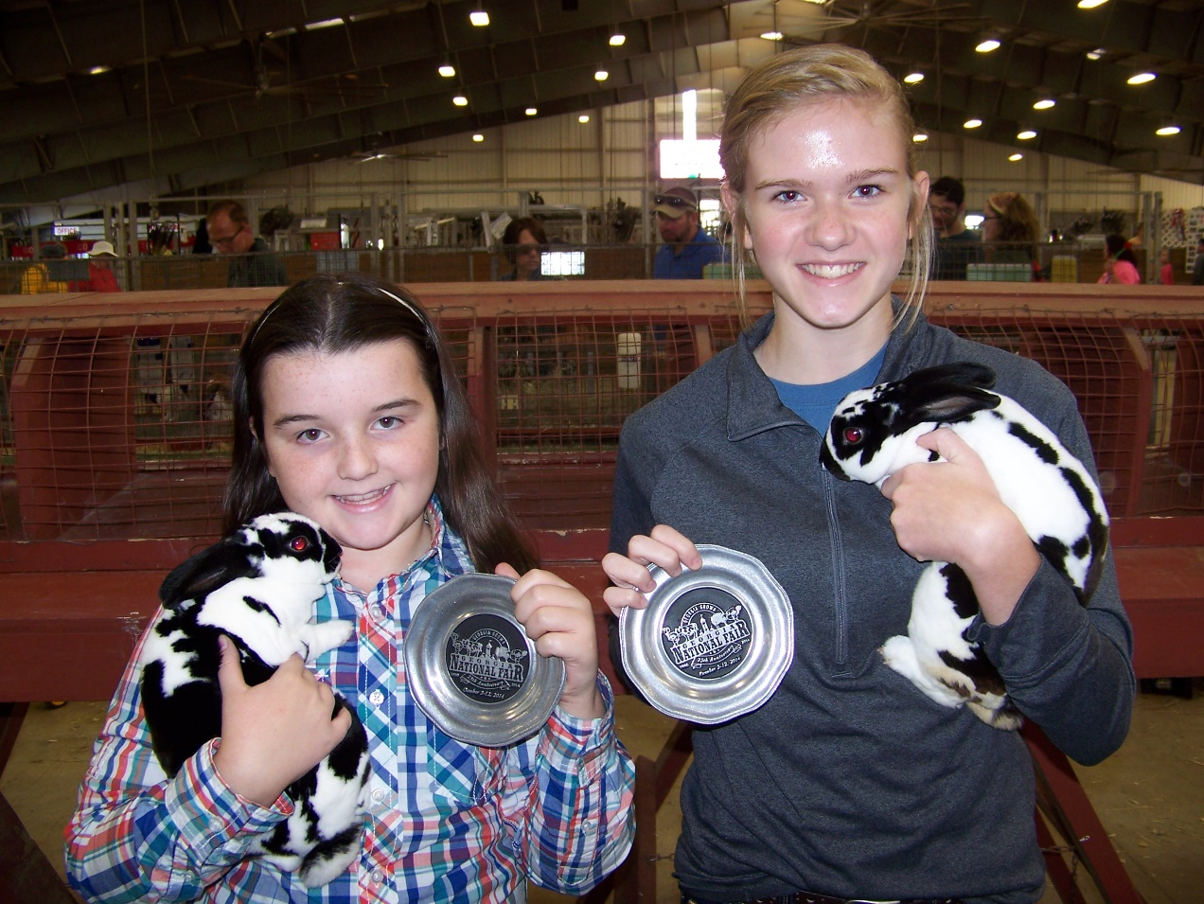
Raising and showing rabbits

Slide 2
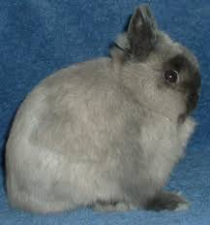
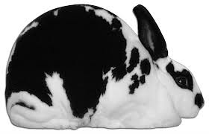
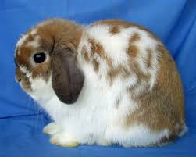
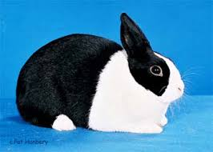
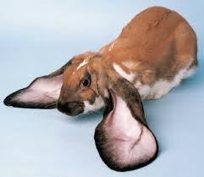
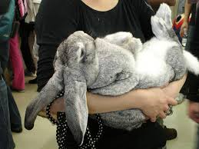
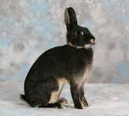
Breed Selection
Factors to Consider:
Breed availability (also consider color if you plan to begin a breeding program)
Is the breed sanctioned
Temperament
Size and resulting cage/facility requirements
Popularity of the breed at shows
www.arba.com

Slide 3
Once you select a breed it is very important that you study the Standard of Perfection for that breed prior to making any purchases. Each breed and color within the breed has characteristics that are considered flaws (points will be deducted at the show table) and disqualifications (rabbit will be dismissed from the show table). Knowing the breed standard will help you to select the best animals possible and protect you and your students from dishonest breeders.

Slide 4
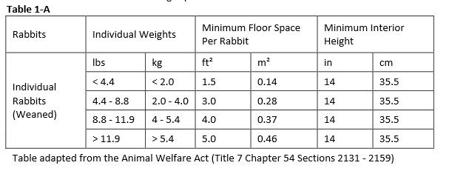
Cage Selection
Source: www.arba.net
Larger cages are required for does with kits

Slide 5
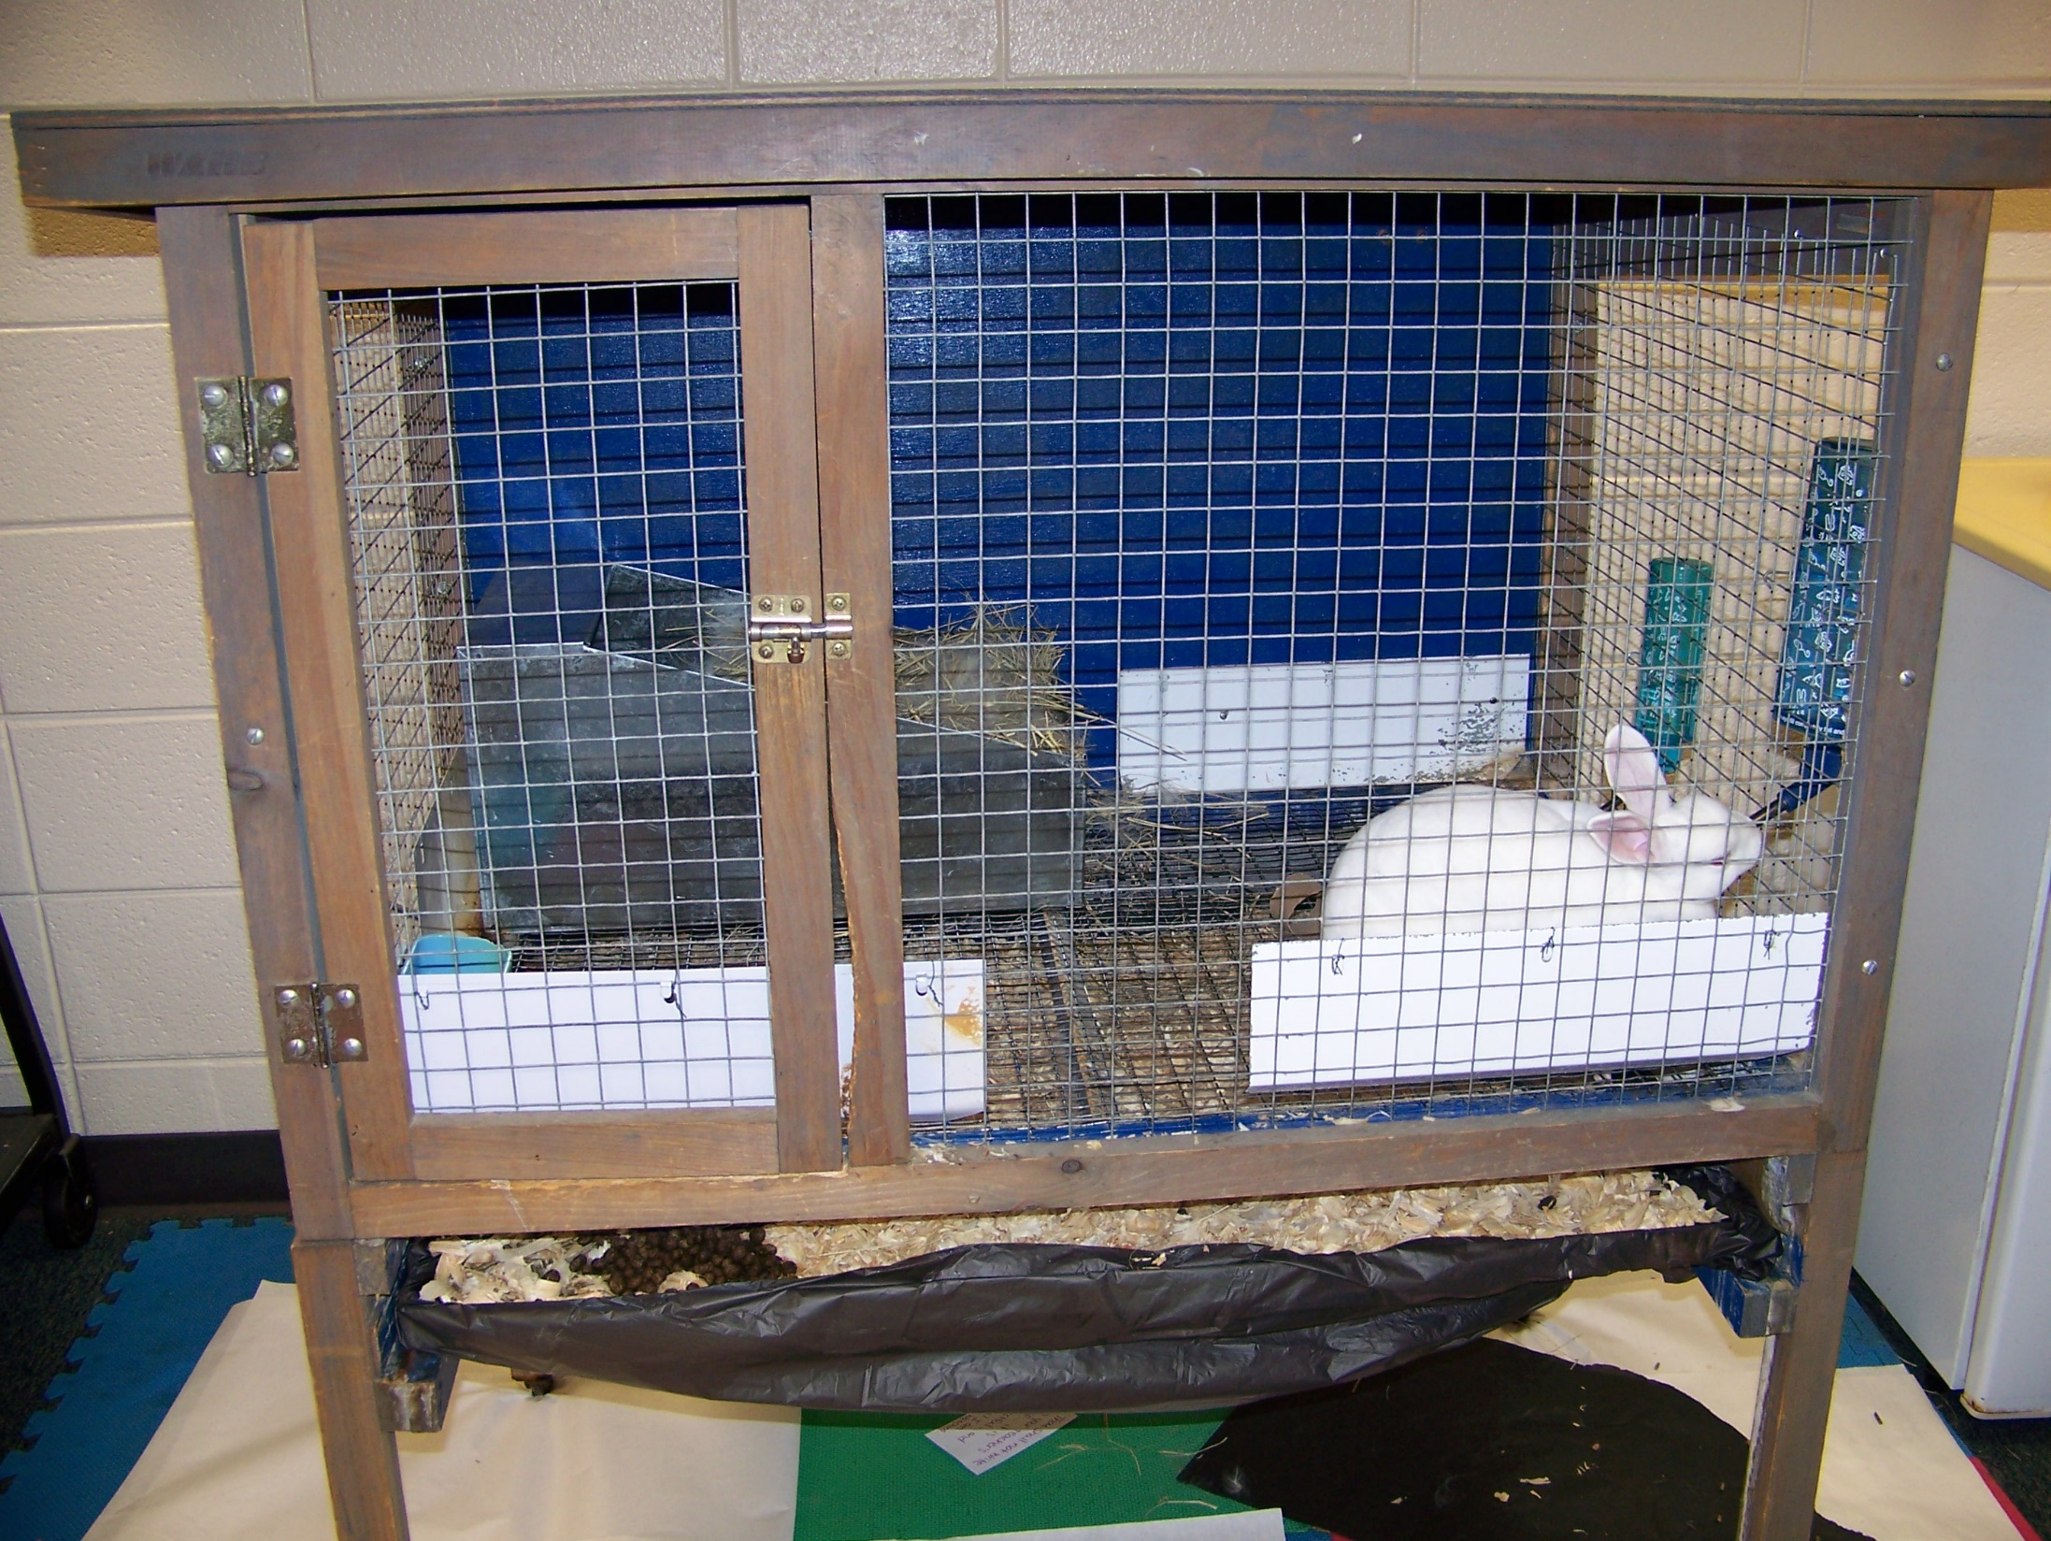

Slide 6
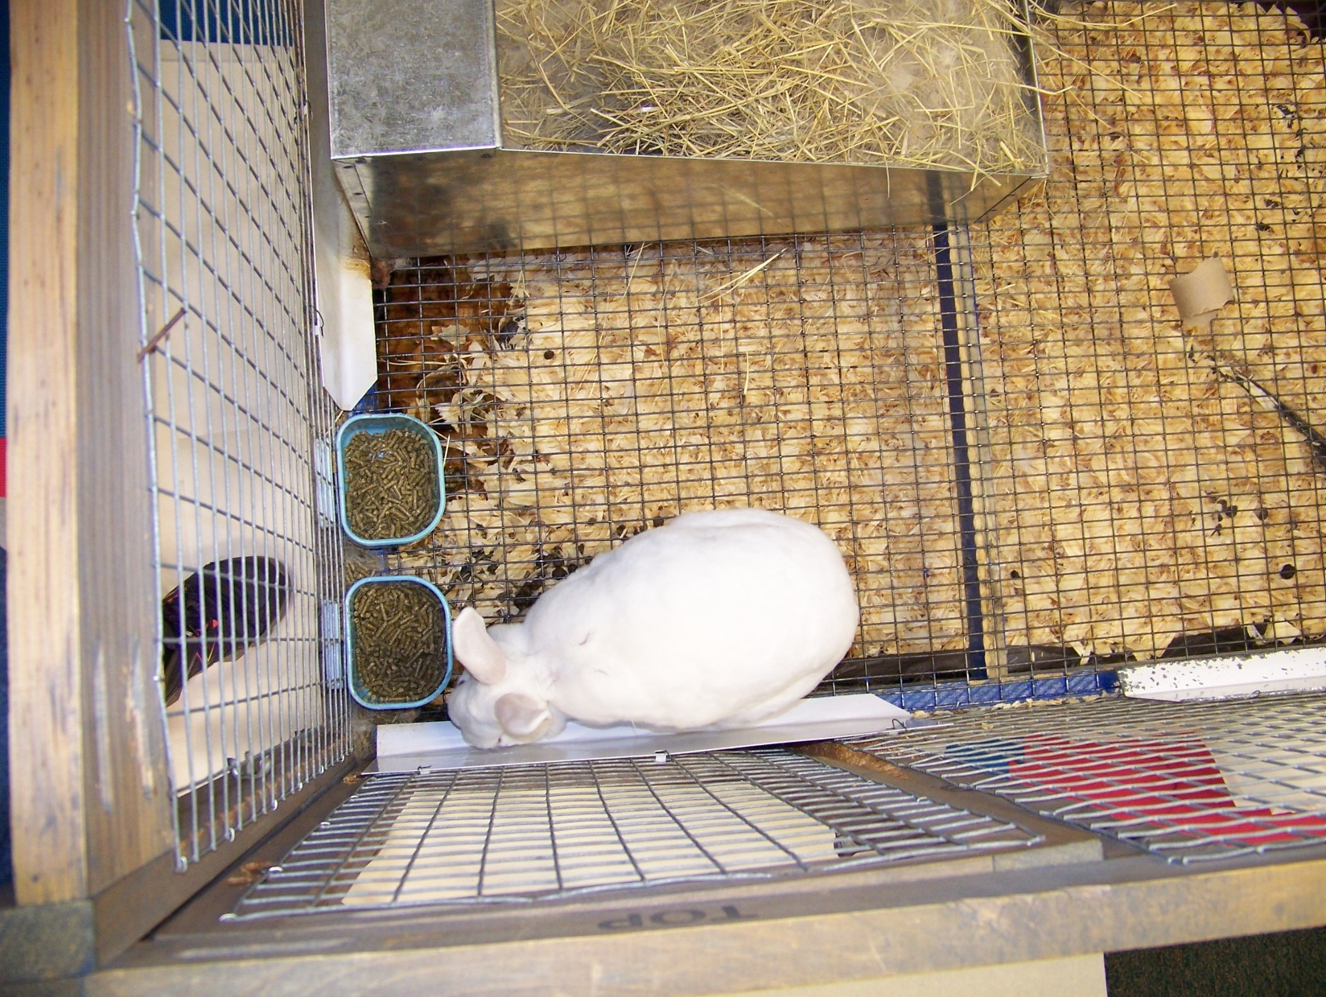

Slide 7
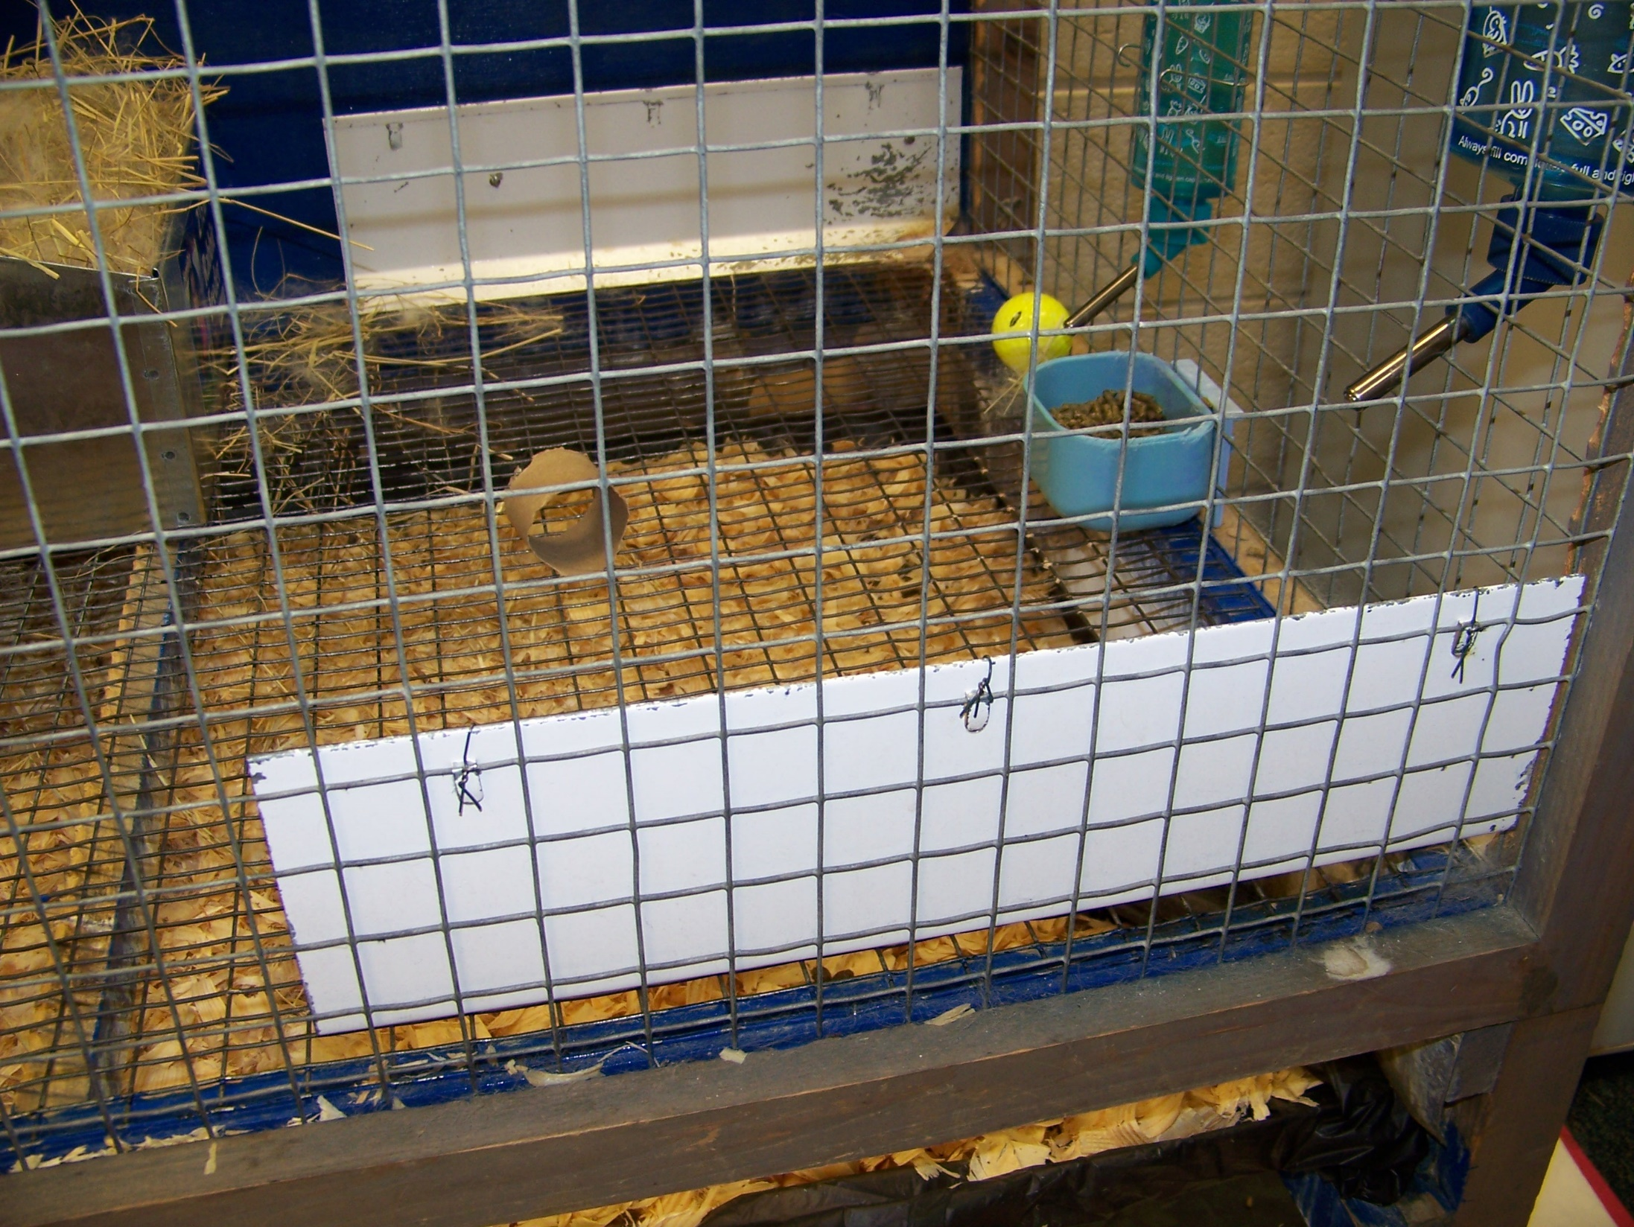

Slide 8
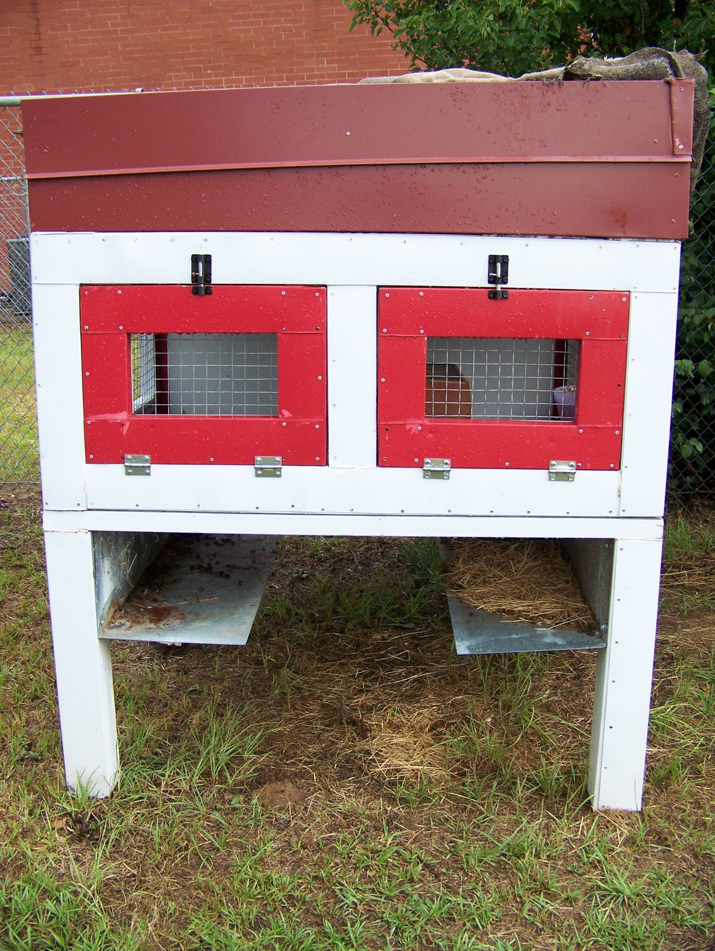
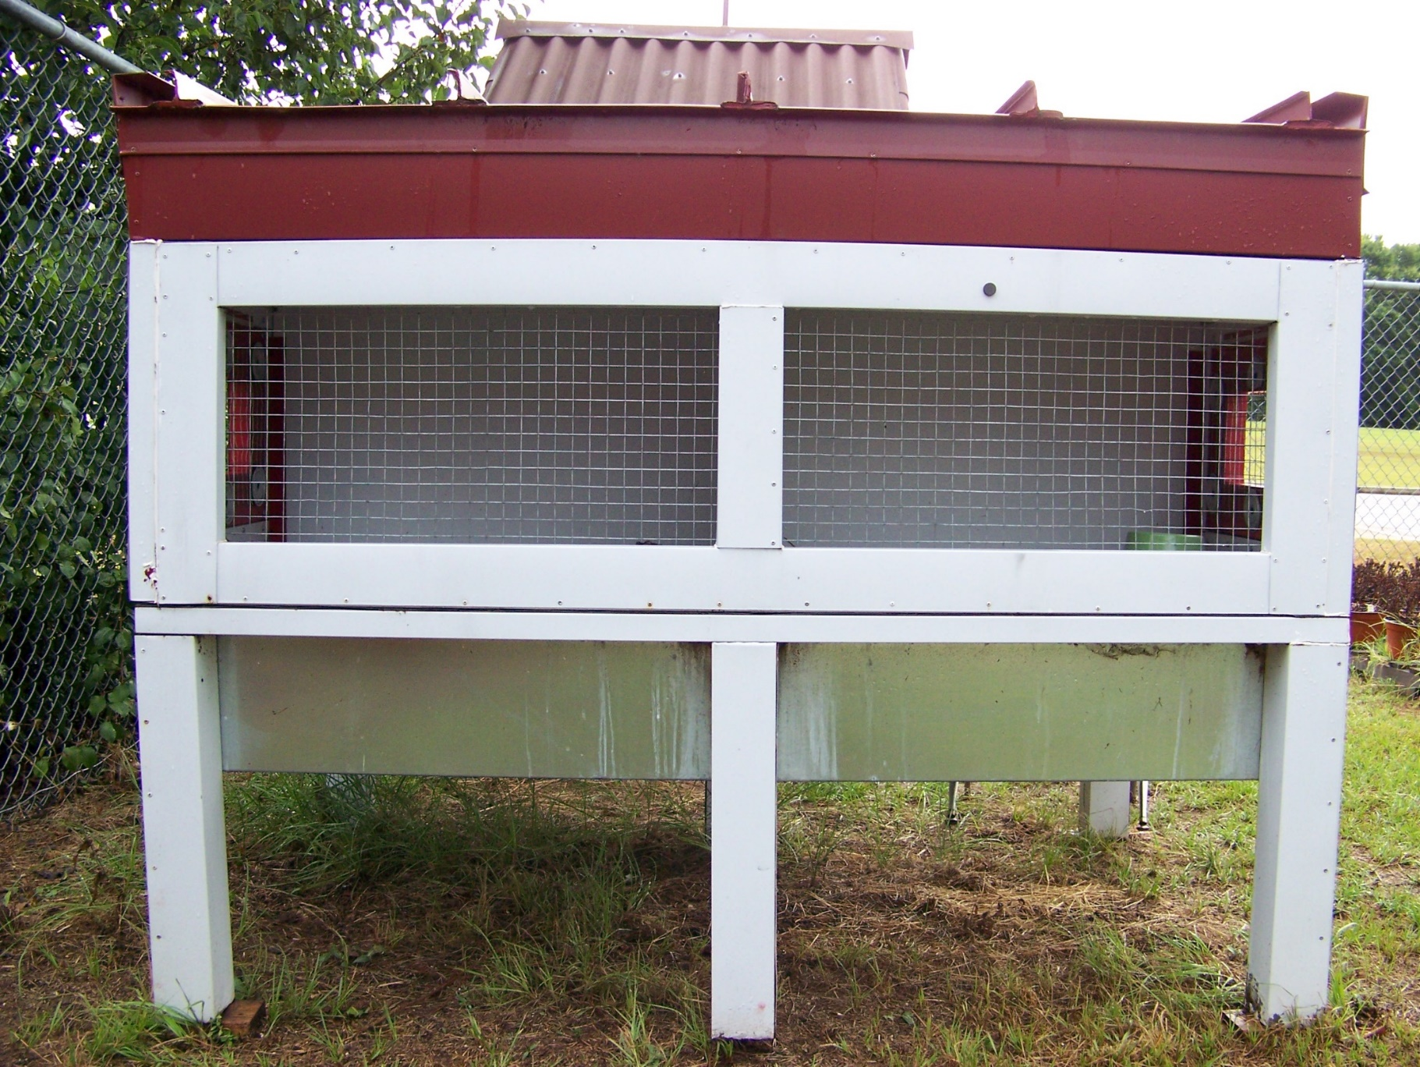

Slide 9
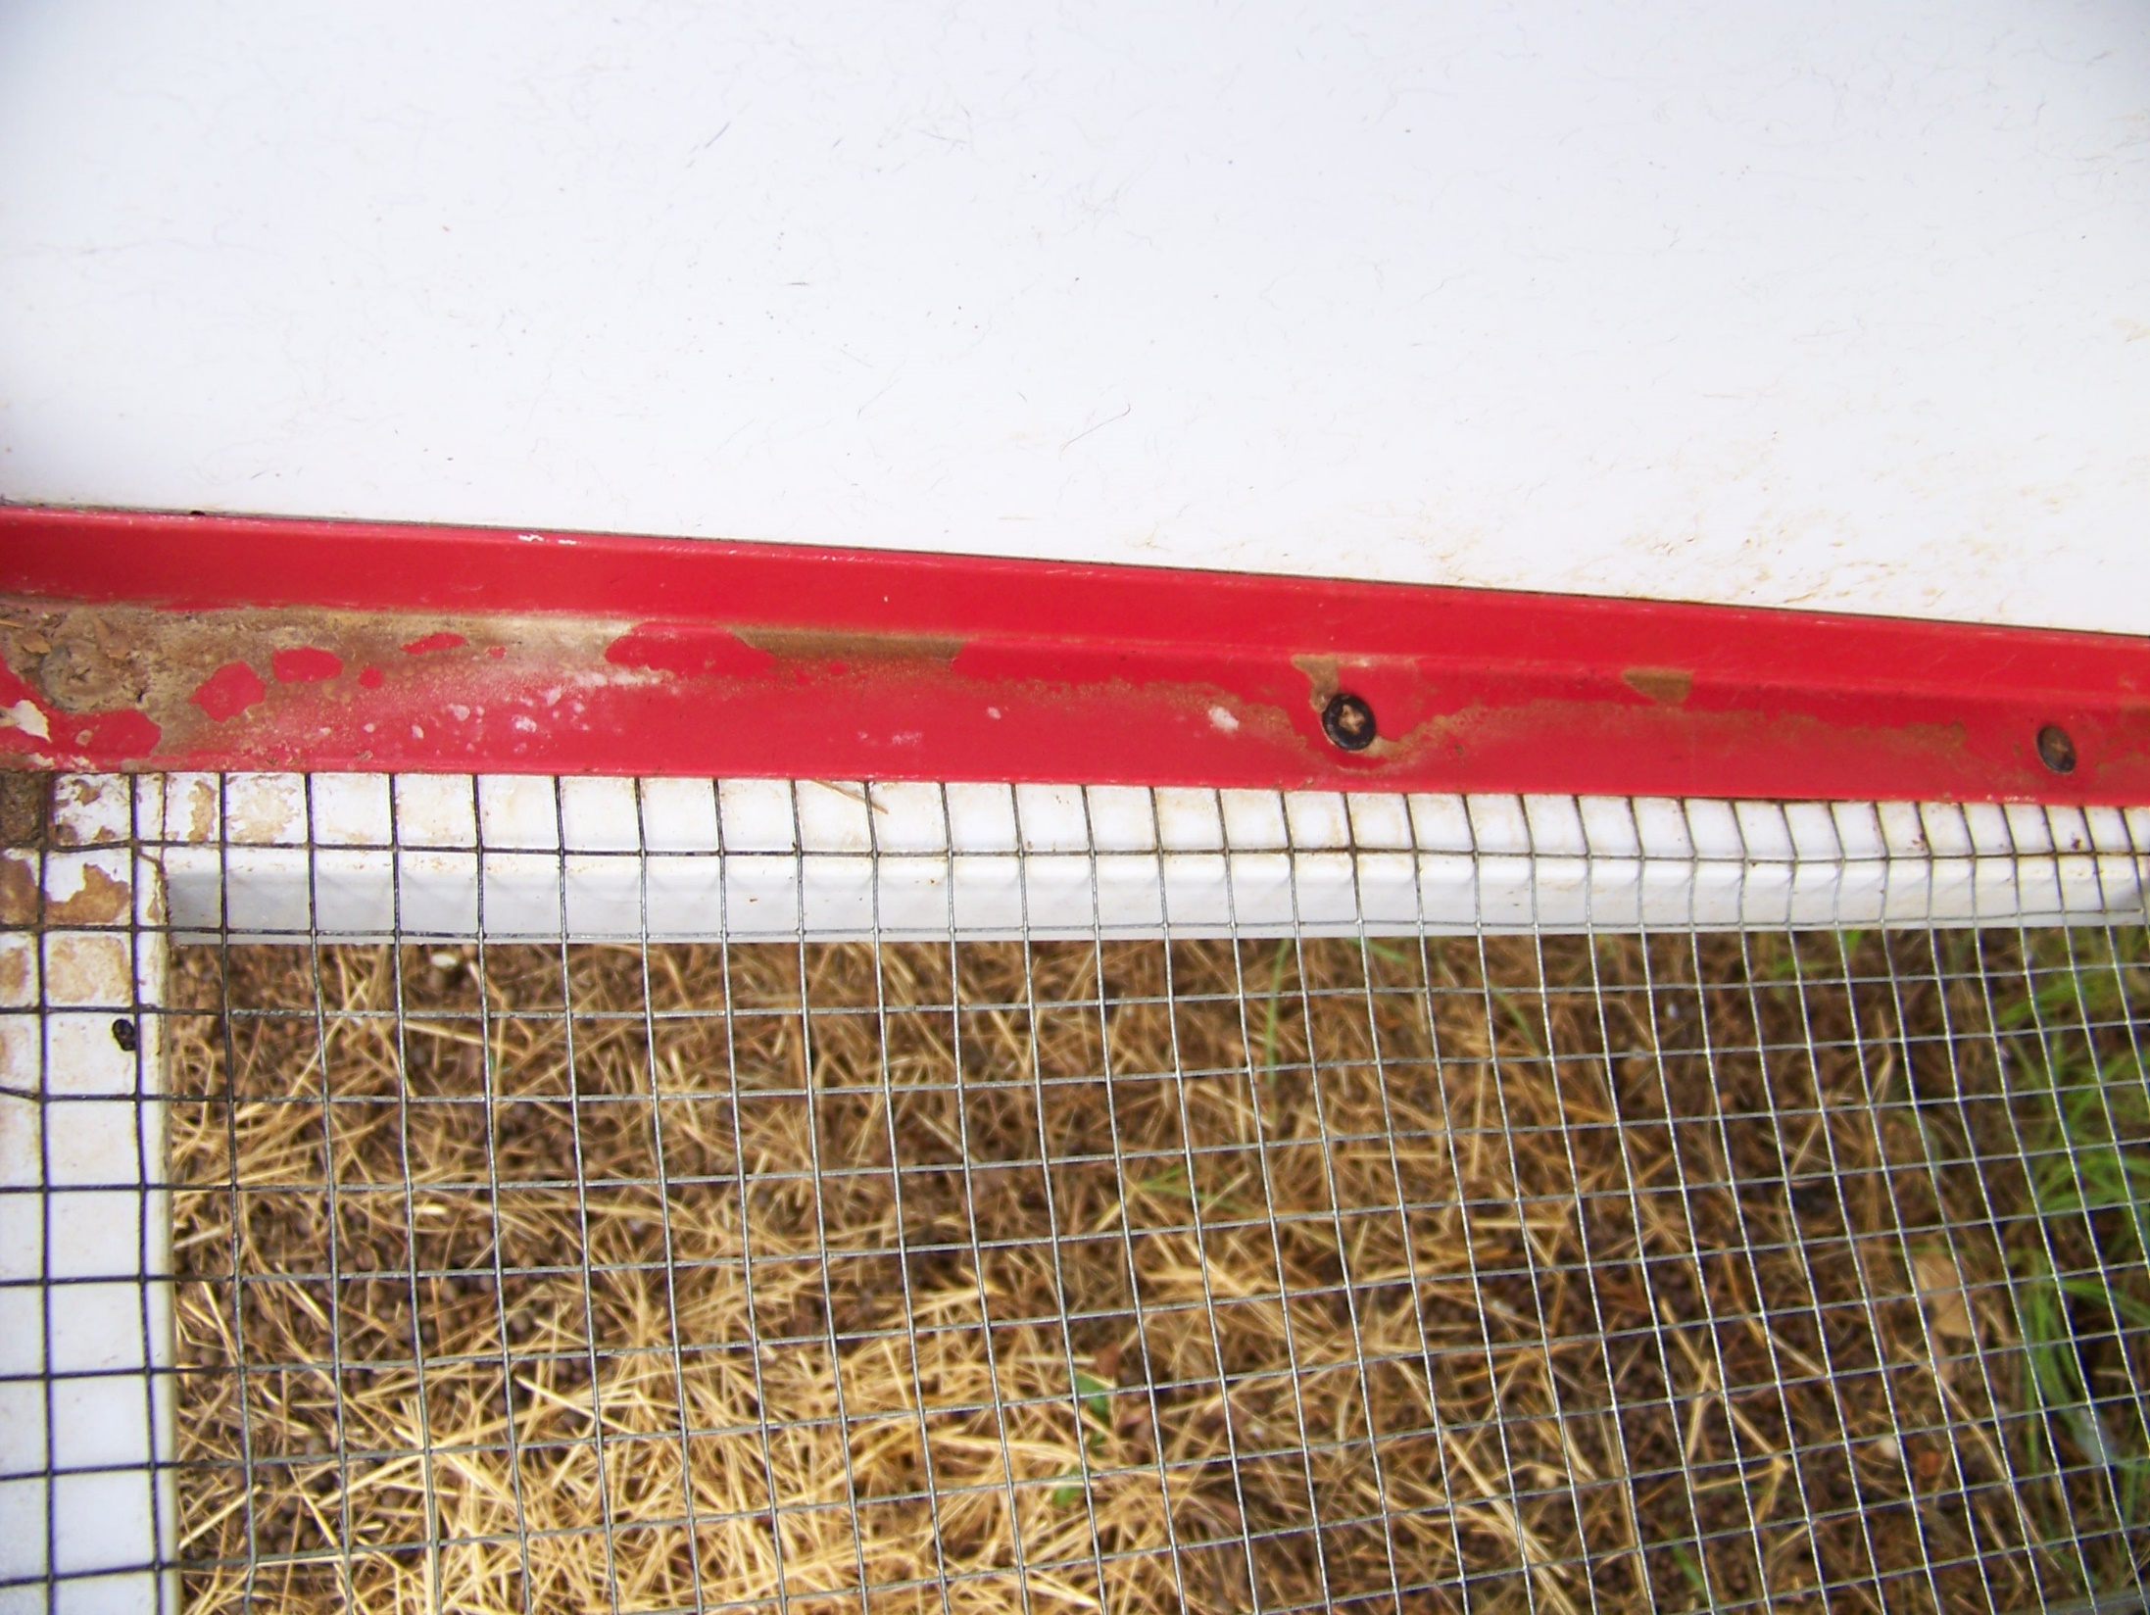
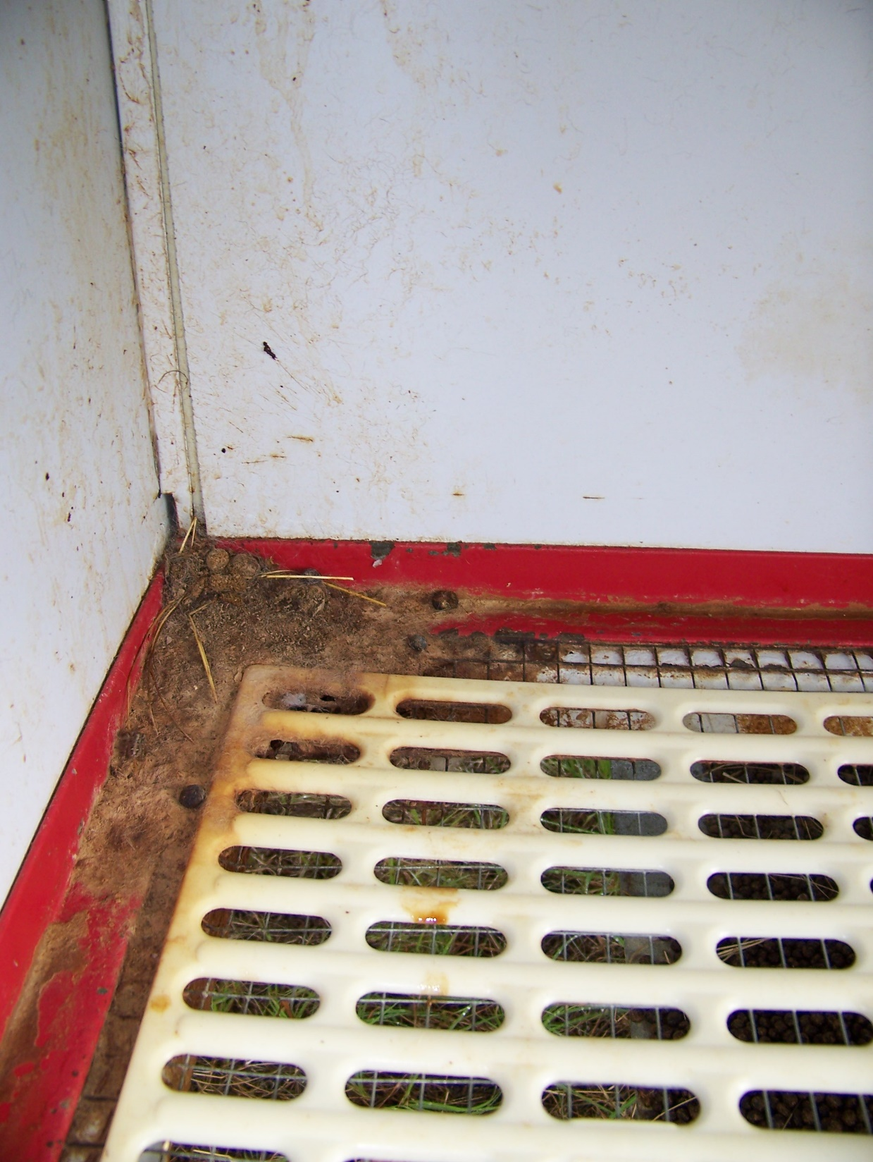

Slide 10
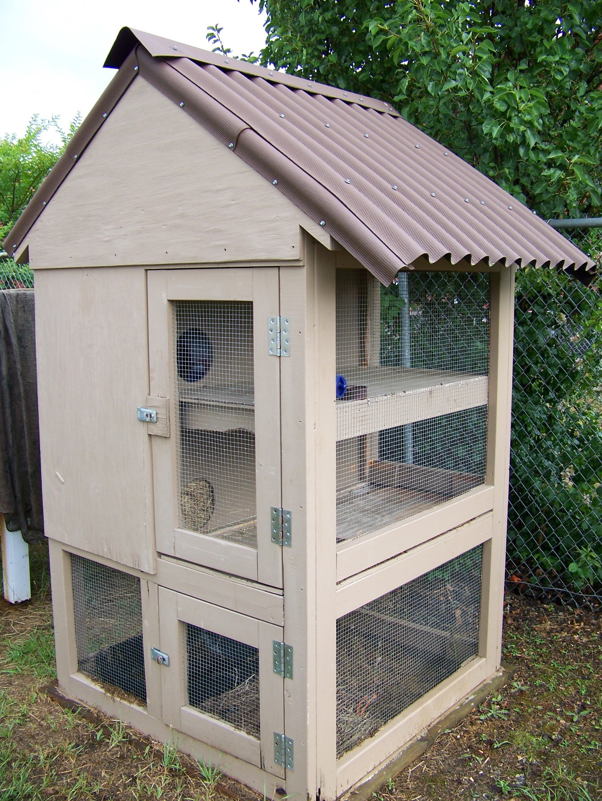
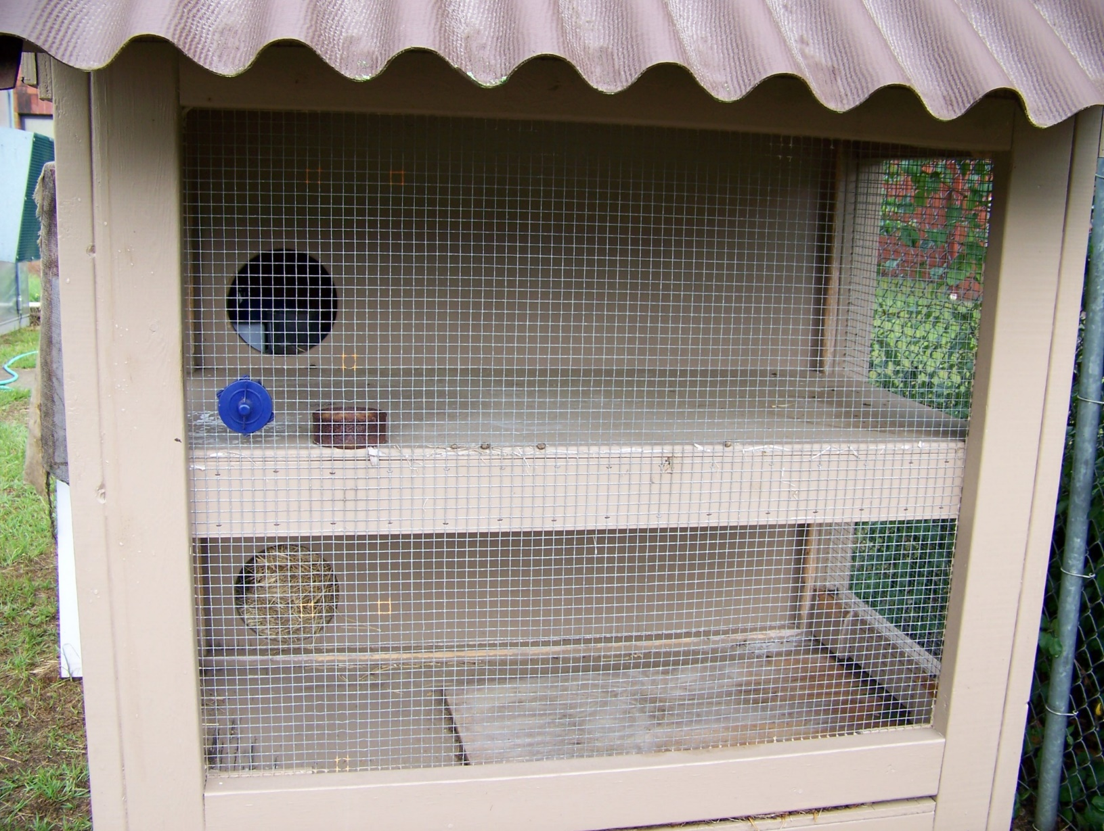

Slide 11
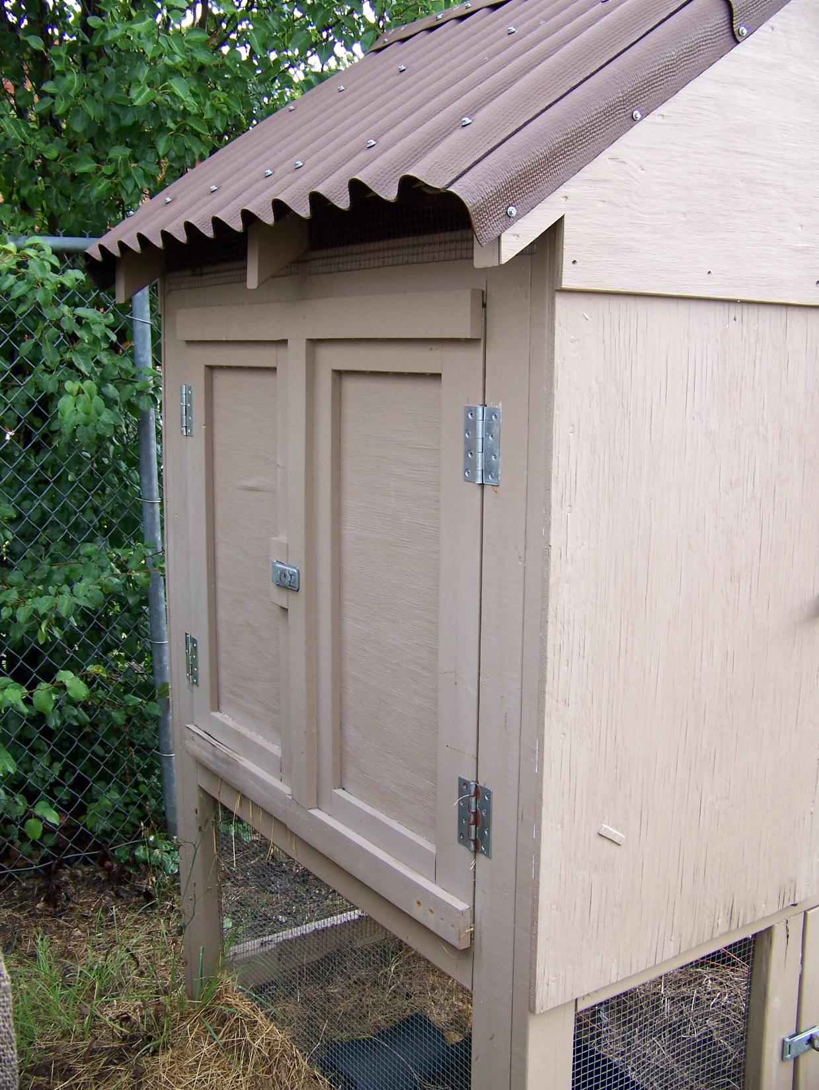
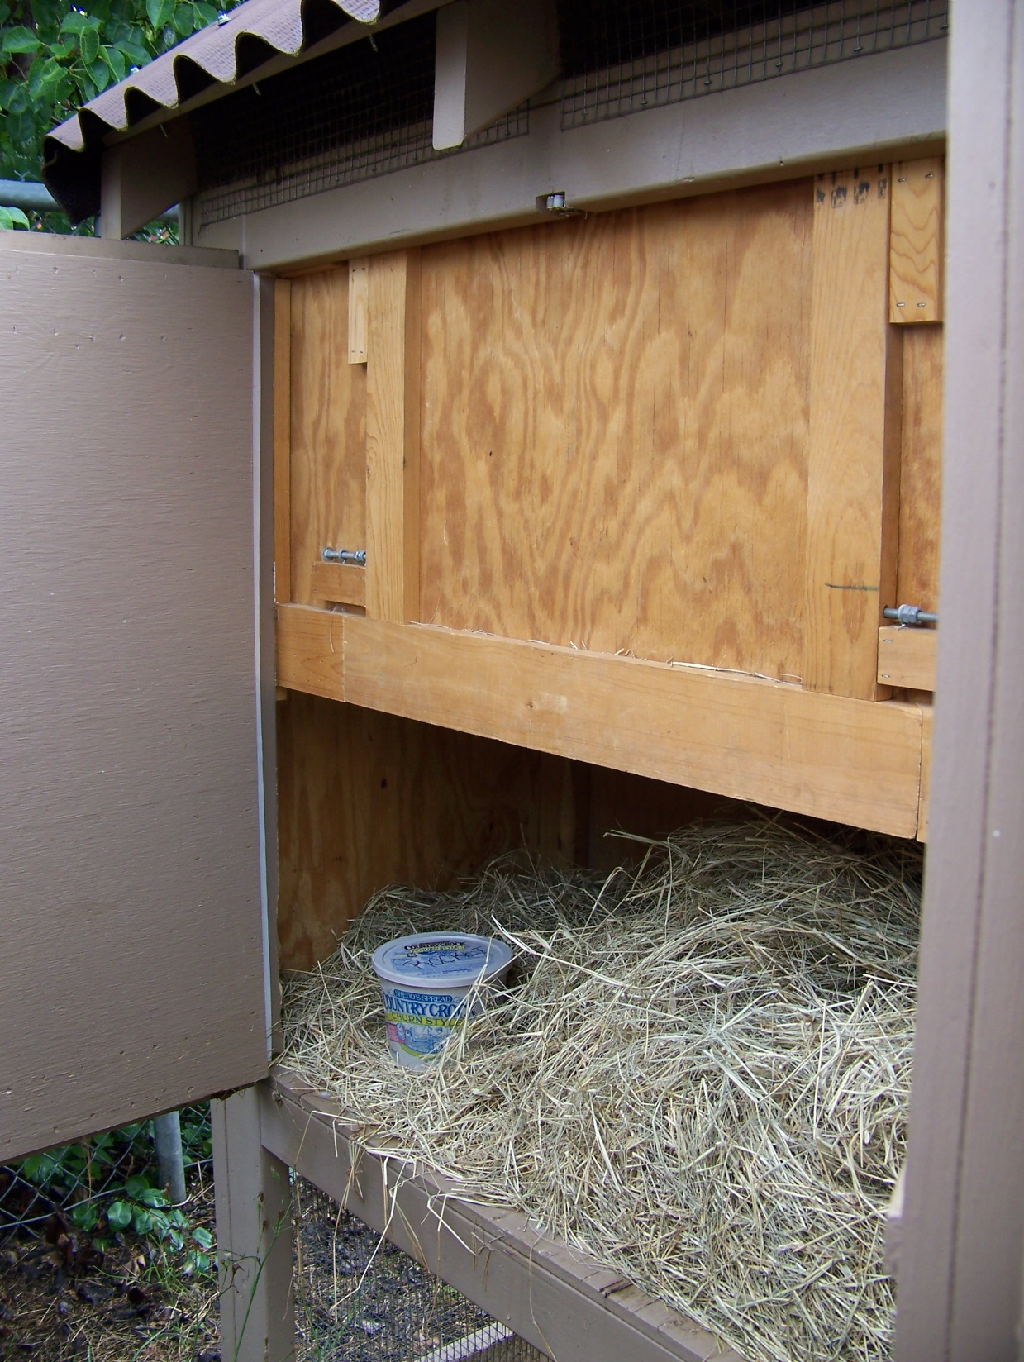

Slide 12
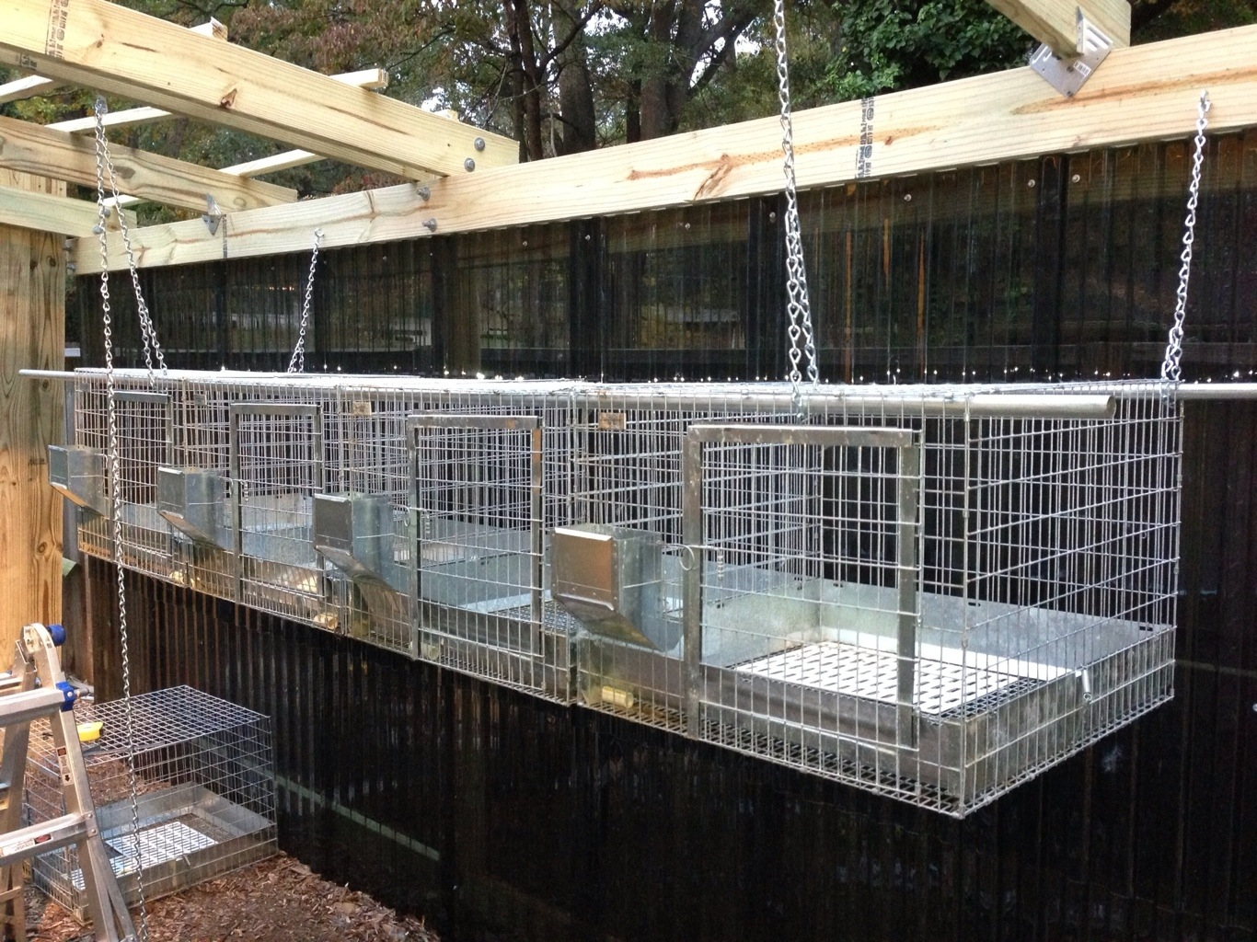

Slide 13
Key Factors to Consider:
Ventilation (ideal temp 55-70 degrees over 85 degrees becomes dangerous)
Protection from sun, wind, rain, and predators
Ease of clean up
Free of areas that can collect urine/feces
Free of sharp edges/wires
Resting pads to prevent sore hocks
Wire small enough on the floor and bottom portions to prevent kits from falling through
Resting Pad

Slide 14
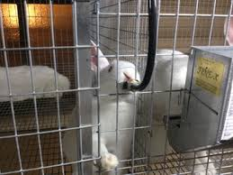
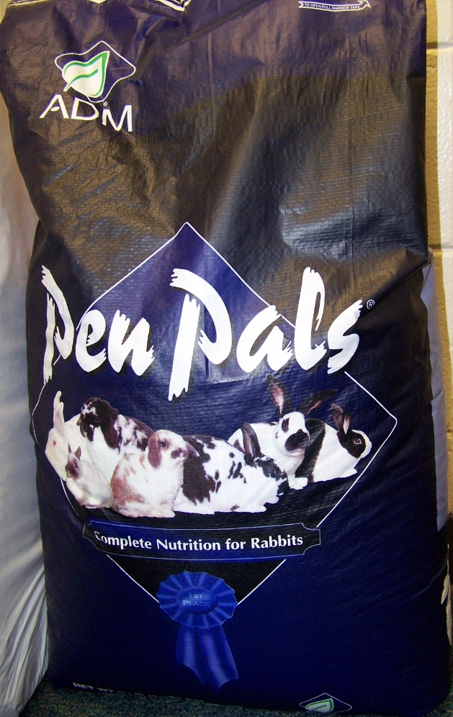
Feeding
What the breeders I work with recommend:
Pelleted Feed: (generally 16% protein)
Some breeds have special protein requirements always
ask the breeder what they have been feeding. Pen Pals by
ADM has been most recommended to me. Feed a specific portion once a day (nursing does may have food free choice).
Hay: Coastal Bermuda is the preferred hay
AVOID Alfalfa and fresh treats
Water: Unlimited freshwater (bottles or automatic water nipple systems)

Slide 15
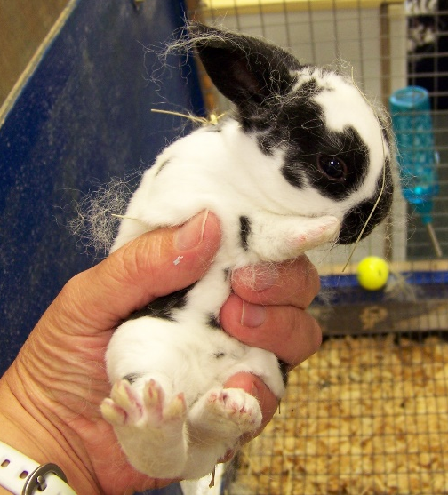
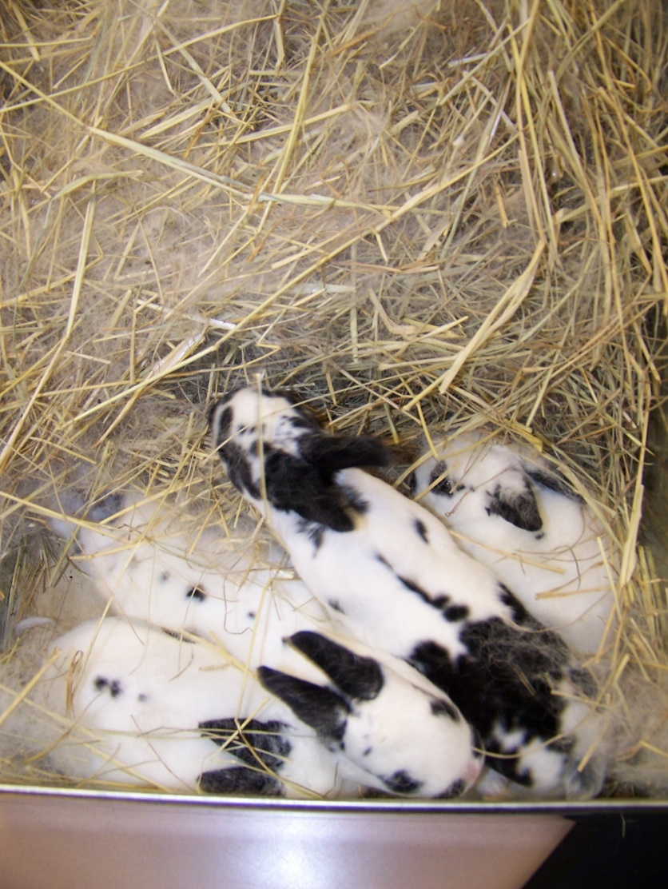
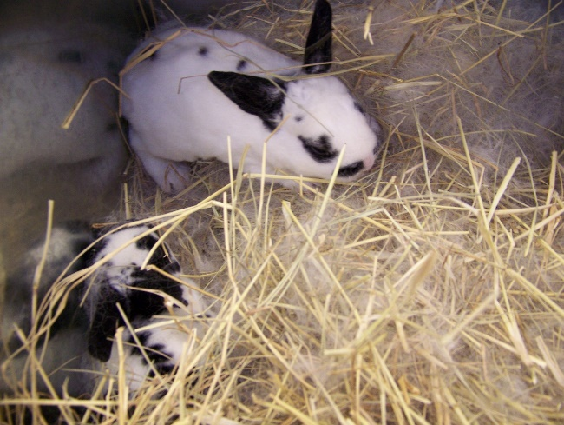
Breeding
Rabbits can enter a breeding program based on their breed and age:
small breeds: 4-6 months of age
medium breeds 6-8 months of age
large/giant breeds 10-12 months of age
The doe should be taken to the bucks cage for breeding
Gestation is generally 28-32 days
A nest box should be offered at a minimum by day 28, the doe will begin to collect hay and pull her own fur to line the nest box within a week of kindling
Kits should be weaned at 6-8weeks of age (no later than 10 weeks to prevent fighting and accidental breeding)

Slide 16
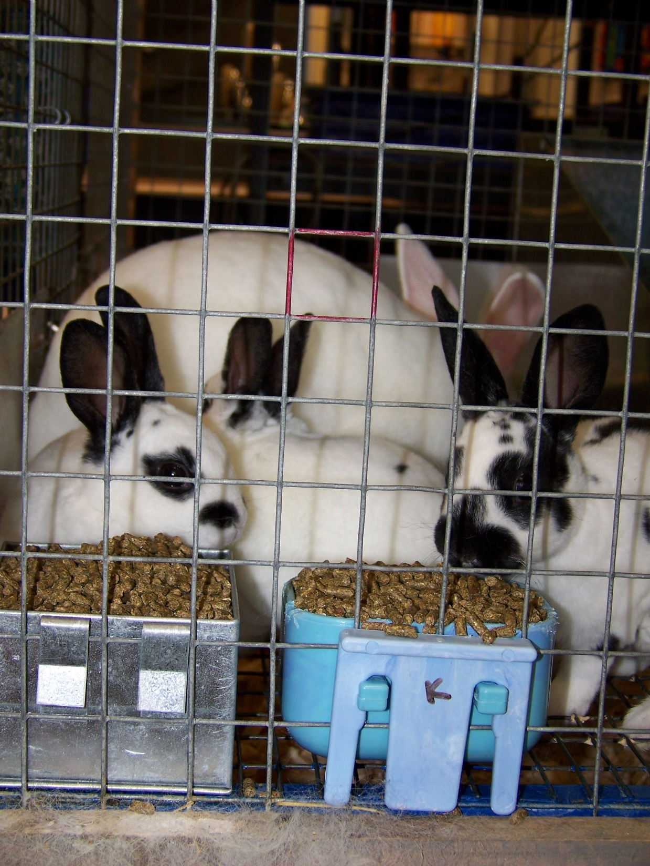
Kits will mimic the doe and naturally begin to eat pelleted food and drink from a water bottle. Simply make sure the food bowls are on the floor of the cage so that the kits can easily reach into them and place a water bottle at a low level just for them. I almost always use food bowls that clip to the side of the cage as most of my rabbits will dump their food and play with the bowls if they are not anchored down.

Slide 17
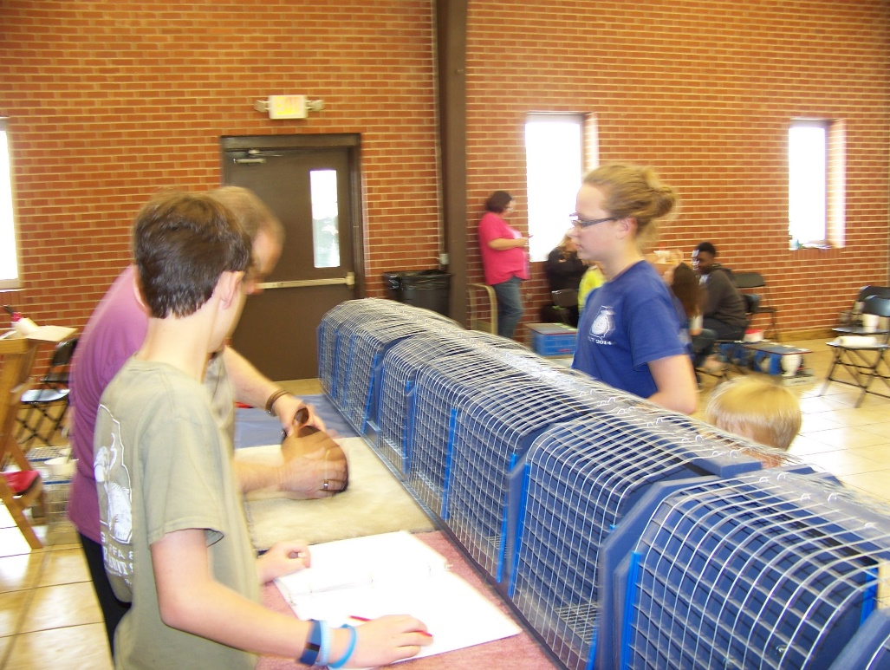
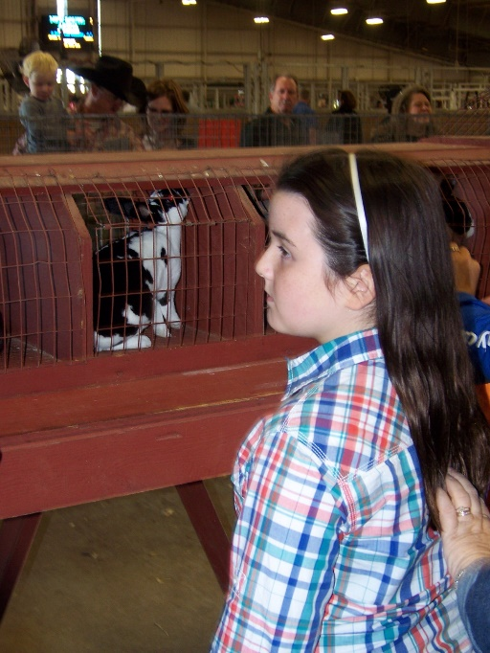
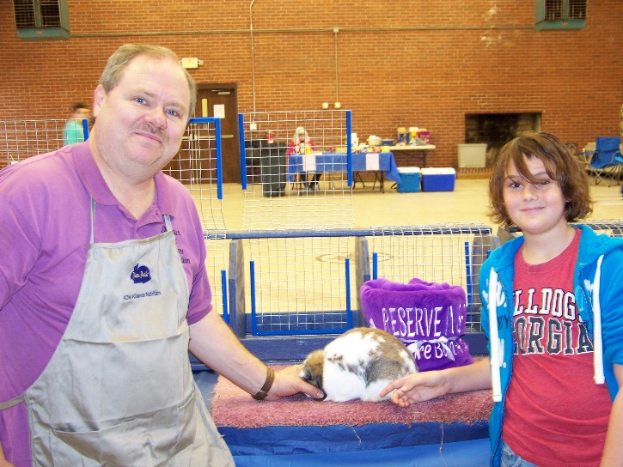
Show Lingo
Tattoo: An identifying group of letters, numbers, or both that you select (unless previously indicated on pedigree). Must be in the rabbit’s LEFT ear. You can tattoo them or arrive early to pretty much any large show and pay a breeder a few dollars per rabbit to do it for you.
Pedigree: A piece of paper with the lineage of your rabbit. This will ensure that your rabbit is purebred, however it will NOT ensure that your rabbit is a high quality show rabbit. Building relationships with breeders is extremely important. You will not have to show your pedigree to enter a show, when you register for the show you are by your entry stating that your rabbit is purebred. Only purebred rabbits may be shown, unless it is a pet class at a fun show.

Slide 18
ARBA Registered Rabbits: In order to register your rabbits, you must be a member of the ARBA. The rabbit or cavy must be at least 6 months of age, and you must have a 3 generation pedigree for the animal being registered. The pedigree must show the name and/or ear number, weight, and variety of the parents, grandparents, and great-grandparents (3 generations) of the animal being registered. (All ancestors in the 3 generations MUST be of the same breed as the animal being registered.) A licensed Registrar for the species must examine the animal and fill out an application for registration, which is sent to the ARBA office. The information for the registered animal is then entered into our computer system which will create a record of that animal for all time. A certificate of registration for the animal is then sent to you, the owner. Registration fee for a rabbit or cavy is $6.00 per animal. A rabbit does not have to be registered with ARBA to show.
Open vs. Youth: You may choose to show your rabbits in open or youth classes. Anyone may show in an open class, only individuals under the age of 21 (?) may show in youth classes. Only a youth may place a rabbit on the show table or remove the rabbit rom the show table if it is being shown in a youth class.
Junior vs. Senior: Rabbits under 6 months of age are shown as juniors, rabbits over 6 months of age are shown as seniors, with the exception of giant breeds which become seniors at 8 months of age. Check the Standard of Perfection for your breed. A junior rabbit may be shown “up” as a senior if it is above the junior weight, however a senior may never be shown as a junior.

Slide 19
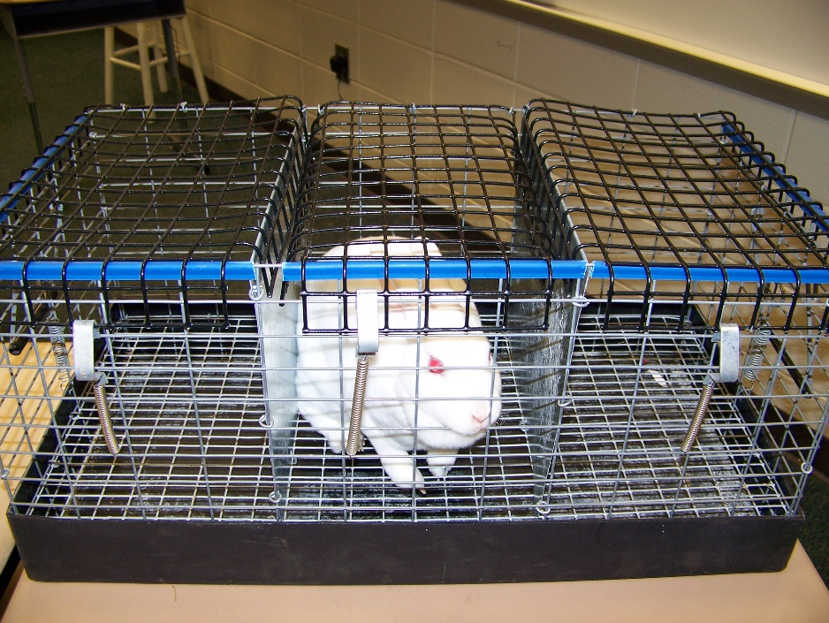
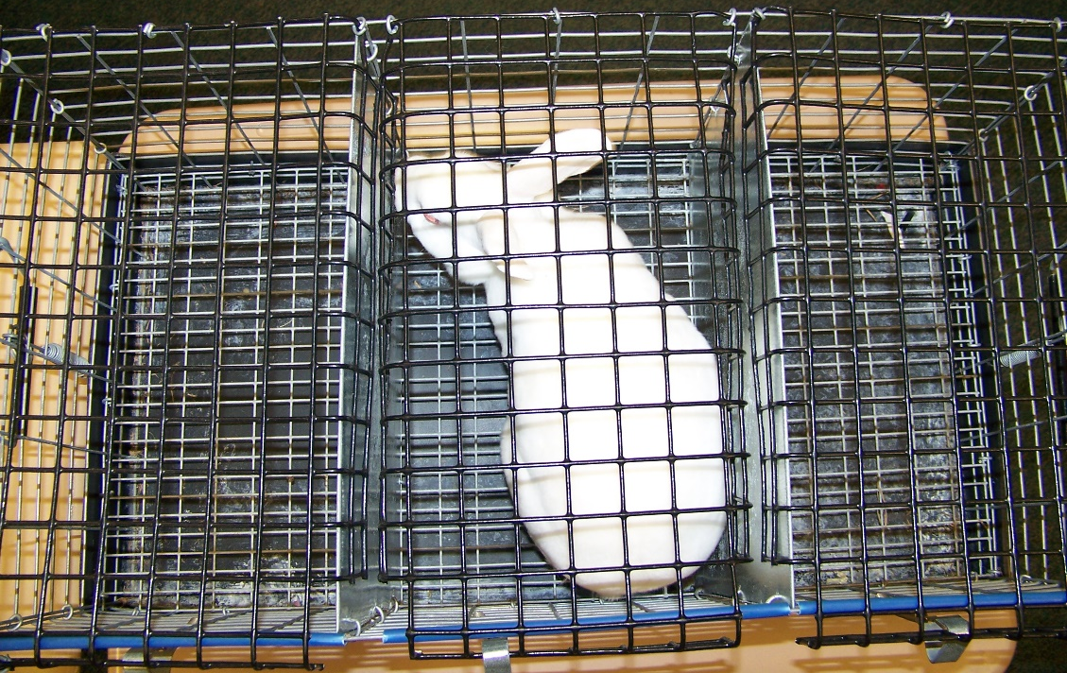
Travel cages: Travel cages can be made with single or multiple compartments. The travel cages should be a snug fit for your rabbit to prevent them from injuring themselves during travel. When panicked rabbits may do significant injury to themselves if they have the space to run, jump, or flip. It is important to be careful when picking rabbits up out of travel cages (or any wire bottom cage) to lift and not drag the animal as that may pull a toenail out (which is a disqualification).
3 hole travel cage

Slide 20
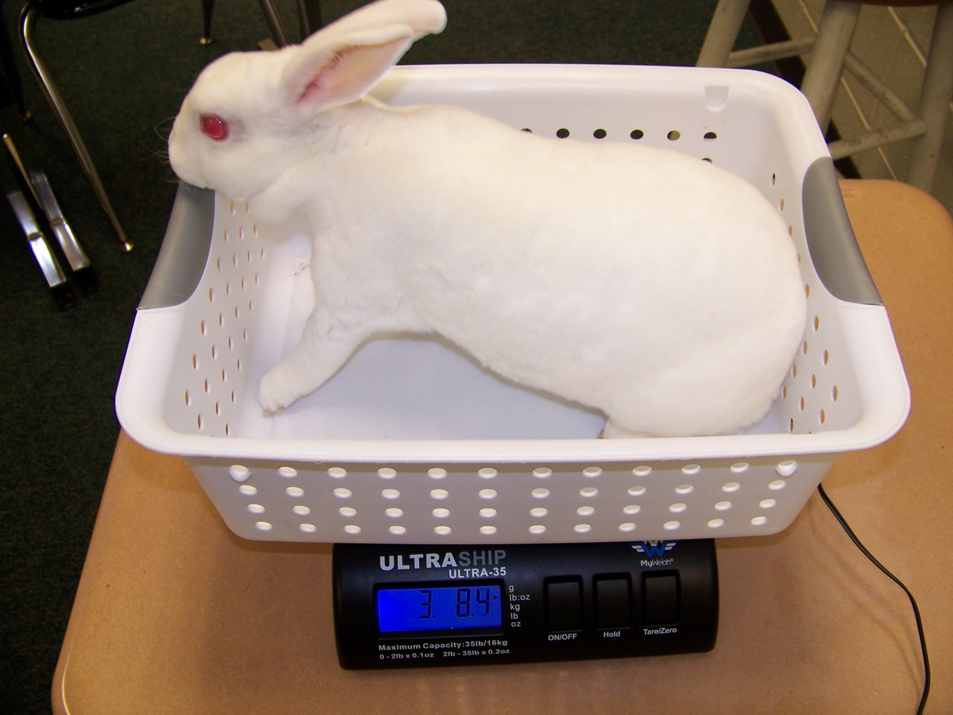
Scale: Weight is a common reason for disqualification. I keep a scale in my classroom that my students are free to use (they bring their rabbits to school) if they have concerns about the rabbit’s weight.

Slide 21
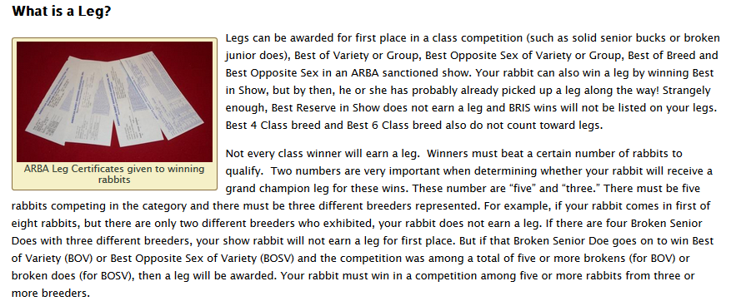
Doesn’t my rabbit already have 4 legs?
Source: www.thenaturetrail.com

Slide 22
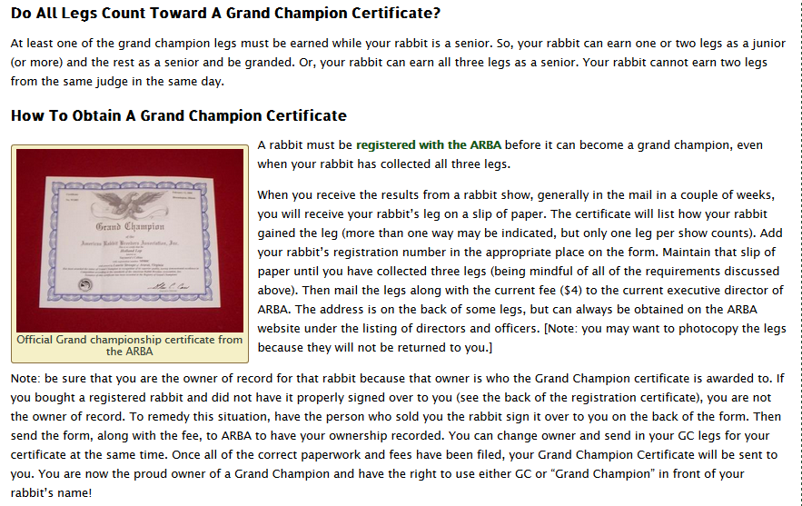
How legs accumulate to Grand Champion status…

Slide 23
Health Care
Vaccines: There are no approved vaccines for rabbits.
The following health questions and answers are from www.arba.net

Slide 24
How do I worm my rabbit, and how often should this be done?
The common intestinal parasites that domestic rabbits can be infected with include pinworms, tapeworms, flukes, and coccidia. Pin worms are thread-sized and approximately one inch long. If an infestation is present, the pinworms can be seen protruding from the droppings or in herd situations. Piperazine, a product sold for livestock, can be mixed in the water at livestock dosages. When pin worms are seen in one rabbit in a herd, treat the entire herd as the worm quickly spreads through the rabbitry. Worming once a week for 3 weeks is indicated to be sure all the immature forms are killed. Watch droppings closely as this proves that the worms are gone and have not come back. Coccidia are a protozoal parasite that requires microscopic confirmation at your local veterinarian and cannot be seen with the naked eye. Very young rabbits will stop eating, become dehydrated, and may or may not have diarrhea. Because these signs are vague and can be due to other problems, it is good practice to use coccidiostats routinely in your herd. The medication Corid, commonly used for poultry, can be used at a dose of 0.5 cc?s per 500 mL (17 oz.) of water. It is recommended that the herd be treated for at least five days to ensure all rabbits have ingested the medication.

Slide 25
Is it true that there are several antibiotics that are toxic to rabbits?
YES! The following medications should not be used if another alternative is available:
Amoxicillin or Amoxicillin/clavulanic acid
Ampicillin
Cephalosporins
Clindamycin
Erythromycin
Lincomycin
Penicillin (orally only; Penicillin can be used parenterally in rabbits)

Slide 26
What are some good items to place in a first aid kit?
Antibiotics: PPG (Penicillin-Procaine G), Terramycin ophthalmic ointment (oxytetracycline with polymixin B), Terramycin soluble powder (oxytetracycline)
Anthelmintics (Anti-parasites): Ivermectin, Fenbendazole, Corid, Piperazine
Anticoagulants (bleeding nails): Kwik Stop (Styptic), corn starch
Bandages: Gauze pads, vetwrap, ace bandage
Critical Care: Sub-Q (subcutaneous) fluids (LRS, Plasmalyte, 0.9% NaCl), Oxbow Critical Care, Rabbit Nutri Drops, Acid Pack 4-Way, Fast Track
Hypodermic needles & Syringes: 22 gauge for injections, 20 gauge for SQ fluids
Healing: Silver Sulfadiazene, Preparation H
Teeth & Nails: Toenail clippers, wire cutters

Slide 27
My rabbit has white nasal discharge when it sneezes. What's going on?
Any rabbit with thick, white (or off white) nasal discharge likely has an upper respiratory infection. These are fairly common in domestic rabbits and relatively easy to treat but many times difficult to completely cure. Many rabbits respond well to antibiotics given twice daily for 2-4 weeks at a time. Most of these medications are obtained through a licensed veterinarian. Please be aware that upper respiratory infections are transmitted via the air. Do not house the sick rabbit near other rabbits or bring him/her to a rabbit show!
The area around my rabbits lower eyes are wet and matted. What is weepy eye?
Weepy eye is the infection and/or inflammation of the conjunctiva (the eyelids), nasolacrimal duct (the tube that connects the eye to the nose), or both. Rabbits will have marked wetness around the eyes and may cause them to lose hair there. This condition can be treated with antibiotic drops or ointments that include Oxytetracycline, Gentamicin, or Ofloxacin drops.
My rabbit has abundant white, scaly, dandruff. What is this?
There is a good chance that your rabbit has fur mites. These microscopic mites burrow through the skin and hair causing large flakes (dandruff) to come off the rabbit. It is most common around the nape of the neck. Ivermectin 1% at a dose of 0.02 cc?s per pound of body weight given orally or subcutaneously is an effective treatment. Treat two weeks after the first dose to ensure the mites are gone.

Slide 28
What are these black crusts in the ear canal of my rabbit?
Ear mites are common in rabbits and cause large crusts and scabs in the ear canals. They can be effectively treated with Ivermectin 1% at a dose of 0.02 cc’s per pound of body weight given orally or subcutaneously is an effective treatment. Treat two weeks after the first dose to ensure the mites are gone.
What are sore hocks?
These are inflamed, ulcerated areas of the hock (the back of the foot, or ankle) and commonly affect Rex breeds of rabbits or breeds over 7 pounds. This can be due to sitting on a wire bottom cage for too long which erodes the protective layer of fur on the hock. Provide a solid resting place for the affected rabbit and consider a topical cream or salve to assist with healing.
My rabbit or cavy just broke his/her tooth!
Fear not! Because rabbits teeth erupt continuously throughout their life, the tooth will grow back in the next few weeks.
My rabbit has misaligned teeth. What is this?
This is called malocclusion in rabbits. Normal rabbits have the upper incisors overlap the lower incisors. The teeth move against each while eating and prevent them from getting longer. The simple form happens when the incisor teeth meet head on and do not overlap. The advanced form, sometimes called ?wolf teeth? occurs when the upper or lower incisors are deviated in a way that allows them to continuously grow. This condition must be corrected by clipping the teeth periodically or they will eventually prevent the rabbit from eating.

Slide 29
Resources
American Rabbit Breeder Association www.arba.net
The Standard of Perfection (available from ARBA)
Breed Associations
University Extension publications created for 4-H such as Rabbits, Rabbits, Rabbits by Iowa State University available as a PDF at:
http://www.extension.iastate.edu/4h/sites/www.extension.iastate.edu/files/4h/Publications/4H662rabbitsrabbitsrabbits.pdf

Slide 30
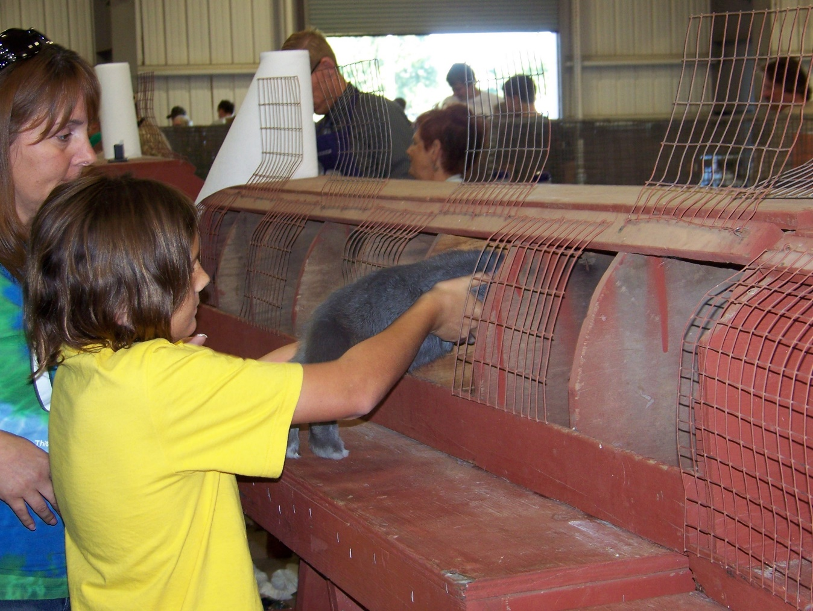
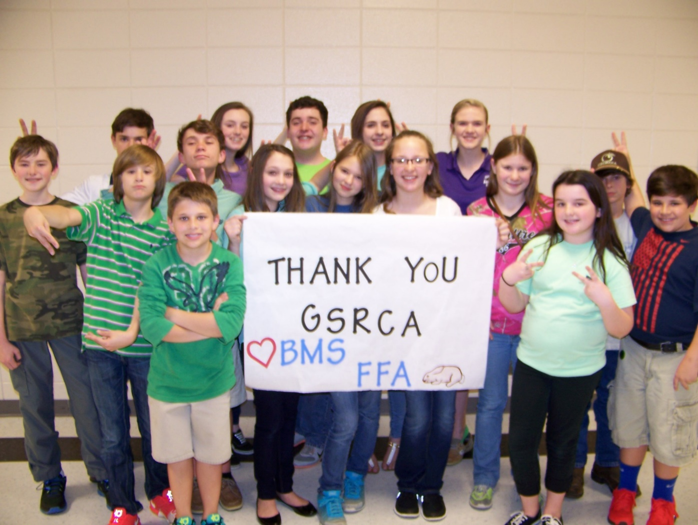
QUESTIONS and Answers….Maybe

