Slide 1
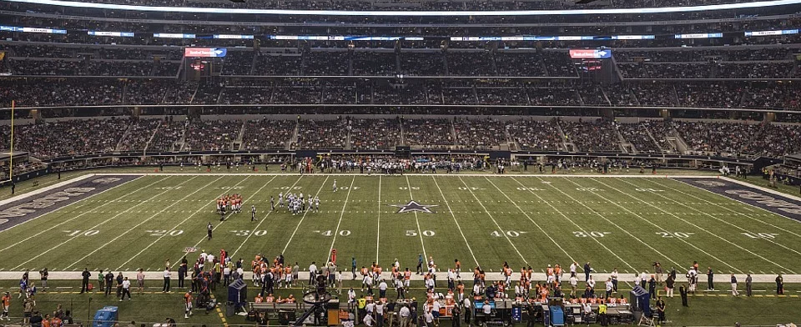
What is the Marketing Concept?
The marketing concept means that a business will focus on satisfying their customers’ needs and wants while also making a profit.
Image Credit: Pixabay.com

Slide 2
What is the Marketing Concept?
A private suite at Dallas Cowboys Stadium features granite counter tops, marble floors, a private restroom, bar space, flat screen televisions, climate control, Wi-Fi, and special parking.
The suites come in different sizes to accommodate between 18 to 52 guests.
The cost is between $100,000 and $500,000 a year.

Slide 3
What is the Marketing Concept?
Luxury suites satisfy the needs and wants of affluent customers and allow the business to make additional profits.
Image Credit: CC 2.0 by Ron Reiring (cropped)
Video: Tour of Dallas Cowboys’ Stadium

Slide 4
The Seven Functions of Marketing
Distribution
Marketing-Information Management
Pricing
Product/Service Management
Promotion
Selling
Financing

Slide 5
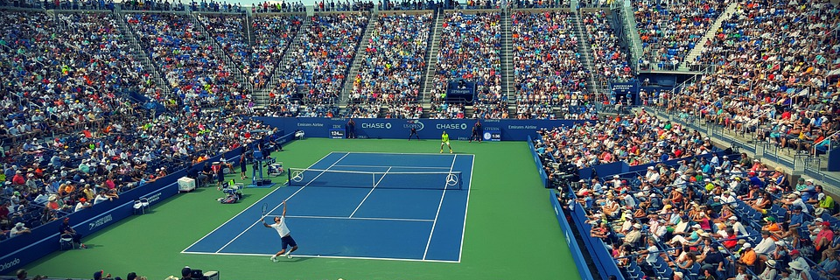
The Seven Functions of Marketing
Distribution requires the business to find the best methods of delivering goods and services to customers.
Image Credit: Pixabay.com
Sports can be distributed to customers in person, online, or via television.

Slide 6
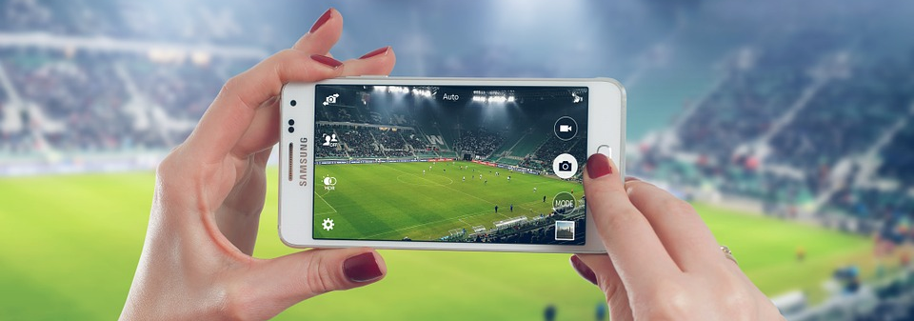
The Seven Functions of Marketing
Marketing-Information Management involves gathering and analyzing information to improve decision making.
Image Credit: Pixabay.com
Many customers are familiar with technology and use it frequently.

Slide 7
The Seven Functions of Marketing
Pricing requires the business to determine the most appropriate pricing strategy for their products.
Image Credit: Pixabay.com
Prices will determine the profitability of the business.

Slide 8
The Seven Functions of Marketing
Product/Service Management involves acquiring, developing, and improving products to better serve customers.
Image Credit: Pixabay.com
Video: New Golf Product Satisfies Customers
Business must create new or improved products to satisfy customers.

Slide 9
The Seven Functions of Marketing
Promotion is any strategy used to communicate with customers about the products or services offered by the business or organization.
Image Credit: Pixabay.com

Slide 10
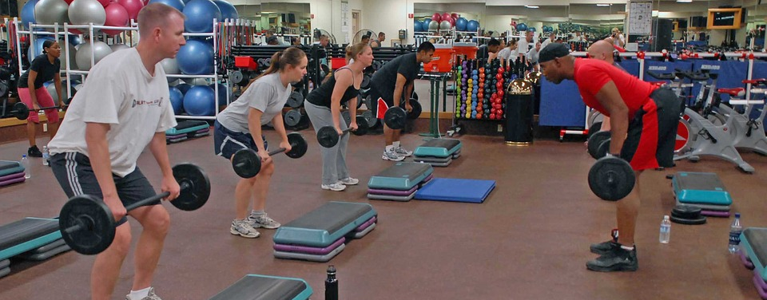
The Seven Functions of Marketing
Selling is any face-to-face contact with customers to determine and satisfy their needs and wants.
Image Credit: Pixabay.com

Slide 11
The Seven Functions of Marketing
Personal training and sports instruction are good examples of selling a service in the area of sports.
Image Credit: Pixabay.com

Slide 12
The Seven Functions of Marketing
Financing involves budgeting for business operations and offering assistance to customers in buying the business’s products.
Image Credit: Pixabay.com

Slide 13
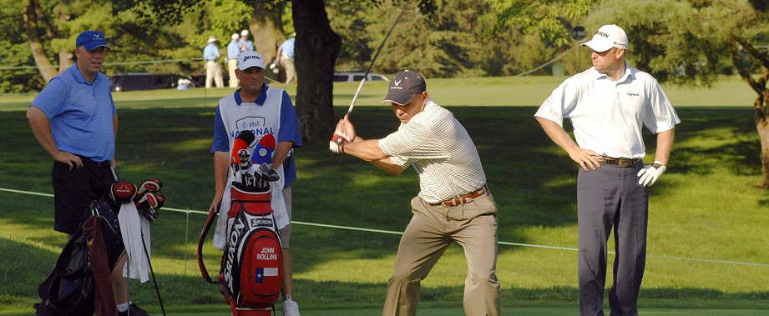
The Target Market
The target market is a specific group of consumers a business or organization wants to reach with its marketing efforts.
Image Credit: Pixabay.com

