Slide 1
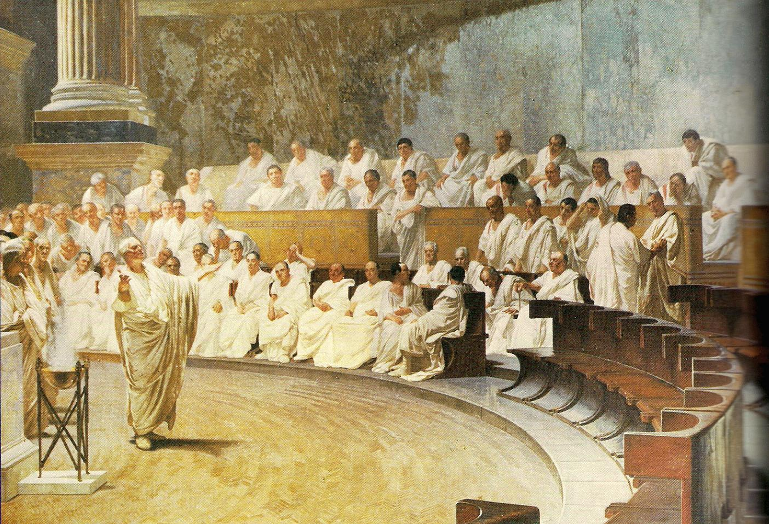
Ancient Rome & The Origin of Christianity
Outcome: A Republic Becomes an Empire

Slide 2
Constructive Response Question
Compare and contrast the Roman Republic and the Roman Empire using specific examples
Classify the contributions the Romans made to the cultural advancement of the world

Slide 3
What are we going to learn?
Decline of the Roman Republics
Rise of Julius Caesar
Rome’s best emperors
Power and accomplishments of the Roman Empire

Slide 4
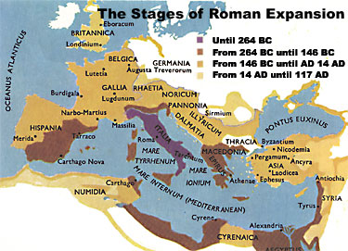
A Republic Becomes an Empire
Setting the Stage
With the defeat of Carthage in the Punic Wars, Rome was proving to be the biggest and most powerful civilization on the Mediterranean
The larger Rome’s territory got, the more unstable the republic form of government became

Slide 5
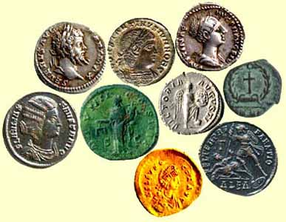
A Republic Becomes an Empire
The Republic collapses
Rome’s increasing wealth and expanding territories brought problems
Discontent among lower classes
Breakdown in military order
Roman Coins

Slide 6
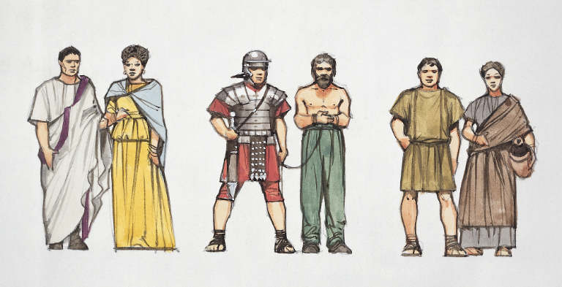
A Republic Becomes an Empire
Economic Turmoil
Gap between rich and poor widened
Rich lived on huge estates
Poor worked on estates (possibly as slaves)
By 100 B.C. one-third of Rome’s population were enslaved

Slide 7
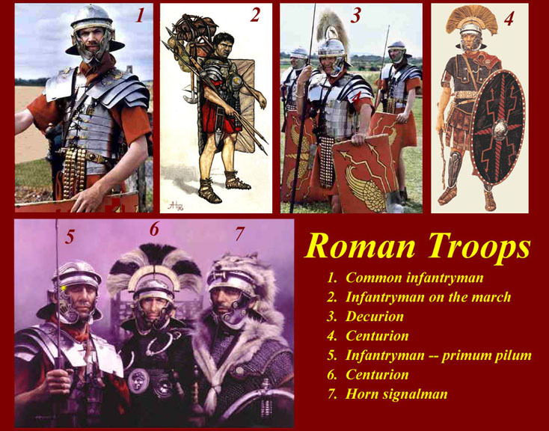
A Republic Becomes an Empire
Military Upheaval
Generals seized power for themselves
Recruited by promising land
Citizens loyal to generals rather than to Rome itself

Slide 8
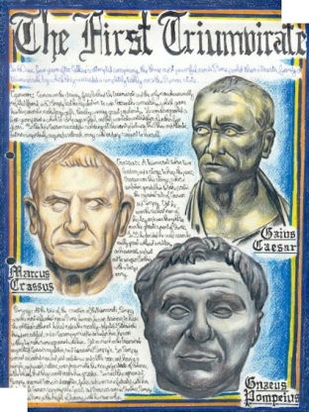
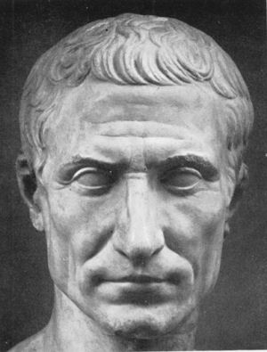
A Republic Becomes an Empire
Julius Caesar
60 B.C. joins with Crassus (wealthy Roman) and Pompey (popular general) to create a Triumvirate
Triumvirate: a group of three rulers
They rule together for 10 years

Slide 9
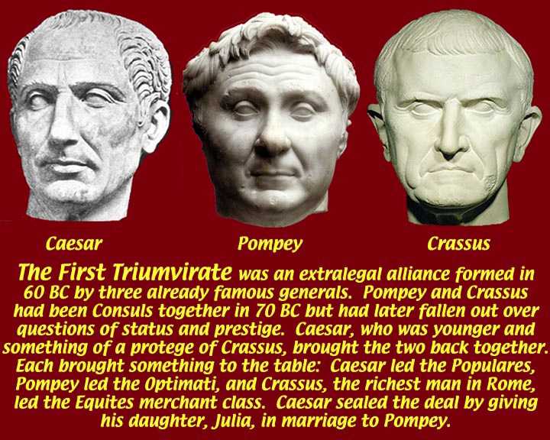

Slide 10
A Republic Becomes an Empire
Caesar takes power
Caesar has success in Gaul (France), becomes quite popular
Political rival Pompey urges the senate to disband Caesar’s legions
Caesar defies senate, marches into Rome
Pompey flees
Caesar defeats Pompey’s troops in Greece, Asia, Spain, and Egypt
Julius Caesar returns home in 46 B.C.- senate appoints him dictator
44 B.C. Caesar is named dictator for life
Result: Even though Caesar has total control, Rome still embraces some of its republic roots, however it is moving closer to empire

Slide 11
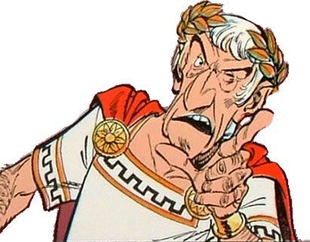
A Republic Becomes an Empire
Julius Caesar’s legacy
Absolute ruler but he also expanded the senate
Granted citizenship to people in Roman provinces
Helped poor by creating jobs and building projects
Increased pay for soldiers

Slide 12
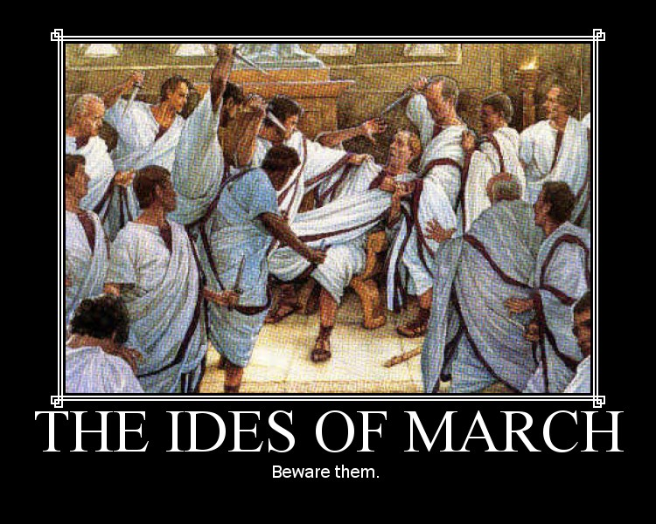
A Republic Becomes an Empire
Beware the Ides of March
Many nobles and senators expressed concern over Caesar’s growing power, success, and popularity; feared losing their influence
Others considered Caesar a tyrant
Many felt Rome would suffer due to his ego
Caesar is stabbed to death in the senate by a gang of senators led by Marcus Brutus and Gaius Cassius on March 15, 44 B.C.

Slide 13
Death of Caesar

Slide 14
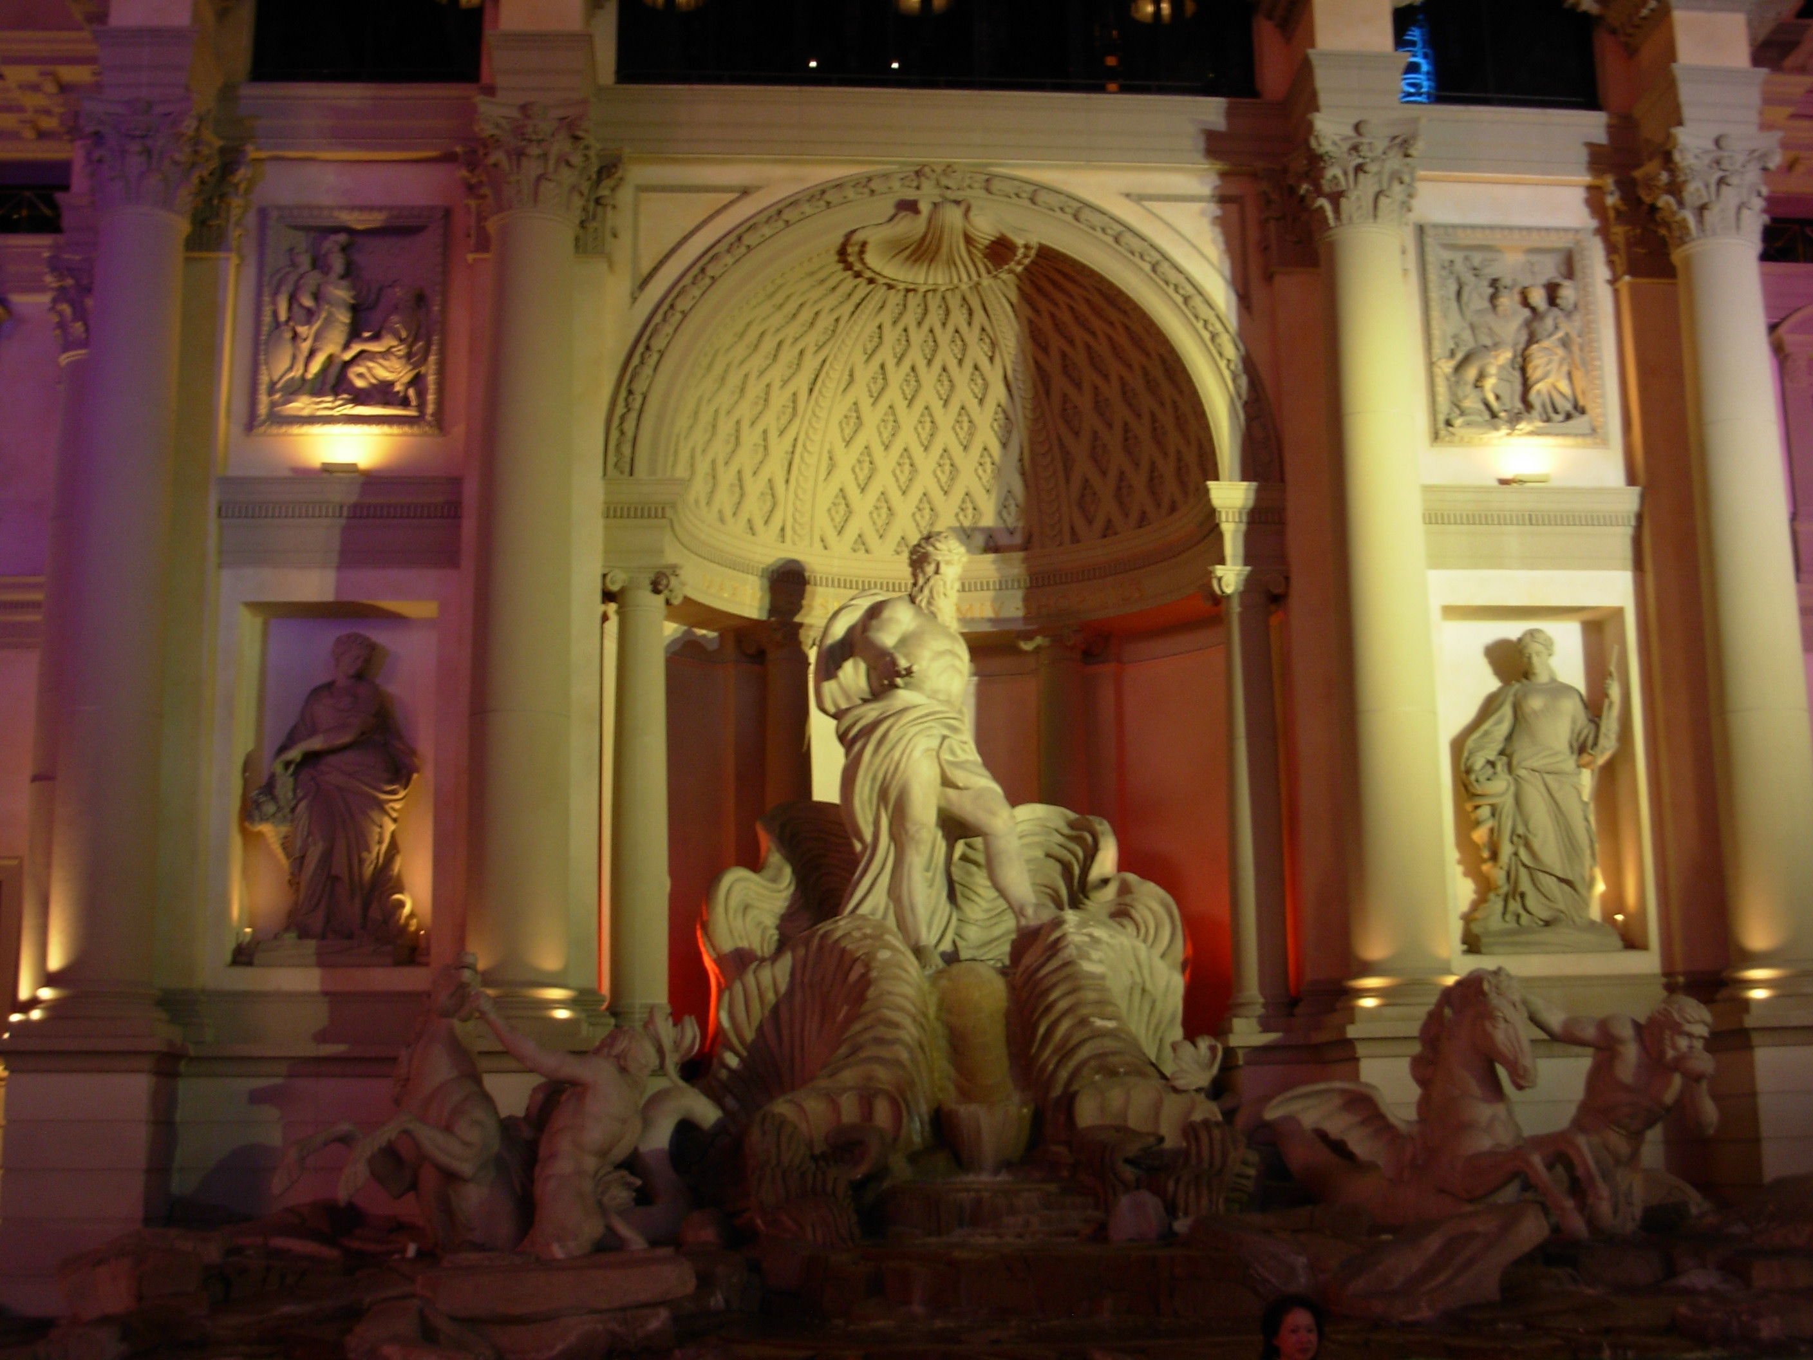
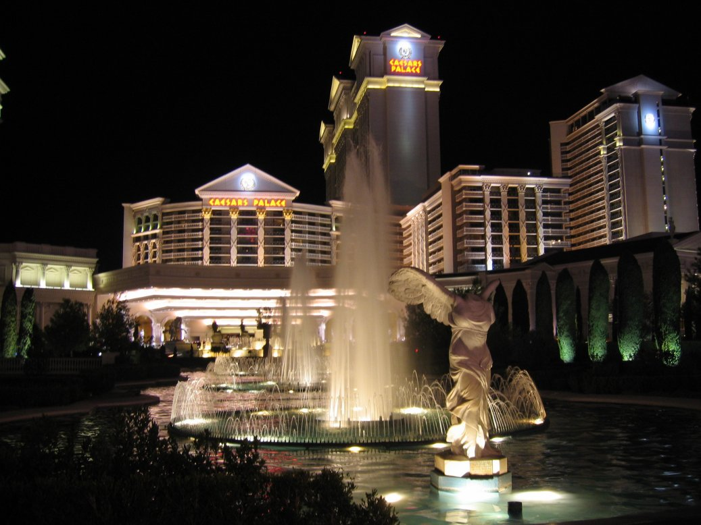
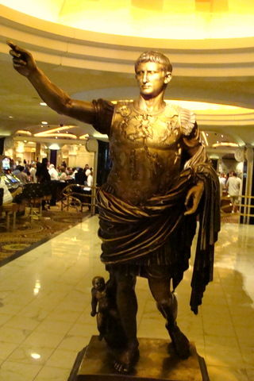
Caesar’s Palace in Las Vegas

Slide 15
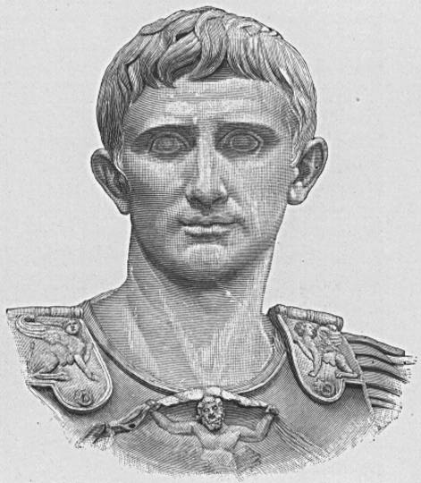
Octavian

Slide 16
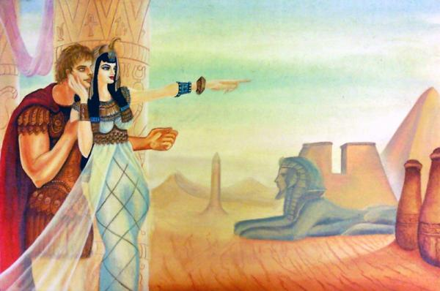
A Republic Becomes an Empire
Octavian
Caesar’s 18 year old nephew and adopted son
Takes power with Mark Antony and Lepidus = Second Triumvirate
Octavian forces Lepidus to retire
Mark Antony falls in love with Queen Cleopatra of Egypt

Slide 17
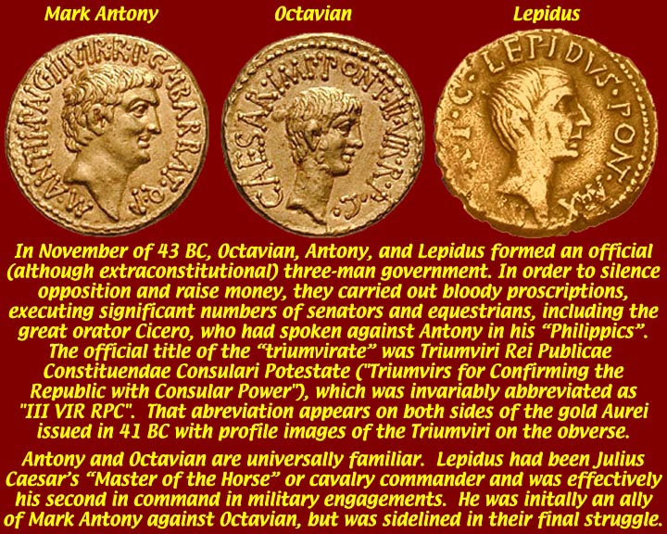
Second Triumvirate

Slide 18
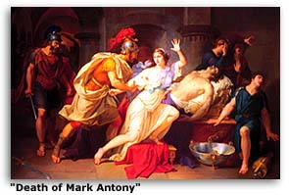
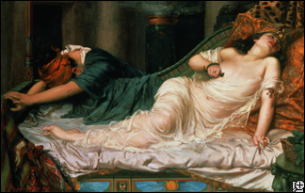
A Republic Becomes an Empire
Octavian
Octavian accuses Antony of plotting to rule Rome from Egypt and this leads to another civil war
Octavian defeats Antony & Cleopatra’s forces at naval battle of Actium (31 B.C.)
Mark Antony and Cleopatra commit suicide; leaving Octavian sole leader
Octavian takes name Augustus meaning “exalted one” -27 B.C.

Slide 19
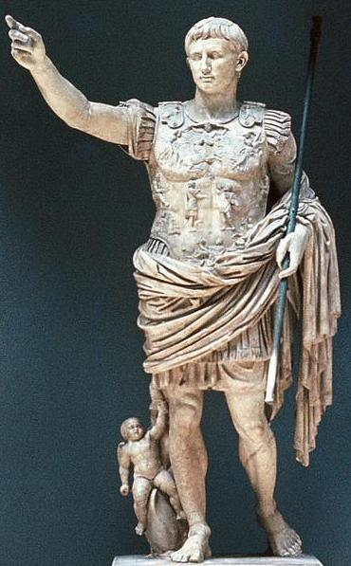
Rome’s Best Emperors
Octavian Augustus
First Roman Emperor
Senate named him Augustus meaning “revered personage” or “exhalted one” in 27 BC
Rules from 27 BC to 14 AD
Ended years of civil war
Was not interested in dictatorial rule; shared power with close advisors
Successfully discharged soliders reducing army (still kept 28 legions for auxillery strength)
Died of illness on August 19, 14 AD

Slide 20
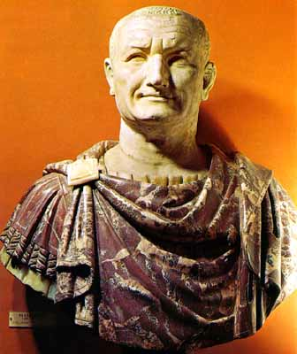
Rome’s Best Emperors
Vespasian
Ruled from 69-79 AD
Worked hard and lived in a stable relationship with a woman he loved (odd for emperors)
First rate soldier
Built the Flavian Amphitheater later known as the Colosseum
Died in 79 AD just before completion of the Colosseum

Slide 21
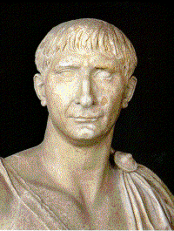
Rome’s Best Emperors
Trajan
Ruled from 98-117 AD
Public works:
Built Trajan’s Forum
Extensive reconstruction of the Circus Maximus, the great arena for chariot races
Great reputation and very efficient
Expanded Rome militarily
Fell ill and died on August 9, 117 AD

Slide 22
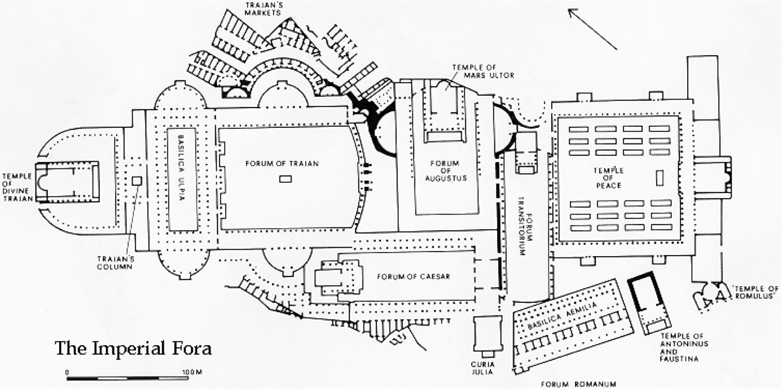
Trajan’s Forum

Slide 23
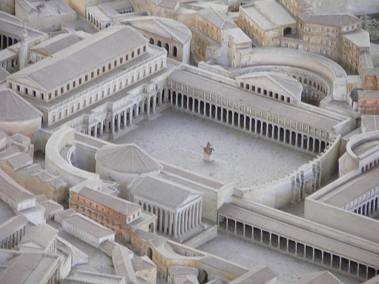
Trajan’s Forum

Slide 24
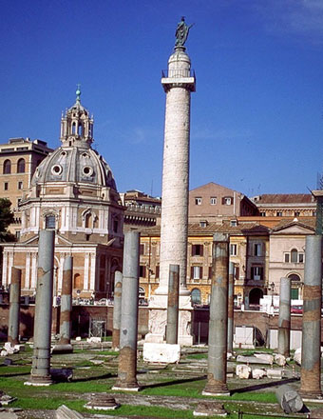
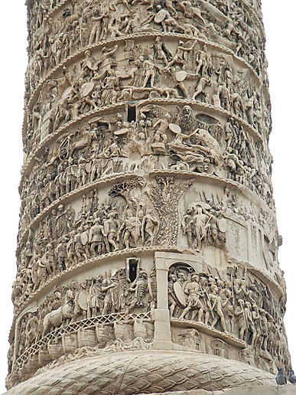
Trajan’s Column (Depicting success in Dacia)

Slide 25
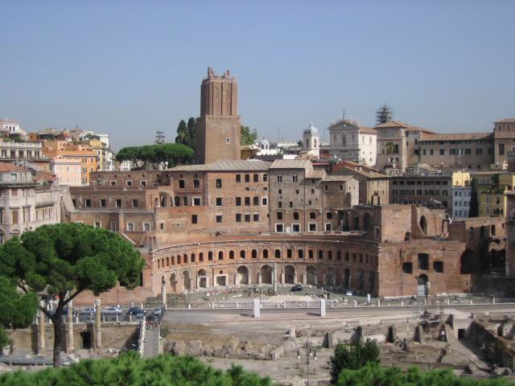
Trajan’s Forum Today

Slide 26
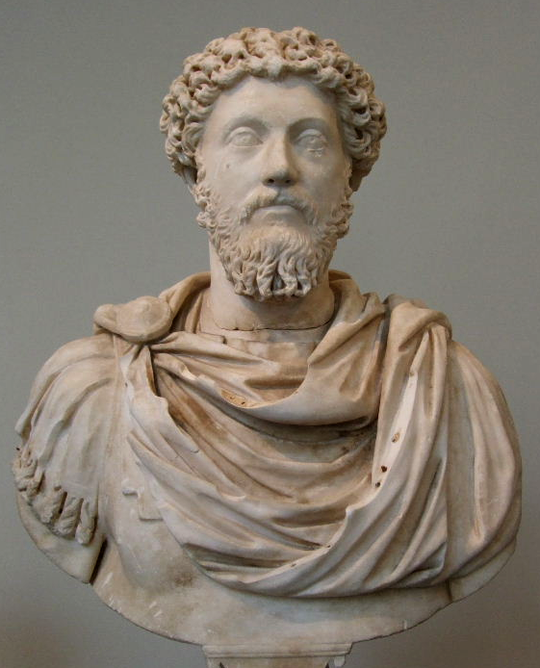
Rome’s Best Emperors
Marcus Aurelius
Ruled from 161-180 AD
Gifted general
Philosopher
Fell ill and died on March 17, 180 AD
Empire began to erode under his son Commodus (end of Pax Romana)

Slide 27
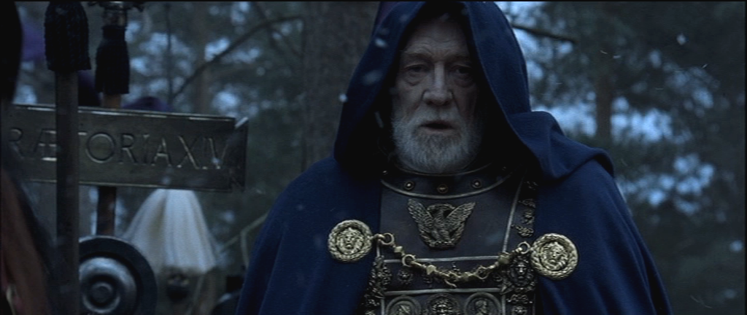
Marcus Aurelius in the film Gladiator

Slide 28
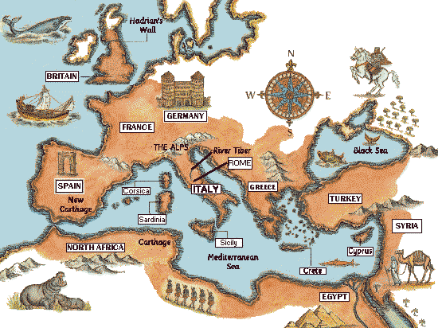
A Republic Becomes an Empire
Result: Rome is officially an empire.

Slide 29
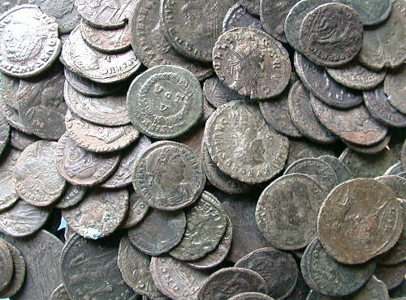
A Republic Becomes an Empire
A Vast and Powerful Empire
Peak of Rome’s power 27 B.C. to 180 A.D.
Period known as the Pax Romana or “Roman Peace”
Population of 60-80 million with 1 million in the city of Rome
Rome held together through efficient means of government started by Augustus however many terrible emperors would gradually weaken the empire over the next 400 years
Common coinage made trade easier
More Roman Coins

Slide 30
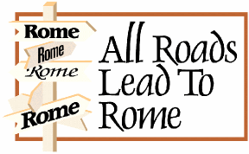
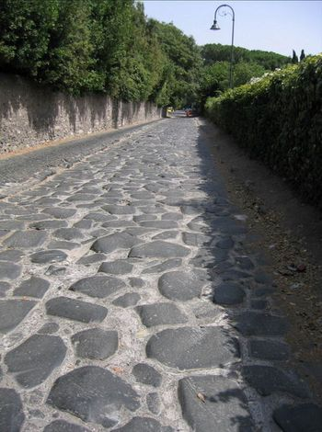
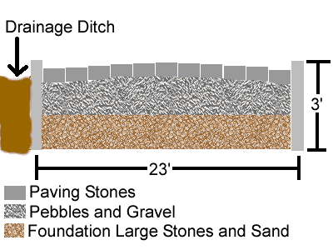
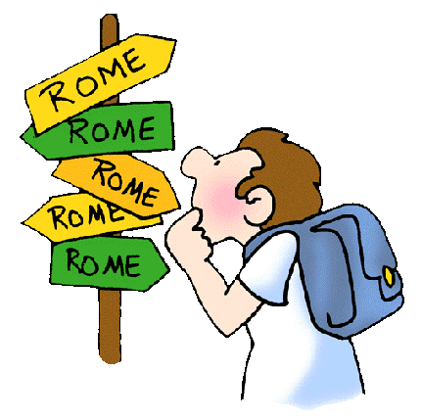
A Republic Becomes an Empire
“All roads lead to Rome;” the Romans built about 250,000 miles of roads

Slide 31
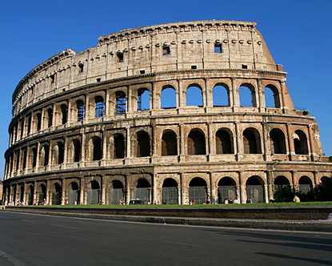
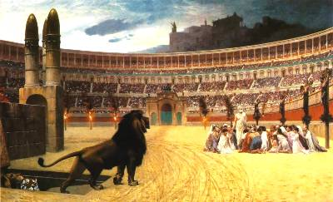
A Republic Becomes an Empire
90 % of the population were poor and slavery was common
The Colosseum was used to distract the masses because much of city of Rome was unemployed; gladiatorial battles were popular for entertainment
Rich continued to live extravagantly

Slide 32
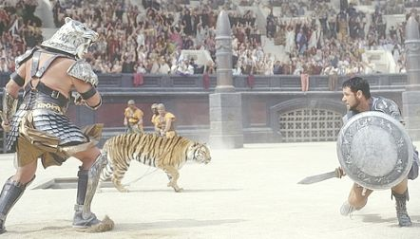
Gladiatorial Battles

Slide 33
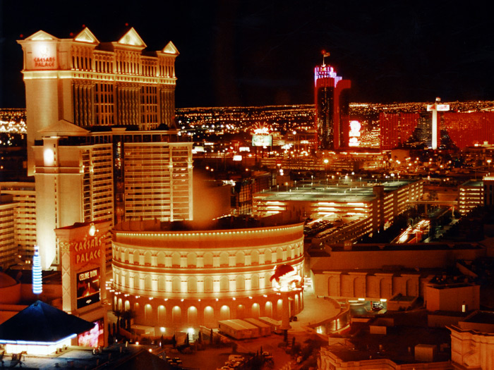
The Colosseum at Caesar’s Palace

Slide 34
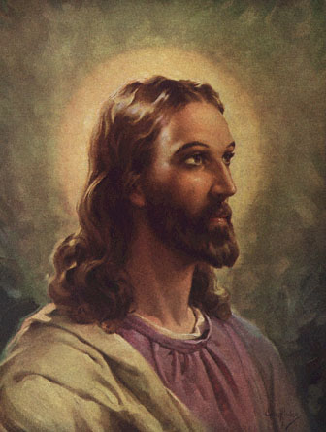
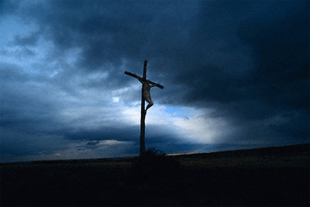
A Republic Becomes an Empire
Coming up next: The works of Jesus of Nazareth and Christianity would change the world forever

Slide 35
Constructive Response Question
Compare and contrast the Roman Republic and the Roman Empire using specific examples:
Classify the contributions the Romans made to the cultural advancement of the world?

