Slide 1
Morning Warm Up
Read Frogs at Risk.
Then complete the graphic organizer.

Slide 2
Incorporating Writing into Common Core Standards
Carrie Chambers chambersc@hcboe.net
Anna McCarter mccartera@hcboe.net

Slide 3
Agenda
Text Features of Non-Fiction
Incorporating Writing with Non-Fiction Text
Creating Checklist to assist in student writing
Examples of Writing with Fiction Text

Slide 4
Text Features of Non-Fiction Text

Slide 7
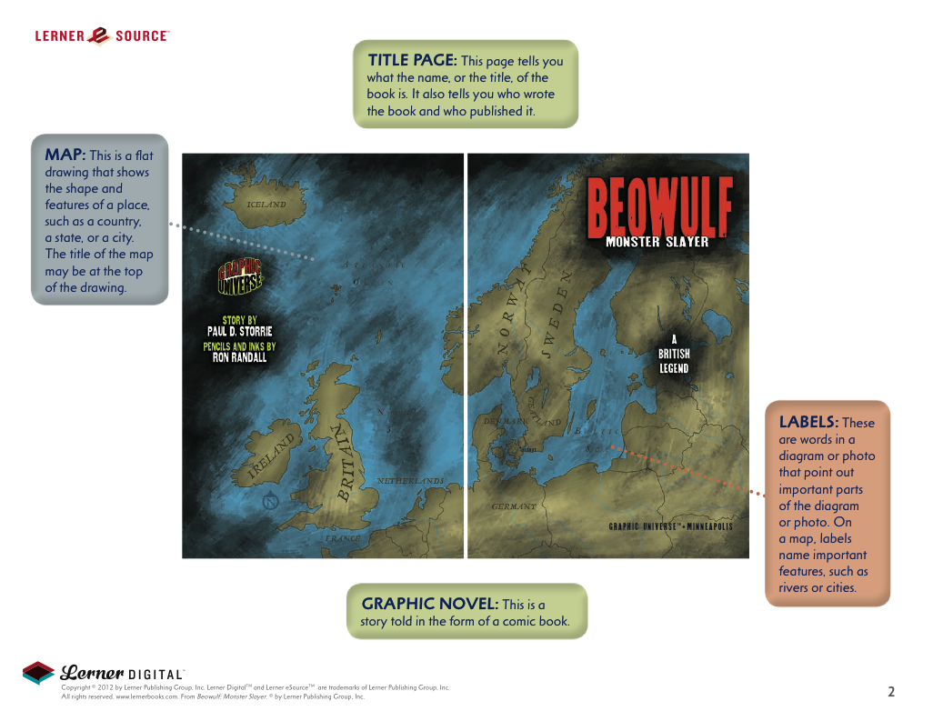

Slide 8
Incorporating Writing into Non-Fiction Text
Main Idea and Details
Compare and Contrasting
Writing from a perspective from a specific non-fiction person/animal/thing

Slide 9
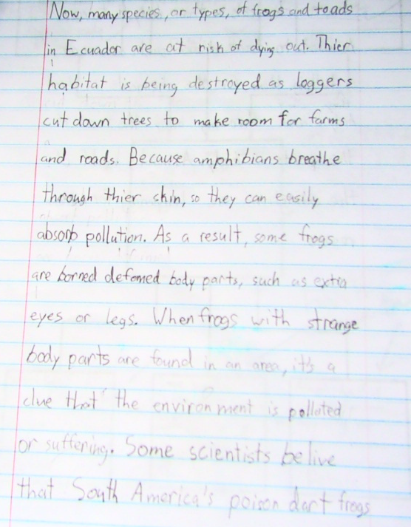
Main Idea and Details

Slide 10
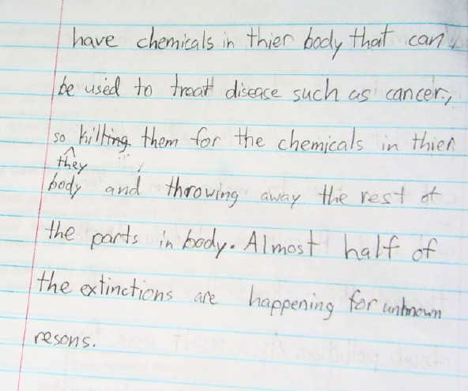
Main Idea and Details…

Slide 11
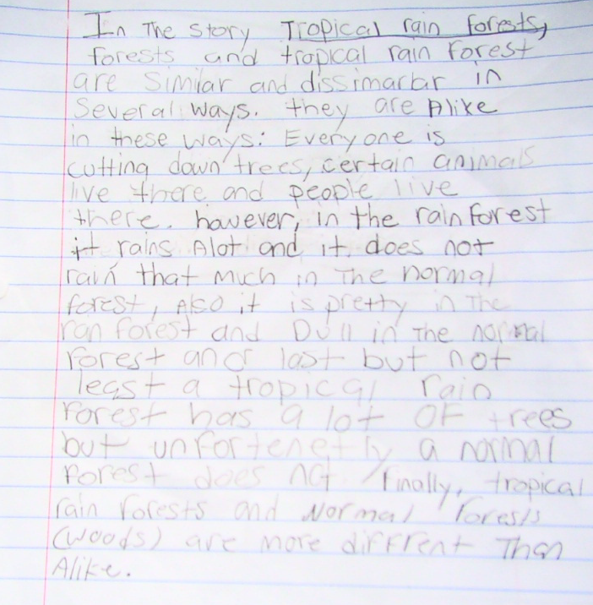
Comparing and Contrasting

Slide 12
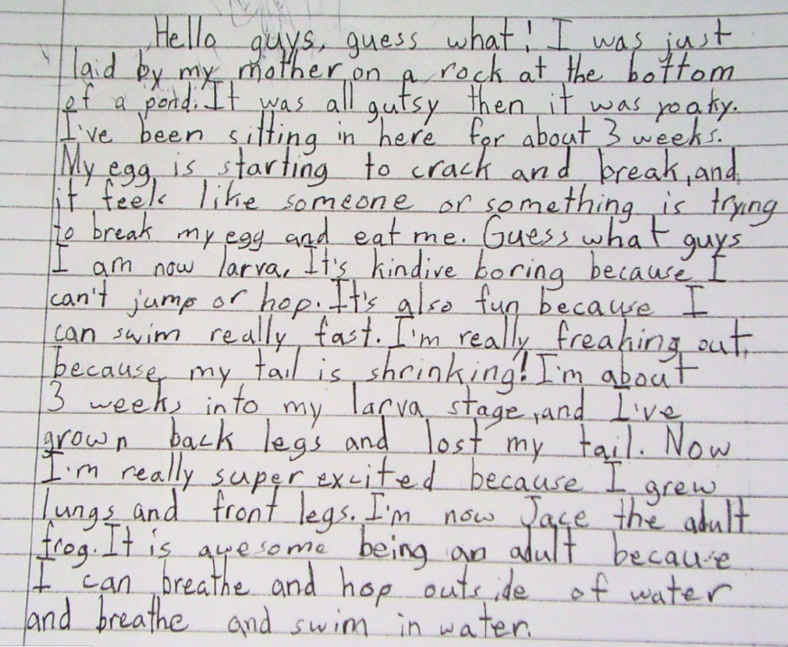
Writing from a perspective from a specific non-fiction person/animal/thing

Slide 13
Writing Checklists
What is the purpose of giving students a writing checklist?
What key elements should be included in a writing checklist?

Slide 14
Developing Writing Checklist
Group by grade level
Choose a genre or skill for writing
Discuss and Develop a checklist with your group

Slide 15
Incorporating Writing in Fiction
Write from a Character’s Perspective
Character Analysis/Sketch
Cause and Effect
Story Summaries
Comparing and Constrasting Novel and Movie/Characters
Rewrite the story ending
Book Letters
Create newspaper articles about characters or story events

Slide 16
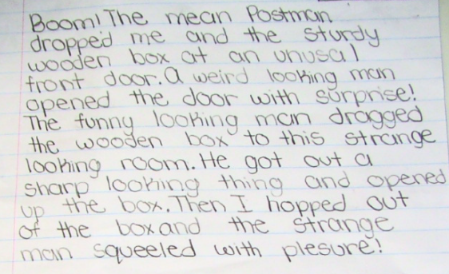
Write from a Character’s Perspective

Slide 17
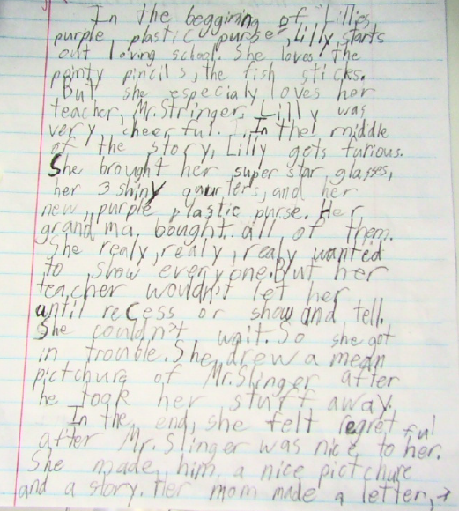
Character Sketch

Slide 18
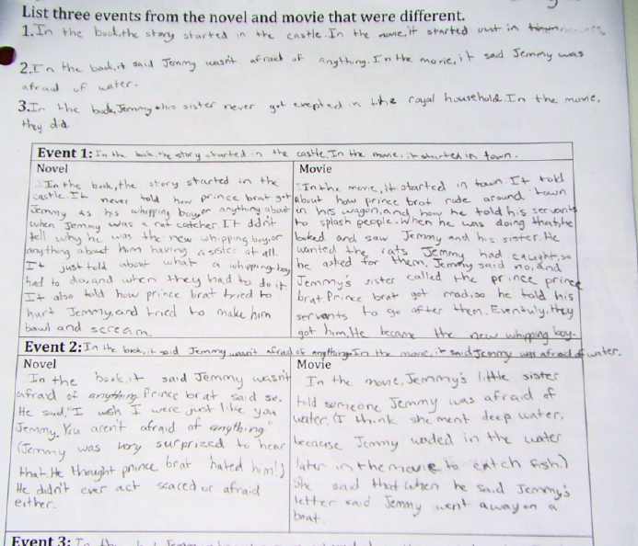
Comparing and Contrasting

Slide 19
Comparing and Contrasting

Slide 20
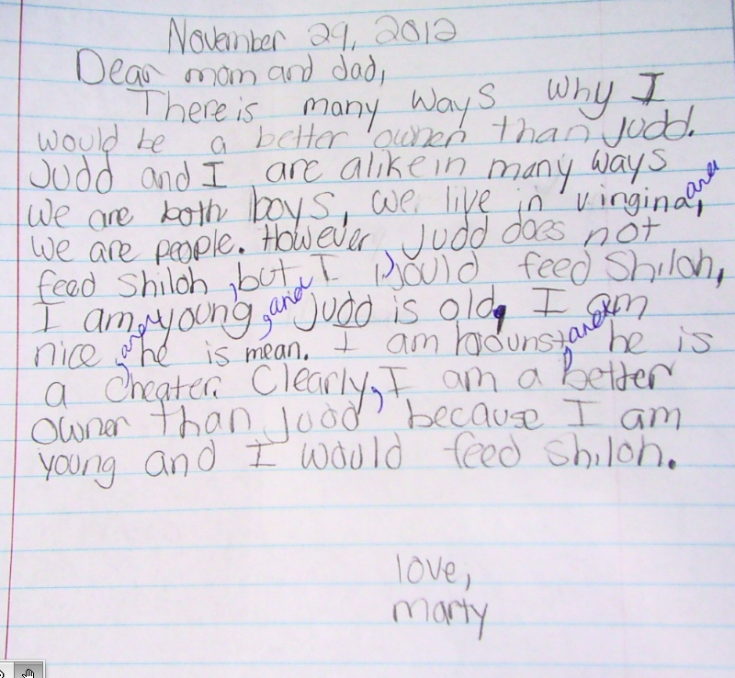
Book Letters

Slide 21
Websites for Resources
http://teacher.depaul.edu/Nonfiction_Readings.htm
http://www.readworks.org/books/passages
http://teacher.depaul.edu/Nonfiction_Reading_Resources.html
http://www.duke.edu/web/pfs/lessons/languagearts/lareadingnonfiction.html
http://www.literacynet.org/cnnsf/archives.html
http://teacher.depaul.edu/mainnavigator.html
http://teacher.depaul.edu/html/Guide_Assess_Nonfiction.html

Slide 22
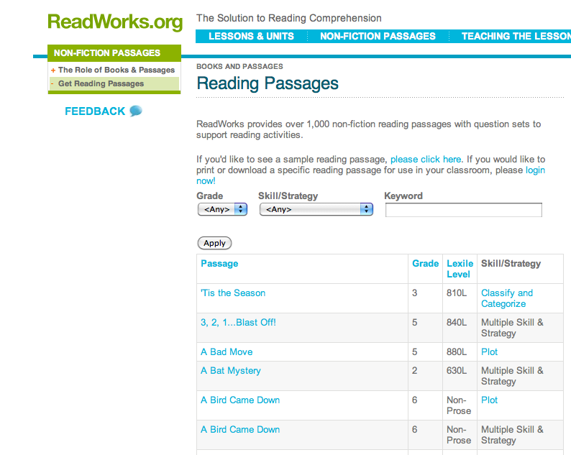
http://www.readworks.org/books/passages

Slide 23
http://teacher.depaul.eduNonfiction_Readings.htm

Slide 24
http://teacher.depaul.edu/Nonfiction_Reading_Resources.html

