Slide 1
Presenting videos in google meet with sound
HSSD Tech Department

Slide 2
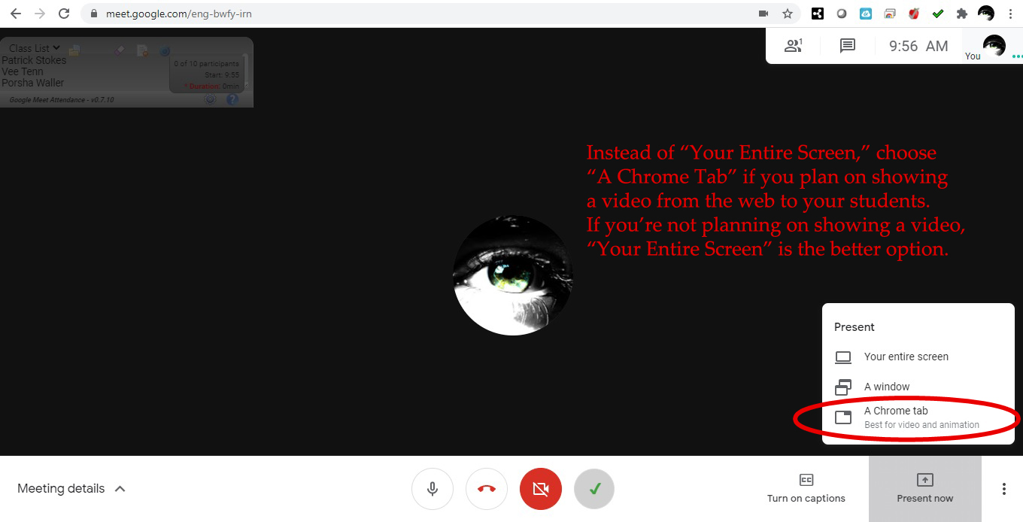

Slide 3
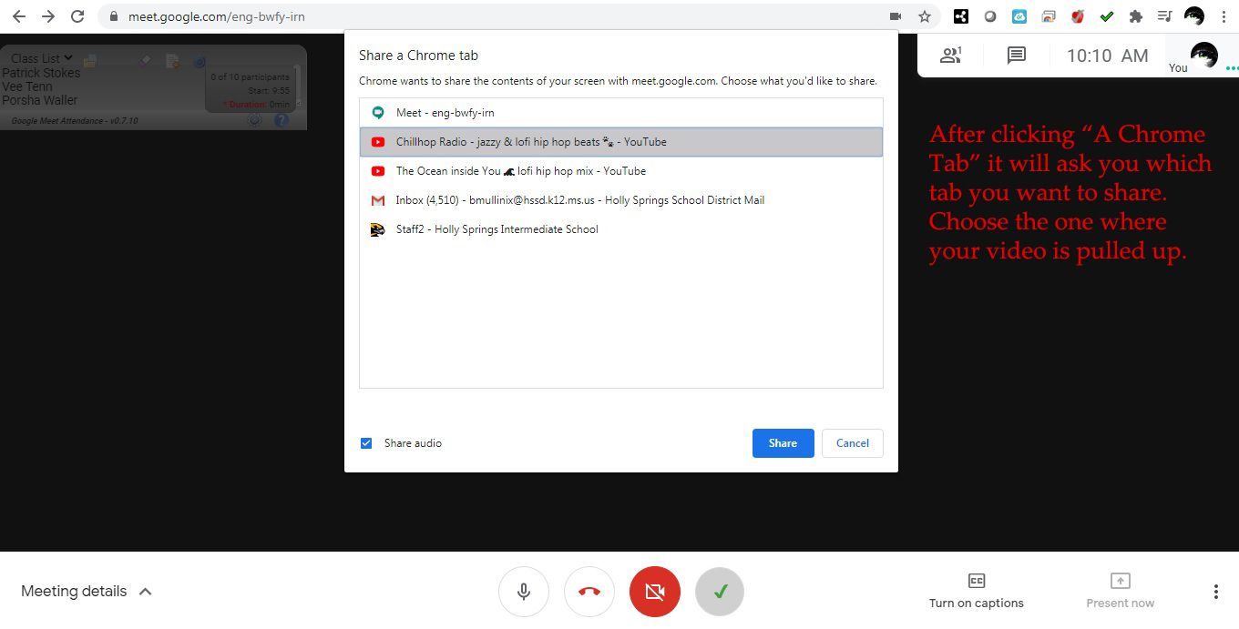

Slide 4
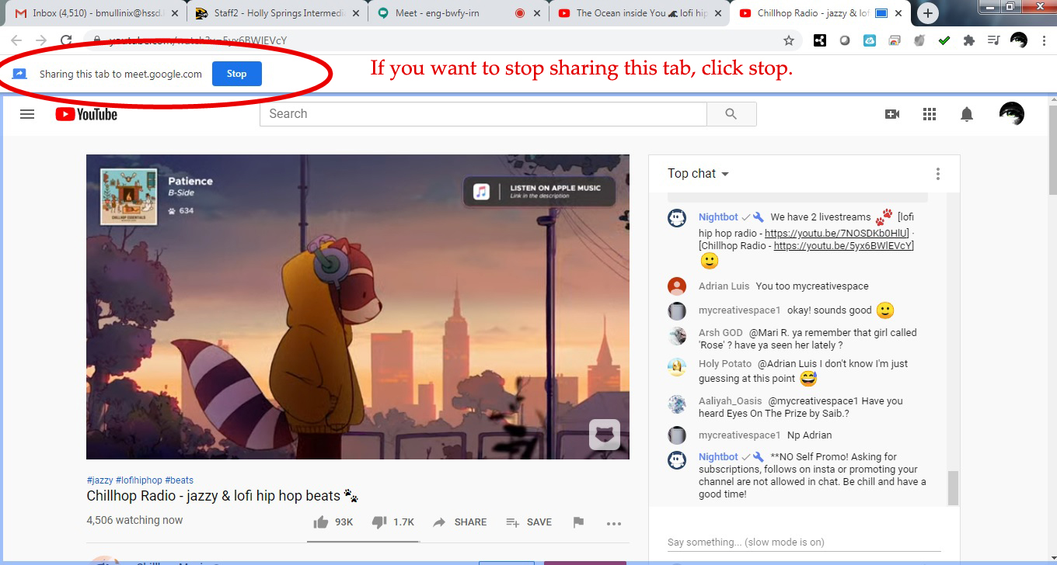

Slide 5
