Slide 1
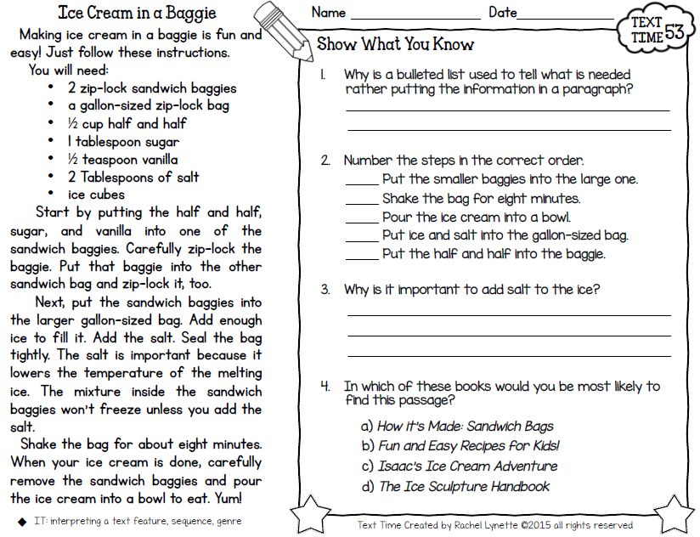

Friday, August 9, 2019
Read independent novel when finished! ☺
7:55 – 8:30

Slide 2
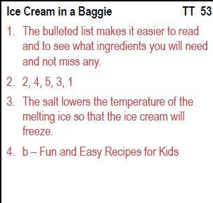

Slide 3
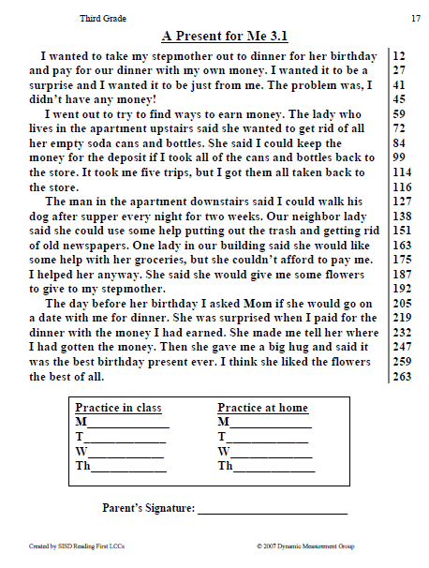
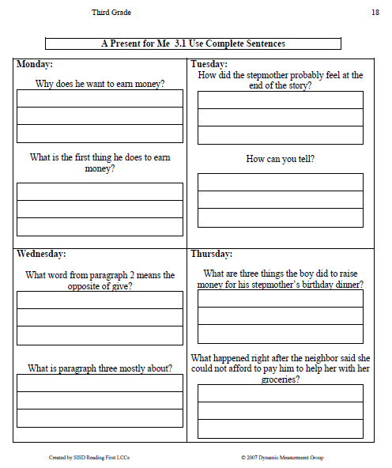
Homework Review - Thursday

Slide 4
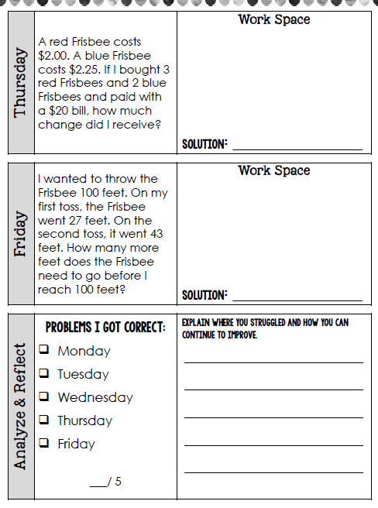
Homework Review – Thursday & Let’s complete Friday ☺
Did you RDW?
(Read, Draw, Write)
Read the problem
Draw and label items
Write an equation.
Write a word sentence (statement).

Slide 5
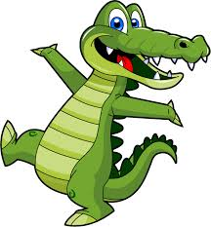
CHOMP TIME
F.A.S.T. Groups
Focused Academic Support Time

Slide 6
Finish Math
Pre-Assessment
Let’s see what we remember from second grade so I’ll know where we need to help you the most! ☺
8:40 – 9:10

Slide 7

Restroom Break
9:10 - 9:20

Slide 8
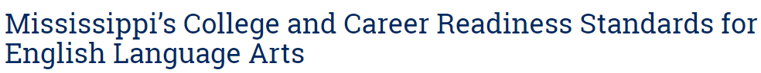

Reading Time
9:20 – 9:55
Objective: RL.3.1
I can ask and answer questions to demonstrate understanding of a text, referring explicitly to the text as the basis for answers.
Objective: RL.3.7
I can explain how specific images and illustrations contribute to or clarify a story.

Slide 9

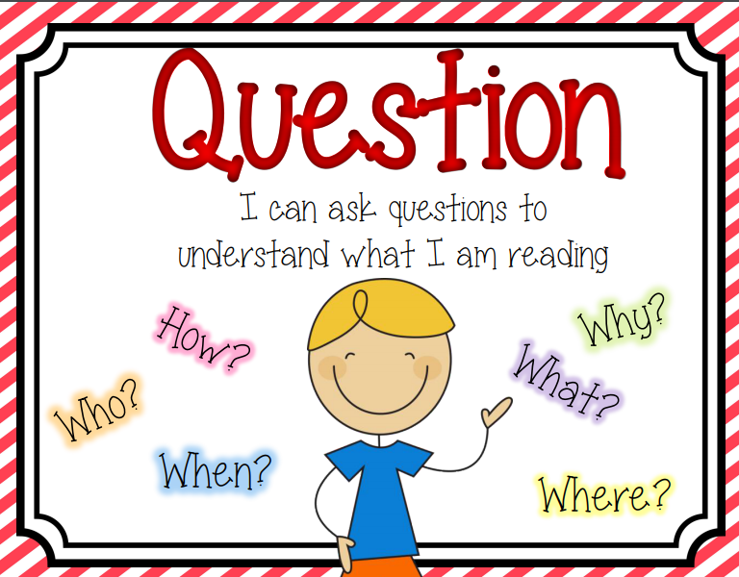
READING STRATEGY Review:
Questioning
HOMEWORK REMINDER
You and your parents can help your reading by asking:
-Who is the main character in the story?
-Who are the other characters in the story?
-Where do you think the story takes place? Why?
-When do you think the story takes place? Why?
-What is the problem in the story?
-How is the problem solved?
-Why do you think the author wrote the story? Why?

Slide 10

Gather at the Carpet…
Are we still doing our best?

Slide 11
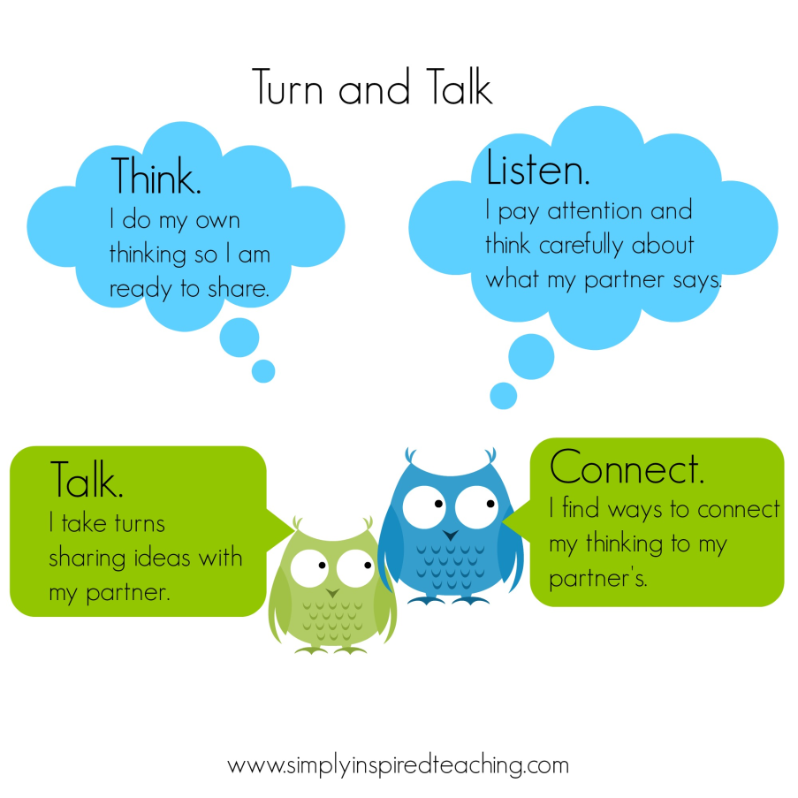
Review Turn to your Partner…
Purpose of talking to a partner is to give everyone a chance to think more about what they are learning.
It is important for each of you to look at your partner when they talk and to take turns talking and listening so that both of you get to share.
Objective: SL.3.1b Follow agreed-upon rules for discussions (e.g., gaining the floor in respectful ways, listening to others with care, speaking one at a time about the topics and texts under discussion).

Slide 12
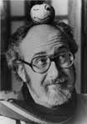


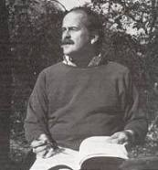
Another book with the same characters by the same author and illustrator!

Slide 13
Listen carefully and think about what is happening in Miss Nelson Has A Field Day.
Pay attention to how the two stories are similar, or alike, and how they are different.

Slide 14
After p17:
What has happened in the story so far?
What do you think will happen next?
Turn to your Partner

Slide 15


Classroom Discussion
What happens in this story?
What is surprising about the ending of the story? Why is that surprising?

Slide 16
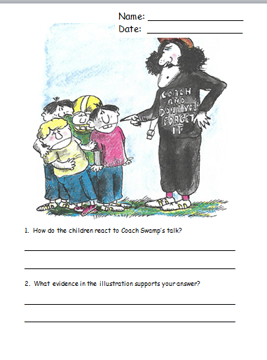
Comprehension Check
9:55 – 10:10

Slide 17

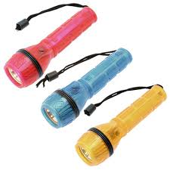

Independent Daily Reading & Teacher Conferences!
Flashlight Friday
IDR – Individualize daily reading time
    Be sure your book is at the right level – It will help you become a stronger reader
      Interests you
      Not too difficult
      Not too easy
        Count the words on the page you do not know – more than 5 = too hard; 1 word = too easy
10:10 – 10:25

Slide 18
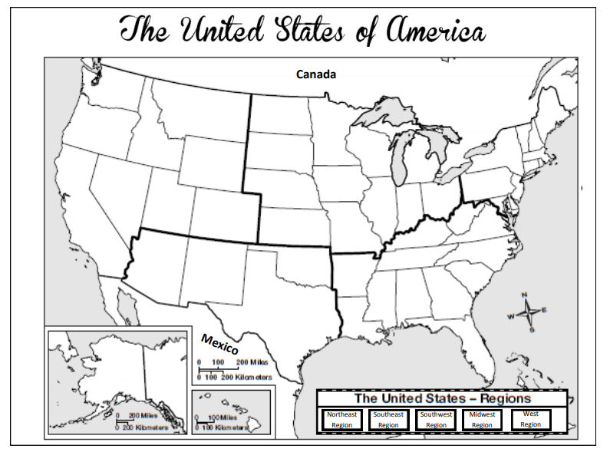
Snack Time & Map Work!

Slide 19
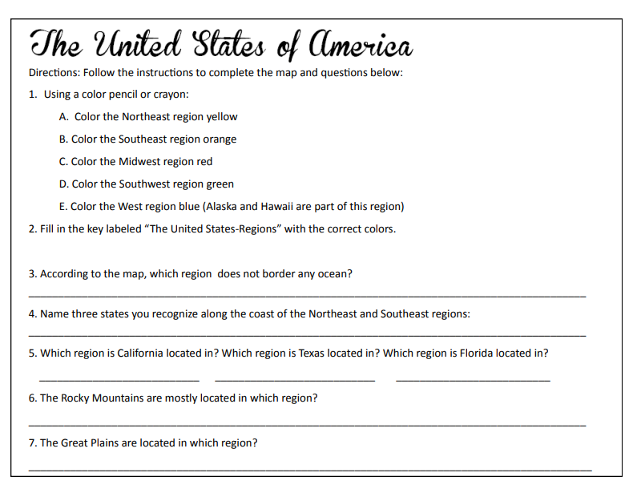

Slide 20

Out of Classroom!
Recess 10:40 – 11:05

Slide 21

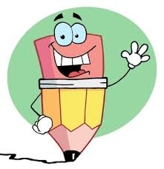

Writing Time
Objective: W3.3
I can write narratives to develop real or imagined experiences or events using effective technique, descriptive details, and clear event sequences.
11:05 – 12:10

Slide 22
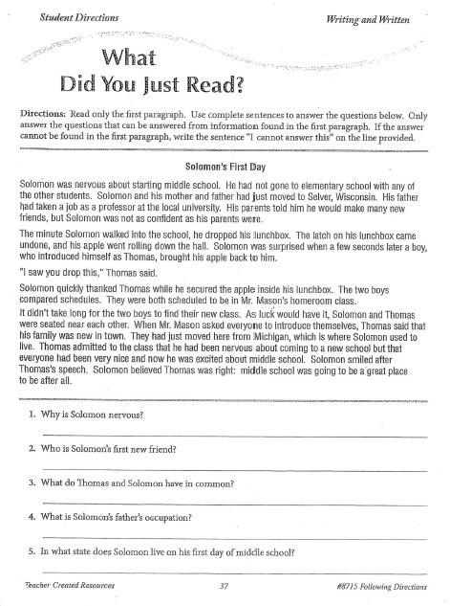
Is it important to understand the directions?
11:05 – 11:20

Slide 23
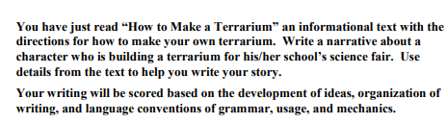
Writing Prompts – Break it Down!
What do you think this is asking you to do? – Let’s think about it and break it down.
11:20 – 11:25

Slide 24
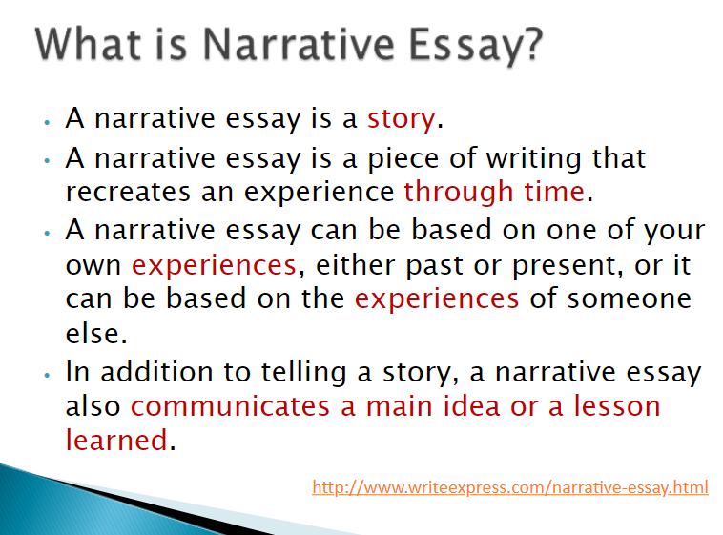

Slide 25
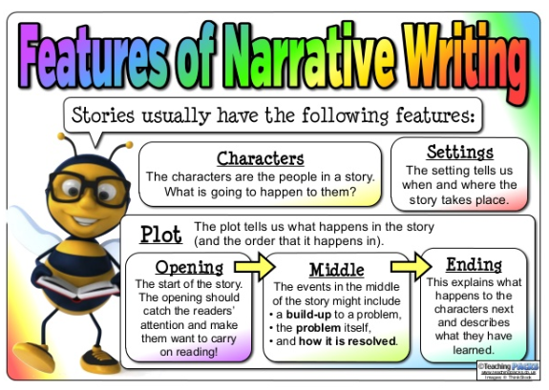
11:25 – 11:30

Slide 26
Now, let’s look at that writing prompt again.
What do we have to be sure and include in our narrative or story?
– Let’s think about it and break it down.
11:30 – 11:35

Slide 27
Classroom
Getting to Know You Activity!
11:30 – 11:40

Slide 28
Kagan Classbuilding ☺
Quiz-Quiz-Trade:
“Respect and Responsibility”

Slide 29
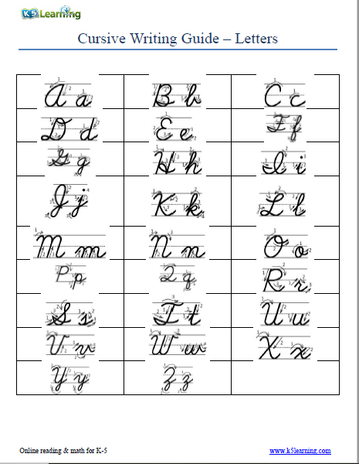
Intro to Cursive
11:40 – 11:45

Slide 30
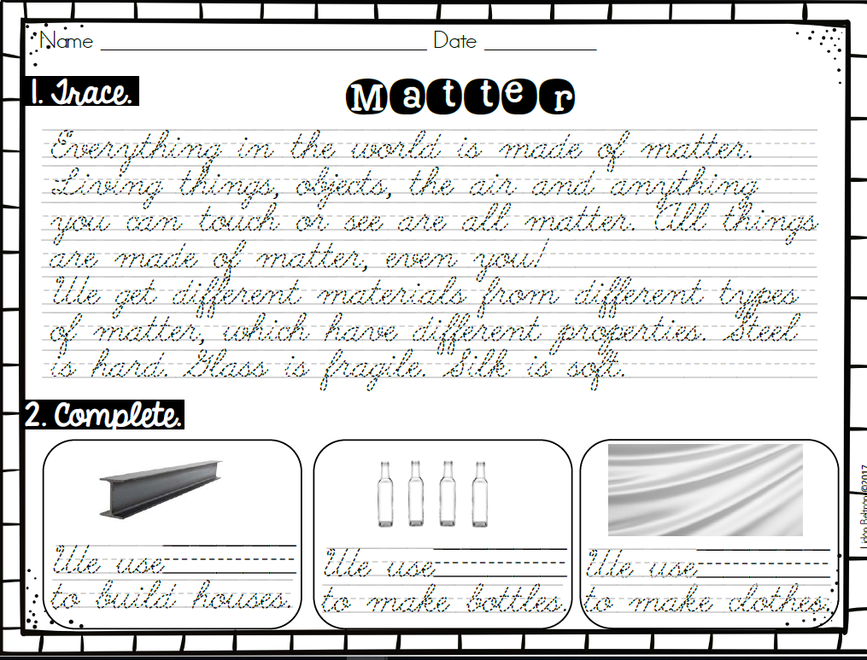
11:45 – 11:55

Slide 31
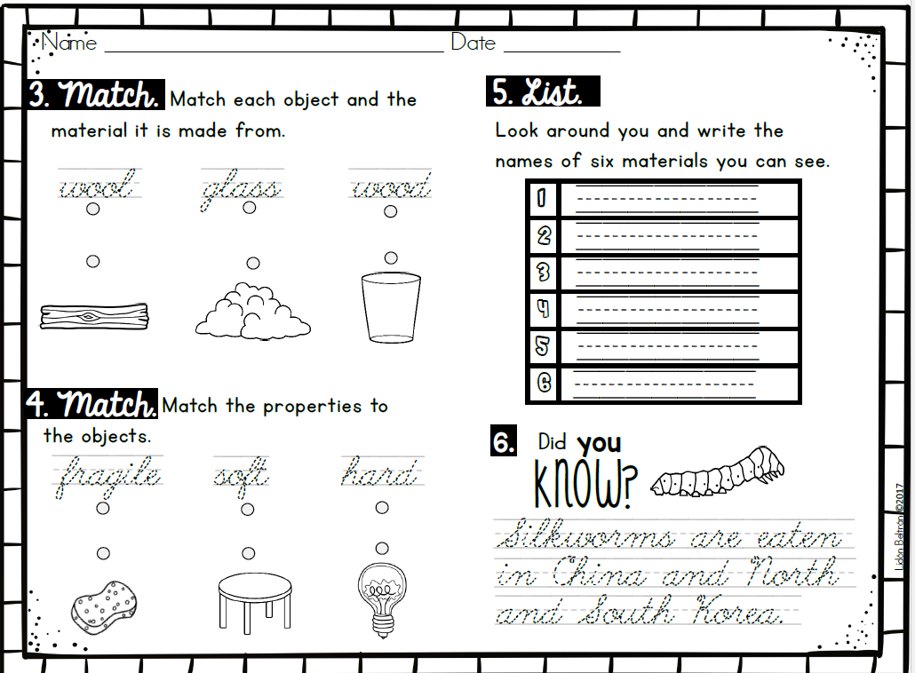
11:55 – 12:10

Slide 32
7 Habits of Highly Effective People
Habit #1: Be Proactive
Habit #2: Begin with the End in Mind
Habit #3: Put First Things First
Habit #4: Think Win-Win
Habit #5: Seek First to Understand, Then to Be Understood
  I listen to other people’s ideas and feelings.
  I try to see things from their viewpoints.
  I listen to others without interrupting.
  I am confident in voicing my ideas.
  I look people in the eyes when talking.

Slide 33
7 Habits of Highly Effective People
Habit #1: Be Proactive
Habit #2: Begin with the End in Mind
Habit #3: Put First Things First
Habit #4: Think Win-Win
Habit #5: Seek First to Understand, Then to Be Understood
Habit #6: Synergize
  I value other people’s strengths and learn from them.
  I get along well with others, even people who are different than me.
  I work well in groups.
  I seek out other people’s ideas to solve problems because I know that by teaming with others we can create better solutions than any one of us alone.
  I am humble.

Slide 34
7 Habits of Highly Effective People
Habit #1: Be Proactive
Habit #2: Begin with the End in Mind
Habit #3: Put First Things First
Habit #4: Think Win-Win
Habit #5: Seek First to Understand, Then to Be Understood
Habit #6: Synergize
Habit #7: Sharpen the Saw
  I take care of my body by eating right, exercising, and getting sleep.
  I spend time with family and friends.
  I learn in lots of ways and lots of places, not just at school.
  I take time to find meaningful ways to help others.

Slide 35
Math Time!
12:10 – 12:35

Slide 36

End of Year Goal: Master standards to pass State Tests
12:10 – 12:30
https://ms.nextera.questarai.com/tds/#practice
Practice Tests – Available Online

Slide 37

Kicking it Quiz!
12:30 – 12:32…

Slide 38

Out of Classroom!
Lunch 12:35 – 1:05

Slide 39

Restroom Break
1:05 – 1:10

Slide 40

Out of Classroom!
Activity 1:10 – 1:55

Slide 41
Math Time!
1:55 – 2:15

Slide 42
Application Problem
Math Stash
http://studyjams.scholastic.com/studyjams/jams/math/problem-solving/pscreating-equations.htm
There are 83 girls and 76 boys in the third grade. How many total students are in the third grade?
Review: RDW = Read, Draw, Write
Read the problem
Draw and label items
Write an equation.
Write a word sentence (statement).

Slide 43
Application Problem
There are 83 girls and 76 boys in the third grade. How many total students are in the third grade?
There are 159 students in third grade.
Bar/Tape Method: OR Number Bond
83
Girls ?
76 83 76
Boys
83
+76
159

Slide 44
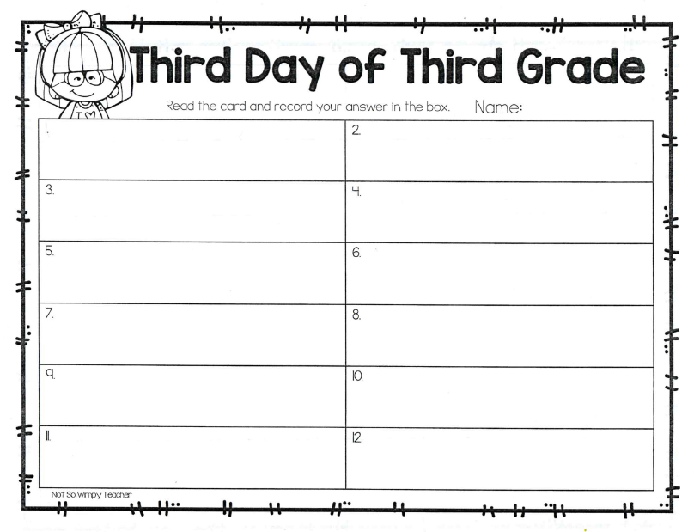
Rotunda Search!!

Slide 45

SCIENCE TIME
Objective: P.3.5.1
I can plan and conduct scientific investigations to determine how changes in heat (i.e., an increase or decrease) change matter from one state to another (e.g., melting, freezing, condensing, boiling, or evaporating).
2:35 – 3:15

Slide 46
Gather at the Carpet…
We should be professionals at this by now! ☺

Slide 47
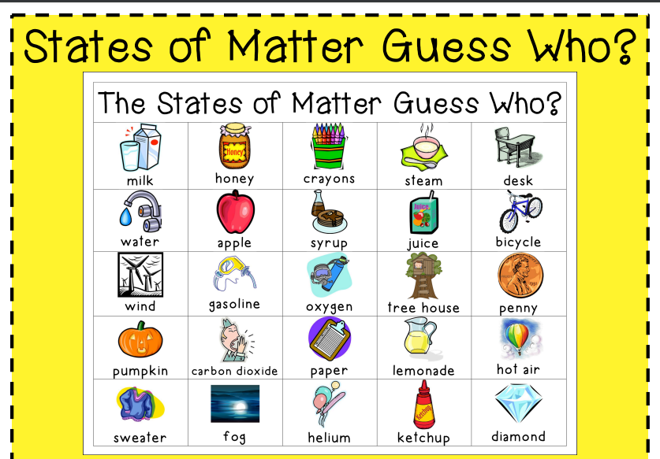
I’m thinking of one of these. You can only ask yes or no questions to determine which one I chose. Be sure you think states of matter for your first question. ☺

Slide 48




3:20 – 3:25 Wrap Up!
Pair-Up back to back and share one thing you learned in class today with your partner
Pack-Up
Office will announce:
Car Riders – Leave around 3:25
Bus Riders – (listen to intercom for dismissal)
2:30 – 3:20
How much time has elapsed?

