Slide 1
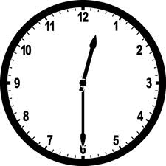
Time Unit
3rd Grade EnVision
Topic 12

Slide 2
Lesson 12-1
Time to the Half Hour and Quarter Hour

Slide 3
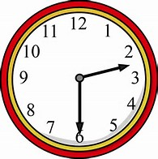
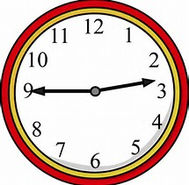
Objective
I can tell time to the nearest half hour and quarter hour using analog and digital clocks, and identify times as A.M. or P.M.

Slide 4
Vocabulary

Slide 5
Vocabulary

Slide 7
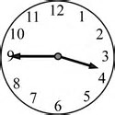
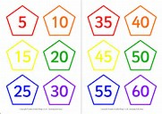
Set the purpose
You know how to tell time to the hour. You also know how to count by ones and fives. Today, you will use these skills to help you tell other times on a clock.

Slide 8
What are some important times in your day?
How do you know when its time to go?

Slide 9
Connect
In your daily life, when is reading a clock and being able to tell time important?
Waking up to get to school on time.
Going to a doctor’s appointment
Going to recess and lunch at school.
Being on time for a job.

Slide 10
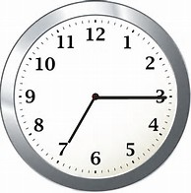
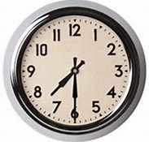
Pose the problem
Alana needs to call her friend at 7:15. Then she needs to leave for school at 7:30. How can you use your clock face to show these times so she will be on time?

Slide 11
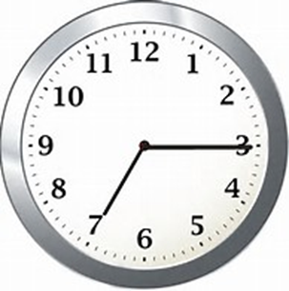
Whole-Class Discussion
Where is the minute hand on
On the 3.
Where is the hour hand?
On the 7.
The time is said 7:15 or a quarter past 7

Slide 12

Whole-class discussion
Where is the minute hand at 7:30?
On the 6.
Where is the hour hand?
Halfway between 7 and 8.
Thirty minutes is half an hour. If the 12 shows the beginning of the hour, what does the 6 represent? Why?
A half hour because the six is halfway around the clock
7:30 is also called half past 7:00.

Slide 13
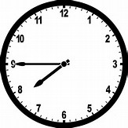
What time does the clock show?
7: 45
How many minutes is it before 8:00?
15 minutes
What might another name be for this time that uses fractions?
A quarter to 8.

Slide 14


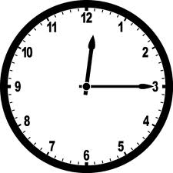
How much of the circle is green?
One half
Half past
How much of the circle is orange?
One quarter
Quarter after

Slide 15
Teaching Tool 25
Partner 1 says a time – quarter or half past the hour.
Partner 2 draws the hands, and writes the time in two ways (digital and words).
Then the partners switch roles.

Slide 16
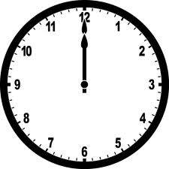

A.M. and P.M.
The hours of the day between midnight and noon are A.M. hours.
12:00 a.m. to 11:59 a.m.

Slide 17
A.M. and P.M.
The hours between noon and midnight are P.M. hours.
12:00 p.m. to 11:59 p.m.

Slide 18
Do you go to sleep at night in the AM or PM?
P.M.

Slide 19
Do you wake up in the AM or PM?
A.M.

Slide 20
Eat dinner?
Have lunch?
Leave School?
Have math class?
P.M.
P.M.
P.M.
A.M.

Slide 21
What time would you eat lunch, 11:30 a.m. or 11:30 p.m.?
11:30 A.M.
11:30 P.M. is late at night!
What time would you play outside, 4:00 a.m. or 4:00 p.m.?
4:00 P.M.
4:00 A.M. is really early in the
morning!

Slide 22
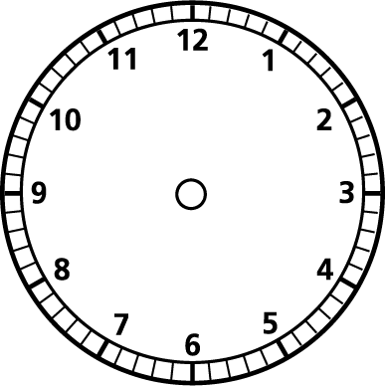

Slide 23
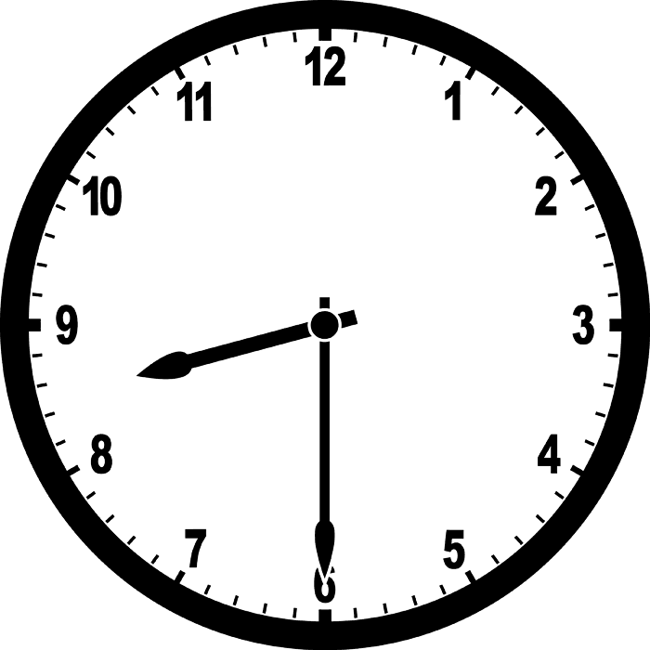
If we start Reading at 8:30 a.m., how else can we say it?
Half past 8
30 minutes past 8
eight thirty

Slide 24
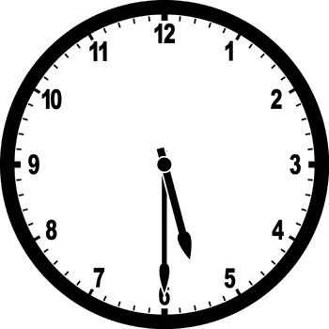
Anytime the minute hand is pointing to the 6 you can say the time is “half past” the hour.
Make your own “half past” on your clock and then tell what it says.

Slide 25
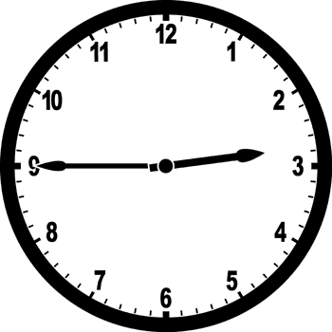
We are out of school by 3:45 every day. How can we say it?
quarter to 4
15 minutes to 4
three forty-five.

Slide 26
Anytime the minute hand is pointing to the 9 you can say the time is “quarter to” the next hour.

Slide 27
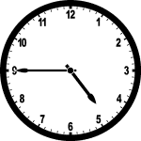
Quarter to 5
4:45

Slide 28
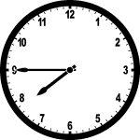
Fifteen minutes to 8
7:45

Slide 29
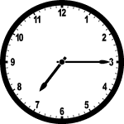
Fifteen minutes after 7
7:15

Slide 30
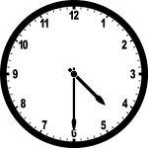
Half past 4
4:30

Slide 31
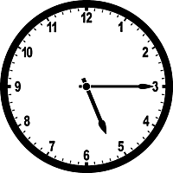
Quarter after 5
5:15

Slide 32
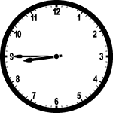
Quarter to 9
8:45

