Slide 1
Autauga County Schools
Spence Agee, Superintendent
Every Student a Graduate; Every Graduate a Success

Slide 2
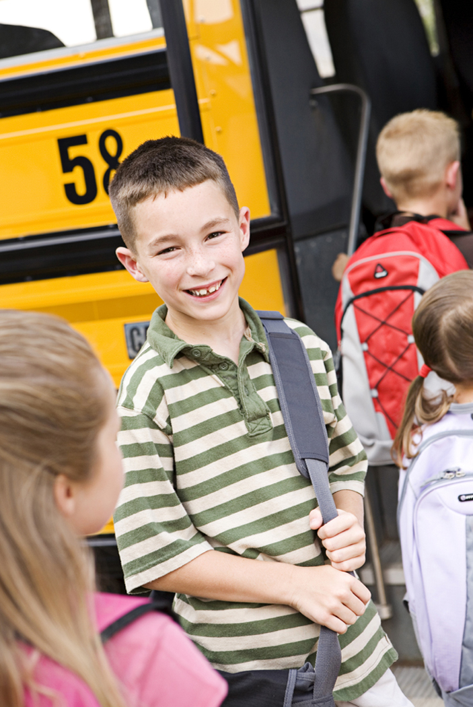
Autauga County Schools
OUR STUDENTS
9,826 Students
46% Free/Reduced Lunch Students
9% Special Education Students
6% Gifted Students
3% English Language Learners

Slide 3
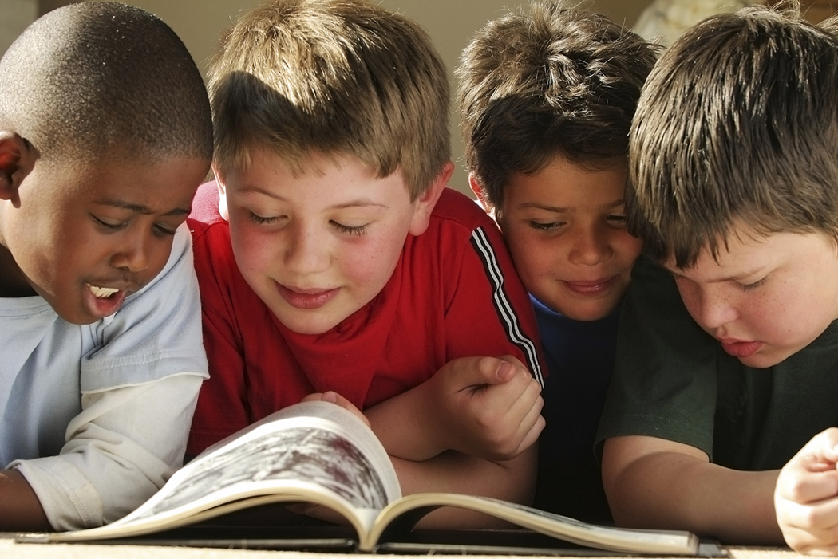
Autauga County Schools
Highest Graduation Rate in River Region Area- 81%
Made AYP in all areas: Reading, Math, Graduation Rate, & Attendance
ACT scores above state average in all areas

Slide 4
Autauga County Schools
91% of students in Grades 3-8 are at or above proficiency level in Reading
89% of students in Grades 3-8 are at or above proficiency levels in Math

Slide 5
Changes for 2012-2013
Implement Alabama’s Common Core Standards
Expand the role of Reading Coach K-3 to Instructional Coach K-12
Establish Ninth Grade Academy and hire a Graduation Coach at PHS
Implement new research-based language arts program for at-risk students

Slide 6
Changes for 2012-2013
Implement Positive Behavior Supports model to reduce discipline infractions
New truancy policy
Renovate the district website
Implement new STRATEGIC PLAN
Promote student learning
Increase parent & community involvement
Demonstrate fiscally responsible practices

Slide 7
FUNDING CHALLENGES
Steps to recoup state mandated operating balance
Student textbooks
School Bus- Fleet Renewal
Five Year Capital Improvement Plan

Slide 8
TRENDS IN EDUCATION
Implementation of new College & Career Readiness Standards
ACT Quality Core
New State Accountability System

Slide 9
Autauga County Schools Every Student a Graduate; Every Graduate a Success
STRATEGIC GOALS:
Promote student learning.
Increase parent & community involvement
Demonstrate fiscal responsibility

