Slide 1
Chapter 1
Making Healthy Decisions

Slide 2
What is Health?
Health: the overall well-being of your body, your mind, and your relationships with other people.
Two factors that can be used to evaluate health are life expectancy and quality of life.

Slide 3
Continued…
Life Expectancy: number of years a person can expect to live.
In the year 2000, life expectancy was at an average of 75 years old. By 2050, life expectancy is projected to be 80+ years old.
Why do you believe life expectancy is increasing? Is there any reason it could decrease?

Slide 4
Continued…
Quality of life: degree of overall satisfaction that a person gets from life.
Example: Two women are born in the same area. One lives an adventurous, healthy lifestyle, the other is sick often and stays home a lot. Both have the same life expectancy but a different quality of life.
Goal: a result that a person aims for and works hard to reach.
Example: New Year’s Resolutions

Slide 5
Aspects of Health
4 aspects of health are important to overall well- being…
Physical Health: how well your body functions.
Mental Health: state of being comfortable with yourself, with others, and with your surroundings.
Emotional Health: how you react to events in your life.
Social Health: how well you get along with others.

Slide 6
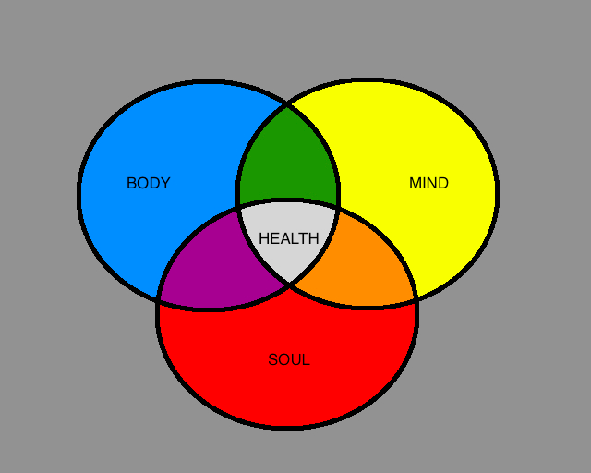

Slide 7
A Continuum of Health
Would you say that you are in perfect health or in poor health?
Continuum: a gradual progression through many stages between one extreme and another.
Wellness: a state of high-level health. (Do not confuse this with the definition of health).

Slide 8
Health Continuum
Refer to the top of page 5 for the continuum.
Your location on the health continuum is not always in one spot.
Many of the choices you make on a daily basis affect your position on the health continuum.
You have more control over your life than you think.

Slide 9
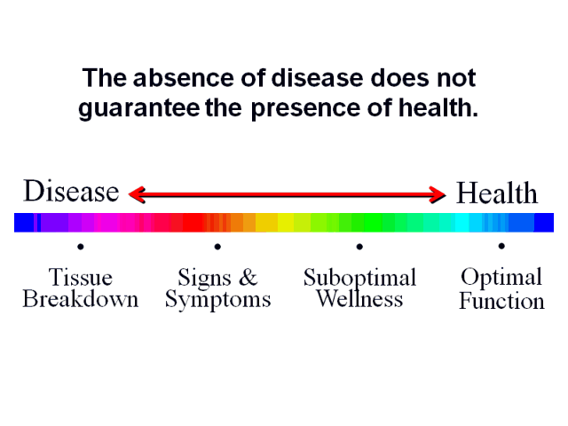
Question???
How could deciding not to smoke affect your position on the health continuum?

Slide 10
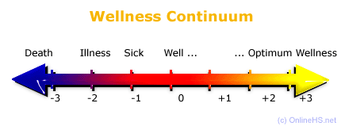
Where are you on the health continuum?

Slide 11
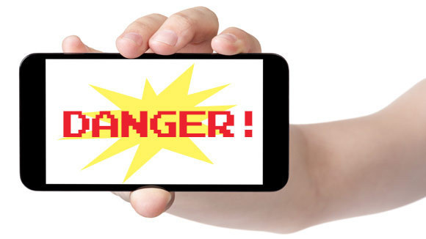
Identifying Health Risks
Fact or Myth?
Using a cell phone puts a person at risk for developing cancer.
MYTH
Truth: Cell phones DO NOT increase the risk of developing cancer. But, using a cell phone while driving does increase your risk of an accident.

Slide 12
??????
Where do you think people get their information about health risks?
How reliable are those sources of information?

Slide 13
Health Influences
Heredity: all the traits that are passed biologically from parent to child.
Examples: skin color, eye color, height, ability to curl your tongue, Achoo syndrome (when exposed to light you suddenly sneeze), far/near sighted, hand clasping, etc.
Gender: whether you are a male or female.

Slide 14
Continued…
Environment: all of the physical and social conditions that surround a person and can influence that person’s health.
Examples: air you breath, noise, radiation, smoke inhalation, sun exposure, etc.
Can be indoor and outdoor risks.

Slide 15
Continued…
Social Environment: includes the people you spend time with.
Most people learn their first basic health lessons from their family.
Who else can influence you?

Slide 16
Continued…
Culture: beliefs and patterns of behavior that are shared by a group of people and passed from generation to generation.
Examples: religions, regions, etc.

Slide 17
Fun Culture Facts
French people have the longest life span for women, the third longest for men, and they have thefastest train in the world clocked at 357mph! If you feel the need for speed and the desire to live a long time, France may be your country.
People in Western China, Tibet, and Mongolia put salt in their tea.
In Tibet, it is considered polite to stick out your tongue at your guests.
The top 4 sources of caffeine in the American diet are coffee, soft drinks, tea, and chocolate.

Slide 18
Influences Continued…
Media: forms of communication that provide news and entertainment.
Average teen spends about 20 hours a week watching television.
What are some of the negative aspects of media?

Slide 19
Technology and Health
What are some positive aspects of technology?
What are some negative aspects of technology?
Have you ever googled your symptoms?
Do the positive influences outweigh
the negative influences?

Slide 20
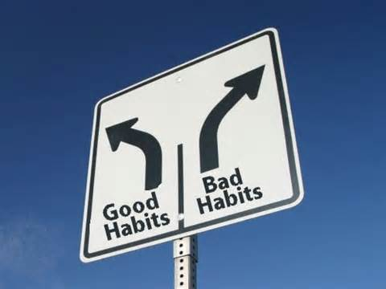
More influences…
Technology
Healthcare
Behavior
Habit: behavior that is repeated so often that it becomes almost automatic.

Slide 21
Habits girls have and don’t even know they have them!
We always apply mascara with an open mouth and, if we ever attempt to shut it up, we always mess up and get that mascara stain.
We definitely need to check out how we look in the mirror before hitting the outside world.
On average, we have over 50 different items in our bathroom most of which men would hardly identify.

Slide 22
Habits
What are a few unhealthy habits?
What are some excuses a person might offer for not being able to break the habit?
What could you say to argue against their excuses?

Slide 23
Evaluating Health Risks
Risk factor: any action or condition that increases the likelihood of injury, disease, or other negative outcome.
You can evaluate a risk factor by:
Considering both the short and long term consequences.
Decide whether you can control the risk factor.
Analyze the possible benefits and risks of a decision.

Slide 24
Analyzing Benefits and Risks
Situation: A friend who only has a learner’s permit offers to drive you home so you don’t miss curfew. What are the risks and benefits of accepting this offer?
Benefits | Risks
Home before curfew | Inexperienced driver crashes car
Avoid arguments with parents | Parents are angry about the decision
Show confidence in friend’s skills | Friend loses permit or is arrested

Slide 25
Crazy Risks Teenagers Have Taken This Year… Already!!
Kids were snorting Smarties so much that letters had to be sent home to parents warning them of the side effects, like nose maggots.
Florida teenager filming himself driving "like an idiot" gets into car accident involving four other vehicles. He's seriously injured, and while in the hospital, he uploads the video of him crashing to YouTube, which helps police arrest him for reckless driving.

Slide 26
Crazy Risks Teenagers Have Taken This Year… Already!!
A teenager got stuck in a storm drain after she dropped her iPhone down it. She had to be airlifted out.
Teenager gets two (that's right, two) tattoos of McDonald's receipts on his arms.
Teenagers (but also adults) wrapped their faces in tape and took selfies. It looked painful. And hilarious.

Slide 27
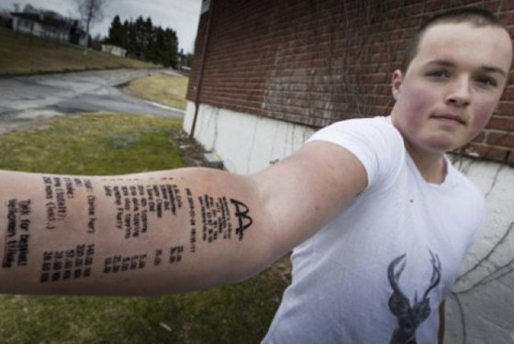

Slide 28
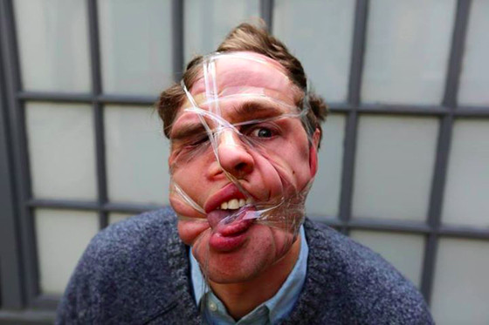

Slide 29
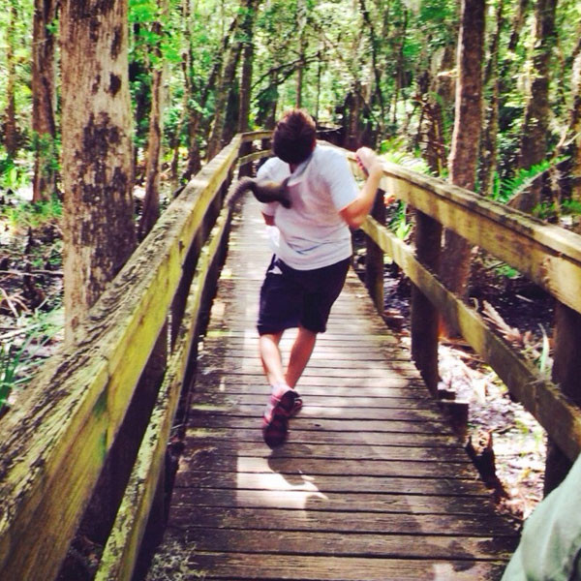
And the Best…
Teenager takes a selfie with a squirrel and then immediately gets attacked by the squirrel.

Slide 30
Taking Responsibility For Your Health
Healthy People 2010 has 2 broad goals.
1. Increase the years of healthy life for each American.
2. Eliminate differences in health based on race, ethnic group, or income.
Leading causes of death for young people are motor- vehicle injuries, homicide, suicide, cancer, and heart disease.

Slide 31
Healthy People 2020
Has 4 broad goals:
Increase the quality of years of healthy life
Eliminate differences in health based on race, ethnic group, or income
Create social and physical environments that promote good health
Promote healthy behaviors, health development, and quality of life across all life stages

Slide 32
There are three steps you can take to help you meet your personal health goals…
1. Gaining Awareness
2. Gaining Knowledge
3. Building Health Skills
Values: standards and beliefs that are most important to you.
Action Plan: series of specific steps you can take to achieve the goal.
Advocacy: using communication to influence and support others in making positive health decisions

Slide 33
Health Literacy
A person with health literacy has the ability to gather, understand, and use health information to improve his or her health.
What is your most common source of health information? What is your most reliable source?

Slide 34
Proposal
Think for a moment and identify a small, but important change that could make our school a healthier place to live…
What would it be? What might be some obstacles might you have to overcome to make this change a reality?

Slide 35
Define the problem
Explore the alternatives
Consider the consequences
Identify your values
Decide and act
Evaluate the results
D
E
C
I
D
E

Slide 36
Being a Wise Health Consumer
Consumer: buys products or services for personal use.
Some factors to consider before buying a product are:
Safety
Cost
Warranty (an offer to repair or replace the product if there is a problem)
Consumer testing

Slide 37
Advertising
Advertising: public promotion of a product or service
Ads can let you know what products and services are available, but they rarely provide the information you need to make wise choices.

Slide 38
Advertising Methods
Method | Message
Scientific Studies | Scientific tests prove the product is effective
Bandwagon approach | Everyone is using the product. You should too.
Testimonial | The product is effective because trustworthy people recommend it
Comparison to other products | The product is more effective than others
Emotional appeal | The product is the safest for you and your family
Price appeal | The product gives more for your money

Slide 39
What are these methods?
1
2
3
4

Slide 40
Did you Know?
Including all media, the average teen sees between 20,000 and 40,000 advertisements each year.
Do you believe advertisements has a major influence on teen behavior and health?

Slide 41
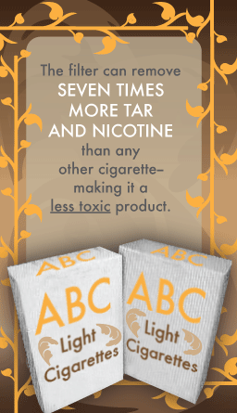
Health Fraud
Fraud: if a person tells lies to obtain money or property.
Quackery: people who sell useless medical treatments or products.

Slide 43
Top Telemarketing Scam
The Unknown Caller – You may receive a call that your computer security has been compromised and that they can help you, or that your grandchild is in jail and in need of money. In either case, it is a cold call that has come out of the blue and is asking you to take action quickly and send money now.

Slide 44
Top Youth Scam
The Insta-scam – A social media mobile app like Instagram targets a lot its young users because its followers are readily willing to “like” or share a picture. Through a mobile app like Instagram, a scammer can post pictures of prize giveaways that look to be linked to big brands and retailers, but in reality may redirect you to online quizzes or other websites trying to get your credit card information.
Users of the social media app may share or “like” a promo in order to fulfill the contest rules, but in reality they are just giving help to spammers and will never get a prize.

Slide 45
Rights as a Consumer
1. Right to information
2. Right to consumer protection
3. Right to complain

Slide 46
Health Around the World
Do you think American school lunches are more or less healthy than other schools around the world?

Slide 55
This puts it into perspective

