Slide 1
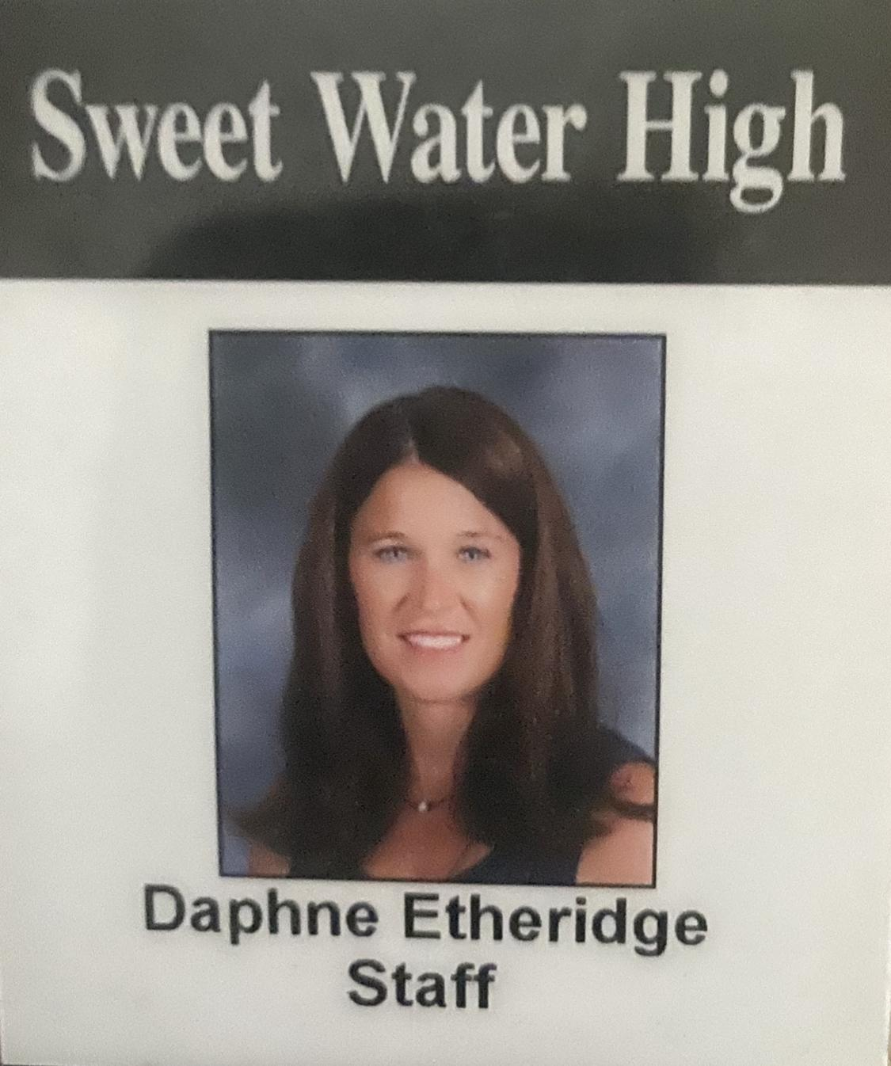
Put a picture or gif of you here!

Slide 3
Hello!!!
It’s gonna be a fun exciting year...you just wait and see all you will learn! I can’t wait to meet YOU!!!

Slide 4
Put a picture or gif of you here!
This is my 20th year to teach at Sweet Water High School! I have taught 1st, 3rd, 4th, 5th, and 6th grade. I have been married to Morris Etheridge for 25 years. We have 2 boys, JT and William Etheridge, and we have 2 chocolate lab dogs named Sadie and Bear! I am looking forward to sharing more about myself with you, but more importantly learning more about all of you this year!

Slide 5
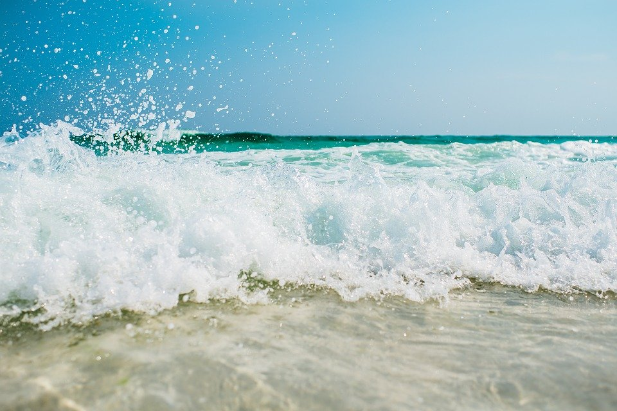
Put a picture or gif of you here!
I love the beach!
I love to cut the grass!
I am the daughter of a Governor of the state of Mississippi!

Slide 6
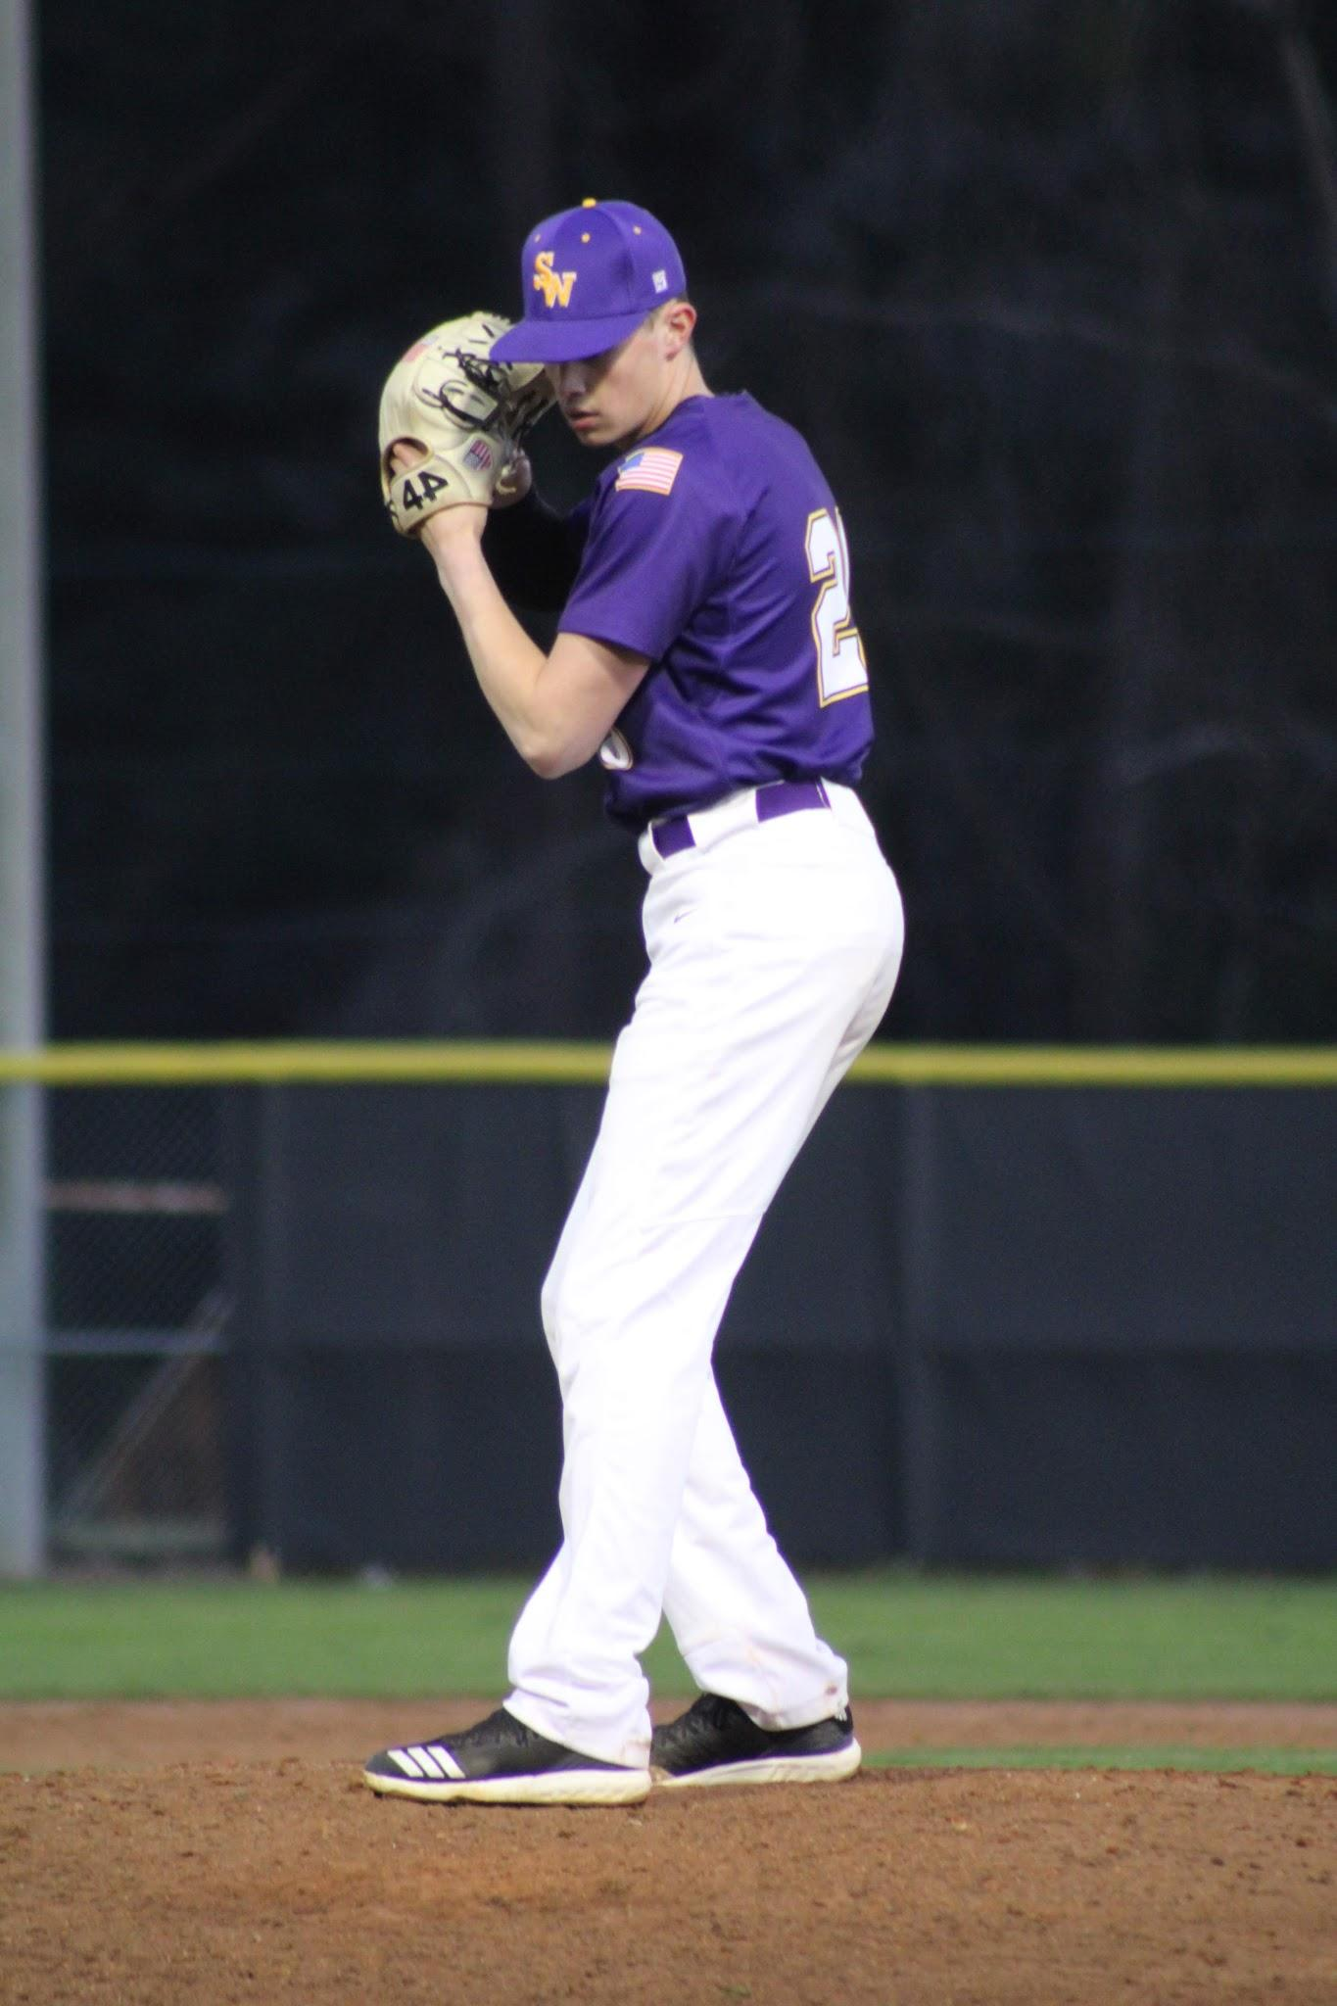
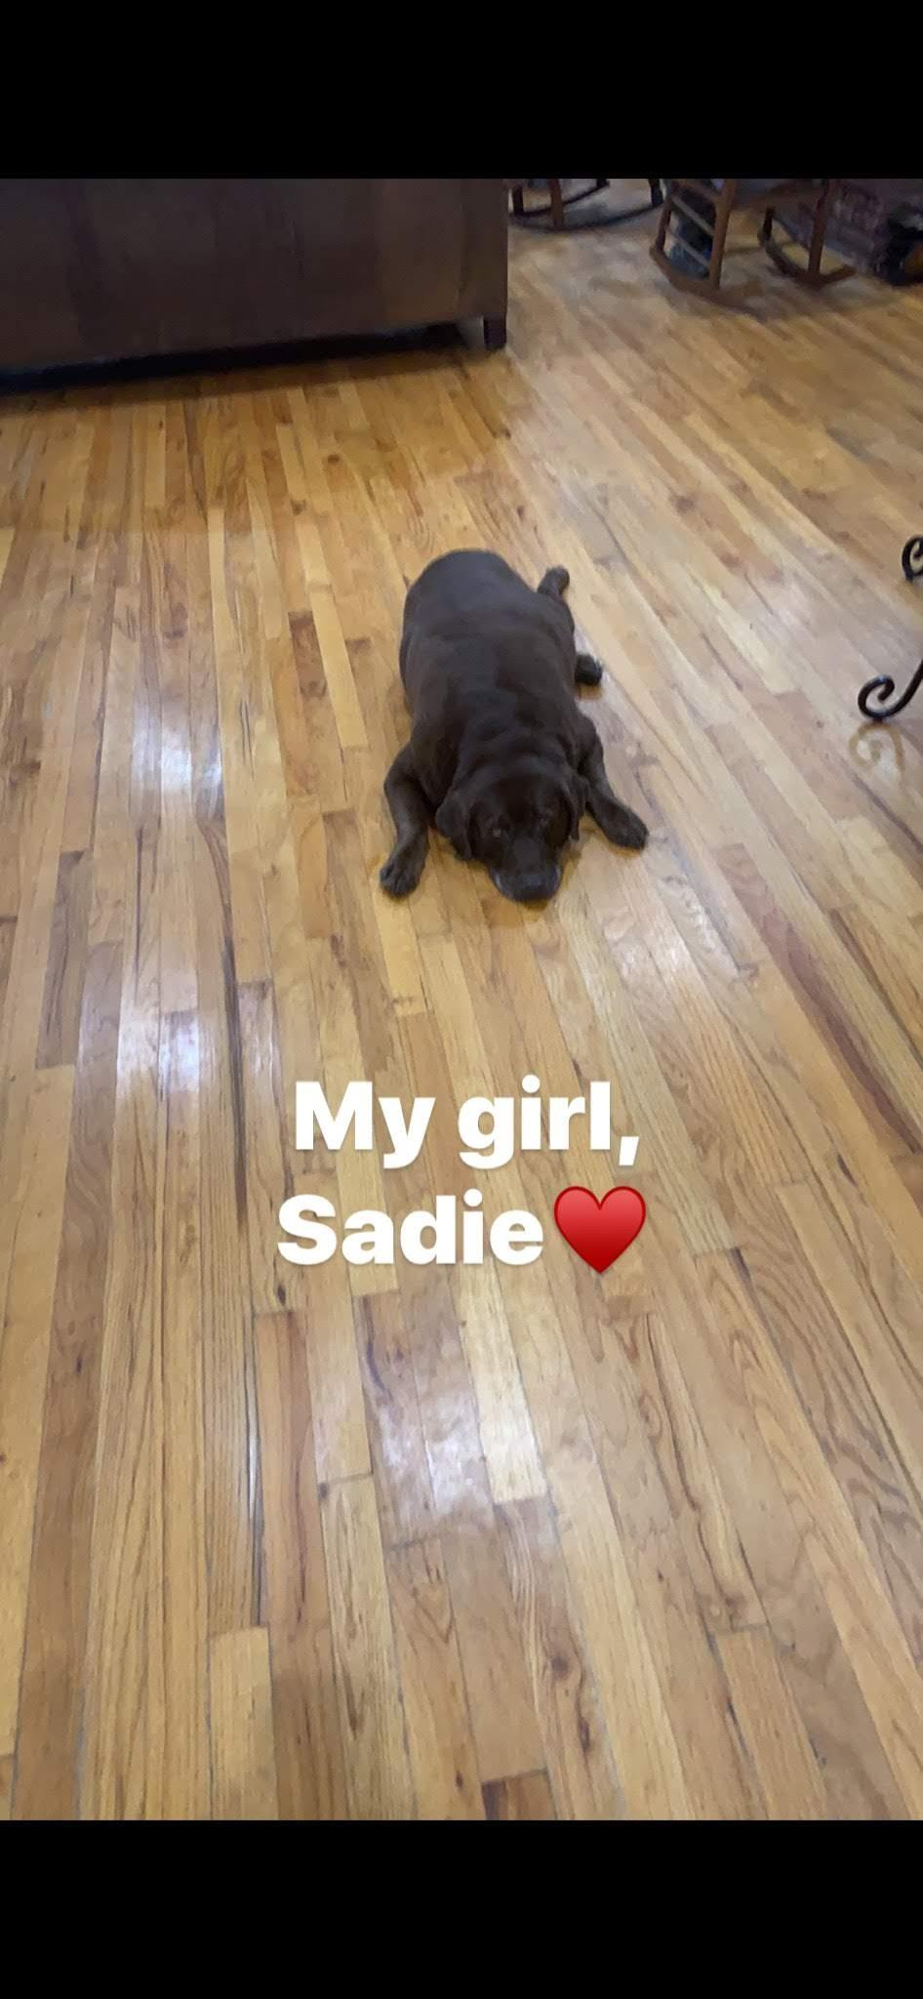
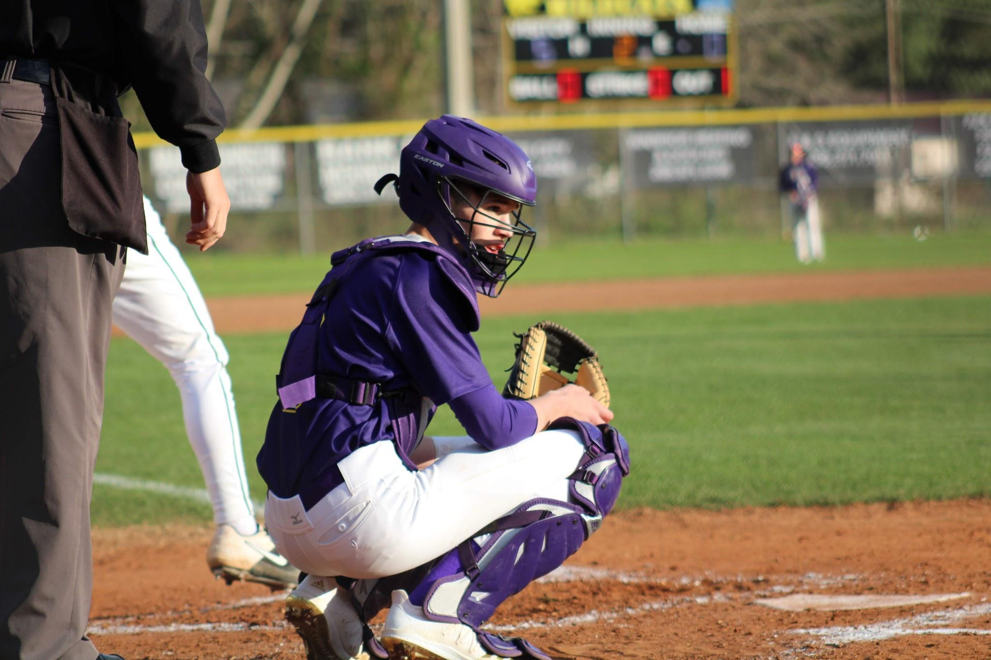
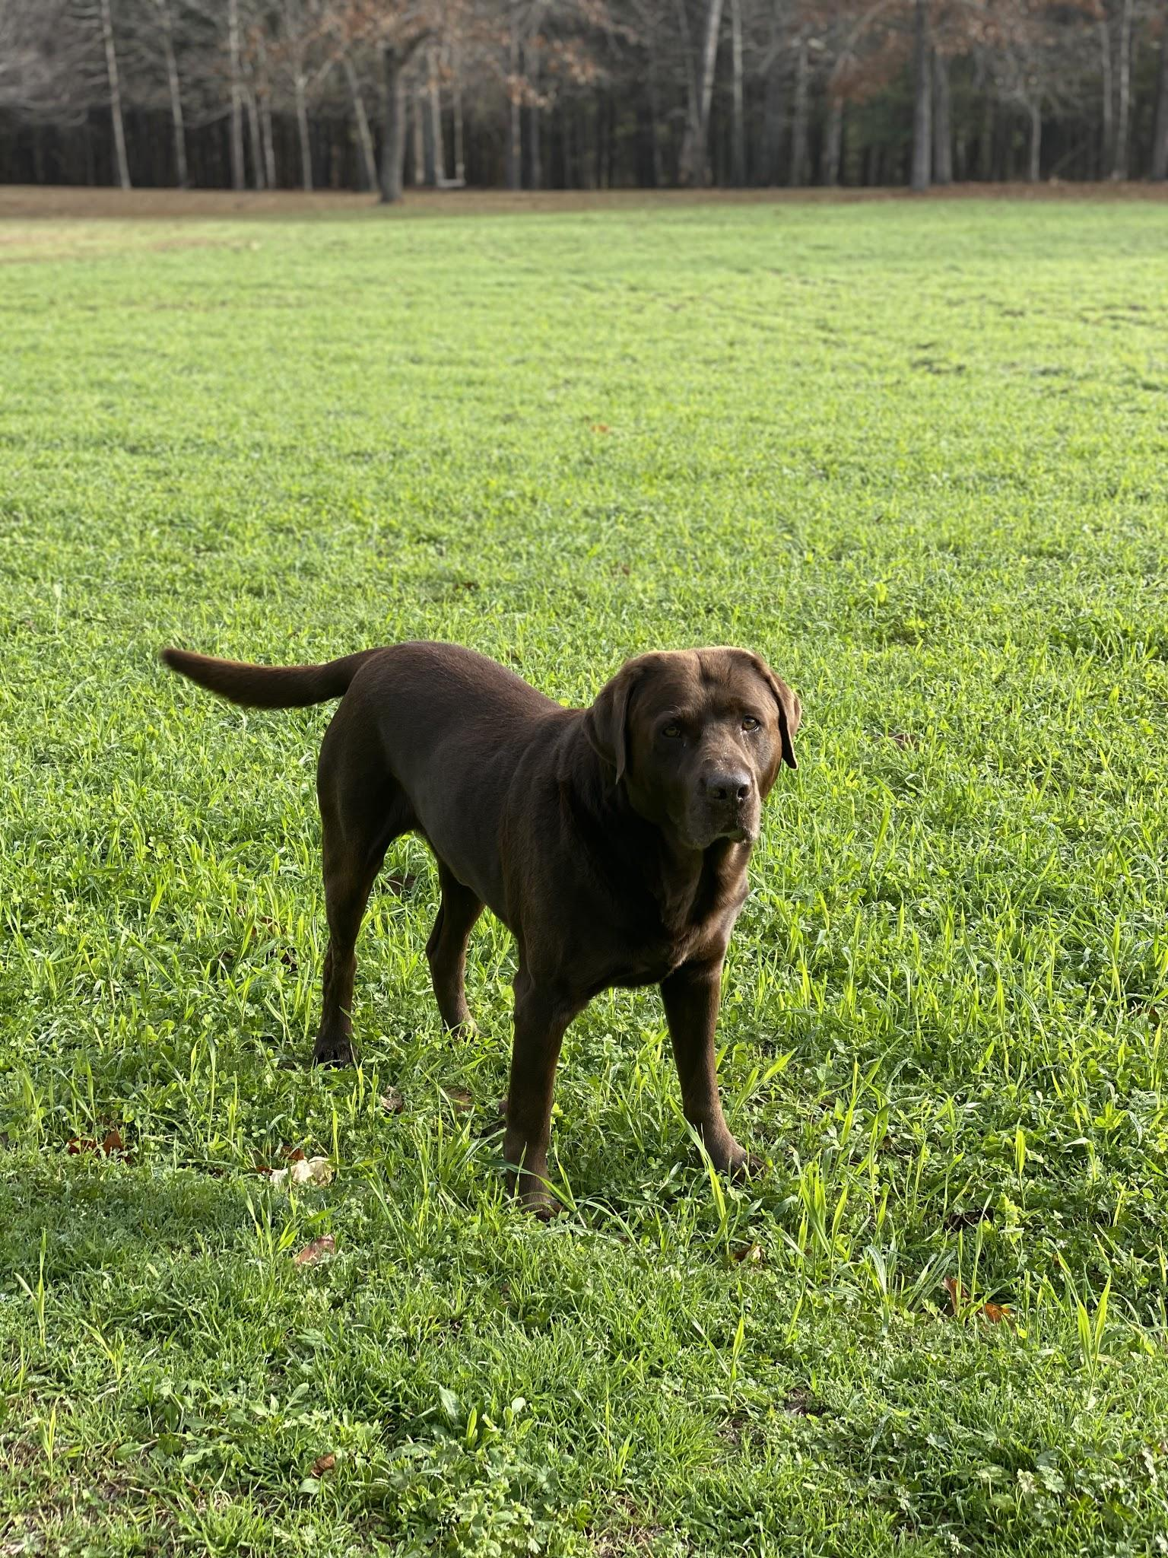
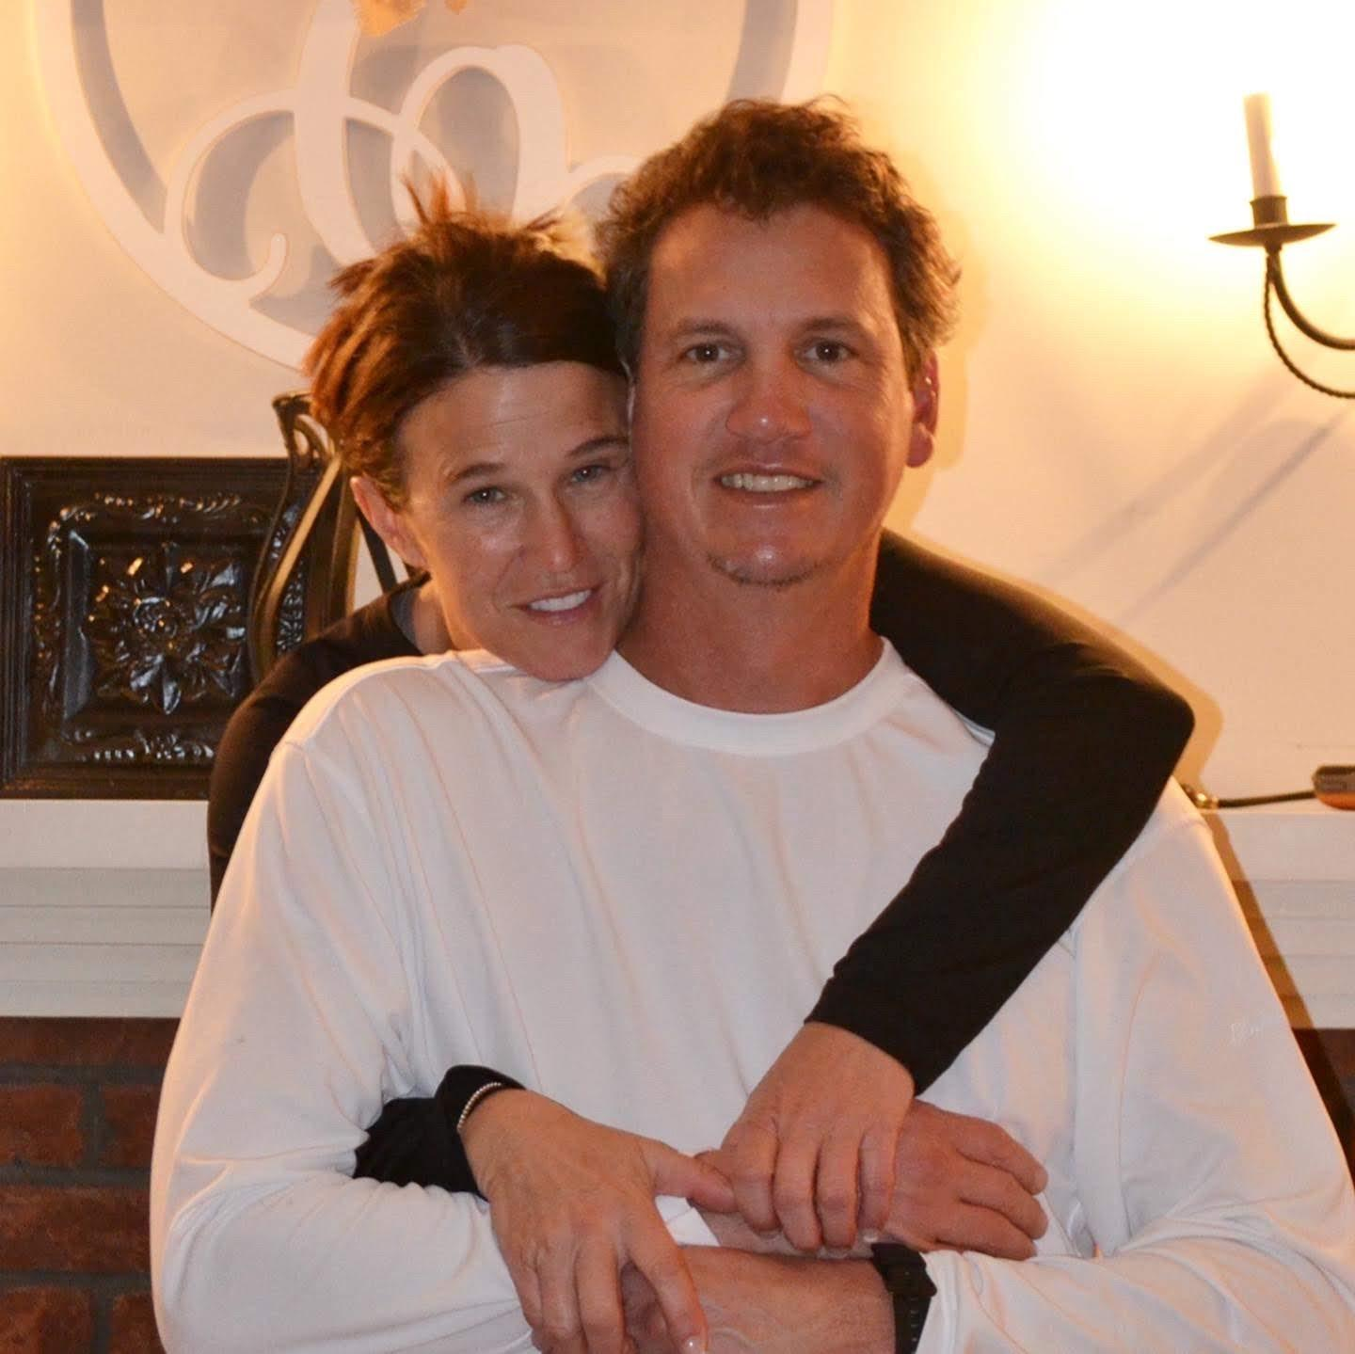

Slide 7
*Calm Waters
*Shiloh
*Charlote’s Web

Slide 8
detheridge@marengo.k12.al.us
334-994-4263

