Slide 1
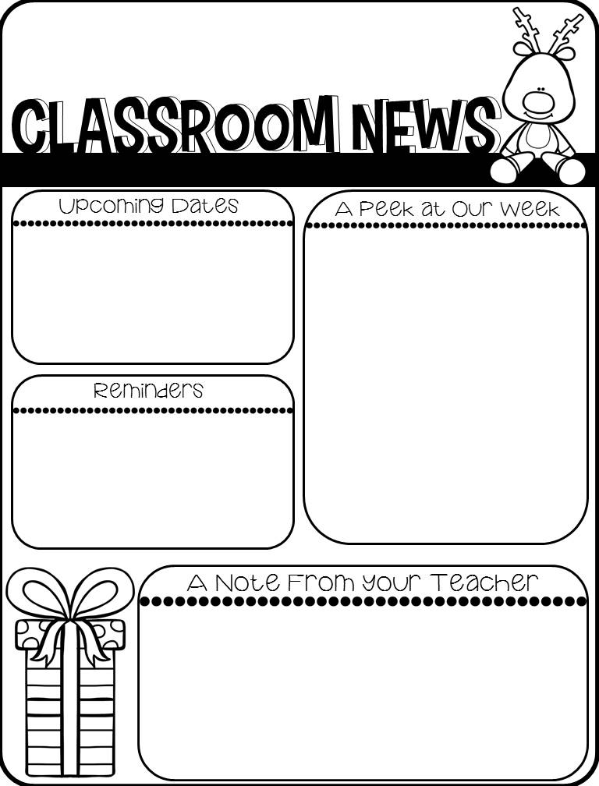
December 3rd – Pzazz and Kona Ice Truck come to DPES.
December 17th – Christmas Parties & Gift Exchange – more information to follow
December 18th – Half Day
Story of the Week: One Good Turn Deserves Another
Phonics Skill – Long A Words
Grammar Skill Posessive Nouns
Grammar Daily Grade & Vocabulary Test - Thursday
Grammar Test, Skills Test, Spelling Test – Friday
Math – Topic 5 Place Value Test on Wednesday.
Daily Grades – Tuesday & Friday
Timed Test Graded - Friday
Don’t forget to send $4 for Kona Ice on Thursday. Please send exact change. It will make everything run smoothly, if they don’t have to count out change.
Please monitor your children’s health extra closely over the next few weeks. I know that a lot of you traveled over the break, and it’s very possible that you or your child could have been exposed to COVID. Please do not send your child to school sick. If in doubt, please keep them home.

