Slide 1
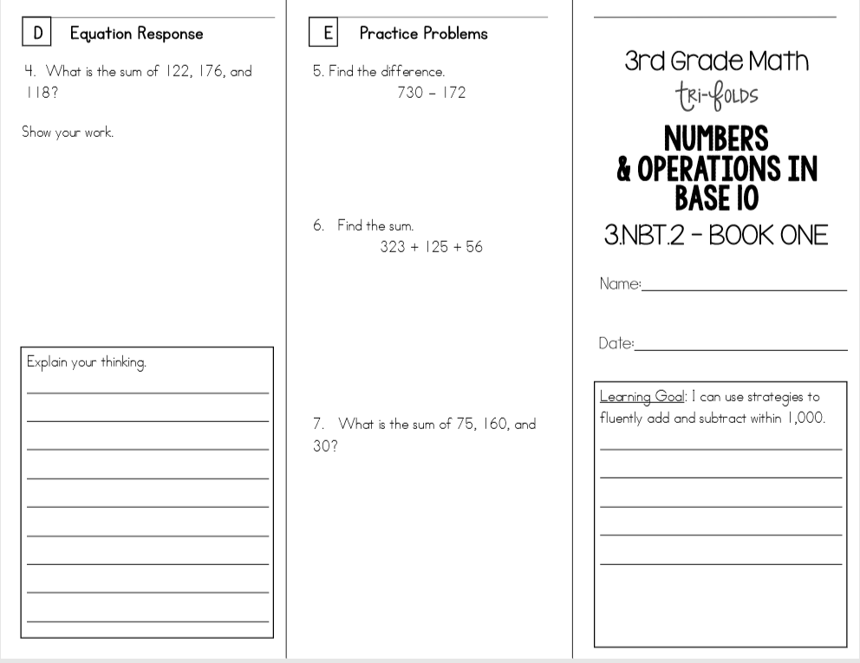
Friday, August 30, 2019
Practice writing “o” in cursive when finished.
7:55 – 8:35

Slide 2
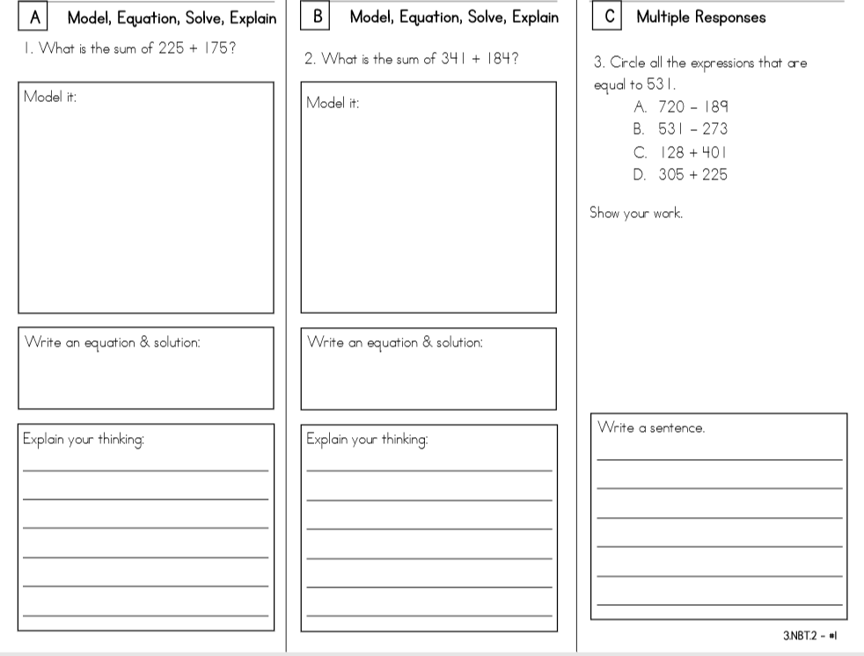

Slide 3
Lockdown Drill

Slide 4
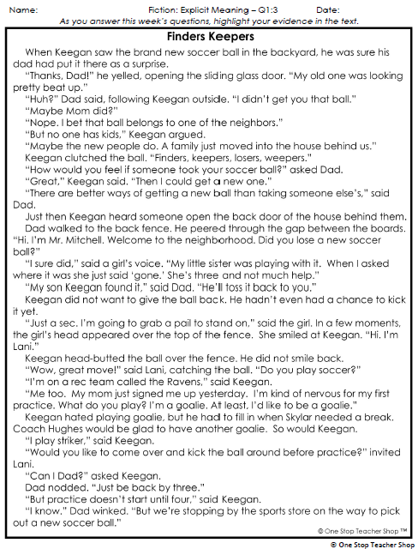
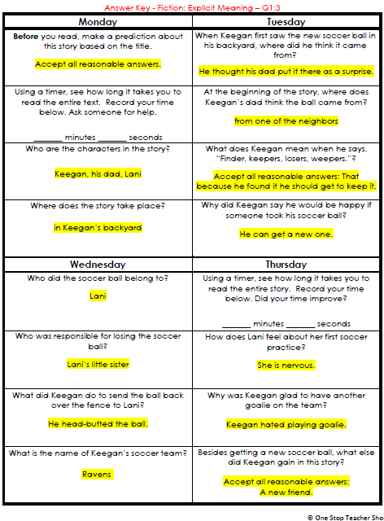
Reading Homework Review

Slide 5
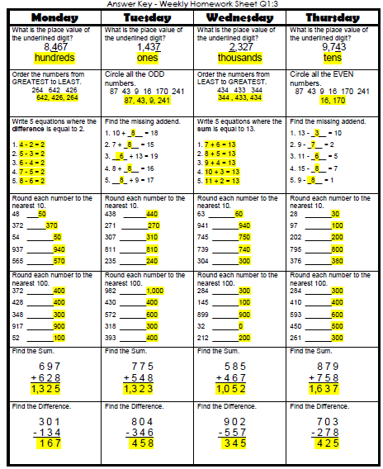
Math Homework Review

Slide 6



Vocabulary & Grammar Time
Snack Time

Slide 7
utter – say something or make some sort of sound
Why might people utter?
I think people might utter because…

Slide 8
“What Might You Utter” Directions
I will describe a situation.
You and your partner will discuss what words or sounds you might utter in that situation and why.
You will share your partner’s thinking, so listen carefully.

Slide 9
“What Might You Utter”
You are excited about going to a sleepover at your best friend’s house. Then you find out the sleepover has been cancelled because your friend is sick.
What might you utter when you hear the sleepover has been cancelled? Why?
I might utter…because…

Slide 10
“What Might You Utter”
Your mother says your family is going for a two-week camping trip in a desert.
What might you utter when you hear you are going for a two-week camping trip in a desert? Why?
I might utter…because…

Slide 11
What’s the new word we are learning that means “say something or make some sort of sound”?
utter

Slide 12
whoop – shout from excitement
Whoop Whoopee
When have you whooped because you were excited?
I whooped when…

Slide 13
What’s the new word we are learning that means “shout from excitement”?
whoop

Slide 14
plop – sit down heavily or put something down heavily
Watch the difference between sitting and plopping.
What did you see when I plopped in my chair?
When you plopped in your chair you…

Slide 15
plop
Why might a person plop? Turn to your partner
A person might plop because...

Slide 16
What’s the new word we are learning that means “sit down heavily or put something down heavily”?
plop

Slide 17




Onomatopoeia – word to imitate a sound

Slide 18

CHOMP TIME
F.A.S.T. Groups
Focused Academic Support Time

Slide 19
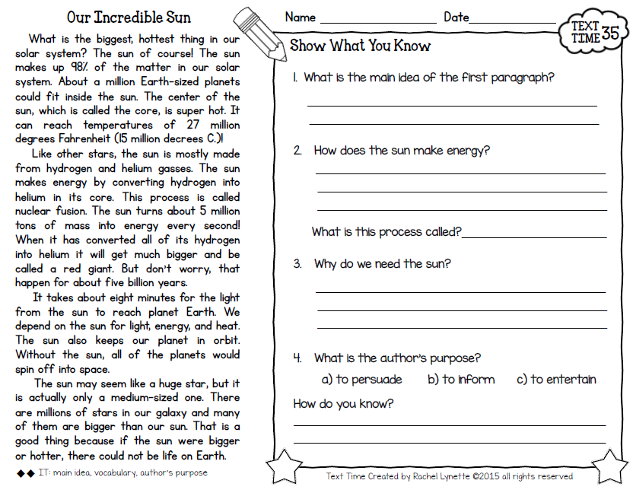
F.A.S.T. Designations
Computers – Epic: Aiden Alexis Cayli Brena Khamani Carleen McKenzie Erin Noah Elin | Mrs. Roby: LLI Landon Paisleigh | Mrs. Thompson: LLI Jaylie Jearon Amiyah Cohen | Paired Partners Complete passage: Katelynn & Caydance Kaylah & Emma Adalyn & Macon Jordyn, Jaiden & Kaylee
9:15 – 9:45

Slide 21

Restroom Break
9:45 – 9:55

Slide 22


Reading Time
9:55 – 10:25
Objective: RI.3.1
I can ask and answer questions to demonstrate understanding of a text, referring explicitly to the text as the basis for answers.
Objective: RI.3.9
I can compare and contrast the most important points and key details presented in two texts on the same topic.

Slide 23

Gather at the Carpet…
Are we still the best?

Slide 24

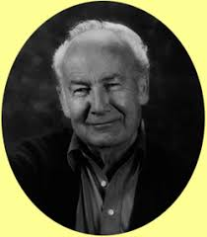
What do you remember about this story? - Turn to Your Partner
Author:
Bill Peet

Slide 25


Today, I will reread parts of the story and you will visualize what is happening.
Read page 8 and model

Slide 26
Read p 17
What did you see in your mind as you listened to this part? - Turn to Your Partner
How do you imagine Prewitt feels in this part of the story? How would you feel if you were him? - Turn to Your Partner

Slide 27
Read p 24-27
What did you see in your mind as you listened to this part? - Turn to Your Partner
How do you imagine Prewitt feels in this part of the story? How would you feel if you were him? - Turn to Your Partner

Slide 28
How did visualizing parts of The Spooky Tail of Prewitt Peacock help you understand and enjoy the story?

Slide 29

Extra Recess Earned
10:25 – 10:40

Slide 30
Out of Classroom!
Recess 10:40 – 11:05

Slide 31



Writing Time
Objective: W3.3
Write narratives to develop real or imagined experiences or events using effective technique, descriptive details, and clear event sequences.
11:05 – 11:30

Slide 32
Gather at the Carpet…
Was it a perfect transition?

Slide 33
Write About Reading
Write from the perspective/point of view of the tiger using sensory details

Slide 34

Kicking it Quiz!

Slide 35

SCIENCE TIME
Objective: E.3.10.1-4
I can demonstrate an understanding that all materials, energy, and fuels that humans use are derived from natural sources.
11:35 – 12:35

Slide 36
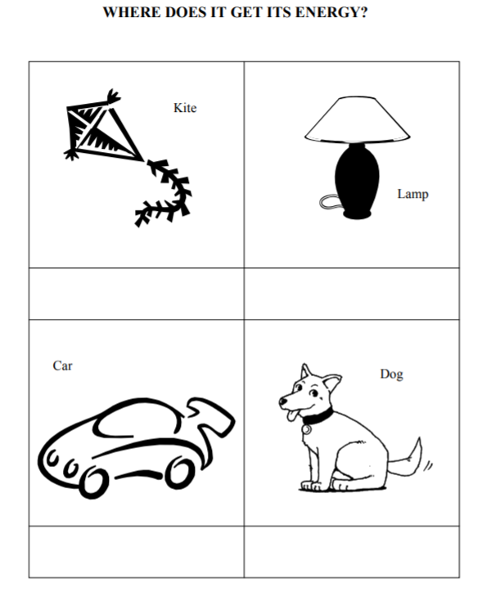
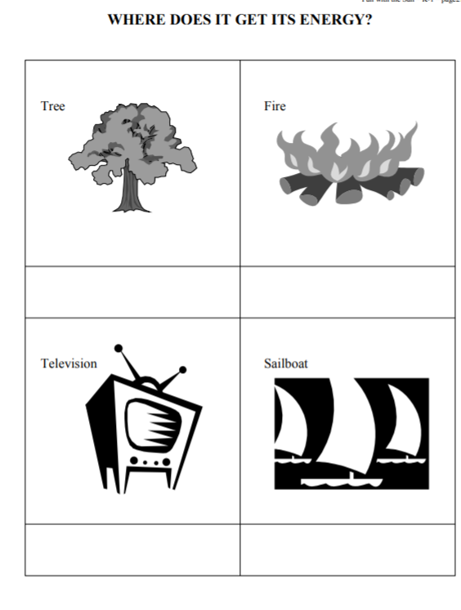
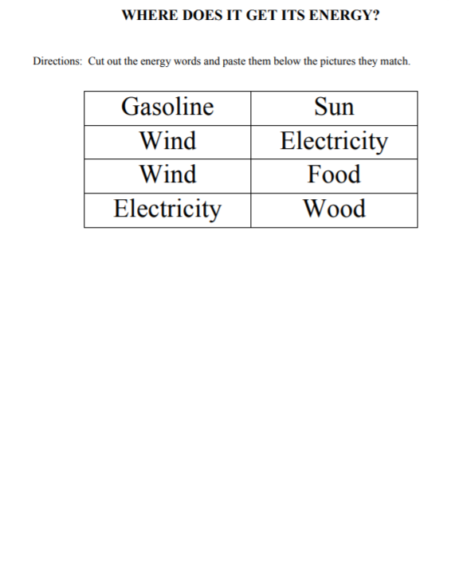
Paired Partners

Slide 37
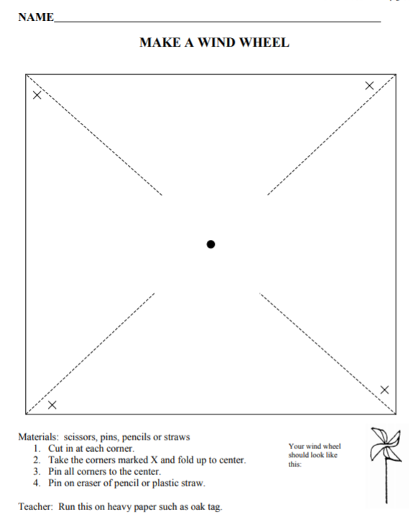
Wind Power

Slide 38

Out of Classroom!
Lunch 12:35 – 1:05

Slide 39
Restroom Break
1:05 – 1:10

Slide 40

Out of Classroom!
Activity 1:10 – 1:55

Slide 41
Math Test!
1:55 – 3:10

Slide 42
Restroom Break
3:10 – 3:15

Slide 43




3:15 Wrap Up!
Pair-Up back to back and share one thing you learned in class today with your partner
Pack-Up
Office will announce:
Car Riders – Leave around 3:20
Bus Riders – (listen to intercom for dismissal)
2:30 – 3:20
How much time has elapsed?

