Slide 1
COUNTING: HOW DID THE ROMANS DO IT?
ROMAN NUMERALS

Slide 2
The burning question…..
Why are they called “numerals” instead of “numbers?”
A numeral is a symbol or name that stands for a number.
Examples: 3, 49, and twelve are all numerals, so the number is an idea, the numeral is how we write it.
Not too many people really worry about the difference, but it’s always good to be precise.

Slide 3
FIRST, A LITTLE HISTORY…
Ancient Rome was a powerful and important civilization that ruled much of Europe for nearly 1000 years. The culture of Ancient Rome was spread throughout Europe during its rule. As a result, Rome's culture still has an impact in the Western world today. The basis for much of Western culture comes from Ancient Rome, especially in areas such as government, engineering, architecture, language, and literature.

Slide 4
Roman numerals were used by the Ancient Romans as their numbering system. This system was used during the middle ages, and We still use them sometimes today.
You see them in the Super Bowl's numbering system, after king's names (King Henry IV), in outlines, on clock faces, and other places.
(What was this year’s Super bowl called? )
http://www.ducksters.com/kidsmath/roman_numerals.php

Slide 5
The basics
Roman numerals are base 10 or decimal, like the number system we use today.
They are not entirely positional, and there is no number zero.
Roman numerals use letters as symbols instead of numbers.
There are seven basic letters you need to know:
I = 1
V = 5
X = 10
L = 50
C = 100
D = 500
M = 1000

Slide 6
How to Make Larger Numbers
You put the letters together to make numbers. Here are a few simple examples: 1) III = 3 three I's together is three 1's and 1 + 1 + 1 equals 3 2) XVI = 16 10 + 5 + 1 = 16 3) XX = 20 10 + 10 = 20
These examples were simple, but there are a few rules and a few tricky things to know when using Roman numerals

Slide 7
operations
#1 You cannot put more than three of the same letter together in a row to represent a number. For example, you can put three I's together( III) to make a 3, but you cannot put four together to make a 4. IIII.
#2 You add letters/numerals, if they come after a bigger letter or number.
Ten =X is bigger than five = V, so in the numeral “XV” you add the two values. It’s like saying
10 + 5 = 15.
X
III = 3 XXX= 30

Slide 8
Subtraction
#3 You SUBTRACT letters/ numbers, if they come BEFORE a bigger letter or number. THE NUMERAL 4=iv. The “I” is less than the “v,” so we SUBTRACT 1 FROM 5 TO MAKE 4.
There are a few restrictions on subtraction:
You can only subtract one number.
You can't get a 3 by writing IIV.
You can only do this with I, X, and C. Not with V, L, or D.
The smaller (subtracted) letter must be either 1/5th or 1/10th the larger one.
For example, 99 cannot be written IC because I is 1/100th of C.)
examples:
IV = 5 - 1 =4 IX = 10 - 1 = 9 XC = 100 - 10 = 90

Slide 9
Roman Numerals
The numbers 1 through 10: 1, 2, 3, 4, 5, 6, 7, 8, 9, 10 I, II, III, IV, V, VI, VII, VIII, IX, X
The tens: 10, 20, 30, 40, 50, 60, 70, 80, 90, 100 X, XX, XXX, XL, L, LX, LXX, LXXX, XC, C

Slide 10
1. Which of the following is the Roman numeral for the number 5? a. I b. X c. V d. L e. C

Slide 11
2. How many of the same letter can you put in a row in Roman numerals? a. Only 1 b. 2 c. 3 d. 5 e. As many as you want

Slide 12
3. When do you subtract the value of a letter instead of adding it in Roman numerals? a. When a letter of lower value comes before a letter of higher value b. When two letters of the same value are used in a row c. When a letter of higher value comes before a letter of lower value d. You never subtract in Roman numerals

Slide 13
4. What is the Roman numeral for 7? a. IIV b. XII c. LL d. ICI e. VII

Slide 14
5. Which of the following is the Roman numeral for the number 10? a. I b. X c. V d. L e. C

Slide 15
6. What is the Roman numeral for 33? a. XIII b. IIIL c. XXII d. XXXIII e. XXLIII

Slide 16
7. Which of the following is the Roman numeral for the number 50? a. I b. X c. V d. L e. C

Slide 17
8. What number does the Roman numeral IX represent? a. 4 b. 7 c. 9 d. 11 e. 19

Slide 18
9. Which of the following is the Roman numeral for the number 100? a. I b. X c. V d. L e. C

Slide 19
10. What number does the Roman numeral LXXIV represent? a. 45 b. 74 c. 92 d. 114 e. 374

Slide 20
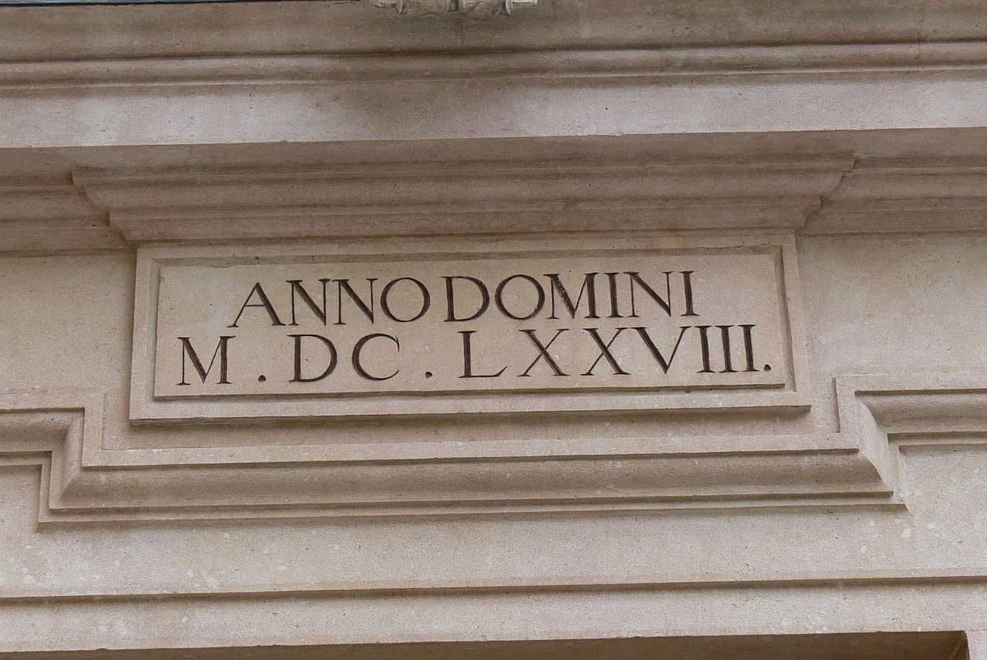
Do you have “Roman Numeral Sense?
How Did You Do?

Slide 21
Roman Numeral challenge
“HIDING IN PLAIN SIGHT”
You will have five minutes to capture as many examples of hidden Roman Numerals around your house. Your goal is to obtain at least one example of the seven basic roman Numerals: I, v, x, l, c, d, m.
You may only use one real letter as an example. The other 6 should be everyday objects.
You will use the camera setting on your device, and you will set a timer for five minutes.
When the timer alarms, you will return immediately to the “classroom.”
It would be great if you could put all your pictures in a collage. There are free apps you can do this with such as photofy, collage maker, and photo collage. It does not have to be fancy, but it will save you time when sending them to me.
When you return to the room, you will send me your pictures. Please include the student’s name and grade in the email/message/post. This can be done in one of the following ways:
email to your spotlight teacher (email is above)
post to DC Spotlight Group (We will have a post where you/parent can add in comments)
Tag @DCE_Spotlight on Instagram
Message to your spotlight teacher on remind
***Please let us know if you have any questions! ☺

