Slide 1
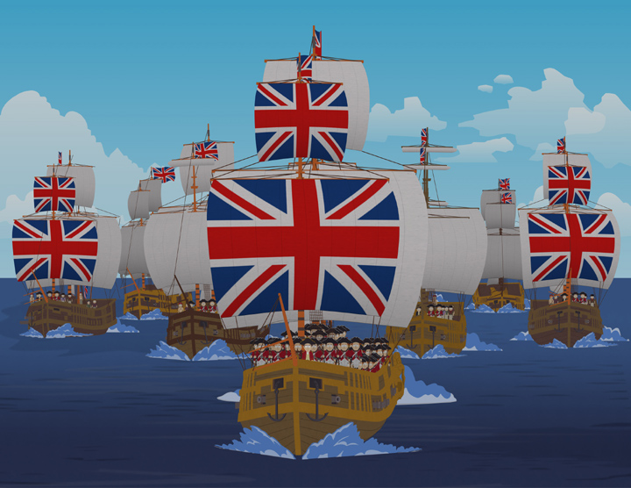
Imperialism to Independence
Outcome: British Imperialism
In India

Slide 2
Constructive Response Questions
Categorize the positive and negative effects of British imperialism:
Describe the Sepoy Mutiny:

Slide 3
What Will We Learn?
Imperialism
The British control India
Positive & negative effects of imperialism
The Sepoy Mutiny
Nationalism emerges

Slide 4
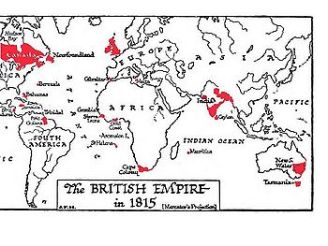
British Imperialism in 1815

Slide 5
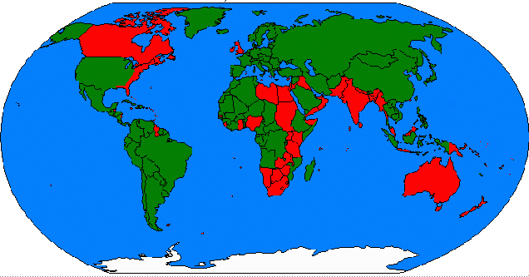
British Imperialism by 1899

Slide 6
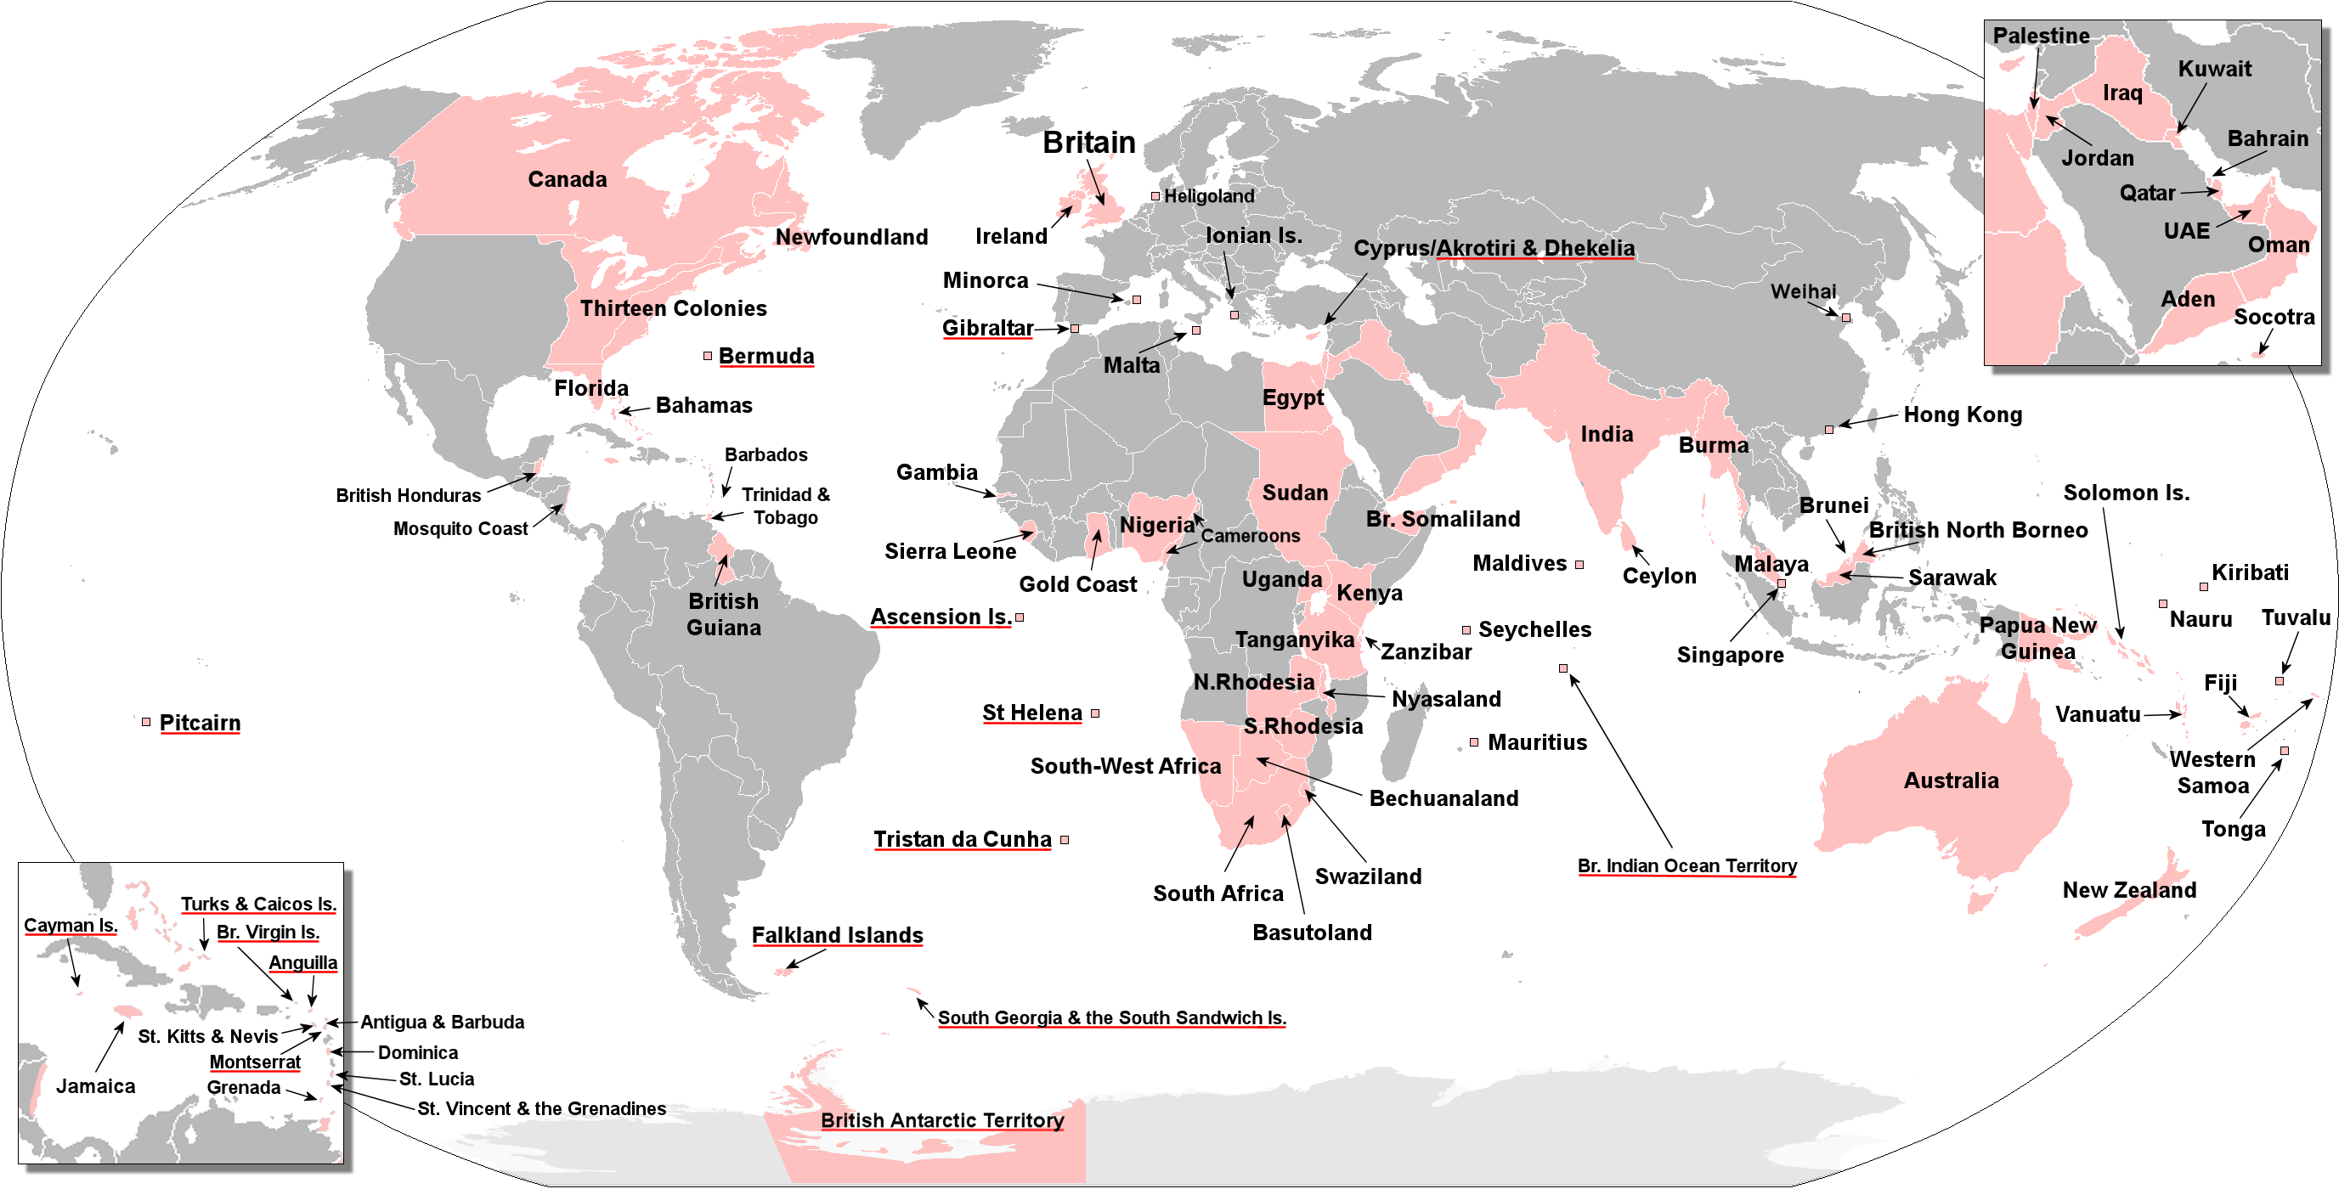
Every Territory Ever Controlled by the British

Slide 7
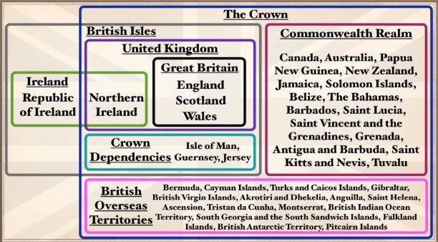
FYI

Slide 8
British East India Company

Slide 9
British Imperialism
Setting the Stage
Review: Imperialism is a policy in which a strong nation seeks to dominate other countries politically, economically, or socially
The British economic interest in India began in the 1600s with the British East India Company
The Mughal Dynasty began to crumble
From 1757 to 1858, The British East India Company was the leading power in India

Slide 10
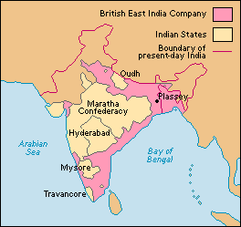
British Imperialism in India

Slide 11
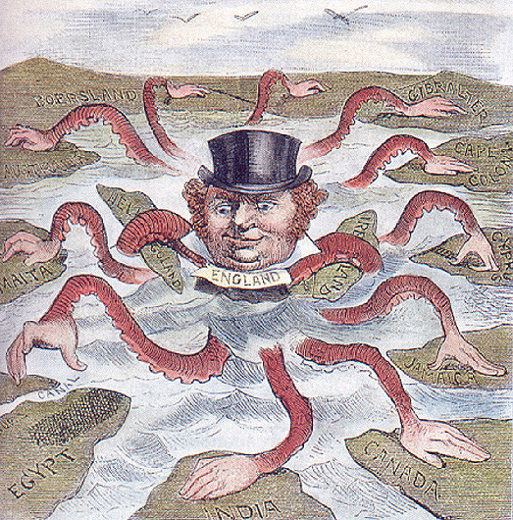
British Imperialism
British Expand Control over India
The area controlled by the East India Company grew, eventually controlled Bangladesh, most of southern India, and territory along the Ganges River

Slide 12
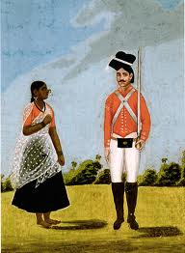
British Imperialism
British Expand Control over India
Sepoys, or Indian soldiers, made up a large part of the East India Company army
The Governor of Bombay referred to the sepoy army as a “delicate and dangerous machine, which a little mismanagement may easily turn against us.”

Slide 13
Think-Pair-Share
Another country invades the United States today…what could be some positive and negative effects of this invasion?
Write your thoughts in the margin
Share your answers with an elbow partner
Prepare to share out to the large group.

Slide 14
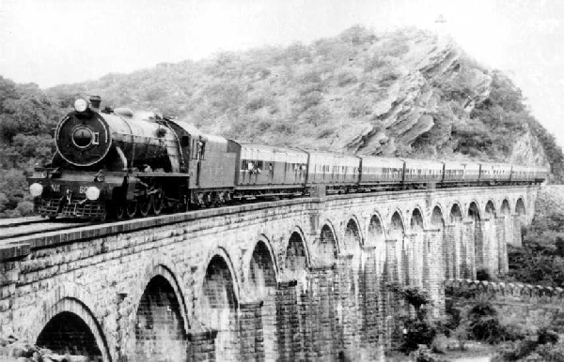
British Imperialism
British Expand Control over India
India was considered the “jewel of the crown” due to its profitability for the British
British policy demanded India to produce raw materials for the British and to buy British goods; British goods drove out local producers (economic effect)
British set up railroads in India and transported tea, indigo, coffee, cotton, & opium

Slide 15
British Imperialism
Positive and Negative Effects of British Colonialism
Negative Effects
The British held much of the political and economic power in India
British restricted Indian industries such as textiles
Emphasis on cash crops resulted in loss of self sufficiency for many villagers
Conversion to cash crops reduced food production causing famines
British missionaries and racism threatened traditional Indian culture

Slide 16
British Imperialism
Positive Effects
The British laid the world’s third largest railroad network creating unity and allowing India to create a modern economy
Road networks, dams, bridges, irrigation canals, telephone/telegraph lines were built which helped India modernize
Sanitation and public health improved
Schools and colleges were established; literacy improved
British troops cleared central India of bandits and put an end to local warfare

Slide 17
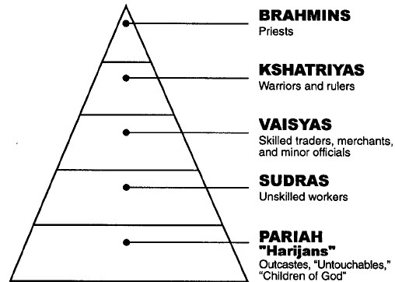
The Caste System

Slide 18
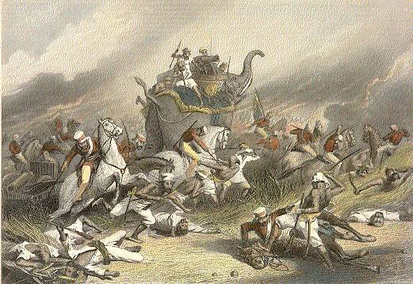
The Sepoy Mutiny

Slide 19
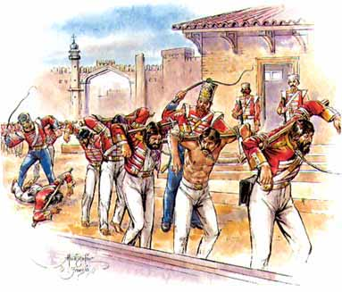
British Imperialism
The Sepoy Mutiny
By 1850, the British controlled most of the Indian subcontinent but there was pockets of discontent
Many Indians believed the British were trying to convert them to Christianity
Indians resented the constant racism the British expressed towards them

Slide 20
British Imperialism
The Sepoy Mutiny
In 1857 a rumor spread that the sepoys rifle cartridges were greased with beef and pork fat (cows are sacred to Hindus; Muslims don’t eat pork)
85 of the 90 sepoys refused the cartridges and were jailed
The next day (May 10, 1857) they rebelled
They marched to Delhi and captured the city; the rebellion spread to northern and central India
Fierce fighting took place; each side tried to slaughter the other side’s army

Slide 21
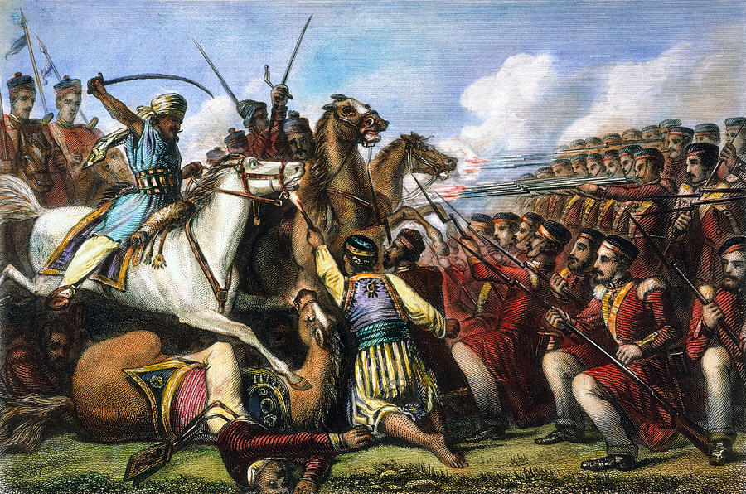
The Sepoy Mutiny

Slide 22
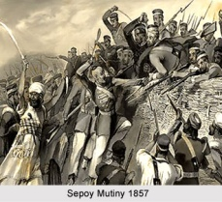
The Sepoy Mutiny

Slide 23
British Imperialism
The Indian government was too weak to intervene
It took a year for the British to regain control: The British took control and ruled until 1947
The part of India under British rule was called The Raj meaning rule or sovereignty
The Sepoy Mutiny fueled the racist attitudes of the British and increased distrust between Indians and the British

Slide 24
Not this Raj

Slide 25
British Imperialism
Nationalism Surfaces in India
In the early 1800s, some Indians began demanding more modernization and a greater role in governing themselves
Nationalism: extreme pride in one’s culture or country

Slide 26
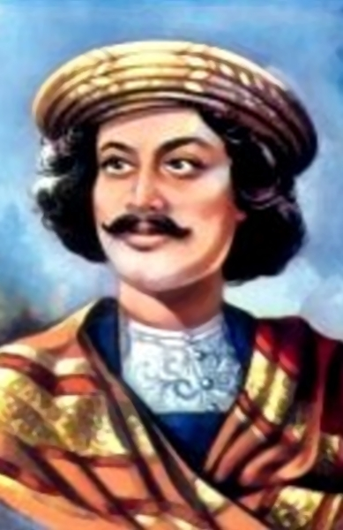
British Imperialism
Nationalism Surfaces in India
Ram Mohun Roy, sometimes called the Father of Modern India, believed arranged child marriages and the rigid caste separation needed to change or India would continue to be controlled by outsiders
Indians began to have nationalist feelings and resented a system that made them second class citizens in their own country

Slide 27
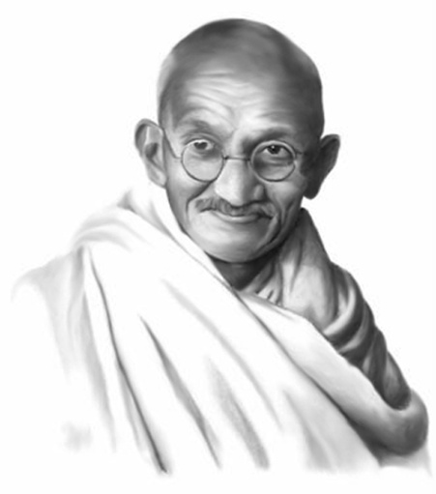
British Imperialism
Result: History has shown that, when mistreated long enough, humans will eventually react in an attempt to improve their situation. The seeds of change had been set in India which later lead to an independence movement led by Mahatma Gandhi.

Slide 28
Constructive Response Questions
Categorize the positive and negative effects of British imperialism:
Describe the Sepoy Mutiny:

