Slide 1
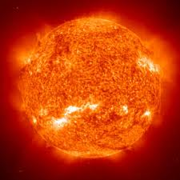
Our Star – The Sun
Using an interactive CD-ROM, students explore the sun, create a working sun clock, and discover sun-earth connections.
Grades K-12

