Slide 1
A.P. Human Geography
Not your Daddy’s or Momma’s Geography SUCKA!!!!

Slide 2
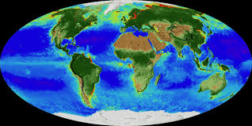
Static Definition:
The systematic study of patterns and processes that have shaped human understanding, use and altercation of Earth’s surface

Slide 3
Some things we will learn in this course
Analyze human social organization? Huh???
Human environmental consequences?? What??
Think geographically and ask critical geographic questions????
Why is Portuguese spoken widely in Mozambique?
Why do most North Americans practice Christianity?
Did Christianity spread hierarchically or contagiously?
What happens demographically in 2043????
Why aren’t the Ft. Wayne Pistons in Ft. Wayne anymore? Why do the play NHL games in Florida?
What do clustering patterns of voting districts in a state tell one about the population?

Slide 4
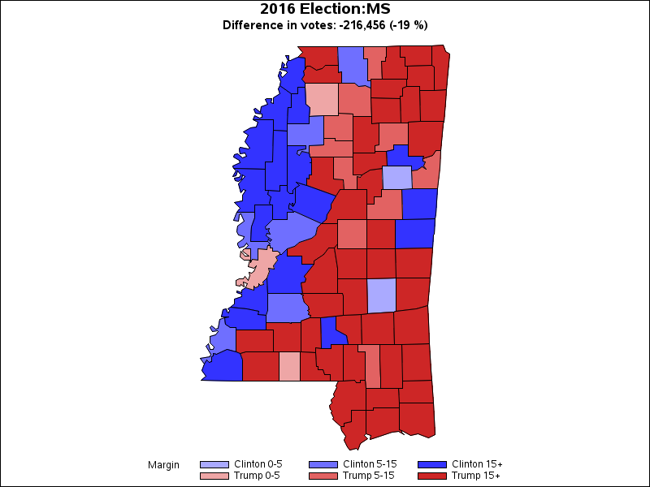
Red= Republican
Blue= Democrat
Pink= Inconclusive
Light Blue= Independent

Slide 5
Course Skills:
Use and think about maps and spatial data sets
Use geographic skills to make connections (Okra)
Understand the implications of associations among patterns and processes
Recognize “SCALE” and its relationships
Write “Free Response” essays
Take notes from lecture and printed material(s)
Learn to ask geographic questions about everything one sees around them

Slide 6
Question:
Which of the following profiles characterizes the population group that is most likely to migrate?
A. Married, 25 years old
B. Single, 25 years old
C. Single, 50 years old
D. Married, 65 years old

Slide 7
A.P. Human Geography Content Area:
Geography: Its nature and perspectives
Population (Patterns of composition- age, sex, race)
Cultural Patterns and Processes (Gender)
Political Organization of Space
Agriculture and Rural Land Use (Women use…)
Industrialization and Economic Development
Cities and Urban Land Use

Slide 8
Themes:
Gender
Nature and Society
Development
Scale
Globalization
Diffusion (How ideas spread)
Regions
Using a map of USA and your thought process, circle and label the following regions: South, North East, Mid West, West

Slide 9
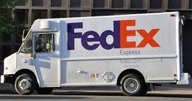
Thinking Spatially
You will see things that have been right in front of you all along in a new way!!!

Slide 10
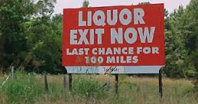
Part 2
Why does this sign exist? Why is there no “Liquor”? Where is there
a place that has no liquor?

