Slide 1
Photosynthesis & Cellular Respiration
This Week’s Unit

Slide 2
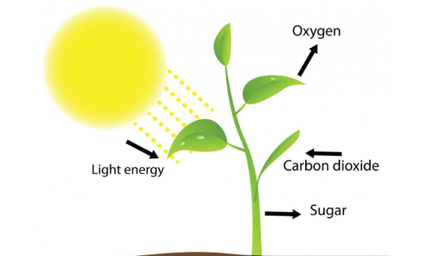
Photosynthesis
Flashcard #1
Only in plants

Slide 3
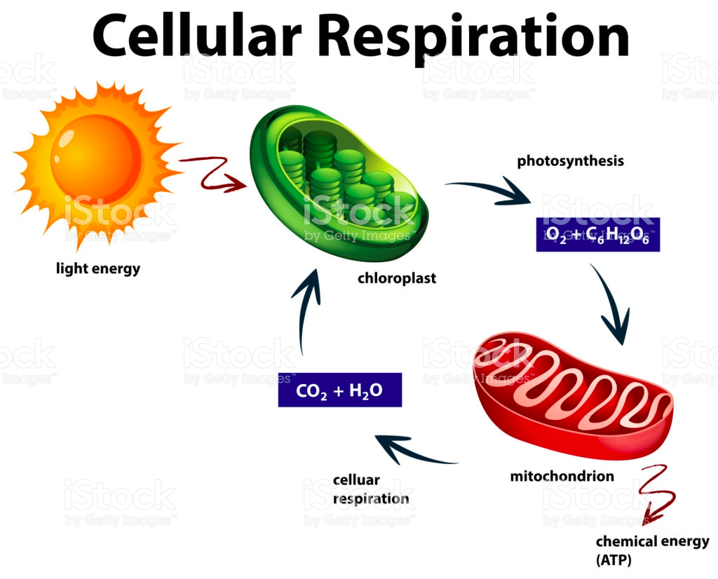
Cellular respiration
#2
Happens in both plants & animals

Slide 4
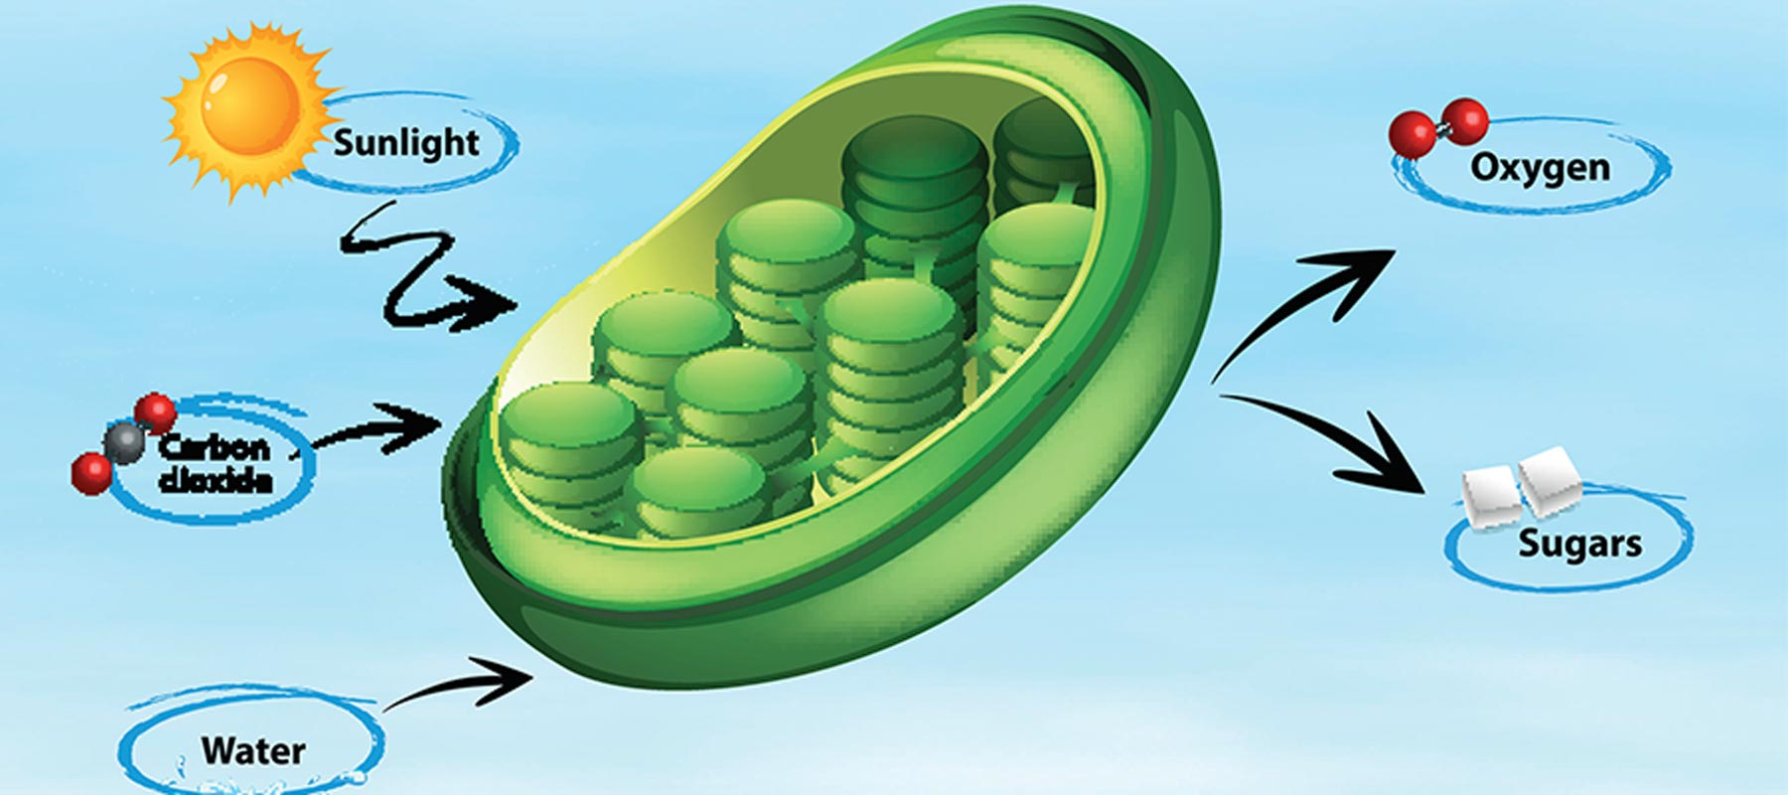
Chloroplast
#3
In plants only
* Most chloroplasts are located in the leaves.

Slide 5
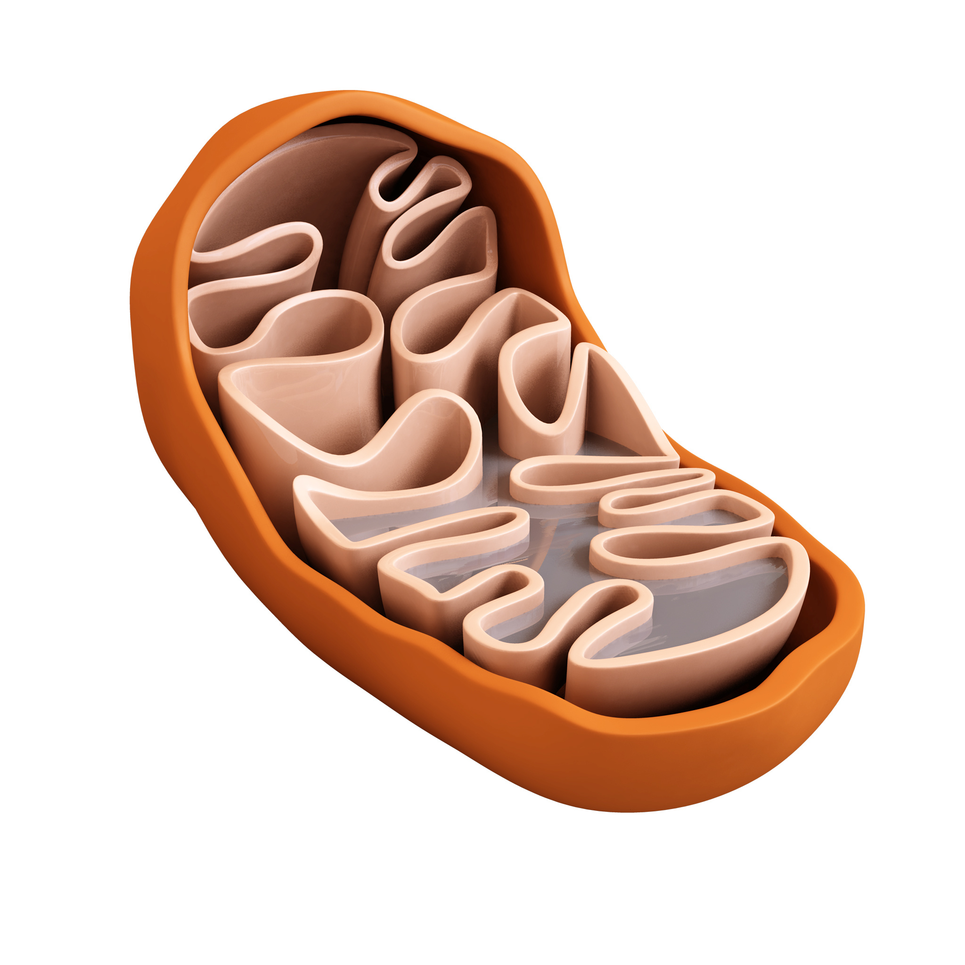
Mitochondria
#4
Both plants & animals have mitochondria

Slide 6
ATP Adenosine Triphosphate
#5
Tip! The prefix “tri” means 3

Slide 7
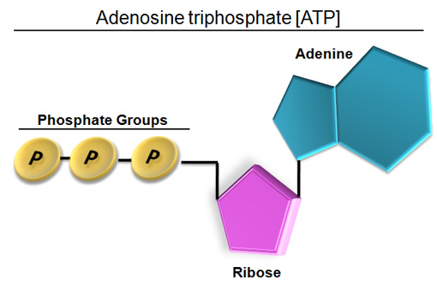
Adenine 3 phosphates Sugar
#6
House, 3 pools, driveway

Slide 8
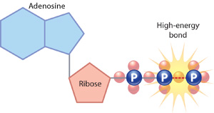
…the 3rd phosphate pops off
#7
A bond is broken and energy is released.

Slide 9
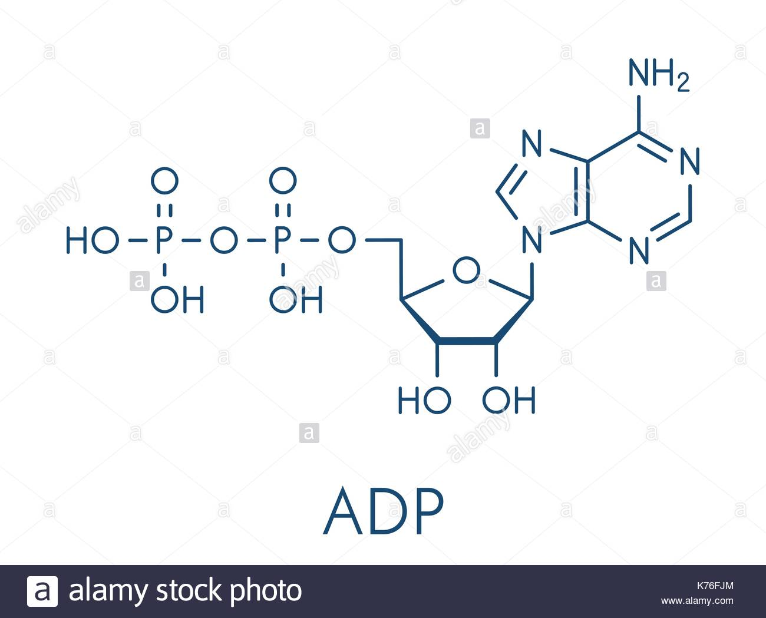
A house (sugar) 2 pools (phosphates) A driveway (adenine)
#8
Tip~
The prefix “di” means 2

Slide 10
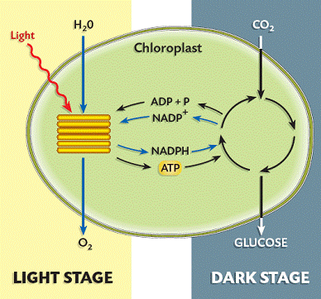
Stage 1- Light Dependent Stage 2 – Calvin Cycle (Light Independent)
#9

Slide 11
Sun Water (H20) CO2
#10
Remember PLANTS need CO2.
WE need O2!

Slide 12
Oxygen (O2) Glucose (C6H12O6)
#11

Slide 13
C6H12O6
#12
Remember CHO?
Sugar is a carbohydrate!

Slide 14
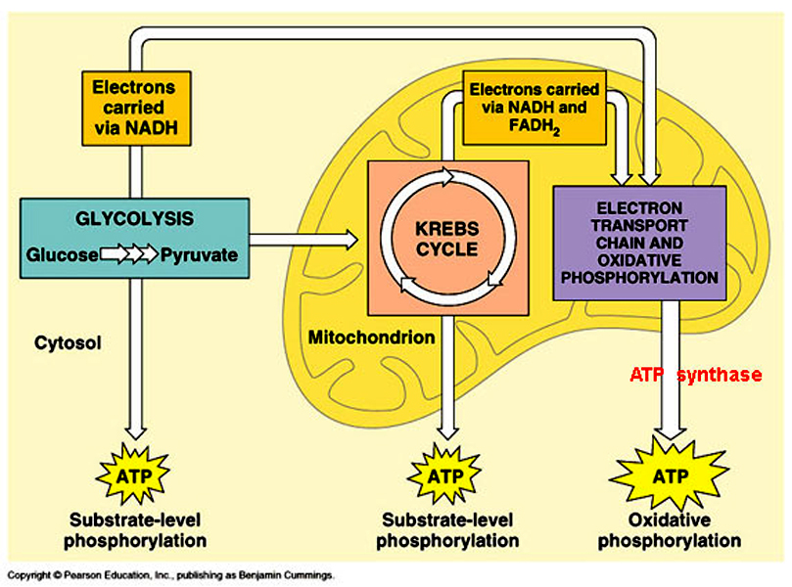
1 – Glycolysis 2 – Krebs Cycle 3 – ETC (electron transport chain)
#13
Krebs can also be called
citric acid cycle

Slide 15
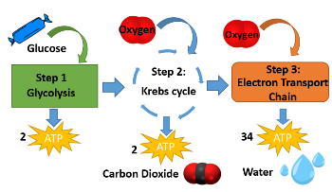
Glucose- (C6H12O6) Oxygen – (O2)
#14

Slide 16
CO2 H2O ATP
#15
36 ATP total!

Slide 17
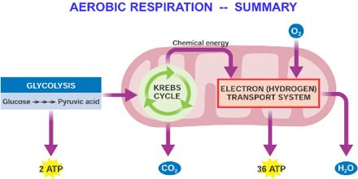
Aerobic respiration
#16

Slide 18
Anaerobic respiration
#17

Slide 19
Bacteria Yeast Muscle cells
#18

Slide 20
Beer/wine Bread Yogurt Muscle cramps
#19

Slide 21
Stage 1 – Glycolysis Stage 2 - Krebs
#20

Slide 22
Only stage 3 ETC
#21

Slide 23
1-Alcoholic fermentation 2-Lactic acid fermentation
#22

Slide 24
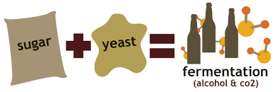
Alcohol CO2
#23

Slide 25
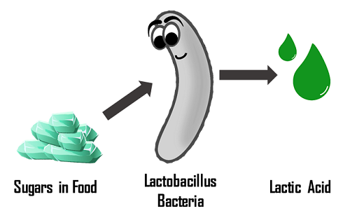
Lactic acid
#24

Slide 26
Energy ATP
#25

Slide 27
light energy chemical energy kinetic energy
#26

Slide 28
Cellular Respiration
#27

