Slide 1
Unit 2
Lesson 1
Grammar on the Go! PowerEd Express
Make the sentence
corrections in red.
Write the vocabulary words
in your personal dictionary.
PowerEd Plans 2014

Slide 2
Grammar on the Go! PowerEd Express
Unit 2-1
Sentence
there was ample space in my new locker and i was proud i got it organized quick myselve
Sentence Identification – Compound, Complex, Simple, Compound/Complex
Type of Sentence(s) – Declarative, Imperative, Interrogative, Exclamatory
PowerEd Plans 2014

Slide 3
Unit 2-1
Corrections
Grammar on the Go! PowerEd Express
New Paragraph
¶There was ample space in my new locker, and I was proud I got it organized quickly myself.
Compound Declarative
Capitalization
Run-on Sentence
End Punctuation
Adjective vs. Adverb
Reflexive Pronoun
PowerEd Plans 2014

Slide 4
Unit 2-1
Paragraph
Grammar on the Go! PowerEd Express
Paragraph ¶
Begin a new paragraph when starting a new topic.. Indent the first line of the new paragraph.
¶ There was ample space in my new locker, and I was proud I got it organized quickly myself.
PowerEd Plans 2014

Slide 5
Unit 2-1
Capitalization
Grammar on the Go! PowerEd Express
Capitalization
Writing a word with its first letter as a capital letter (upper-case letter) and the remaining letters in lower case.
The first word of every sentence.
Capitalize the word “I” when referring to oneself in the first person.
There was ample space in my new locker, and I was proud I got it organized quickly myself.
PowerEd Plans 2014

Slide 6
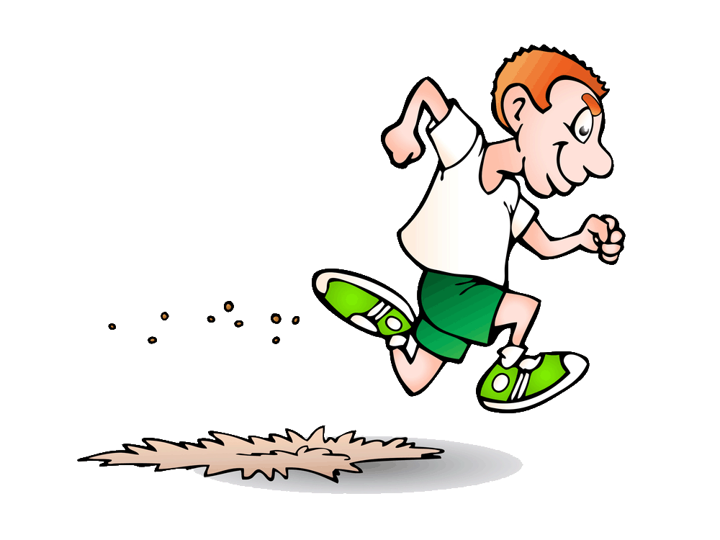
Unit 2-1
Run-on Sentence
Grammar on the Go! PowerEd Express
Run-on Sentence
A run-on sentence is a sentence in which two or more independent clauses with more than one complete idea are joined without appropriate punctuation or a conjunction.
There was ample space in my new locker, and I was proud I got it organized quickly myself.
PowerEd Plans 2014

Slide 7
Unit 2-1
Reflexive Pronouns
Grammar on the Go! PowerEd Express
Reflexive Pronouns
Reflect back on the subject, like a mirror.
Use a reflexive pronoun to refer back to the subject of the sentence or clause. Reflexive pronouns end in "-self" (singular) or "-selves" (plural).
Singular: myself yourself himself herself itself
Plural: ourselves yourselves themselves
There was ample space in my new locker, and I was proud I got it organized quickly myself.
PowerEd Plans 2014

Slide 8
Unit 2-1
Adjective vs. Adverb
Grammar on the Go! PowerEd Express
Adjective vs. Adverb
Adjectives are used to modify (describe) nouns and pronouns. They answer the questions: Which one? What kind? How many? How much? Whose?
Adverb are used to modify (describe) verbs, adjectives, and other adverbs. They answer the questions: How? When? Where? How much?
There was ample space in my new locker, and I was proud I got it organized quickly myself.
PowerEd Plans 2014

Slide 9
Unit 2-1
End Punctuation
Grammar on the Go! PowerEd Express
End Punctuation
. A period is a full stop. It marks the end of a sentence. It marks the end of an idea or a thought. It marks the end of an action.
? A question mark is, naturally, a mark which shows the sentence is a question. A question mark is required at the end of an interrogative sentence.
! Exclamation marks are used in exclamatory sentences, and sometimes in imperative sentences.
There was ample space in my new locker, and I was proud I got it organized quickly myself.
PowerEd Plans 2014

Slide 10
Unit 2-1
Compound Sentence
Grammar on the Go! PowerEd Express
Compound Sentence
A compound sentence contains two independent clauses joined by a coordinator or a semi-colon. The coordinators are as follows: for, and, nor, but, or, yet, so. Coordinators are preceded by a comma.
There was ample space in my new locker, and I was proud I got it organized quickly myself.
PowerEd Plans 2014

Slide 11
Unit 2-1
Declarative
Grammar on the Go! PowerEd Express
Declarative Sentence
A sentence in the form of a statement. In a declarative sentence, the subject normally precedes the verb. A declarative sentence ends with a period.
There was ample space in my new locker, and I was proud I got it organized quickly myself.
PowerEd Plans 2014

Slide 12
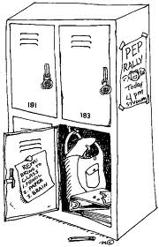
Unit 2-1
Vocabulary
Grammar on the Go! PowerEd Express
ample
Adjective
enough or more than
enough; plentiful
large and
accommodating
PowerEd Plans 2014

