Slide 1





Grade 3 EnVisions Math
Topic 15
Power Point Lessons

Slide 2
Customary Units of Capacity
Lesson 15-1
3.MD.2
Notes:
Literature Link: Pastry School in Paris by Cindy Neuschwander

Slide 3
Warm Up
Use place value blocks to show the following numbers.
324
1,000 + 200 + 60 + 7
Four hundred eighty six
500 + 40 + 9

Slide 4
Think and Share
When have you used the terms “cup”, “pint”, “quart” or “gallon”?

Slide 5
Storytime!
Once upon a time, there was a beautiful kingdom called GALLON. GALLON had 4 beautiful QUART Queens. Each Queen Quart has 2 sons, both named Prince PINT, and the Princes have 2 children, CUPS, who are 8 OUNCES old.
Notes:
This silly story will help you remember equivalent measurements! I often have children draw it out. I give them each a large cutout G to represent the kingdom of Gallon. Inside, they draw 4 Qs to represent the Quart Queens, and decorate each Q with a crown. They draw two Prince Pints next to each Queen and 2 child cups next to each Prince. The children enjoy it and can visualize the kingdom.

Slide 6
Customary Units of Measurement
Although most of the world measures capacity (the amount a container holds) in metric units, in the United States, we often use customary units.
Customary units of capacity are ounce, cup, pint, quart, and gallon.

Slide 7
Fluid Ounces
A fluid ounce is a very small amount of liquid.
One cup equals 8 fluid ounces.
We would measure medicine given to a baby or the amount of water in a bottle cap in fluid ounces (fl. Oz.).

Slide 8
Cups
A cup equals 8 ounces.
Cups are customary units of measurement.
What objects hold about a cup of water?
Notes:
Prior Prep: I highly recommend bringing in containers that hold a cup, a pint (school milk carton), a quart, and a gallon as visuals.

Slide 9
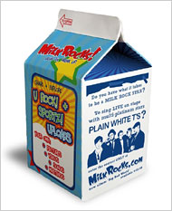
Pints
A pint is equal to 2 cups.
What items might hold about a pint of liquid?
How many fluid ounces are in a pint?

Slide 10
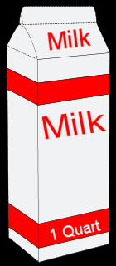
Quarts
One quart is equal to 2 pints.
How many cups are equal to 1 quart?
What capacities might we measure in quarts?

Slide 11
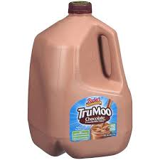
Gallons
Gallons are the largest customary unit of capacity.
One gallon equals 4 quarts.
How many pints are in a gallon?
How many cups are in a gallon?

Slide 12
Name That Unit!
What unit would you use to measure the capacity of a bathtub?

Slide 13
Name That Unit!
What unit would you use to measure the capacity of a bathroom sink?

Slide 14
Which is the better estimate?
40 cups or 40 gallons?

Slide 15
Which is the better estimate?
3 pints or 3 gallons?

Slide 16
Metric Units of Capacity
Lesson 15-2
CCSS 3.MD.2
Notes:
Literature Link: Lulu’s Lemonade Stand by Barbara deRubertis

Slide 17
Warm Up
Find the perimeter and area of Shape A and Shape B.
Which shape has the greater perimeter? The greater area? Why?
7 cm 3 cm
4 cm

Slide 18
Think and Write
Which measurement is larger, 4 quarts or 8 cups? Explain.

Slide 19
Metric Units of Capacity
The Metric Units of Capacity are used to measure how much an object holds in most areas of the world.
There are 2 main units of capacity, the milliliter (mL) and liter (L).

Slide 20
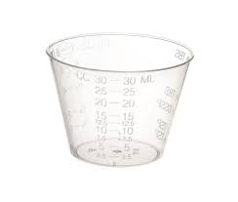
Milliliters
Milliliters are used to measure the capacity of small objects. We would use milliliters to measure the capacity of a spoon, a small glass, or a small teacup.
Which customary unit is similar to milliliters?

Slide 21
Liters
Liters are used to measure the capacity of larger objects. One water bottle is similar to one liter.
1 Liter = 1,000 mL
What objects might we measure in liters instead of milliliters?

Slide 22
Liter or Milliliter?
5 L or 5 mL?

Slide 23
Liter or Milliliter?
30 mL or 30 L?

Slide 24
Liter or Milliliter?
300 mL or 300 L?

Slide 25
Liter or Milliliter?
10 mL or 10 L?

Slide 26
Units of Mass
Lesson 15-3
CCSS 3.MD.2
Notes:
Literature Link: Mighty Maddie by Stuart Murphy

Slide 27
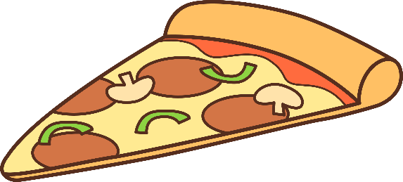
Warm-Up
Pete’s Pizza has 3 sizes of pie: Small, Medium, and Large. They give you the choice of 3 toppings: Pepperoni, Veggie, or Mushroom. How many different combinations can you choose from?
If Pete’s Pizza adds another size, X-Large, how many combinations will you be able to choose from?

Slide 28
Think and Write
List these objects from least to greatest in terms of weight.
Boy
Elephant
Book
Pencil
18 Wheeler Truck

Slide 29
What are the units of weight?
We measure weight in these units:
Ounce (oz.)
Pound (lb.)
Ton

Slide 30

Ounce (Oz)
An ounce (oz) is used to measure VERY small things. Some things we might measure weight using ounces are a feather, a pencil, a dollar or a piece of paper.
Can you think of anything else?

Slide 31
Pound (lb)
We measure medium-sized things using pounds (lb). Some examples are people, desks, books, and dogs.
What else can I measure with pounds?

Slide 32
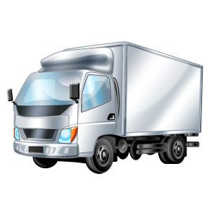
Ton
Tons are used to measure VERY big things. We measure the weight of elephants, monster trucks, and buildings with tons.

Slide 33

Choose the better measurement!
12 oz. or 12 lb.?

Slide 34
Choose the better measurement!
35 oz. or 35 lb.?

Slide 35
Choose the better measurement!
15 lb. or 15 tons?

Slide 36
Choose the better measurement!
12 lb. or 12 tons?

Slide 37
Mass: Gram and Kilogram
Lesson 15-4
CCSS
Notes:
Literature Link: Is a Blue Whale the Biggest Thing There Is? By Robert Wells

Slide 38
Warm Up
Look at the number pattern below.
2, 6, 10, 14, 18….
What are the next two numbers in the pattern?
What is the rule for the pattern?

Slide 39
Think and Write
List some objects you would weigh that you think might weight about 25 pounds.

Slide 40
Mass Using Metric System
There are 2 units of mass in the metric system.
Gram (g.)
Kilogram (kg.)

Slide 41

Grams
Gram: Small unit similar to ounce. A paper clip weighs about a gram. Some objects measured by grams are folders, paper, and pencils.
What else might you measure with a gram?

Slide 42
Kilogram
1 kilogram= 1000 grams
1 kilogram is about 2 pounds.
Kilograms are more similar to pounds. In many countries, people measure their weight in kilograms.
What else might we measure in kilograms?

Slide 43
Choose the better measurement!
50 g. or 50 kg.?

Slide 44
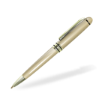
Choose the better measurement!
5 g. or 5 kg.?

Slide 45
Choose the better measurement!
10 g. or 10 kg.?

Slide 46
Choose the better measurement!
90 g. or 90 kg.?

Slide 47

Choose the better measurement!
20 g. or 20 kg.?

Slide 48
Problem Solving: Draw a Picture
Lesson 15-5 CCSS 3.MD.2
Notes:
Literature Link: Millions to Measure by David Schwartz

Slide 49
Warm Up
Mariah is making 7 dog puppets. Karli makes twice as many puppets as Mariah. If each puppet has 2 googly eyes, how many googly eyes will Mariah use? Solve and explain.

Slide 50
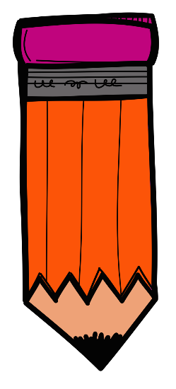
Think and Write
When you write an explanation about how you solve a problem, what information do you have to include in order for the explanation to be considered “complete”?

Slide 51
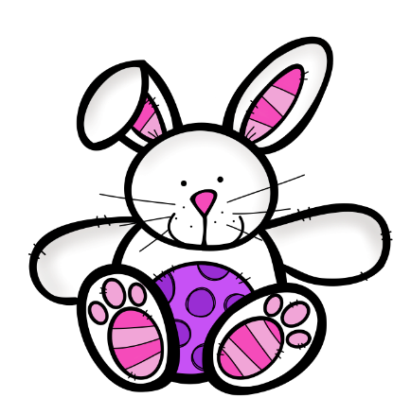
Using Pictures to Solve
Drawing a picture is a strategy we have learned for solving many types of problems. We can also use pictures to solve problems involving units of mass.
Example: The rabbits at a pet store eat 80 kg. of food a day. How many kilograms do they eat in 1 week?
1 week (7 Days)
80 | 80 | 80 | 80 | 80 | 80 | 80
Notes:
Have students write the equation for this problem (80 x 7) and solve. Use multiples of 10 pattern to help.

Slide 52
Problem 1
Thunder the horse eats 30 pounds of hay in 1 day. How many pounds does he eat in 1 week? Draw a picture to solve.

Slide 53
Problem 2
Each pig eats 3 kilograms of slop a day. If there are 8 pigs, how many total kilograms of slop do they eat? Draw a picture to solve.

Slide 54
Problem 3
Farmer Bob’s cow drinks 8 gallons of water a day. How much water does the cow drink in a week? Draw a picture to solve.

Slide 55
Problem 4
Polly Parrot eats 20 grams of birdseed in 1 day. How many grams of birdseed does she eat in a week? Draw a picture to solve.
How many grams does she eat in a month? Draw a picture to solve.

Slide 56






If you like this product, please check out my other products at:
https://www.teacherspayteachers.com/ Store/Kristin-Jason-7154
Thanks to these wonderful teachers & artists for the fantastic clip art, frames, backgrounds & fonts!

