Slide 1
What is an Epic Poem?
The Odyssey

Slide 2
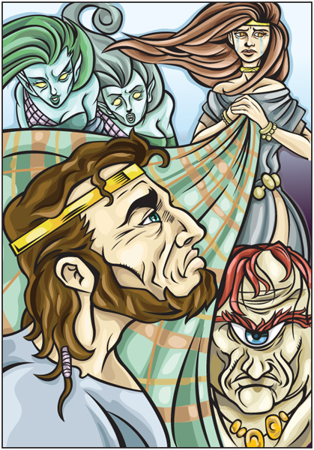
Epic Poetry
Definition: a lengthy narrative poem that usually contains the heroic deeds and events significant to a particular culture or society.
Example: The Odyssey

Slide 3
Epic Poetry
Characteristics:
Begins “in medias res” (in the middle of things)
Has a vast setting
Features lengthy, formal speeches
Contains divine interventions—THE GODS!
Features heroes that embody the values and morals of the civilization
The protagonist descends into the underworld/hell
The hero is a figure of heroic stature, of national importance, or international prominence, and of great historical or legendary significance.
The action consists of deeds of great valor or requiring great courage
Poets open by invoking a muse to inspire and instruct him

