Slide 1

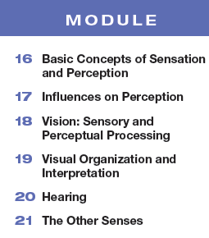

Unit 4
Sensation and Perception

Slide 2

Learning Targets
Module 17
17-1 Analyze the ways in which our expectations, contexts, motivation, and emotions influence our perceptions.
Influences on Perception
17-2 Describe the claims of ESP, and discuss what most research psychologists have concluded after putting these claims to the test.

Slide 3
What is a perceptual set?
a mental
predisposition to perceive one
thing and not another
…we see what we expect to see

Slide 4


How does priming influence perceptual set?
When viewing this image initially…
…subjects were more likely to see the
old woman.

Slide 5
Why the change in perception?
When viewing this image initially…
…subjects were more likely to see the
young woman.

Slide 6

What do you see here?
Share your answers with the class.

Slide 7


How does expectation influence perceptual set?
It’s the number 13!
… or is it?

Slide 8

How does top-down processing influence perceptual set?
our experience with numbers and letters
(13 comes between 12 and 14….
B comes between A and C)
influences our expectation…

Slide 9
How does context influence perceptual set?
Reading from left to right, our expectations
cause us to perceive the middle script differently than when reading from top to bottom.

Slide 10

What is on the woman’s head?
Where is the family? What are they doing?

Slide 11

How does cultural context impact perceptual set?
When asked what was above the woman’s head…. rural East Africans saw a woman with a box on her head and a family under a tree.

Slide 12
How does a different cultural context impact perceptual set?
Westerners,
used to running water and boxlike houses with corners, saw a woman sitting under a window and a family indoors.
(Gregory & Gombrich, 1973)

Slide 13
1. What Would You Answer?
On a warm summer day, Kimberly tells her brother to put on a suit. Kimberly’s brother knows
to put on a swimsuit instead of a
business suit because of
context.
B. priming.
C. sensory adaptation.
D. bottom-up processing.
clairvoyance.

Slide 14
What does research show about how motivation can influence perceptual set?
Desirable objects, such as a water bottle viewed by a thirsty person, seem closer than they really are.
(Balcetis & Dunning, 2010).
A to-be-climbed hill can seem steeper when we are carrying a heavy backpack, and a walking destination further away when we are feeling tired.
(Burrow et al., 2016; Philbeck &Witt, 2015; Proffitt 2006a,b)
Going on a diet can lighten our biological “backpack”. When heavy people lose weight, hills and stairs no longer seem so steep.
(Taylor-Covill & Eves, 2016).

Slide 15
What does research show about how emotion can influence perceptual set?
When angry, people more often perceive
neutral objects as guns.
Baumann & DeSteno, 2010)
Hearing sad music can predispose people to perceive a sad meaning in words that sound alike…mourning rather than morning, die rather than dye, pain rather than
pane. (Halberstadt et al., 1995)
When mildly upset by subliminal exposure to a scowling face, people perceive a neutral face as less attractive and likeable.
(Anderson et al., 2012)

Slide 16
What is parapsychology and ESP?
parapsychology
ESP
(extra sensory perception)
The study of
paranormal phenomena, including
ESP and psychokinesis (the ability of the mind to move objects).
The controversial claim that awareness can occur apart from sensory input; includes telepathy (mind to mind communication),
clairvoyance (seeing remote events), and precognition (seeing the future).

Slide 17
How have researchers tried to test
ESP claims?
In one study, psychologists
created a “mind machine” to see if people could influence or predict a coin toss.
Using a touch-sensitive screen, visitors to British festivals were given four attempts to call heads or tails, playing against a computer that kept score.
By the time the experiment ended, nearly 28,000 people had predicted 110,959 tosses—with 49.8 percent correct.
Wiseman and Greening, 2002

Slide 18
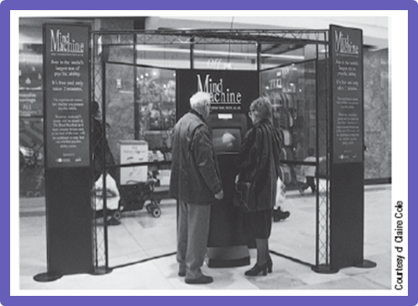
The Mind Machine.

Slide 19
What have most researchers concluded regarding the veracity of ESP claims?
Researchers have been unable to replicate ESP claims under controlled conditions.

Slide 20
Learning Target 17-1 Review
Analyze the ways in which our
expectations, contexts, motivation,
and emotions influence our perceptions.
Perceptual set is a mental predisposition that functions as a lens through which we perceive the world.
Our learned concepts (schemas) prime us to organize and interpret ambiguous stimuli in certain ways.
Our motivation, as well as our physical and emotional context, can create expectations and color our interpretation of events and behaviors.

Slide 21
Learning Target 17-2 Review
Describe the claims of ESP, and
discuss what most research
psychologists have concluded after putting
these claims to the test.
Parapsychology is the study of paranormal phenomena, including extrasensory perception (ESP); telepathy, clairvoyance, precognition, and psychokinesis.
Skeptics argue that (1) to believe in ESP, you must believe the brain is capable of perceiving without sensory input, and (2) researchers have been unable to replicate ESP phenomena under controlled conditions.

