Slide 1
Models for subtracting 3-digit numbers
Lesson 3-7 CCSS 3.NBT.2, 3.OA.8
Notes:
Literature Link: The Action of Subtraction by Brian Cleary

Slide 2
Warm Up
Write the numbers in expanded form.
386
714
203
4,912

Slide 3
Think and Write
Suppose you only have a hundred dollar bill and you need to give someone $10. What could you do?

Slide 4
Problem 1
You have 2 hundreds, 4 tens, and 6 ones. You need to give away 1 hundred, 5 tens, and 3 ones. How could you do this?
246=
Now, subtract 1 hundred, 5 tens, and 3 ones. Start with the ones.
How many hundreds, tens, and ones do you have?
Notes:
This would be a good partner discussion problem but if your class cannot do partnering, it can be done as a class or independently.

Slide 5
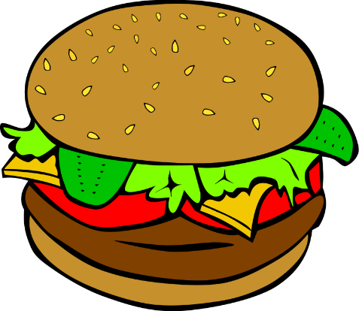
Problem 2
The burger shop sells 546 burgers on Saturday and 317 burgers on Sunday. How many more burgers were sold on Saturday? Use place value blocks to subtract 546 – 317.

Slide 6
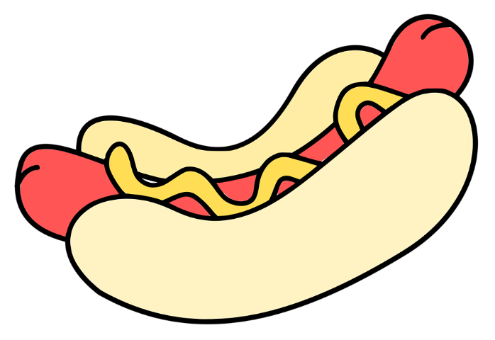
Problem 3
On Friday night, the hot dog shop sold 418 hot dogs and 229 chili dogs. How many more hot dogs did they sell than chili dogs? Use place value blocks to subtract 418 – 229.

Slide 7
Problem 4
Sam has $215. He spends $174 at the video game store. How much money does Sam have left? Use place value blocks to model.

Slide 8
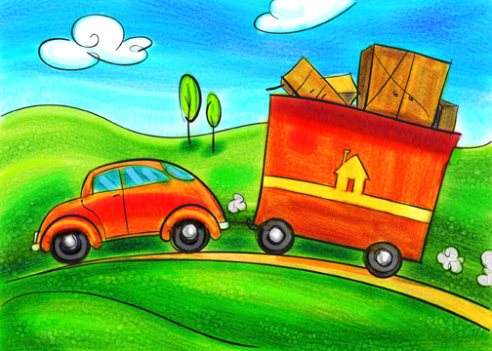
Problem 5
It is 346 miles from Cleveland to Chicago. Tara and her family have driven 193 miles. How much farther do they still have to go?

