Slide 1
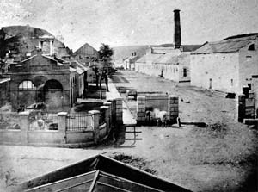
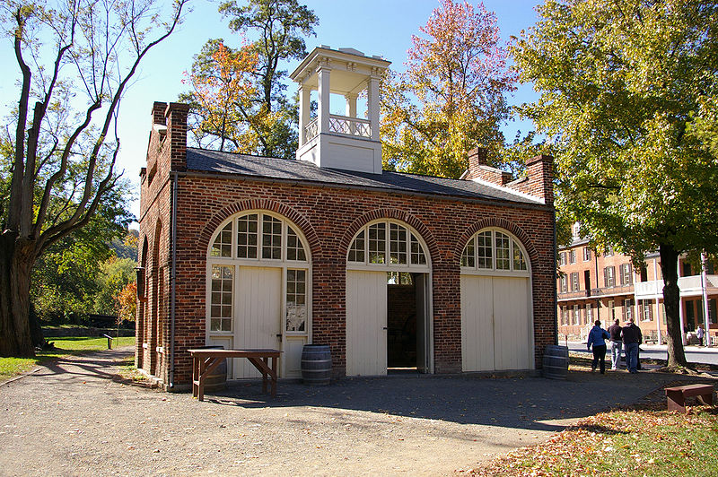
Page 109

Slide 2
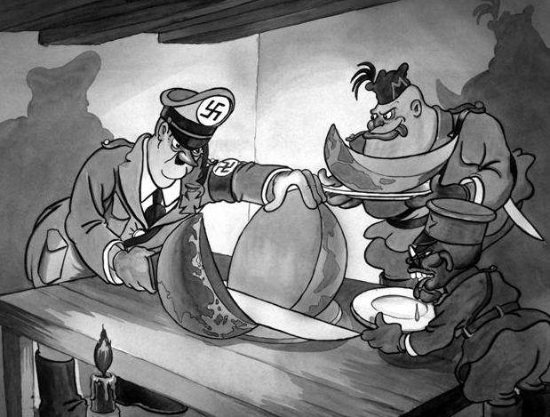

Slide 3
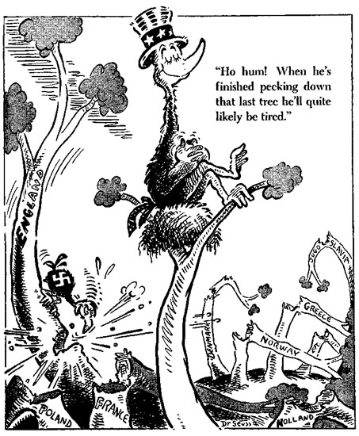
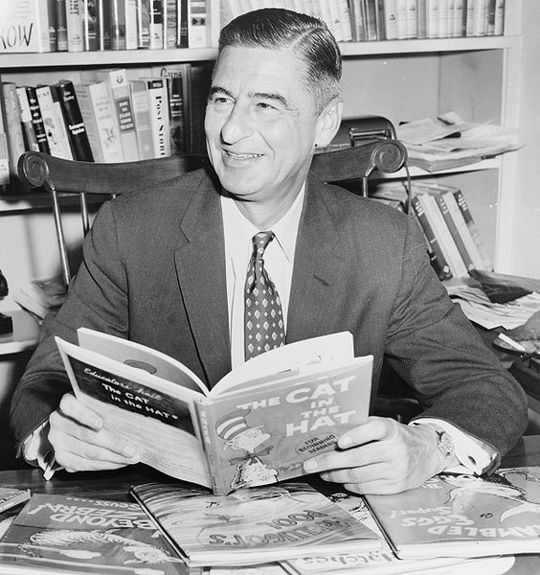
Who is the cartoonist?
Dr. Seuss
Theodor Seuss Geisel

Slide 4
Objectives
MS1 Explain how geography, economics, history, and politics have influenced the development of Mississippi.
MS1e Analyze the historical and political significance of key events in our state's development (e.g., Civil War, Civil Rights Movement, etc.).

Slide 5
Objectives
MS3 Describe the relationship of people, places, and environment through time.
MS3d Analyze the significance of key events in our state's history.
MS3e Analyze the ways Mississippians have resolved conflict and adapted to change, and continue to address cultural issues unique to our state.

Slide 6
Objectives
MS4 Demonstrate the ability to use social studies tools (e.g., timelines, maps, globes, resources, graphs, a compass, technology, etc.).

Slide 7
Review
The Antislavery Movement
The Nullification Crisis
Texas
Wilmot Proviso
Compromise of 1850

Slide 8
Overview
Kansas-Nebraska Act
Dred Scott
Harpers Ferry, Virginia
Mississippi’s Reaction
The 1860 Presidential Election

Slide 9
Kansas-Nebraska Act in 1854
Repealed the Missouri Compromise.
Initial purpose of the Kansas-Nebraska Act was to create opportunities for a Mid-eastern Transcontinental Railroad.
It was not problematic until popular sovereignty was written into the proposal.

Slide 10
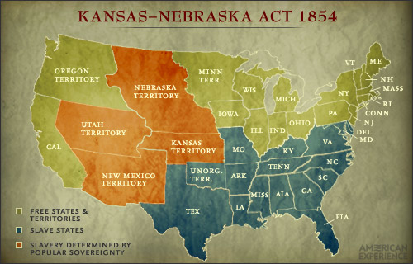
Kansas and Nebraska Territory

Slide 11
Kansas
Because Kansas was north of the 36° 30’N parallel, abolitionists were outraged.
Pro-slavery settlers came to Kansas mainly from neighboring Missouri.
Abolitionist settlers moved from the East with express purpose of making Kansas a free state.

Slide 12
Bleeding Kansas, Bloody Kansas, or the Border War
A series of violent events, involving anti-slavery Free-Soilers and pro-slavery "Border Ruffian" elements, that took place in the Kansas Territory.
At one point, Kansas had two separate governments, each with its own constitution, although only one was federally recognized.

Slide 13
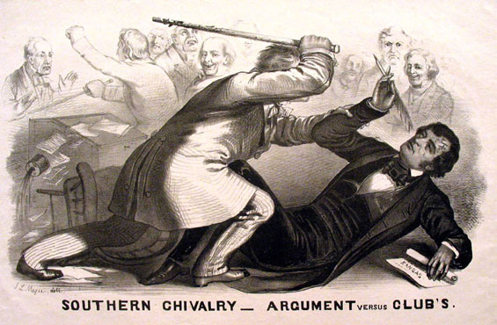
Preston Smith Brooks (a Democratic Congressman from South Carolina) physically attacked Senator Charles Sumner of Massachusetts in the United States Senate chambers.
Bleeding Kansas

Slide 14
Sumner was blinded by his own blood, and staggered away until he collapsed, lapsing into unconsciousness. Brooks continued to beat Sumner until he broke his cane.
He did not return to his Senate desk for three years as a result of his injuries to the head and neck area.

Slide 15
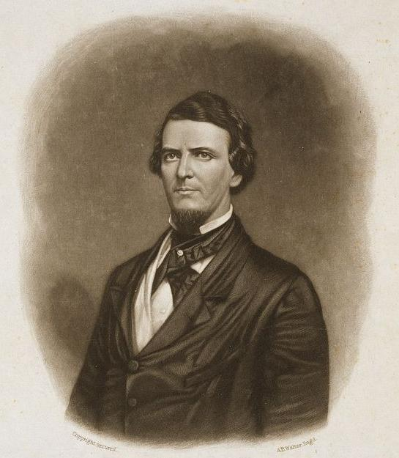
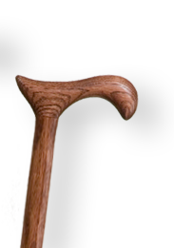
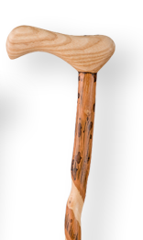
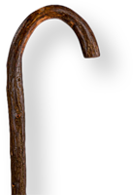
South Carolinians sent Brooks dozens of brand new canes, with one bearing the phrase, "Hit him again."
Preston Brooks
Congressman from South Carolina

Slide 16
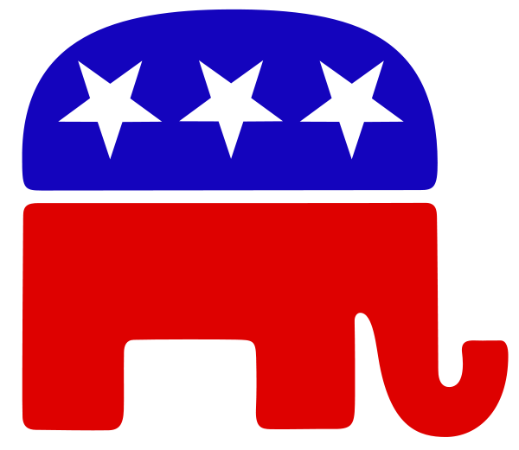
Republican Party
The Republican party was formed to oppose the expansion of slavery.
The party began to form in the late 1840s, though it would take opposing the Kansas-Nebraska Act to unify the party.

Slide 17
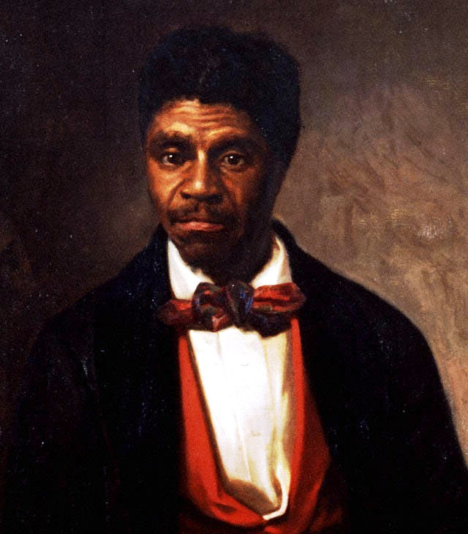
Dred Scott v. Sandford
In 1832, U.S. Army Major John Emerson, stationed outside of St. Louis, Missouri, purchased Scott.

Slide 18
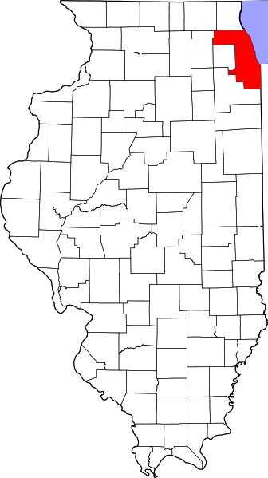
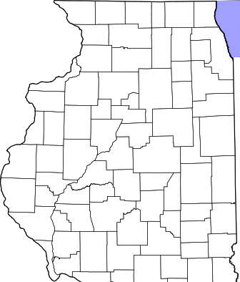
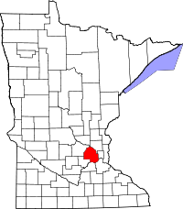
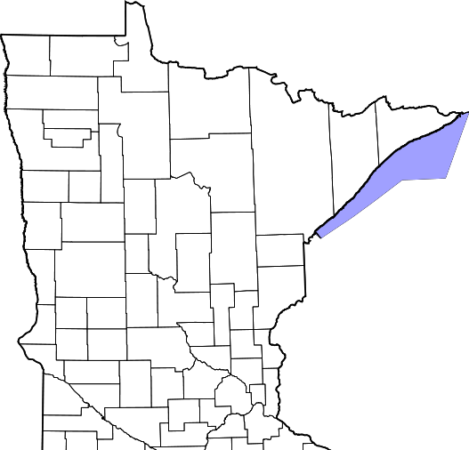
Over the next 12 years, Emerson took Scott along to new assignments at Fort Armstrong, Illinois and later to Fort Snelling in the Wisconsin Territory (present-day Minnesota). Illinois, a free state, had been free as a territory under the Northwest Ordinance of 1787, and had prohibited slavery in its constitution in 1819 when it was admitted as a state.
Fort Armstrong
Fort Snelling

Slide 19
In 1837, the Army ordered Emerson to Jefferson Barracks Military Post, south of St. Louis, Missouri. Emerson left Scott and Scott's wife Harriet at Fort Snelling. Emerson was then quickly reassigned to Fort Jessup, Louisiana.
In 1842, Emerson left the Army. He died in the Iowa Territory in 1843, his widow (in St. Louis, Missouri) Eliza inheriting his estate, including Scott.

Slide 20
Scott then attempted to purchase his freedom, but Mrs. Emerson refused.
After failing to purchase the freedom of his family and himself, and with the help of abolitionist legal advisers Scott sued Mrs. Emerson.
The US Supreme Court ruling (7 to 2) was handed down on March 6, 1857.

Slide 21
The Court first held that Scott was not a "citizen of a state" within the meaning of the United States Constitution, as that term was understood at the time the Constitution was adopted, and therefore not able to bring suit in federal court.

Slide 22
According to the Court, the drafters of the Constitution had viewed all African-Americans as:
"beings of an inferior order, and altogether unfit to associate with the white race, either in social or political relations, and so far inferior that they had no rights which the white man was bound to respect."

Slide 23
The court held that the Fifth Amendment barred any law that would deprive a slaveholder of his property, such as his slaves, because he had brought them into a free territory.
Although the issue was not before the Court — that the territorial legislatures had no power to ban slavery.

Slide 24
The sons of Peter Blow, Scott's first owner, purchased emancipation for Scott and his family on May 26, 1857. Their gaining freedom was national news and celebrated in northern cities.
He died of tuberculosis only eighteen months later.

Slide 25
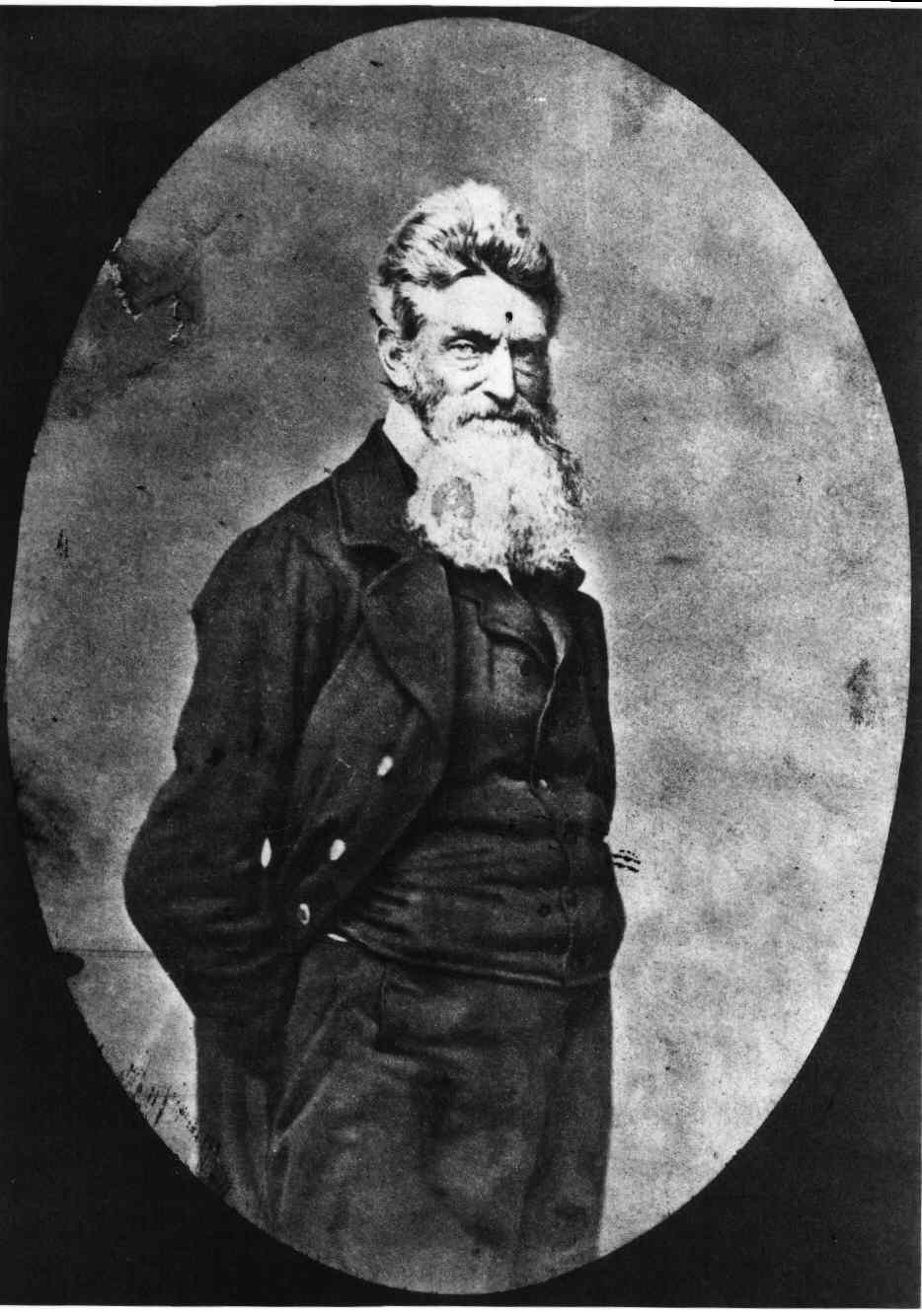
Harpers Ferry, Virginia
It was an attempt by white abolitionist John Brown to start an armed slave revolt by seizing a United States Arsenal at Harpers Ferry in Virginia in 1859.
John Brown

Slide 26
Brown came with a trained, small group of men for military action. His group included 16 white men, 3 free blacks, 1 freed slave and 1 fugitive slave.
A Baltimore & Ohio train conductor alerted the authorities in Washington D.C. about the raid.
Brown's men captured the armory that evening.

Slide 27
Armory workers discovered Brown's men early on the morning of October 17. Local militia, farmers and shopkeepers surrounded the armory.
When a company of militia captured the bridge across the Potomac River, any route of escape was cut off.
President James Buchanan ordered a detachment of U.S. Marines to march on Harpers Ferry.

Slide 28
The president’s choice to command this detachment was Brevet Colonel Robert E. Lee.
10 marines, used a ladder as a battering ram to knock the front doors in.
The action inside the engine house happened very quickly. In three minutes, all of the raiders still alive were taken prisoner and the action was over.

Slide 29
John Brown was taken to the court house in nearby Charles Town for trial. He was found guilty of treason against the commonwealth of Virginia and was hanged on December 2.
This execution was witnessed by the actor John Wilkes Booth.
17 Raiders killed in raid, or hanged.
3 Civilians killed in raid, 1 on the train.
2 Slaves
2 Marines

Slide 30
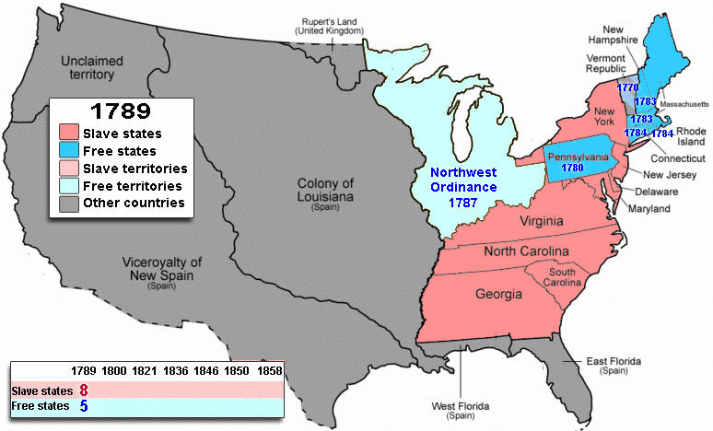
13 States – the civil war

Slide 31
Mississippi’s Reaction
Mississippi politicians defended the “peculiar institution” (as slavery was called) including the right of slave owners to take their property (slaves) anywhere in the United States.
What is secession?
Withdrawal from the Union.

Slide 32
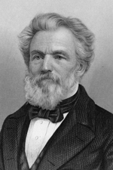
John A. Quitman
Governors of Mississippi
Whig Party
Fire-Eaters a group of extremist pro-slavery politicians from the South who urged the separation of southern states into a new nation.

Slide 33
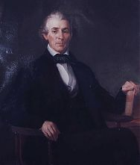
Meeting in Nashville
In 1850, a state convention in Jackson called for a regional meeting in Nashville to decide what should be done to protect slavery.
William Sharkey, who presided at the Nashville convention.
William Lewis Sharkey
Whig Party

Slide 34
Nashville convention
William Sharkey urged delegates to give Congress time to work out an acceptable compromise.
Mississippi Senator Henry S. Foote of Vicksburg tried to make sure that the compromise would protect the South.
Senator Jefferson Davis and most of the congressmen from Mississippi believed secession was the only answer.

Slide 35
Governor’s Race of 1851
Foote organized a new party, called the Union party, and ran against Quitman.
The only issue was that of union or secession.
Quitman dropped out when it was clear that most Mississippians did not favor secession.

Slide 36
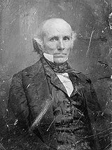
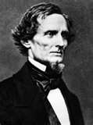
Governor’s Race of 1851
Jefferson Davis, who was not as radical as Quitman, entered the contest.
Foote won, but it was a close contest.
Henry S. Foote
Jefferson Davis

Slide 37
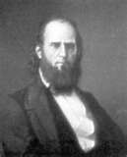
1859
In 1859, John Jones Pettus of Kemper County, a supporter of secession, was elected governor of Mississippi.

Slide 38
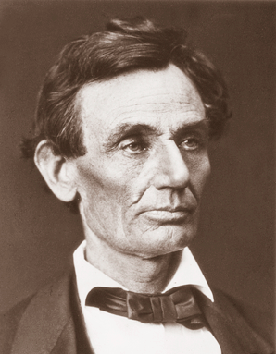
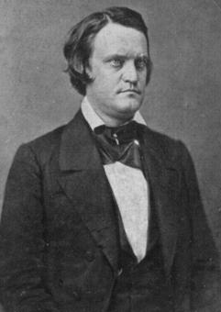
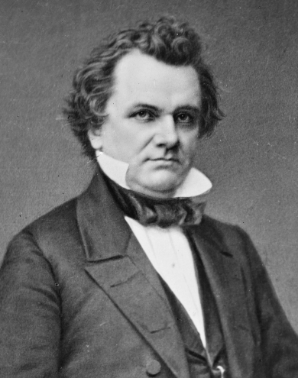
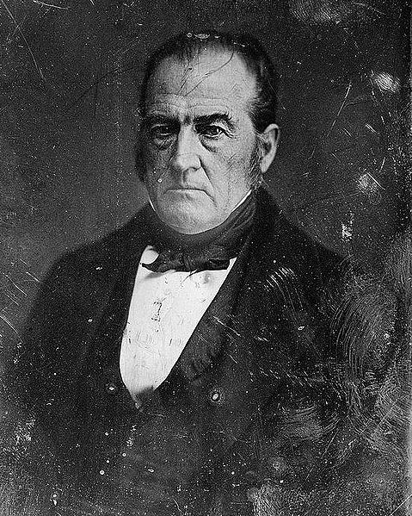
The 1860 Presidential Election
Abraham Lincoln
John C. Breckinridge
Stephen A. Douglas
John Bell
Republican
Southern Democratic
Northern Democratic
Constitutional Union/Whig
Candidates gallery

Slide 39
The Democratic Party
The Democratic Party was divided over the issue of slavery.
At the convention in Charleston in April 1860, 51 Southern Democrats walked out because of a platform dispute over defending slavery in the territories.

Slide 40
Six candidates were nominated.
Douglas, a moderate on the slavery issue who favored "popular sovereignty", was ahead on the first ballot, needing 56.5 more votes.
On the 57th ballot, Douglas was still ahead, but still 50.5 votes.
On May 3 the delegates agreed to stop voting and adjourn the convention.

Slide 41
The Democrats convened again in Baltimore, Maryland on June 18.
This time 110 southern delegates (led by “Fire-Eaters”) walked out when the convention would not adopt a resolution supporting extending slavery into territories.
After two ballots, the remaining Democrats nominated the ticket of Stephen A. Douglas.

Slide 42
Southern Democrats
The Southern Democrats, led by Yancey, reconvened in Richmond, Virginia, and on June 28 nominated the pro-slavery incumbent Vice President, John Cabell Breckinridge of Kentucky, for President.

Slide 43
Constitutional Union Party
Die-hard former Whigs and Know Nothings who felt they could support neither the Democratic Party nor the Republican Party formed the Constitutional Union Party, nominating John Bell of Tennessee for president.
The party platform advocated compromise to save the Union.

Slide 44
Republicans
The Republican National Convention met in mid-May, after the Democrats had been forced to adjourn their convention in Charleston.
Since it was essential to carry the West, and because Lincoln had a national reputation from his debates and speeches as the most articulate moderate, he won the party's nomination on the third ballot

Slide 45
Abraham Lincoln
The Republicans nominated Abraham Lincoln on a platform that opposed slavery in the territories, but pledged not to interfere with slavery where it already existed.
The election revealed the deep divisions in the country.
Lincoln won the election.

Slide 46
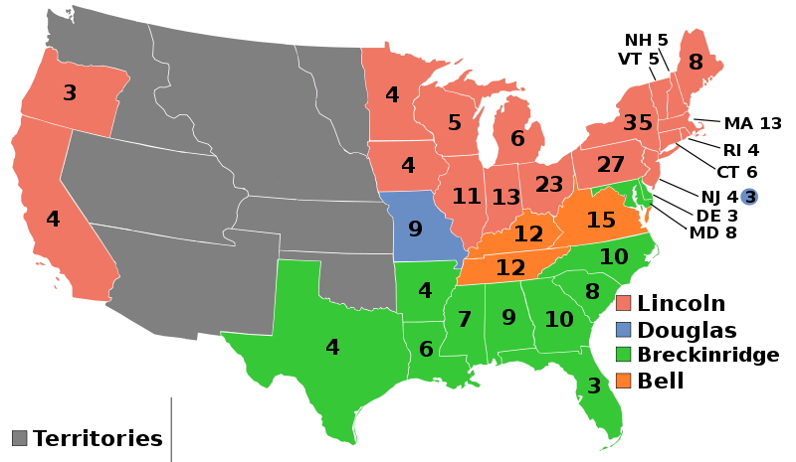
Nominee | Abraham Lincoln | John C. Breckinridge
Party | Republican | Southern Democratic
Electoral vote | 180 | 72
States carried | 18 | 11
John Bell | Stephen A. Douglas
Constitutional Union | Northern Democratic
39 | 12
3 | 1

Slide 47
Review
Kansas-Nebraska Act
Dred Scott
Harpers Ferry, Virginia
Mississippi’s Reaction
The 1860 Presidential Election

Slide 48
Homework
Read pages 112 to 114.

