Slide 1
Environmental Safety Equipment & Solutions Safety Patient & Resident Safety Personal Safety
HS1
DHO8 Chapter 14, pg 361

Slide 2
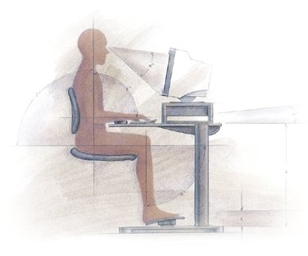
Ergonomics Review from Friday
Promotes personal safety in the workplace.
Includes the correct placement and use of furniture and equipment.
Encourages workers to avoid repetitive motions.

Slide 3
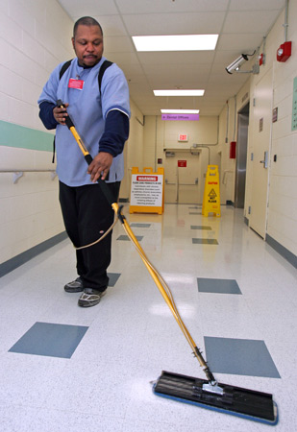
Ergonomics
Healthcare workers should have an awareness of the environment to prevent injuries.
It is our responsibility to report unsafe situations.

Slide 4
Do You Know?
While observing good body mechanics, how should a radiologic technologist move a portable x-ray machine to a patient’s room?
A. Stand 2 feet away from the machine and push using the arm and back muscles.
B. Stand close to the machine and pull while walking backwards.
C. Stand 2 feet away from the machine and pull using the arm and leg muscles.
D. Stand close to the machine and push using the weight of the body.

Slide 5
Do You Know?
Darla is a medical office assistant and must take a heavy box from the floor to the storage room. How should she lift it?
A. Bend at the hips and knees with the back straight, get close to the box, and lift using the leg muscles.
B. Keep one leg straight and bend the other to get close to the box, then lift while straightening the bent leg and bending the straight leg.
C. Put a chair next to the box, kneel down, pick up the box and place it on the chair. Then stand and lift the box, holding it close to the chest.
D. Bend at the waist to pick up the box, and then use the arm muscles to lift and bring the box close in to the body.

Slide 6
Do You Know?
Diane and Elena work at a nursing home and have similar patient care assignments. At the end of every shift, Diane is tired and her back and shoulders ache, while Elena feels pretty good. What MOST LIKEY causes the difference?
A. Elena must be much younger.
B. Elena must be much thinner.
C. Elena must use good body mechanics.
D. Diane must work much harder.

Slide 7
Do You Know?
You are getting ready to move a patient up in bed, and your supervisor tells you to broaden your base of support. You should:
A. Bend at the knees.
B. Place your feet further apart.
C. Raise your arms up at your sides.
D. Lean up against the bed.

Slide 8
Do You Know?
After ergonomics training, a healthcare worker should know how to:
A. Prevent injuries in the work environment.
B. Practice aseptic technique in a specific work setting.
C. Read and understand Material Safety Data Sheets.
D. Wear PPE.

Slide 9
Equipment and Solutions
DO NOT operate equipment until you are instructed on its proper use.
Read and follow operating instructions.
Report damaged or malfunctioning equipment immediately.

Slide 10
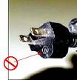
Equipment and Solutions
Use lockout tags/devices following agency procedures.
DO NOT use frayed or damaged electrical cords, or a plug with a broken prong.
x

Slide 11
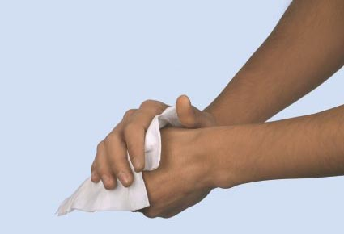
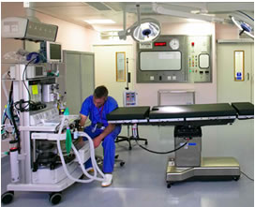
Equipment and Solutions
DO NOT handle electrical equipment with wet hands or around water.
Store all equipment in its proper place.
Read Material Safety Data Sheets before using chemicals.

Slide 12
Equipment and Solutions
DO NOT use solutions in unlabeled bottles.
Read the label three times to assure you are using the correct solution.
DO NOT mix solutions unless done under proper supervision.

Slide 13
Labels
Use solutions only as directed on the label.
Follow manufacturers directions for storage of chemicals.
For breakage or spills, notify your supervisor immediately and follow disposal instructions on the label or MSDS.

Slide 14
Implications of Hazardous Materials
Manufacturers must provide Material Safety Data Sheets (MSDS) for hazardous products.
The MSDS must provide:
Information about the chemical
Protection/precautions to be used
Instructions for safe use
Procedures for spills, cleanup and disposal
Emergency first aid if injury occurs

Slide 15
Do You Know?
You should consult a Material Safety Data Sheet to get information about cleaning up what type of spill?
A. Blood
B. Chemical
C. Food
D. Bottle of pills

Slide 16
Do You Know?
A computer in the medical records section of the hospital has a frayed cord. What should the office manager do?
A. Replace the cord with a new one.
B. Wrap the cord with electrical tape.
C. Report the damage to the manufacturer.
D. Report the damage to the hospital administrator.

Slide 17
Patient and Resident Safety
DO NOT perform procedures unless instructed to do so.
Use only correct and approved methods, never shortcuts.

Slide 18
Patient and Resident Safety
Provide patient privacy:
Knock before entering the room.
Speak to the patient and identify yourself.
Ask for permission to go around a privacy curtain.
Provide privacy before beginning a procedure.

Slide 19
Patient and Resident Safety
Identify the patient.
Check the ID band.
Ask the patient to state his or her name.
Address the patient by his or her name at least twice.
Explain what you are going to do.
Never perform a procedure if the patient refuses.

Slide 20
Patient and Resident Safety
Be alert to the patient’s condition at all times, and report any changes.
Be alert to environmental safety hazards.
Before leaving a patient, be sure:
The bed is at its lowest level, wheels locked.
The call bell is within reach.
Supplies are within easy reach.
To leave the area neat and clean.

Slide 21
Do You Know?
You are a medical assistant in an office practice and have been asked to get Mrs. James in room 6 to sign a consent form. What should you do FIRST?
A. As Mrs. James to spell her full name for you.
B. Explain the procedure needing consent before you ask her to sign the form.
C. Knock on the door before entering the room.
D. Read the history and physical on Mrs. James’ chart.

Slide 22
Do You Know?
After caring for a resident in a nursing home, before leaving the room the healthcare worker should:
A. Check to be sure the bed is in its highest position.
B. Be sure the wheels on the bed are not locked.
C. Pull the privacy curtains and place the call bell on the bedside table.
D. Put the client’s phone, tissues and glasses within easy reach.

Slide 23
Do You Know?
You are working in a nursing home and have been asked to take Mr. Arnold to recreational therapy in a wheelchair. When you arrive in the room, Mr. Arnold refuses to go. What should you do?
A. Gently guide Mr. Arnold to sit in the wheelchair.
B. Explain to Mr. Arnold that if he does not do as you ask, he will never get better.
C. Ask why and then report Mr. Arnold’s refusal to your supervisor.
D. Have Mr. Arnold sign an “Against Medical Advice” refusal form.

Slide 24
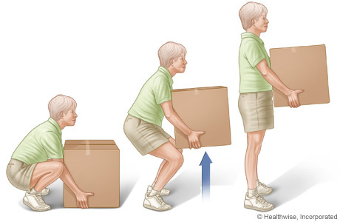
Personal Safety
Protect yourself and others from injury.
Use correct body mechanics.
Wear the required uniform.
Walk – DO NOT run!

Slide 25
Personal Safety
Immediately report personal injury to your supervisor.
Report unsafe situations to your supervisor.
Keep areas clean and neat with everything in the proper place.
Wash hands frequently.

Slide 26
Personal Safety
Keep hands away from face, eyes and mouth.
Dry hands before touching equipment.
Use safety glasses when needed.

Slide 27
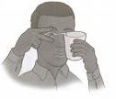
Personal Safety
Avoid horseplay and practical jokes.
If solutions get in your eyes, flush with water and inform your supervisor.
If a particle gets in your eye – inform your supervisor and DON’T rub it or try to remove the particle.

Slide 28
Do You Know?
You are cleaning a patient’s dentures when some of the soaking solution splashes into your eye. What should you do FIRST?
A. Flush your eyes with water.
B. Call 911.
C. Notify your supervisor.
D. Complete an incident report.

Slide 29
Do You Know?
You are working in a hospital when you hear a patient in a room at the end of the hall call for help. What should you do FIRST?
A. Run to the room and offer assistance.
B. Find your supervisor and tell him/her what you heard.
C. Walk quickly to the room and assess the situation.
D. Go to the nurse’s station, call the room, and offer assistance.

Slide 30
Signs and Symbols
Bio-hazard symbol

Slide 31
Signs and Symbols
Standard precaution symbols for:
Wash hands
Wear gloves
Wear mask
Wear eye protection
Wear gown

Slide 32
Do You Know?
What does this symbol tell a healthcare worker?
A. This is a poison
B. Practice standard precautions
C. This item is sterile
D. Bloodborne pathogen alert

Slide 33
Do You Know?
What should you place in a red bag with the words “Biohazardous Waste” on the front of the bag?
A. Soiled bed linens
B. Patient’s clothes that are stained with blood
C. A soiled dressing from a wound
D. A wet disposable baby diaper

