Slide 1
Shanghai Tower
By: Adrian & Marx

Slide 2
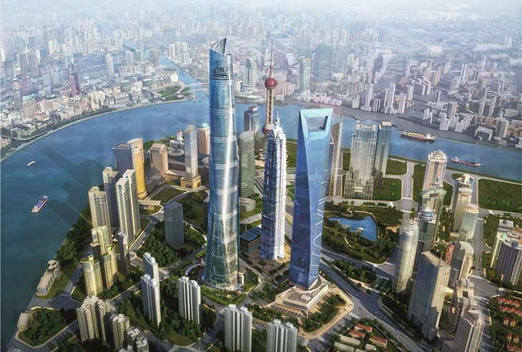
THE WHO, WHAT, WHEN, AND WHERE OF THE SHANGHAI TOWER
A man named Gensler designed the Shanghai Tower. A company named The Shanghai Tower Construction and Development built the tower. The building was Proposed in 2008. Construction started in 2009. The building will be completed in 2014 . The building is a hotel and office. The tower is in Shanghai, China.

Slide 3
MATERIALS AND SIZE
The material that the building is made of composite. The size is 853 feet to the top.

Slide 4
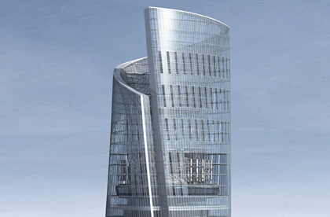
WHAT IS IT USED FOR
It is used for a hotel and offices.

Slide 5
Fun facts
Former name: Shanghai Center
It is under construction
It collapsed in 2012
It will be completed in 2014

Slide 6
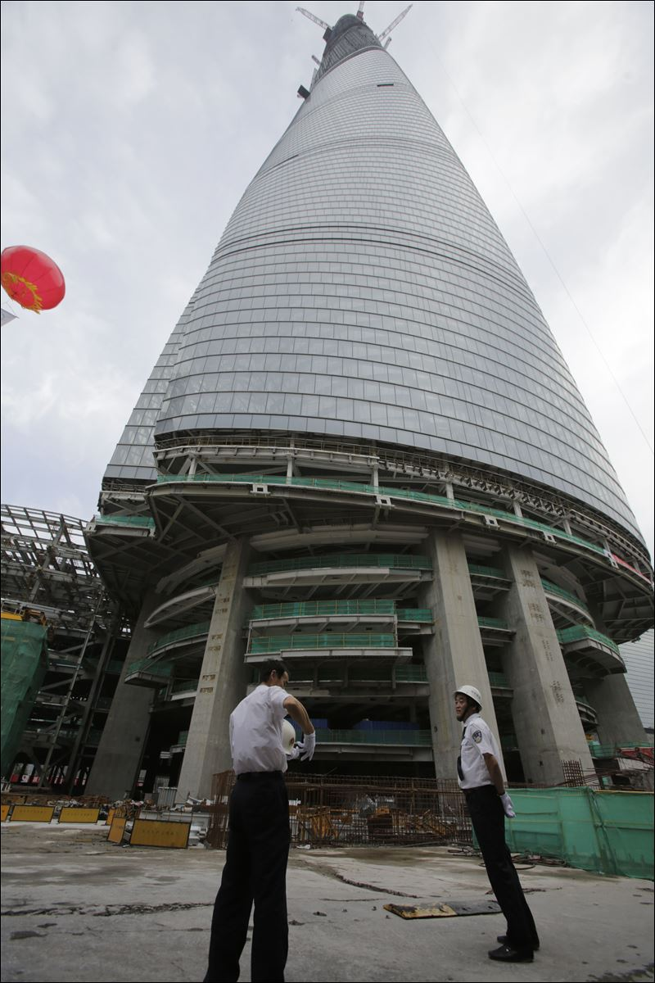
resource
Sky scraper center

