Slide 1
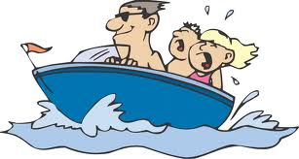
Boating/Swimming Safety
By: Kelly, Kyla, Jasmine, Mariah, Timesha, Beverly, Lauren, Josh

Slide 2
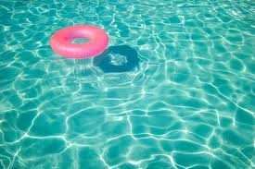
Swimming Basics
Know how to swim before getting into water
Always swim in a supervised area
Look before you leap
Wait an hour after eating
Never swim after consuming any alcoholic beverages

Slide 3
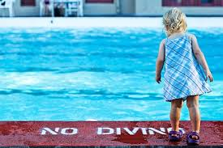
Swimming with Young Children
Never leave a child near water unattended
Make sure they know how to swim or put safety gears on them (floaties or life jacket)
Teach children to always ask permission to go near water

Slide 4
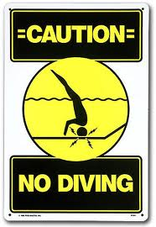
Swimming Pool Rules
Swim in designated areas supervised by lifeguards
Swim with other people
Don’t dive around shallow ends
No running around the pool
Don’t horseplay (drowning each other, etc.)

Slide 5
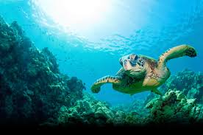
Swimming in Bodies of Water
Wear safety gear when going into deep or questionable waters
Stay closer to the shallow parts of water
Make sure water is warm enough to swim in

Slide 6
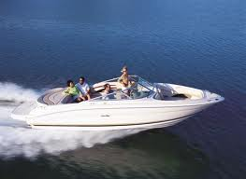
Boating Safety
Make sure the boat driver has a Boating License
Keep safety gear on the boat
Have a fire extinguisher in a safe place on the boat
Have working boat lights

Slide 7
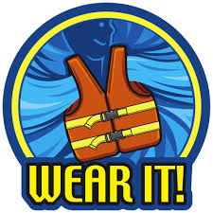
Boating Safety Cont…
Be aware of tides
In case of capsizing, stay with your boat then swim to surface
Don’t sit on safety railings
Follow boat traffic rules
Everyone wears a life jacket

Slide 8
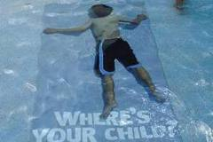
Identify a Drowning Victim
An active drowning victim is conscious and struggling. This type of victim displays the following characteristics:
- Unable to call for help
- Thrashing arms
- Vertical in the water
- Body is very low in the water, with the mouth just above the surface.

Slide 9
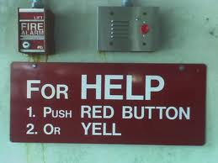
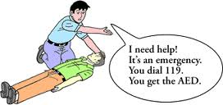
Alert Help if Possible
If you are the only person present, proceed to rescue the victim. If there are bystanders, yell for help so others are aware of the situation or can also help with the rescue.

Slide 10
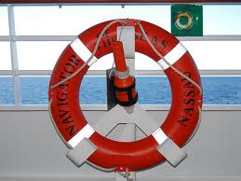
Get a Floatation Device
This will allow the victim something to hold on to once he or she is reached. The most common type of floatation device is called a rescue tube, often found at local swimming areas.

Slide 11
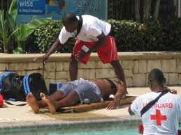
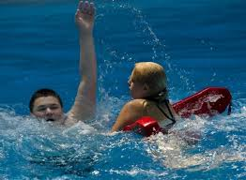
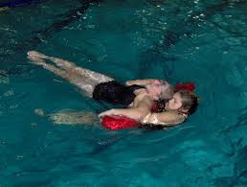
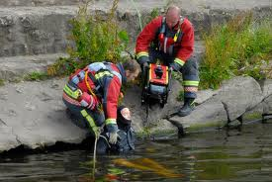
Begin the Rescue
Enter the water and approach the victim. The safest way to avoid harm to oneself is to approach the victim from behind. An active drowning victim only concern is getting air. In fear he or she might grab you and pull you under, leading to two victims.

Slide 12
Place Your Arms Under Victim
Once you get behind the victim, place your arms under each of the victim’s armpits. Then bend your arms back so you are pointing at yourself and hold tight. If you are using a floatation device, keep it between you and the victim, across your chest.

Slide 13
Reassure the Victim
As you pull the victim to safety, calm the victim down by saying, “Are you okay?” or “You’re going to be okay.” Swim calmly and slowly while pulling the victim, unless they need immediate help.

Slide 14
Monitor the Victim
Once you have reached safety, seek medical assistance. Although a person may look okay, water left in the lungs can kill a person in just a few hours.

Slide 15
Key Terms
Life Jacket- a sleeveless buoyant or inflatable jacket for keeping a person afloat
Life Guard- a person responsible for overseeing the safety of the users of a body of water.
Shallow- wetland areas with water of two meters in depth or less.
Deep- waters of great depth

Slide 16
Key Terms Cont…
Lake- a large body of water surrounded by land.
Water Current- flow of water
Ocean- a very large expanse of sea

Slide 17
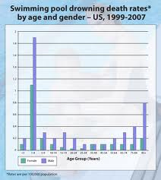
Drowning Death Rates

Slide 18
Sources
http://www.google.com/
Wikipedia
Dictionary.com
Riesgos.com

