Slide 1
The Civil Rights Movement

Slide 2
Learning Goals
Explain early efforts to end segregation
Explain how legalized segregation deprived African Americans of their rights as citizens
Describe the expansion of the civil rights movement
Compare segregation in the north with segregation on the south
Summarize the accomplishments of the Civil Rights Movement

Slide 3
Segregation
Plessy v. Ferguson- 1896- Supreme Court ruled that “separate but equal” was constitutional
Southern states passed Jim Crow laws
African Americans began demanding more rights after WWII.
Notes:
DESEGREGATION
1. World War 2 and the Double V Campaign- Much like WW1, black Americans in ww2 fought in segregated units. Jim crow segregation had pervaded every aspect of American society since the 1890s. The “Double V Campaign” became the battle cry of black American soldiers because they wanted victory at home in the U.S. and victory on the battlefield.
2. Philip Randolph and the brotherhood of sleeping car porters-
AA’S demanded the gov’t force companies to integrate their work forces. A. Philip Randolp: the head of the brotherhood of sleeping car porters, promised that AA’s would march to Washington if FDR did not pass legislation. Executive Order 8802 was pssed preventing racial discrimination in defense industries.

Slide 4
Brown v. Board of Education
Linda Brown was denied admission to an all-white school.
Supreme Court ruled that “separate but equal” violated the 14th Amendment
States were forced to integrate schools.
Notes:
Brown vs. Board of Education--The fight for school desegregation.
The NAACP lead by Thurgood Marshall went through the court system to fight school segregation. He focused his efforts on ending segregation in public schools.
Brown v. Board of Education (1954)-Supreme Court ruled that school segregation was unconstitutional and that separate but equal was by its very nature unequal and wrong. Southern states response? Did nothing towards desegregation. This case involved Linda Brown, who was denied admission to her neighborhood school in Topeka, Kansas, because of her race. She was told to attend an all-black school across town. With the help of the NAACP, her parents sued the Topeka school board. In May 1954, the courts ruled unanimously that segregation in public schools as unconstitutional and violated the equal protection clause of the 14 amendment. Separate educational facilities were now seen as inherently unequal. This threatened the result of Plessy v. Ferguson case. Brown v. Board applied only to public schools, but it threatened the entire system of segregation. It angered many white southerners, who became even more determined to defend segregation, regardless of what the Supreme Court said. Southerners pressured their local governments into defying the Supreme court
4. Brown II-court ordered southern schools to desegregate “with all deliberate speed”. The ruling was important bc it was a reminder by America’s highest court that segregation was unconstitutional, however, the ambiguous language allowed some deep southern states to justify delaying integration.

Slide 5
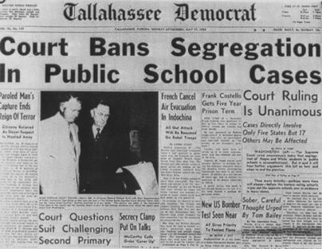
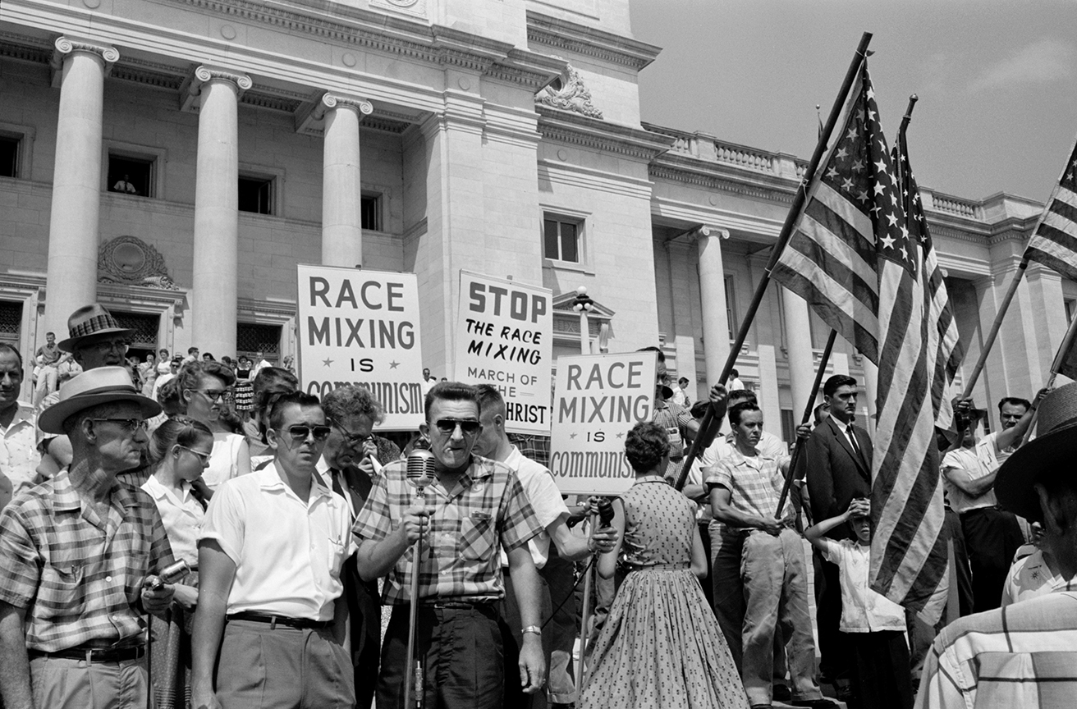
Brown v. Board

Slide 6
Little Rock 1957
Governor attempted to block admission of black students to Central High School.
“Little Rock Nine” first black students at Central
Eisenhower ordered the National Guard and 1,000 troops to Little Rock
Civil Rights Act of 1957- gave federal government jurisdiction over A.A. voting rights

Slide 7
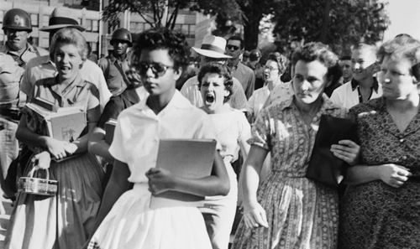
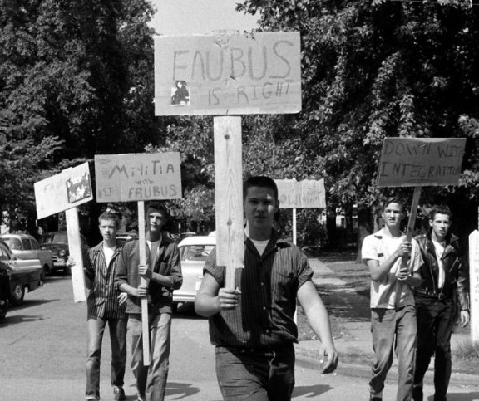
Little Rock Nine

Slide 8
Montgomery Bus Boycott 1955
Rosa Parks- A.A. seamstress refused to give up her bus seat for a white man
Arrested
Martin Luther King, Jr- led bus boycott for over a year
Nonviolent protests/civil disobedience
Based on teachings of Jesus, Thoreau, and Gandhi
Supreme Court outlawed bus segregation
Notes:
Montgomery Bus Boycott-Rosa Parks was arrested for not giving her seat to a white man. Dr. Martin Luther King helped start the bus boycott which lasted for almost a year and put financial pressure on the city of Montgomery. It ended bus segregation in Montgomery.

Slide 9
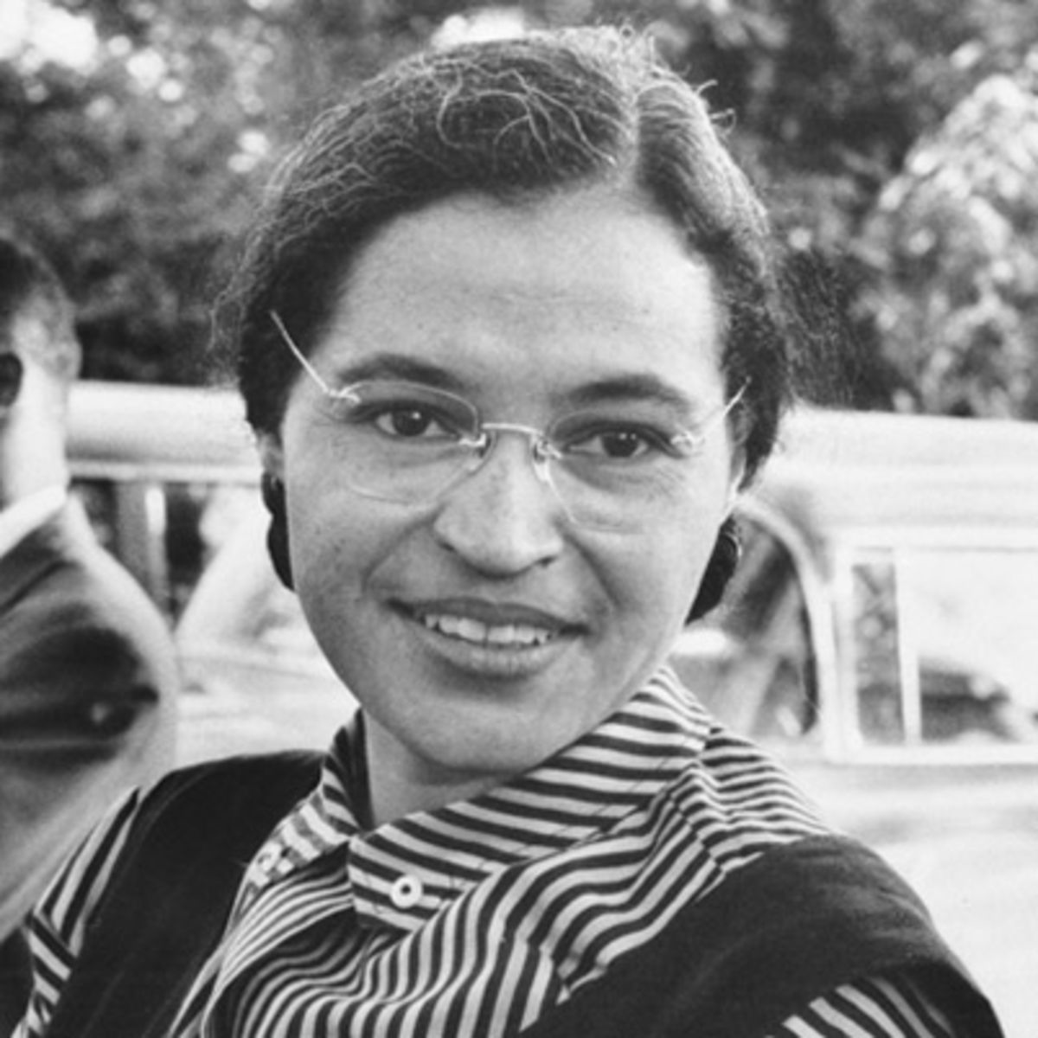
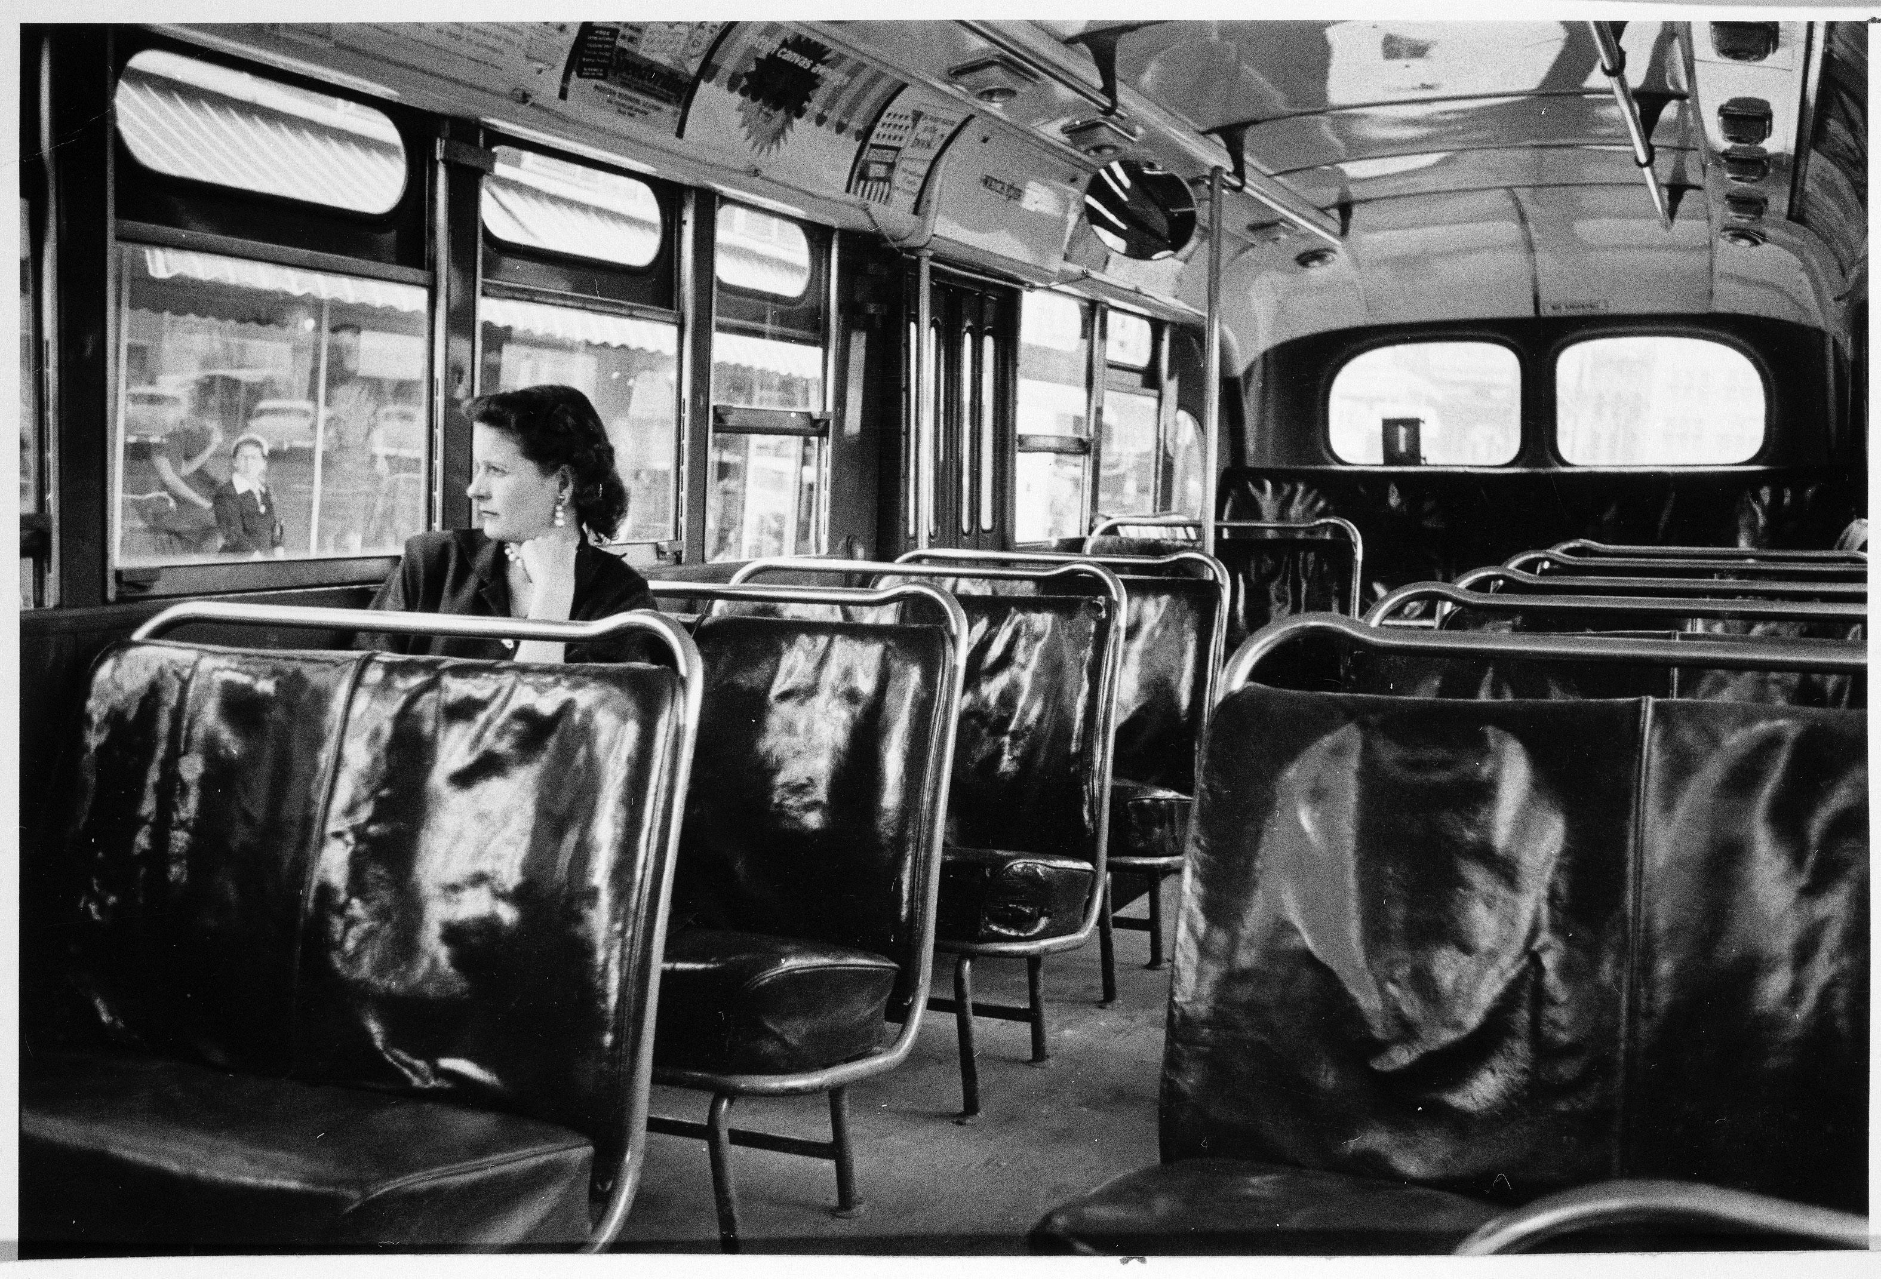
Bus Boycott

Slide 10
SCLC
Southern Christian Leadership Conference(1957) - MLK and other ministers
Organized nonviolent protests and demonstrations across the South
Student Nonviolent Coordinating Committee- SNCC- college students who viewed change as too slow
Notes:
Dr. Martin Luther King’s philosophy-became the greatest leader in the Civil Rights movement. He led numerous protests ALL of which he insisted be nonviolent. Inspired by Gandhi. SCLC-Dr. Kings organization that led to nonviolent protests, boycotts, and marches. King noticed that only when violence and disorder got out of hand would the federal government intervene. So, he decided to launch demonstrations in Birmingham Alabama knowing that it would probably provoke a violent response. He thought it was the only way to get Kennedy to support civil rights. Eight days after the protests began, King was arrested and held in solitary confinement. Birmingham police used high pressure water hoses to force civil rights protesters to stop their marches.

Slide 11
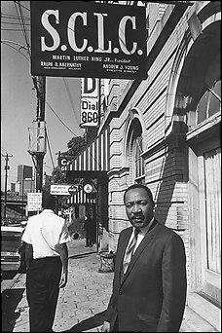
SCLC and SNCC

Slide 12
Sit-ins
Protesters would sit at segregated lunch counters until they were served.
Woolworth’s in NC was televised
Brought attention to movement
Protestors were beaten, humliated by whites
Notes:
SNCC- (Student Nonviolent Coordinating Committee) college aged Civil Rights protester, both black and white, who led sit-ins at segregated lunch counters (restaurants). Sit-in-a protest of sitting in a place that was segregated to disrupt the business African American college students from all across the South made up the majority of SNCCS members, although many whites also joined. They played a key role in desegregating public facilities in dozens of Southern communities. They also sent volunteers into the Deep South to help register African Americans to vote. Several had their lives threatened and were beaten.
They were staged at segregated stores, restaurants, hotels, movie theaters, and swimming pools. African American would just sit in a segregated facility until they were served. This offered them a way to take matters into their own hands. They had to remain nonviolent, even if they were provoked. Woolworth’s sit in is one of the most famous. Four African Americans went to Woolworth’s and purchased school supplies then sat at the lunch counter and ordered coffee. They were not served, so the students stayed at the counter until it closed then announced they would be back everyday until they were served.

Slide 13
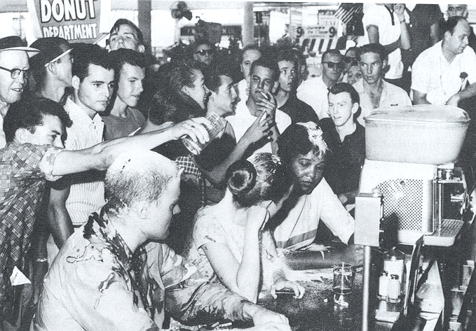
Sit-ins

Slide 14
Freedom Riders 1960
CORE organized bus trips across the South to test court decision banning segregation
Buses were attacked, bombed
Riders were pulled off and beaten
JFK sent US marshals to protect the riders
Interstate Commerce Commission banned segregation in all interstate travel facilities
Notes:
Freedom Riders-Civil Rights workers who rode through the south and led sit-ins at segregated bus stops. One of their buses was firebombed which led the President to send federal marshals to escort the riders. African Americans and whites who rode around the south to draw attention to the south’s refusal to integrate bus terminals. They were met by angry mobs in Alabama at one of the bus stops. They were beaten, tires were slashed, and they were spit on. One bus was even firebombed. In Birmingham when the workers arrived, whites with chains and bats met them. They were beaten until they were almost unrecognizable. The head of police, Bull O’Connor, said that because it was mother’s day he had given his men the day off. However, that was not true. He had ordered these men, who were from the KKK, to beat the workers. JFK was president.

Slide 15
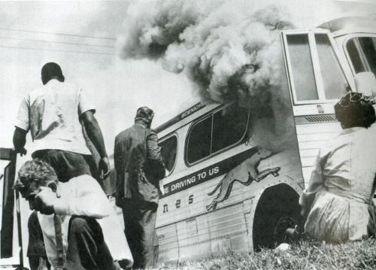
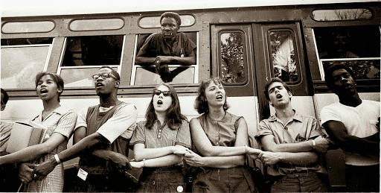
Freedom Riders

Slide 16
Ole Miss
James Meredith was refused entry by Governor Ross Barnett
JFK ordered marshals to Oxford
Sept. 30, 1962- riots broke out
2 killed, took thousands of soldiers to stop
Marshals escorted Meredith to class
Notes:
Ole Miss-James Meredith won the right to be the 1st black student at Ole Miss. There was a riot on the Ole Miss campus that was stopped by the army and Meredith was allowed to attend Ole Miss. On the same day Kennedy was inaugurated, Meredith tried to transfer to Ole Miss. Up to this point, the university would still not accept black students. Meredith had a court order which said he was allowed to register, but Mississippi’s governor, Ross Barnett, met him at Ole Miss and blocked his path. President Kennedy sent federal marshals to escort Meredith to the campus. Shortly after Meredith and the marshals arrived, a white mob attacked the campus and a riot erupted. They hurled rocks, bricks, and acid at the marshals. Some people fired shotguns at them. The marshals responded with tear gas. The fighting continued all night. Kennedy sent more troops and the mob was put down. Meredith attended classes there the rest of the year under federal guard and even graduated from Ole Miss.

Slide 17
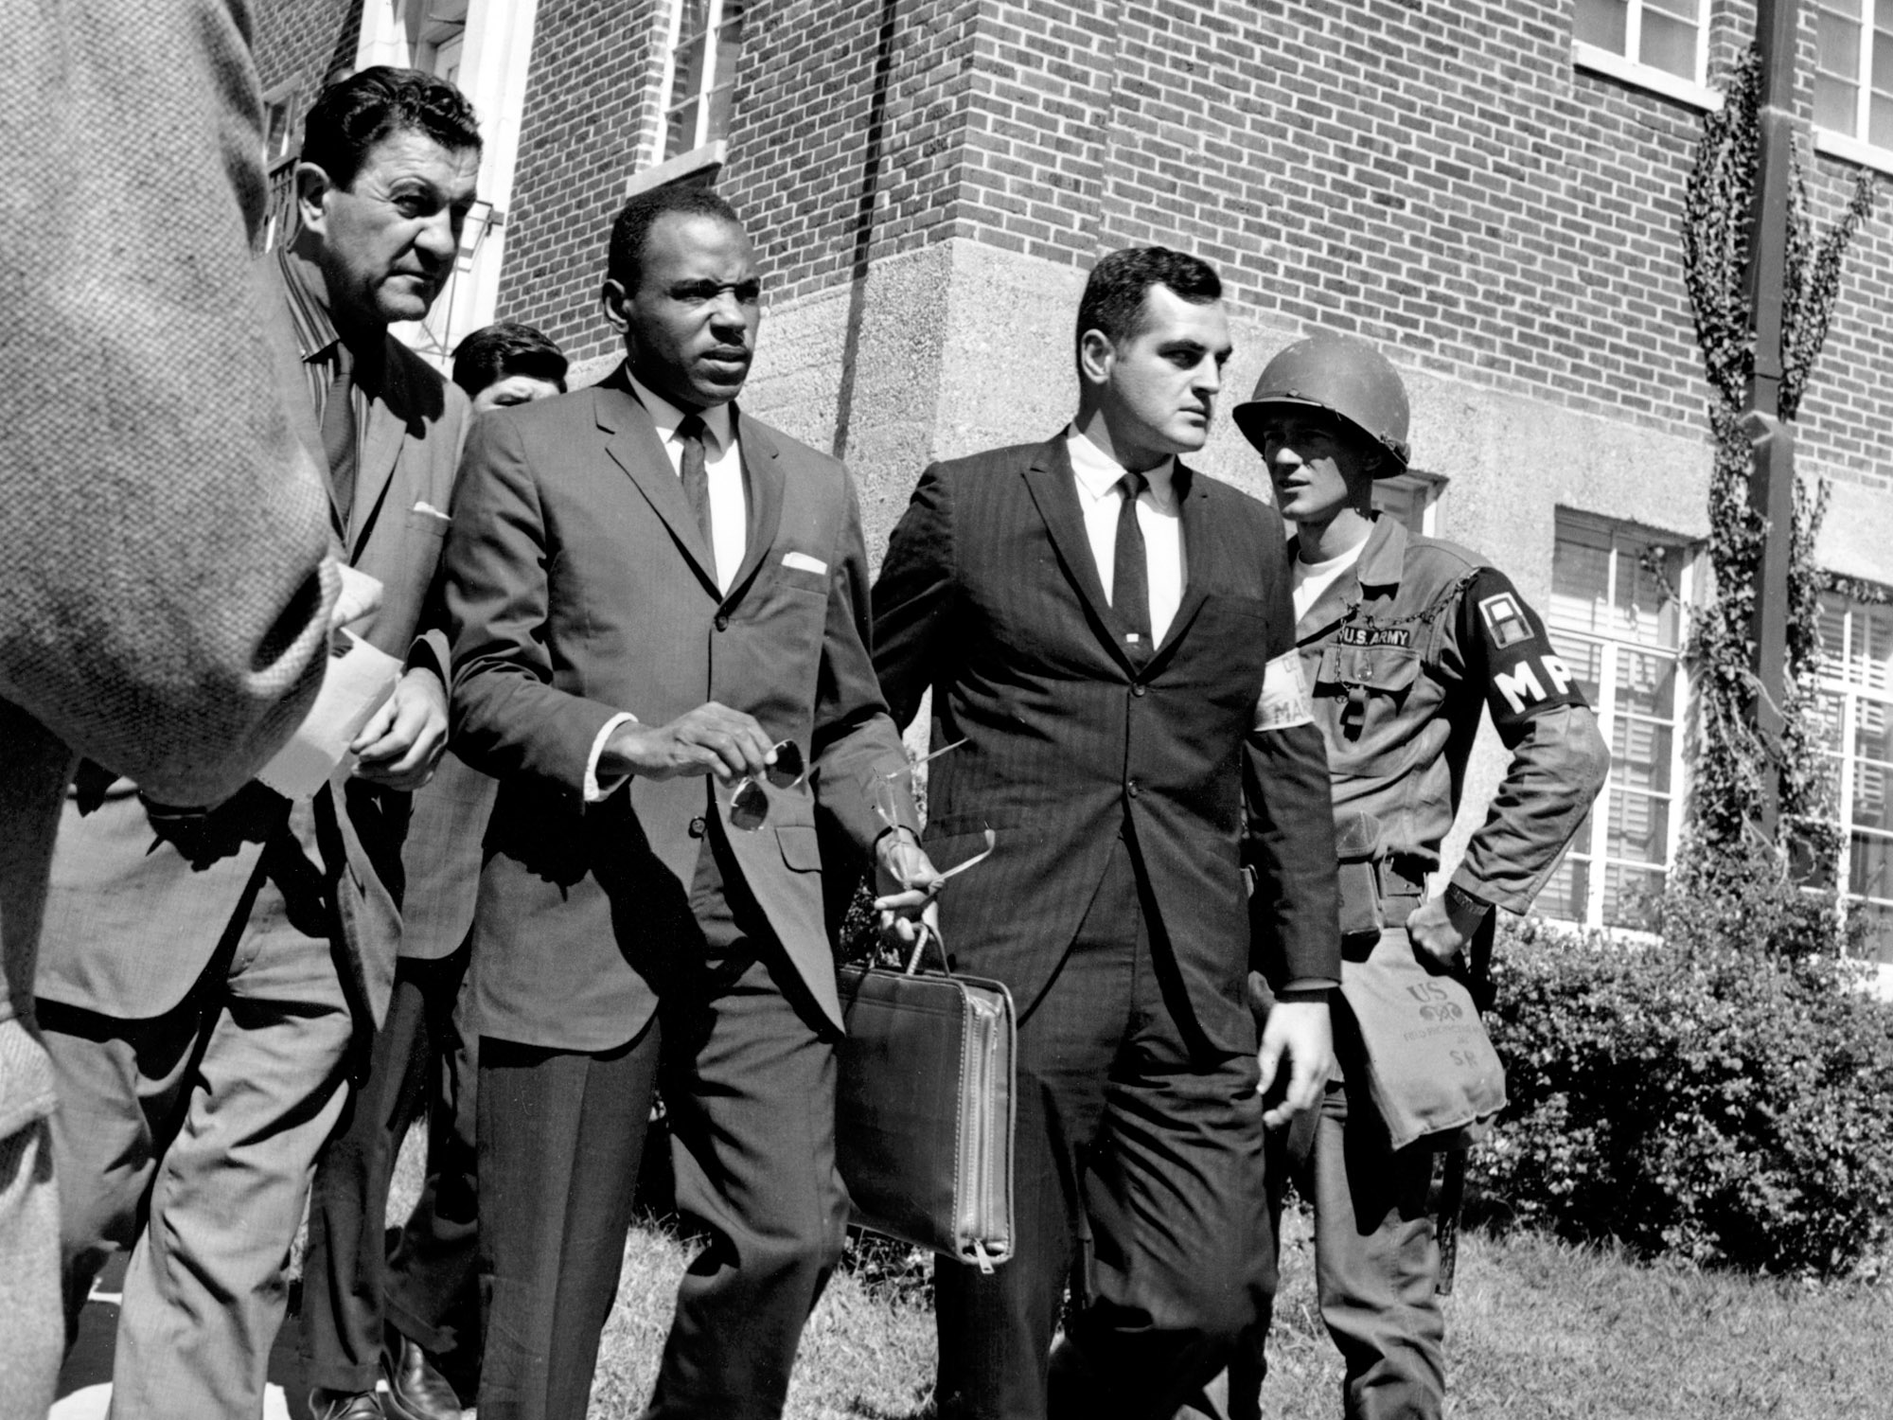
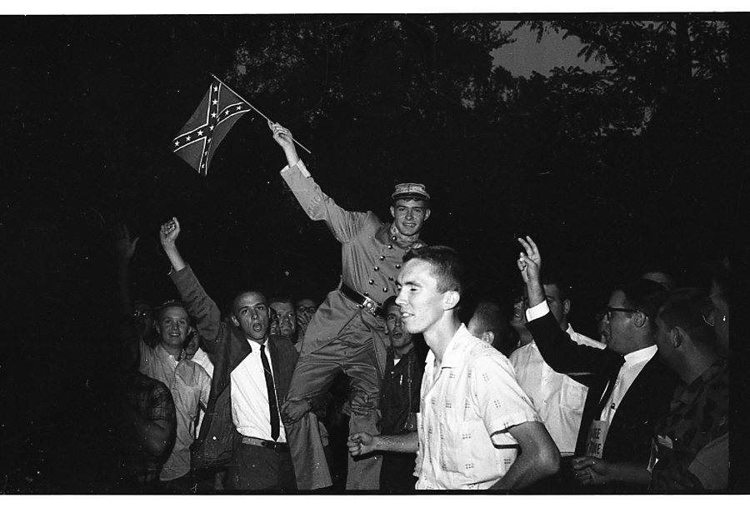
Ole Miss

Slide 18
Birmingham
“Bombingham” “most segregated city in America”
SCLC led protests, King was arrested
Police used fire hoses and attack dogs on protesting children
Shown on TV
Notes:
The role of TV in Civil Rights-When people across the country saw video of the violence against Civil Rights workers it created sympathy for the movement. ( little rock 9, ole miss, Selma campaign)

Slide 19
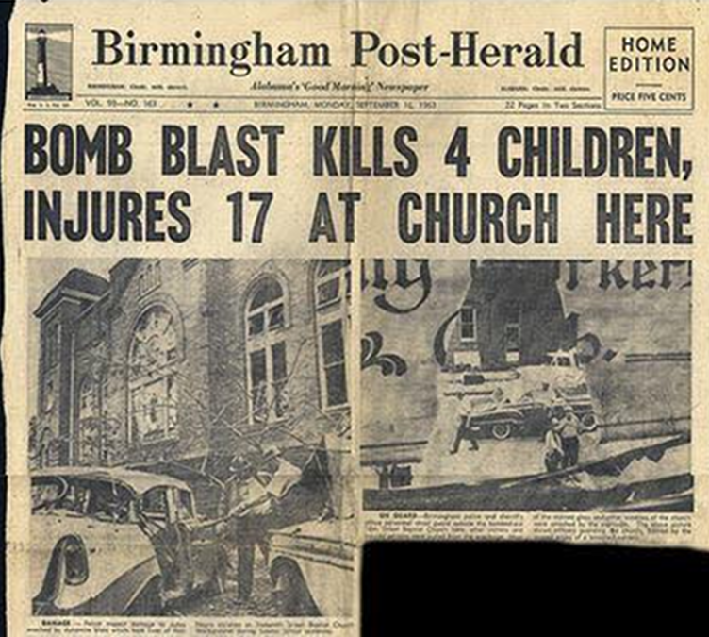
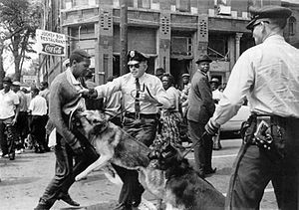
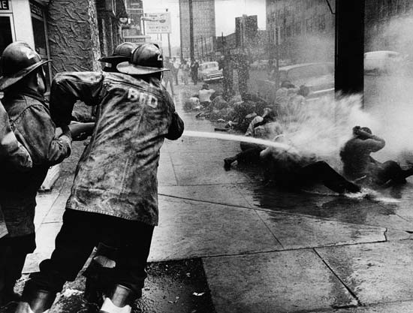
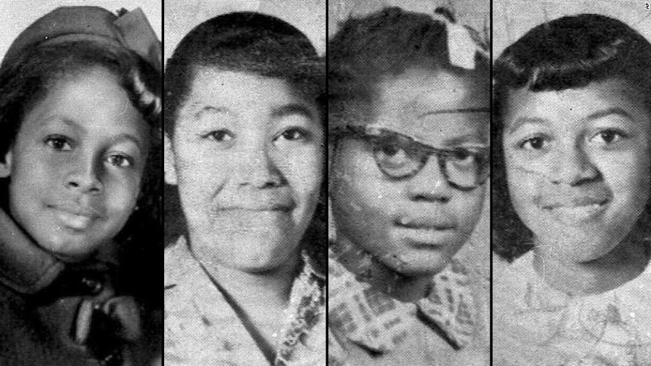
Birmingham

Slide 20
March on Washington
JFK had sent a civil rights bill to Congress
A. Philip Randolph and Bayard Rustin organized march
250,000 at Washington Monument
MLK “I Have Dream Speech”
Notes:
March on Washington-August 1963 over half a million Civil Rights supporters went to Washington to put pressure on Congress to support a Civil Rights law. Where Dr. King gave the “I have a Dream” speech. The audience heard speeches and sang hymns and gathered peacefully from the Washington Monument to the Lincoln Memorial. The March was very peaceful and organized.

Slide 21
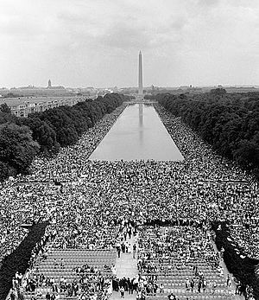
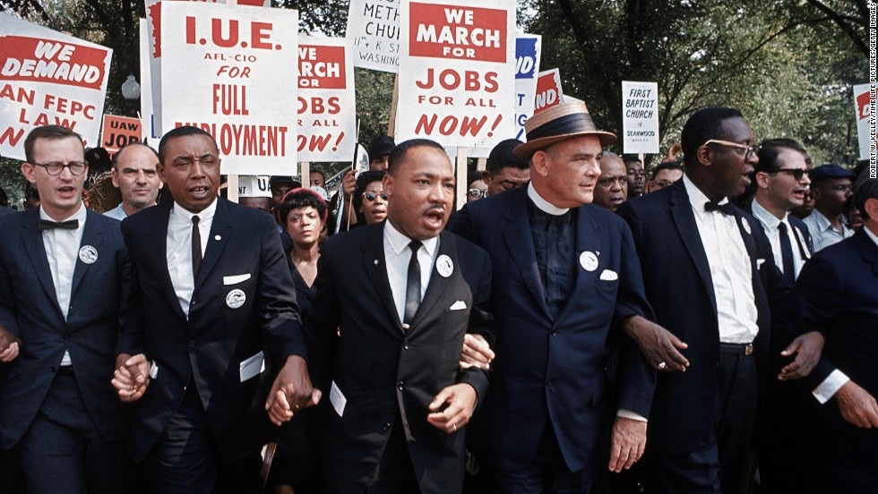
March on Washington

Slide 22
Civil Rights Act of 1964
Signed in July 1964 by Lyndon B. Johnson
Prohibited discrimination based on race, religion, national origin, and gender
Gave all citizens the right to enter libraries, parks, restaurants, and other public places
Equal Employment Opportunity Commission- to ensure fair treatment in hiring
Notes:
Civil Rights Act 1964-ended segregation in all public places/ signed by LBJ. Kennedy was assassinated, Johnson became president. He knew how to build public support and how to put pressure on members of Congress because he served in Congress for three years. The civil rights bill passed, after 87 days of filibuster and President Johnson signed it into law. It prohibited segregation and gave citizens of all races and nationalities equal access to such facilities as restaurants, parks, libraries, and theaters. It also established the Equal Employment Opportunity Commission which monitored the ban on job discrimination.

Slide 23
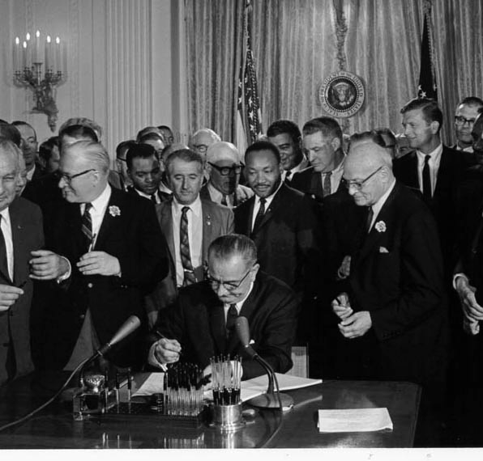
Civil Rights Act
Notes:
Equal Employment Act- Employers cannot discriminate in hiring, promotion, or in pay because of race, color, origin, or sex. This was attached to the Civil Rights Act of 1964.

Slide 24
Freedom Summer
CORE and SNCC workers went to Mississippi to register black voters
Mostly white college students from the North
In Philadephia, MS, 3 workers were killed by KKK members
Many other workers were beaten or jailed
Notes:
Freedom Summer-hundreds of volunteers went to MS to register black voters. They were met with resistance and 3 were killed near Philadelphia, MS. Poll taxes-had to pay to vote/ Literacy test-take a test to vote

Slide 25
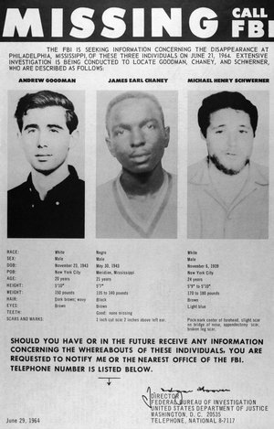
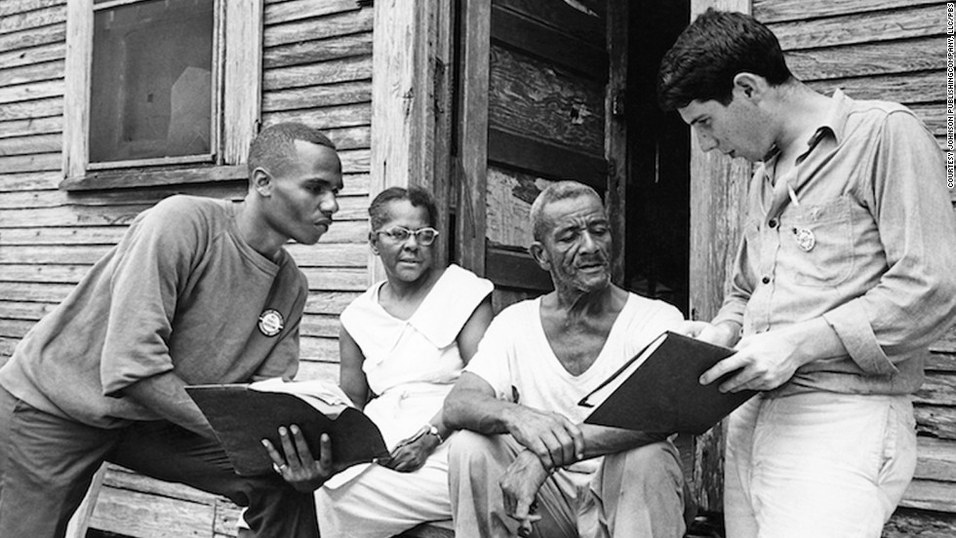
Freedom Summer

Slide 26
Voting Rights Act of 1965
MLK led marchers to Montgomery
Beaten and gassed by police
Voting Rights Act of 1965- eliminated literacy tests, allowed federal workers to register voters
African-American voters in the South tripled
24th Amendment- 1964- banned poll tax
Notes:
Selma Campaign-Dr. King and many volunteers went to Selma, AL, to register black voters. They were harassed by the cops including the use of tear gas, water cannons, and attack dogs. This was SCLC chose Selma Alabama to campaign for voting rights. African Americans made up most of Selma’s population, but less than 3% of the voting population. White citizens terrorized blacks and attacked them with clubs and electric cattle prods. King’s demonstrations in Selma led to 2,000 African Americans being arrested and attacked and beaten. Then Dr. King organized a march for freedom from Selma to the state capitol in Montgomery, which was about 50 miles away. As the protesters marched, the Sheriff of Selma ordered them to stop. When the marchers kneeled in prayer, more than 200 state troopers and deputized citizens rushed the demonstrators. Many were beaten in full view of tv cameras. This brutal attack became known as “bloody Sunday” and it left 70 African Americans hospitalized and many more injured. The nation was shocked as it viewed law enforcement beating peaceful demonstrators. President Johnson was furious and eight days later proposed a new civil rights law.
Voting Rights Act-ended literacy tests, signed by LBJ Federal examiners were sent to register qualified voters, bypassing local officials who often refused to register African Americans. It also suspended discriminatory devices such as literacy tests.
20. 24th Amendment-ended poll taxes.. By the end of the year al most 250,000 African Americans had registered as new voters. This was a turning point in the civil rights movement. Segregation had been outlawed and now voting rights protected.

Slide 27
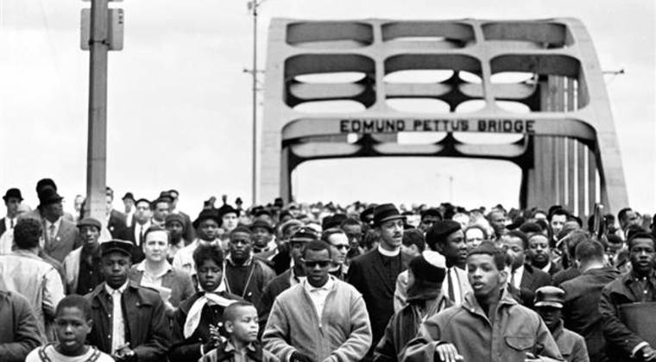
Selma to Montgomery

Slide 28
Changes in Movement
Leaders turned attention to the North
De jure segregation- segregation by law
De facto segregation- segregation by practice and custom
Whites had moved out of cities.
Housing and schools deteriorated
Race riots- Harlem, Watts, LA
Notes:
scope of the problem-proving discrimination is much more difficult than fighting segregation. Racism was still common in the South and this was much harder to stop. Chanignn the law could not change people’s attitudes immediately, nor could it help those African Americans trapped in poverty.
De Jure segregation-segregation by law
De facto segregation-segregation in reality These are areas without laws requiring segregation because they already have it by custom and tradition
White Flight-when whites moved out of cities and into suburbs as blacks moved in their neighborhoods and in the schools. (this happened in Harlem, NY with the Harlem Renaissance) ‘

Slide 29
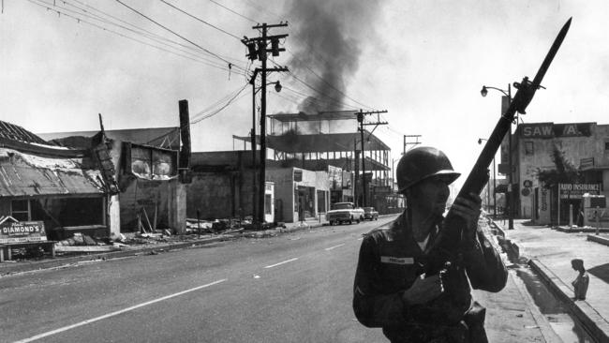
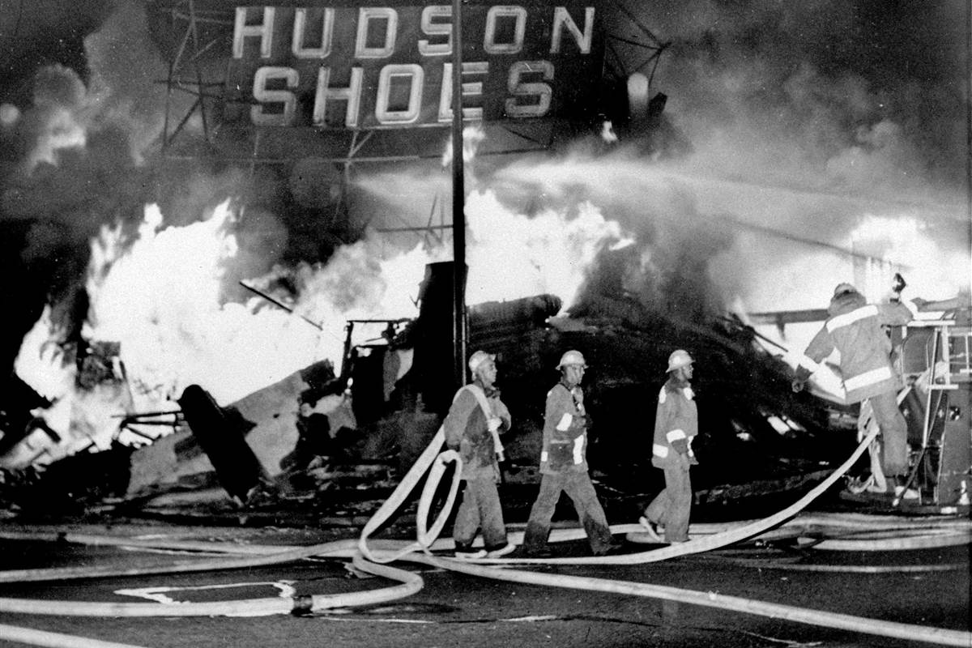
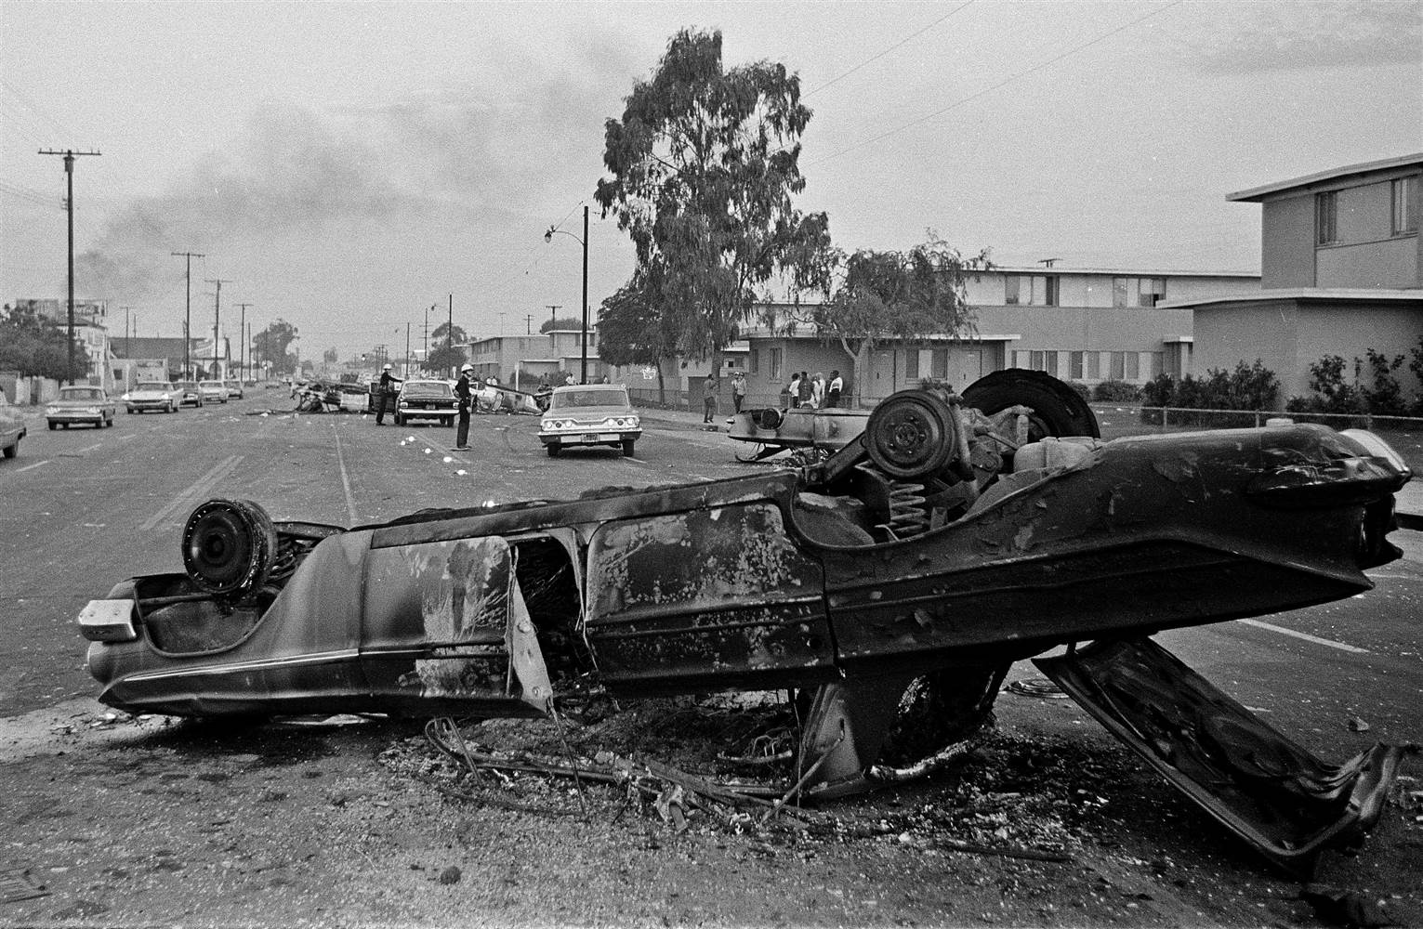
Watts Riots
Notes:
Watts Riots-In the 60s there were many large race riots that started over protests about discrimination. The largest were in the Watts neighborhood of LA. Race riots that broke out in LA five days after the Voting Rights Act was signed. The riots broke out due to claims of police brutality. The riots lasted for six days and required over 14,000 members of the national Guard and 1,500 law officers to restore order. Rioters burned and looted entire neighborhoods and destroyed about 45 million in property. 34 people were killed and 900 suffered injuries. This led to more race riots all over the country.

Slide 30
Malcolm X
Called for African-Americans to arm and defend themselves
Nation of Islam- Black Muslims- followers of Elijah Muhammad
Preached that whites were the cause of black condition and that blacks should separate themselves
Became more peaceful after pilgrimage to Mecca
“Ballot or Bullet”

Slide 31
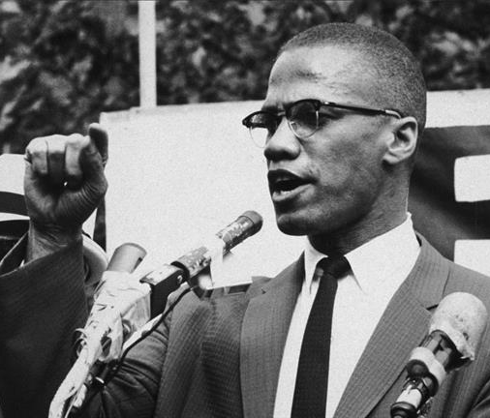
Malcolm X
“Education is the passport to the future, for tomorrow belongs to those who prepare for it today.”
Notes:
Black Muslims-many people in the black community turned to the Muslim faith and joined the black Muslims who demanded a country of their own.
Malcolm X-the most famous leader of the black Muslims. Assassinated. Malcolm joined the nation of Islam, known as the Black Muslims. They did not hold the same beliefs as mainstream Muslims. They preached Black Nationalism. They believed that African Americans should separate themselves from whites and form their own self-governing communities. They viewed themselves as their own nation and tried to be as self-sufficient as possible. They ran their own businesses, organized their own schools, and established their own newspapers. They did not advocate violence, but did advocate self-defense. His mind was changed when he went to Mecca and saw many different races worshipping together. So he broke with the Black Muslims and then criticized the organization. He was assassinated for this.

Slide 32
Black Power
Stokely Carmichael- SNCC leader who encouraged African-American pride and wanted to stop recruiting whites to SNCC
Black Panthers- militant political organization to fight police brutality
Founded by Huey Newton and Bobby Seale
Provided services in ghettoes
Notes:
Black Power Movement-an attempt by many in the black community to express pride in their culture and demand control over their economic and social situations. The African American population was becoming frustrated with Dr. King’s “nonviolent” protests and thought that new strategies of armed self-defense had to be implemented. Many young African Americans called for black power. Some interpreted this to mean that physical self defense and even violence were accept ale in defense of one’s freedom. Others thought it meant that African Americans should control the social, political, and economic direction of their struggle. It also stressed pride in their culture by adopting new afro hairstyles and African style clothing. Many also took on African names. Dr. King criticized black power, however the idea became more popular.
Black Panthers-a group of black militants who carried weapons and patrolled black neighborhoods and said they did not want racist white cops bothering black people. Ideas were influenced by Malcolm X. They recruited most of their members from poor urban communities across the nation. They believed that a revolution was necessary in the US and urged African Americans to arm themselves and confront white society in order to force whites to grant them equal rights.

Slide 33
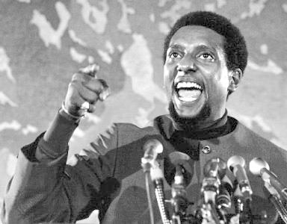
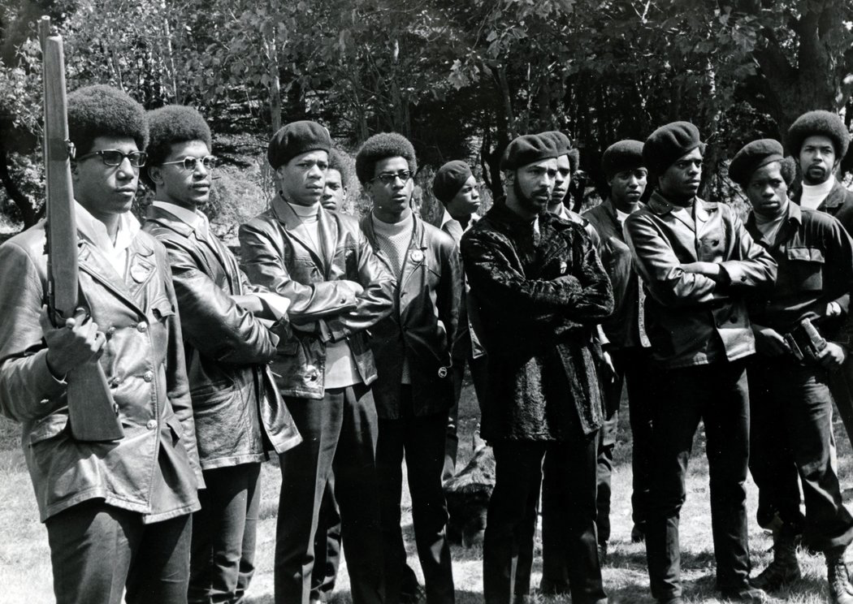
Black Power

Slide 34
Death of MLK
April 1968
Had been in Memphis to support striking sanitation workers
Shot while standing on balcony at Lorraine Motel
Led to the worst rioting in US history
June 1968- Robert F. Kennedy- Democratic candidate for President was killed
Notes:
King Assassination-April 4, 1968. Dr. King was shot and killed in Memphis by James Earl Ray. He went to Memphis to support a strike of African American sanitation workers. He was trying to promote economic advancement for all impoverished Americans. He wanted to lobby the federal government to commit billions of dollars to end poverty and unemployment in the US. On the evening of April 4 1968, he stood outside his hotel balcony in Memphis as was assassinated by a sniper. The nation mourned.

Slide 35
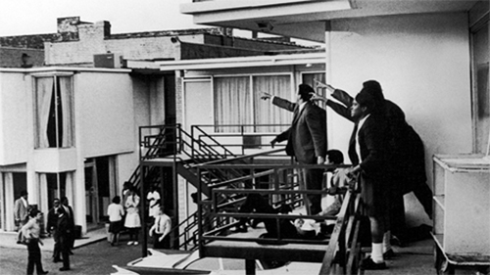
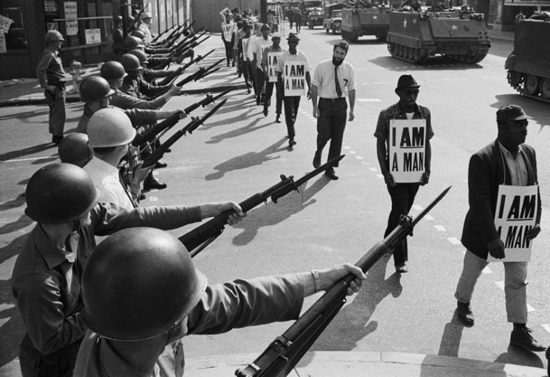
MLK Assassination

Slide 36
Kerner Commission
Appointed to study causes of urban violence
White racism
Stated that country is moving toward two societies: black and white
Called for creating jobs, ending de facto segregation
Notes:
Kerner Commission-gov’t study that said that the problems of crime and lack of education in the black community were caused by white racism. The Commission was to study the causes of the urban riots and to make recommendations to prevent them. The commission blamed white society and white racism for the majority of the problems in the inner city. It recommended the creation of 2 million new jobs in the inner city, the construction of new public housing units, and a renewed federal commitment to fight defacto segregation.

Slide 37
Civil Rights Act of 1968
Prohibited discrimination in housing
Strengthened anti-lynching laws
Made it a crime to harm civil rights workers

Slide 38
Affirmative Action
Making a special effort to hire or enroll minorities
Some colleges and universities
Critics call it “reverse discrimination”
Notes:
affirmative action- purpose is to break down barriers and level the playing field. This is the policy of favoring members of a disadvantaged group who suffer from discrimination, especially in employment or education

Slide 39
Results of Civil Rights Movement
Greater pride
More elected officials
People adopted African-American styles
More frequently on TV and in movies

