Slide 1
Welcome to 1st Grade!
Mrs. Trammell’s Class
September 3, 2020
Orientation Information

Slide 2
Welcome to Room 109 on the Green Hall!
If this video doesn’t play automatically, hover your cursor over the picture and press the arrow to play the video.

Slide 3
Supply Drop Off Day Thursday, September 3, 2020
8:00 – 11:00 a.m.
Please drop your child’s supplies off at this time and pick up a folder from me. This folder has a lot of important forms from the school. I will explain what’s in it on the next two slides.
THANKS!!!

Slide 4
Contents of Folder
Left Side – Can be “Left” at Home
LEFT SIDE
Student Handbook (a lot has changed since school staff printed them this summer)
A Parents’ Guide to First Grade (from me)
Class Dojo Code and Information
White Carpool Sign
ACBOE Calendar
Lunchroom Information
YMCA Fall Programs

Slide 5
Contents of Folder
Right Side – Send “Right” Back the first day of school in your child’s dog folder
RIGHT SIDE
Transportation tag (attach to backpack /book bag)
White rolodex card (for front office)
Envelope for Fees
Student Information Sheet (both sides)
INOW Form (return in envelope if you want to purchase/list all your children at DPES on one form)
Code of Conduct Forms (return pages 43-48)
Free/Reduced Lunch Form

Slide 6
Arrival/Dismissal
Enter for carpool off of Jay Street.
Carpool drop off starts at 7:15. Jay St. carpool closes at 7:55. McQueen-Smith carpool loop closes at 7:45.
Only bus riders and walkers enter through the front doors.
Carpool pick up begins at 3:00.
Child’s white card needs to be visible in car window.
Walkers dismiss at 2:40.

Slide 7
Important Information
Check the DPES website Parent Section. Several important documents are posted under “Publications” www.dpeseagles.com
For school wide information, see the Student Handbook and Code of Conduct (in folder).
Our principal, Donna Finch, will do a “Call Out” to parents every Sunday at 3:00 p.m.
COVID Guidelines are on the main page of the school website.
All posted plans are subject to change.
Please sign up for NotifyMe at the top of the school website.

Slide 8
Money
Please send ALL money in an envelope or plastic bag with your child’s name, reason for money, amount, and teacher’s name.
All checks should have student’s name on the memo line. (Cash only for snacks)
All money must be taken up before 8:00 a.m.

Slide 9
Breakfast/Lunch/Snack
Breakfast is $1.25 a day for students and is optional. It will be delivered to our classroom each morning around 8:00. Students can eat at home before school or bring breakfast with them to school as well.
Lunch is $2.50 a day for students. You can send cash or check for meals. You may also use this website to pay for breakfasts/lunches: www.paypams.com (Students are welcome to bring their own lunch).
Snack can be brought from home or purchased at school. Snack can be bought from the school for $1.50 - $2.00. (cash only). Special Snacks are sold on most Fridays. All Special Snacks cost $1 each.
You may apply for Free or Reduced Lunch by returning form or online at www.SchoolLunchApp.com

Slide 10
Important Lunchroom Update
I just received word today from our Lunchroom Manager that our county has received a waiver from the state allowing ALL students to eat breakfast and lunch for FREE until December 31, 2020.
However, if you think your child qualifies for Free or Reduced Lunch, please fill the form out now so that you won’t be charged in January 2021.

Slide 11
Absences
Please send a parent or doctor note within 3 days of your child returning to school after being absent.
Please keep your child at home if they are sick.

Slide 12
Other Information
Any medication to be given to a child at school must be taken by the parent to the school with a completed Medication Authorization Form (available on website).
Label all items with your child’s name!
Please notify me in writing with any changes in transportation, address, or phone number.

Slide 13
“DOG” Binder
Daily Organizational Guide
Your child will bring his/her binder home each day. Please check it daily for information.
Folder – daily papers & notes
Reading materials & homework (no homework the first week of school)
Spelling Words /High Frequency Words
Behavior Calendar

Slide 14
Academics
Papers that come home with a numerical grade will be entered in my gradebook. Papers that are not for a grade will have check marks, smiley faces, the number missed noted, etc. (Students will receive a S,N, or U in science and social studies)
GRADING SCALE
A 90 – 100
B 80 – 89
C 70 – 79
D 60 – 69
F 0 - 59
Promotion and Retention Policy
Regular education students in first grade will be retained if they fail either reading or mathematics in a given school year. A yearly numerical average of below 60% constitutes failure.

Slide 15
Communication
The best way to contact me is through email: margaret.trammell@acboe.net
You can call the school at 361-6400 and leave a message with the office staff. I will not receive it until my planning time.
Weekly newsletters will be sent home on Mondays and will also be on my webpage on the school website: www.dpeseagles.com (go to my page)
Sign up for Notify Me on the school website! (at the top of home page)

Slide 16
Class Dojo
Please see your Class Dojo code and sign in information on the gold page in Orientation Folder.
There is also a white page that tells about Class Dojo and the First Grade Behavior Plan.

Slide 17
First Grade Reminders
Send an extra mask to remain in your child’s backpack.
One lanyard will be provided for each student (so masks won’t get lost at lunch, etc.) and will remain at school at the end of each day.
Send a filled water bottle each day (thermos type with a spout to close).
Allow your child to wear no tie shoes if he/she isn’t able to tie them.
Send a change of clothes for possible accidents to remain in your child’s backpack (underwear, socks, top & bottom).
Please attach yellow Transportation Tag to backpack for first 2 weeks of school.

Slide 18
Our Daily Schedule
Lunch 11:20 – 11:43 a.m.
P.E. 12:10 – 12:50 a.m.
Snack 1:15 – 1:30 p.m.

Slide 19
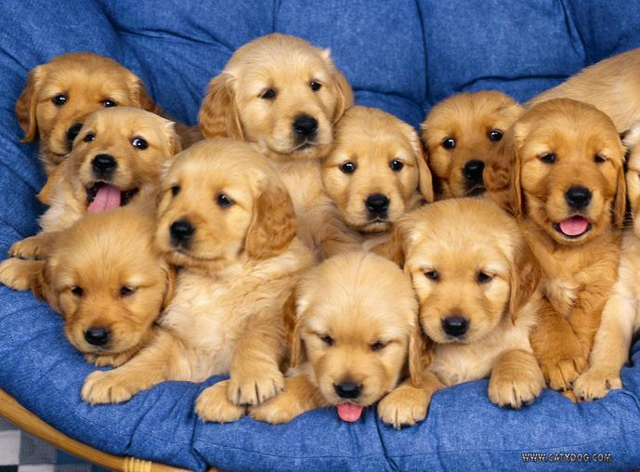
Thank you for taking the time to read this information. And thank you for sharing your children with me. I am excited about starting the school year with them!

