Slide 2
Skeletal Cartilages
Skeleton
Cartilage→Bone
Cartilage helps form skeleton
3 types
Hyaline
Elastic
Fibrocartilage

Slide 3
Basic Structure, Types, and Locations
Skeletal cartilage
Consists primarily of water
Contains no blood vessels or nerves
Perichondrium: dense connective tissue surrounding cartilage
Helps cartilage resist outward expansion
Contains blood vessels

Slide 4
Basic Components of Cartilage
Chondrocytes: type of cells
Lacunae: small cavities encasing cells
Extracellular Matrix: jelly-like ground substance and fibers

Slide 5
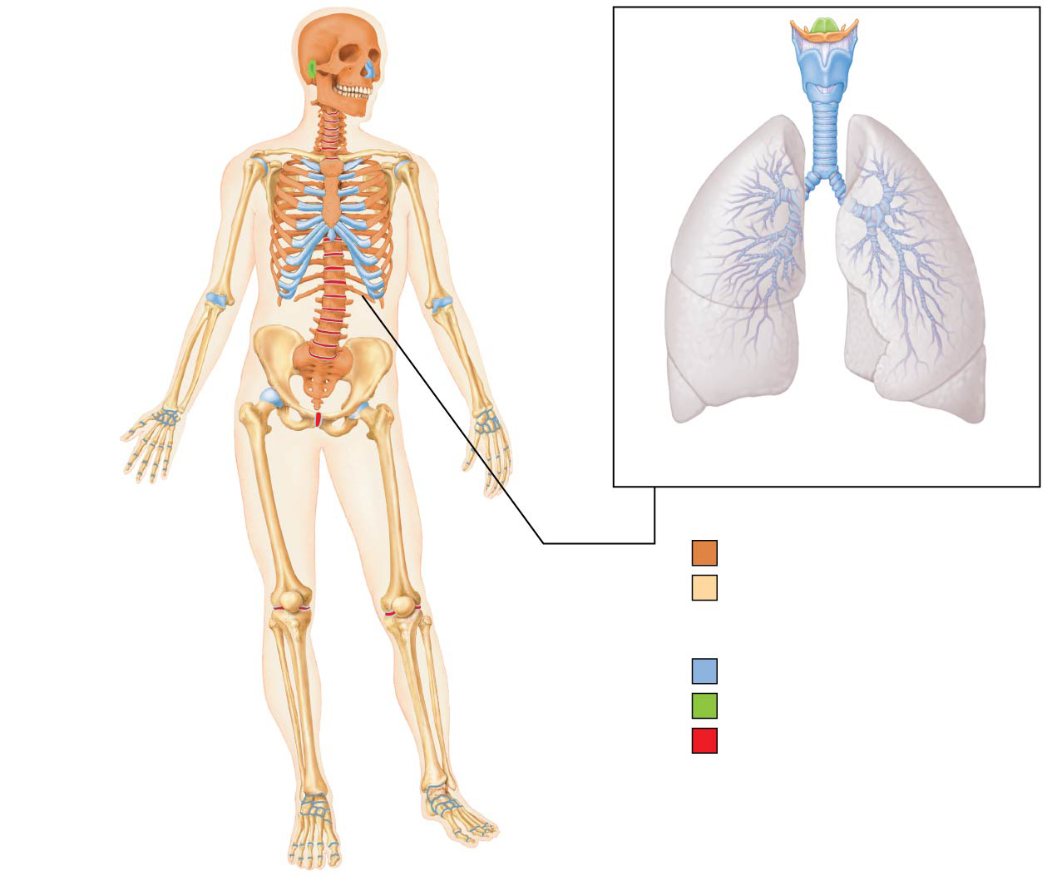
Basic Structure, Types, and Locations (cont.)
Hyaline cartilage
Provides support, flexibility
Most abundant type; contains collagen fibers only
Articular (joints),
costal (ribs),
respiratory (larynx),
nasal cartilage
Highlighted in blue in pic

Slide 6
Basic Structure, Types, and Locations (cont.)
Elastic cartilage
Similar to hyaline cartilage, but contains elastic fibers
External ear and epiglottis
Highlighted in green on next slide
Fibrocartilage
Thick collagen fibers: has great strength
Menisci of knee; vertebral discs
Highlighted in red on next slide

Slide 7
Figure 6.1 The bones and cartilages of the human skeleton.
Epiglottis
Cartilage in
external ear
Cartilages in
nose
Thyroid
cartilage
Larynx
Articular
cartilage
of a joint
Cricoid
cartilage
Trachea
Lung
Costal
cartilage
Cartilage in
intervertebral
disc
Respiratory
tube cartilages
in neck and thorax
Pubic symphysis
Bones of skeleton
Axial skeleton
Meniscus (padlike
cartilage in
knee joint)
Appendicular skeleton
Cartilages
Articular cartilage
of a joint
Hyaline cartilages
Elastic cartilages
Fibrocartilages

Slide 8
Functions of Bones
Support
Protection
Movement
Mineral and growth factor storage
Blood cell formation
Hematopoiesis occurs in red marrow cavities
Triglyceride (fat) storage
Hormone production
Osteocalcin regulate insulin, glucose, and metabolism
s reservoir

Slide 9
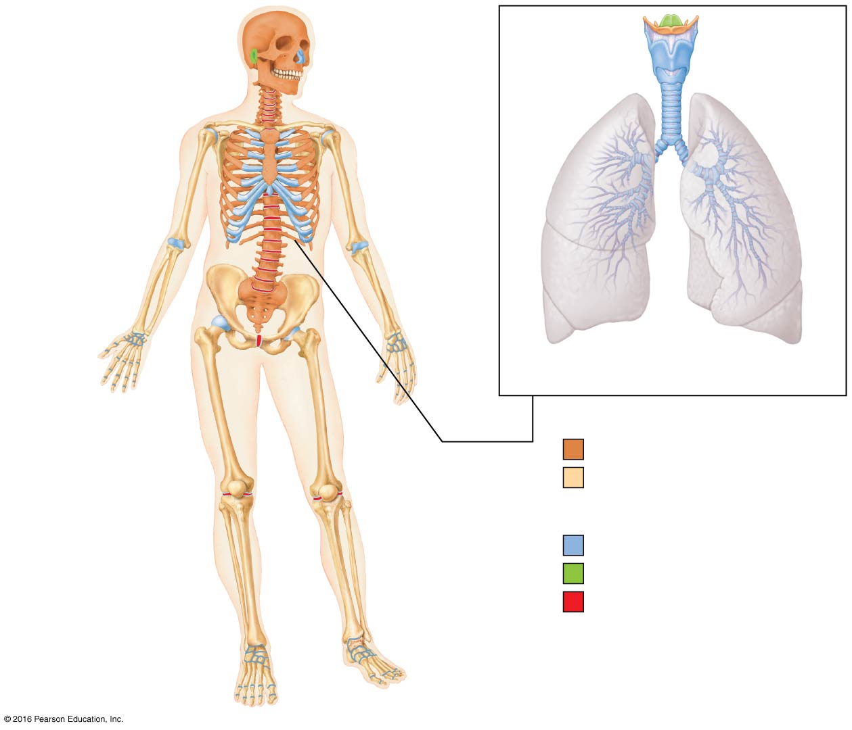
Classification of Bones
206 named bones in human skeleton
Divided into two groups based on location
Axial skeleton
Skull, vertebral column, rib cage
Appendicular skeleton
Bones of upper and lower limbs
Girdles

Slide 10
Classification of Bones
Bones are also classified according to one of four shapes:
Long bones
Longer than they are wide
Limb bones
Short bones
Cube-shaped bones (in wrist and ankle)

Slide 11
Classification of Bones
Flat bones
Thin, flat, slightly curved
Sternum, scapulae, ribs, most skull bones
Irregular bones
Complicated shapes
Vertebrae and hip bones

Slide 12
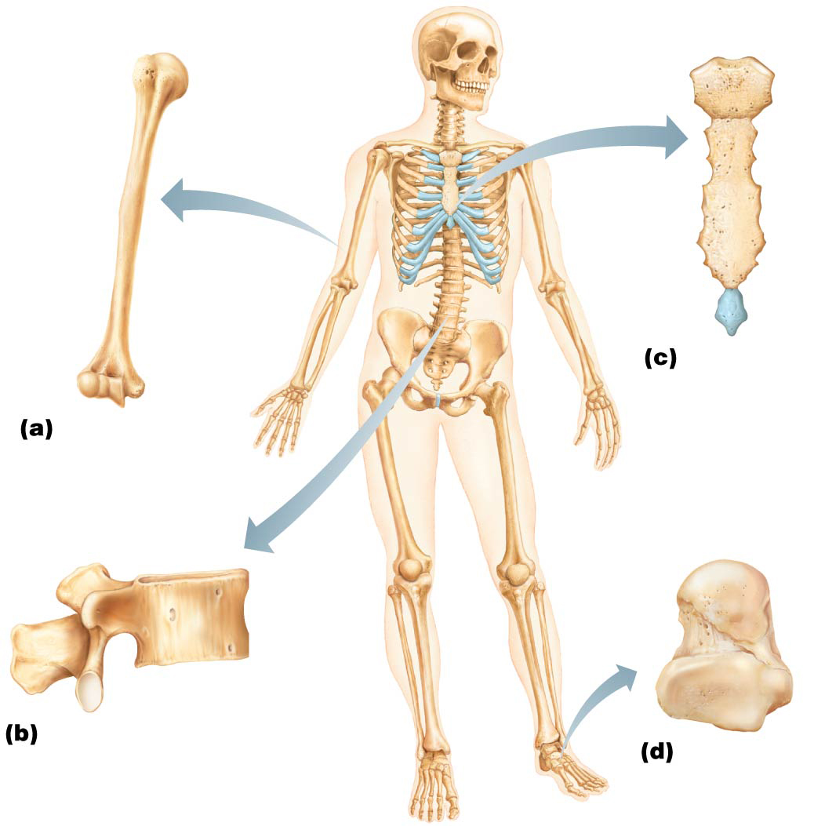
Figure 6.2 Classification of bones on the basis of shape.
Flat bone
(sternum)
Long bone
(humerus)
Irregular bone (vertebra),
right lateral view
Short bone
(talus)

Slide 13
Bone Structure
Bones are organs because they contain different types of tissues
bone (osseous) tissue**
nervous tissue
cartilage
fibrous connective tissue
muscle cells
epithelial cells in its blood vessels

Slide 14
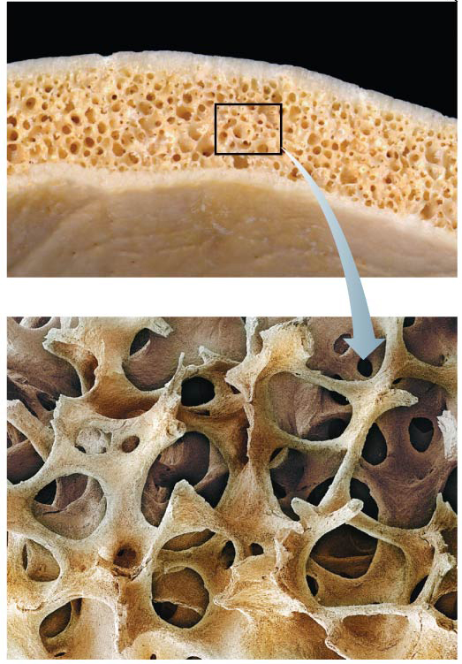
Gross Anatomy
Compact bone: dense outer layer on every bone that appears smooth and solid
Spongy bone: made up of a honeycomb of small, needle-like or flat pieces of bone called trabeculae
Open spaces between trabeculae are filled with red or yellow bone marrow

Slide 15
Gross Anatomy (cont.) of 4 Bone Types
Structure of short, irregular, and flat bones
thin plates of spongy bone covered by compact bone
Compact bone sandwiched between connective tissue membranes
Periosteum covers outside
Endosteum covers inside
Bone marrow is scattered throughout spongy bone; no defined marrow cavity
Hyaline cartilage covers area of bone that is part of a movable joint

Slide 16
Gross Anatomy (cont.)
Structure of typical long bone
All long bones have a shaft (diaphysis), bone ends (epiphyses), and membranes
Diaphysis
Consists of compact bone surrounding central medullary cavity that is filled with yellow marrow in adults
Epiphyses
consist of compact bone externally and spongy bone internally
Articular cartilage covers articular (joint) surfaces
Between diaphysis and epiphysis is epiphyseal line
Remnant of childhood epiphyseal plate where bone growth occurs

Slide 17
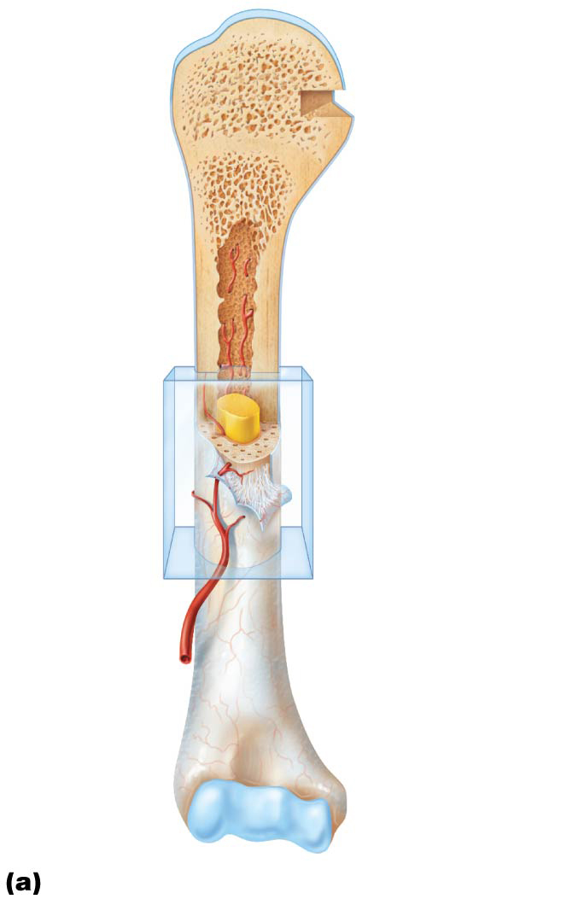
Figure 6.4a The structure of a long bone (humerus of arm).
Articular
cartilage
Proximal
epiphysis
Spongy bone
Epiphyseal
line
Periosteum
Compact bone
Medullary
cavity (lined
by endosteum)
Diaphysis
Distal
epiphysis

Slide 18
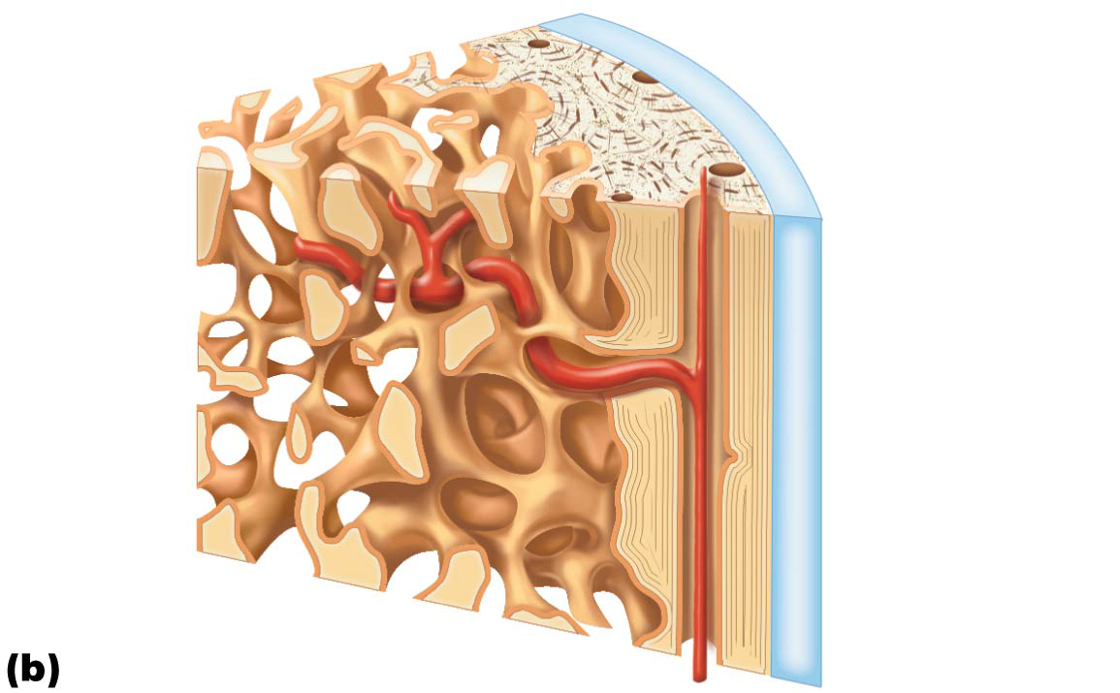
Figure 6.4b The structure of a long bone (humerus of arm).
Articular
cartilage
Compact
bone
Spongy
bone
Endosteum

Slide 19
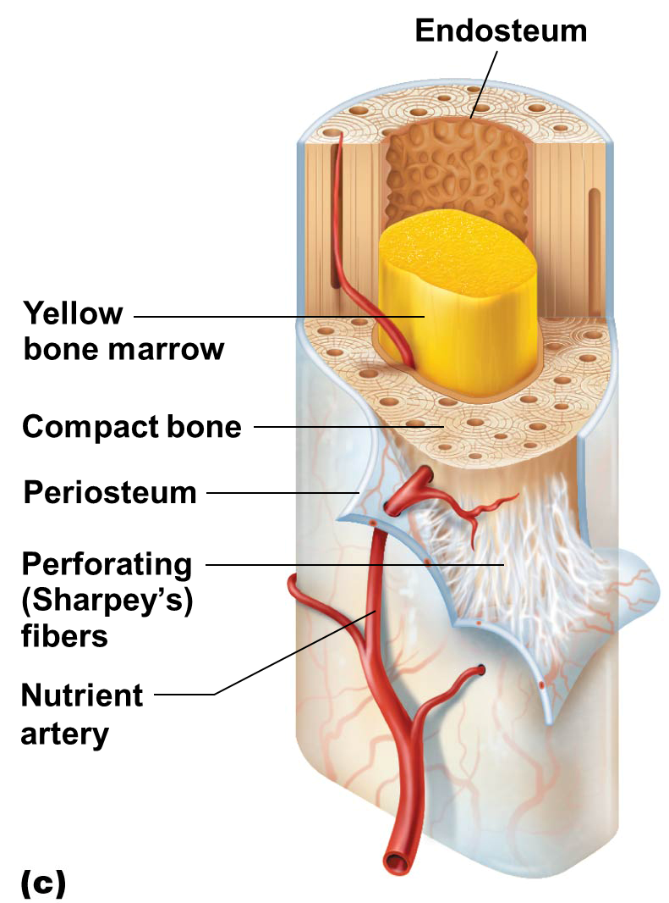
Gross Anatomy (cont.)
Membranes: two types (periosteum and endosteum)
Periosteum: covers external surfaces except joints
Endosteum: covering internal bone surface

Slide 20
Gross Anatomy (cont.)
Bone markings
Sites of muscle, ligament, and tendon attachment on external surfaces
Areas involved in joint formation or conduits for blood vessels and nerves

Slide 21
Gross Anatomy (cont.)
Bone markings (cont.)
Three types of markings:
Projection: outward bulge of bone
Depression: bowl- or groove-like cut-out that can serve as passageways for vessels and nerves, or plays a role in joints
Opening: hole or canal in bone that serves as passageways for blood vessels and nerves

Slide 22
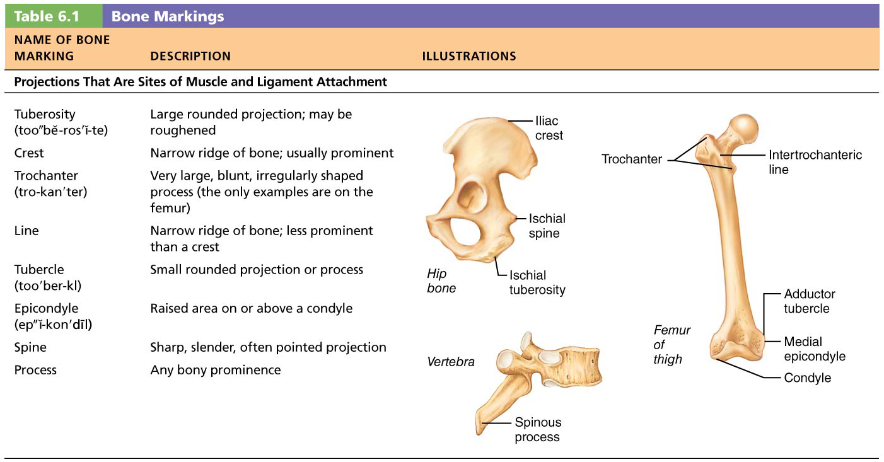
Table 6.1-1 Bone Markings
We will Study in Lab

Slide 23
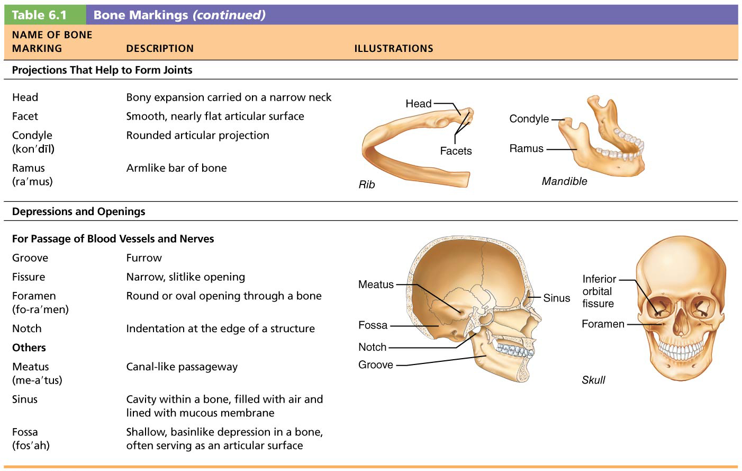
Table 6.1-2 Bone Markings (continued)
We will Study in Lab

Slide 24
Microscopic Anatomy of Bone
Organic Components
Cells
Osteoid (bone matrix)
Inorganic Components
Hydroxyapatites (crystals of calcium phosphate

Slide 25
Microscopic Anatomy of Bone
Cells of bone tissue
Five major cell types, each of which is a specialized form of the same basic cell type
Osteogenic cells
Osteoblasts
Osteocytes
Bone-lining cells
Osteoclasts

Slide 26
Microscopic Anatomy of Bone (cont.)
Osteogenic cells (osteoprogenitor)
Mitotically active stem cells
Differentiate into osteoblasts or bone-lining cells
Some remain as osteogenic stem cells
Osteoblasts
Bone-forming cells that secrete unmineralized bone matrix called osteoid
Actively mitotic

Slide 27
Microscopic Anatomy of Bone (cont.)
Osteocytes
Mature bone cells in lacunae that no longer divide
Maintain bone matrix and act as stress or strain sensors
Communicate information to osteoblasts and osteoclasts (cells that destroy bone) so bone remodeling can occur

Slide 28
Microscopic Anatomy of Bone (cont.)
Bone-lining cells
Flat cells on bone surfaces believed to also help maintain matrix (along with osteocytes)
Osteoclasts
Giant, multinucleate cells
function in bone resorption

Slide 29
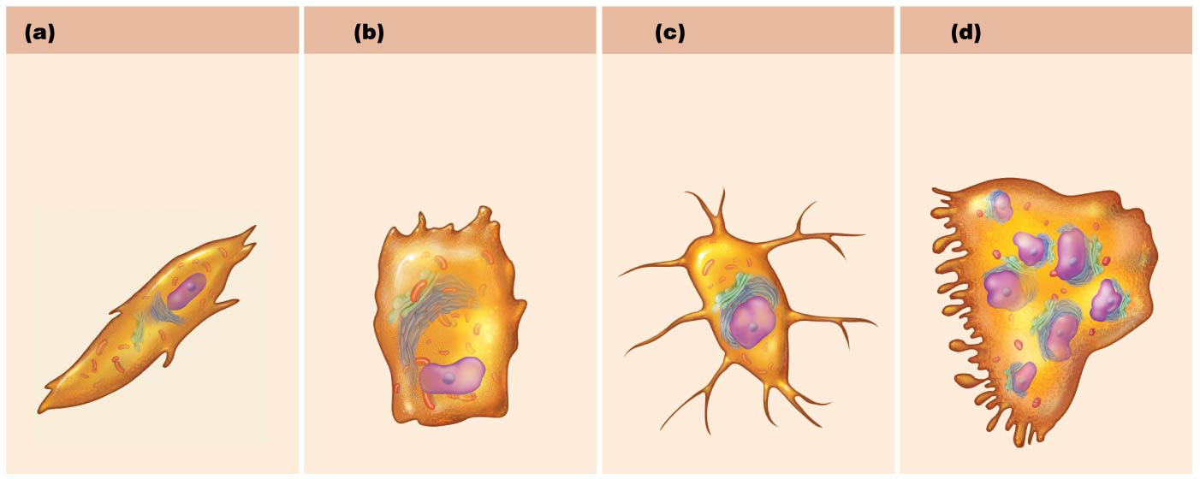
Figure 6.5ab Comparison of different types of bone cells.
Osteogenic cell
Osteoblast
Osteocyte
Osteoclast
Stem cell
Matrix-synthesizing
cell responsible for
bone growth
Mature bone cell that
monitors and maintains
the mineralized
bone matrix
Bone-resorbing cell

Slide 30
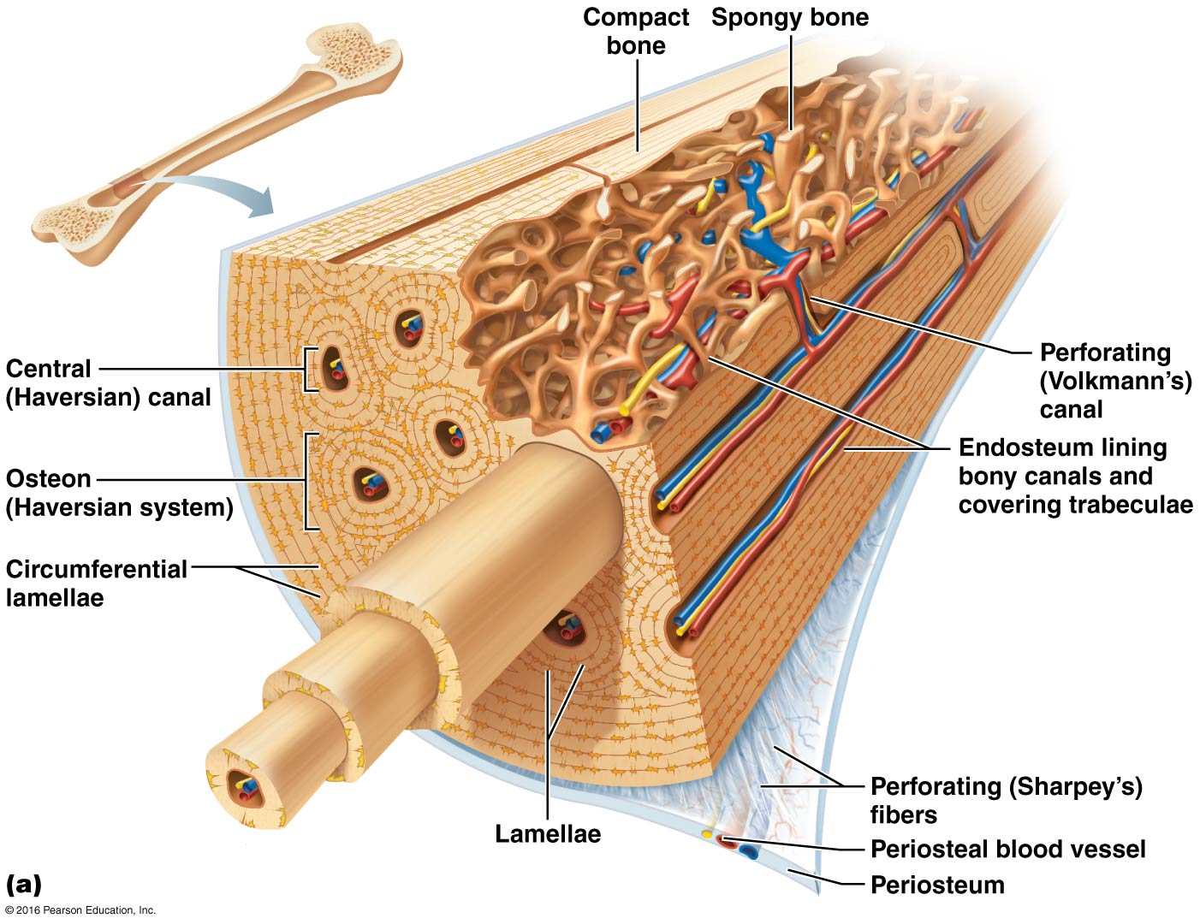
Microscopic Anatomy of Bone (cont.)
Compact bone
Osteon
(Haversian system)
Canals and canaliculi
Interstitial and circumferential lamellae

Slide 31
Microscopic Anatomy of Bone (cont.)
Osteon
Structural unit of compact bone
Elongated cylinder that runs parallel to long axis of bone
Consists of several rings of bone matrix called lamellae
Lamellae contain collagen fibers that run in different directions in adjacent rings
Withstands stress and resist twisting

Slide 32
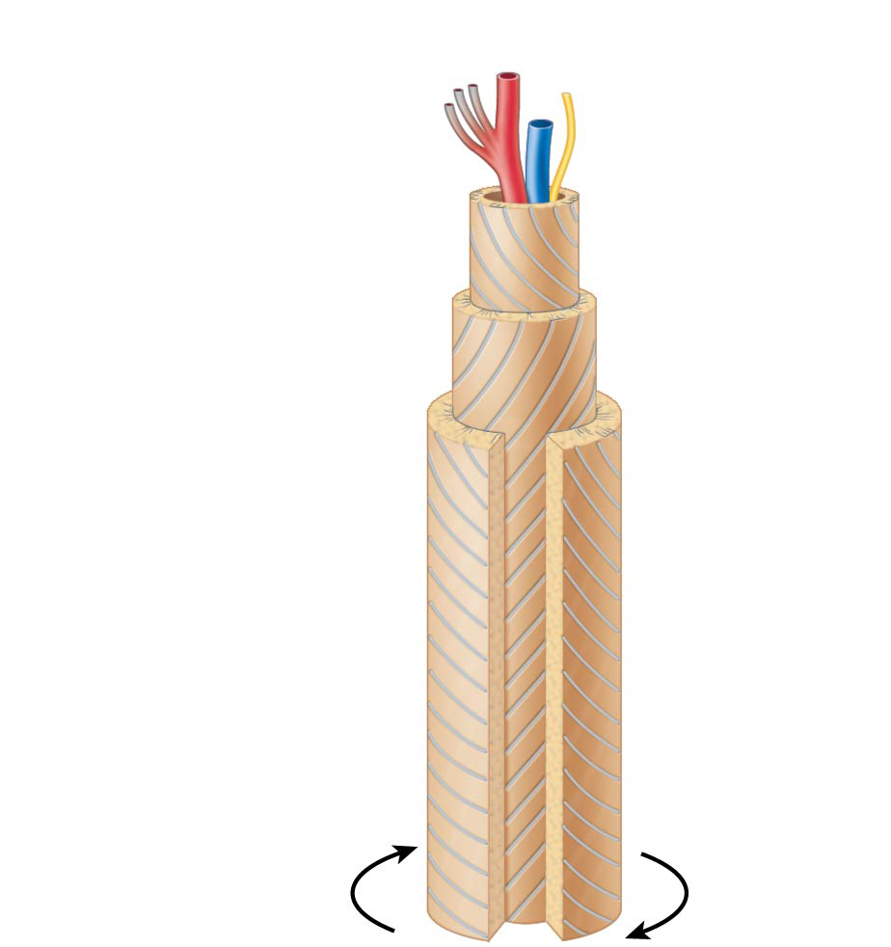
Figure 6.6 A single osteon.
Artery with
capillaries
Structures
in the
central
canal
Vein
Nerve fiber
Lamellae
Collagen
fibers
run in
different
directions
Notice different directions!
Twisting
force

Slide 33
Microscopic Anatomy of Bone (cont.)
Canals and canaliculi
Central (Haversian) canal runs through core of osteon
Contains blood vessels and nerve fibers
Perforating (Volkmann’s) canals: canals at right angles to central canal
Connect blood vessels and nerves of periosteum, medullary cavity, and central canal

Slide 34
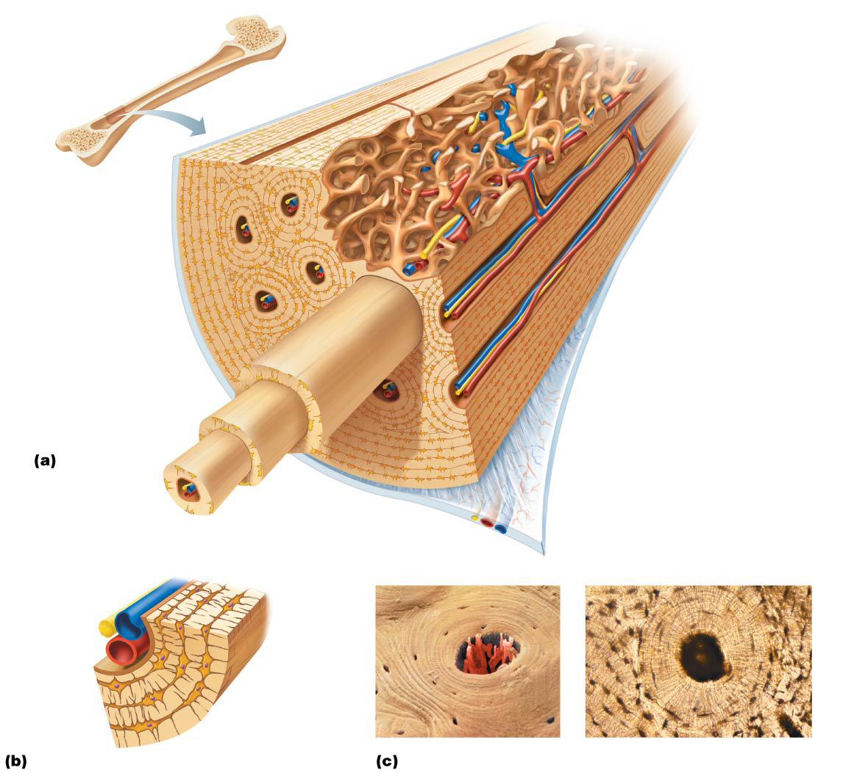
Figure 6.7 Microscopic anatomy of compact bone.
Compact
bone
Spongy bone
Central
(Haversian) canal
Perforating
(Volkmann’s) canal
Endosteum lining bony canals
and covering trabeculae
Osteon
(Haversian system)
Circumferential
lamellae
Perforating (Sharpey’s) fibers
Lamellae
Periosteal blood vessel
Periosteum
Nerve
Vein
Lamellae
Artery
Canaliculi
Central
canal
Osteocyte
in a lacuna
Lacunae
Interstitial lamella
Lacuna (with osteocyte)

Slide 35
Microscopic Anatomy of Bone (cont.)
Canals and canaliculi (cont.)
Lacunae: small cavities that contain osteocytes
Canaliculi: hairlike canals that connect lacunae to each other and to central canal
Communication
Nutrient delivery and waste removal

Slide 36
Figure 6.7 Microscopic anatomy of compact bone.
Compact
bone
Spongy bone
Central
(Haversian) canal
Perforating
(Volkmann’s) canal
Endosteum lining bony canals
and covering trabeculae
Osteon
(Haversian system)
Circumferential
lamellae
Perforating (Sharpey’s) fibers
Lamellae
Periosteal blood vessel
Periosteum
Nerve
Vein
Lamellae
Artery
Canaliculi
Central
canal
Osteocyte
in a lacuna
Lacunae
Interstitial lamella
Lacuna (with osteocyte)

Slide 37
Microscopic Anatomy of Bone (cont.)
Interstitial and circumferential lamellae
Interstitial lamellae
Lamellae that are not part of osteon
Some fill gaps between forming osteons; others are remnants of osteons cut by bone remodeling
Circumferential lamellae
Just deep to periosteum, but superficial to endosteum, these layers of lamellae extend around entire surface of diaphysis
Help long bone to resist twisting

Slide 38
Figure 6.7 Microscopic anatomy of compact bone.
Compact
bone
Spongy bone
Central
(Haversian) canal
Perforating
(Volkmann’s) canal
Endosteum lining bony canals
and covering trabeculae
Osteon
(Haversian system)
Circumferential
lamellae
Perforating (Sharpey’s) fibers
Lamellae
Periosteal blood vessel
Periosteum
Nerve
Vein
Lamellae
Artery
Canaliculi
Central
canal
Osteocyte
in a lacuna
Lacunae
Interstitial lamella
Lacuna (with osteocyte)

Slide 39
Microscopic Anatomy of Bone (cont.)
Spongy bone
Appears poorly organized BUT
Organized along lines of stress
Trabeculae: like cables on a suspension bridge, confer strength to bone
No osteons are present
Capillaries in endosteum supply nutrients

Slide 40
Bone Development
Ossification (osteogenesis) is the process of bone tissue formation
Formation of bony skeleton begins in month 2 of development
Postnatal bone growth occurs until early adulthood
Bone remodeling and repair are lifelong

Slide 41
Formation of the Bony Skeleton
Week 8, bony skeleton forms
Endochondral ossification
Bone forms by replacing hyaline cartilage
Bones are called cartilage (endochondral) bones
Form most of skeleton
Intramembranous ossification
Bone develops from fibrous membrane
Bones are called membrane bones

Slide 42
Formation of the Bony Skeleton (cont.)
Endochondral ossification
Hyaline cartilage → bone
Forms essentially all bones inferior to base of skull, except clavicles
Begins late in month 2 of development
Begins at primary ossification center in center of shaft

Slide 43
Formation of the Bony Skeleton (cont.)
Five main steps in the process of ossification:
Bone collar forms around diaphysis (shaft) of cartilage model
Central cartilage in diaphysis calcifies, then develops cavities
Periosteal bud (blood vessels) invades cavities, leading to formation of spongy bone
Secondary ossification and diaphysis elongates and medullary cavity forms
Epiphyses (ends of bone) ossify

Slide 44
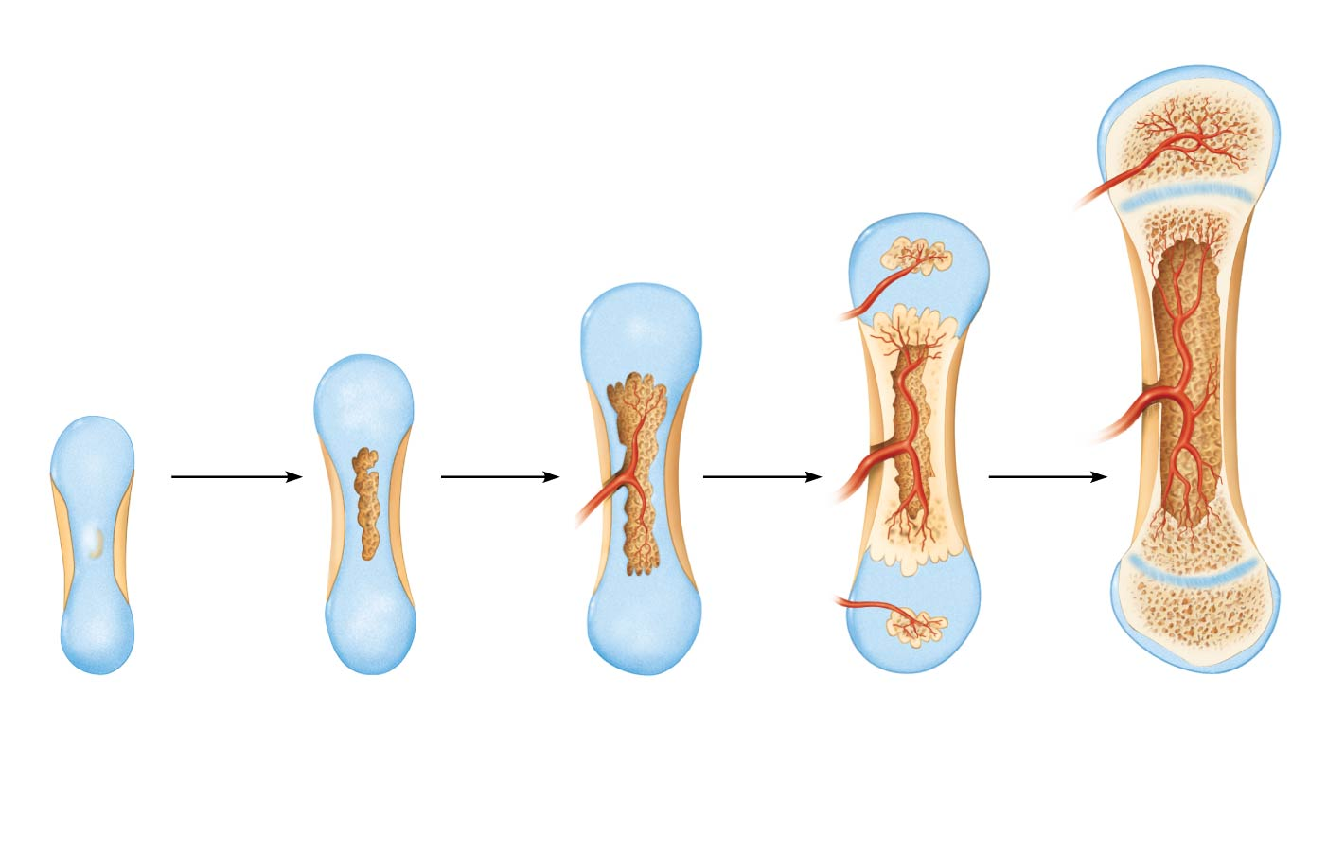
Figure 6.8 Endochondral ossification in a long bone.
Slide 6
Week 9
Month 3
Birth
Childhood to adolescence
Articular
cartilage
Secondary
ossification
center
Spongy
bone
Epiphyseal
blood vessel
Area of
deteriorating
cartilage matrix
Epiphyseal
plate
cartilage
Hyaline
cartilage
Spongy
bone
formation
Medullary
cavity
Bone
collar
Blood
vessel of
periosteal
bud
Primary
ossification
center
1
2
3
4
5
1
Cartilage in the center of the diaphysis calcifies and then develops cavities.
The periosteal bud invades the internal cavities and spongy bone forms.
The epiphyses ossify. When completed, hyaline cartilage remains only in the epiphyseal plates and articular cartilages.
Bone collar forms around the diaphysis of the hyaline cartilage model.
The diaphysis elongates and a medullary cavity forms. Secondary ossification centers appear in the epiphyses.

Slide 45
Formation of the Bony Skeleton (cont.)
Intramembranous ossification: begins within fibrous connective tissue membranes formed by mesenchymal cells
Forms frontal, parietal, occipital, temporal, and clavicle bones

Slide 46
Postnatal Bone Growth
Long bones grow lengthwise by interstitial (longitudinal) growth of epiphyseal plate
Bones increase thickness through appositional growth
Bones stop growing during adolescence
Females around 18 years old
Males around 21 years old

Slide 47
Bone Remodeling
About 5–7% of bone mass is recycled each week
Spongy bone replaced ~ every 3-4 years
Compact bone replaced ~ every 10 years
Bone remodeling = bone deposit and bone resorption
Which cells responsible?

Slide 48
Bone Repair
Fractures are breaks
During youth, most fractures result from trauma
In old age, most result from weakness of bone due to bone thinning

Slide 49
Fracture Classification
Three “either/or” fracture classifications
Position of bone ends after fracture
Nondisplaced: ends retain normal position
Displaced: ends are out of normal alignment
Completeness of break
Complete: broken all the way through
Incomplete: not broken all the way through
Whether skin is penetrated
Open (compound): skin is penetrated
Closed (simple): skin is not penetrated

Slide 50
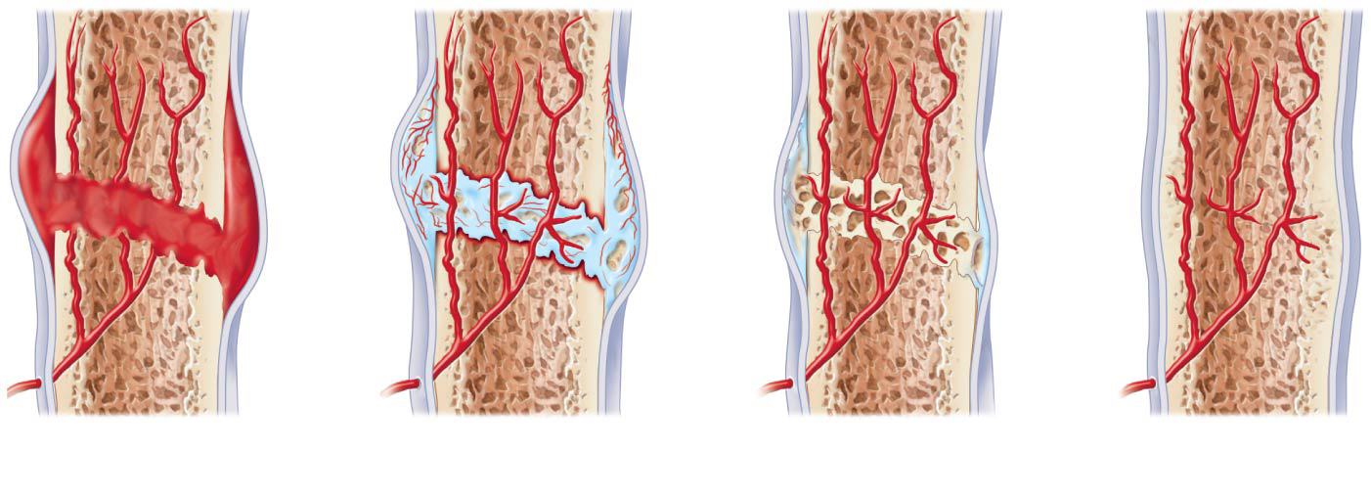
Fracture Treatment and Repair (cont.)
Repair involves four major stages:
Hematoma formation
Fibrocartilaginous callus formation
Bony callus formation
Bone remodeling
Hematoma
External
callus
Bony
callus of
spongy
bone
Internal
callus
(fibrous
tissue and
cartilage)
New
blood
vessels
Healed
fracture
Spongy
bone
trabecula
1
A hematoma forms.
2
3
Bony callus forms.
4
Fibrocartilaginous callus forms.
Bone remodeling occurs.

Slide 51
Bone Disorders
Imbalances between bone deposit and bone resorption
Three major bone diseases:
Osteomalacia (poor mineralization) and rickets (vitamin D deficient and calcium deficient)
Osteoporosis (bone resorption > bone deposit)
Paget’s disease (bone made too fast and poorly)

Slide 52
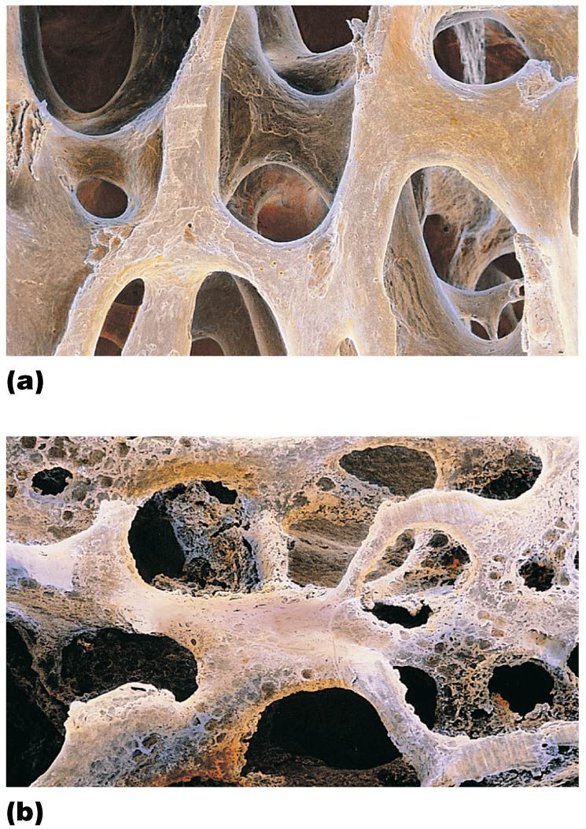
Figure 6.15 The contrasting architecture of normal versus osteoporotic bone.
Normal bone
Osteoporotic bone

