Slide 1
MT. RUSHMORE
By Kaci and Jayleigh

Slide 2
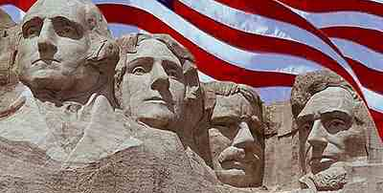
MT.RUSHMORE
MT. Rushmore is located in South Dakota’s Black Hills National Forest.

Slide 3
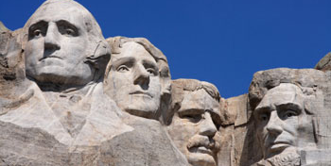
THIS IS MT. RUSHMORE
0

Slide 4
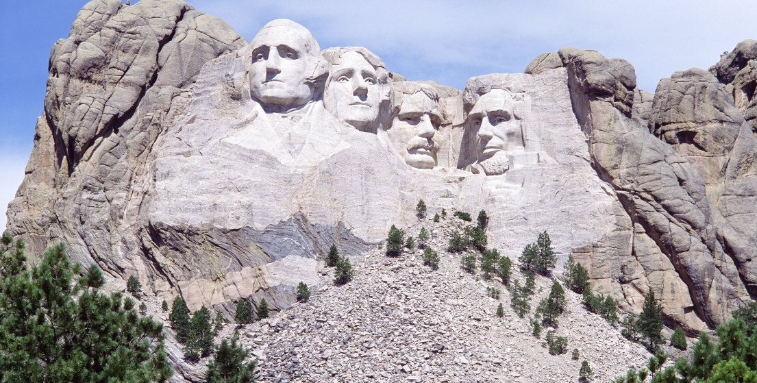
MT. Rushmore began in 1927 and was completed in1941. MT. Rushmore is sixty feet (8 meters.)

Slide 5
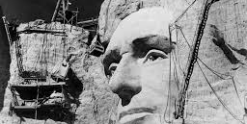
It was designed by Gutzon Borglum

Slide 6
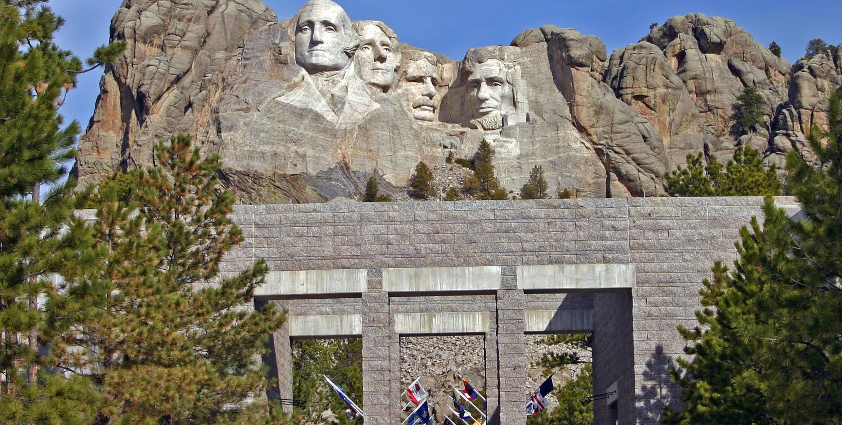
For the materials they used four hundred fifty thousand tons of rock.

Slide 7
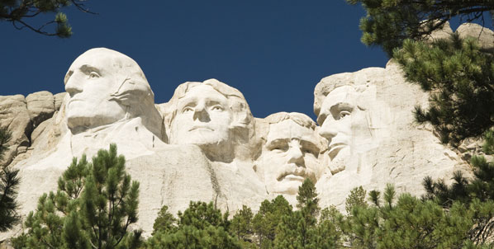
Mt. Rushmore was used for founding , expansion , preservation, and unifucation.

Slide 8
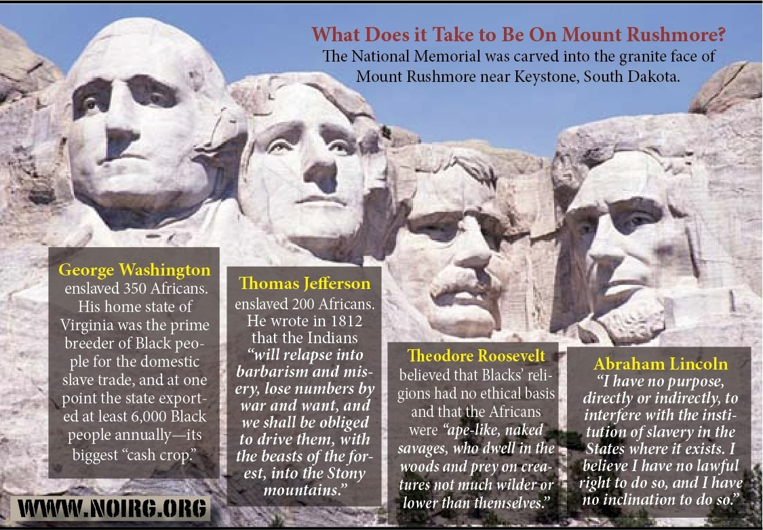
Interesting facts
On MT. Rushmore there is George Washington, Thomas Jefferson, Theodore Roosevelt, and Abraham Lincoln.

Slide 9
WHERE WE FOUND THE INFO.
MT. Rushmore history.com

