Slide 1
Studying Chemistry
A Survival Guide

Slide 2
Why am I here?
Slacker Reasons
Responsible Reasons
I heard the class was easy.
It looks good on my transcript.
My mother made me sign-up.
I needed one more Science class.
To blow things up!
To develop a better understanding of the natural world.
To prepare myself for the rigors of college.
To prepare myself for a future career.
To strengthen my higher-order thinking skills.

Slide 3
How to Succeed
Wrong Way
Right Way
Skip Homework Assignments
Cram for tests the night before.
Fail to complete lab reports.
Copy friends homework.
Use textbook to keep table steady.
Spend class time mastering Clash of Clans.
Complete homework every week.
Study class material on a daily basis.
Complete all lab reports.
Read textbook to reinforce class discussions.
Spend class time taking notes and participating in class discussions.

Slide 4
Science isn’t a spectator sport!
In order to learn Science you must do Science.
This is an active learning classroom you will have to learn to process data and draw conclusions in order to succeed.

Slide 5
What is Science?
Can you define science?
How do you differentiate science and technology?
What makes science different from other areas of learning?

Slide 6
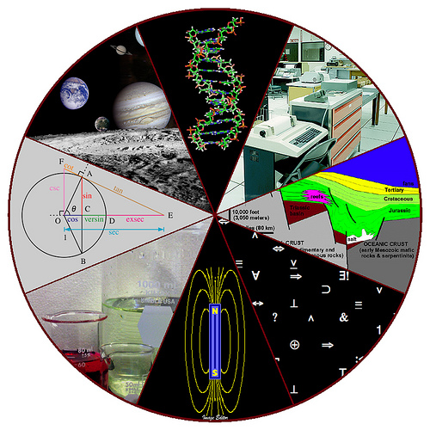
Science
The systematic exploration of the natural world.
A method of studying the natural world based on controlled experiments and collection of data.
The analysis of empirical evidence in order to draw conclusions about the system being studied.

Slide 7
Fields of Science
Physical Sciences
Life Sciences
Physics
Chemistry
Astronomy
Geology
Biology
Botany
Zoology
Anatomy
Medicine
Ecology

Slide 8
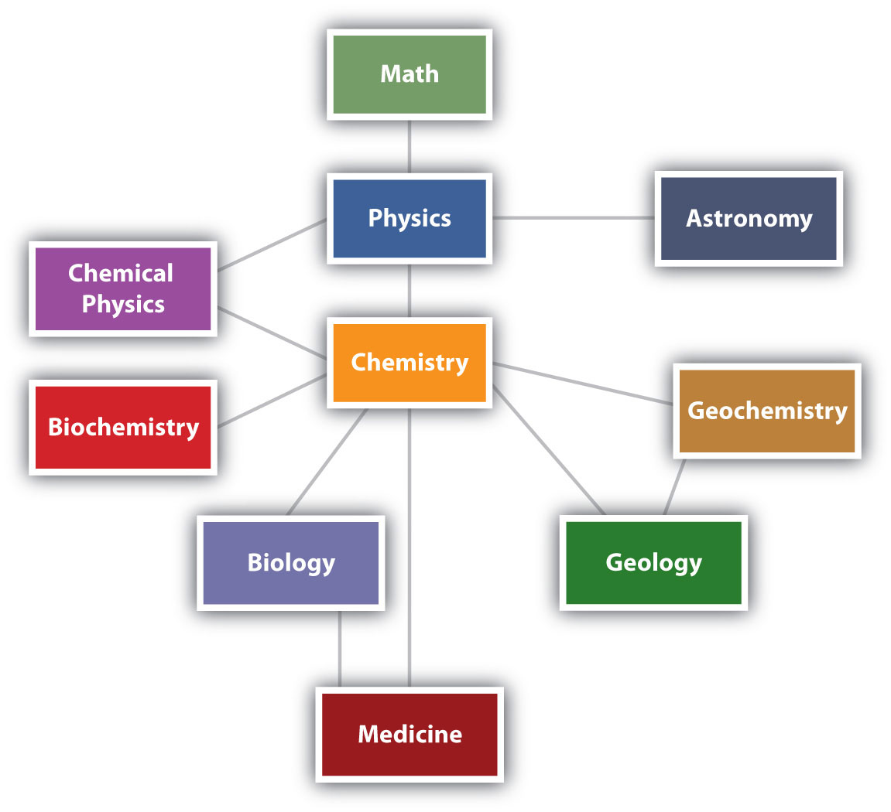
How do the Sciences relate?

Slide 9
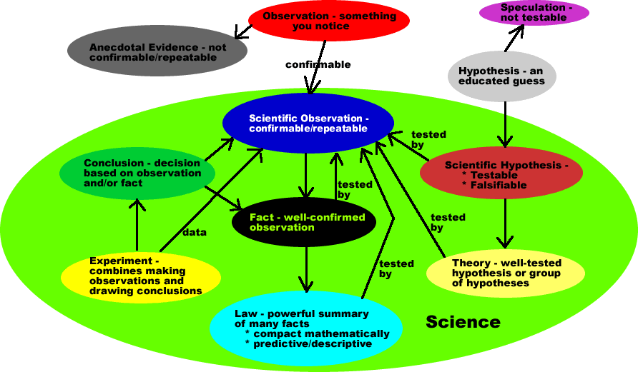
Scientific Method

Slide 10
How does this compare to the Scientific Method?

Slide 11
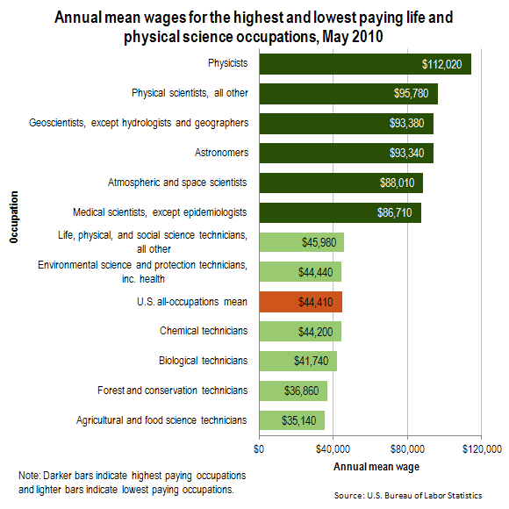
Why Study Science?

Slide 12
What is Chemistry?

Slide 13
Chemistry is…
The study of matter, its structure, and the changes it undergoes.

Slide 14
What is Matter?
Matter
Not Matter
Things you can grab.
Things which take up space.
Things which have mass.
Light
Heat
Charge

Slide 15
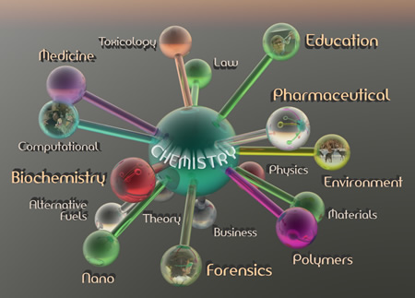
Fields of Chemistry
Inorganic Chemistry
Organic Chemistry
Biochemistry
Physical Chemistry
Nuclear Chemistry
Polymer Chemistry
Environmental Chemistry

