Slide 1

Tuesday, August 13, 2019
Complete Math Independent Practice pages 291-292 from yesterday.
Practice writing “b” in cursive when finished.
7:55 – 8:35

Slide 2
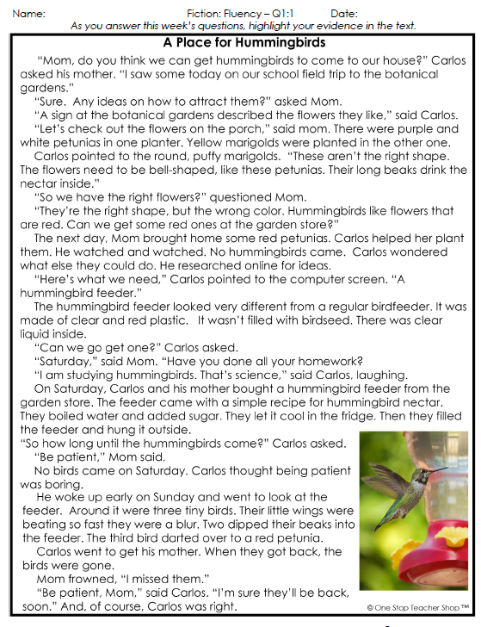
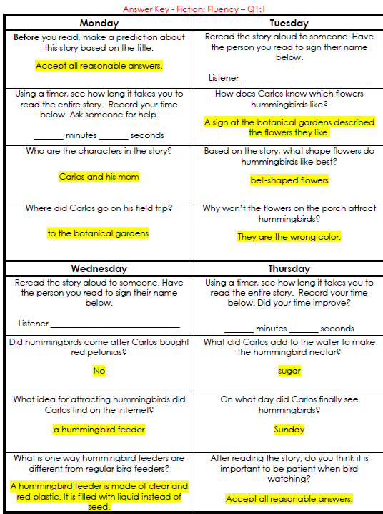
Reading Homework

Slide 3
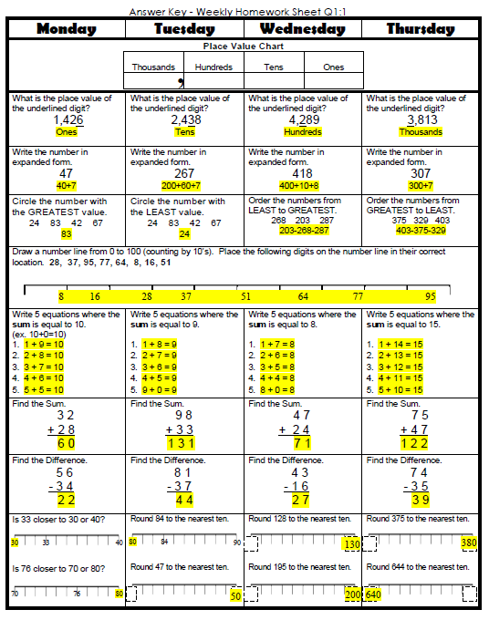
Math Homework

Slide 4

CHOMP TIME
F.A.S.T. Groups
Focused Academic Support Time

Slide 5

F.A.S.T. Designations
Computers – Epic: Jaiden Macon Kaylah Katelynn Carleen McKenzie Erin Noah Elin | Mrs. Roby: LLI Landon Paisleigh | Mrs. Thompson: LLI Jaylie Jearon Amiyah Cohen | IDR – 40 book challenge All others
8:40 – 9:10

Slide 6

Restroom Break
9:10 – 9:20

Slide 7

Reading Time
9:20 – 10:25
Objective: RL.3.1
I can ask and answer questions to demonstrate understanding of a text, referring explicitly to the text as the basis for answers.
Objective: RL.3.2
I can recount stories; determine the central message, lesson, or moral and explain how it is conveyed through key details in the text.
Objective: RL.3.3
I can describe characters in a story and explain how their actions contribute to the sequence of events.
Objective: RL.3.7
I can explain how specific images and illustrations contribute to or clarify a story.

Slide 8

Reread Miss Nelson is Missing – Quiz Next ☺

Slide 9
Quiz

Slide 10

Computers - Epic:
  Amiyah
  Aiden
  Caydance
  Jearon
  Emma
  Adalyn
  Jaylie
  Khamani
  Lexi
  Jordyn
Independent Daily Reading & Teacher Conferences
All others Independent Novel for Book Challenge! ☺
10:25 – 10:40

Slide 11
Out of Classroom!
Recess 10:40 – 11:05

Slide 12



Writing Time
Objective: W3.3
Write narratives to develop real or imagined experiences or events using effective technique, descriptive details, and clear event sequences.
11:05 – 11:35

Slide 13
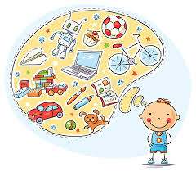

Review
Our Writing Community Goals
Write about things that interest us
Share and talk about our writing
Learn about what professional authors do
Become stronger writers

Slide 14

Gather at the Carpet…
Was it a perfect transition?

Slide 15

Today we will hear the whole book.
Be thinking, would you like to try writing a story like this one?

Slide 16

After Page 20 – Question…
What is the second part of this book going to be about?
How do you know?

Slide 17
Classroom Community Discussion
What’s funny about the way this story is written?
What do you find out about the big sister in this story?
What other ideas do you have for people you could write about today?
What might you write about them?
Objective: RL.3.1 Ask and answer questions to demonstrate understanding of a text, referring explicitly to the text as the basis for answers.
Objective: SL.3.1b Follow agreed-upon rules for discussions (e.g., gaining the floor in respectful ways, listening to others with care, speaking one at a time about the topics and texts under discussion).

Slide 18
People We Can Write About
Anchor Chart
-baby sister – she follows me all over the house
-big brother – hair’s a mess in the morning
-best friend – makes funny faces
Let’s add some more of your ideas to our chart
Objective: W3.3 Write narratives to develop real or imagined experiences or events using effective technique, descriptive details, and clear event sequences.

Slide 19


Share Time – Classroom Discussion Intro
Whose perspective did you most relate to in the book The Pain and The Great One?

Slide 20
Math Fluency & Focus Lesson!
11:35 – 11:55

Slide 21

Kicking it Quiz!

Slide 22
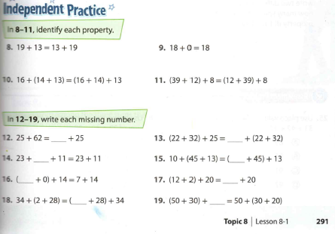

Slide 23
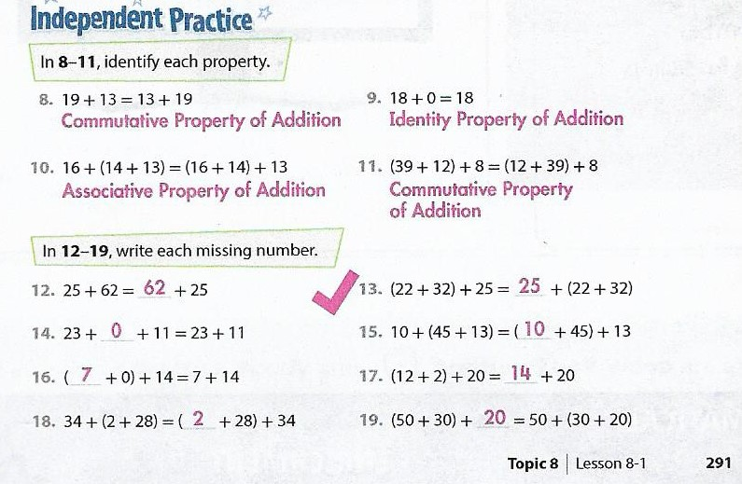
Independent Practice Check

Slide 24
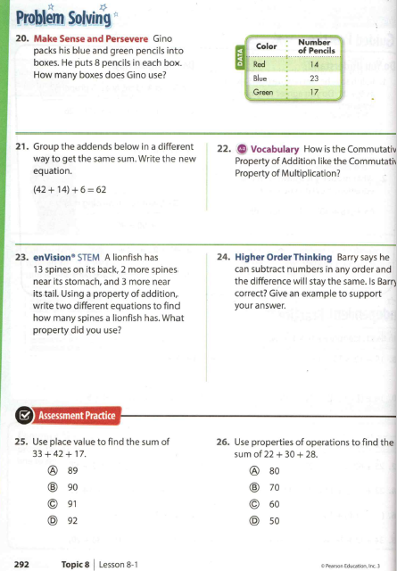
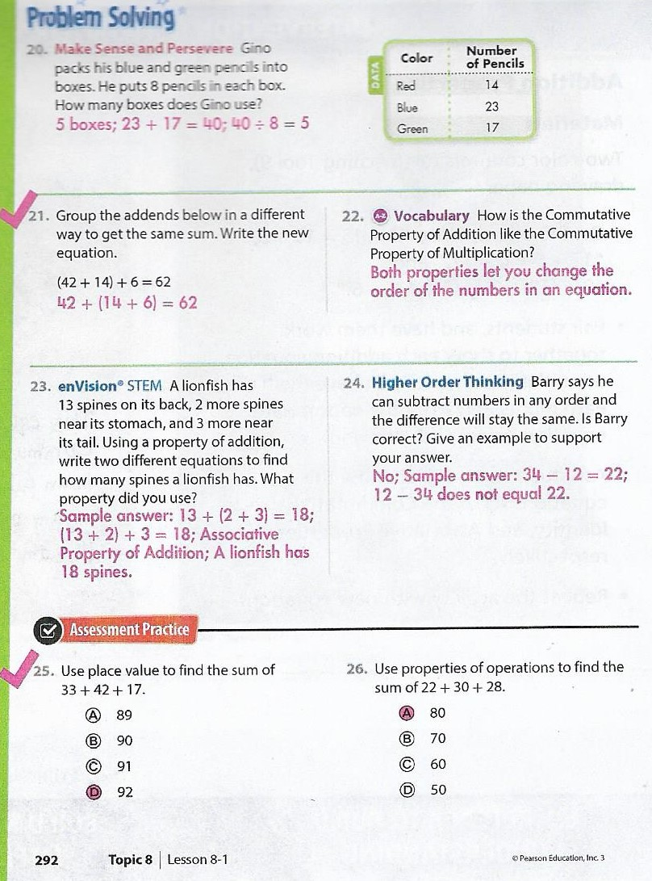

Slide 25
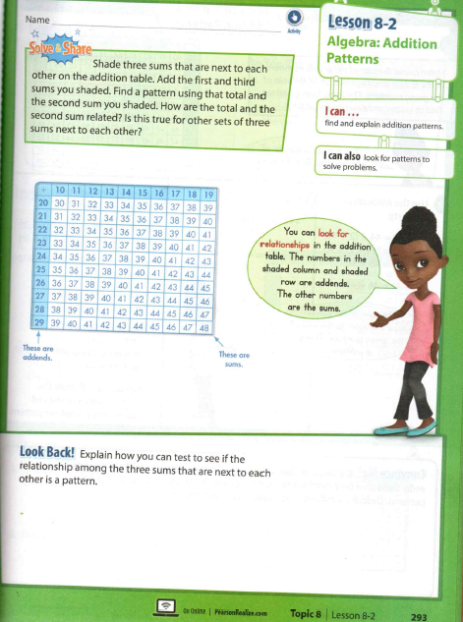
Let’s Solve and Share!

Slide 26

Out of Classroom!
Lunch 12:35 – 1:05

Slide 27
Restroom Break
1:05 – 1:10

Slide 28

Out of Classroom!
Activity 1:10 – 1:55

Slide 29
Math Fluency & Focus Lesson!
1:55 – 2:40

Slide 30
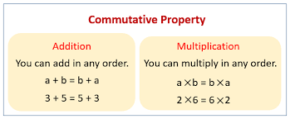
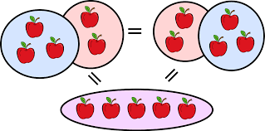
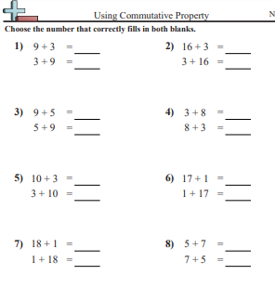
Math Stash

Slide 31
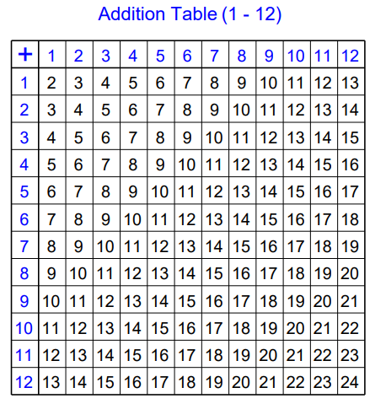

Slide 32
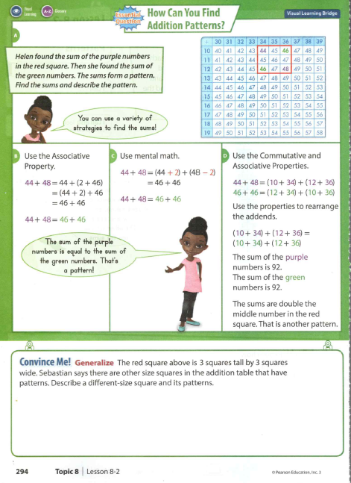
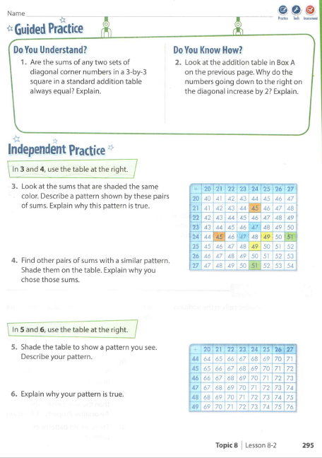

Slide 33
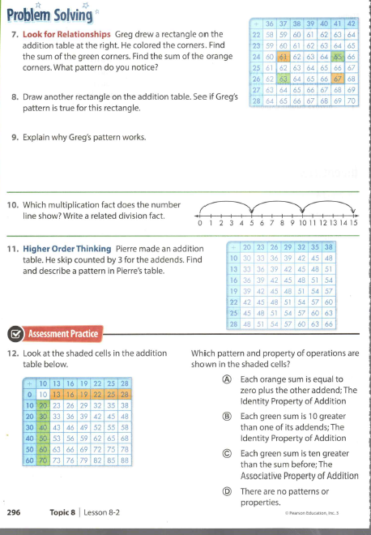

Slide 34

SCIENCE TIME
Objective: P.3.5.1
I can plan and conduct scientific investigations to determine how changes in heat (i.e., an increase or decrease) change matter from one state to another (e.g., melting, freezing, condensing, boiling, or evaporating).
2:40 – 3:10

Slide 35
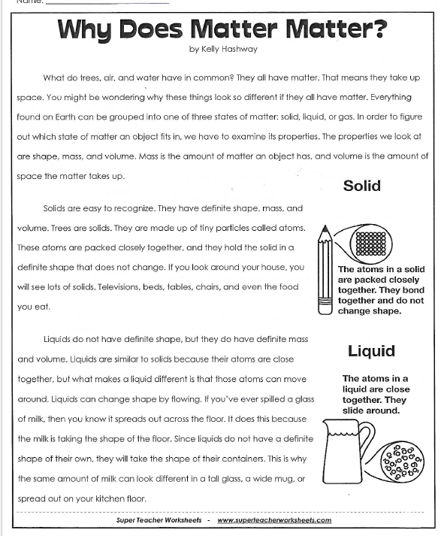
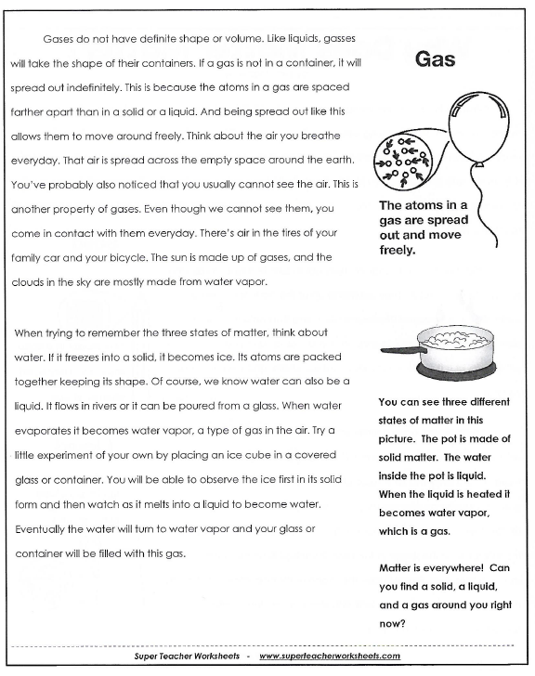
Paired Partners☺

Slide 36
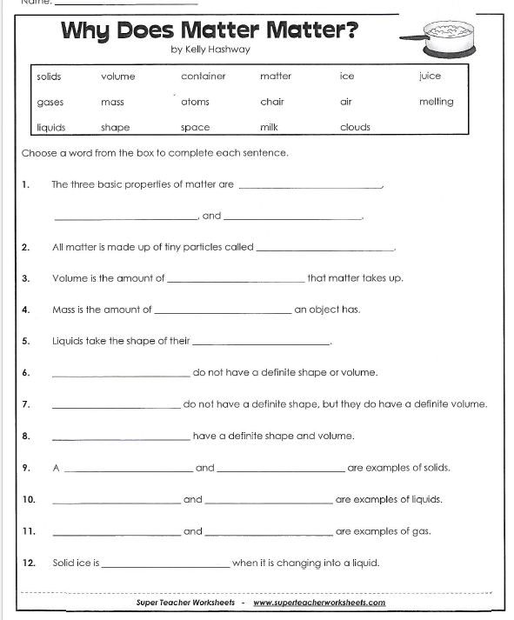
Where did you find your answer in the passage?

Slide 37
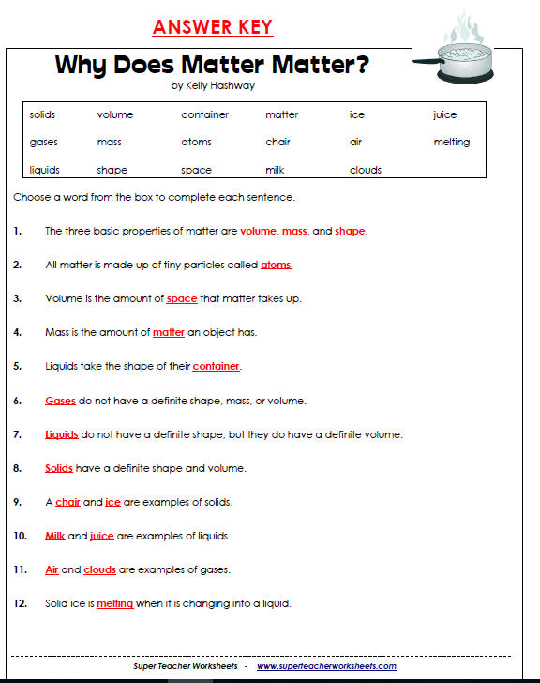

Slide 38
Restroom Break
3:10 – 3:15

Slide 39




3:15 – 3:20 Wrap Up!
Pair-Up back to back and share one thing you learned in class today with your partner
Pack-Up
Office will announce:
Car Riders – Leave around 3:20
Bus Riders – (listen to intercom for dismissal)
2:30 – 3:20
How much time has elapsed?

