Slide 1
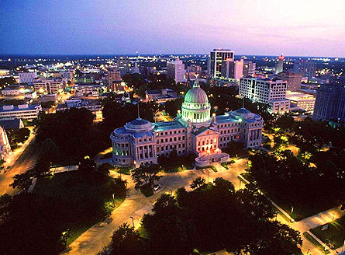
State Government
Page 357

Slide 2
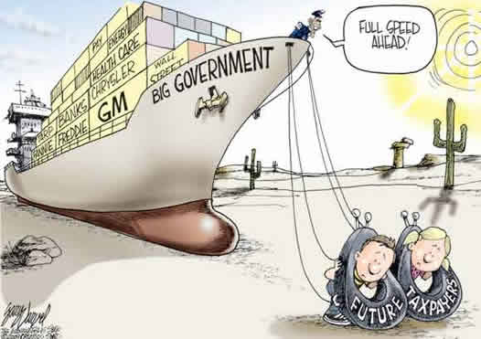

Slide 3
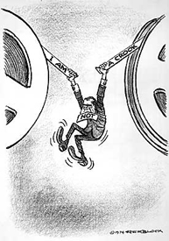
What is this about?
President Richard Nixon 1974
3,071 hours of tapes minus 18 minutes.

Slide 4
Review from last class
Constitution
Mississippi Constitution.
Principles of the Constitution.
Changing the Constitution.
Mississippi Legislature
How it is set-up.
Sessions
Power
Organization
How to make a law.

Slide 5
Objectives :
Explain how civic responsibilities are important to Mississippians as citizens of the United States and residents of a global setting. MS5
Explain the necessity of politics and government. MS5a
Explain how the United States Constitution grants and distributes power to national and state government. MS5c

Slide 6
Overview
Executive Branch
Court System
Finance

Slide 7
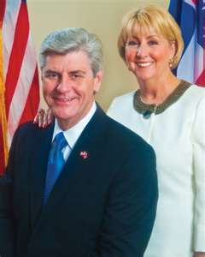
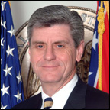
Governor
Phil Bryant
Deborah Bryant
First Lady

Slide 8
Governor
If you wish to run for Governor what requirements must you meet?
At Least 30 years old.
Citizen of the U.S. for 20 years.
Resident of the state for at least 5 years.

Slide 9
Governor
He/she is elected for a 4 year term.
May be reelected only 1 time.

Slide 10
Governor
Commander-in-chief of the Mississippi National
Guard

Slide 11
Governor
Pardon
Reprieve

Slide 12
What is a Pardon?
Is legal forgiveness of the crime.

Slide 13
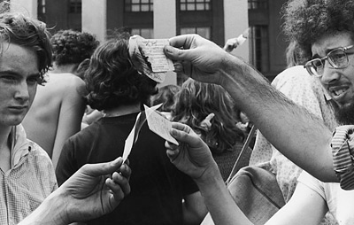
Example of a Pardon.
Draft dodger
The Vietnam War citizens of the United States who dodged the mandatory conscription policy, in order to avoid serving in the war, by leaving the country, originally to Sweden, but later in greater numbers to Canada and Mexico.

Slide 14
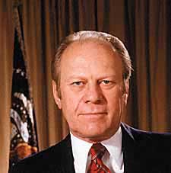
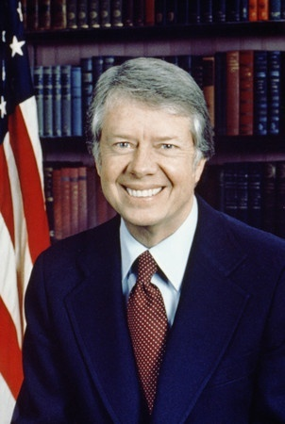
Example of a Pardon
President Gerald Ford had earlier introduced a conditional amnesty, but Carter, hoping to heal the war's wounds, made no conditions.
Gerald Ford
Jimmy Carter

Slide 15
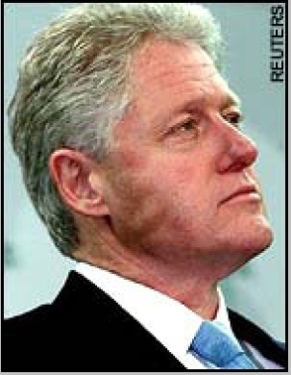
Bad Example of a Pardon
During his last week in office, President Bill Clinton pardoned Marc Rich, who had fled the U.S. during his prosecution and was residing in Switzerland. Clinton's eleventh-hour move, along with pardons of his half-brother, Roger, and former business partner Susan McDougal, outraged Republicans and Democrats alike.

Slide 16
What is a reprieve?
Is a postponement of a sentence.
When would one issue a reprieve?
Death sentence.

Slide 17
Hanging was the first form of execution used in Mississippi. The state continued to execute prisoners sentenced to die by hanging until October 11, 1940.
Death Sentence

Slide 18
On October 11, 1940, when Hilton Fortenberry, convicted of capital murder in Jefferson Davis County, became the first prisoner to be executed in the electric chair. Between 1940 and February 5, 1952, the old oak electric chair was moved from county to county to conduct executions. During the 12-year span, 75 prisoners were executed in the Magnolia State for offenses punishable by death.
Death Sentence

Slide 19
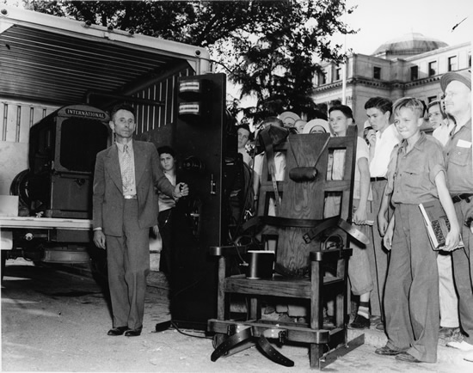

Slide 20
PRISONERS EXECUTED IN THE MISSISSIPPI GAS CHAMBER
Name | Race-Sex | Offense | Date Executed
Gerald A. Gallego | White Male | Murder | 03-03-55
Allen Donaldson | Black Male | Armed Robbery | 03-04-55
August Lafontaine | White Male | Murder | 04-28-55
John E. Wiggins | White Male | Murder | 06-20-55
Mack C. Lewis | Black Male | Murder | 06-23-55
Walter Johnson | Black Male | Rape | 08-19-55
Murray G. Gilmore | White Male | Murder | 12-09-55
Mose Robinson | Black Male | Rape | 12-16-55
Robert Buchanan | Black Male | Rape | 01-03-56
Edgar Keeler | Black Male | Murder | 01-27-56
O.C. McNair | Black Male | Murder | 02-17-56
James Russell | Black Male | Murder | 04-05-56
Dewey Towsel | Black Male | Murder | 06-22-56
Willie Jones | Black Male | Murder | 07-13-56
Mack Drake | Black Male | Rape | 11-07-56
Henry Jackson | Black Male | Murder | 11-08-56

Slide 21
PRISONERS EXECUTED IN THE MISSISSIPPI GAS CHAMBER
Name | Race-Sex | Offense | Date Executed
Minor Sorber | White Male | Murder | 02-08-57
Joe L. Thompson | Black Male | Murder | 11-14-57
William A. Wetzell | White Male | Murder | 01-17-58
J.C. Cameron | Black Male | Rape | 05-28-58
Allen Dean, Jr. | Black Male | Murder | 12-19-58
Nathaniel Young | Black Male | Rape | 11-10-60
William Stokes | Black Male | Murder | 04-21-61
Robert L. Goldsby | Black Male | Murder | 05-31-61
J.W. Simmons | Black Male | Murder | 07-14-61
Howard Cook | Black Male | Rape | 12-19-61
Ellic Lee | Black Male | Rape | 12-20-61
Willie Wilson | Black Male | Rape | 05-11-62
Kenneth Slyter | White Male | Murder | 03-29-63
Willie J. Anderson | Black Male | Murder | 06-14-63
Tim Jackson | Black Male | Murder | 05-01-64
Jimmy Lee Gray | White Male | Murder | 09-02-83
Edward E. Johnson | Black Male | Murder | 05-20-87
Connie Ray Evans | Black Male | Murder | 07-08-87
Leo Edwards | Black Male | Murder | 06-21-89

Slide 22
PRISONERS EXECUTED BY LETHAL INJECTION
Name | Race-Sex | Offense | Date Executed
Tracy Alan Hansen | White Male | Murder | 07-17-02
Jessie D. Williams | White Male | Murder | 12-11-02
John B. Nixon, Sr. | White Male | Murder | 12-14-05
Bobby G. Wilcher | White Male | Murder x 2 | 10-18-06
Earl W. Berry | White Male | Murder | 05-21-08
Dale L. Bishop | White Male | Murder | 07-23-08
Paul Woodward | White Male | Murder | 05-19-10
Gerald J. Holland | White Male | Murder | 05-20-10
Joseph D. Burns | White Male | Murder | 7-21-10
Benny Joe Stevens | White Male | Murder x 4 | 05-10-11
Rodney Gray | Black Male | Murder | 05-17-11
Edwin Hart Turner | White Male | Capital Murder | 02-08-12
Larry Matthew Puckett | White Male | Capital Murder | 03-20-12
William J Mitchell | Black Male | Capital Murder | 03-22-12
Henry Curtis Jackson | Black Male | Capital Murder x 4 | 06-05-12
Jan Michael Brawner | White Male | Capital Murder x 4 | 06-12-12
Gary Carl Simmons | White Male | Capital Murder | 06-20-12

Slide 23
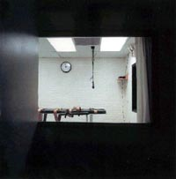
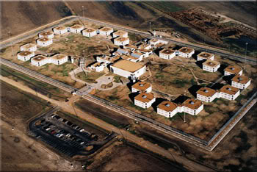
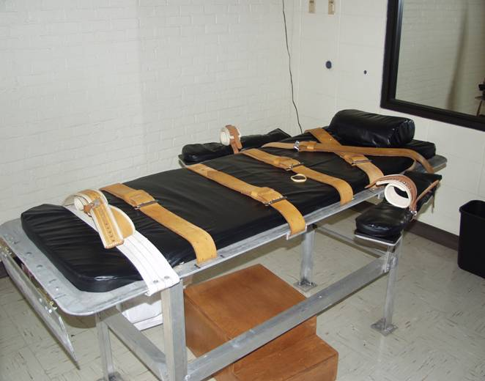
Unit 29, J Block
Lethal Injection Chamber from Family Witness Room, Unit 17, Parchman, Mississippi, 1998.
Lethal Injection Gurney

Slide 24
Lethal Injection Cocktail
Pentobarbital – causes death by respiratory arrest.
Pavulon – if the anesthetic agent used in lethal injection is ineffective, the individual may never achieve unconsciousness, and thus be able to feel all of the pain associated with the procedure, but unable to cry out or move due to the pancuronium's complete paralytic action.
Potassium – stops the heart, and thus causes death by cardiac arrest.
Mississippi previously used Sodium Thiopental.

Slide 25
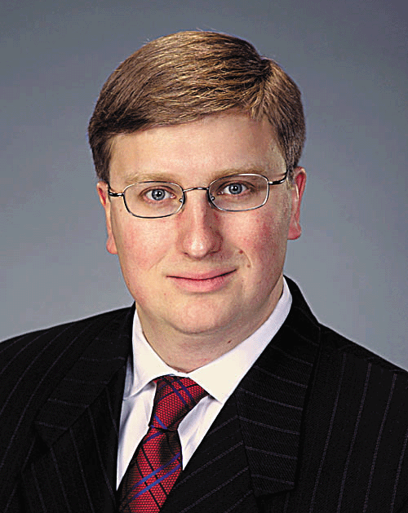
Who is the Lieutenant Governor?
Tate Reeves

Slide 26
Is the Lieutenant Governor a member any committee(s)?
Commission of Budget and Accounting
Tate Reeves

Slide 27
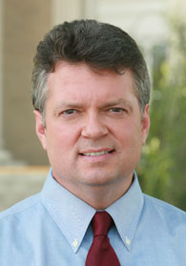
Who is the Attorney General?
Jim Hood

Slide 28
What are the requirements for Attorney General?
At least 26 years old.
Practicing attorney for 5 years.
Citizen of the state for 5 years.

Slide 29
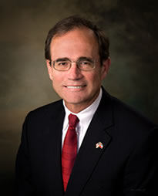
Secretary of State

Slide 30
Secretary of State
“Keep of the Capital”.
In charge of the state’s official records.
Administers elections.
Administers Public lands.
Publish state documents.

Slide 31
What are the requirements for the Secretary of State
At least 25 years old.
A citizen of the state for 5 years.

Slide 32
State Treasurer
Lynn Fitch

Slide 33
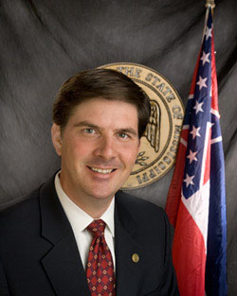
Auditor of Public Accounts
Stacey Pickering

Slide 34
Other Elected State Offices
Commissioner of Agriculture and Commerce
Highway Commissioner
Public Service Commissioner
Insurance Commissioner

Slide 35
Appointed Offices
State Board of Education
– Appointed by the Governor.
– Appointed by the Lt Governor.
– Appointed by the Speaker of the House.
5
2
2

Slide 36
Court System

Slide 37
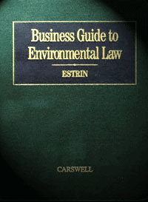
What are the 2 Systems?
2 Court Systems in the United States
Law
The Federal System.
The State System.

Slide 38
U.S. Supreme Court
U.S. Courts of Appeals
12 Circuit
U.S. Courts of Appeals for the Federal Circuit
U.S. Courts of Appeals for the Armed Forces
94 District Courts
and
3 Territorial Courts
U.S. Tax Court
U.S. Court of Inter-national Trade
U.S. Court of Federal claims
U.S. Court of Veterans Appeals
Army, Navy, Air Force, Marines, Coast Guard, Courts of Criminal Appeals

Slide 39
What is jurisdiction?
Jurisdiction
Is a courts’ area of authority.
Mississippi Studies book
The right and power to interpret and apply the law.
Answers.com
The territorial range of authority or control.
Answers.com

Slide 40
What is original jurisdiction?
Jurisdiction
The court that hears the case first.
What is appellate jurisdiction?
The courts that review a case on appeal from a lower court.

Slide 41
Page 361
Court System

Slide 42
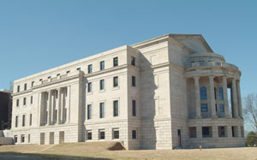
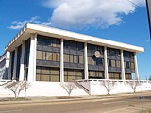
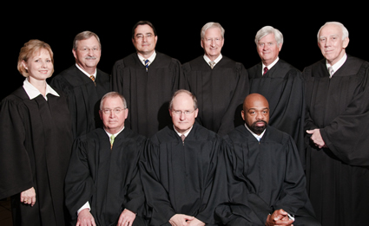
What is the highest court in Mississippi?
The Mississippi Supreme Court
New Building
Gartin Justice Building
Old Building
450 High Street Jackson, MS Cost: $42,700,000 Complete 2008

Slide 43
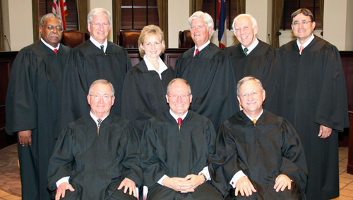
Justices are elected for 8 year terms
The Mississippi Supreme Court
The Supreme Court Justices:
Chief Justice William L. (Bill) Waller, Jr.
Presiding Justice George C. Carlson, Jr.
Presiding Justice Jess H. Dickinson
Associate Justice Michael K. Randolph
Associate Justice Ann H. Lamar
Associate Justice James W. Kitchens
Associate Justice David A. Chandler
Associate Justice Randy G. Pierce
Associate Justice Leslie D. King
Justices usually hear cases in 3 person panels.

Slide 44
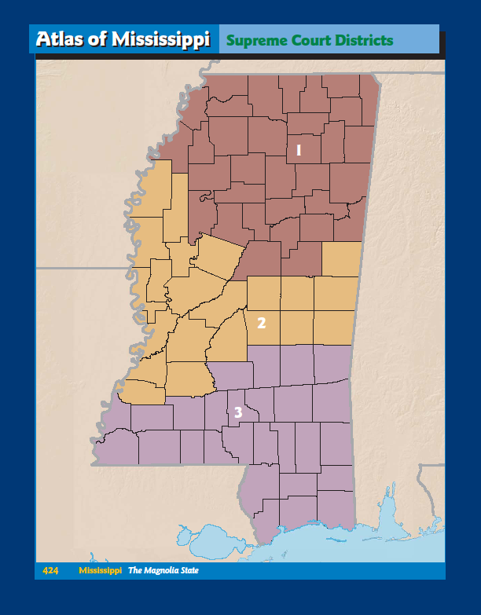
Page 424
The Mississippi Supreme Court
Justices are elected from 3 Supreme Court Districts (Northern, Central and Southern).

Slide 45
What are the requirements to run for justices of the Mississippi Supreme court?
The Mississippi Supreme Court
At least 30 years old.
A practicing attorney.
Citizen for 5 years.

Slide 46
In 1992, Mississippi Supreme Court was averaging 981 days from the lower court’s judgment and the supreme court’s decision. To ease the workload, what court was created by the legislature?

Slide 47
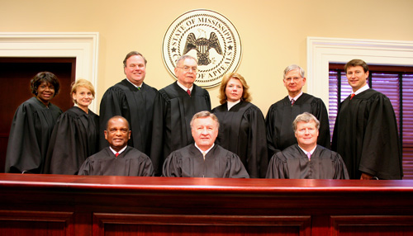
The Court of Appeals
The Court of Appeals began hearing cases in 1995.

Slide 48
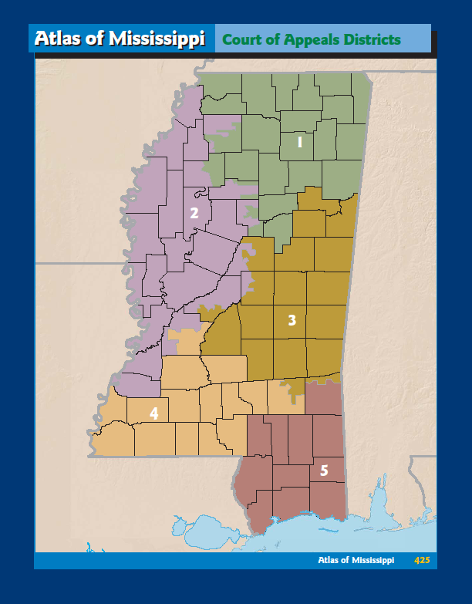
10 Court of Appeals judges are elected from 5 districts.
Court of Appeals judges serve eight-year terms.
Page 425

Slide 49
The Court of Appeals is an error correction court. It hears and decides appeals on issues in which the law is already settled, but the facts are in dispute.
Court of Appeals has 270-day deadline to issue a decision.

Slide 50
Appeals which go directly to the Supreme Court include annexations, bond issues, constitutionality challenges, death penalty cases, disciplinary matters involving attorneys and judges, election contests, certified questions from federal court, utility rates, cases of first impression and issues of broad public interest.
Supreme Court now has 270-day deadline to issue a decision.

Slide 51
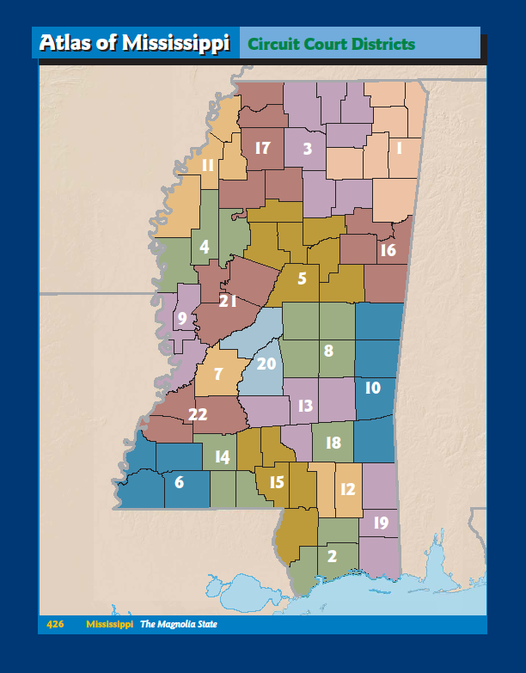
Page 426
Circuit Court
There are 22 Circuit Court districts and 51 Circuit Court judges. The number of Circuit Judges per district ranges from 1 to 4.

Slide 52
DeSoto, Panola, Tallahatchie, Tate & Yalobusha Counties
District 17
Judge Robert P. Chamberlin
Judge Andrew C. Baker
Judge James McClure, III

Slide 53
Circuit Courts hear felony criminal prosecutions and civil lawsuits.
Circuit Court
Also, Circuit Courts hear appeals from County, Justice and Municipal courts.

Slide 54
Circuit Courts have original jurisdiction in certain civil matters (over $300). And for all serious criminal matters (felonies) which are punishable by prison or death.
Circuit Court

Slide 55
A serious crime like robbery or murder that would be punishable by prison or death.
What is a felony?

Slide 56
Trials are heard with a 12-member jury and usually one or two alternate jurors.
A jury is a group a citizens chosen from the list of registered voters to hear evidence in the case and make a decision (verdict) based on the evidence presented.

Slide 57
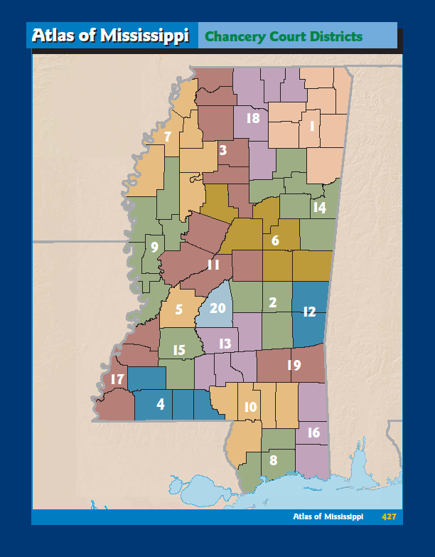
Chancery Court
There are 20 Chancery Court districts and 48 Chancery Court judges. The number of chancery judges per district ranges from 1 to 4.
Page 427

Slide 58
DeSoto, Tate, Panola, Yalobusha, Grenada & Montgomery Counties
District 3
Judge Mitchell M. Lundy, Jr.
Judge Percy L. Lynchard, Jr.
Judge Vicki Cobb

Slide 59
Chancery Courts have jurisdiction over disputes in matters involving equity; domestic matters including adoptions, custody disputes and divorces; guardianships; sanity hearings; wills; and challenges to constitutionality of state laws. Land records are filed in Chancery Court.
Chancery Court
Chancery Courts have jurisdiction over juvenile matters in counties which have no County Court.

Slide 60
Trials are typically heard by a chancellor (judge) without a jury, although state law allows parties to request a jury in Chancery Court.
Chancery Court
The chancellor may appoint a lawyer in private practice to sit as a youth court referee to hear juvenile matters such as delinquency, abuse and neglect.

Slide 61
County court
Lower Courts
Family court
Youth court
Justice court
Municipal court

Slide 62
County Courts share jurisdiction with Circuit and Chancery Courts in some civil matters. The jurisdictional limit of County Courts is up to $200,000. County Courts may handle non-capital felony cases transferred from Circuit Court. In counties which have a County Court, a County Court judge also serves as the Youth Court judge. County Courts have exclusive jurisdiction over eminent domain proceedings. County Court judges may issue search warrants, set bond and preside over preliminary hearings.
County Court

Slide 63
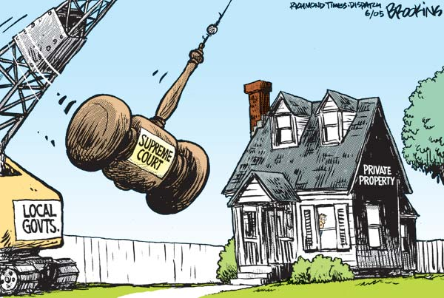
Eminent Domain

Slide 64
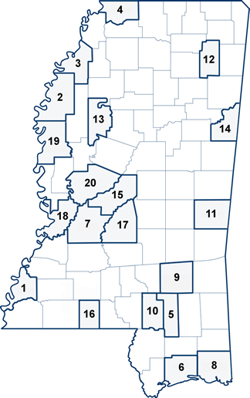
Mississippi has 20 County Courts and 30 County Court judges.
County Court
1. | Adams County Court
2. | Bolivar County Court
3. | Coahoma County Court
4. | Desoto County Court
5. | Forrest County Court
6. | Harrison County Court
7. | Hinds County Court
8. | Jackson County Court
9. | Jones County Court
10. | Lamar County Court
11. | Lauderdale County Court
12. | Lee County Court
13. | Leflore County Court
14. | Lowndes County Court
15. | Madison County Court
16. | Pike County Court
17. | Rankin County Court
18. | Warren County Court
19. | Washington County Court
20. | Yazoo County Court

Slide 65
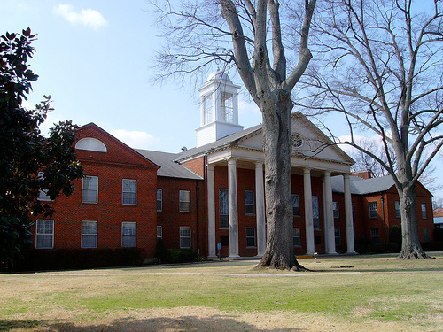
Allen Couch Judge Celeste Wilson Youth Court Judge
Desoto County Court
2535 Hwy. 51 South, Rm 200
Hernando, MS 38632

Slide 66
HARRISON COUNTY
Family Court
There is only one family court in the state.
The family court serves as a youth court handling delinquency and neglect cases, but it also hears cases involving adults committing crimes against juveniles.

Slide 67
The Youth Courts deal with matters involving abuse and neglect of juveniles, as well as offenses committed by juveniles.
Youth Court
In counties which do not have a County Court, the Chancery Judge may hear Youth Court matters.

Slide 68
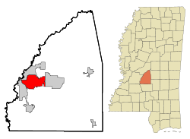
The city of Pearl is the only city to have its own municipal Youth Court.
Youth Court

Slide 69
Justice Courts have jurisdiction over small claims civil cases involving amounts of $3,500 or less, misdemeanor criminal cases and any traffic offense that occurs outside a municipality.
Justice Court
There are 82 Justice Courts with 197 judges. Justice Court judges are the only Mississippi judges elected in partisan races.

Slide 70
What is the requirement to run for this office?
Justice Court Judge
If you what to be Judge Judy!
You must have a high school diploma or its equivalent.

Slide 71
There are 226 Municipal Courts. Most municipalities have one municipal judge, although a few jurisdictions have several.
Municipal Court
Most municipal judges are appointed by governing bodies of municipalities. Must be attorneys living within the city limits. In towns of less than
10,000 people, the mayor may serve as municipal judge.

Slide 72
The first drug court began in Ridgeland Municipal Court in 1995. Mississippians are beginning to realize the benefits of a treatment based approach in dealing with its non-violent drug offending population.
Drug Court Movement in Mississippi

Slide 73
Drug court participants undergo long-term treatment and counseling, sanctions, incentives, and frequent court appearances.
Drug Court
17th Circuit
Location: Hernando, Mississippi
Judge Robert Chamberlin
Coordinator Craig Sheley

Slide 74
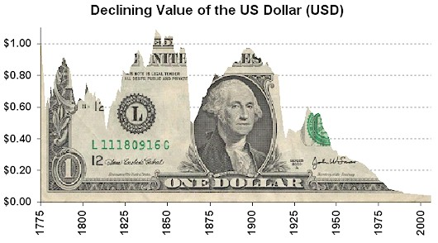
Revenue (Money)
Financing Government

Slide 75
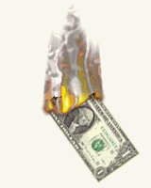
Revenue – expenditures = Budget
Budget
Estimate
Estimate

Slide 76
General Sales Tax
The major sources of revenue for the state government are sales taxes.
Mississippi State Tax Commission
As of July 2009
Retail Sales
Automobiles and light trucks (10,000 lbs. or less) …………………………………..5%
Other tangible personal property including alcoholic beverages and beer……….7%
Wholesale Sales
Alcoholic Beverages and beer…………………………………………………….…..7%
Food and drinks for full service vending machines…………………………….……8%
The general tax rate is …………………………………………………………….…7%

Slide 77
Income Tax
If your income range is between $0 and $5,000, your tax rate on every dollar of income earned is 3%.
If your income range is between $5,001 and $10,000, your tax rate on every dollar of income earned is 4%.
If your income range is $10,001 and over, your tax rate on every dollar of income earned is 5%.
The income tax is a progressive tax; the more a person earns, the more a person pays in taxes.

Slide 78
Called the “sin” tax”.
Tobacco and Alcoholic Tax
Most of the money from these taxes goes into the state’s general fund, which is used to pay the state’s general expenses. The major general fund expense for the state is education.

Slide 79
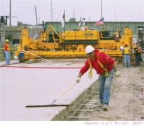
Money from fuel taxes (gasoline, kerosene, and motor oil) must be used for highway construction and maintenance.
Designated Taxes

Slide 80
Review
Executive Branch
Governor
Other Elected offices (Lt. Gov., Attorney General, Secretary of State and so on.)
Court System
Upper Courts (Supreme, Court of Appeals, Circuit and Chancery.
Lower Courts (County, Family, Youth, Justice, Municipal and Drug Courts)
Finance
Budget
General Sales Tax

Slide 82
Test is next.

