Slide 1
Unit 10 Personality
11-15%

Slide 2
Learning Targets
Module 55
55-1 Explain what psychologists mean by personality, and identity the theories that inform our understanding of personality.
55-2 Explain how Sigmund Freud’s treatment of psychological disorders led to his view of the unconscious mind, and describe his view of personality.
Psychoanalytic and Psychodynamic Theories
55-3 Identify the developmental stages Freud proposed, and discuss how he thought people defended themselves against anxiety.

Slide 3
Learning Targets cont.
Module
55
55-4 Identify which of Freud’s ideas his followers accepted and rejected.
55-5 Describe projective tests and how they are used, and discuss some criticisms of them.
Psychoanalytic and Psychodynamic Theories
55-6 Discuss how contemporary psychologists view Freud’s psychoanalysis, and describe how modern research has developed our understanding of the unconscious.

Slide 4
What is personality?
an individual’s
characteristic pattern of thinking,
feeling, and acting
Our personality drives what we laugh at, whom we hang with, how we occupy our time, why we cry and where we choose to live.
Our personality underlies all that makes us…. us.

Slide 5
What theories inform our understanding of personality?
Psychoanalytic or psychodynamic theories proposed that childhood sexuality and unconscious motivations influence personality.
Humanistic theories focused on our inner capacities for growth
and self-fulfillment.
Trait theories examine characteristic patterns of
behavior (traits).
Social-cognitive theories explore the interaction
between people’s traits (including their thinking) and their social
context.

Slide 6
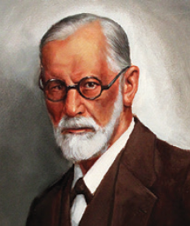
What are the psychodynamic theories?
Psychodynamic theories of personality view human personality as a dynamic interaction
between the conscious mind and unconscious mind, including associated motives and
conflicts.
Sigmund Freud
(1856-1939)

Slide 7
How are psychodynamic theories related to psychoanalysis?
Psychodynamic theories are descended from Sigmund Freud’s psychoanalysis and his theory that proposed childhood sexuality and unconscious motivations influence personality.
Sigmund Freud
(1856-1939)

Slide 8
How did Sigmund Freud’s treatment of psychological disorders lead to his view of the unconscious mind?
In treating patients whose disorders had no clear physical explanation, Freud concluded that these problems reflected unacceptable thoughts and feelings, hidden away in the unconscious mind
For instance, Freud speculated that lost feeling in one’s hand might be caused by a fear of touching one’s genitals; that unexplained blindness or deafness might be caused by not wanting to see or hear something that aroused intense anxiety.

Slide 9
What is the unconscious?
According to Sigmund Freud, the unconscious is a reservoir of mostly unacceptable thoughts, wishes, feelings, and memories.

Slide 10
How did Sigmund Freud explore the unconscious?
To explore the unconscious, the hidden part of a patient’s mind, Freud used free association and dream analysis.
In psychoanalysis, free association is a method of exploring the unconscious in which the person
relaxes and says whatever comes to mind, no matter
how trivial or embarrassing.

Slide 11
1. What Would You Answer?
Carly’s therapist asks her to simply say what is on her mind rather than responding to specific questions or topics. Her therapist is making use of a technique known as
A. the ego.
B. self-efficacy.
C. sublimation.
D. free association.
E. identification.

Slide 12
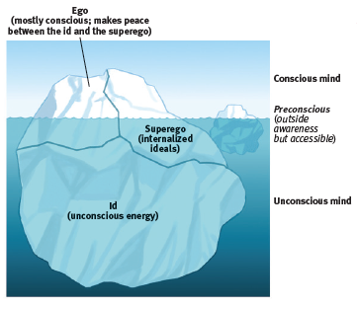
How is Freud’s view of the mind depicted?
Psychologists have used an iceberg image to illustrate Freud’s idea that the mind is mostly hidden beneath the
conscious surface.

Slide 13
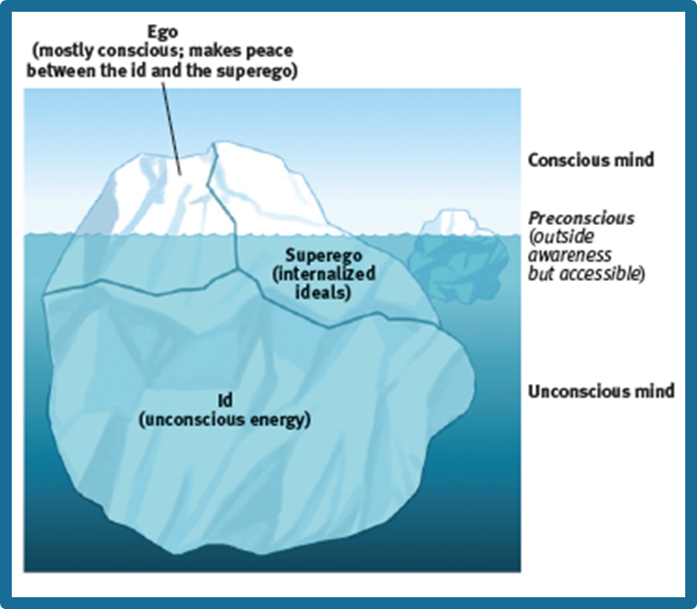
How did Freud view the mind?
Basic to Freud’s theory was his belief that the mind is mostly hidden Our conscious awareness is like the part of an iceberg that floats above the surface. Beneath this
awareness is the larger unconscious mind, with its thoughts, wishes, feelings, and memories.

Slide 14
What did Freud believe about the unconscious?
Of greater interest to Freud was the mass of
unacceptable passions and thoughts that he believed we repress, or forcibly block from our consciousness because they would be too unsettling to acknowledge.
Freud believed that without our awareness, these unconscious, troublesome feelings and ideas powerfully influence us, sometimes gaining expression in disguised forms—the work we choose, the beliefs we hold, our daily habits, our upsetting symptoms.

Slide 15
What was Freud’s belief about human personality?
Freud believed that human personality, including its emotions and desires, arises from a conflict between impulse and restraint—between our aggressive, pleasure-seeking biological urges and our internalized social controls over these urges.
Freud believed personality arises from our efforts to resolve this basic conflict—to express these impulses in ways that bring satisfaction without also bringing guilt or punishment.

Slide 16
Freud’s proposition
To understand the mind’s dynamics during this conflict, Freud proposed three interacting systems:
the id, ego, and
superego.

Slide 17
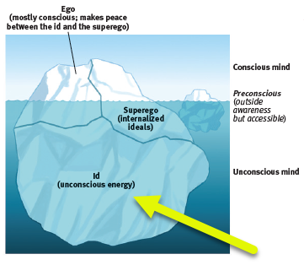
the id
a reservoir of unconscious
psychic energy that, according to Freud, strives to satisfy basic sexual and aggressive drives
The id operates on the pleasure principle, demanding immediate
gratification.

Slide 18
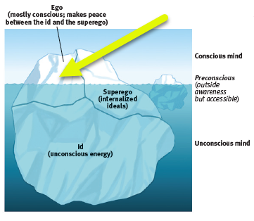
the ego
the largely conscious,
“executive” part of personality that, according to Freud, mediates among the demands of the id, superego, and reality
The ego operates on the reality principle, satisfying the id’s desires and the superego’s restraints in ways that will realistically bring pleasure rather than pain.

Slide 19
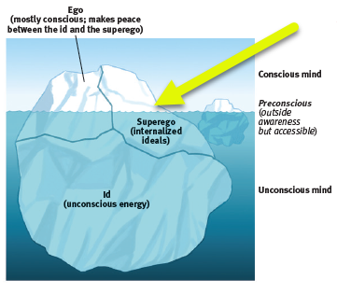
the superego
the part of personality
that, according to Freud,
represents internalized ideals and provides standards for judgment (the conscience) and for future aspirations

Slide 20
Can you name the three parts of the mind?
Give a brief explanation of the function of each part of the mind, according to Sigmund Freud.

Slide 21
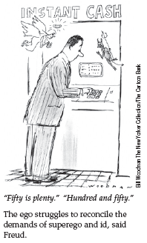
What is the role of the ego?
Because the superego’s demands often oppose the id’s, the ego struggles to reconcile the two.
The ego is the personality “executive,” mediating among the impulsive demands of the id, the restraining demands of the superego, and the real-life demands of the external world.

Slide 22
2. What Would You Answer?
The Freudian concept of the ego is
best described as
A. operating on the reality principle.
B. operating on the pleasure principle.
C. focusing solely on the morality of an issue.
D. the repression of disturbing thoughts.
E. the strive for perfection.

Slide 23
What developmental stages did Freud propose?
Freud believed that children pass through a series of psychosexual stages, during which the id’s pleasure-seeking energies focus on distinct pleasure-sensitive areas of the body called erogenous zones.

Slide 24
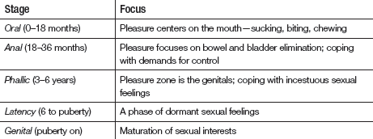

Slide 25
What is the Oedipus complex?
Freud believed that during the phallic stage, for example, boys develop both unconscious sexual desires for their mother and jealousy and hatred for their father, whom they consider a rival.
These feelings, he thought, lead boys to feel guilty and to fear punishment, perhaps by castration, from their father.
He called this collection of feelings the Oedipus complex after the Greek legend of Oedipus, who unknowingly killed his father and married his mother.

Slide 26
How did Freud believe the child reduced the threat of the Oedipus complex?
Freud believed children eventually cope with the threatening feelings of the Oedipus complex by repressing them and by identifying with (trying to become like) the rival parent.
Through this identification process, children’s superegos gain strength as they incorporate many of
their parents’ values.

Slide 27
What is the Electra complex?
Some psychoanalysts in Freud’s era believed that girls experience a parallel Electra complex (named
after a mythological plotting daughter).
As with the Oedipus complex, young girls in the phallic stage would seek to identify with their mother or step-mother in hopes of diffusing the unconscious tension.

Slide 28
forming identity
Freud believed that identification with the same-sex parent provided what psychologists now call our gender identity—our sense of being male, female, or some combination of the two.

Slide 29
What is fixation?
in psychoanalytic theory, according to Freud, a lingering focus of pleasure-seeking energies
at an earlier psychosexual stage, in
which conflicts were unresolved
In Freud’s view, conflicts unresolved during earlier psychosexual stages could surface as maladaptive behavior in the adult years.
At any point in the oral, anal, or phallic stages,
strong conflict could lock, or fixate, the person’s
pleasure-seeking energies in that stage.

Slide 30
How did Freud believe people defended themselves against anxiety?
Freud proposed that the ego protects itself with defense mechanisms —tactics that reduce
or redirect anxiety by distorting reality.

Slide 31
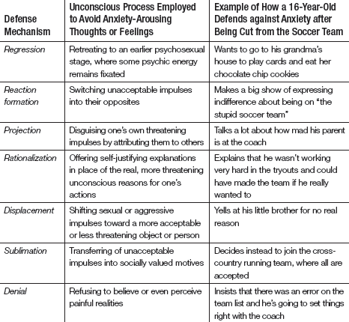

Slide 33
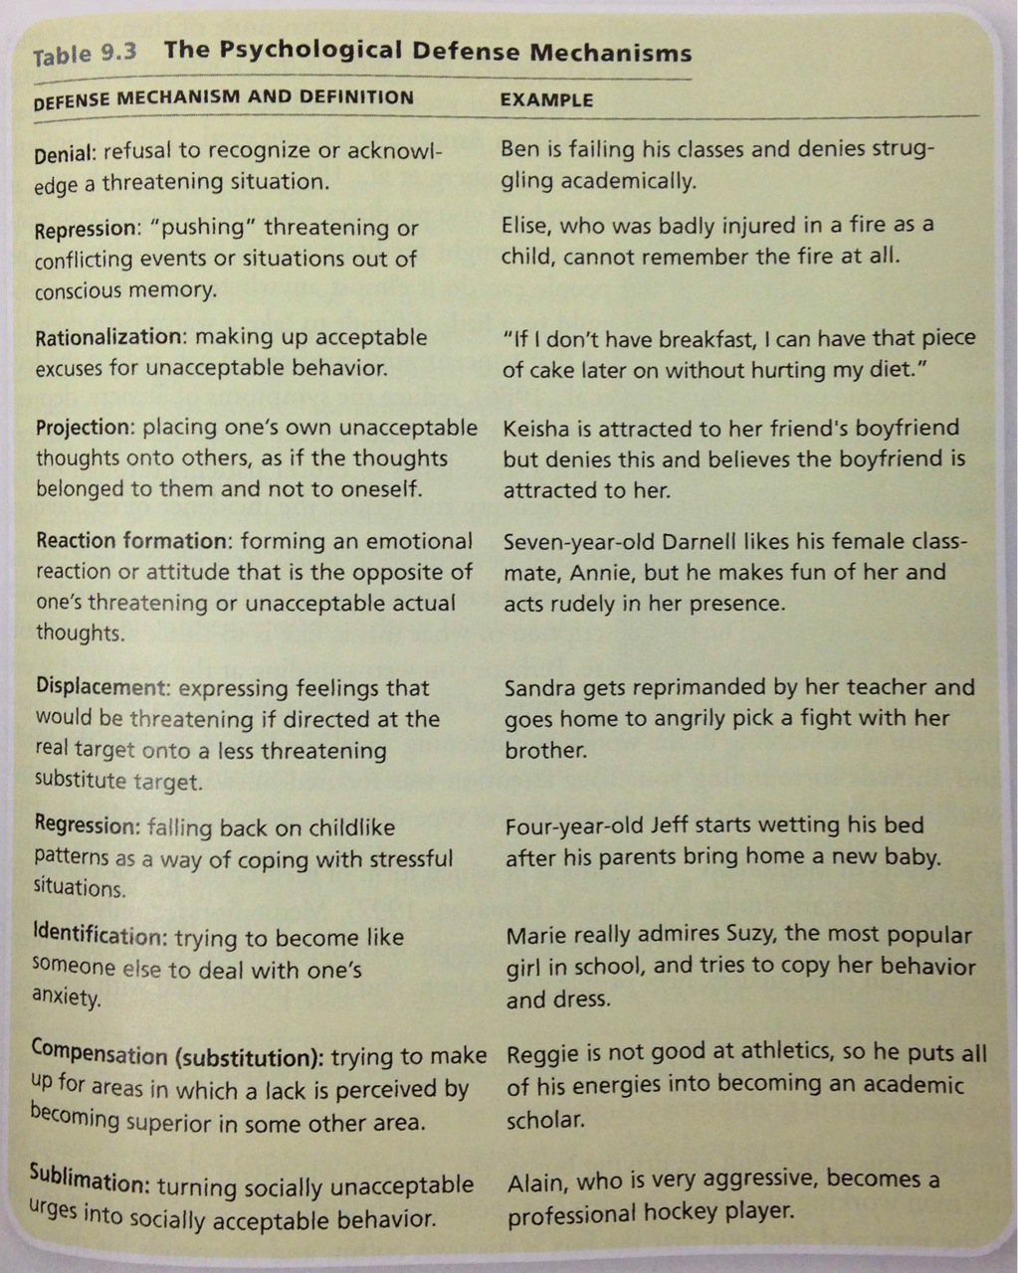

Slide 34
You have been given a speeding violation from a sheriff's deputy. First, look at the defense mechanism. Second, using this situation (during or after), provide a statement to illustrates that defense mechanism. Repeat for each.
Denial-
Projection-
Regression-
Reaction Formation-
Displacement-
Sublimation-
Rationalization-
Repression-

Slide 35
AP® Exam Tip
The differences between these defense mechanisms aren’t always clear.
For example, repression can be found in most examples.
Focus on each example’s key feature.
If the key feature is seeing your own impulse in someone else, it’s projection.
If the key feature is shifting your aggression from one
target to another, it’s displacement.

Slide 36
What are defense mechanisms and how did Freud believe they function?
In psychoanalytic theory, defense mechanisms are the ego’s protective methods of reducing anxiety by unconsciously distorting reality.
For Freud, all defense mechanisms function
indirectly and unconsciously. Just as the body unconsciously defends itself against disease, so also
does the ego unconsciously defend itself against anxiety.

Slide 37
What is repression?
in psychoanalytic theory, the basic defense
mechanism that banishes from consciousness anxiety-arousing thoughts, feelings, and memories
For example, repression banishes anxiety-arousing wishes and feelings from consciousness.
According to Freud, repression underlies all the other defense mechanisms.
However, because repression is often incomplete, repressed urges may appear as symbols in dreams or as slips of the tongue in casual conversation.

Slide 38
What are “Freudian slips?”
Freud believed he could glimpse the unconscious seeping through what we today call “Freudian slips.”
Freud also viewed jokes
as expressions of repressed sexual and aggressive tendencies.

Slide 39
Psychology Joke
A Freudian slip is when you say one thing and mean your mother.

Slide 40
What did Freud believe about dreams?
Freud viewed dreams as the
“royal road to the unconscious.”
The remembered content of dreams
(the manifest content) he believed to be a censored expression of the dreamer’s unconscious wishes
(the dream’s latent content).
In his dream analyses, Freud searched for
patients’ inner conflicts.

Slide 41
Who were the neo-Freudians?
These pioneering psychoanalysts, referred to as the neo-Freudians, adopted Freud’s interviewing techniques and accepted his basic ideas: the personality structures of id, ego, and superego; the importance of the unconscious; the childhood roots of personality; and the dynamics of anxiety and the defense mechanisms.

Slide 42
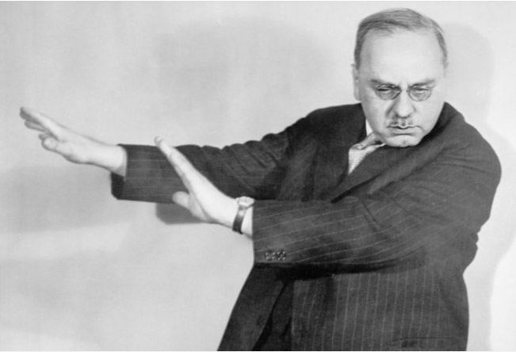
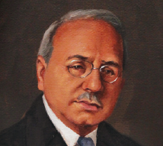
Who was Alfred Adler?
Adler (who gave us the still popular inferiority complex idea) had struggled to overcome childhood illnesses and accidents.
He believed that much of our behavior is driven by efforts to conquer childhood inferiority feelings that
trigger our strivings for superiority and power.
Alfred Adler
(1870-1937)

Slide 43
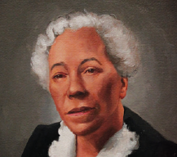
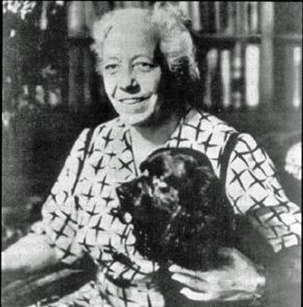
Who was Karen Horney?
Horney said childhood anxiety triggers our desire for love and security.
She also opposed Freud’s assumptions that women have weak superegos and suffer “penis envy,” and she attempted to balance his masculine bias.
Karen Horney
(1885-1952)

Slide 44
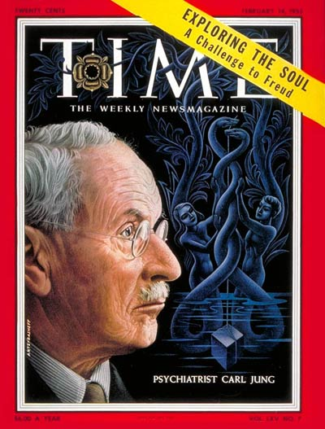
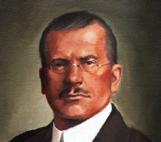
Who was Carl Jung?
Jung believed the unconscious contains more than our repressed thoughts and feelings.
He believed we also have a
collective unconscious, a common reservoir of images, or archetypes, derived from our species’
universal experiences.
Carl Jung
(1875-1961)

Slide 45
What are examples of archetypes?
The Hero and the Rebel, the Caregiver and the Innocent are among the twelve archetypes Jung believed reside within the collective unconscious of humans.
Jung thought these twelve archetypes generate deep emotions, and dominate the personality.
Carl Jung
(1875-1961)

Slide 46
What is the collective unconscious?
Jung said that the collective unconscious explains why, for many people, spiritual concerns are deeply rooted and why people in different cultures share certain myths (such as the flood myth) and images.
Most of today’s psychologists discount the idea of inherited experiences.
But they do believe that our shared evolutionary history shaped some universal dispositions, and that
experience can leave epigenetic marks affecting gene expression.

Slide 47
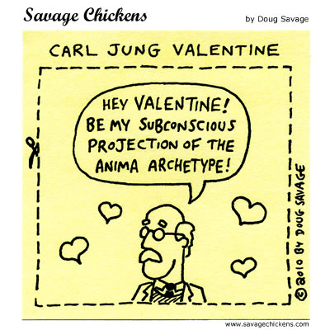

Slide 48
3. What Would You Answer?
What did Carl Jung call the shared, inherited reservoir of memory traces from our species’ history?
A. Neurosis
B. Archetypes
C. Collective unconscious
D. Inferiority complex
E. Terror management

Slide 49
What is a projective test?
a personality test that provides ambiguous images
designed to trigger projection of one’s inner dynamics
A psychologist working in the Freudian tradition would require a personality test that could provide some sort of road into the unconscious—to unearth the residue of early childhood experiences, move beneath surface thoughts, and reveal hidden conflicts and impulses.
Objective assessment tools, such as agree-disagree or true-false questionnaires, would be inadequate because they would merely tap the conscious surface.

Slide 50
What is the Thematic Apperception Test (TAT)?
a projective test in which people express their inner feelings
and interests through the stories they make up about ambiguous
scenes

Slide 51
How does the Thematic Apperception Test (TAT) work?
Shown a daydreaming boy, those who imagine he is fantasizing about an achievement are presumed to be projecting their own goals.
“As a rule,” said Henry Murray, developer of the TAT, “the subject leaves the test happily unaware that he has presented the psychologist with what amounts to an X-ray of his inner self.” (quoted by Talbot, 1999)
Numerous studies suggest that Murray was right: The TAT provides a valid and reliable map of people’s implicit motives.

Slide 52
What is the Rorschach inkblot test?
the most widely used projective test; a set of 10 inkblots, designed by
Hermann Rorschach; seeks to identify people’s inner feelings by analyzing their interpretations of the blots

Slide 53
How does the Rorschach inkblot test work?
In the Rorschach inkblot test, people tell what they see in a series of symmetrical inkblots.
Some who use this test are confident that the
interpretation of ambiguous images will reveal unconscious aspects of the test-taker’s personality.
Some clinicians cherish the Rorschach test, even offering Rorschach-based assessments of criminals’ violence potential. Others view the test as a source of suggestive leads, an icebreaker, or a revealing interview technique

Slide 54
How is the Rorschach inkblot test criticized?
Critics argue that only a few of the many Rorschach-derived scores, such as those for cognitive impairment and thought disorder, have demonstrated reliability and validity. (Mihura et al., 2013, 2015; Wood et al., 2015)
Inkblot assessments have inaccurately diagnosed many
healthy adults as pathological.
(Wood, 2003; Wood et al., 2006)
“Even seasoned professionals can be fooled by their intuitions and their faith in tools that lack strong evidence of effectiveness,” (Scott Lilienfeld, James Wood, and Howard Garb (2001, p. 47).

Slide 55
How do contemporary psychologists view Freud’s psychoanalysis?
Both Freud’s devotees and his detractors agree that recent research contradicts many of his specific ideas.
Today’s developmental psychologists see our development as lifelong, not fixed in childhood. They doubt that infants’ neural networks are mature enough
to sustain as much emotional trauma as Freud assumed.
Some think Freud overestimated parental influence and underestimated peer influence.

Slide 56
How do Freud’s theories fall short?
Psychologists further criticize Freud’s theory for its scientific shortcomings.
Recall from Module 5 that good scientific theories explain observations and offer testable hypotheses.
Freud’s theory rests on few objective observations, and parts of it offer few testable hypotheses.
For Freud, his own recollections and interpretations of patients’ free associations, dreams, and slips—sometimes selected to support his theory—were evidence enough.

Slide 57
What is the most serious problem with Freud’s theory?
It offers after-the-fact explanations of any characteristic (of one person’s smoking, another’s fear of horses, another’s sexual orientation), yet fails to predict such behaviors and traits.
A good theory makes testable predictions.
For example, If you feel angry at your mother’s death, you illustrate Freud’s theory because “your unresolved childhood dependency needs are threatened.”
If you do not feel angry, you again illustrate his theory because “you are repressing your anger.”

Slide 58
How do Freud’s supporters respond?
Freud’s supporters object to the criticism.
To criticize Freudian theory for not making testable predictions is, they say, like criticizing baseball for not being an aerobic exercise—something it was never intended to be.
Freud never claimed that psychoanalysis
was predictive science.
He merely claimed that, looking back, psychoanalysts could find meaning in our state of mind.
(Rieff, 1979)

Slide 59
How has Freud’s idea of reaction formation been supported in the research?
One study demonstrated the defense mechanism reaction formation (trading unacceptable impulses for their opposite) in men who reported strong antigay attitudes.
Compared with those who did not report such attitudes, these antigay men experienced greater arousal when watching videos of homosexual men having sex. (Adams et al., 1996)
Likewise, some evidence suggests that people who unconsciously identify as homosexual—but who consciously identify as straight—report more negative
attitudes toward gays. (Weinstein et al., 2012)

Slide 60
How might Freud’s theories have been correct?
Research has supported Freud’s idea that we unconsciously defend ourselves against anxiety. Researchers have proposed that one source of anxiety is “the terror resulting from our awareness of vulnerability and death” (Greenberg et al., 1997).
Nearly 300 experiments testing terror-management theory show that thinking about one’s
mortality— for example, by writing a short essay on dying and its associated emotions—provokes
various terror-management defenses.
(Burke et al., 2010)

Slide 61
What are terror-management defenses?
Death anxiety increases terror-management defenses such as aggression toward rivals and esteem for oneself.
(Cohen & Solomon, 2011; Koole et al., 2006)
Faced with a threatening world, people act not only to enhance their self-esteem but also to adhere more strongly to worldviews that answer questions about life’s meaning.
(Norenzayan & Hansen, 2006)

Slide 62
What is terror-management theory?
a theory of death-related anxiety;
explores people’s emotional and
behavioral responses to reminders of their impending death

Slide 63
Was Freud right about the unconscious?
Freud was right about a big idea that underlies today’s psychodynamic thinking: We have
limited access to all that goes on in our mind.
(Erdelyi, 1985, 1988, 2006; Norman, 2010)
Our two-track mind has a vast out-of-sight realm.
Some researchers even argue that “most of a person’s everyday life is determined by
unconscious thought processes.”
(Bargh & Chartrand, 1999)

Slide 64
Learning Targets
Module 56
56-1 Describe how humanistic psychologists viewed personality, and explain their goal in studying personality.
56-2 Explain how humanistic psychologists assessed a person’s sense of self.
Humanistic Theories
56-3 Describe how humanistic theories have influenced psychology, and discuss the criticisms they have faced.

Slide 65
How did humanistic psychologists view personality?
Two pioneering theorists—
Abraham Maslow and Carl Rogers offered a third-force perspective that emphasized human potential.
In contrast to Sigmund Freud’s emphasis on disorders born out of dark conflicts, these humanistic theories emphasized the ways people strive
for self-determination and self-realization.
In contrast to behaviorism’s scientific objectivity,
humanists studied people through their own self-reported experiences and feelings.

Slide 66
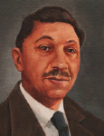
What were Abraham Maslow’s beliefs?
“Any theory of
motivation that is worthy of attention must deal with the highest capacities
of the healthy and strong person as well as with the defensive maneuvers
of crippled spirits”
(Motivation and
Personality, 1970, p. 33)
Abraham Maslow
(1908 – 1970)

Slide 67
What is a hierarchy of needs?
Maslow’s hierarchy of needs begins at the base with physiological needs that must first be satisfied before higher level safety needs and then psychological needs are addressed.

Slide 68
Can you label the levels?
Test yourself to see if you understand Maslow’s hierarchy of needs.
Think of an example that helps explain the challenge at each level.

Slide 69
What is the progression of needs on the hierarchy of needs?
If our physiological needs are met, we become concerned with personal safety.
If we achieve a sense of security, we then seek to love, to be loved, and to love ourselves.
With our love needs satisfied, we seek self-esteem.
Having achieved self-esteem, we ultimately seek self-actualization (the process of fulfilling our potential) and self-transcendence (meaning, purpose, and identity beyond the self).

Slide 70
Applying what you have learned.
Explain how Maslow’s hierarchy relates to humanist personality theory.
How might the personality of someone focused on physiological needs differ from one focused on self-actualization, for example?

Slide 71
How did Carl Rogers view personality development?
Fellow humanistic psychologist Carl Rogers agreed with much of Maslow’s thinking.
Rogers’ person-centered perspective held that people are basically good and are endowed with self-actualizing tendencies.
Particularly in a growth-promoting social climate, people are free to pursue their needs.

Slide 72
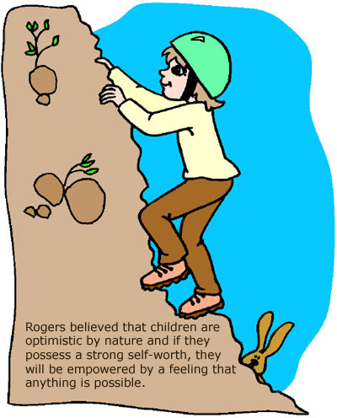

Slide 73
What does a growth-promoting social climate consist of?
acceptance
When people are accepting, they offer unconditional positive regard, an
attitude of grace that values us even knowing our failings.
genuineness
When people are genuine, they are open with their own feelings, drop their
facades, and are transparent and self-disclosing.
empathy
When people are empathic, they share and mirror other’s feelings and reflect
their meanings.

Slide 74
What is unconditional positive regard?
a caring, accepting, nonjudgmental
attitude, which Carl Rogers
believed would help people
develop self-awareness and
self-acceptance

Slide 75
Think about it.
Have you had someone in your life who accepted you unconditionally?
Do you think this person helped you to know
yourself better and to develop a better image of yourself?
Talk about it with a classmate.

Slide 76
What is self-concept?
all our thoughts and feelings about ourselves, in
answer to the question, “Who am I?”
For Rogers and Maslow, a central feature of personality
is one’s self-concept.
If our self-concept is positive, we tend to act and perceive the world positively.
If it is negative—if in our own eyes we fall far short of our ideal self— said Rogers, we feel dissatisfied and unhappy.

Slide 77
How did humanistic psychologists assess a person’s sense of self?
Humanistic psychologists sometimes assessed personality by asking people to fill out
questionnaires that would evaluate their self-concept. One questionnaire, inspired by
Carl Rogers, asked people to describe themselves both as they would ideally like to be and
as they actually are.
When the ideal and the actual self are nearly alike, said Rogers, the self-concept is positive.

Slide 78
1. What Would You Answer?
Adolescents are struggling to form their identity and determine who they are. Abraham Maslow and Carl Rogers would explain that adolescents are searching to discover their
A. self-transcendence.
B. self-actualization.
C. self-esteem.
D. self-worth.
E. self-concept.

Slide 79
How have humanistic theories influenced psychology?
Maslow’s and Rogers’ ideas have influenced counseling, education, child raising, and management.
The humanists laid the groundwork for today’s scientific positive psychology subfield and help renewed interest in the concept of the self.

Slide 80
What criticisms have humanists faced?
First, said the critics, its concepts are vague and subjective. Consider Maslow’s description of
self-actualizing people as open, spontaneous, loving, self-accepting, and productive.
Is this a scientific description?
Or is it merely a description of the theorist’s own values and ideals?

Slide 81
What criticisms have humanists faced? Cont.
First, said the critics, its concepts are vague and subjective. Consider Maslow’s description of
self-actualizing people as open, spontaneous, loving, self-accepting, and productive.
Is this a scientific description?
Or is it merely a description of the theorist’s own values and ideals?

Slide 82
What is another criticism of humanist theories?
Critics also objected to the idea that, as Rogers put it, “The only question which matters is, ‘Am I living in a way which is deeply satisfying to me, and which truly expresses me?’”
This emphasis on individualism—trusting and acting on one’s feelings, being true to oneself, fulfilling oneself—could lead to self-indulgence, selfishness, and an erosion of moral restraint.
(Campbell & Specht, 1985; Wallach & Wallach, 1983)

Slide 83
What is a final criticism of humanist theories?
A final accusation leveled against humanistic psychology is that it is naive—that it fails to
appreciate the reality of our human capacity for evil Faced with climate change, overpopulation, terrorism, and the spread of nuclear weapons, we may become apathetic because we either believe everything will just work out or everything is hopeless.
Humanistic psychology, say the critics, encourages the needed hope but not the equally necessary realism.

Slide 84
2. What Would You Answer?
As a new student, Canya is hoping to fit in. If the
students at her new school were embracing the
ideas of Carl Rogers, how would each of these principles affect how they treat Canya?
acceptance
genuineness
empathy

Slide 85
Learning Targets
Module 57
57-1 Explain how psychologists use traits to describe personality.
57-2 Discuss some common misunderstandings about introversion.
57-3 Describe personality inventories, and discuss their strengths and weaknesses as trait assessment tools.
Trait Theories
57-4 Identify the traits that seem to provide the most useful information about personality variation.
57-5 Discuss whether research supports the consistency of personality traits over time and across situations.

Slide 86
How well do you know yourself?
If asked, what would you say are your top ten personality traits?
List them and share with a partner.

Slide 87
What is a trait?
a characteristic pattern
of behavior or a disposition to
feel and act in certain ways, as
assessed by self-report inventories
and peer reports
So, are you logical? Emotional? Solid? Unreliable? Hilarious? Moody?

Slide 88
1. What Would You Answer?
Which of the following is the best term or phrase for a characteristic pattern of behavior or a disposition to feel and act?
A. Myers-Briggs indicator
B. Factor analysis
C. Introversion
D. Extroversion
E. Trait

Slide 89
How do psychologists use traits to describe personality?
Trait theorists such as Gordon Allport, Isabelle Briggs-Myers and her mother Katherine Briggs were concerned less with explaining individual traits than with describing them.
Tests designed to sort people into personality types, such as the Myers-Briggs Type Indicator (MBTI), have been used in business and career counseling, but may have outlived their validity.

Slide 90
What are the limitations of relying on traits to classify individuals?
Classifying people as one or another distinct personality type fails to capture their full individuality.
We are each a unique complex of multiple traits.
Instead, by placing people on several trait
dimensions simultaneously, psychologists can describe countless individual personality
variations.

Slide 91
What are two possible dimensions on which to place people?
British psychologists Hans Eysenck and Sybil Eysenck believed that we can reduce many of our normal individual variations to two dimensions: extraversion–introversion
and emotional stability–instability.

Slide 92
How has the idea been tested?
People in 35 countries around the world, from China to Uganda to Russia, have taken the Eysenck Personality Questionnaire.
When their answers were analyzed, the extraversion and emotionality factors inevitably emerged as basic personality dimensions. (Eysenck, 1990, 1992)

Slide 93
What is introversion?
For example, an introverted person may attend a party along with an extraverted person and have a great time. When the party is over, the introvert goes home and puts their feet up. The extravert wants to keep the party going!

Slide 94
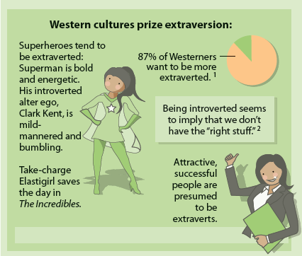
What makes an extravert?
Just because someone is successful, fun or talks a lot around others, don’t assume they are extraverted.
They may be an introvert that is using all of their energy toward that event… later they will want to reduce the stimulation.

Slide 95
What is a personality inventory?
an objective questionnaire (often with true-false
or agree-disagree items) on which
people respond to items designed
to gauge a wide range of feelings
and behaviors; used to assess
selected personality traits
The classic personality inventory is the Minnesota Multiphasic Personality Inventory (MMPI).

Slide 96
What is the Minnesota Multiphasic Personality Inventory (MMPI)?
the most widely researched and clinically
used of all objective personality tests
The MMPI was originally developed to identify emotional disorders (still considered its most appropriate use), it is also used in employment situations to assess personality characteristics

Slide 97
How is the MMPI designed?
Over 500 empirically derived self-report T/F questions such as “Nothing in the newspaper interests me except the comics” are asked.
Answers are then compared to answers given by people diagnosed with depression, schizophrenia, antisocial personality disorder and other disorders.
The more similar the respondents answers are to those clinically diagnosed, the more indication exists that the person may be suffering a disorder.

Slide 98
What is an empirically-derived test?
a test such as the Minnesota Multiphasic Personality Inventory (MMPI) created by
selecting from a pool of items those
that discriminate between groups
Personality inventories are scored objectively.
Objectivity does not, however, guarantee validity.

Slide 99
What are the scales on the MMPI?
The researchers grouped the questions into 10 clinical scales, including scales that assess depressive tendencies, masculinity–femininity (how rigidly one conforms to gender stereotypes), and introversion–extraversion.
Today’s MMPI-2 has additional scales that assess work attitudes, family problems, and anger.

Slide 100
Which traits provide useful information about personality variation?
Today’s trait researchers believe that simple trait factors, such as the Eysencks’ introversion–
extraversion and stability–instability dimensions, are important, but they do not tell the whole story.
A slightly expanded set of factors developed by Robert McCrae and Paul Costa—dubbed the Big Five—does a better job. (Costa & McCrae, 2011)

Slide 101
What are the Big Five personality factors?
Around the world-across 56 nations and 29 languages in one study-people describe others in terms roughly consistent with this list.
(Schmitt et al., 2007)

Slide 102
What is conscientiousness?
Highly conscientious individuals tend to be highly organized with great attention to detail. They are also goal-oriented and driven to succeed.

Slide 103
What is agreeableness?
People high in agreeableness are cooperative, empathetic and caring. They enjoy helping and being part of a group.

Slide 104
What is neuroticism?
People high in neuroticism experience mood swings and are often irritable. They worry about many things and get upset and anxious easily.

Slide 105
What is openness?
People high in openness are creative and adventurous. They enjoy trying new things and taking on new challenges.

Slide 106
What is extraversion?
People high in extraversion are outgoing and gain energy from being with others. They like to meet new people, start conversations and have a wide variety of friendships.

Slide 107
Where do you fall?
Write down your scores on the 10 questions above.

Slide 108
Now score yourself
Consider your results. How well do they align with how you see yourself?

Slide 109
What are the Big Five personality factors?

Slide 110
Thinking critically.
Before trying the self-assessment where would you have placed yourself on the Big Five personality dimensions?
Where might your family and friends place you?
Did the actual results surprise you, and do you think these results would surprise them?
Share with your partner.

Slide 111
2. What Would You Answer?
Jayne refuses to cheat on an exam that many of her friends have shown her copies of. Jayne would rank high on the Big Five trait of
A. conscientiousness.
B. agreeableness.
C. openness.
D. extraversion.
E. neuroticism.

Slide 112
What are the Big Five personality factors?

Slide 113
Are personality traits consistent over time?
In some ways, our personality seems stable.
Cheerful, friendly children tend to become cheerful, friendly adults.
But it’s also true that a fun-loving jokester can suddenly turn serious and respectful at a job interview.
New situations and major life events can shift the personality traits we express.

Slide 114
What is the person-situation controversy?
Our behavior is influenced by the interaction of our inner disposition with our environment.
Still, the question lingers: Which is more important? When we explore this person-situation
controversy, we look for genuine personality traits that persist over time and across situations.
Are some people dependably conscientious and others unreliable, some cheerful and others dour, some friendly and outgoing and others shy?
If we are to consider friendliness a trait, friendly people must act friendly at different times and places. Do they?

Slide 115
Is personality stable?
With age, personality traits become more stable, as reflected in the stronger correlation of trait scores with follow-up scores 7 years later.
(Data from Roberts & DelVecchio, 2000.)

Slide 116
Do traits = behaviors?
Although our personality traits may be both stable and
strong, the consistency of our specific behaviors from one situation to the next is another matter.

Slide 117
When do environments limit or encourage expression of traits?
In unfamiliar, formal situations—perhaps as a guest in the home of a person from another culture—our traits remain hidden as we carefully attend to social cues. In familiar, informal situations—just hanging out with friends—we feel less constrained, allowing our traits to emerge. (Buss, 1989)

Slide 118
How does the research apply to you?
How do think your own personality traits shine through in your music preferences, communication style, online presence and personal spaces?
Can you recall a recent time in which the situation you were in definitely constrained your usual behavior?
Share with a classmate.

Slide 119
Learning Targets
Module 58
58-1 Describe how social-cognitive theorists view personality development and how they explore behavior.
58-2 Discuss the criticisms social-cognitive theorists have faced.
Social-Cognitive Theories

Slide 120
Applying the theories.
Can you think of a recent situation in which your personality led you to react differently than did some classmates who experienced the same event?
Talk about it with your class.

Slide 121
What is the social-cognitive perspective?
views behavior as influenced by the interaction between people’s traits (including their thinking)
and their social context
Much as nature and nurture always work together, so do individuals and their situations.

Slide 122
What is the behavioral approach?
focuses on the effects of learning on our
personality development
We are conditioned to repeat certain behaviors, and we learn by observing and imitating others.
For example, a child with a very controlling parent may learn to follow orders rather than think independently, and may exhibit a more timid personality.

Slide 123
How do the two approaches relate?
Social-cognitive theorists do consider the behavioral perspective, believing that we learn many of our behaviors either through conditioning or by observing and imitating others.
They also emphasize the importance of mental processes: What we think about a situation affects our resulting behavior.
Instead of focusing solely on how our environment controls us, as behaviorists do, social-cognitive
theorists focus on how we and our environment interact.

Slide 124
What is reciprocal determinism?
the interacting influences of behavior, internal
cognition, and environment

Slide 125
How does reciprocal determinism explain personality development?
Albert Bandura proposes that our personalities are shaped by the interaction of our personal traits (including our thoughts and feelings), our environment, and our behaviors.

Slide 126
Check your understanding.
Choose a personality trait such as the one pictured above and identify how each of the three parts of reciprocal determinism interact and influence each of the others.

Slide 127
What are three specific ways in which individuals and environments interact?
Different people choose different environments.
…the reading you do, the shows you watch, the music you listen to…
Our personalities shape how we interpret and react .
If we perceive the world as threatening, we watch for threats and prepare to defend ourselves.
Our personalities create situations to which we react.
How we view and treat
people influences how they then treat us.

Slide 128
biopsychosocial approach
As with other psychological phenomena, personality is
fruitfully studied at multiple levels.

Slide 129
What is the gene-environment interaction?
In addition to the interaction of internal personal factors, the environment, and our behaviors, we also experience gene-environment interaction.
Our genetically influenced traits evoke certain responses from others, which may nudge us in one direction or another.
In one study, those with the interacting factors of
(1) having a specific gene associated with aggression, plus (2) being raised in a difficult environment were most
likely to demonstrate adult antisocial behavior.
(Caspi et al., 2002)

Slide 130
What are the influences on personality?
In such ways, we are both the products and the architects of our environments: Behavior emerges from the interplay of external and internal influences. Boiling water turns an egg hard and a potato soft. A threatening environment turns one person into a hero, another into a scoundrel.

Slide 131
What criticisms have social-cognitive theorists faced?
Critics charge that social-cognitive theories focus so much on the situation that they fail to appreciate the person’s inner traits.
Where is the person in this view of personality, ask
the dissenters, and where are human emotions?
Social-cognitive theorists have also been faulted for underemphasizing the importance of unconscious motives, emotions, and biologically influenced traits.

Slide 132
What Would You Answer?
Heidi is an exceptionally avid reader of books.
Explain how Heidi’s desire to read is supported by
the following elements of reciprocal determinism:
Internal factors
Environmental factors
Behavioral factors

Slide 133
Learning Targets
Module 59
59-1 Explain why psychology has generated so much research on the self, and discuss the importance of self-esteem to our well-being.
59-2 Describe how excessive optimism, blindness to one’s own incompetence, and self-serving bias reveal the costs of self-esteem, and explain how defensive and secure self-esteem differ.
Exploring the Self
59-3 Discuss how individualist and collectivist cultures differ in their values and goals.

Slide 134
Why has psychology generated so much research on the self?
Psychology’s concern with our sense of self dates back at least to William James, who devoted more than 100 pages of his 1890 Principles of Psychology to the topic.
By 1943, Gordon Allport lamented that the
self had become “lost to view.”
Although humanistic psychology’s later emphasis on the self did not instigate much scientific research, it did help renew the concept of self and keep it alive.

Slide 135
Where are we today?
Now, more than a century after James, the self is one of Western psychology’s most vigorously researched topics.
Every year, new studies galore appear on self-esteem, self-disclosure, self-awareness, self-schemas, self-monitoring, and more.

Slide 136
Where is the self located in the brain?
Neuroscientists have searched for the self, by identifying a central frontal lobe region that activates when people respond to self-reflective questions about their traits and dispositions.
(Damasio, 2010; Mitchell, 2009; Pauly et al., 2013)

Slide 137
So, what is the self?
in contemporary psychology, assumed to be the center of personality, the organizer of our
thoughts, feelings, and actions
The self answers the question: “Who Am I?”

Slide 138
What are possible selves?
Possible selves include your visions of the self you dream of becoming- the rich self, the successful self- and the self you fear becoming – the lonely self, the failed self.
Pretend play lets children imagine possible selves.

Slide 139
What is the spotlight effect?
Our self-focused perspective may motivate us, but it can also lead us to presume too readily
that others are noticing and evaluating us.
overestimating
others’ noticing and evaluating
our appearance, performance,
and blunders
(as if we presume a spotlight shines on us)

Slide 140
What research has been conducted on the spotlight effect?
One study had Cornell University students don T-shirts featuring soft-rock singer Barry Manilow before entering a room with other students.
(Gilovich, 1996)
The T-shirt wearers guessed that nearly half their peers would take note of the shirt as they walked in.

Slide 141
What were the results of the study?
In reality, only 23 percent of the students’ classmates noticed the Barry Manilow shirt.
The point to remember: We stand out less than we
imagine, even with dorky clothes and bad hair.
(Gilovich & Savitsky, 1999;
Savitsky et al., 2001)

Slide 142
What are self-esteem and self-efficacy?
self-esteem
self-efficacy
one’s feelings of high or low self-worth
one’s sense of competence and effectiveness
Self-esteem is how we feel about our self – if we like our self, if we think we’re kinda cool, or if we don’t like our self and feel like we don’t really matter.
Self-efficacy is our belief about our ability to do something…pass a hard math test, construct a cabinet, take care of someone else.

Slide 143
1. What Would You Answer?
Which of the following is an example of
self-efficacy?
A. Manuela believes others are always watching her.
B. Abraham believes he is a good person.
C. Rasheed has placed in skating competitions, which
makes him believe that he is a competent skater.
D. Saundra believes it rained because she’s been wishing for rain for days.
E. Igor maintains his optimism despite doing poorly in
his math class.

Slide 144
What are the benefits of high self-esteem?
People who feel good about themselves have fewer sleepless nights.
People who have high self-esteem succumb less easily to pressures to conform.
People with high self-esteem are more persistent at difficult tasks.

Slide 145
What are the effects of low self-esteem?
Those who are negative about themselves have tended to be oversensitive and judgmental. (Baumgardner et
al., 1989; Pelham, 1993)

Slide 146
What is the drawback to excessive optimism?
Excessive optimism can blind us to real risks.
(Tenney et al., 2015)
More than 1000 studies have shown how our natural positive thinking bias can promote “an unrealistic
optimism about future life events”
(Shepperd et al., 2015; Weinstein, 1980).

Slide 147
What does it mean to be blind to one’s own incompetence?
People often are most overconfident when most incompetent.
That, said Justin Kruger and David Dunning (1999), is because it often takes competence to recognize competence.
This “ignorance of one’s own incompetence” phenomenon—now called the Dunning-Kruger effect—can produce overconfidence.

Slide 148
Which one sounds like you?
Imagine dashing to class, hoping not to miss the first few minutes. But you arrive five minutes
late, huffing and puffing. As you sink into your seat, what sorts of thoughts go through
your mind?
Do you go through a negative door, thinking “I’m such a loser”?
Or do you go through a positive door, telling yourself “I really tried to get here on time”?

Slide 149
What is a self-serving bias?
Personality psychologists have found that most people choose the second “positive” door, which
leads to positive self-thoughts.
We have a good reputation
with ourselves.
a readiness to
perceive oneself favorably

Slide 150
People accept more responsibility for good deeds than for bad, and for successes than for failures.
Athletes often privately credit their victories to their own prowess, and their losses to bad breaks, lousy officiating, or the other team’s exceptional performance.
Most students who receive poor test grades criticize the test or the teacher, not themselves.
Drivers filling out insurance forms have explained their accidents in such words as “A pedestrian hit me and went under my car.”

Slide 151
2. What Would You Answer?
Karl was late to his interview because he left the house late and did not use his GPS for directions.
If Karl is making use of the self-serving bias, what might he say to explain his lateness?
Talk about your answer before moving to the next slide.
_________
First, come up with your own answer.
Next, on the next slide, choose the statement that best matches what you believe Karl might say.

Slide 152
3. What Would You Answer?
A. “I thought I knew where I was going, but I got lost.”
B. “I spent too much time trying to find a tie that
matched this shirt.”
C. “My GPS told me to turn left when I should have
turned right.”
D. “I am usually right in predicting how long it takes me
to get places, but today there was more traffic than I anticipated.”
E. “Sometimes I procrastinate and do not leave enough
time to get places.”

Slide 153
Most people see themselves as better than average.
In several studies, 90% of business managers and more than 90% of college professors also rated their performance as superior to that of their average peer.
In Australia, 86% of people rate their job performance as above average, and only 1% as below average.
In the U.S. National Survey of Families and Households, 49% of men said they provided half or more of the child care, though only 31% of their wives or partners
saw things that way. (Galinsky et al., 2008)

Slide 154
Explain the cartoon.
In this Peanuts comic strip, how does Lucy illustrate the self-serving bias?

Slide 155
What is narcissism?
excessive self-love and self-absorption
People with a narcissistic personality tend to be materialistic, desire fame, have inflated expectations, hook up more often without commitment, and gamble and cheat more—all of which have been increasing as narcissism has increased.

Slide 156
What are some negative effects of narcissism?
Narcissistic people (more often men) forgive others less, take a game-playing approach to their romantic relationships, and engage in sexually forceful behavior. (Blinkhorn et al., 2015; Bushman et al., 2003; Grijalva et al., 2015)
Narcissists crave adulation, are active on social media, and often become enraged when criticized.
(Geukes et al., 2016; Krizan & Johar, 2015; McCain & Campbell, 2017)
Conceited, self-important individuals turn nasty toward those who puncture their bubbles of self-love.
(Baumeister, 2001)

Slide 157
What is the difference between secure self-esteem and defensive self-esteem?
Secure self-esteem
Defensive self-esteem
Sense of self is less contingent on external evaluations.
To feel accepted for who we are, and not for our looks, wealth, or acclaim, relieves pressures to
succeed and enables us to focus beyond ourselves.
The focus is on sustaining itself, which makes failure and criticism feel threatening.
Defensive people may respond to such perceived threats with anger or aggression. (Crocker & Park, 2004; Donnellan et al., 2005)

Slide 158
What factors contribute to your identity?
Imagine that someone ripped away your social connections, making you a solitary refugee
in a foreign land.
How much of your identity would remain intact?
Discuss with your classmate.

Slide 159
What is the difference between individualism and collectivism?
individualism
collectivism
giving priority to one’s own goals over group goals and defining one’s identity in terms of personal attributes rather
than group identifications
giving priority to
the goals of one’s group (often one’s extended family or work group) and defining one’s identity
accordingly

Slide 160
What characterizes an individualist culture?
Individualists have an independent sense of “me,” and an awareness of their unique personal convictions and values. Individualists prioritize personal goals. They define their identity mostly in terms of personal traits. They
strive for personal control and individual achievement.

Slide 161
How are Americans’ individualistic tendencies reflected in baby names?
In recent years, the percentage of American babies receiving one of that year’s 10 most common
names has plunged.
(Data from Twenge et al., 2010, 2016.)

Slide 162
What characterizes a collectivist culture?
Group identifications provide a sense of belonging, a set of values, and an assurance of security.
Collectivists have deep attachments to their groups—their family, clan, or company.
Elders receive respect.

Slide 163
How might collectivist cultures respond to disaster?
Japan’s collectivist values, including duty to others and social harmony, were on display after the devastating 2011
earthquake and tsunami.
Virtually no looting was reported, and residents remained orderly, as shown above waiting for drinking water.

Slide 164
What are some value contrasts between individualism and collectivism?

Slide 165
Kurt Lewin
Kurt Lewin explained that when something attracts us, we approach it; when something frightens us, we try to avoid it.
Lewin showed how different combination of these tendencies (approach or avoidance) create three basic types of conflict.

Slide 166
Approach/Approach Conflict
Approach/Approach Conflict- is the result of simultaneous attraction to two appealing possibilities, neither of which has any negative quality.
Ex: job-seeker offered two intriguing jobs, two attractive homes in a desired area, choosing between desserts
Stress arises from give up one desirable option for another.

Slide 167
Avoidance/Avoidance Conflict
Avoidance/Avoidance Conflict- is the result of facing a choice between two undesirable possibilities. Neither of which has any positive qualities.
Ex: caught in a rundown, caught between a rock and a hard place, choice of punishment, risky surgery or live with back pain
Conflict arises from having to choose “the lesser of two evils” or waiting for the conflict to solve itself.

Slide 168
Approach/Avoidance Conflict
Approach/Avoidance Conflict- is the result of being simultaneously attracted to and repelled by the same goal.
Ex: one person wants to continue the relationship (approach), but is wary of making a life-long commitment (avoidance)
Ex: person pursuing a captain or president position for their team or club (approach), but is wary of the amount of responsibility (avoidance)
Ex: Leaving home for college?

Slide 169
Provide a personal or potential situation that illustrates each of the following conflicts:
Approach/Approach Conflict
Avoidance/Avoidance Conflict
Approach/Avoidance Conflict

Slide 170
4. What Would You Answer?
Which of the following is most likely to be true of a person from an individualist culture?
A. His behavior would be a reflection of his personality
and attitudes.
B. He would chose a career based on the needs of his
community.
C. He would view his life task as fitting in and
maintaining connections.
D. He would strive to develop a few close and enduring
relationships.
E. He would focus on his duty to his family.

Slide 171
Applying the theories.
In which type of culture were you raised?
Collectivist or individualist?
Do you fit completely in either category, or are you
sometimes a collectivist and sometimes an individualist?
How much of your response is impacted by nature? How much by nurture?

Slide 172
Why are assessment centers the best predictor of personality and behavior?
Assessment centers, where simulations are created to test people’s responses to stress, crisis, etc.. exploit the principle that the best means of
predicting behavior is neither a personality test
nor an interviewer’s intuition.
Rather, the best predictor of future behavior
is the person’s past behavior patterns in similar situations.
(Lyons et al., 2011; Mischel, 1981; Schmidt & Hunter, 1998)

