Slide 1
Body Organization Cells, structures, and tissuE
DHO 8
Chapter 7
7:1
2018-2019

Slide 2
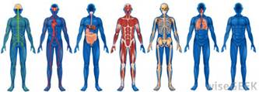
7:1 Basic Structure of the Human Body
The normal function of the human body is compared to an organized machine
If the machine malfunctions, disease occurs
Anatomy: study of form and structure
Physiology: study of processes
Pathophysiology: study of how disease occurs and body’s response

Slide 3
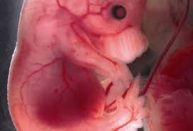
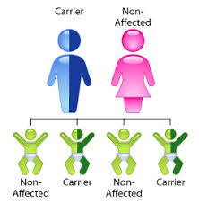
7:1 Basic Structure of the Human Body
Different types of diseases include:
Congenital=acquired during development of the infant in the uterus (cleft lip, spina bifida)
Inherited=transmitted from parents to child genetically (hemophilia, Down syndrome)

Slide 4
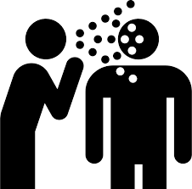
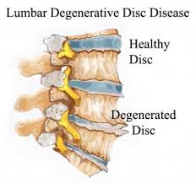
7:1 Basic Structure of the Human Body
Infectious=caused by a pathogenic organism such as a bacteria or virus (cold, STD)
Degenerative=caused by deterioration of the function/structure of body tissues & organs either by normal aging or lifestyle choices (COPD, osteoarthritis)

Slide 5
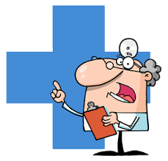
7:1 Basic Structure of the Human Body
Other terms associated with disease:
Diagnosis=identifying the disease or stating what it is
Etiology=cause of the disease
Idiopathic=unkown
Prognosis=prediction of the probable course and/or the expected outcome of the disease

Slide 6
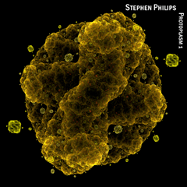
Protoplasm
Basic substance of life
Made of ordinary elements (carbon, oxygen, hydrogen, sulfur, nitrogen, phosphorus)
Scientists can combine these elements, but not create life

Slide 7
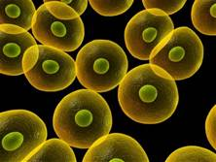
Cells
Made of protoplasm which forms the basic structure and function of all living things
The CELL: Microscopic structures
Carry on all functions of life (food and oxygen, produce heat and energy, eliminate waste)
Body contains trillions of cells
Vary in shape and size
Perform different functions

Slide 8
Basic Parts of Cells
Cell membrane-outer protective cover and semipermiable
Cytoplasm-semifluid in the cell but outside the nucleus
Organelles-cell structures that help it function and located in cytoplasm
Nucleus-brain of the cell
Nucleolus-located inside the nucleus and important for cell reproduction
Chromatin-located in the nucleus and made of DNA and protein; forms chromosomes during cell reproduction

Slide 9
Basic Parts of Cells
Mitochondria-powerhouses of the cell; breakdown carbs, protein, fat to make ATP (energy source of cell)
Golgi apparatus-produces, stores, and packages secretions for discharge from cell
Endoplasmic reticulum-allows for transport of materials in and out of cell
Vacuoles-stores food or waste
Lysosomes-contain digestive enzymes for old cells, bacteria, and foreign materials

Slide 10
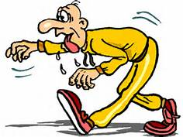
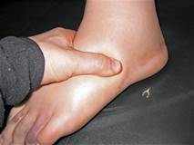
Tissues
Cells of same type joined together form tissue
Tissues are 60%–99% water
This water is slightly salty and is called tissue fluid
Not enough tissue fluid=dehydration
Too much tissue fluid=edema

Slide 11
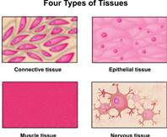
Tissues
4 main groups of tissues
Epithelial
Connective
Nerve
Muscle

Slide 12
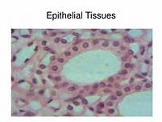
Types of Tissues
Epithelial tissue:
covers the surface of the body and main tissue in skin
forms lining of intestinal, respiratory, circulatory, & urinary tracts
forms body glands where it specializes to produce secretions for the body like mucus & digestive juices

Slide 13
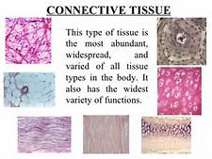
Types of Tissues
Connective tissue is the supporting fabric of organs and other body parts.
There are 2 types: soft and hard

Slide 14
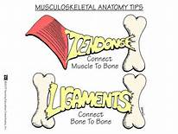
Types of Tissues
Soft connective tissue is divided into 2 types: adipose & fibrous connective tissue
Adipose tissue (fatty tissue) stores fat as a food reserve or source of energy & acts as padding
Fibrous connective tissue helps hold body structures together (ligaments & tendons)

Slide 15
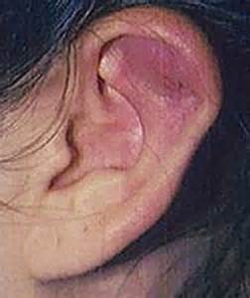
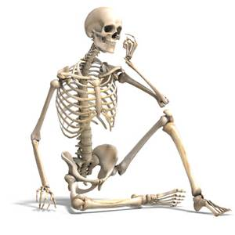
Types of Tissues
Hard connective tissue includes cartilage and bone
Cartilage is a tough, elastic material found between the bones of the spine & at the ends of long bones. It acts as shock absorber and allows for flexibility. It is also found in the nose, ears, & larynx
Bone (osseous tissue) forms rigid structure of body

Slide 16
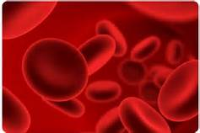
Types of Tissues
There is also a class of connective tissue called liquid connective tissue (vascular tissue)
It includes blood and lymph – they transport substances in the body

Slide 17
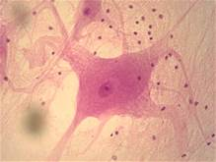
Types of tissues
Nerve tissue
controls and coordinates body activities by transmitting messages though the body
Nerves, brain, & spinal cord are made of nerve tissue

Slide 18
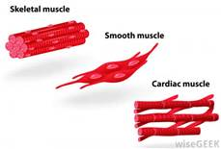
Types of tissues
Muscle tissue
produces power and movement by contraction of muscle fibers.
There are 3 main kinds of muscle tissue: skeletal, cardiac, visceral/smooth

Slide 19
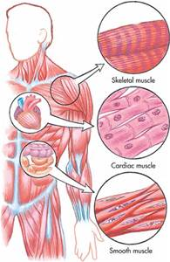
Types of tissues
Muscle tissue
Skeletal which attaches to bones and provides movement
Cardiac which causes heart to beat
Visceral/smooth which is walls of respiratory, digestive, urinary tract, and blood vessels

Slide 20
Organs and Systems
Organs: two or more tissues joined together for a specific purpose
Organ Systems: organs and other body parts joined together for a particular function

Slide 21
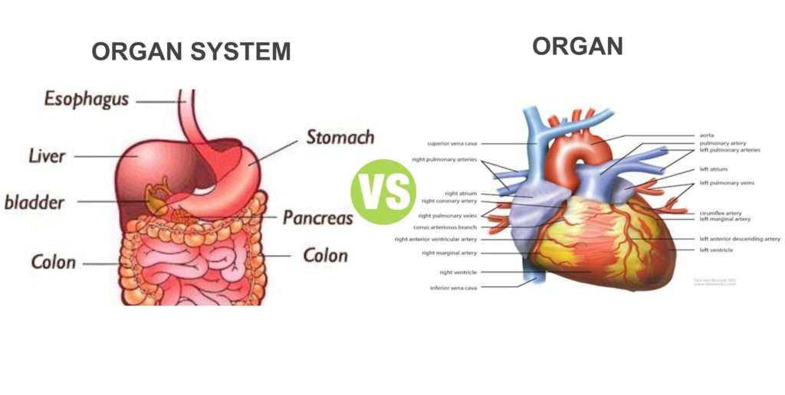
Organs and Systems

Slide 22
Organs and Systems
Cells combine to form tissue
Tissues combine to form organs
Organs combine to form systems
Systems work together to form the organism

Slide 24
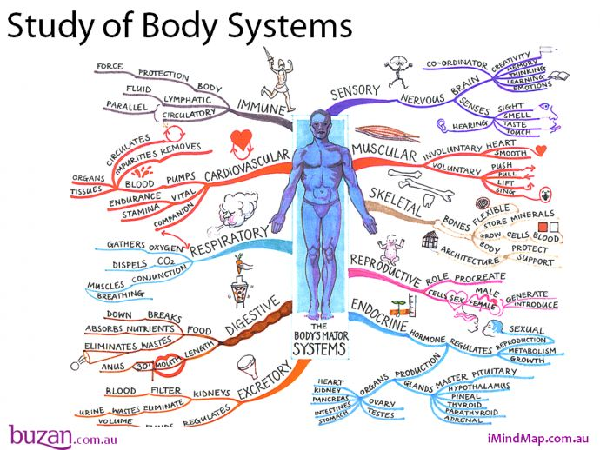
Organs and Systems
There are 11 basic systems:
Integumentary
Skeletal
Muscular
Circulatory
Lymphatic
Respiratory
Digestive
Urinary
Nervous
Endocrine
Reproductive

Slide 25
Do You Know?
Which of the following is a type of muscle tissue?
A) Smooth
B) Squamous
C) Osseous
D) Carotid
And the answer is….A

Slide 26
DO You Know?
Where would you find epithelial tissue?
A) Inside long bones
B) Inside the brain
C) Lining the inside of the nose
D) In the walls of the large intestine
And the answer is….C

Slide 27
Do you know?
What type of tissue transmits messages from the head to the toes?
A) Connective
B) Epithelial
C) Nerve
D) Muscle
And the answer is…C

Slide 28
Do you know?
What type of tissue is classified as hard or soft?
A) Epithelial
B) Muscle
C) Nervous
D) Connective
And the answer is…D

Slide 29
Do you know?
What is the primary function of muscle tissue?
A) To produce movement
B) To control and coordinate body activities
C) Transportation
D) To produce body secretions
And the answer is…A

Slide 30
Do you know?
Blood is classified as what type of tissue?
A) Epithelial
B) Connective
C) Nerve
D) Muscle
And the answer is…B

Slide 31
Do you know?
Of the following, which is the MOST complex?
A) Nucleus
B) Muscle tissue
C) Nerve cell
D) Kidney
And the answer is…D

Slide 32
Do you know?
Which organ or structure does NOT belong with the other three?
A) Stomach
B) Heart
C) Liver
D) Mouth
And the answer is…B

Slide 33
Body organization Planes and direction
DHO 8
Chapter 7
7:2
2018-2019

Slide 34
7:2 Body Planes/Directions/Cavities
Anatomic position-standing upright, facing forward, arms at the sides with palms facing forward
Notes:
https://www.youtube.com/watch?v=kvHWnJwBkmo Anatomical Terms - Drawn & Defined (Updated)

Slide 35
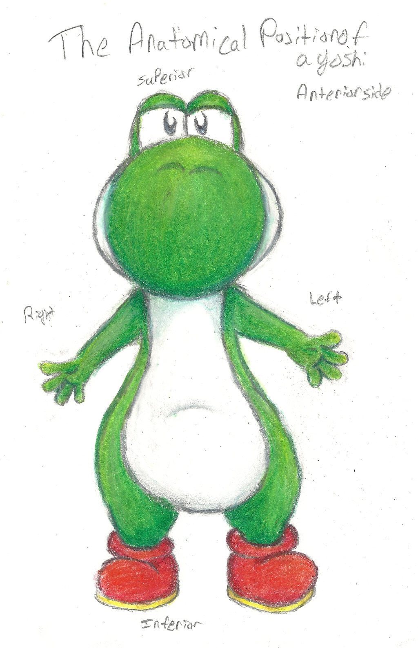
7:2 Body Planes/Directions/Cavities
Body planes: imaginary lines drawn through body at various levels to separate body into sections (3 main planes)
Directional terms are created by planes (12 terms)
Body planes & directional terms were developed to describe the relationship of one part of the body to another (must be in anatomic position)

Slide 36
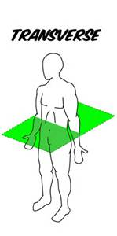
3 main planes with 12 directional terms
Body plane #1:
Transverse plane: horizontal plane that divides the body into top and bottom halves.
It creates the following 4 directional terms:
Superior-top half (knee is superior to ankle)
Inferior-bottom half (knee is inferior to hip)
Cranial-towards the head
Caudal-towards the tail (sacral region of spinal column)

Slide 37
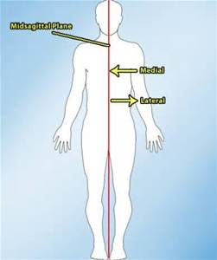
3 main planes with 12 directional terms
Body plane #2
Midsagittal (median) plane: vertical plane that divides body into left and right sides
It creates the following 2 directional terms:
Medial-body parts close to the midline
Lateral-body parts away from the midline

Slide 38
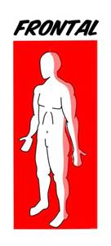
3 main planes with 12 directional terms
Body plane #3
Frontal (coronal) plane: vertical plane divides the body into front and back section
It creates the following directional terms:
Ventral or Anterior-body parts on the front of the body
Dorsal or Posterior-body parts on the back of the body

Slide 39
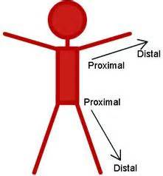
3 main planes with 12 directional terms
Last 2 directional terms are proximal & distal.
These are used to describe the location of the extremities (arms & legs) in relation to the main body trunk
The main body trunk is called the point of reference
Proximal-body parts close to the point of reference
Distal-body parts distant from the point of reference

Slide 40
Can you label the planes?

Slide 41
Let’s Review!
Get your white boards and markers ready to answer review questions!

Slide 42
Do you know?
If the body were cut in a transverse plane, what organ would NOT be in the same half as the other three?
A) Brain
B) Bladder
C) Lungs
D) Heart
And the answer is….B

Slide 43
Do you know?
What body part is inferior to the chest?
Head
Neck
Heart
Hips
And the answer is…D

Slide 44
Do you know?
If you divided the body with a midsagittal plan and added up the number of eyes, arms, and toes on one side, how many would you have?
5
7
9
12
And the answer is…B

Slide 45
Do you know?
An autopsy photo shows the dorsal side of the victim. What could you see in the photo?
Back of the head
Kidneys
Knees
Front of the abdomen
And the answer is…A

Slide 46
Do you know?
Of the following, which structures are the most medial?
Ears
Hips
Eyes
Lips
And the answer is…D

Slide 47
Do you know?
What body parts are distal to the hand?
Fingers
Eyes
Ribs
Lungs
And the answer is…A

Slide 48
Do you know?
What structure is proximal to the thigh?
Ankle
Calf
Hip
Foot
And the answer is…C

Slide 49
Body organization cavities and quadrants
DHO 8
Chapter 7
7:2
2018-2019

Slide 50
Body Cavities
Body cavities: spaces within the body that contain vital organs
There are 2 main cavities
Dorsal or posterior cavity
Ventral or anterior cavity
And there are 3 small cavities
Orbital cavity-contains eyes
Nasal cavity-contains nose structures
Buccal cavity-(mouth)-teeth & tongue

Slide 51
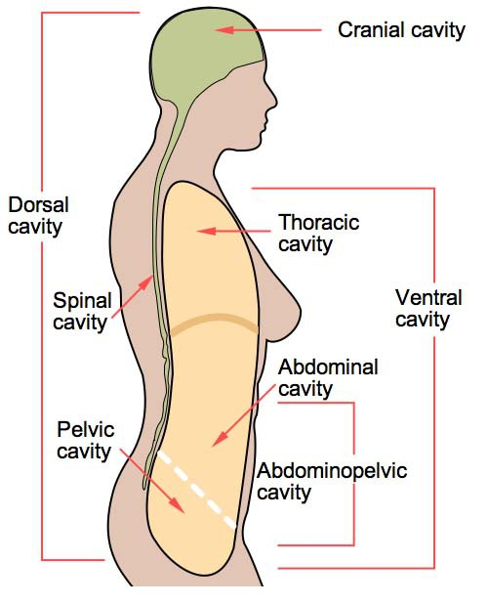
The main cavities
Dorsal cavity is one long, continuous cavity on the back of the body
It can be broken down into 2 sections: cranial cavity and spinal cavity
Cranial cavity holds the brain
Spinal cavity holds the spinal cord

Slide 52
The main cavities
Ventral cavity long cavity on the front of the body
It is separated into 2 distinct cavities by the diaphragm muscle
Thoracic cavity is the upper cavity located in the chest and contains the esophagus, trachea, bronchi, lungs, heart, and large blood vessels
Abdominal cavity (abdominopelvic cavity) is the lower cavity below the diaphragm muscle

Slide 53
The main cavities
Abdominal cavity is divided into an upper part and a lower part
Upper abdominal cavity contains the stomach and a large part of digestion system
Lower abdominal cavity (pelvic cavity) has the urinary bladder, reproductive organs, and last part of large intestine

Slide 54
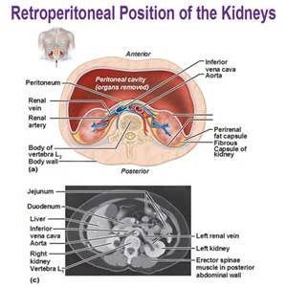
The main cavities
The kidneys and the adrenal glands are located outside the abdominal cavity and behind the peritoneal membrane
This area is called the retroperitoneal space

Slide 55
Can you label the cavities?

Slide 56
Do you know?
What structures are located anterior to the cranial cavity?
Eyes
Ears
Lungs
Neck muscles
And the answer is…A

Slide 57
Do you know?
What body cavity contains the brain and spinal cord?
Cranial
Spinal
Dorsal
Ventral
And the answer is…C

Slide 58
Do you know?
What cavity would a surgeon enter to repair a heart defect?
Dorsal
Thoracic
Abdominal
Pelvic
And the answer is…B

Slide 59
Do you know?
If a physician performs a pelvic exam, what organs can be evaluated?
Respiratory
Reproductive
Esophagus and stomach
Liver and gallbladder
And the answer is…B

Slide 60
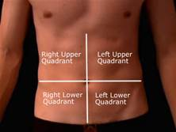
Abdominal Regions
Abdominal cavity is separated into quadrants or regions because it is so large
Quadrants divide the abdominal cavity into 4 sections:
RUQ-right upper quadrant
LUQ-left upper quadrant
RLQ-right lower quadrant
LLQ –left lower quadrant

Slide 61
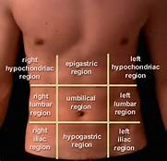
Abdominal regions
A more precise way of describing the abdominal cavity is with 9 regions, looking like a tic-tac-toe board.
Epigastric-center above stomach
Umbilical-center at navel
Hypogastric-center below stomach
Hypochondriac-sides below ribs (R & L)
Lumbar-sides and same as spinal column (R & L)
Iliac or inguinal-bottom near the groin (R & L)

Slide 62
Can you label the Abdominal quadrants?

Slide 63
Can you label the Abdominal regions?

Slide 64
Do you know?
If a physician writes that the patient has RUQ pain, what might be causing it?
Head injury
Arthritis in the hip
Cracked rib
Dislocated shoulder
And the answer is…C

Slide 65
HOmeostatis
Positive and negative feedback
Transport
pH acids and bases
Temperature regulation
Glucose regulations
Notes:
https://www.youtube.com/watch?v=Iz0Q9nTZCw4 homeostatis amoeba sisters
https://www.khanacademy.org/science/high-school-biology/hs-human-body-systems/hs-body-structure-and-homeostasis/v/homeostasis khan academy
https://www.youtube.com/watch?v=uBGl2BujkPQ human body org and homeostatis Crash course

