Slide 1
What is your WHY?
7 Mindsets Academy Redelivery
Melissa Bourke/Kaley Chafin
July 28, 2017

Slide 2
Let’s start with Inky…
Inky Johnson

Slide 3
Back to basics…social emotional learning
So let’s go back before we started our 7 Mindsets Journey… back to why this advisement method is so important to us.
“Social and emotional learning (SEL) is the process through which children and adults acquire and effectively apply the knowledge, attitudes, and skills necessary to understand and manage emotions, set and achieve positive goals, feel and show empathy for others, establish and maintain positive relationships, and make responsible decisions.” (http://www.casel.org/what-is-sel/)
SEL is NOT a program- it how you live. It’s a lifestyle. That is what we need to be teaching and modelling for our students, peers, families, and peers each day.

Slide 4
Five competencies of SEL
Self- Awareness- Recognizing your own emotions, thoughts and values and how they influence behavior; able to assess one’s own strengths and weaknesses as well
Self- Management- Able to regulate one’s emotions, thoughts and behaviors in different situations; manages stress and controls impulses, motivates self
Social Awareness- Perspective taking and empathizing; understands social and ethical norms for behavior
Relationship Skills- Ability to establish and maintain healthy and healthy relationships with individuals and groups; communicates and listens effectively; cooperates; resists social pressure; resolves conflict appropriately
Responsible Decision-Making- Ability to make constructive choices about personal behavior and social interaction; understands consequences

Slide 5
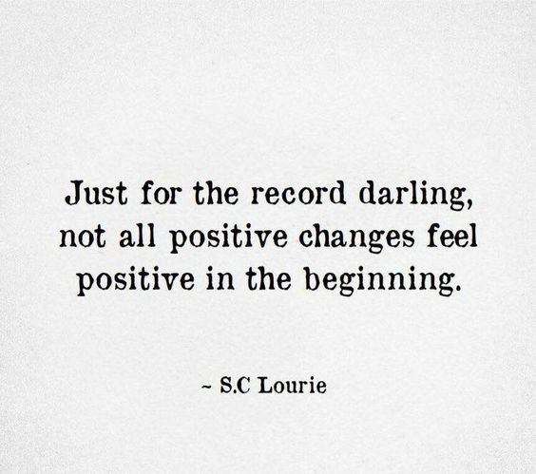
7 Mindsets refresher
#1 Everything is Possible- (My Why and if for My Dreams I had a Magic Wand )
#2 Passion First- (My Core Values)
#3 We Are Connected- (My Dream Team)
#4 100% Accountable- (No Excuses)
#5 Attitude of Gratitude- Being More Grateful)
#6 Live to Give- (What Impact Have you Had on Others?)
#7 The Time is Now- (My Plan)
“Your playing small does not serve the world.” -Nelson Mandela

Slide 6
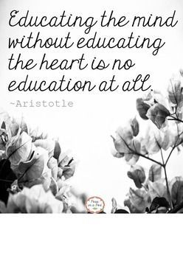
Relationship building
Building relationships with your students starts DAY #1
May be easy, but could click months later
Students need to have relationships (at least one trusted adult), a spark or passion that motivates them, and a voice in order to thrive
Know at least one piece of info about every student you teach!
Take an interest in something the student is passionate about- whether you
have a conversation about this hobby or interest, cheer them on at a game
or support him/her at a FFA rabbit show, be present at something!
The smallest word or action can be a major deposit into your relationship “bank account” with a student- before you need to start making withdrawals.

Slide 7
Relationship building
One of the seven schools who have completely implemented the 7 Mindsets curriculum, Mashburn Elementary (Forsyth County), ranked 55 in the state among elementary schools for 2016-2017 Milestone testing. According to their staff, the 7 Mindsets curriculum has had a significant impact on learning in their school.
Do you think that students learn more enthusiastically when they feel safe and cared about by the adults in the school?
Teachers Compliment Students
Students Compliment Teachers

Slide 8
Who is on your DREAM TEAM????
Your spouse, a parent, best friend???
Your team of teachers- sure!!
Your dream team that was picked for you Wednesday?
Whoever it is, those are the people who encourage and cheer you on. Your personal cheerleaders in life. When you are feeling defeated, drained, and discouraged, your DREAM TEAM is there to pick you up and dust you off. Your DREAM TEAM celebrates your successes with you as well. This is how we are connected to each other. We need each other. This is what we need to encourage our students to do- to have people in their life who encourage and lift them up, and to be the same to others.

Slide 9
I Teach because…
Find your Passion- Eric Julius
Take 5-7 minutes…Think about a student you have taught- one of your very favorite students OR one of your most difficult students. What was it about that student that made you work harder to be the teacher they needed you to be?
Now, think about why you decided to become a teacher. Despite the ups and downs, you keep coming back, year after year. There is something that draws you back when others give up and choose another career. What is it?
Write that reason(s) down in a few sentences on the “I teach because…” half sheet.
Your students and parents will be able to learn something special about you the first time they meet you!

Slide 10
Plans with 7 Mindsets this year- school-wide
One Mindset Topic per month (see next slide)
Hallways and classrooms need to have mindset visible in some form- in hallways- Ms. Jackson is going to help us out ☺
Once a week- during HR/A2- 5-10 video
Attendance Competition- to be announced soon
Mrs. Bourke- Club/Ambassadors to help with spreading the mindset culture among their peers
Dream Team Break-out: 7-10 minutes Any other ideas??

Slide 11
BMS Mindset/advisement schedule 17-18
August- Intro to Mindsets
September- Everything is Possible
October- Live to Give
November- Attitude of Gratitude
January- 100% Accountable
February- We are Connected
March- Passion First
April- The Time is Now

Slide 12
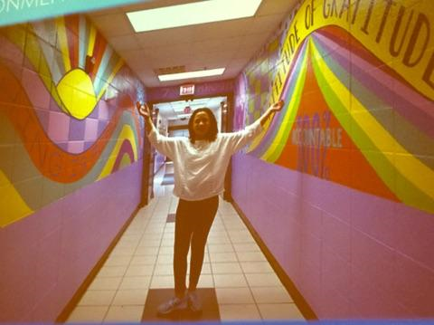
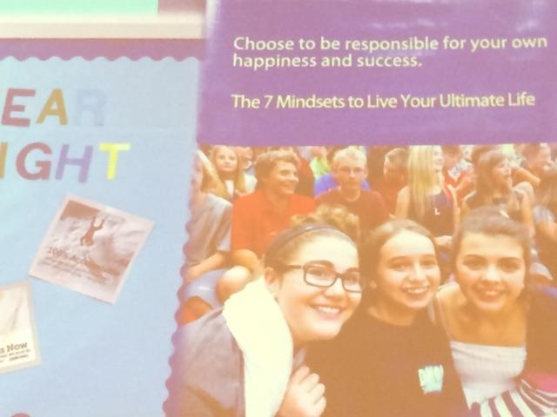
Art in the hallways-
Created by students- Mindsets advertised
Schools can get banners printed
with their own students on them- they
would feel like celebrities!! ☺
Attendance Competition-
Reward given to best attendance

Slide 13
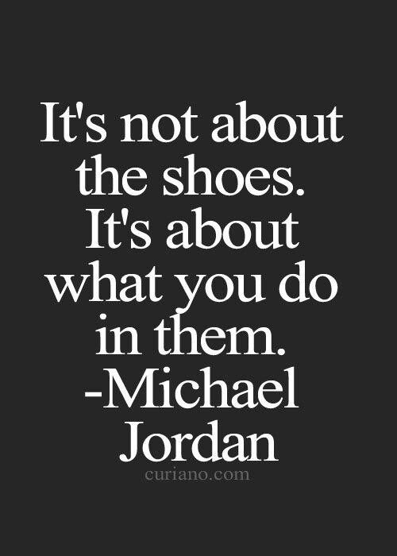
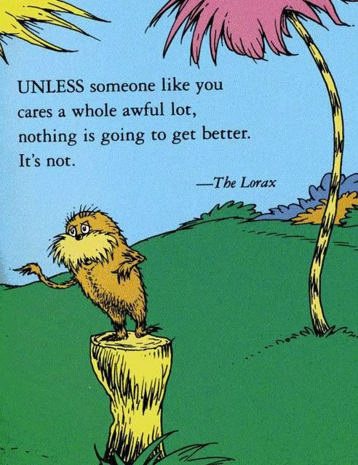
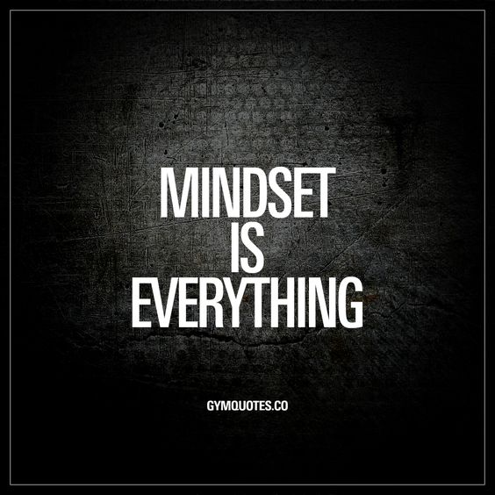
Classroom advisement tips and ideas
Ideas from Kaley
Resource Hub
https://www.7mindsetsacademy.net/

Slide 14
We challenge you!
Try out this Mindset thinking…not just every other week during Advisement. Each day…with your dream teams, your students, your own children and families at home!
Can you imagine what we can all accomplish if we attempted to fill our minds with these seven ideas??

Slide 15
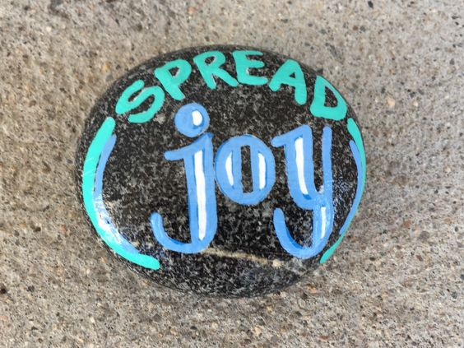
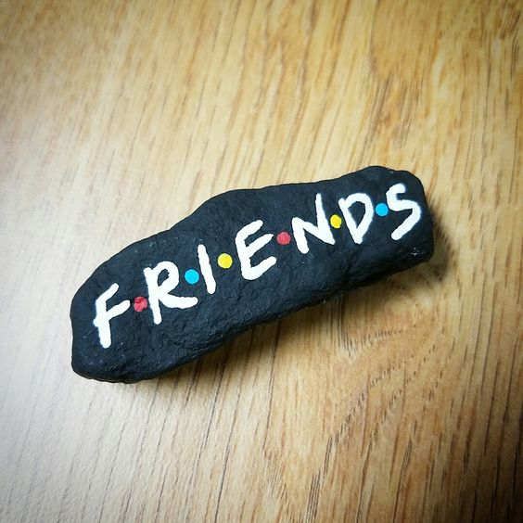
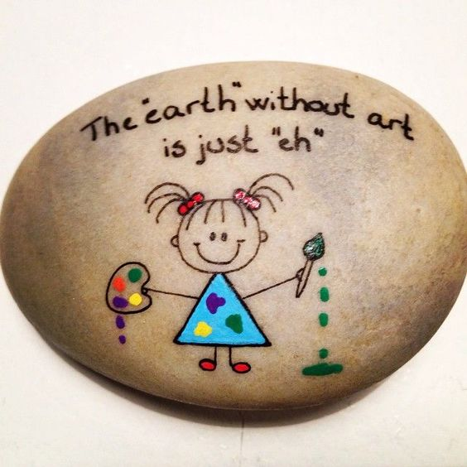
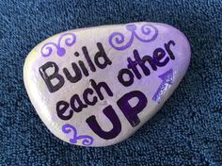
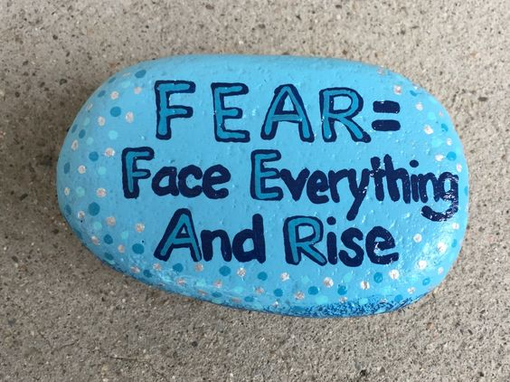
Thank you for all you do!!!
What is your Why
Rock Activity ☺

Slide 16
Songs/Videos- fill-ins
I won't give up song- Shakira

