Slide 1
Page 348

Slide 2
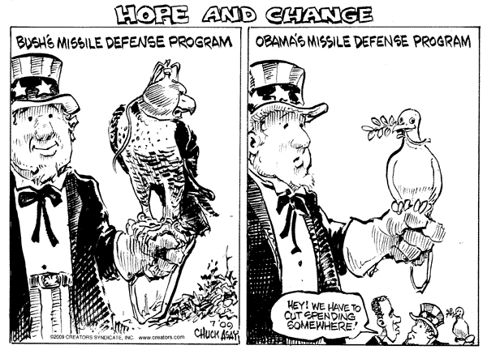
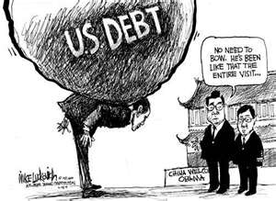
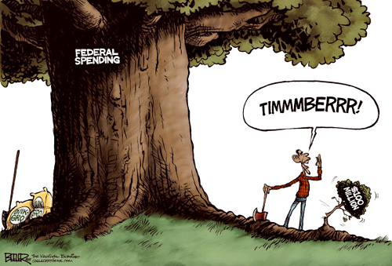
Obama finally cuts spending!

Slide 3
Review from last class
Executive Branch
Judicial Branch
Electoral College
Requirements for office.
Line of Succession
Supreme Court
Other Courts

Slide 4
Objectives :
Explain how civic responsibilities are important to Mississippians as citizens of the United States and residents of a global setting. MS5
Explain the necessity of politics and government. MS5a
Explain how the United States Constitution grants and distributes power to national and state government. MS5c

Slide 5
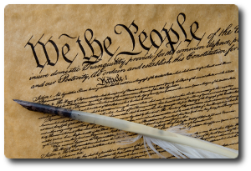
How important is it that you know about the constitution?
What about churches or National Rifle Association?

Slide 6
Overview
Constitution
Mississippi Constitution.
Principles of the Constitution.
Changing the Constitution.
Mississippi Legislature
How it is set-up.
Sessions
Power
Organization
How to make a law.

Slide 7
What is a constitution?
A document that sets up the framework of a government and determines its power and limitations.

Slide 8
Constitution of 1890
We, the people of Mississippi in convention assembled, grateful to almighty God, and invoking his blessing on our work, do ordain and establish this constitution.

Slide 9
How many constitutions has Mississippi had?
4 or 5

Slide 10
What was Mississippi’s first Constitution?
The Constitution of 1817

Slide 11
What was Mississippi’s second Constitution?
The Constitution of 1832

Slide 12
What was Mississippi’s third Constitution?
The Constitution of 1865 or 1869

Slide 13
What was Mississippi’s fourth Constitution?
The Constitution of 1869 or 1890

Slide 14
What was Mississippi’s fifth Constitution?
The Constitution of 1890

Slide 15
Who wrote the Mississippi’s 1890 Constitution?
Male, mostly white, lawyers, farmers and planters.

Slide 16
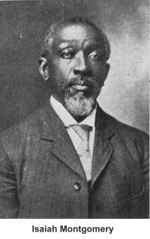
Any black member of the convention?
(1 out of 134)
Isaiah T. Montgomery, a wealthy planter.

Slide 17
How did the constitution go into effect?
When the convention adjourned.
November 1, 1890.

Slide 18
If you looking at the United States and Mississippi constitutions together would there be any difference in the two?

Slide 19
Yes

Slide 20
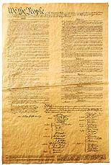
USA
Mississippi’s Constitution is three times as long as the United States Constitution.

Slide 21
Why is the Mississippi Constitution 3X as long?
Greater detail.

Slide 22
How did they write the Constitution of 1817?
Copied it.

Slide 23
The basic principles in the United States Constitution are they the same as in the Mississippi Constitution?

Slide 25
What is popular sovereignty?
The people set up the government and are sovereign (rule) over it.

Slide 26
We the people of the United States, in order to form a more perfect union, establish justice, insure domestic tranquility, provide for the common defense, promote the general welfare, and secure the blessings of liberty to ourselves and our posterity, do ordain and establish this Constitution for the United States of America.
We, the people of Mississippi in convention assembled, grateful to Almighty God, and involving his blessing on our work, do ordain and establish this Constitution.

Slide 27
Are all governments set up and ruled by the people?
Sort of.

Slide 28
Where is Tian’an Men Square?
China’s Capital.

Slide 29
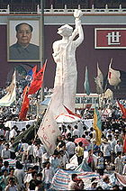
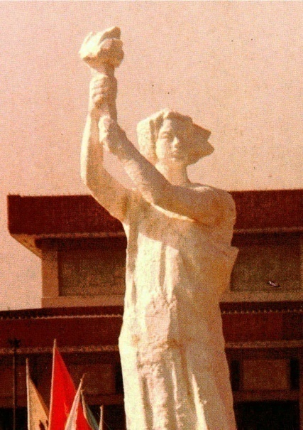
What happened in Tian’an Men Square on April 14, 1989?
Protests.

Slide 30
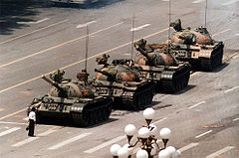

Slide 31
What are limits?
The Founders of the American system of government believed that there was a need to limit the role of government to avoid the abuse of power.

Slide 32
What is separation of power?
That when a single person or group has a large amount of power, they can become dangerous to citizens. Separation of Power is a method of removing the amount of power in any group’s hands, making it more difficult to abuse.

Slide 33
How do we use separation of power?
The Legislative Branch –
Make law.
The Executive Branch –
Enforces, executes and administers the law.
The Judicial Branch –
Interpret and apply the law.

Slide 34
What are checks and balances?
Each branch of government can use its powers to promote equality amoung the branches.

Slide 35
How do we change the constitution?
Amendments.

Slide 36
How many amendments have their been to the United States Constitution?
27

Slide 37
How many amendments have their been to the Mississippi Constitution?
121 by 2003

Slide 38
How do we begin to amend the Mississippi Constitution?
Usually it starts in the legislature.

Slide 39
When a bill is proposed to amend the Mississippi Constitution what will it take to pass?
2/3 of each houses.

Slide 40
Is the Constitution amended after both houses approve it?
No, it is placed on a ballot for the people in the state to vote on.

Slide 41
Can a student in High School change the constitution?
Yes

Slide 42
How do you change the constitution?
Indirect initiative.

Slide 43
The proposed amendment must be signed by registered voters. What is the number of signatures required?
12% of the total number of votes cast in the last governor’s race.

Slide 44
Brittany Baker (2004)

Slide 45
Page 350
Mississippi State Legislature

Slide 46
What is the basic job of the legislature?
Make Law

Slide 47
What are the houses in the legislature?
The Senate
The House of Representatives

Slide 48
How many senators?
52
100
ARTICLE 13, Mississippi Constitution
Section 254

Slide 49
How many house members?
122
435
ARTICLE 13, Mississippi Constitution
Section 254

Slide 50
Senate
House of Representative
Page 350
Page 351

Slide 51
What is apportionment?
The process by which the number of seats in the senate and house are determined.
ARTICLE 13, Mississippi Constitution

Slide 52
When does the state do apportionment?
Within the first two years after a national census.
ARTICLE 13, Mississippi Constitution
Section 254

Slide 53
How long do the members of the legislators serve?
4 years.
May be reelected for an unlimited number of terms.
ARTICLE 4, Mississippi Constitution
Section 34 and 35

Slide 54
If you would like to run for a seat in the House of Representatives you must be:
21 years or older.
A state resident for 4 or more years.
A district resident for 2 or more years.
ARTICLE 4, Mississippi Constitution
Section 41

Slide 55
If you would like to run for a seat in the Senate you must be:
25 years or older.
A state resident for 4 or more years.
A district resident for 2 or more years.
ARTICLE 4, Mississippi Constitution
Section 42

Slide 56
If you have convicted of a major felony, you can not hold office.
Rape
Bank
Robbery
Bribery
Murder
Fraud
ARTICLE 4, Mississippi Constitution
Section 44

Slide 57
The Legislature meets every year for regular session, when will it start?
“On the Tuesday after the first Monday of January of the year A.D., 1970, and annually thereafter, unless sooner convened by the Governor.”
ARTICLE 4, Mississippi Constitution
Section 36

Slide 58
How many days is regular session?
New Administration 125 days.
Old Administration 90 days
ARTICLE 4, Mississippi Constitution
Section 36

Slide 59
Are their more session than regular session?
The governor can call a special session.
“Unless sooner convened by the Governor.”
ARTICLE 4, Mississippi Constitution
Section 36

Slide 60
The Special session in 2002.
Page 354
On September 5, 2002, Mississippi Governor Ronnie Musgrove called for a special session on tort reform.
A cap on non-economic awards of $500,000 until 2011, $750,000
until 2017, and $1 million thereafter.

Slide 61
The last Special session was in 2008.
The House committee on Medicaid tried to pass a bill to fund a $90 million Medicaid shortfall using a cigarette tax and a hospital tax.

Slide 62
Other Powers of the Legislature
Impeach.
House chooses the Governor (if no candidate receives a majority of the popular vote.
ARTICLE 4, Mississippi Constitution
Section 49
ARTICLE 5, Mississippi Constitution
Section 141

Slide 63
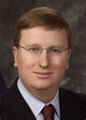
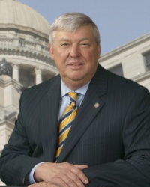
Organization of the Senate
Lieutenant Governor presides over the senate.
President pro tempore when the Lieutenant Governor is absent.
Tate Reeves (R)
Terry W. Brown (R)

Slide 64
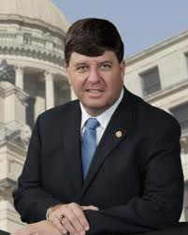
Organization of the House
Speaker of the house presides over the house.
Speaker pro tempore when the Speaker is absent.
Philip Gunn (R)
Greg Snowden (R)

Slide 65
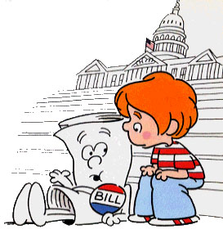
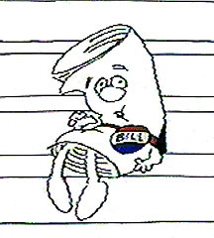
How are laws made?
Schoolhouse Rock
I'm Just a Bill

Slide 66
Page 356

Slide 67
Summary
Constitution
Mississippi Constitution.
Principles of the Constitution.
Changing the Constitution.
Mississippi Legislature
How it is set-up.
Sessions
Power
Organization
How to make a law.

Slide 68
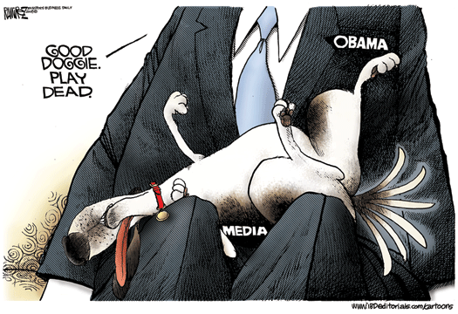
So can you make political cartoons at Olive Branch High School?

Slide 69
Assignment for next class.
Read pages 357 to 363.

