Slide 1
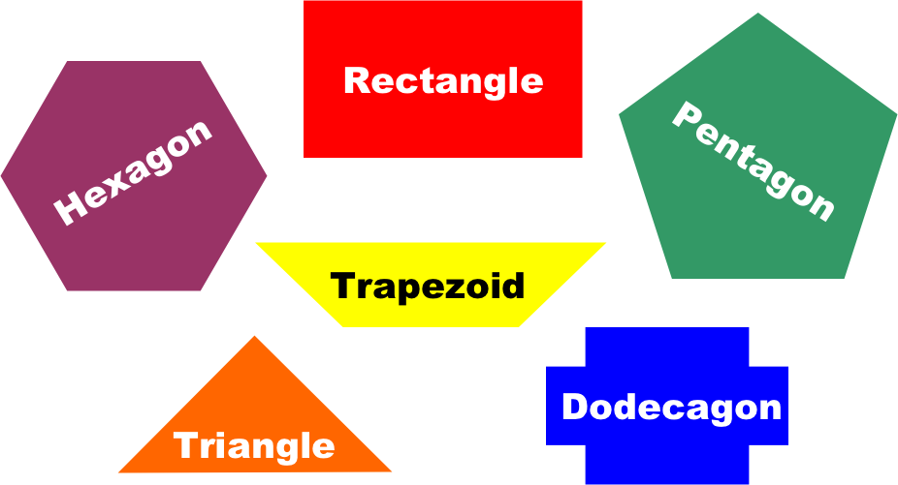
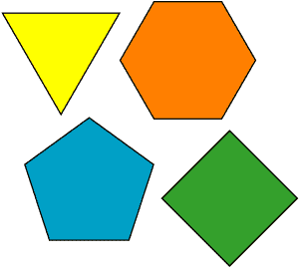
Polygons
Lesson 11-3

Slide 2
Today we are going to distinguish among different shapes.
Name some shapes you know.
What are some characteristics of those shapes.

Slide 3
Polygon
A polygon is a closed shape made up of line segments.

Slide 4
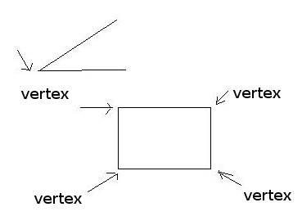
Vertex
The point at which two sides meet is called the vertex of the polygon.

Slide 5
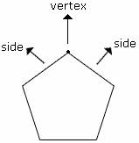
Side
Each line segment is a side of the polygon.

Slide 6
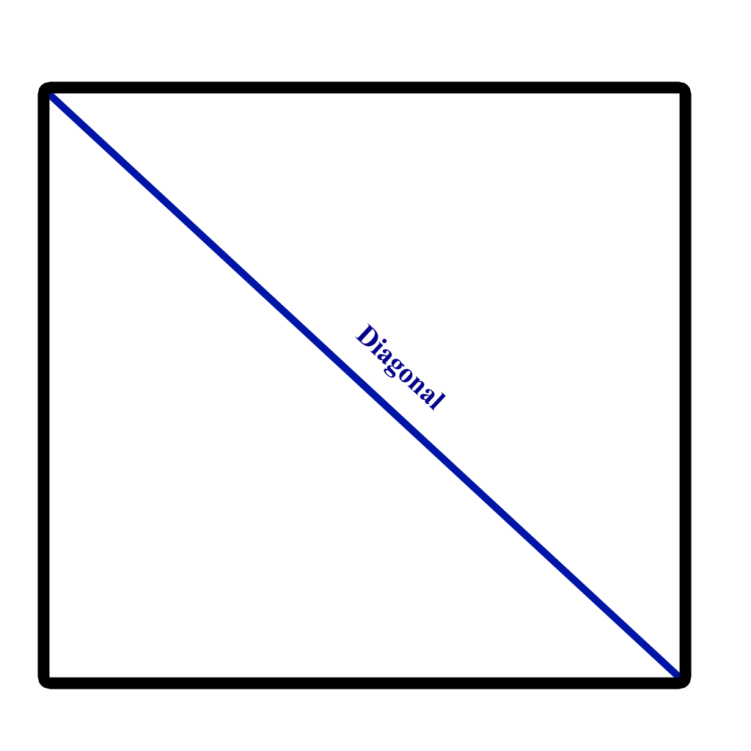
Diagonal
A diagonal is a line segment that connects two vertices that are not next to each other.

Slide 7
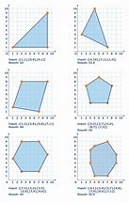
Convex
When a polygon curves outward and is not rounded in shape it is convex

Slide 8
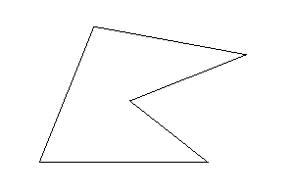
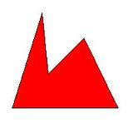
Concave
When a polygon curves inward and it is not round in shape it is concave (think about a cave)

Slide 10
Triangle
A triangle is a polygon with 3 sides

Slide 11
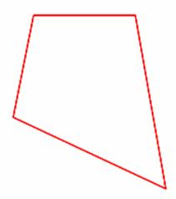
Quadrilateral
A quadrilateral is a polygon with 4 sides

Slide 12
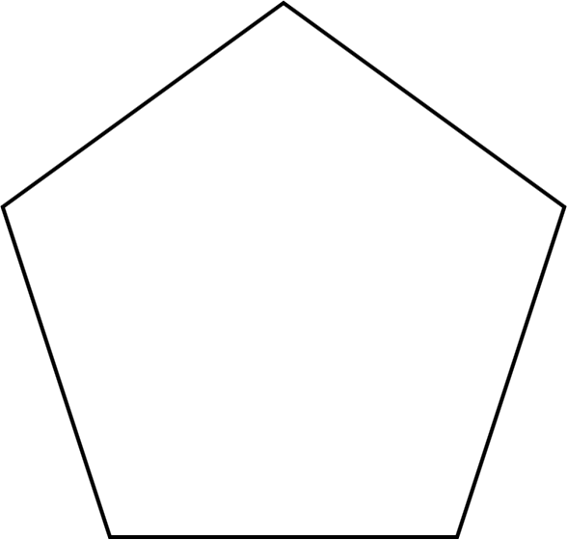
Pentagon
A pentagon is a polygon with 5 sides

Slide 13
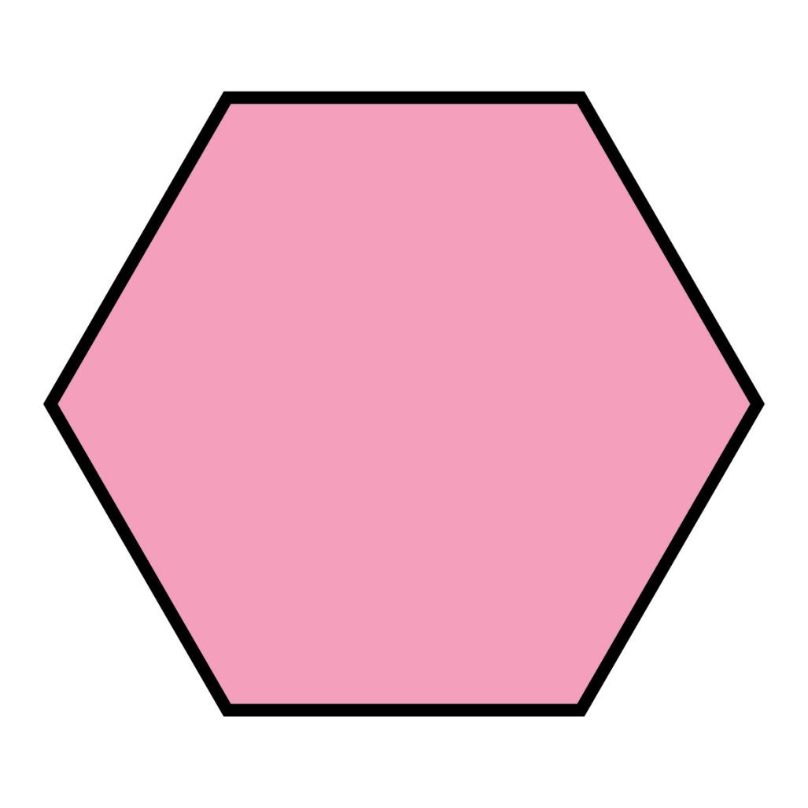
Hexagon
A hexagon is a polygon with 6 sides

Slide 14
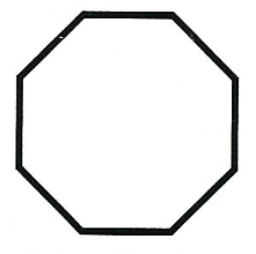
Octagon
An Octagon is a polygon that has 8 sides

Slide 15
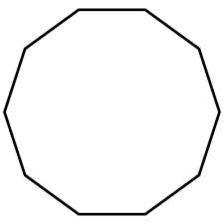
Decagon
A decagon is a polygon with 10 sides

Slide 16
Lets Practice!
Is this Polygon Concave or Convex?
Convex

Slide 17
Is this Polygon Concave or Convex?
Concave

Slide 18
Is this Polygon Concave or Convex?
Concave

