Slide 1
Period 3, Part 3
AP U.S. History

Slide 2
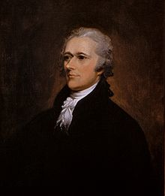
Hamilton’s Economic Plans
Reports on the Public Credit
Debt Problems
$75M debt between national government and states government
Worthless national currency
Little to no foreign credit
The Debt Plan
Federal government assumes national and state debts
Report on a National Bank
Manage revenues, currency, and debt
Private institution
“necessary and proper”
Sources of Revenue
Tariffs
Excise taxes
Report on Manufactures
Protective tariffs
Promotion of domestic industries
Opposition to Hamilton’s Debt and Bank Plans
Thomas Jefferson and James Madison
Unconstitutional
Mostly British financial investments
Undermine state governments and state banks
Favors bankers, merchants, speculators, business, northern commercial interests
Weakens farmers, western settlers, southern agrarian interests
Compromise
“Dinner Table Bargain”
Approval of Assumption Plan and National Bank
National capital in the South
Washington, D.C.
John Adams Debate

Slide 4
Whiskey Rebellion (1791-1794)
Excise tax on domestic whiskey
Western Pennsylvanian farmers attacked federal tax collectors
Washington and Hamilton led federal troops and quashed the rebels
Asserted federal authority over lawlessness
Public could denounce and protest laws
Thomas Jefferson and Opposition
Overuse of federal military
Jefferson caters to western farmers

Slide 5
Election of 1792
George Washington
Unanimously elected
John Adams (F)
As VP
Competition from George Clinton (D-R)

Slide 6
Washington’s Foreign Policy
Pro-French
Pro-British
Thomas Jefferson
French Revolution
Citizen Genet
Proclamation of Neutrality (1793)
“Whereas it appears that a state of war exists between Austria, Prussia, Sardinia, Great Britain, and the United Netherlands, of the one part, and France on the other; and the duty and interest of the United States require, that they should with sincerity and good faith adopt and pursue a conduct friendly and impartial toward the belligerant Powers;”
Alexander Hamilton
Jay’s Treaty (1796)
“Art. 1: There shall be a firm inviolable and universal Peace, and a true and sincere Friendship between His Britannick Majesty, His Heirs and Successors, and the United States of America; and between their respective Countries, Territories, Cities, Towns and People of every Degree, without Exception of Persons or Places.”
“Damn John Jay! Damn everyone that won't damn John Jay! Damn every one that won't put lights in his window and sit up all night damning John Jay!”

Slide 7
Washington’s Precedents
Two terms
“Mr. President”
Cabinet
Neutrality
Special Relationship with Great Britain
Farewell Address

Slide 8
Washington’s Farewell Address (1796)
Political Parties
Entangling Alliances
“I have already intimated to you the danger of parties in the State, with particular reference to the founding of them on geographical discriminations. Let me now take a more comprehensive view, and warn you in the most solemn manner against the baneful effects of the spirit of party generally. This spirit, unfortunately, is inseparable from our nature, having its root in the strongest passions of the human mind. It exists under different shapes in all governments, more or less stifled, controlled, or repressed; but, in those of the popular form, it is seen in its greatest rankness, and is truly their worst enemy. The alternate domination of one faction over another, sharpened by the spirit of revenge, natural to party dissension, which in different ages and countries has perpetrated the most horrid enormities, is itself a frightful despotism. But this leads at length to a more formal and permanent despotism. The disorders and miseries which result gradually incline the minds of men to seek security and repose in the absolute power of an individual; and sooner or later the chief of some prevailing faction, more able or more fortunate than his competitors, turns this disposition to the purposes of his own elevation, on the ruins of public liberty. Without looking forward to an extremity of this kind (which nevertheless ought not to be entirely out of sight), the common and continual mischiefs of the spirit of party are sufficient to make it the interest and duty of a wise people to discourage and restrain it.”
“The great rule of conduct for us in regard to foreign nations is in extending our commercial relations, to have with them as little political connection as possible. So far as we have already formed engagements, let them be fulfilled with perfect good faith. Here let us stop. Europe has a set of primary interests which to us have none; or a very remote relation. Hence she must be engaged in frequent controversies, the causes of which are essentially foreign to our concerns. Hence, therefore, it must be unwise in us to implicate ourselves by artificial ties in the ordinary vicissitudes of her politics, or the ordinary combinations and collisions of her friendships or enmities… It is our true policy to steer clear of permanent alliances with any portion of the foreign world; so far, I mean, as we are now at liberty to do it; for let me not be understood as capable of patronizing infidelity to existing engagements. I hold the maxim no less applicable to public than to private affairs, that honesty is always the best policy. I repeat it, therefore, let those engagements be observed in their genuine sense. But, in my opinion, it is unnecessary and would be unwise to extend them. Taking care always to keep ourselves by suitable establishments on a respectable defensive posture, we may safely trust to temporary alliances for extraordinary emergencies. Harmony, liberal intercourse with all nations, are recommended by policy, humanity, and interest. But even our commercial policy should hold an equal and impartial hand; neither seeking nor granting exclusive favors or preferences; consulting the natural course of things; diffusing and diversifying by gentle means the streams of commerce, but forcing nothing;”

Slide 9
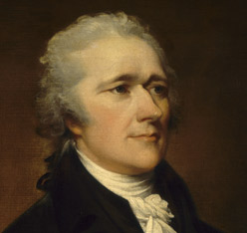
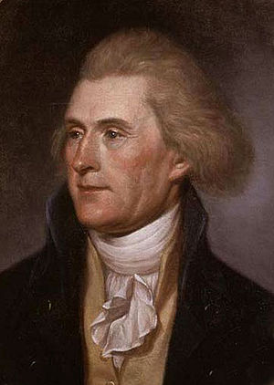
First Political Party System (1789-1824)
Alexander Hamilton
Thomas Jefferson
Federalists
National policies
Strong central government
Loose constructionists
Commerce and manufacturing
Urban
The rich, the well-born, the able; merchants, bankers
Pro-British
Anti-French revolution
Northeast
Democratic-Republicans
States rights
Strong local/state governments
Strict constructionists
Agricultural
Rural
Small farmers, plantation owners, artisans
Anti-British
Pro-French Revolution
West and South

Slide 10
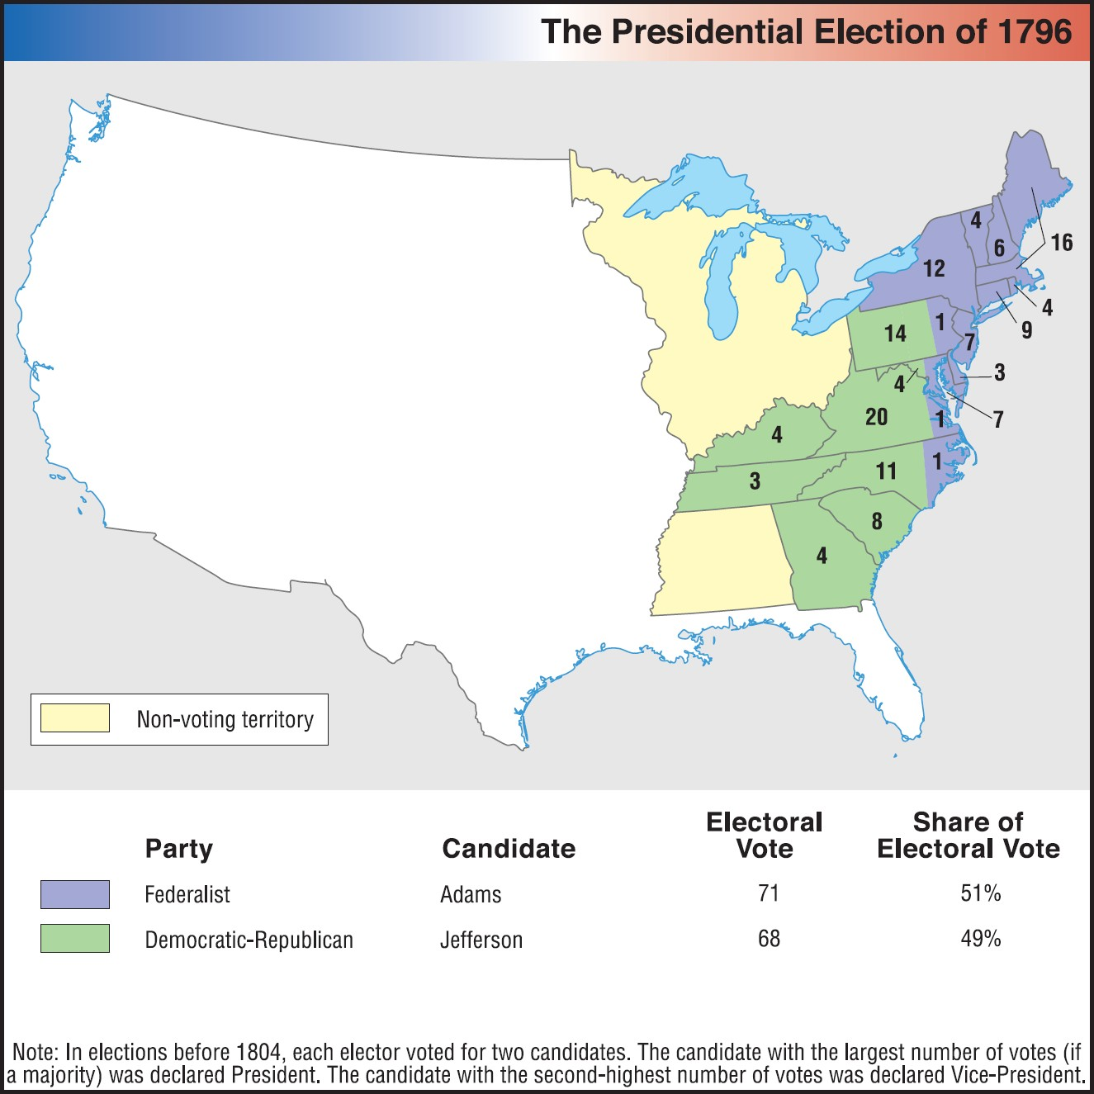
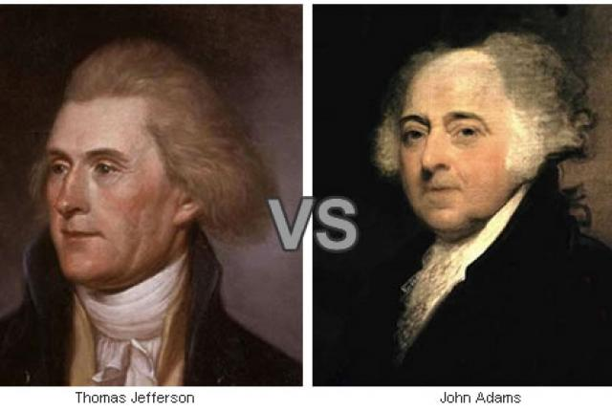
Election of 1796
John Adams (F)
Thomas Jefferson (D-R)
First election of competing political parties
Democratic-Republicans accuse Adams of monarchism
Federalists accused Jefferson of condoning French Revolution violence

Slide 11
Adams and the XYZ Affair
French seizure of American ships
American delegation to France
John Marshall
Elbridge Gerry
Charles Pinckney
Talleyrand
Quasi War (1797-1798)
“The Paris Monster”, 1797

Slide 12
Alien and Sedition Acts (1798)
Alien Act
“That whenever there shall be a declared war between the United States and any foreign nation or government, or any invasion or predatory incursion shall be perpetrated, attempted, or threatened against the territory of the United States, by any foreign nation or government, and the President of the United States shall make public proclamation of the event, all natives, citizens, denizens, or subjects of the hostile nation or government,…who shall be within the United States, and not actually naturalized, shall be liable to be apprehended, restrained, secured and removed, as alien enemies.”
Sedition Act
“That if any persons shall unlawfully combine or conspire together, with intent to oppose any measure or measures of the government of the United States, which are or shall be directed by proper authority, or to impede the operation of any law of the United States,…he or they shall be deemed guilty of a high misdemeanor
That if any person shall write, print, utter or publish, or shall cause or procure to be written, printed, uttered or published, or shall knowingly and willingly assist or aid in writing, printing, uttering or publishing any false, scandalous and malicious writing or writings against the government of the United States, or either house of the Congress of the United States, or the President of the United States, with intent to defame the said government, … or to stir up sedition within the United States, or to excite any unlawful combinations therein, for opposing or resisting any law of the United States,…
Matthew Lyon (D-R) and Roger Griswold (F)

Slide 13
Virginia and Kentucky Resolutions
Virginia Resolution
Kentucky Resolution
“That this Assembly doth explicitly and peremptorily declare, that it views the powers of the federal government as resulting from the compact to which the states are parties, as limited by the plain sense and intention of the instrument constituting that compact, as no further valid than they are authorized by the grants enumerated in that compact; and that, in case of a deliberate, palpable, and dangerous exercise of other powers, not granted by the said compact, the states, who are parties thereto, have the right, and are in duty bound, to interpose, for arresting the progress of the evil, and for maintaining, within their respective limits, the authorities, rights and liberties, appertaining to them.”
“That the several states who formed that instrument, being sovereign and independent, have the unquestionable right to judge of its infraction; and that a nullification, by those sovereignties, of all unauthorized acts done under colour of that instrument, is the rightful remedy: That this commonwealth does upon the most deliberate reconsideration declare, that the said alien and sedition laws, are in their opinion, palpable violations of the said constitution; and however cheerfully it may be disposed to surrender its opinion to a majority of its sister states in matters of ordinary or doubtful policy; yet, in momentous regulations like the present, which so vitally wound the best rights of the citizen, it would consider a silent acquiesecence as highly criminal: That although this commonwealth as a party to the federal compact; will bow to the laws of the Union, yet it does at the same time declare, that it will not now, nor ever hereafter, cease to oppose in a constitutional manner, every attempt from what quarter soever offered, to violate that compact:”

Slide 14
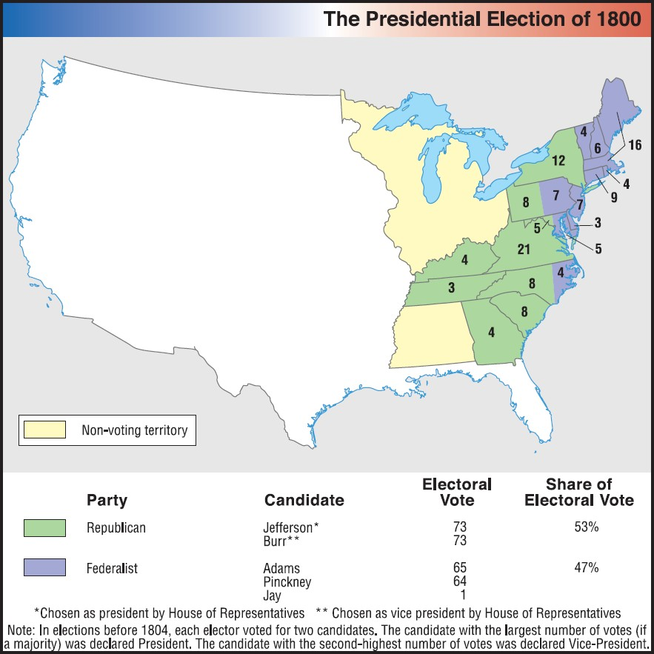
Revolution of 1800
Election of 1800 Campaign Ad

Slide 15
American Republicanism
Individual rights and liberty
Virtuous and autonomous citizens
Promote common good
Popular sovereignty
Avoid mob rule (tyranny of the majority; direct democracy)
Establishment of republic with representative democracy
Rejection of monarchy and aristocracy
Limited government based on written constitution with separation of powers and checks and balances
Promote the plain folk and yeoman farmer
Prevent dominance of wealthy elites
Civic virtue and civic duty
Promote education
Avoidance and prevention of corruption
Subvert personal wealth and ambitions for community
Equality and equal opportunity

Slide 16
An American Society
Abolition of Aristocratic Titles
New Opportunities
In the past, most families produced for personal consumption
In the new nation, families attempted to meet new demands and focused on production with old and new markets
New class of entrepreneurs and investors
American claims to western lands
Split between manufacturers (Hamilton) and farmers (Jefferson)
Separation of church and state
Churches lost state support
Charles Wilson Peale,The Artist's Mother, Mrs Charles Peale and Her Grandchildren: 1783

Slide 17
Women in the New Republic
Limited political and property rights
Increased marital rights
“Republican motherhood”
Raise virtuous citizens
Increased educational opportunities
James Peale, The Artist and His Family (1795)

Slide 18
Blacks and Slaves in the New Republic
Thomas Jefferson, Declaration of Independence (1776)
Benjamin Banneker, Letter to Thomas Jefferson (1791)
We hold these truths to be self-evident, that all men are created equal, that they are endowed by their Creator with certain unalienable rights, that among these are life, liberty, and the pursuit of happiness.
…Sir, how pitiable is it to reflect, that although you were so fully convinced of the benevolence of the Father of Mankind, and of his equal and impartial distribution of these rights and privileges, which he hath conferred upon them, that you should at the same time counteract his mercies, in detaining by fraud and violence so numerous a part of my brethren, under groaning captivity and cruel oppression, that you should at the same time be found guilty of that most criminal act, which you professedly detested in others, with respect to yourselves.

Slide 19
Percentage of Free Blacks of Total Black Population (1800)
New York - 33%
10,374 Free Blacks
New Jersey - 26%
4,402 Free Blacks
Maryland - 16%
19,587 Free Blacks
Virginia - 6%
20,124 Free Blacks
North Carolina - 5%
7,043 Free Blacks
South Carolina - 2%
3,185 Free Blacks
Georgia - 2%
1,019 Free Blacks
Kentucky - 2%
741 Free Blacks
Tennessee - 2%
309 Free Blacks
United States - 11%
108,395 Free Blacks
Total U.S. Population:
5.3 million
Massachusetts - 100%
7,378 Free Blacks
Vermont - 100%
557 Free Blacks
New Hampshire - 99%
855 Free Blacks
Rhode Island - 90%
3,304 Free Blacks
Pennsylvania - 89%
14,564 Free Blacks
Connecticut - 85%
5,300 Free Blacks
Delaware - 57%
8,268 Free Blacks
Total Black Population:
1 million

Slide 20
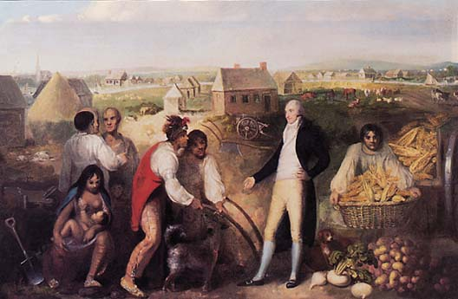
Natives in New Republic
Battle of Fallen Timbers (1794)
Treaty of Greenville (1795)
Indian Trade and Intercourse Acts (1790-1796)
Protect against illegal land seizures and abuses
“civilization” programs
Treaty of Greenville (1795)
Benjamin Hawkins and the Creek Indians (1805)

