Slide 1
Coffee County Schools
College and Career Ready Standards
2013

Slide 2
Coffee County CCRS Team
Created a video to introduce the system’s teachers to the
College and Career Ready Standards

Slide 3
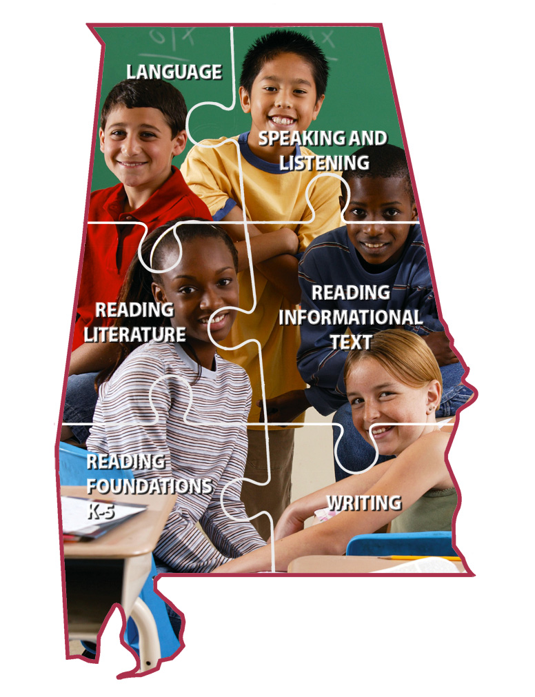
ELA, Literacy in History/SS, Science, & Technical Subjects Standards Exploration 2012

Slide 4
Outcomes
To explore the vertical alignment of the grade-level standards
To learn a process that can be used to further explore the standards

Slide 5
Things to Remember
This is an extended process toward full implementation.
The process should not be rushed – it’s a marathon, not a race.
Our focus today is to learn HOW to explore the content literacy standards.

Slide 6
A Vision for Implementation
Notes:
The foundation is the Common Core State Standards. This includes the College and Career Ready Standards (Anchor Standards) and the K-12 standards (Grade Level Standards). These are our national standards (CCSS) that were agreed upon by the National Governor’s Association (NGA) and the chief state school officers (CSSO) in 40 states. Alabama’s governor (Bob Riley) and superintendent (Dr. Tim Bice) were part of this process.
We are currently putting up the frame. We have in place the 2010 AL ELA COS (State Standards) and the assessments (high stakes assessments) and curricula framework (mapping, pacing guides, content movement, adding rigor) are currently being developed.
The exterior and interior details are the responsibility of each district. They represent the districts’ implementation plans. Student success depends on local system leadership, school leadership, and effective classroom instruction.
This house will be effective in 2013.

Slide 7
Important Local Decisions
Important local decisions include:
How students will accomplish these standards?
In what sequence teachers will address the standards?
How much time will be allotted for instruction of the standards?
Notes:
Districts will complete “the house” as these important decisions are made.
We have already begun to plan and with your support, these questions will be answered.
Each is an extremely important consideration because the answers determine curriculum, pacing, scheduling, and most importantly –the instruction.

Slide 8
Prepared Graduate Defined
Knowledge and Skills
Ability to Apply Learning
Possesses the knowledge and skills needed to enroll and succeed in credit-bearing, first-year courses at a two or four year college, trade school, technical school, without the need for remediation.
Possesses the ability to apply core academic skills to real-world situations through collaboration with peers in problem solving, precision, and punctuality in delivery of a product, and has a desire to be a life-long learner.

Slide 9
Portrait of a Literate Individual
Students who are college and career ready …
Demonstrate independence
Build strong content knowledge
Respond to varying demands of audience, task, purpose, and discipline
Comprehend as well as critique
Use technology and digital media strategically and capably
Understand other perspectives and cultures
Value Evidence
Notes:
We will further investigate specific characteristics of a literate individual during our grade-level discussions later today.

Slide 10
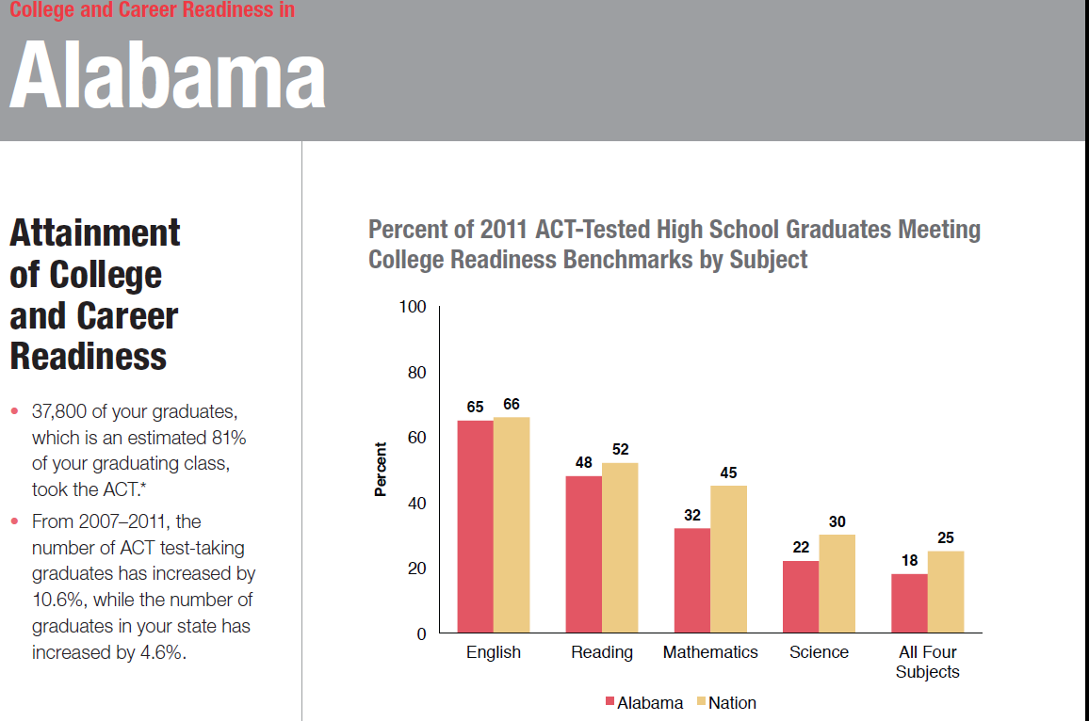
According to ACT, Inc.
Notes:
Read the graph:
Title: Click: College and Career Readiness in Alabama (according to ACT)
Attainment of College and Career Readiness: Click:
In Alabama, 37,800 graduates -81% of Alabama’s graduates, took the ACT
In Alabama the number of ACT test-taking graduates has not increased at the same rate as the nation (Nation 10.6%, Alabama 4.6%)
Percent of 2011 ACT-Tested High School Graduates Meeting College Readiness Benchmarks by Subject:
Vertical Axis = Percent of HS grads meeting benchmarks
Horizontal Axis = Subject areas, Alabama compared to the nation CLICK:
All Four Subjects: Nationally, the percentage of the graduating students meeting the benchmark in all 4 subject areas is 25%..........in Alabama that is 18%........ SO…of the students graduating in Alabama and taking the ACT, 81% DID NOT benchmark on all 4 subjects…….
Talk to your partner for a minute about what this slide is telling you.
Background for Facilitator
Historically, the Northeast took one test: the SAT. It was THE college entrance exam accepted by most colleges in the Northeast, as well as by many major universities throughout the US. Whereas, the ACT had always been popular in the Midwest, accepted by most colleges and universities in that part of the country. Well, all of that has changed. Now most schools throughout the United States accept either exam to fulfill the college entrance exam requirement, should the college have such a requirement, and most do.)
Beginning in 2013-2014, All students in Grade 11 will take the ACT
The ACT: The ACT exam consists of five subtests in five areas: English, Math, Reading, Science, and Writing. ((History and Social Studies are included in the reading section of the ACT)The subtests are always presented in the order you see on the slide. So as you can see, there is only one subtest in English, one subtest in math, one in reading, and so on, numbers decline and may indicate stamina on the test.

Slide 11
According to ACT, Inc.
Demands of college, careers, and citizenship on readers have increased over the last 50 years .
K-12 reading texts have actually trended downward in difficulty in this same period.
Standards, curriculum, and instructional practice have not done enough to foster independent comprehension of complex texts.
Notes:
Read bullets.
In response to the states’ crisis, which has now become a national crisis – the rest of the world is surpassing us, and in response the governors and state school superintendents came together and the new ELA standards were created. This is why other countries are now competing and winning the same jobs we have historically held. Their students are better prepared and we cannot let the reasons why be an excuse for us.
Adoption of the standards was the first step. WE, all of us collectively are the next steps!!
Our activities today will help us take a closer look at the standards and the implications for instruction.

Slide 12
Notes:
Slides 16-26: 90 minutes
In order to begin thinking about implementation, we need to really “dig into” the standards.
Reminder:
Alabama’s standards are based on and include all standards in the 2010 Common Core State Standards for English Language Arts and Literacy Standards in History/Social Studies, Science, and Technical Subjects.
Some standards have been added and this will be indicated by the Alabama symbol. (Handout: 26 Alabama Added Standards)
The standards set requirements not only for English language arts (ELA) but also for literacy in history/social studies, science, and technical subjects.
This is one of the MOST IMPORTANT features of the new standards. When students can clearly see connections among content areas, they see concepts as being relevant to their world. Students CANNOT truly be ready for college and careers until they can formulate conceptual understandings and apply learning to authentic situations.

Slide 13
Notes:
In the beginning we shared our process for our time together today – We are still in the information gathering phase, so remember those parameters – listening carefully and taking notes.
Let’s begin by looking at Alabama’s COS document.
Pages 1 and 2: Flip through the “front matter” (the roman numeral pages) and look at pages 1 and 2, a helpful narrative about the outgrowth of the standards
Page 3: is a graphic that represents the conceptual framework. The banner represents the goal that all students achieve English Language Literacy in order to be college/career ready.
The standards are organized through the strands that you see in the graphic….Language, Speaking and Listening, Reading Literature, Reading Informational Text, Reading Foundations in grades K-5, and Writing.
No strand stands alone…all are necessary and depend on each other
All must be connected in classroom instruction in order for students to become college and career ready, to graduate prepared
Pages 4-8: more helpful narratives about the framework, some important position statements, and some notes on the content literacy standards
Pages 9-12: anchor standards

Slide 14
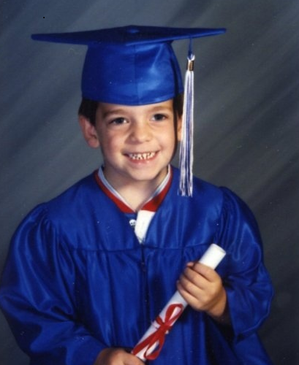
Anchor Standards Were Developed For…
Reading
Writing
Speaking and Listening
Language
Notes:
Anchor standards were developed prior to the grade level standards.
They define expectations that must be met for entry into college and workforce training programs. (The BIG picture)
They complement the grade specific standards-together they define the skills and understandings demonstrated by a prepared graduate.
Click for picture of graduate.
On pages 9-12 you will find the 10 anchor standards for reading, the 10 anchor standards for writing, the 6 anchor standards for speaking and listening, and the 6 anchor standards for writing.
These anchor standards are the same across all grade levels – grades K-12
Note that the anchor standards are grouped into sub-categories. (4 in Reading, 4 in Writing, 2 in Speaking and Listening, and 3 in Language)

Slide 15
Grade Level Standards
Grade level standards define what students should understand and be able to do by the end of each grade.
Grade level standards complement the anchor standards.
Together they define the skills and understandings that all students must demonstrate in order to be college- and career-ready.

Slide 16
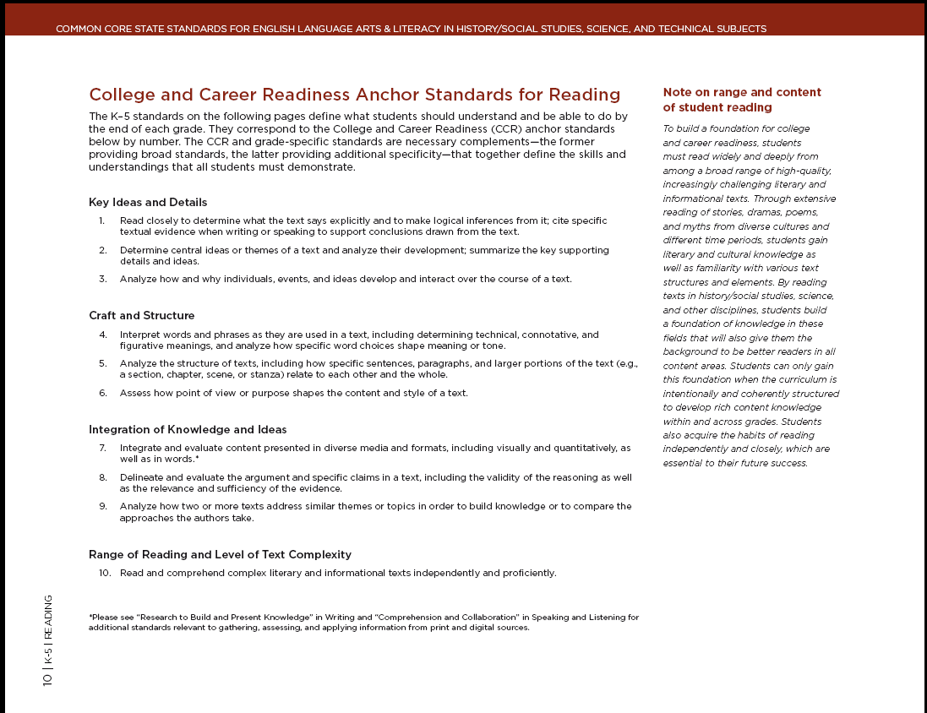
Anchor Standards for Reading
Notes:
Here you will see the 10 anchor standards for reading. These are the same as the anchor standards on page 9 in the Alabama COS.
Click: Notice the brief paragraph at the top describing the relationship between the anchor standards and the grade level standards.
Click: Below the introductory paragraph you will see the 10 anchor standards for reading. Notice the sub-categories on this page. These are the same in the Alabama document.
Click: Finally, there is a brief narrative about the range and content of student reading.
So…these 10 anchor standards are for Reading Literature and Reading Informational texts. Later today, we will have grade-level/content meetings to further examine reading informational texts.

Slide 17
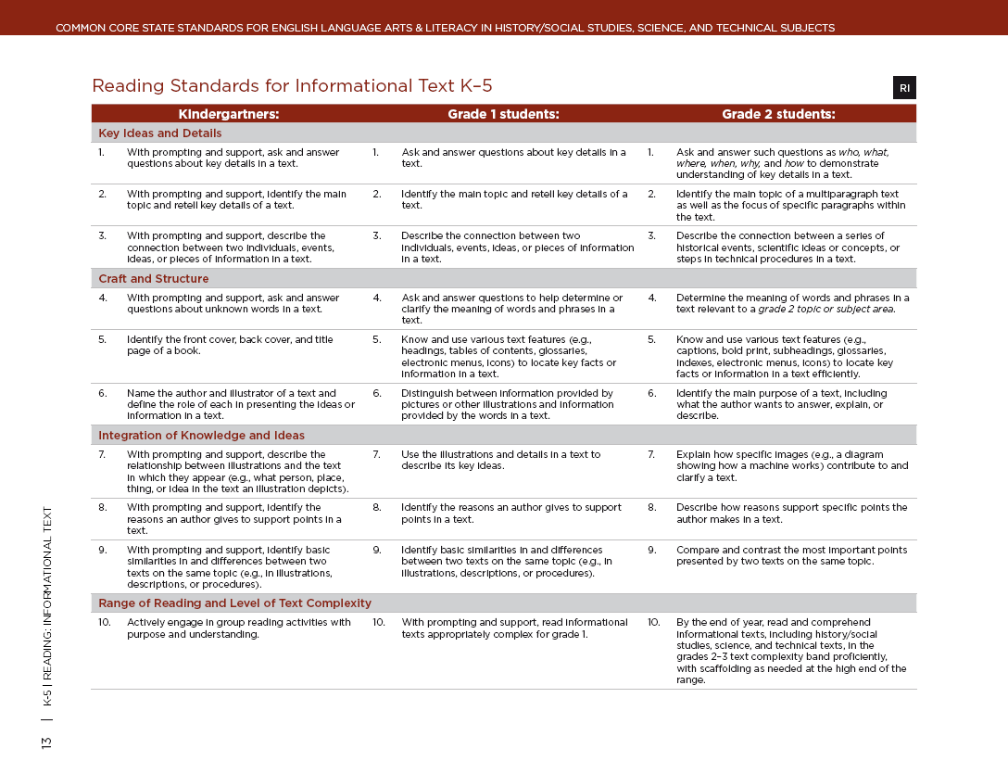
Notes:
This slide shows the vertical alignment of the standards.
Notice the format.
Click: There is more than one grade level on the page.
Click: The numbers correspond in this document. They start over for each Strand.
Click: The grade level standards are organized by sub-categories.
This format is what makes it easier to trace the standards across grade levels using the Common Core document.

Slide 18
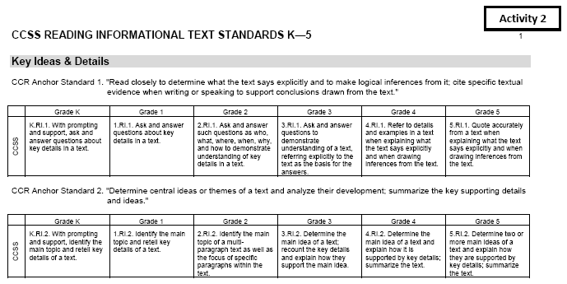
Tracing the Standards (K-5)
Notes:
Page 14 in your Alabama COS begins the grade level standards.
“Grade Level standards define what students should understand and be able to do by the end of each grade”. When viewing the vertical alignment, you will note:
The same four subcategories as you did in the anchor standards.
The subcategories in your grade level are the same as the subcategories in other grade levels, this is consistent across the grade levels.
Alabama added standards
The numbering system is continuous through the grade level. The numbers do not start over in each strand. (This is how the old standards were numbered, so it should be familiar)
Tracing Standards: We could conceivably look through each grade level in the Alabama Course of Study and see how these standards progress from K-12….However, the Common Core document’s clean, coherent design makes it much easier to do that.

Slide 19
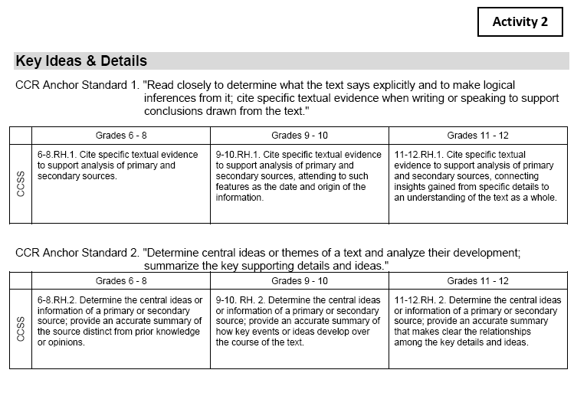
Tracing the Standards (6-12)
Notes:
This is what we will use to trace the standards today.
Activity 2 Handout: This format shows the anchor standard and the corresponding grade level standards.
It also shows all grades (K-5 or 6-12).

Slide 20
Thank you for your participation!
This information and more is available at:
http://alex.state.al.us
Presented by:
Leigh Barr (ZC)
Shannon Clark (NBH)
Angela Kelley (KS)
Jan Moore (NBE)
Holli Richardson (ZC)
Shan Sessions (KS)

Slide 21
CCRS Continued Training
COMMON CORE READINESS STANDARDS
PHASE 2 MEETING
AGENDA
Investigating the Portrait of a Literate Individual Activity
Give teachers blank handout and ask them to discuss what each of the characteristics looks like in the classroom and fill into the blanks.
Then have teachers turn to “Students Who Are College and Career Ready” handout and highlight phrases that stand out. Lead a discussion on this information.
Information Text Activity
Give teachers the Informational Text handout. Discuss purpose of informational text listed at the top of the handout.
Have teachers look through the list and place a check beside items they already use. Then have them circle at least three new ones they could incorporate next semester.
Have teachers look at the “Snapshots of Informational Text Instruction” and highlight the ones already seen in their classrooms. Discuss.
Tracing the Standards Activity
Have each grade level/subject area trace at least two of the standards. Ask them to underline words in each standard that are the same from grade level to grade level. Then have them circle the words that show increased rigor at each grade level.
GROUPS WILL NEED THEIR SPECIFIC INFORMATIONAL TEXT STANDARDS TO COMPLETE THIS ACTIVITY.
Alabama Insight
Give Alabama Insight handout to teachers and review.
Encourage teachers to use Alabama Insight to begin unpacking and becoming familiar with their new standards.
The team presented the video as an introduction to CCRS. Afterwards, teachers were engaged in the training through completion of activities such as defining a prepared graduate and tracing the standards through grade levels. In addition, the team demonstrated how Alabama Insight is a beneficial resource for teachers.

Slide 22
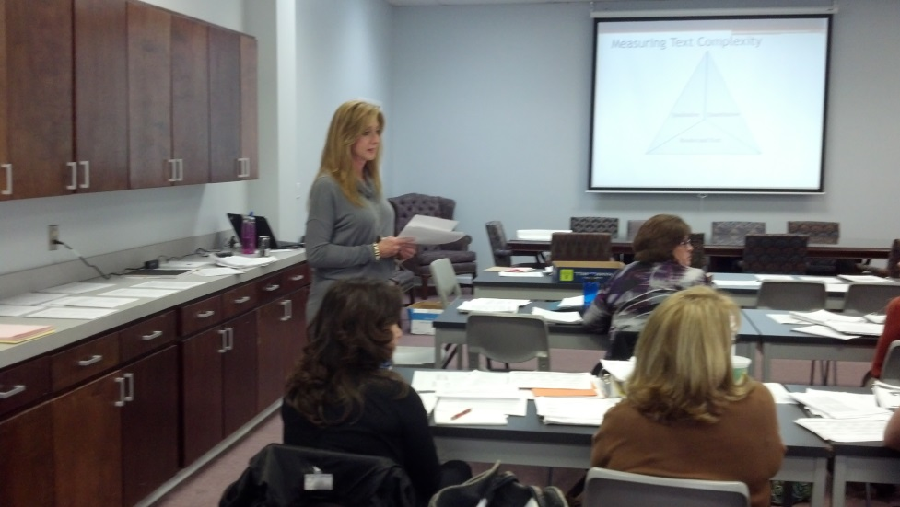
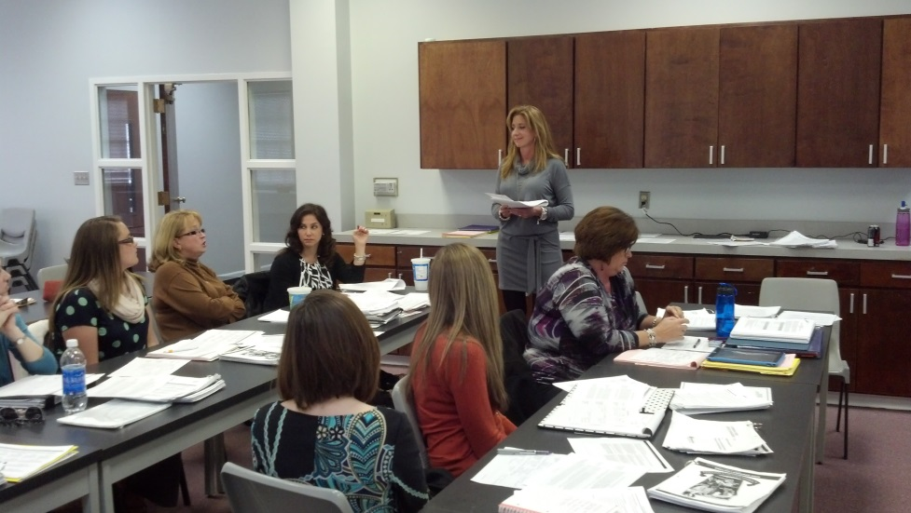
System Training

Slide 23
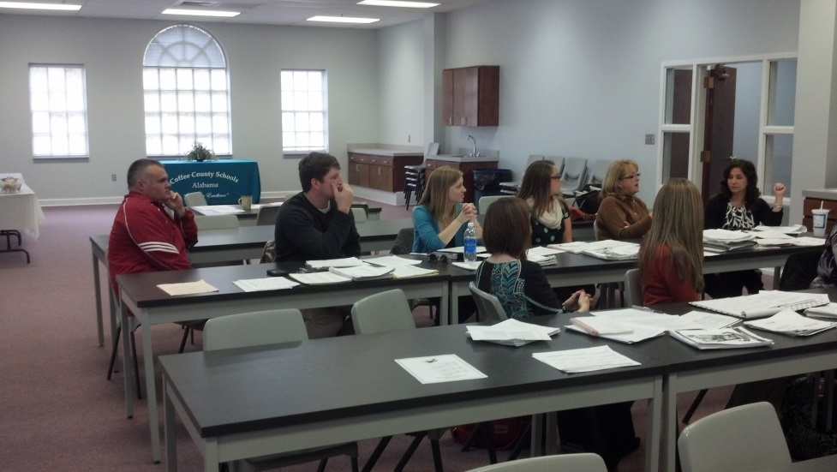
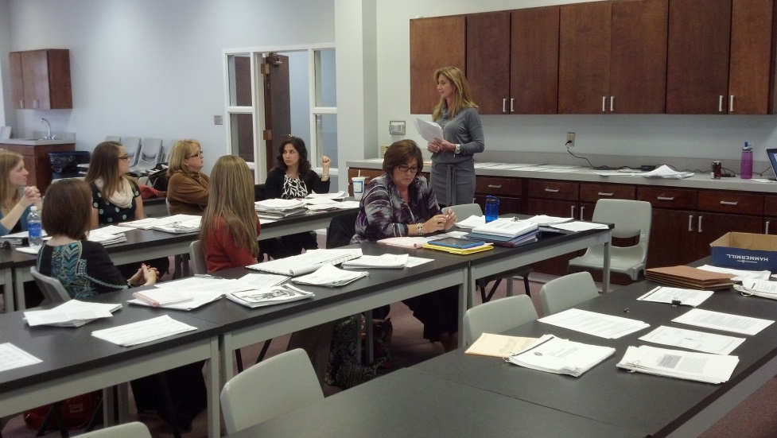
System Training

Slide 24
Professional Development Provided by the CCRS Team
Presentations were used by the CCRS team to continue the implementation of
Strategic Teaching and College and Career Ready Standards.

Slide 25
Strategic PD Training: Literacy Foundations
5 Essential Components of Reading per ARI: Phonemic Awareness, Phonics, Fluency, Vocabulary, & Comprehension

Slide 26
5 Components of Active Literacy
One outcome
Two instructional practices
Three parts: before, during, after
Four steps: I do, We do, Y’all do, You do
Five components to be embedded in every day instruction: T.W.I.R.L.

Slide 27
Focus for 7-12
Vocabulary
Comprehension
Take a moment to talk with your partner. Collectively define vocabulary and comprehension in student friendly terms and decide what you deem the importance of each is.

Slide 28
Comprehension
Look through your hand-out, pages 4-6. (ARI Handouts provided)
Read through the “What?” and list 2 important facts about what comprehension is.
Read through the “How?” and list 2 important facts about how we are supposed to teach comprehension.
Read through the “Why? and list 2 important facts about why we need to teach students strategies to help improve their comprehension skills.

Slide 29
QAR: Question-Answer Relationships
IN THE BOOK
Right there
Think and search
IN MY HEAD
Author and me
On my own

Slide 30
Developing Vocabulary
What vocabulary IS NOT: listing 25 words, defining them and taking a quiz on them at the end of the week.
What vocabulary IS: learning meanings to new and unfamiliar words AND incorporating the use of these words DAILY throughout instruction.
EVERY activity the students engage in should include the active use of vocabulary words.

Slide 31
The Three Reading Cues
Teaching a combination of the three reading cues—meaning, structure, and visual helps students to become strategic readers.
Turn and talk with your partner about these cues and what you think they mean.

Slide 32
Cues, continued
Meaning cues:
Come from the text
Come from the reader’s prior knowledge
Structure cues:
Based upon the word order or syntax of the text.
Visual cues:
Do NOT refer to examining the illustrations. They are letters, punctuation marks, and size of print. These cues refer to the sound/symbol relationship.

Slide 33
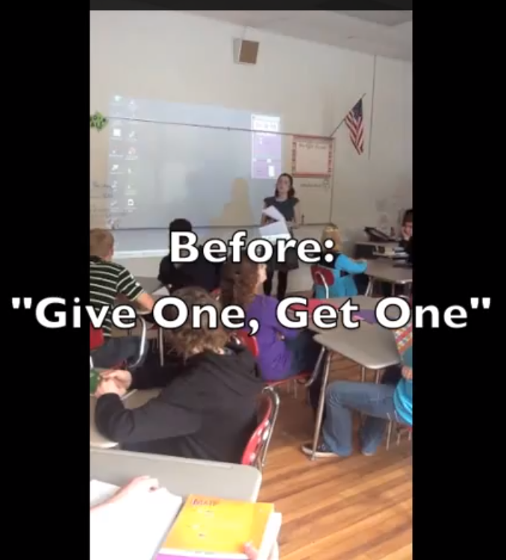
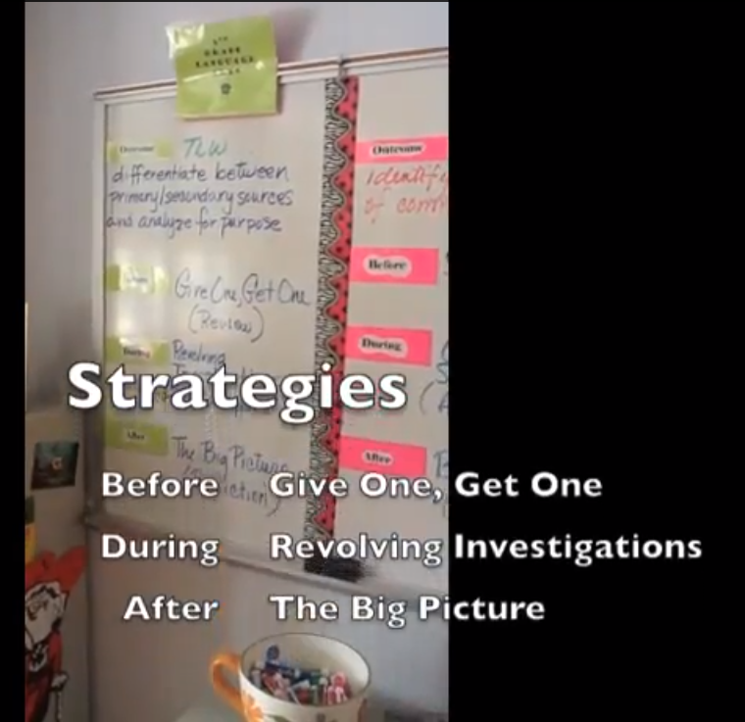
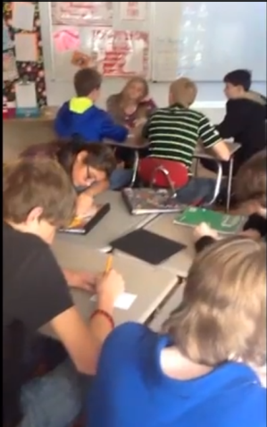
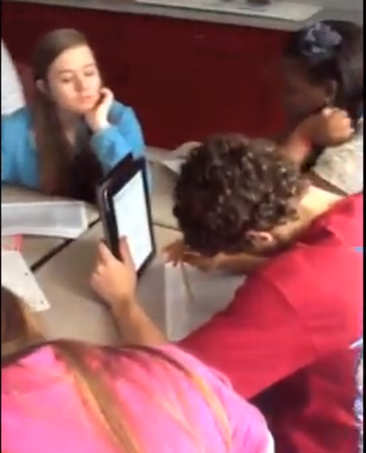
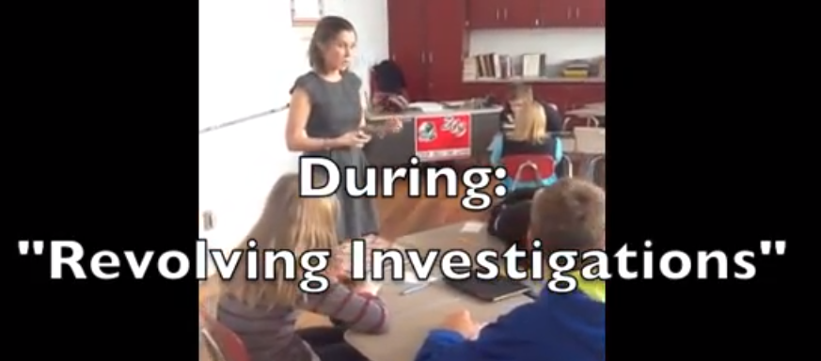
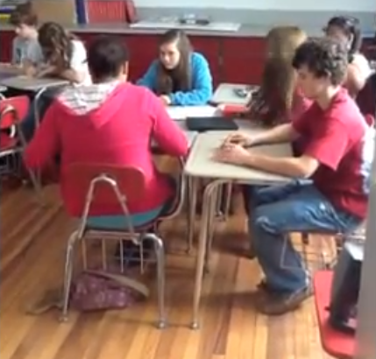
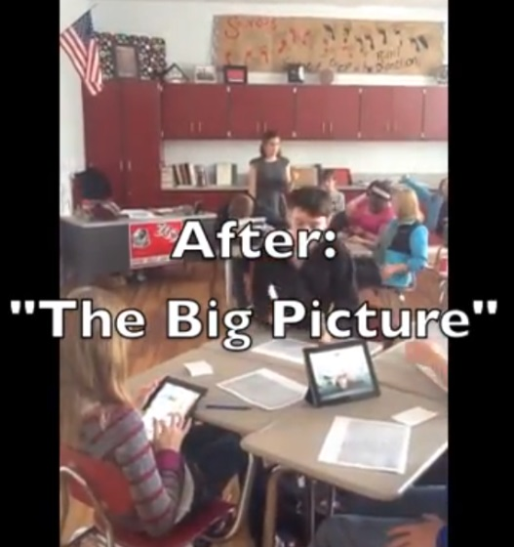
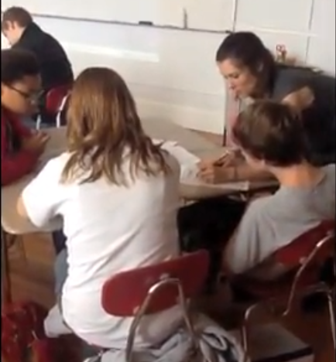
Teachers in Action After Training
Coffee County teachers used video to demonstrate and evaluate teaching Common Core Standards. These are pictures from a teacher’s videos.

Slide 34
Why Choose Common Core?

